Slide 1

Domain Adversarial Training for Aspect-Based Sentiment Analysis
Joris Knoester
Erasmus University Rotterdam
joris.knoester@gmail.com
Flavius Frasincar
Erasmus University Rotterdam
fransincar@ese.eur.nl
Maria Trusca
Bucharest University of Economic Studies
maria.trusca@csie.ase.ro
Notes:
My name is Maria Trusca, and I am from Bucharest University of Economic Studies. The name of our work is “Domain Adversarial Training for Aspect-Based Sentiment Analysis”. My colleagues are Joris Knoester, and Flavius Frasincar from Erasmus University Rotterdam

Slide 2
Introduction
Aspect-based Sentiment Classification (ABSC) finds the sentiment label (positive, negative or neutral) at the aspect-level of the entity of interest.
Using Domain-Adversarial Neural Networks (DANN), we aim to decrease the dependence on labeled data and to solve the problem of its limited availability in terms of ABSC.
Our approach is developed based on a state-of-the-art ABSC model, the Left-Center-Right Rotatory Attention model with multiple hops and hierarchical attention (LCR-Rot-hop++). Since we extend this approach with Domain-Adversarial Training (DAT), the proposed model is dubbed DAT-LCR-Rot-hot++.
Notes:
The topic of our work is aspect-based sentiment classification which aims to find sentiment labels at the aspect level of the entity of interest. The sentiment labels are usually classified as positive, negative and neutral.
A problem that is not related not only to aspect-based sentiment classification but also to any other NLP task is the limited availability of the labelled data. Given that generation of new labelled data is expensive, one option might be to rely on transfer learning. According to this approach, we can make predictions on our target domain by first training our models on other source domains. In order to achieve this task, in the current work we rely on domain-adversarial neural networks or DANNs.
The method that we proposed is developed based on the state-of-the-art Left-Center-Right Rotatory Attention model with multiple hops and hierarchical attention. The model is designed especially for aspect-based sentiment classification. Since we extend this approach with Domain-Adversarial Training, the proposed model is dubbed DAT-LCR-Rot-hot++.

Slide 3
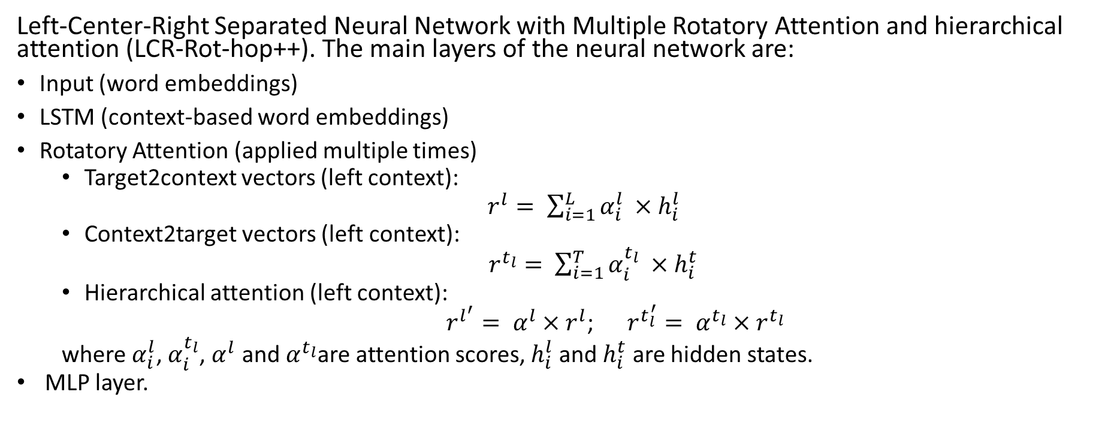
LCR-Rot-hop++
Left-Center-Right Separated Neural Network with Multiple Rotatory Attention and hierarchical attention (LCR-Rot-hop++). The main layers of the neural network are:
Input (word embeddings)
LSTM (context-based word embeddings)
Rotatory Attention (applied multiple times)
Target2context vectors (left context):
$r^{l}= \sum_{i=1}^{L}{α_{i}^{l}} ×h_{i}^{l}$
Context2target vectors (left context):
$r^{t_{l}}= \sum_{i=1}^{T}{α_{i}^{t_{l}}} ×h_{i}^{t}$
Hierarchical attention (left context):
$r^{l^{′}}= α^{l}×r^{l}$; $r^{t_{l}^{′}}= α^{t_{l}}×r^{t_{l}}$
where $α_{i}^{l}$, $α_{i}^{t_{l}}$, $α^{l}$ and${ α}^{t_{l}}$are attention scores, $h_{i}^{l}$ and $h_{i}^{t}$ are hidden states.
MLP layer.
Notes:
The LCR-Rot-hop++ model is actually an LSTM model with a hierarchical attention mechanism.
As we are interested to predict the sentiment of the aspect terms with respect to their context, the first step is to split the input sentence into three parts: left context, target or aspect terms and right context. Then, three LSTM layers are applied over the three parts and the result is represented by three sets of context-based word embeddings. The next layer is the rotatory attention through which the input sentence is represented by two target2context and two context2target vectors. Each left and right context is represented by one target2context vector computed by weighting its hidden states with some attention scores that incorporate information about the target.
On the other hand, each target is represented by two context2target vectors, one for the left side and one for the right side. The context2target vectors are computed by weighting the target’s hidden states with some attention scores that incorporate information about the context. As the four vectors can store only local information eighter about one context or only about the target, an additional attention layer is added to adjust the vectors in order to capture also the global information of the entire input sentence. The process is applied multiple times, in a rotatory way.
In the final step, the final four adjusted vectors are concatenated and fed a multi-layer perceptron for the final sentiment prediction.

Slide 4
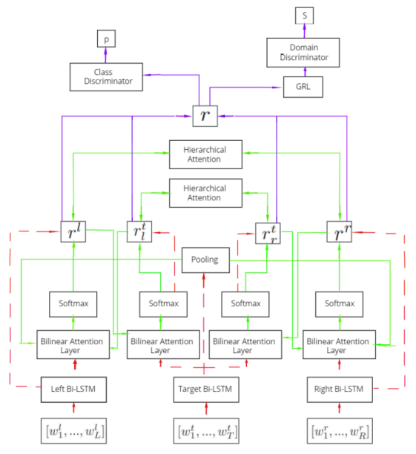
DAT-LCR-Rot-hop++
Starting from the architecture of generative neural networks (GANs), the implemented DANN applied over the baseline LCR-Rot-hop++:
requires two discriminators:
Domain discriminator trained on both source and target data;
Class discriminator trained only on source data.
and replace the generator with the Gradient Reversal Layer (GRL).
Notes:
Starting from the architecture of generative neural networks, the implemented DANN applied over the baseline LCR-Rot-hop++
requires two discriminators and a Gradient Reversal Layer. The two discriminators are actually a domain discriminator trained on both source and target data and a class discriminator trained only on source data.
Regarding the gradient reversal layer, the purpose is to make the task of the domain discriminator as hard as possible. Therefore, the Gradient Reversal Layer is similar to the generator of the generative adversarial neural networks.
According to the implementation of DAT-LCR-Rot-hop++ model, the Gradient Reversal Layer is used to reverse the gradient before backpropagation into the LCR-Rot-hop++ model. In the end, the Gradient Reversal Layer makes the discriminator unable to distinguish between the target and source instances and forces the LCR-Rot-hop++ model to learn domain-independent features.

Slide 5
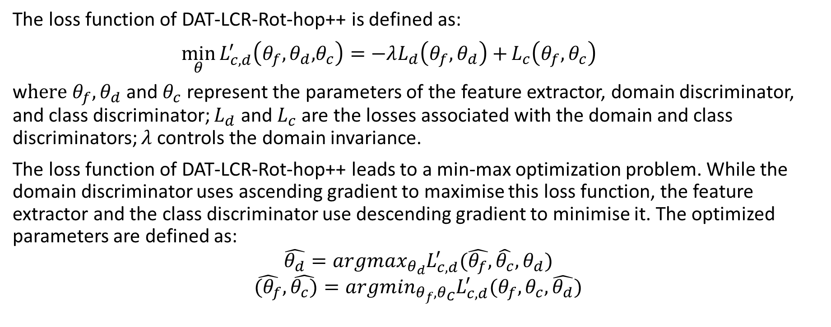
DAT-LCR-Rot-hop++
The loss function of DAT-LCR-Rot-hop++ is defined as:
$\min_{θ}{L_{c,d}^{′}\left(θ_{f},θ_{d}\text{,}θ_{c}\right)=−λL_{d}\left(θ_{f},θ_{d}\right)+}L_{c}\left(θ_{f},θ_{c}\right)$
w$here θ_{f},θ_{d}$ and $θ_{c}$ represent the parameters of the feature extractor, domain discriminator, and class discriminator; $L_{d}$ and $L_{c}$ are the losses associated with the domain and class discriminators; $λ$ controls the domain invariance.
The loss function of DAT-LCR-Rot-hop++ leads to a min-max optimization problem. While the domain discriminator uses ascending gradient to maximise this loss function, the feature extractor and the class discriminator use descending gradient to minimise it. The optimized parameters are defined as:
$$\hat{θ_{d}}={argmax}_{θ_{d}}L_{c,d}^{′}(\hat{θ_{f}},\hat{θ_{c}},θ_{d})$$
$$\hat{(θ_{f}}, \hat{θ_{c})}={argmin}_{θ_{f},θ_{C}}L_{c,d}^{′}(θ_{f},θ_{c},\hat{θ_{d}})$$
Notes:
The objective of the DAT-LCR-Rot-hop++ model is reducing the error term of both the domain discriminator, denoted as Ld and the class or sentiment discriminator denoted as Lc.
However, as previously described, the gradient reversal layer tries to fool the domain discriminator. After the domain is predicted and its parameters are updated, the loss is back-propagated into the LCR-Rot-hop++ model to change the weights accordingly. But this loss first passes through the gradient reversal layer, which reverses the gradient by multiplying it with −λ in order to hinder the performance of the domain discriminator. The reversing of the gradient forces the hidden layers of the LCR-Rot-hop++ to respond by adjusting their weights in the exact opposite way as desired by the domain discriminator, hereby making the task of the domain classifier more difficult. As a result, the features become more domain indiscriminative. This process is represented by the loss function mentioned on this slide.
The loss function of DAT-LCR-Rot-hop++ leads to a min-max optimization problem. While the domain discriminator uses ascending gradient to maximise this loss function, the feature extractor LCR-Rot-hop++ and the class discriminator use descending gradient to minimise it.

Slide 6
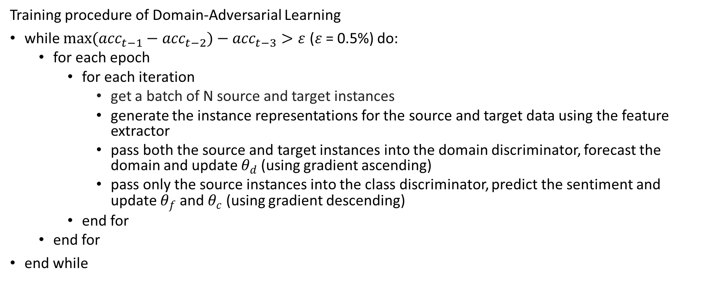
DAT-LCR-Rot-hop++
Training procedure of Domain-Adversarial Learning
while ${max(acc}_{t−1}−{acc}_{t−2})−{acc}_{t−3}>ε$ ($ε$ = 0.5%) do:
for each epoch
for each iteration
get a batch of N source and target instances
generate the instance representations for the source and target data using the feature extractor
pass both the source and target instances into the domain discriminator, forecast the domain and update $θ_{d}$ (using gradient ascending)
pass only the source instances into the class discriminator, predict the sentiment and update $θ_{f}$ and $θ_{c}$ (using gradient descending)
end for
end for
end while
Notes:
After constructing the feature representations by the feature extractor, both the source and target domain aspects are passed into the domain discriminator. However, only the source instances are fed into the class discriminator. In our research, the aspects of the target domain also contain a sentiment polarity, but this information is not used in the training and remains unknown to the model up until the moment of testing.
According to the training procedure, for each epoch and for each iteration, we need to sample approximately identical percentage batch of source and target domain data. The total number of instances is equal to N.
Next, we generate the instance representations for the source and target data using the feature extractor LCR-Rot-hop++.
Then, we need to pass both the source and target instances into the domain discriminator, forecast the domain and update parameters of the discriminator using gradient ascending
In the end, only the source instances pass into the class discriminator. In this way, the model learns to predict the sentiment labels of the source data and update the parameters of the feature extractor and the class discriminator using gradient descending.
All the process ends when a stopping condition is met. According to our implementation, we need to stop when the maximum of the accuracy of the previous epoch and the epoch before minus the loss of three epochs ago is larger than a given threshold.

Slide 7
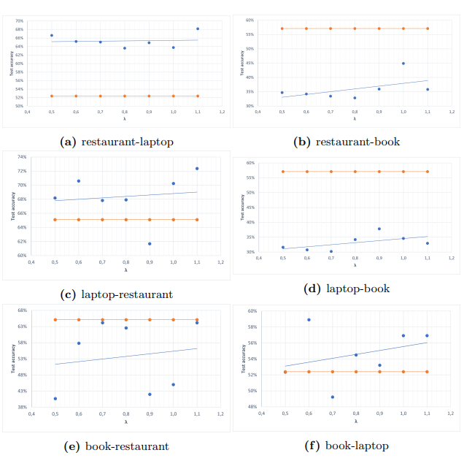
Evaluation- Impact of $λ$
Data: The cross-domain learning is analysed using SemEval 2014 restaurant and laptop datasets, and Amazon/LibraryThing (ALT) 2019 dataset that contains data about the book domain. This leads to six different domain combinations.
Notes:
In order to evaluate out proposed cross-domain learning approach, we use SemEval 2014 restaurant and laptop datasets, and Amazon/LibraryThing 2019 dataset that contains data about the book domain. This leads to six different domain combinations.
In the current slide we are interested to understand the impact of lambda for all 6 combination by running the DAT-LCR-Rot-hop++ model using different λ values. In each graph, the blue line represents the target accuracy, while the light orange line shows the base performance when the majority group of the test sample was selected.
When analysing Figures a and c, we observe that the classifying accuracy for the restaurant-laptop and laptop-restaurant domain combinations is significantly higher than for the other four. Even if the datasets come from very different domains, the two datasets have a similar distribution of sentiment labels. Also, the fraction of neutral aspects in the book data test set is significantly higher than the neutral percentage in the training sets of both the restaurant and laptop domains, with a percentage of 63 compared to 18, and 20 respectively.
Furthermore, the accuracy of book as a target domain is worse than applying book as a source domain. Because each domain has a disproportionate training set, it causes the neurons of the model to start with predicting the sentiment that occurs most often, especially in the early iterations. So, for both the restaurant and laptop domain this results in predicting a positive sentiment, which leads to a low score for the book target domain. On the other hand, using book as a source domain does lead to acceptable performance.
Also, when we look at Figure a, we observe a scattered graph with an almost flat regression line. The same holds for Figure c, which has a slope of about 2. One reason for this could be the previously mentioned overlap between the restaurant and laptop domain, thereby decreasing the difficulty of the cross-domain task and hence, making λ less important. However, in contrast to the flat regression lines of the restaurant-laptop and laptop restaurant combinations, lambda has a more significant effect for combinations such as restaurant-book and laptop-book.

Slide 8
Evaluation - Results
 | test | train | max | base | pos | neu | neg
rest-lap | 77% | 87% | 80% | 52% | 94% | 38% | 83%
rest-book | 37% | 88% | 48% | 57% | 71% | 9% | 88%
lapt-rest | 74% | 83% | 78% | 65% | 90% | 9% | 85%
lapt-book | 42% | 90% | 52% | 57% | 86% | 11% | 72%
book-rest | 72% | 88% | 76% | 65% | 78% | 81% | 40%
book-lap | 60% | 92% | 66% | 52% | 75% | 79% | 0%
Notes:
While the previous results were obtained by training the DAT-LCR-Rot-hop++ model only for 50 epochs, the final results presented on this slide are obtained after running the model on 2 hundred epochs, and as expected the overall performance was improved. For example, the training label accuracy increases from 84% up until 92% for the book-laptop domain. In addition, the maximum testing accuracy of 80% for the restaurant-laptop is a 9 percentage points improvement from the previous 71%.
The relevance of not requiring any labeled target data should not be underestimated when comparing it with other research, because this ability reduces labeling costs significantly. Specifically, the outcomes for the book-restaurant are promising. Both domains are not closely related in terms of sentiment distribution, but the model achieves an encouraging test accuracy of 72%, which is an improvement of 8 percentage points as compared to the value after the previous runs. Interestingly, the fraction of correctly labeled sentiments is more balanced, instead of one polarity that is driving the results.

Slide 9
Conclusion
Starting from a state-of-the-art LCR-Rot-hop++ model for ABSC, we propose DAT-LCR-Rot-hop++ as an adversarial component based on DANN that reduces the problem of label unavailability.
Our findings:
Increasing λ (domain invariance) improves, in general, the performance on the target domain, especially for distant domains.
The model is sensitive to the sentiment distribution which means that differences between the target and source distribution will lead to poorer performance.
Considering the accuracy scores, the model is mainly effective for domain combinations such as restaurant-laptop, laptop-restaurant, and book-restaurant.
Future work:
Investigate the effectiveness of the proposed model for a different number of sentiment classes (two classes, to reduce the difference between polarity distributions).
Replace the LCR-Rot-hop++ model with a less complicated feature extractor or reduce the dimensionality of its internal network layers in order to prevent overfitting.
Notes:
In conclusion, starting from the state-of-the-art LCR-Rot-hop++ model developed for aspect-based sentiment classification, we propose DAT-LCR-Rot-hop++ as an adversarial component based on DANN that reduces the problem of label unavailability.
The findings of our research can be summarized as follows. First of all, we found that increasing λ or domain invariance improves, in general, the performance on the target domain, especially for distant domains. We also observed that the model is sensitive to the sentiment distribution which means that differences between the target and source distribution will lead to poorer performance. Considering the accuracy scores, we also found that the model is mainly effective for domain combinations such as restaurant-laptop, laptop-restaurant, and book-restaurant.
Regarding our future work, we are interested to investigate the effectiveness of the proposed model for a different number of sentiment classes. Here, we are mainly interested to check the benefits of using only two classes, that might reduce the difference between polarity distributions. Besides this, we would like to replace the LCR-Rot-hop++ model with a less complicated feature extractor or reduce the dimensionality of its internal network layers in order to prevent overfitting.

Slide 10
Thank you! For questions, please send an email to maria.trusca@csie.ase.ro
Notes:
Thank you for your time and for your attention and if you have further questions please send me an email.

