Slide 1
An Ontology-Enhanced Hybrid Approach to Aspect-Based Sentiment Analysis
Daan de Heij, Artiom Troyanovsky, Cynthia Yang, Milena Zychlinsky Scharff, Kim Schouten, and Flavius Frasincar

Slide 2
What is sentiment analysis?
Many people freely express their opinions on the Web
Extract sentiment from unstructured text
Useful:
For consumers when making a purchase decision
For producers to assess the impact of marketing campaigns, success of product launches, etc.
Many companies in business analytics include some form of sentiment analysis
Notes:
Lexalytics, Brandwatch, startups: Wonderflow, Vita.io

Slide 3
Why aspect-based?
Finer level of analysis
Directly link expressed sentiment to actual topic or aspect
Useful when topic is not known beforehand, or when there can be multiple topics
Two main tasks:
Aspect detection
Sentiment analysis for aspects

Slide 4
Data Snippet
<sentence id="1032695:1">
<text>Everything is always cooked to perfection , the service is excellent , the decor cool and understated .</text>
<Opinions>
<Opinion target="NULL" category="FOOD#QUALITY" polarity="positive" from="0" to="0"/>
<Opinion target="service" category="SERVICE#GENERAL" polarity="positive" from="47" to="54"/>
<Opinion target="decor" category="AMBIENCE#GENERAL" polarity="positive" from="73" to="78"/>
</Opinions>
</sentence>

Slide 5
Data Snippet
<sentence id="1032695:1">
<text>Everything is always cooked to perfection , the service is excellent , the decor cool and understated .</text>
<Opinions>
<Opinion target="NULL" category="FOOD#QUALITY" polarity="positive" from="0" to="0"/>
<Opinion target="service" category="SERVICE#GENERAL" polarity="positive" from="47" to="54"/>
<Opinion target="decor" category="AMBIENCE#GENERAL" polarity="positive" from="73" to="78"/>
</Opinions>
</sentence>

Slide 6
Data Snippet
<sentence id="1032695:1">
<text>Everything is always cooked to perfection , the service is excellent , the decor cool and understated .</text>
<Opinions>
<Opinion target="NULL" category="FOOD#QUALITY" polarity="positive" from="0" to="0"/>
<Opinion target="service" category="SERVICE#GENERAL" polarity="positive" from="47" to="54"/>
<Opinion target="decor" category="AMBIENCE#GENERAL" polarity="positive" from="73" to="78"/>
</Opinions>
</sentence>

Slide 7
Data Snippet
<sentence id="1032695:1">
<text>Everything is always cooked to perfection , the service is excellent , the decor cool and understated .</text>
<Opinions>
<Opinion target="NULL" category="FOOD#QUALITY" polarity="positive" from="0" to="0"/>
<Opinion target="service" category="SERVICE#GENERAL" polarity="positive" from="47" to="54"/>
<Opinion target="decor" category="AMBIENCE#GENERAL" polarity="positive" from="73" to="78"/>
</Opinions>
</sentence>
Task: Aspect Detection

Slide 8
Data Snippet
<sentence id="1032695:1">
<text>Everything is always cooked to perfection , the service is excellent , the decor cool and understated .</text>
<Opinions>
<Opinion target="NULL" category="FOOD#QUALITY" polarity="positive" from="0" to="0"/>
<Opinion target="service" category="SERVICE#GENERAL" polarity="positive" from="47" to="54"/>
<Opinion target="decor" category="AMBIENCE#GENERAL" polarity="positive" from="73" to="78"/>
</Opinions>
</sentence>

Slide 9
Data Snippet
<sentence id="1032695:1">
<text>Everything is always cooked to perfection , the service is excellent , the decor cool and understated .</text>
<Opinions>
<Opinion target="NULL" category="FOOD#QUALITY" polarity="positive" from="0" to="0"/>
<Opinion target="service" category="SERVICE#GENERAL" polarity="positive" from="47" to="54"/>
<Opinion target="decor" category="AMBIENCE#GENERAL" polarity="positive" from="73" to="78"/>
</Opinions>
</sentence>
Our Task: Sentiment Analysis for Aspects

Slide 10

Motivation and Setup

Slide 11
Why use external knowledge?
Using external knowledge alleviates the need for data
Good for resource sparse languages / domains
Use machine learning for its high performance
Our setup:
Use linear SVM
Basic linguistic features (lemmas/synsets)
Add features and/or adjust feature weights based on external knowledge

Slide 12
Ontology as external knowledge
An ontology is
a formal representation of knowledge
usually created manually by domain experts
An ontology allows
easy sharing of knowledge (e.g. LOD)
reasoning to derive (new) facts
Our ontology describes a part of the restaurant domain
56 sentiment expressions
3 sentiment values
185 target concepts
Notes:
5:00

Slide 13
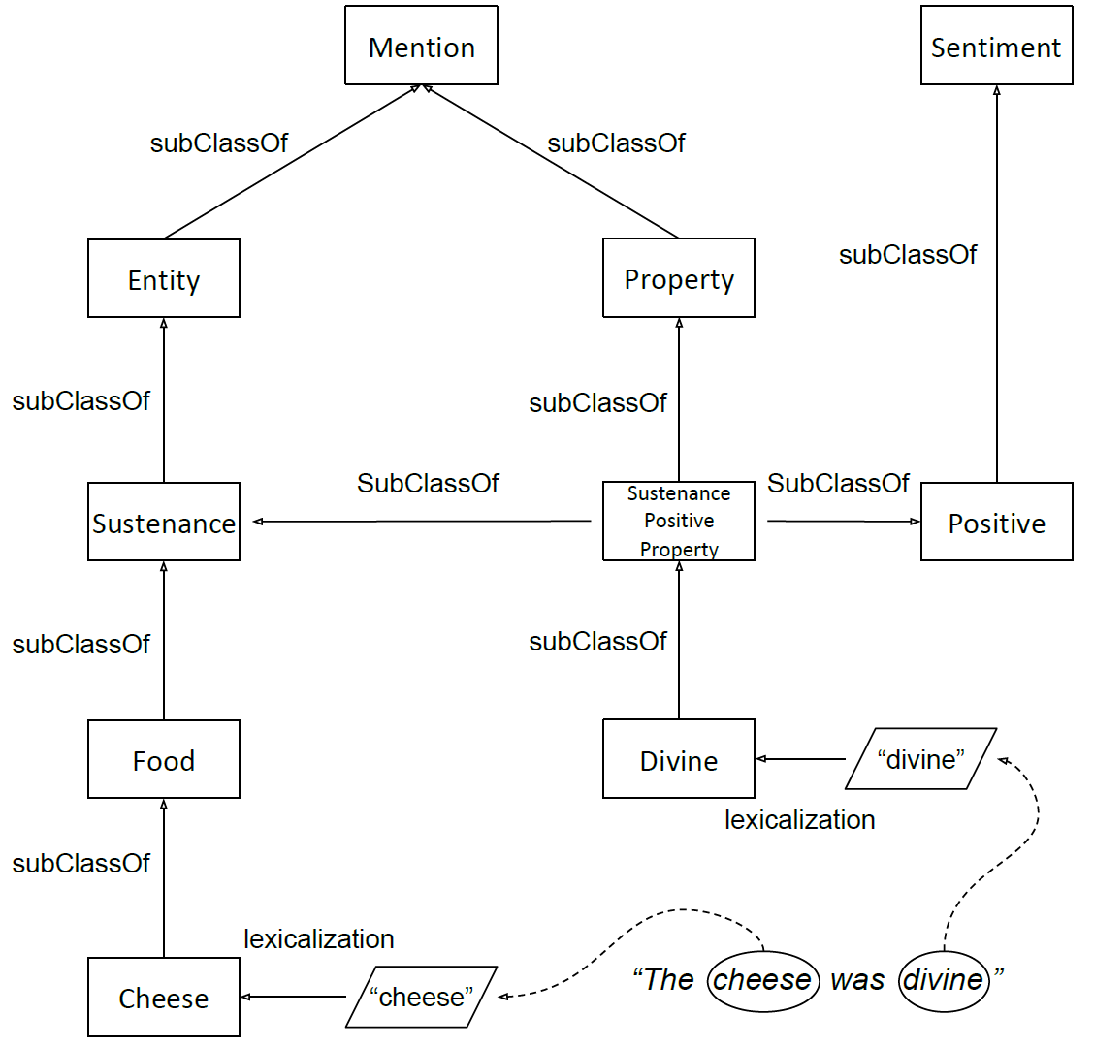
Ontology Snippet
Notes:
5:00

Slide 14
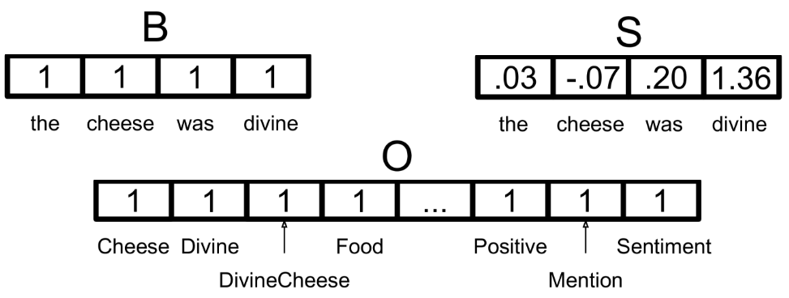
Setup for Aspect Sentiment Classification
Single linear multiclass SVM to find positive, neutral, and negative
Input features:
Bag-of-Words
Stanford sentiment tool and NRC sentiment word list to get a sentiment value of each word
Ontology concepts

Slide 15
Three different ontology scenarios
We find a generally positive/negative word, which can apply to any aspect
We find a sentiment word that is limited to a certain concept in the ontology.
Only aspects related to that class can be associated with that sentiment word
We find a sentiment word that is not limited to a single concept, but may have different sentiment values depending on which concept it is applied to (small price vs. small portions)
If the word is syntactically related to the aspect word, a new concept is created, that is the subclass of both the sentiment concept and the aspect concept, possibly triggering an axiom

Slide 16
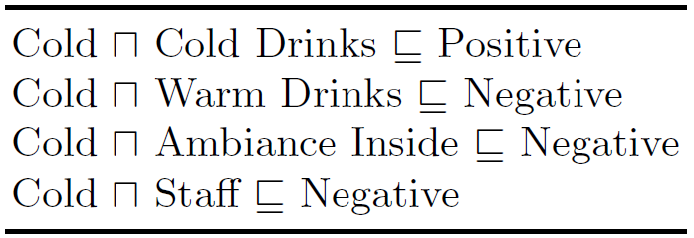
Axioms
Are combinations of a sentiment concept and an aspect concept
Each combination is specified to be positive or negative
When an axiom is triggered, the Positive or Negative class is added as an active feature in the feature vector

Slide 17
Context Dependent Sentiment - Example
<sentence>
<text>Food was delicious, staff was rude</text>
<Opinions>
<Opinion target="Food" category="FOOD#QUALITY" polarity="positive" from="0" to="4"/>
<Opinion target="staff" category="SERVICE#GENERAL" polarity="negative" from="20" to="25"/>
</Opinions>
</sentence>

Slide 18
Results

Slide 19
Results
Average over 10 runs with 10-fold cross-validation
Aspect Sentiment Classification |  |  | p-values of two-sided paired t-test
 | Avg. F₁ | St.dev. | base | +S | +O
B | 0.7555 | 0.0412
S | 0.7569 | 0.0305 | 0.8894
BO | 0.7715 | 0.0405 | 0.0034 | 0.1018
SO | 0.7813 | 0.0373 | 0.0039 | 0.0070 | 0.1364

Slide 20
Results
Single run on training and test data
Aspect Sentiment Classification
 | In-sample F₁ (on training data) | Out-of-sample F₁ (on test data)
B | 0.8839 | 0.7835
S | 0.8448 | 0.7905
BO | 0.8823 | 0.8079
SO | 0.8420 | 0.8068

Slide 21
Data size sensitivity analysis
Keep the test set the same
Use only n% of available training data
Set n to 10:100 with step size 10
Performed for both aspect detection and aspect sentiment classification

Slide 22
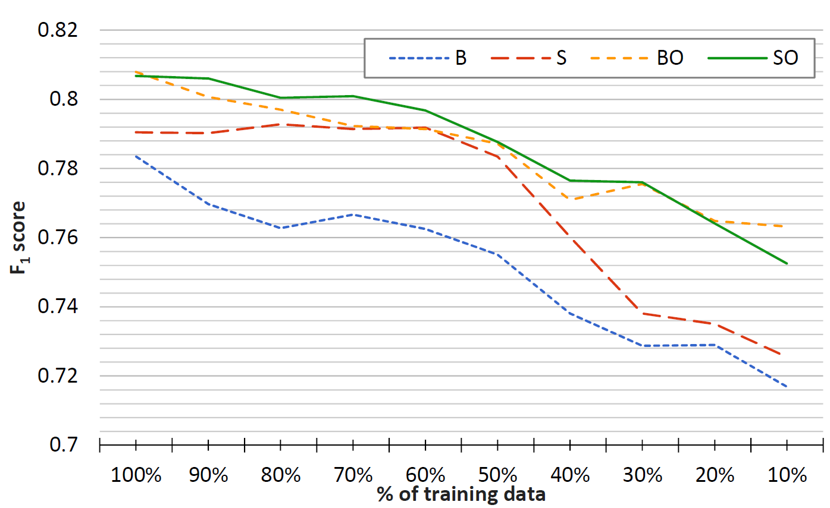

Slide 23
Conclusions & Future Work

Slide 24
Conclusions
External knowledge improves aspect-based sentiment analysis
Better overall performance
Less data is needed when using ontology
Ontology coverage is important

Slide 25
Future Work
Include more sentiment expressions
Improve reasoning
Investigate best way to combine sentiment and distance information
Automate ontology population

Slide 26
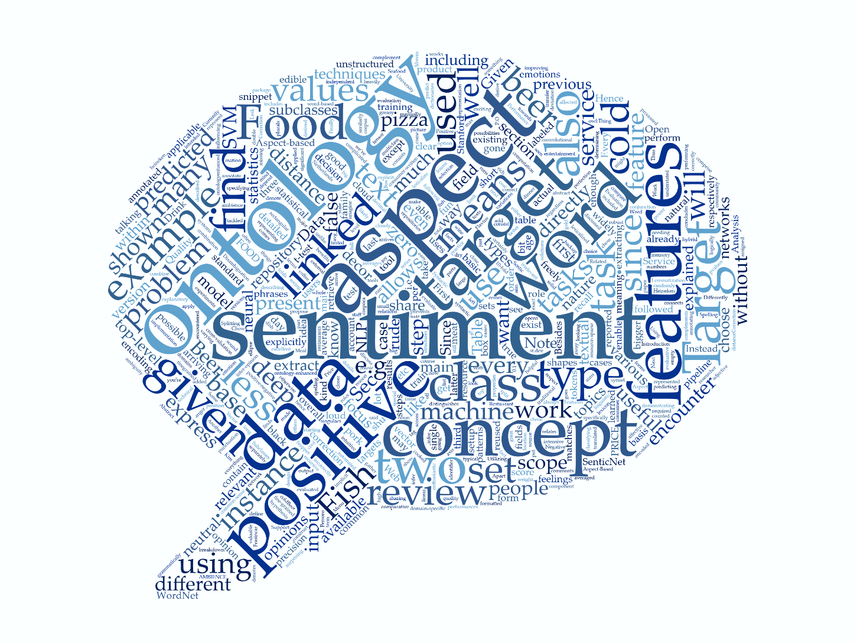
Discussion

Slide 27
Bonus slides: Data Analysis

Slide 28
Natural Language Processing

Slide 29
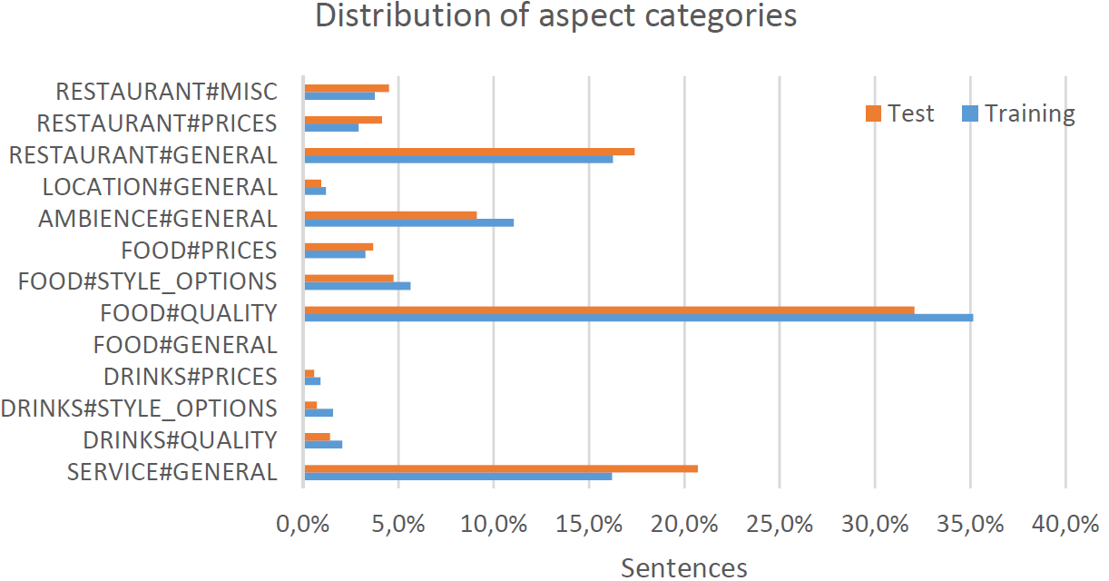
Aspect Statistics

Slide 30
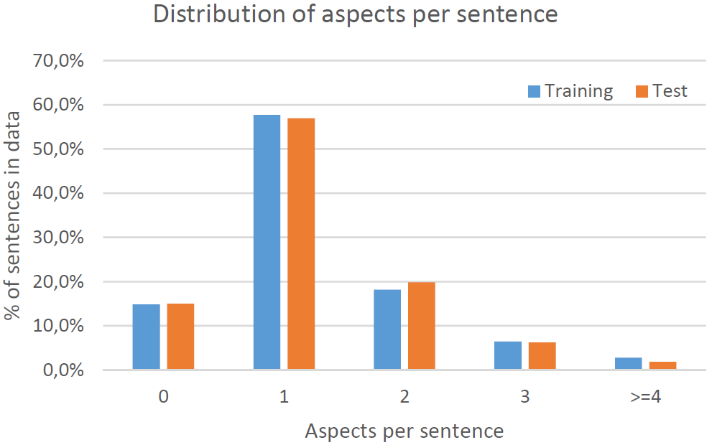
Aspect Statistics

Slide 31
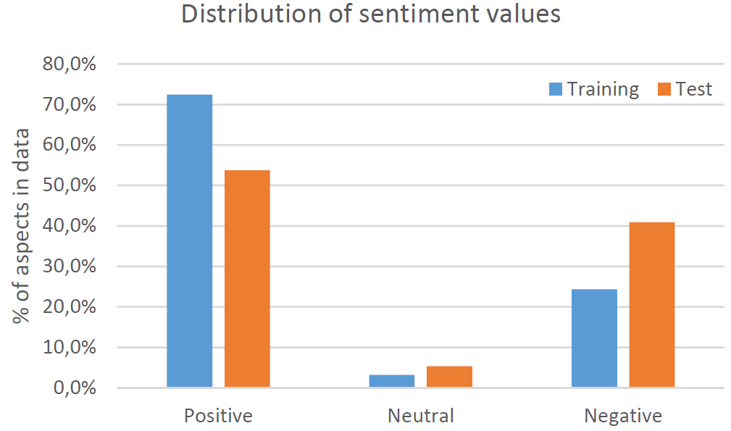
Sentiment Statistics

Slide 32
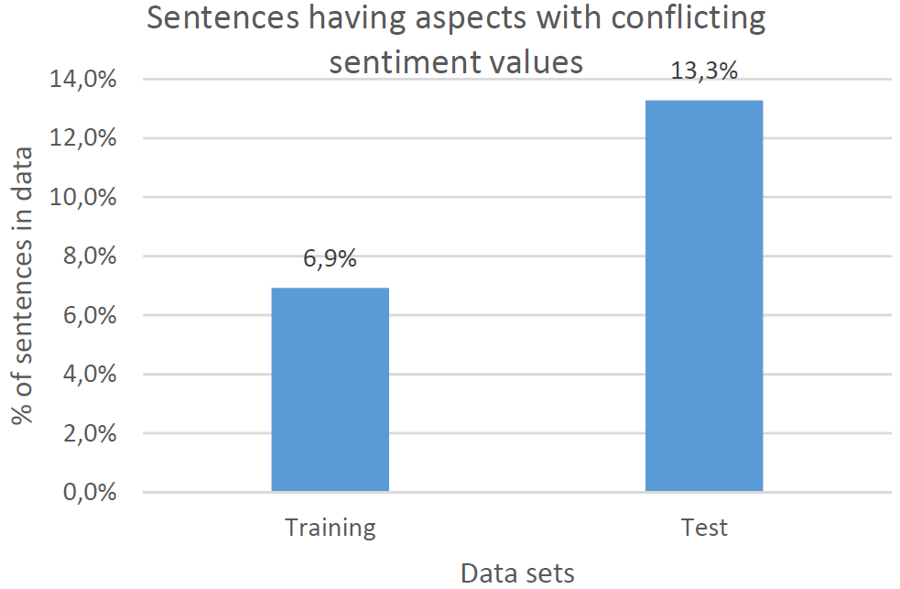
Sentiment Statistics

