Slide 1
Aspect-Based Sentiment Analysis
Using Lexico-Semantic Patterns
Kim Schouten, Frederique Baas, Olivier Bus, Alexander Osinga,
Nikki van de Ven, Steffie van Loenhout, Lisanne Vrolijk, and Flavius Frasincar
Erasmus University Rotterdam
the Netherlands

Slide 2
Many opinions…
Nowadays the Web is filled with opinion and sentiment
People freely share their thoughts on basically everything
Useful, but lot of noise
Need automatic methods to sift through this much data
Our scope is consumer reviews

Slide 3
Sentiment Analysis
Sentiment Analysis -> extract sentiment from text
Sentiment can be defined as polarity (positive/negative)
Or as something more complex (numeric scale or set of emotions)
Useful for consumers to know what other people think
Useful for producers to gauge public opinion w.r.t. their product

Slide 4
Aspect-Based Sentiment Analysis (ABSA)
Sentiment Analysis has a scope, for instance a document
More interesting however is the aspect level
An aspect is a characteristic or feature of a product or service being reviewed
This can range from general things like price and size of a product, to very specific aspects like wine selection for restaurants or battery life for laptops

Slide 5
SemEval ABSA Data
Restaurants
Sentiment | Number of aspects
Positive | 1198
Neutral | 53
Negative | 403
Total | 1654
Laptops
Sentiment | Number of aspects
Positive | 1103
Neutral | 106
Negative | 765
Total | 1974

Slide 6
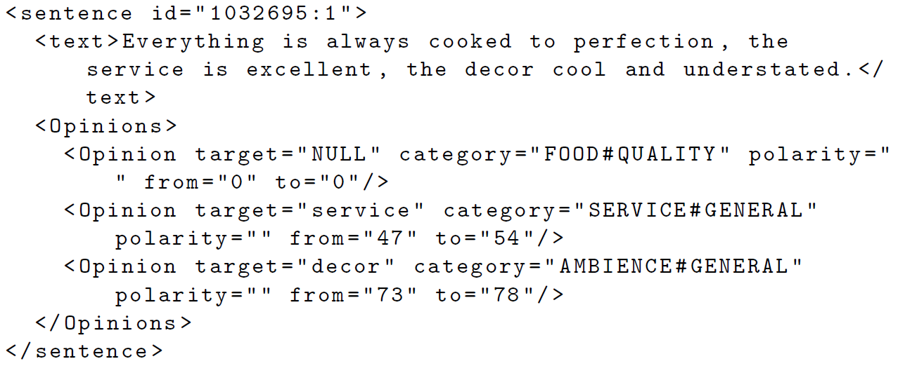
Data snippet

Slide 7
Currently…
Mostly supervised machine learning algorithms
Focus on performance
Feature overload
But what type of features are actually useful?

Slide 8
Features we analyze
Word unigram, bigram, trigram, quadgram
Part-of-Speech bigram, trigram, quadgram
Synset unigram, bigram
Synset-POS bigram
Negator-POS bigram
Sentisynset unigram
Negator-sentisynset bigram

Slide 9
Setup
Main classifier is an SVM
We perform 10-fold cross-validation
From the 90% training data, we designate 20% as the validation data
Forward feature selection to get optimal set of features
Perform ablation experiment to get contribution of features to final performance
Analyze the features by inspecting the feature weights inside the SVM

Slide 10
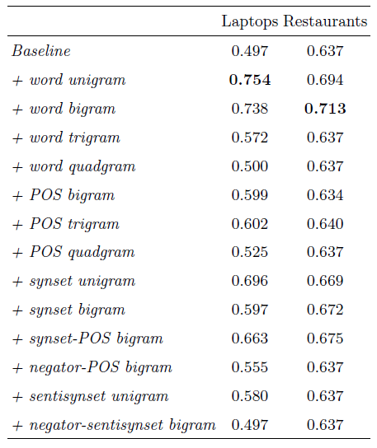
Feature performance from majority baseline

Slide 11
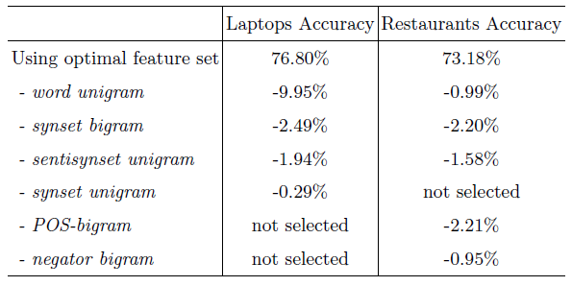
Feature performance from baseline

Slide 12
Individual features
Mostly not so interesting
  Obviously positive words have high weights (best, amazing)
  As well as negative words (worst, not)
Some domain dependent features are present too:
  For laptops: Dell is a strong negative indicator
  For restaurants: soggy is a strong negative indicator

Slide 13
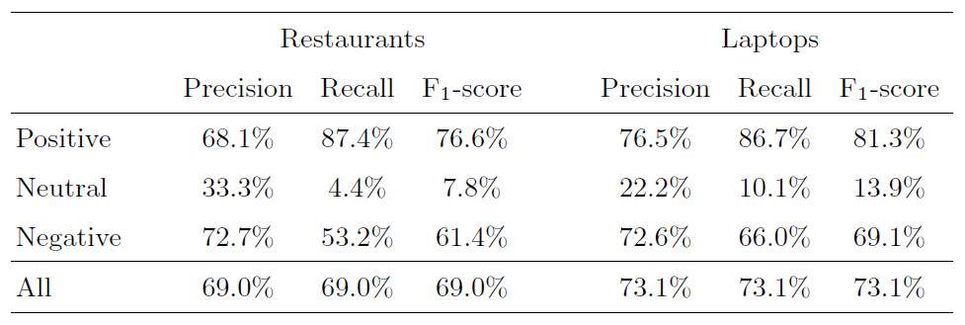
Performance

Slide 14
Conclusions
Not all features are useful, so just overloading the SVM with every feature you can think of is not a good idea
In our experiments, the more semantical features, such as synsets, were preferred over more syntactical features, such as POS n-grams
For restaurants, the POS-bigram and negator-bigram were beneficial, while for laptops they were not: patterns are very domain dependent and cannot be reused across domains
Investigating these domain differences is an interesting direction for future work

Slide 15
Conclusions
In our experiments, lexico-semantic patterns have proven to be useful for the task of aspect-level sentiment analysis
However, the current set of features is just a subset of all possible features, so a bigger experiment that includes more of them is also a good option for future work
Thank you

