Slide 1
A Data Type-Driven Property Alignment Framework for Product Duplicate Detection on the Web
Flavius Frasincar*
frasincar@ese.eur.nl
* Joint work with Gijs van Rooij, Ravi Sewnarain, Martin Skogholt, Tim van der Zaan, and Kim Schouten

Slide 2
Contents
Motivation
Related Work
Property Alignment Framework
Product Duplicate Detection Framework
Evaluation
Conclusion and Future Work

Slide 3
Motivation
Explosion of Web shops:
Heterogeneous product information
Product aggregators (e.g., comparison sites):
Need to reconcile heterogeneous product descriptions:
Product descriptions use different lexical representations for the same properties
Product descriptions have missing properties/values or wrong information
Need to find product duplicates (model numbers often absent or incorrect)
Idea:
Align product properties by determining and using their data types
Find product duplicates using the previous property alignment (reduce the number of properties that need comparison)

Slide 4
Product Representation
Example (for one product):
Header:
‘shop’: ‘newegg.com’
‘title’: ‘Sharp 70\" 1080p 120Hz LED-LCD HDTV - LC70LE650U’
‘modelID’: ‘LC70LE650U’
Key-Value Pairs (KVP):
‘brand’: ‘Sharp’
‘maximum resolution’: ‘1920 x 1080’
‘refresh rate’: ‘120Hz’
‘screen size’: "70\"’
‘aspect ratio’: ‘16:9’
‘USB’: ‘2’
‘energy star compliant’: ‘Yes’
etc.

Slide 5
Related Work
Term Frequency-Inverse Document Frequency (TDF-IDF):
Cosine similarity is used to decide which products are duplicates
Multi-Component Similarity Method (MSM):
Similarity based on three component:
Title component
Key-Value Pairs component for matching keys
Key-Value Pairs component for non-matching keys
Adapted hierarchical clustering is used to decide which products are duplicates (products from the same Web shop or different brands are never placed in the same cluster)
Matching keys and values is done lexically using the Jaccard similarity with q-shingles at character level

Slide 6
Method Overview
Property Alignment Framework: discover matching properties between Web shops (applied for pairs of properties)
Block Classification
Value Classification
Property Classification
Property Matching
Product Duplicate Detection Framework: uses the previously matched properties to discover product duplicates (applied for pairs of products)

Slide 7
1. Block Classification
Values from KVP are split based on white spaces, resulting in blocks
Block types:
If numerical content, Numerical:
Integer: e.g., ‘12’
Float: e.g., ‘5.4’
Fraction: e.g., ‘1/2’
Ratio: e.g., ‘1:2’
Percentage: ‘60%’
Dash: ‘1-2’
If lexical content, Lexical:
Boolean: ‘Yes’ and ‘No’
Measure: e.g., ‘mmm’
Compound: e.g., ‘x’
Word (fall-back type)
Otherwise:
Universal (fall-back type)

Slide 8
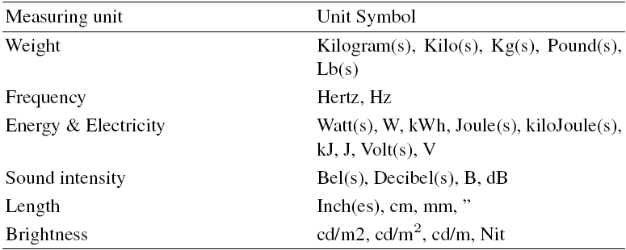
Measurement Units
Refinement: universal blocks with integers and measurement unit are split into two blocks: An integer block and a Measure block (e.g., ‘180Hz’ split in ‘180’ and ‘Hz’)

Slide 9
Examples of Block Classification

Slide 10
2. Value Classification
Depends on the block classification
Value types:
If one block:
Boolean: if block is Boolean
Quantitative: if block is Numerical
Qualitative: otherwise
If two blocks:
Measure: if first block is Numerical and second block is Measure
Quantitative: if first block is Numerical and second block is Word
Qualitative: otherwise
If three or more blocks:
Qualitative: if there is no Compound block
Compound: e.g., ‘52 mm x 45 mm x 20 mm’

Slide 11
Compound Value
Needs to contain one of more Compound blocks
Three restrictions must hold:
One or two blocks before a Compound block must be:
Numerical block followed by a Word/Measure block or
Numerical block
Between two Compound blocks must be:
Numerical block followed by a Word/Measure block or
Numerical block
First block after the last compound block must be:
Numerical block

Slide 12
3. Property Classification
Depends on the value classification
Two step approach:
The values associated to a unique key (property) are aggregated in a list (per Web shop)
The most frequently encountered type of values is associated to the considered key
Allows to deal with values that have been misspelled or wrongly entered:
E.g., for the ‘Brightness’ property the following values are found: ‘450 Nit’ (Measure type), ‘300 Nit’ (Measure type), and ‘250’ (Quantitative), so the type will be Measure and not Quantitative

Slide 13
4. Property Matching
Depends on the property classification and value classification
Two properties (from different Web shops) are compared by means of their similarity score
$$PropertyScore=\left(1−θ\right) KeyScore+ θ ValueScore$$
using a trained weight θ
If the property score is higher than a trained threshold, the properties are classified as a match

Slide 14
Key Score
The KeyScore similarity is computed as
$$KeyScore=\left(1−δ\right) LexicalScore+δ SemanticScore$$
using a trained weight δ
The LexicalScore is the Jaccard similarity with k-shingles (character level)
The SemanticScore is computed as follows:
First key words are disambiguated by applying an adapted Lesk algorithm where the context is defined by the other keys of the current product type and the synset glosses are from WordNet
If the word sense disambiguation algorithm is successful (i.e., key words are in WordNet) the SemanticScore is computed as the Jaccard similarity of the key synset glosses (word level) [stop words are previously eliminated]

Slide 15
Value Score
Depends on the property classification
Two step approach:
All the values of the compared properties are collected; only the values that match the type of the property are retained
If both properties are of type Qualitative:
Jaccard with k-shingles is used (same as for LexicalScore)
If both properties are of type Boolean:
Use $1−|{frequency}_{Product1}\left(Yes\right)−{frequency}_{Product2}\left(Yes\right)$|
If both properties are of the type Quantitative, Measure, or Compound:
The p-value of the Mann-Whitney U test is used to check whether the null hypothesis of equal distribution of values (for the two compared properties) is statistically significant [only the Numerical values are used and the units of measurement have to match, if present]

Slide 16
II Product Duplicate Detection Framework
Three heuristics aim to reduce the number of product comparisons to be made:
Shop heuristic: there are no duplicates among products from the same shop
Brand heuristic: there are no duplicates among products from different brands
Screen size heuristic (domain dependent, i.e., for TVs): there are no duplicates among products with different screen sizes
$$ProductScore=\left(1−τ\right) TitleScore+τ PropertiesScore$$
where τ is a trained parameter
If the product score is higher than a trained threshold, the properties are indicated as duplicates

Slide 17
Heuristics
Brands are retrieved from Wikipedia
The list of brands is extended using a two step procedure:
The keys that point to previously determined brand names are identified
The values of the previously identified keys are used to extend the list of brands
Screen sizes are collected from the title (most TV products have screen sizes in their title)
The digits before the “(inch) symbol represent the diagonal size of the display

Slide 18
Title Score
Titles are cleaned by removing brands and common (composed) words that indicate the type of product (i.e., “refurbished” and “open box:”)
The TitleScore is just the Jaccard similarity with k-shingles (same as for LexicalScore in property matching)

Slide 19
Properties Score
The properties score is computed as follows:
$$PropertiesScore=\frac{\sum_{{(p}_{i},p_{j})∈PairsOfMatchingProperties}{w_{ij} score(p_{i},p_{j})}}{|PairsOfMatchingProperties|}$$
where:
PairsOfMatchingProperties are pairs of properties that have been matched by the Property Alignment Framework
w_{ij} is a learned weight associated to the common type of the matched properties (one weight for non-matching types)
score(p_{i},p_{j}) is
If type is Qualitative, Boolean, Universal, or non-matching we use the Jaccard similarity with k-shingles (same as for LexicalScore in property matching)

Slide 20
Properties Score (Cont’d)
score(p_{i},p_{j}) is:
If type is Measure or Quantitative with only a numerical value, the score is:
1, if $\left|value\left(p_{i}\right)−value\left(p_{j}\right)\right|<1$ and units match, if present
0, otherwise
[small differences usually do not indicate dissimilarity, but the resolution differences, while for integers, e.g., ‘Number of HDMI ports’, the differences that are larger than 1 indicate dissimilarity]
If type is Quantitative with both a numerical part and a non-numerical part, the score is the average of the score of the numerical part (using the above formula) and the non-numerical part (Jaccard similarity with k-shingles, same as for LexicalScore in property matching)
If type of Compound, the score is the average of the score of each individual parts
Notes:
For the compound values, the comparison is done for each corresponding block. So for example block 1 with block 1 the usual integer/float is done. These two or three compared numbers are simply averaged to give a single score.
With the ratio (A:B), with A and B numbers, then A is divided by B so that the ratio becomes A/B:1 and then the integer/float comparison is done on A/B.
With the dash type, we added the two numbers. So A-B becomes A+B. This was because we saw that all of the dash types were A-B/C so an integer with a fractional part, for example 3 - 3/4 inches. This was then transformed to 3.75 inches and treated as integer/float.
In the case that a compound contains either a ratio or dash then these two transformations are done before the comparison.

Slide 21
Evaluation
TV data set with 1446 televisions collected from two Web shops bestbuy.com (774 televisions) and newegg.com (672 televisions)
300 television are duplicates
200 unique keys
Product with most number of characteristics has 61 properties
Product with least number of characteristics has 1 property
Products from bestbuy.com have 37 properties on average and products from newegg.com have 22 products on average

Slide 22
Gold Standards
Property Alignment Framework:
4 annotators matched properties between products from the two webshops
3 of 4 annotators have to agree for a match
Inter-Annotator Agreement of 82.2% (percentage of matches based on unanimous annotations)
Product Duplicate Detection Framework:
Duplicate products are based on the modelID
ModelID was not used in the two proposed frameworks

Slide 23
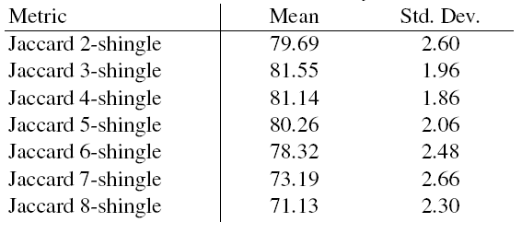
Property Alignment Framework
50 bootstraps (each bootstrap was used for training and the remaining parts were used for testing)
F1 with varying k for the k-shingles lexical similarity measure:
Keys are rather short, for e.g., k = 7 keys have to be lexically the same, which is not always good (due to small variations in the lexical representations of the same keys) that is why the drop in performance for k ≥ 7

Slide 24
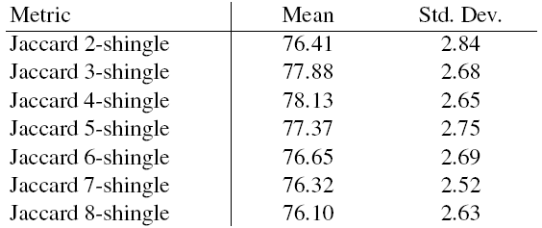
Product Duplicate Detection Framework
50 bootstraps (each bootstrap was used for training and the remaining parts were used for testing)
F1 measure with varying k for the k-shingles lexical similarity measure:
For high k the drop in performance is less drastic than before as the titles are longer than keys and for a high k you still have enough shingles for comparison

Slide 25
Our Method vs. MSM
50 bootstraps (each bootstrap was used for training and the remaining parts were used for testing)
Using a paired t-test our method significantly outperforms MSM for F1, even with a significance level of 99.9%
Complexity:
Property Alignment Framework: O($p2$) where $p$ is the number of (unique) properties in the dataset
Product Duplicate Detection Framework: O($n2{\overline{p}}^{2})$ where $n$ is the number of products and $\overline{p}$ is the average number of properties per product in the dataset

Slide 26
Conclusion and Future Work
Conclusion:
Infer and exploit property datatypes for product duplicate detection
Property Alignment Framework: F1 = 81.55
Product Duplicate Detection Framework: F1 = 78.13
Boost of 30.21% points compared to MSM
Future Work:
Sensitivity analysis of the parameters (weights and thresholds)
Convert values using various types of units of measurements
Match properties with values:
‘Parental Control’: ‘V-Chip’
‘V-Chip’: Yes
Extend the Product Duplicate Detection Framework to handle more than 2 Web shops: Use a clustering algorithm in conjunction with the defined product similarity function (similar to MSM)

