Slide 1
An Empirical Study for Determining Relevant Features for Sentiment Summarization of Online Conversational Documents
Gino Mangnoesing* gvh.sing@gmail.com |  | Arthur van Bunningen† Arthur.van.Bunningen@teezir.com |  | Alexander Hogenboom* hogenboom@ese.eur.nl
 |  |  | Flavius Frasincar* frasincar@ese.eur.nl
Frederik Hogenboom*
fhogenboom@ese.eur.nl
*Erasmus University Rotterdam P.O. Box 1738, NL-3000 DR Rotterdam, the Netherlands †Teezir BV Wilhelminapark 46, NL-3581 NL, Utrecht, the Netherlands

Slide 2
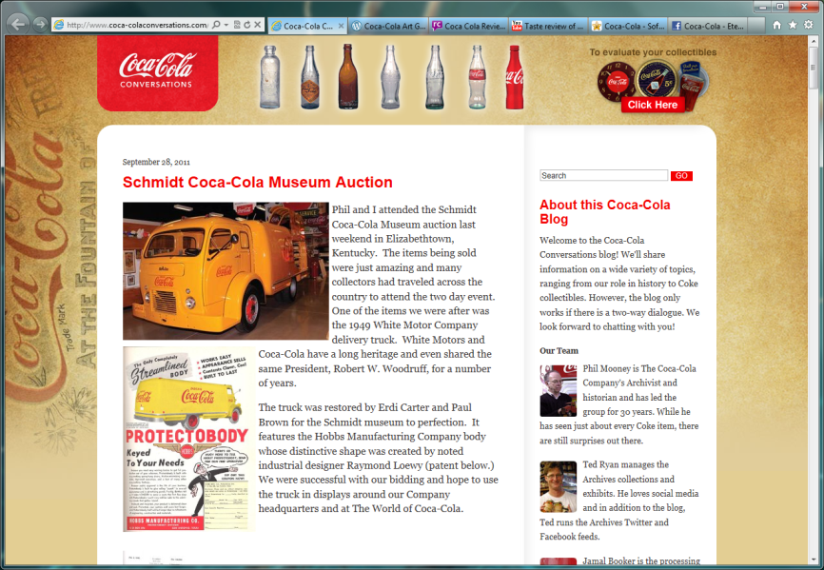
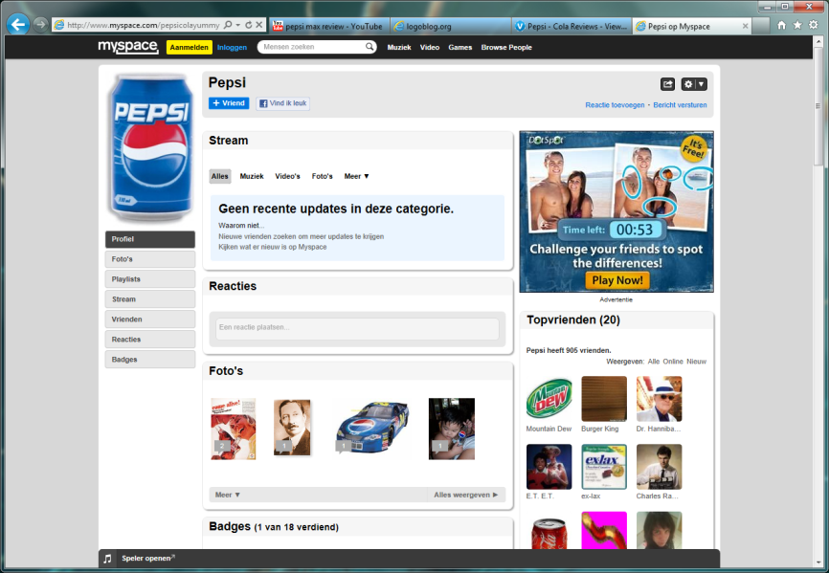
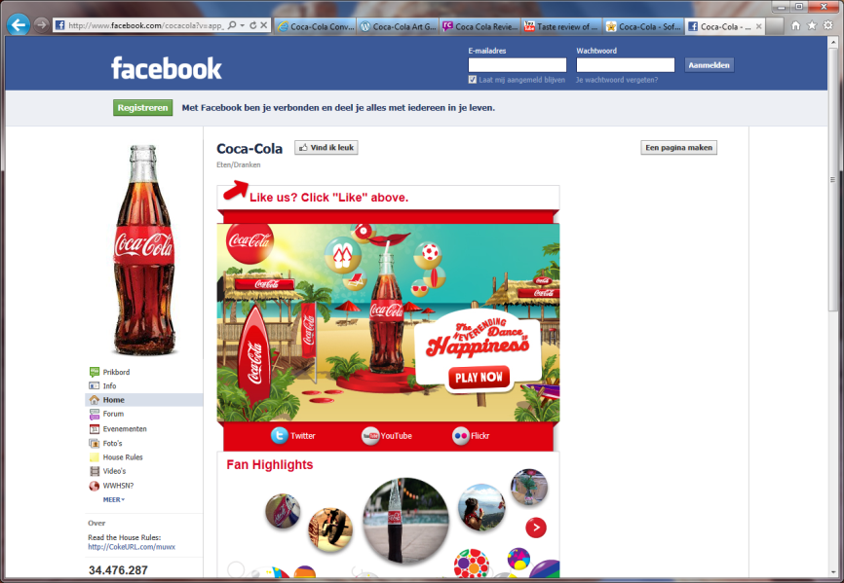
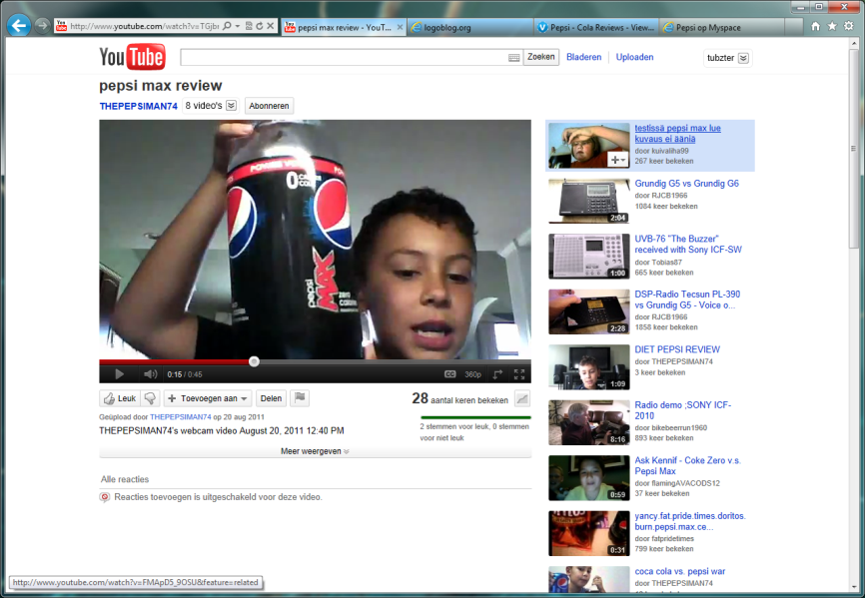
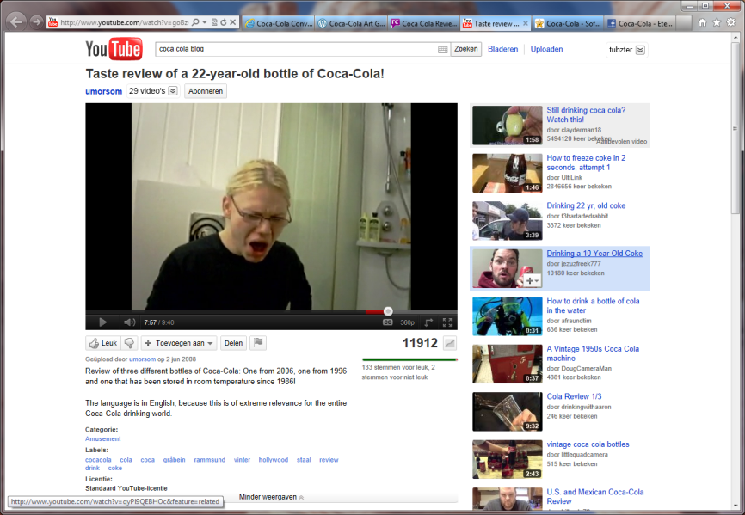
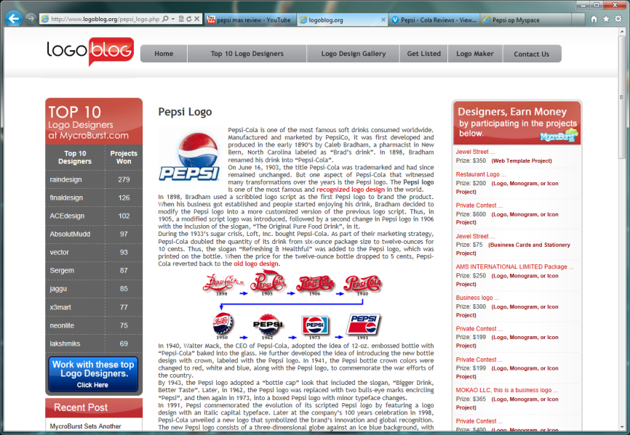
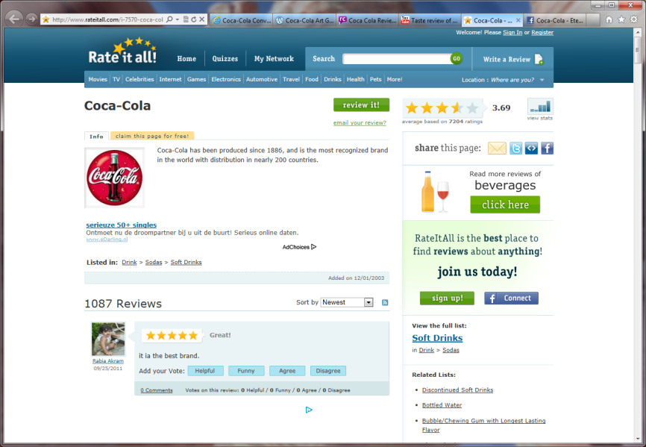
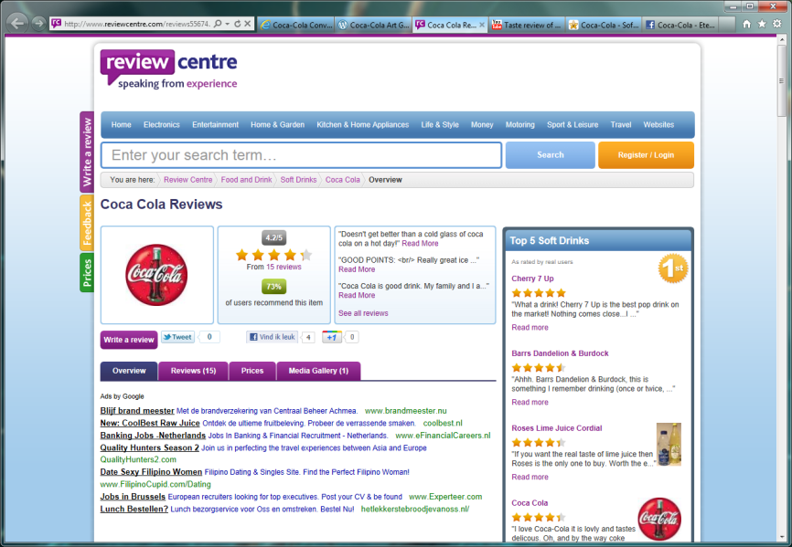
Introduction (1)
The Web offers an overwhelming amount of textual data, containing traces of sentiment
Information monitoring tools for tracking sentiment are of paramount importance for today's businesses
Notes:
The Web, as we know it today. Massive amounts of user-generated content. It’s great that it’s available to us, yet if we need to extract some information from all of this content, the amount of data available to us is simply confusing and overwhelming.
Today's Web enables people to produce an ever-growing amount of virtual utterances of opinions. People can post reviews of products, write blogs, or put whatever crosses their minds on Twitter without giving it a second thought. This yields a massive amount of data, containing traces of valuable information - people's sentiment with respect to products, brands, and so on.
Recent estimates indicate that twenty percent of all tweets and one third of all blog posts discuss products or brands. In this light, automated information monitoring tools are crucial for today's businesses. The big challenge here is to extract this valuable information from an amount of data that is so big and ever-growing, that manual analysis is not an option anymore. This is where automated sentiment analysis comes in.

Slide 3
Introduction (2)
A reliable analysis of the sentiment of authors of user-generated content is crucial for reputation management
There is a great need for knowing what people (dis)like about products or brands and why they feel this way
A major challenge lies in the identification of text segments capturing and explaining the sentiment of a text as a whole
Notes:
In order to be able to identify the signals that should be acted upon in the context of, for instance, reputation management, a reliable indication of the sentiment conveyed by user-generated content is of crucial importance.
However, it is not so much a quantification of the sentiment by itself that is important for reputation management, but rather how this sentiment is motivated. It is of crucial importance to be able to analyze user-generated content for clues as to why, for example, people like or dislike products or brands. In this light, the question whether people like the new iPhone or not is not the most interesting question. Marketeers would be more interested in questions like: what features do people like? What is it that makes people happy about the iPhone? What is it that turns people off? Are people complaining about battery life? Are people happy with the design?
In order to be able to answer such questions, we need to make summaries of opinionated pieces of text, reflecting the sentiment of the full text and capturing what exactly constitutes this sentiment. A major challenge here is to identify those text segments that capture the sentiment of a text as a whole. In our paper, we have performed an empirical study in order to identify the features of text segments that can be included in a summary reflecting the sentiment of a text.

Slide 4
Sentiment Analysis
Sentiment analysis is typically focused on determining the polarity of natural language text: positive, negative, neutral, or anything in between
Many practical applications typically aim to capture a general mood (reviews, consumer confidence, politics)
As such a quantification of sentiment in a score or class alone is not sufficient anymore, methods for summarizing opinionated texts are gaining interest
Notes:
Sentiment analysis essentially aims to determine the polarity of natural language text. Even though this task is commonly approached as a binary classification problem, in which a text is to be classified as either positive or negative, some research focuses on ternary classification by introducing a third class of neutral documents. Other work even focuses on determining the degree of positivity or negativity of natural language text in order to produce, for instance, rankings of positive and negative documents.
Sentiment analysis has many practical applications, most of which aim to capture some sort of general mood. This may be the overall mood of (potential) customers towards a product or brand. In an economic environment, an interesting mood could be for instance consumer confidence. Also, several other applications already exist for mining for example Twitter in order to determine people’s attitudes towards certain individuals, political parties, etcetera.
As such quantifications of sentiment in a score or class alone are not sufficient anymore, methods for summarizing opinionated texts have been gaining interest in recent research.

Slide 5
Sentiment Summarization (1)
The goal of sentiment summarization is to distinguish relevant from irrelevant text fragments with respect to conveying the overall sentiment of an opinionated text
Existing work considers using as feature whether or not a text segment:
Discusses one or more (sub)aspects of the topic
Contains an opinion about the topic
Is rather positive or rather negative (high intensity)
Is part of the introduction of the text
Is part of the conclusion of the text
Contains an adjective
Contains an adverb
Notes:
The goal of sentiment summarization is to distinguish relevant from irrelevant text fragments with respect to conveying the overall sentiment of an opinionated text. In order to accomplish this, common approaches typically look for sentences with specific features.
Existing work only considers few features as proxies for the relevance of a text fragment for a sentiment summary. Existing work shows only few common denominators in considered features, with one of the most widely used features being the discussion of certain aspects of a topic. Another rather straightforward feature considered in existing work is whether or not a text segment contains an opinion about the topic. Some work additionally looks for text segments having a high intensity. The role of text segments is sometimes taken into account as well; some approaches account for whether or not a text segment is part of the introduction or conclusion of a text. Last, some work uses as distinguishing feature whether or not a text segment contains an adjective or an adverb.

Slide 6
Sentiment Summarization (2)
It may also be relevant whether or not a text segment:
Addresses an event or experience described in the text
Contains an advice or recommendation
Contains an argument supporting an opinion, vision, or statement in the text
Contains or is part of a comparison in the text
Contains non-stopwords that are present in the title of the text
Contains a list or sequence
Is relatively long
Is relatively short
Notes:
However, there are more features that may be relevant and have not been taken into account yet in the state-of-the-art on sentiment summarization. We envisage the following features to be viable as well.
First, we hypothesize that discussions of events are relevant in user-generate content, because people tend to use the Web to complain about something, which is typically a recent experience or event. In addition to this, an experience may yield an advice or recommendation. For
example, an advice may reflect or be supported by someone’s sentiment towards the brand. Similarly, arguments can further motivate an opinion or statement. In a similar way, people may also motivate why the favor one brand over another and as such use comparisons in order to motivate their sentiment towards the topic of their text.
Other features that may be considered can be defined on a different level of abstraction; such features are not necessarily defined at a semantic level, but rather at a syntactic or lexical level. A relevant text segment may for instance contain words (except for definite and indefinite articles) that occur in the title of the text as well. Additionally, fragments containing lists or sequences may be relevant, as people tend to list their complaints and
possible advantages or disadvantages. Last, the length of a fragment may play a role as well.
We aim to investigate which of the existing as well as new features can identify relevant fragments for sentiment summaries.

Slide 7
Feature Evaluation (1)
We have performed an analysis on a collection of 60 Dutch conversational documents (forum posts) about the Dutch company Ziggo
For each document, 7 candidate summary sentences were selected, such that each of our 15 considered features was as well-represented as possible
Each of these 420 sentences was evaluated by 3 out of 9 human annotators:
Sentiment of text (negative, neutral, positive)
Sentiment of sentence (negative, neutral, positive)
Relevance of sentence (highly irrelevant, irrelevant, relevant, highly relevant)
Applicability of each of our 15 features (true, false)
Notes:
We have performed an analysis on a collection of 60 Dutch conversational documents (forum posts) about the Dutch company Ziggo.
For each document, 7 candidate summary sentences were selected, such that each of our 15 considered features was as well-represented as possible.
Each of these 420 sentences was evaluated by 3 out of 9 human annotators. These annotators were asked to classify the sentiment of the text as either negative, neutral, or positive. They were asked to do the same for the sentiment of the selected sentence. Additionally, the annotators were asked to rate the relevance of the selected sentence on a four-point scale, ranging from highly irrelevant to highly relevant. The relevance of a sentence is measured in terms of the extent to which it summarizes the sentiment conveyed by the document as a whole. Last, the annotators were asked whether our considered features applied to the selected sentence or not.

Slide 8
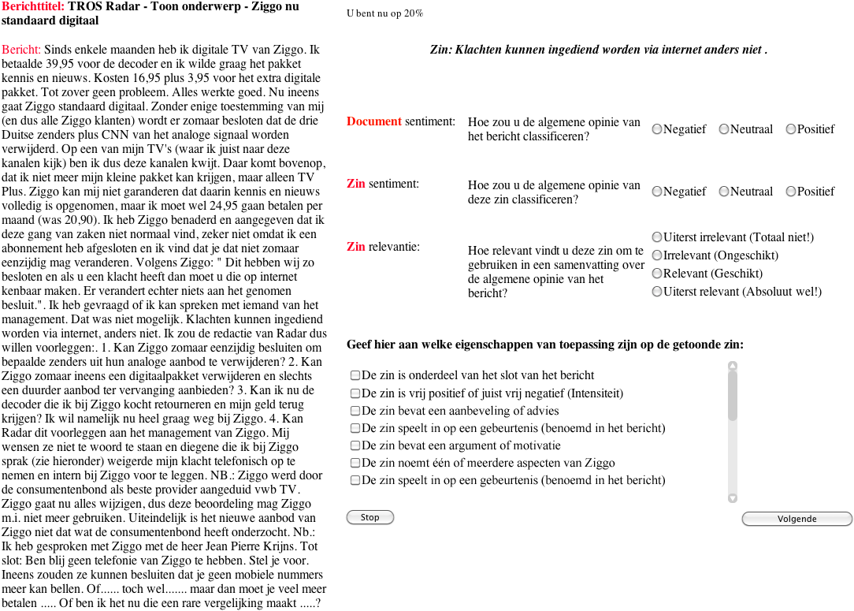
Feature Evaluation (2)
Notes:
In order to be able to perform these annotations, we have developed a web application. The nine annotators have used this interface in order to perform their tasks.

Slide 9
Feature Evaluation (3)
Scores were aggregated per sentence:
Sentiment scores were averaged over all 3 annotators
Relevance scores were mapped onto binary classes (relevant and irrelevant) and subsequently aggregated by means of majority voting over all 3 annotators
Applicability of features was aggregated per feature by means of majority voting over all 3 annotators
We have identified important proxies for the relevance of a sentence in a sentiment summary by means of:
The information gain metric
Feature selection focused on subsets of features with low inter-correlation, but high correlation with relevance
We have used 10-fold cross-validation in our analyses
Notes:
After having collected all ratings from the annotators, we have aggregated the annotators’ scores in order to turn each sentence into one data point. To this end, we have averaged all sentiment scores over all 3 annotators per sentence. The relevance scores were first mapped onto binary classes and subsequently aggregated by means of majority voting over all 3 annotators. The applicability of features was aggregated per feature per sentence by means of majority voting as well.
We have subsequently analyzed the collection of data points thus obtained in order to identify important proxies for the relevance of a sentence in
a sentiment summary. First, we have used the collected data in order to determine the information gain of each considered feature with respect to the binary classification of the relevance of our evaluated sentences. As an alternative method, we have used a feature selection method in order to identify the most informative subset of features, by considering the predictive power of each individual feature along with the degree of redundancy between the features; subsets of features that are highly correlated with the class while having low inter-correlation are preferred. For these analyses, we have used the Weka software package. In order to validate the results, we have used 10-fold cross-validation on these analyses. As you may have noted, we have not used all data in this analysis; some data (the sentiment scores and the more detailed relevance scores) has been collected for future research.

Slide 10
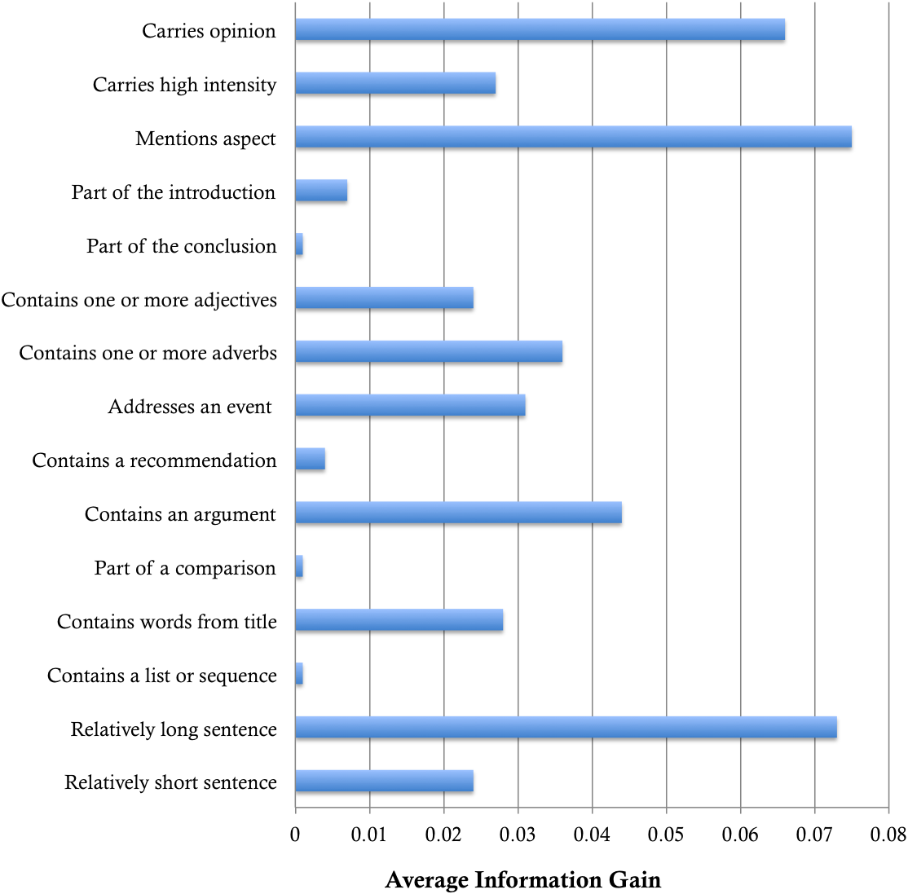
Experimental Results (1)
Notes:
When we analyze the features in our data set in terms of their associated information gain, we can clearly distinguish useful from less useful features. This figure suggests that in our data, three features contain relatively much information that can be used to distinguish relevant from irrelevant text fragments for sentiment summaries. Aspects provide the highest information gain, closely followed by sentences that are relatively long and sentences that carry opinion.
Conversely, three features seem to have a rather marginal relevance: conclusion sentences, sentences with lists, and sentences that are part of a comparison. This may be related to their relatively low frequency in our data set.

Slide 11
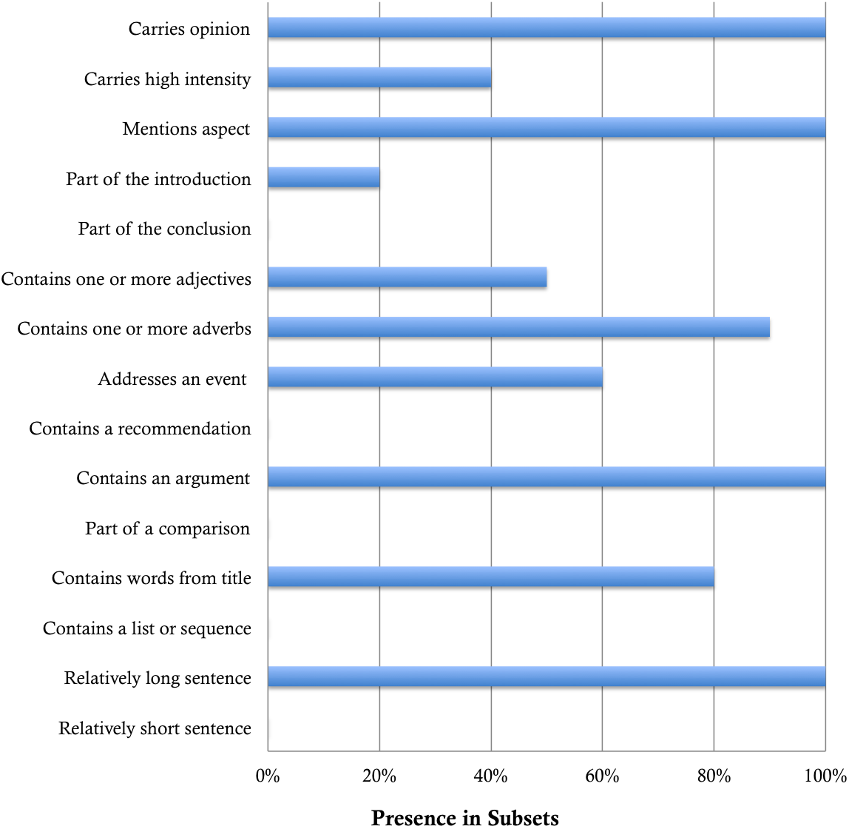
Experimental Results (2)
Notes:
In another analysis, in which we apply a feature selection method in order to identify the most informative subset of features in each of our 10 folds, we obtain similar results. This figure shows that four features are always selected: sentences with opinions, sentences with aspects, sentences with arguments, and long sentences. Sentences containing adverbs and sentences containing words that also occur in the title of a document are selected relatively often, yet not in all cases.

Slide 12
Conclusions
Relevant text segments for sentiment summaries are:
Segments discussing (aspects of) the text’s subject
Long text segments
Segments containing opinions
Segments containing arguments supporting these opinions
It is not so much the absolute position of text segments, but rather the role that sentiment-carrying text segments play that renders them useful in summaries reflecting a text’s sentiment
Notes:
Our results indicate that, according to our human annotators, four features are relatively important proxies for a text segment’s relevance in sentiment summaries of conversational documents. These features include segments discussing aspects of a text’s subject, segments that are relatively long, segments with opinions, and segments containing arguments supporting these opinions. Especially features referring to arguments and long text fragments are remarkable, as they are, to the best of our knowledge, not used in existing sentiment summarizers.
Our results indicate that in our corpus of Dutch conversational documents, it is not so much the absolute position of text segments – for instance, their occurrence in an introduction or conclusion – that distinguishes relevant from irrelevant segments. Conversely, it is rather the role sentiment-carrying text segments play – for instance arguments supporting the overall message, or segments discussing different aspects of the topic – that
renders them useful in summaries reflecting the sentiment of a document.

Slide 13
Future Work
Validate our findings in other corpora and languages
Investigate how to account for structural features (e.g., argumentation structures) of content in sentiment summarization
Investigate the link between the sentiment of relevant text segments and the sentiment of a text as a whole
Optimize the combination of relevant sentences in a final sentiment summary
Implement our findings in an automated sentiment summarization tool
Notes:
In future work, we plan to validate our findings on other corpora and languages, as well as to further investigate how we can account for structural features like argumentation structures when summarizing the sentiment conveyed by a text. In future work, we additionally aim to investigate the link between sentiment of relevant text segments and sentiment of a text as a whole. Furthermore, we aim to find combinations of sentences constituting a good summary. Last, we plan to implement our findings and to assess different (weighted) combinations of features in order to improve the state-of-the-art in sentiment summarization.

Slide 14
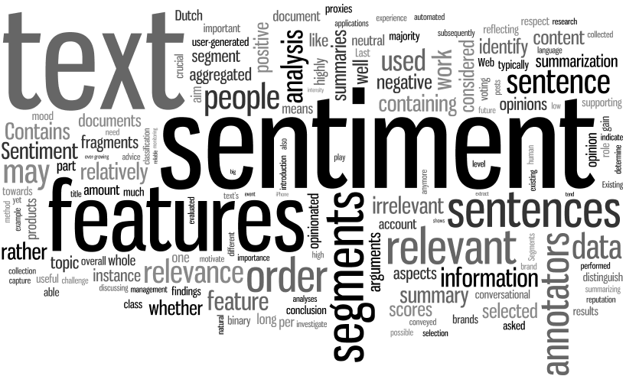
Questions?
Alexander Hogenboom Erasmus School of Economics Erasmus University Rotterdam P.O. Box 1738, NL-3000 DR Rotterdam, the Netherlands
hogenboom@ese.eur.nl

