Slide 1
Ontology Updating Driven by Events
Frederik Hogenboom fhogenboom@ese.eur.nl | Jordy Sangers jordysangers@hotmail.com | Flavius Frasincar frasincar@ese.eur.nl
Erasmus University Rotterdam PO Box 1738, NL-3000 DR Rotterdam, the Netherlands
This talk is based on the paper Event-Driven Ontology Updating. Sangers, J., Hogenboom, F.P. & Frasincar, F. (2012). In X.S. Wang, I.F. Cruz, A. Delis & G. Huang (Eds.), Thirteenth International Conference on Web Information System Engineering (WISE 2012) Vol. 7651. Lecture Notes in Computer Science (pp. 44-57). Springer.

Slide 2
Introduction (1)
Most modern Web applications represent domain specific knowledge by means of Web ontologies
Ontologies:
Concepts
Relations
Triples: subject - predicate - object
Structured data facilitates data understandability and interoperability

Slide 3
Introduction (2)
Due to society's non-static nature, knowledge bases require regular updates
Traditional data sources like relational databases have mechanisms for automatic updates
What about Web ontology updating?

Slide 4
Introduction (3)
There is no principled way for automatic Web ontology updating
Domain experts mostly update ontologies manually:
Tedious
Repetitive
Error-prone
Time-consuming
…

Slide 5
Introduction (4)
Ontology Update Language (OUL):
Alleviates the process of manual Web ontology updating
Define sets of SPARQL/Update rules
Based on automatic update mechanism from active databases: SQL-triggers
Event-Condition-Action model:
Event occurrences trigger actions through changehandlers
Preconditions are assessed
No support for a fully automated update mechanism
Hence, we propose OULx:
Language features
Execution models

Slide 6
OUL Syntax
<changerequest> ::== add [unique] (<SPARQL>)
| delete [unique] (<SPARQL>)
<SPARQL> ::== SPARQL SELECT query WHERE clause
CREATE CHANGEHANDLER <name>
FOR <changerequest>
AS
[ IF <precondition>
THEN ] <actions>
<name> ::== string
<precondition> ::== contains(<SPARQL>)
| entails(<SPARQL>)
| entailsChanged(<SPARQL>)
| (<precondition>)
| <precondition> and <precondition>
| <precondition> or <precondition>
<actions> ::== [<action>]|<action><actions>
<action> ::== <SPARQL update>
| for( <precondition> ) <actions> end;
| feedback(<text>) | applyRequest
<SPARQL update> ::== a MODIFY action (in SPARQL/Update)
<text> ::== string (may contain SPARQL variables)
Notes:
Context-free grammar

Slide 7
OULx Syntax
<changerequest> ::== add [unique] (<SPARQL>)
| delete [unique] (<SPARQL>)
<SPARQL> ::== SPARQL SELECT query WHERE clause
<prefixes> ::== <prefix>[<prefixes>]
<prefix> ::== <SPARQL prefix>
<SPARQL prefix> ::== SPARQL query PREFIX statement
CREATE CHANGEHANDLER <name>
[<prefixes>]
FOR <changerequest>
AS
[ IF <precondition>
THEN ] <actions>
<name> ::== string
<precondition> ::== contains(<SPARQL>)
| entails(<SPARQL>)
| entailsChanged(<SPARQL>)
| (<precondition>)
| <precondition> and <precondition>
| <precondition> or <precondition>
| !<precondition>
<actions> ::== [<action>]|<action><actions>
<action> ::== <SPARQL update>
| for( <precondition> ) <actions> end;
| feedback(<text>) | applyRequest
<SPARQL update> ::== a MODIFY action (in SPARQL/Update)
<text> ::== string (may contain SPARQL variables)
Notes:
Negation contradicts the open world assumption, but in practice it is still used a lot; we borrowed this from databases

Slide 8
OULx Example
Adding to a product ontology an item that was not yet present could be accomplished by using the following OULx changehandler:
Changehandler
Name
Prefixes
Changerequest
Preconditions
Actions
CREATE CHANGEHANDLER addProductHandler
PREFIX kb: <http://www.hermes.com/knowledgebase.owl#>
PREFIX rdf: <http://www.w3.org/1999/02/22-rdf-syntax-ns#>
FOR add(?company kb:hasProduct ?product)
AS IF (contains(?company rdf:type kb:Company)
and !(contains(?product rdf:type kb:Product)))
THEN insert data{?product rdf:type kb:Product};
applyRequest;
addProductHandler
kb:<...>
rdf:<...>
add Product to Company
Company in ontology
Product not in ontology
insert Product
execute changerequest

Slide 9
OUL Execution Model
Event occurrences (update requests) trigger actions through changehandlers
The first matching changehandler (where all preconditions are met) is executed
In case of multiple events deferred execution is used

Slide 10
OULx Execution Models
Extensions inspired from active databases:
Immediate execution
Execution of all matching changehandlers
Update chaining
Update looping

Slide 11
OULx Execution Models: Execution
Updates can be executed during rule interpretation or after all updates have been collected
Deferred execution:
Match changehandlers
Collect actions and store SPARQL/Update statements
Apply stored statements to the ontology
Immediate execution:
Match changehandlers
Collect actions and apply SPARQL/Update statements

Slide 12
OULx Execution Models: Execution
event
Changehandler
Name
Prefixes
Changerequest
Preconditions
Actions
Changehandler
Name
Prefixes
Changerequest
Preconditions
Actions
…
execute
Storage
execute
execute
Notes:
For simplicity, we assume there is one event. An event is matched to changerequests, and if preconditions are matched actions are executed.
With deferred execution, actions are stored first, and executed after collecting all actions. With immediate execution, actions are executed immediately.

Slide 13
OULx Execution Models: Matching
The number of changehandlers to be matched determines the updates to be collected
First matching changehandler:
Iterator moves forward through the ontology update specification document until:
End of document
Preconditions of a changehandler are met
Returns binding information of single changehandler
All matching changehandlers:
Iterator moves forward through the ontology update specification document until end of document
Returns binding information of all changehandlers that meet their preconditions

Slide 14
OULx Execution Models: Matching
event
Changehandler
Name
Prefixes
Changerequest
Preconditions
Actions
Changehandler
Name
Prefixes
Changerequest
Preconditions
Actions
…
execute
execute
Notes:
Blue changehandler is first matching changehandler (changerequest matches, preconditions are met), and actions are executed immediately (deferred execution is of course also possible)
Pink changehandler is another matching changehandler and is only executed when all matching changehandlers are executed; otherwise it is never triggered

Slide 15
OULx Execution Models: Chaining
Changehandlers could fire new update requests, hence triggering other changehandlers
Chaining updates:
Collect updates from first/all matching changehandlers
Also collect updates from those handlers that are triggered by other matching handlers
Execute updates in a deferred/immediate way

Slide 16
OULx Execution Models: Chaining
event
Changehandler
Name
Prefixes
Changerequest
Preconditions
Actions
Changehandler
Name
Prefixes
Changerequest
Preconditions
Actions
execute
execute
Notes:
The blue changehandler is the only matching changehandler. If we assume immediate execution, during execution we trigger another changehandler. Its actions are then also executed.
Of course you can also collect all the actions first when using deferred execution. Also, you can extend this example with multiple matching changehandlers. Then you can distinguish between executing only the first or all matching changehandlers.

Slide 17
OULx Execution Models: Looping
For deferred/immediate execution of first/all changehandlers, applying updates to the ontology changes the ontology, and could trigger new changehandlers to become matched with the same event
Looping updates:
Iterate over changehandlers using the same event
Apply update actions until there are no matching changehandlers left

Slide 18
OULx Execution Models: Looping
event
Changehandler
Name
Prefixes
Changerequest
Preconditions
Actions
Changehandler
Name
Prefixes
Changerequest
Preconditions
Actions
…
execute
execute
Notes:
An event is matched to changerequests, and if preconditions are matched actions are executed. In this picture, we assume immediate execution of all matching changehandlers. Once finished, the event is thrown again until no changehandlers match.

Slide 19
Implementation
OULx has been fully implemented as a stand-alone Java application (available online)
Syntax: parsing and compiling of changehandlers is performed via a compiler created with JavaCC
Execution: SPARQL and SPARQL/Update implemented using Jena and ARQ 2.8.8
Inputs:
Ontology
Changehandlers
Execution model
Output: updated ontology

Slide 20
Discussion (1)
No benchmarks for OUL
Deferred/immediate execution:
Some deferred updates could make subsequent ones invalid
Deferred execution could be more efficient than immediate execution (merging duplicates, simplification)
First/all matching changehandlers:
All matching changehandlers is computationally more intensive due to the increased complexity
However, updates are more efficient (in one pass, all matched handlers are dealt with, eliminating the need for multiple user-triggered iterations)

Slide 21
Discussion (2)
Chaining:
Increased level of automation (no need for manual triggering of updates resulting from earlier updates)
Contributes to the usability of the language by separating atomic update actions and thus delivering modularity and an increased possibility to reuse changehandlers
Looped execution models:
Efficiency is higher compared to non-looped models
Interpretability of updates is lower than for models without looping due to the repeated event generation
Note of caution:
Rule specification differs per execution model
Termination not always guaranteed

Slide 22
Conclusions
We have extended OUL to OULx:
New language features:
Prefixes
Negation
New execution models:
Immediate updating (opposed to deferred updating)
Execution of all matching handlers (instead of just the first one)
Update chaining (internal triggering mechanism)
Looping (repetitive treatment of an event)
Future work:
Determine conditions to ensure termination of changehandlers
Develop IE language that combines information extraction and ontology updates
Notes:
Termination of changehandlers:
borrow techniques from active databases (Alexander Aiken, Jennifer Widom & Joseph M. Hellerstein, 1992)
simple implementation is to only allow changehandlers to be executed once per event

Slide 23
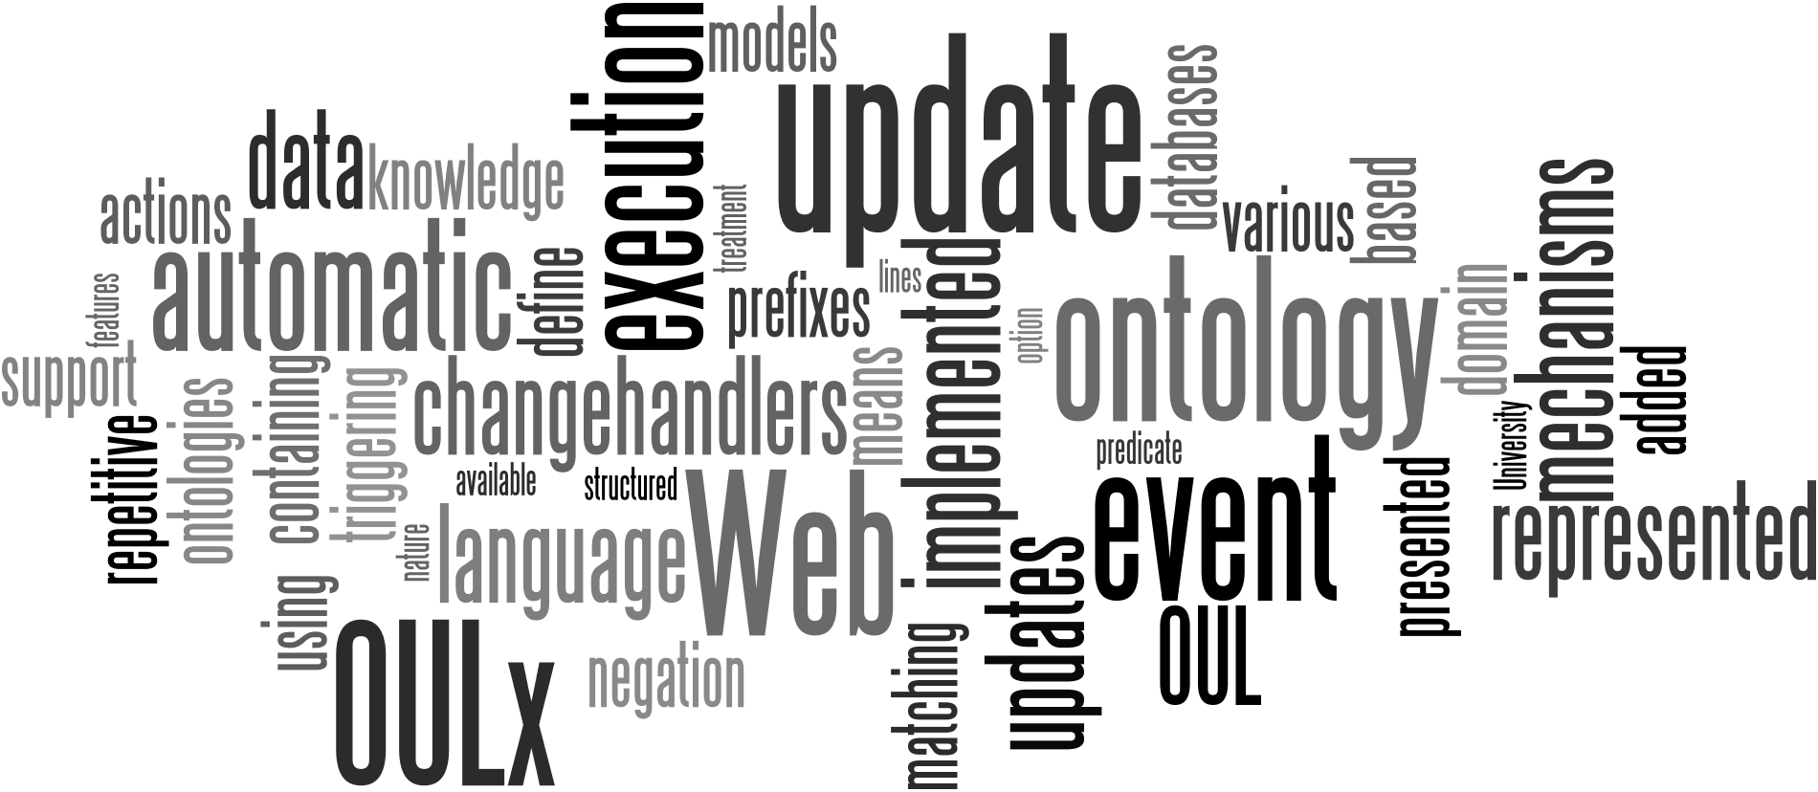
Questions
http://people.few.eur.nl/fhogenboom/oulx.html

