Slide 1
Word Sense Disambiguation for Automatic Taxonomy Construction from Text-Based Web Corpora
Jeroen de Knijff 312470jk@student.eur.nl | Kevin Meijer 312177km@student.eur.nl
Flavius Frasincar frasincar@ese.eur.nl | Frederik Hogenboom fhogenboom@ese.eur.nl
Erasmus University Rotterdam PO Box 1738, NL-3000 DR Rotterdam, the Netherlands
;)
Notes:
Introduction: name, research topic, link with this
Topic: what is it, who are the other people

Slide 2
Introduction (1)
An increasing amount of documents is digitally stored on the Web
Documents can be structured through taxonomies
Many documents are unstructured, hence driving the need for taxonomy construction
Notes:
Nowadays, an ever increasing amount of documents is digitally stored and readily available on the Web. A common issue with managing these documents is that many of these are organized in an unstructured manner. Organizing these documents in a structured way by creating a taxonomy representation to clarify documents can be beneficial, as it enhances the overview of available documents. A taxonomy is defined as a specific form of an ontology, which is a formal, explicit specification of a shared conceptualization that provides users with insight into the type relations between (domain) concepts.

Slide 3
Introduction (2)
Taxonomy construction:
  Manually:
    More accurate
    Main method
  Automatic:
    Less knowledge needed
    Less time consuming
Taxonomy construction enables inter operability between Web sites, tools, etc. due to the knowledge aggregation into shared taxonomies
Notes:
Currently, many taxonomies are manually created. While manually constructing taxonomies is usually more accurate because of the involvement of domain experts, automatically generating taxonomies is often less costly and time consuming. Taxonomy construction on the Web is particularly of interest, as it enables inter operability between Web sites, tools, etc., due to the knowledge aggregation into shared taxonomies. The Web fosters an incredible large amount of information and knowledge that up until know is mostly not linked and even remains virtually invisible because of the lack of structure. Within the last decade, there has been a trend of connecting related data that has not been previously linked before.

Slide 4
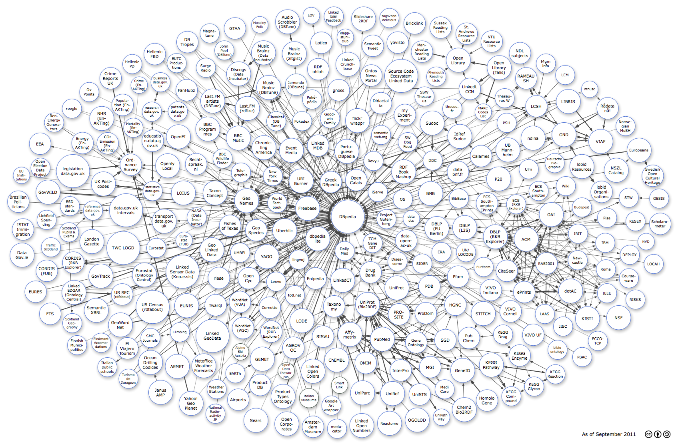
Introduction (3)
What’s new?
Notes:
The well-know Linked Open Data cloud diagram, which aims to show the inter-connectivity of today's Web sites and their knowledge bases, grows by the year. Half a year ago when I would’ve shown this picture, it would’ve actually been readable.
This cloud could grow at an even higher rate and become increasingly more complex when widely applying automatic taxonomy construction. Hence, due to the need for structured information, as well as the complexity and considerable effort for manually creating taxonomies, automatic taxonomy construction is an interesting field to explore.
So, what’s new?

Slide 5
Introduction (4)
Taxonomy construction is a mature and widely researched topic
Little literature exists on applying Word Sense Disambiguation (WSD), even though WSD improves results of used techniques like clustering!
Hence, we propose the Automatic Taxonomy Construction from Text (ATCT) framework, which implements WSD
Notes:
Although there is a substantial body of literature on automatic taxonomy construction, the amount of literature focusing on applying Word Sense Disambiguation (WSD) is limited, even though WSD is proven to be able to improve the results of clustering. Hence, we evaluate the influence of a sophisticated WSD algorithm on an existing concept subsumption method. We propose a framework for Automatic Taxonomy Construction from Text (ATCT), which we use for the evaluation of the added value of WSD in taxonomy construction.

Slide 6
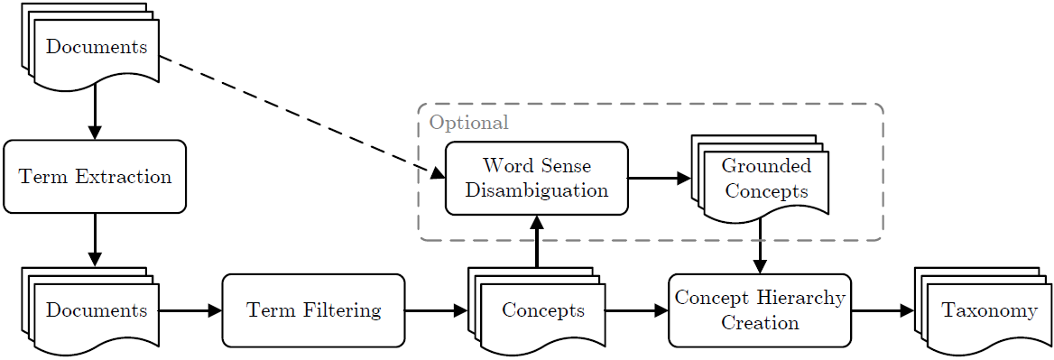
ATCT: Framework (1)
Notes:
In our four-step ATCT framework for automatically constructing a domain-specific taxonomy, first the terms are extracted from the documents, which subsequently get processed in our term filtering step. Here, terms are filtered on lexical cohesion and domain pertinence, after which the most relevant terms are selected on the basis of a score, which is determined by domain pertinence, domain consensus, and structural relevance. The selected terms are processed into concepts as concept labels. The next optional step is Word Sense Disambiguation (WSD), which is used to derive the sense of a concept term and to find synonyms of the disambiguated term. Lastly, a concept hierarchy is created by constructing the type relations between concepts. The resulting hierarchy is represented in SKOS, a commonly used domain taxonomy representation format.

Slide 7
ATCT: Framework (2)
Term extraction:
  Part-of-Speech (POS) tagging
  All nouns are extracted
Term filtering:
  Based on domain pertinence and lexical cohesion
  Most relevant terms are subsequently selected through a score, based on domain pertinence, domain consensus and structural relevance
Cohesion among words in compound nouns: (# words × term freq. corpus × log(term freq.)) / word freq. corpus
Relevance w.r.t. target domain: term freq. domain corpus / term freq. contrastive corpus
Importance of term: term freq. corpus
Importance of term: appearance (position) in document
Notes:
Within the ATCT framework, terms are extracted from a set of documents by tagging all the words that appear in these documents and extracting those terms that are tagged as a noun. The choice for nouns is motivated by the fact that concepts are usually represented by nouns rather than other types of words, which is also the case for our utilized golden taxonomies.
Extracted terms are filtered on multiple criteria, i.e., their domain pertinence and their lexical cohesion value. The most relevant terms are selected by calculating a score, which is based on the domain pertinence, domain consensus and structural relevance of the term.
Domain pertinence measures whether a term is relevant for the target domain. The more frequently a term appears in the domain corpus and the less frequently the term appears in the contrastive corpus, the higher the domain pertinence.
Lexical cohesion measures cohesion among words in a term and is only used for compound nouns. Based on initial experiments, we find that for optimal performance for both measures the 30% terms with the lowest values should be filtered out.
Domain consensus checks whether a term is important, i.e., it appears in several documents.
Structural relevance is used for measuring importance of terms in relation to their document position appearance (title or body).

Slide 8
ATCT: Framework (3)
Word Sense Disambiguation:
  Optional step
  Synsets are retrieved from a semantic lexicon
  Structural Semantic Interconnections (SSI)
  Utilizes a similarity measure that is proposed by Jiang and Conrath (1997)
  Terms with similar senses are removed
  Term counts are aggregated per concept
Notes:
The optional WSD procedure is used for deriving the sense of a concept term and for finding the synonyms of the concept term. In order to find the sense of a term, we retrieve the possible senses that are associated to the term. For this, we employ a semantic lexicon, which is a large lexical database that contains many words with their synsets (collections of synonyms). When a term is recognized as a noun in the semantic lexicon, we retrieve the possible synsets for that particular term. One of those synsets is selected as the sense for a term by using the SSI algorithm.
The SSI approach uses graphs to describe word groups and their context (word senses), as derived from a semantic lexicon. The senses are determined based on the number and type of detected semantic interconnections in a labeled directed graph representation of all senses of the considered word groups. The term (word or word group) with the greatest similarity is selected as best sense. As similarity measure, we employ the one that is proposed by Jian and Conrath in their 1997 paper. This is one of the best performing similarity measures around.

Slide 9
ATCT: Framework (4)
Concept hierarchy creation:
  Based on the subsumption algorithm, which determines potential parents (subsumers) of concepts:
    x potentially subsumes y, if:
      x appears in at least the proportion t of all documents in which y appears
      y appears in less than the proportion t of all documents in which x appears
  Additionally takes into account ancestor positions:
    Weighting scheme based on the number of layers between terms x and y
    Close parents get assigned more weight

Slide 10
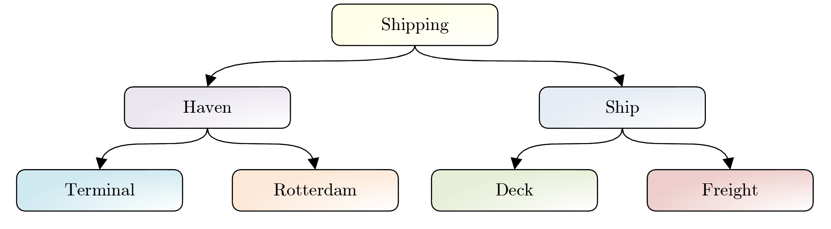
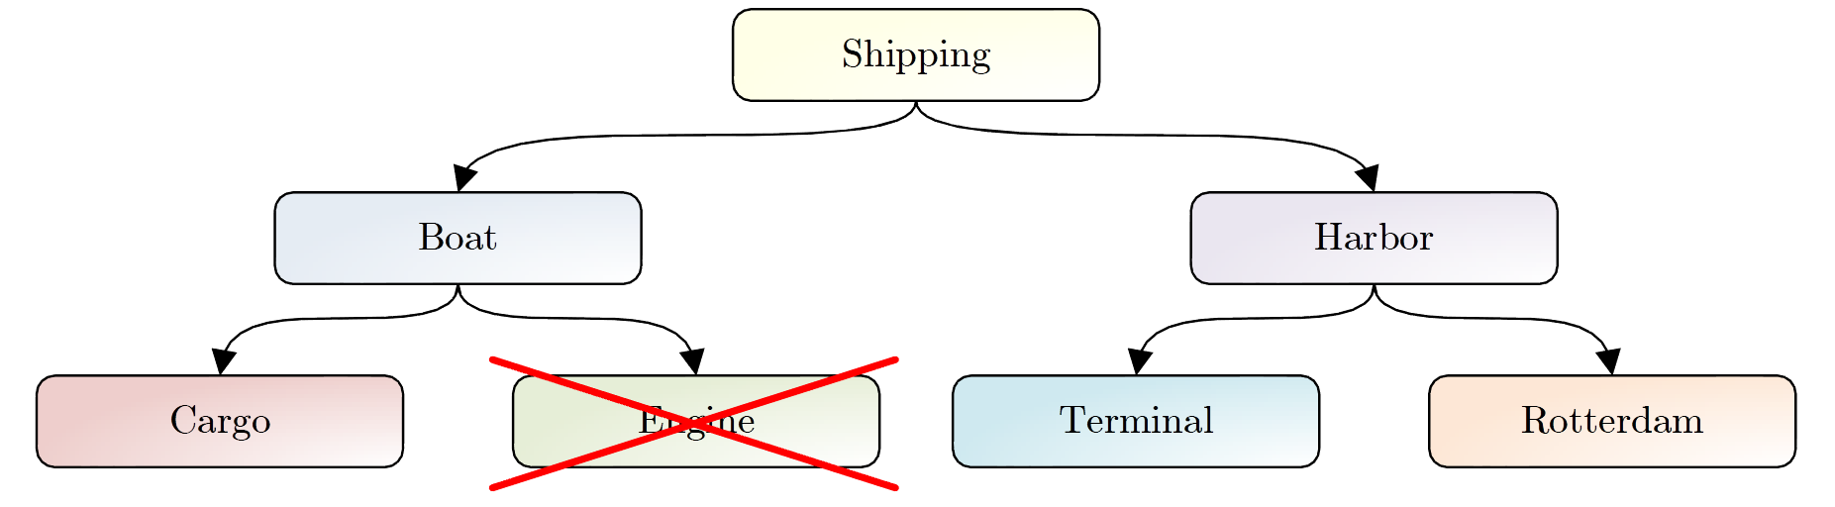
ATCT: Framework (5)
Concept hierarchy creation (cont’d):
  Evaluating taxonomy concepts is not trivial:
    Reference taxonomy:
    Generated taxonomy:

Slide 11
ATCT: Framework (6)
Concept hierarchy creation (cont’d):
  Look at senses through taxonomy concept disambiguation:
    Similar to term WSD from text, but now surrounding concepts are used instead of surrounding words
    Terms with single sense for lexicon are disambiguated
    Other terms are disambiguated using their surrounding terms:
      Concept neighborhood of 2 (up/down)
      Root node is disregarded
    Lexicon senses are compared
    In case no sense is available (e.g., compound nouns):
      Lexical matching
      Descendant / ancestor comparison
    Graph distances are calculated

Slide 12
ATCT: Implementation
Java-based pipeline
Noun parsing with the Stanford parser
RDF implementation using Jena
Domain taxonomies are expressed in SKOS

Slide 13
Evaluation (1)
Data:
  Economics & management:
    25,000 abstracts from RePub & RePEc
    2,000 distinct concepts
    Golden taxonomy using STW Thesaurus annotations
  Medicine & health:
    10,000 abstracts from RePub
    1,000 distinct concepts
    Golden taxonomy using MeSH annotations
Measures:
  Precision
  Recall
  F-measure
Notes:
We measure precision as the number of concepts in the generated taxonomy that have been identified correctly over the number of concepts in the generated taxonomy. Recall is the number of matching concepts in the generated taxonomy over the number of concepts in the target taxonomy. The F-measure is the harmonic mean between the two values.

Slide 14
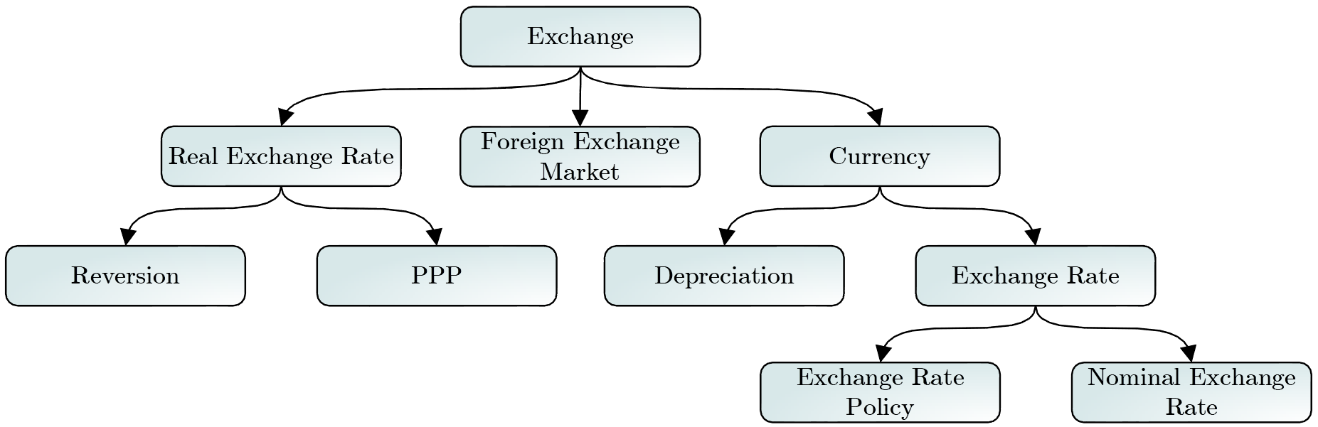
Evaluation (2)
Domain | Taxonomy | Precision | Recall | F-Measure
E&M | Without WSD | 0.7382 | 0.5082 | 0.6023
 | With WSD | 0.8056 | 0.5813 | 0.6753
M&H | Without WSD | 0.5681 | 0.6051 | 0.5860
 | With WSD | 0.5907 | 0.6016 | 0.5961

Slide 15
Conclusions
ATCT framework:
  Extracts potential taxonomy terms from large corpora
  Filters relevant terms
  Performs WSD to remove redundant terms
  Creates a taxonomy using a subsumption method
Evaluation shows performance improvement when using WSD (up to 12.12%)
Future work:
  Benchmark against other taxonomy creation methods (hierarchical clustering, classification, etc.)
  Explore other domains (law, chemistry, physics, history, etc.)

Slide 16
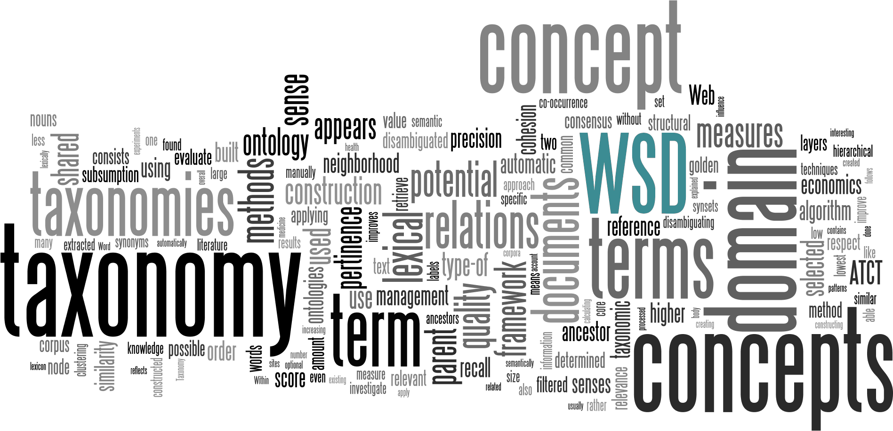
Questions

