Slide 1
Sentiment Analysis with a Multilingual Pipeline
Daniëlla Bal daniella.bal@xs4all.nl | Malissa Bal malissa.bal@xs4all.nl | Arthur van Bunningen arthur.van.bunningen@teezir.com
Alexander Hogenboom hogenboom@ese.eur.nl |  | Flavius Frasincar frasincar@ese.eur.nl
Frederik Hogenboom
fhogenboom@ese.eur.nl
Erasmus University Rotterdam
PO Box 1738, NL-3000 DR
Rotterdam, the Netherlands
Notes:
Introduction: name, research topic, link with this
Topic: what is it, who are the other people

Slide 2
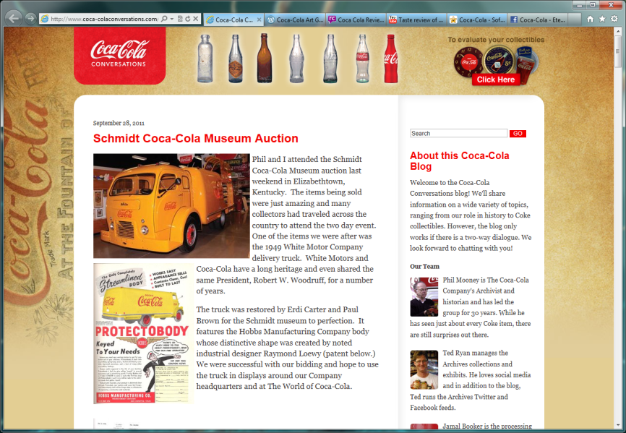
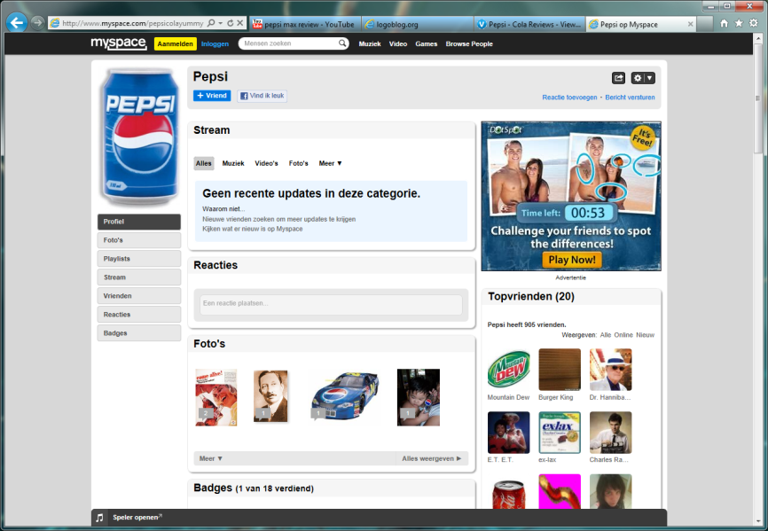
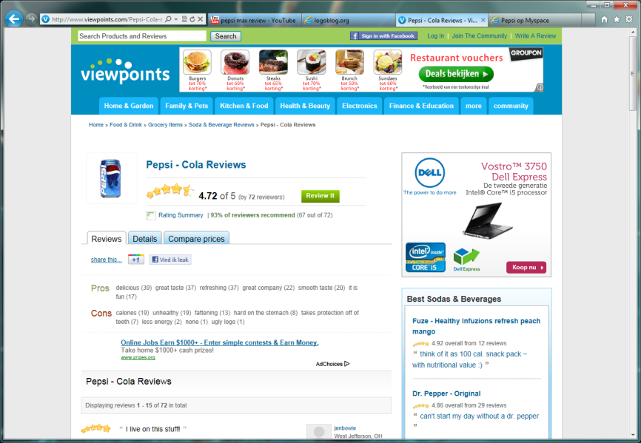
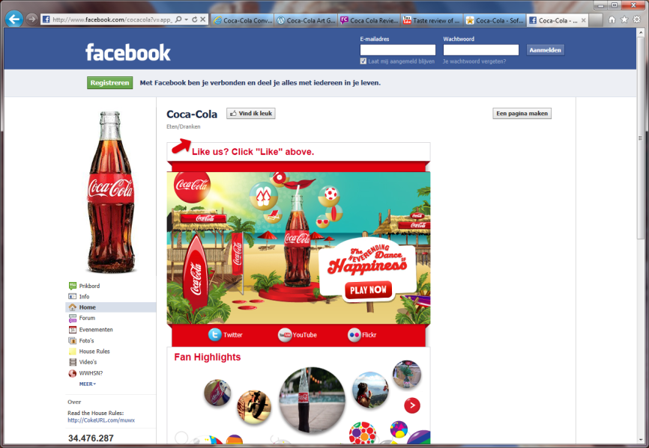
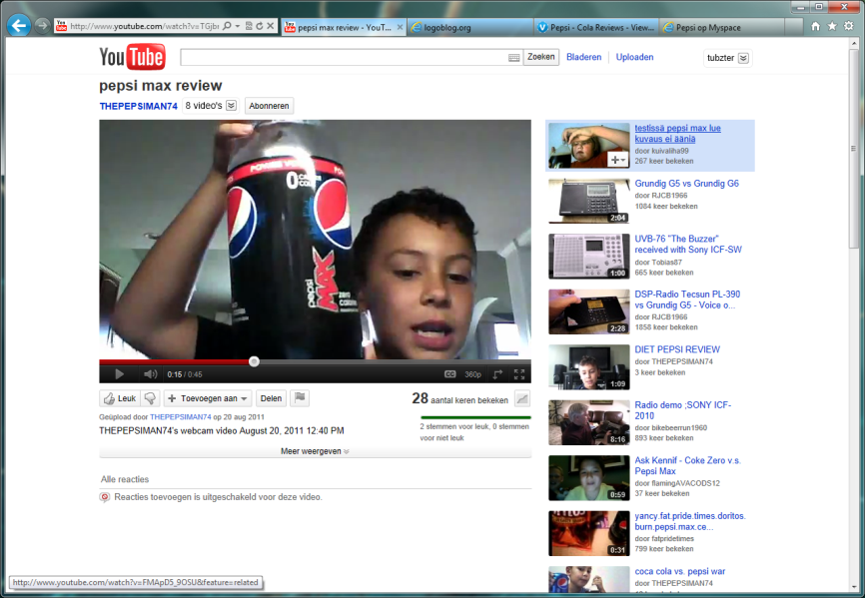
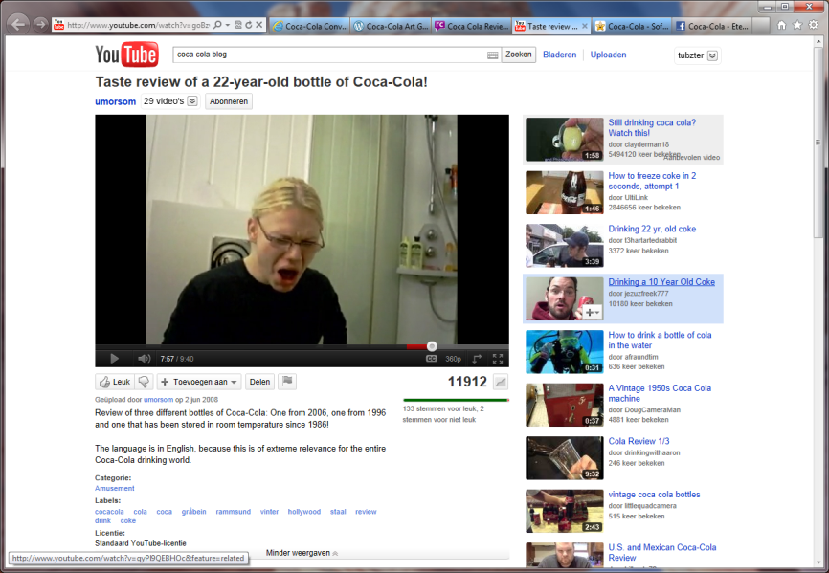
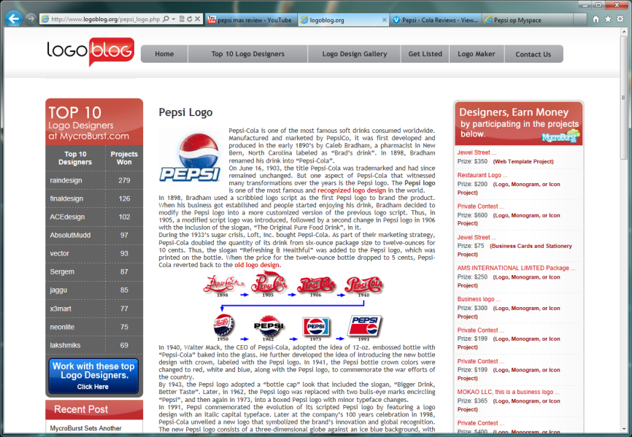
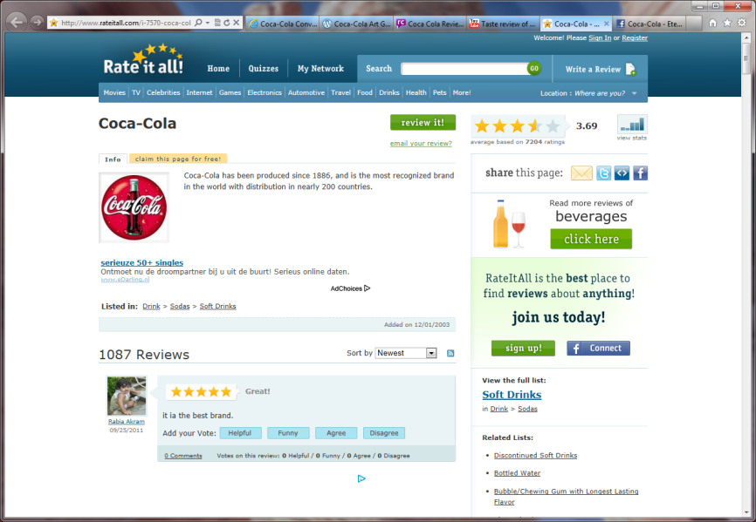
Introduction (1)
The Web increases the availability of data:
Reviews – Blogs – Social media
Previews – Forums – …
Increased transparency and convenience of data gathering leads to increased global competition
Notes:
The Web, being available to a continually expanding audience all over the world, dramatically increases the availability of data in the form of reviews, previews, blogs, forums, social media, etc. Because of increased transparency and convenience of gathering data on the Web, global competition between companies is also highly increased. In this expanding competitive landscape it becomes more important for a company to understand its market and target audience.
With the vast amounts of information available on the Web it is impossible for companies to read everything that is written about their position between competitors and competing products manually. Moreover, a company's staff would have to master many languages to read all the relevant texts.
Here’s an example of the information that can be found on a specific company or product on the Web. Take Coca-Cola. There are blogs, textual reviews, social network pages, heck, even youtube reviews of people grossing out over 22-year-old bottles of coke. For rival Pepsi it is not much different. There is simply a lot – a LOT – to be found on the Web on almost anything.

Slide 3
Introduction (2)
Understand market and target audience by means of sentiment analysis:
Retrieving sentiment (opinions) from text
World-wide market:
Multi-lingual analysis
Localized marketing strategies
Existing work:
Assumes comparability of results across languages
Often does not even bother taking into account multi-lingual sentiment
Isn’t this too simplistic?
Notes:
Sentiment analysis comes to answer this need, as it can be used as a marketing tool to find out what people are generally saying about their products or products of their competitors. Sentiment analysis -- also referred to as opinion mining -- is the process of retrieving the sentiment or opinion of the author from a text.
Yet, for international companies it is not only important to know what people are saying about them in one language; they need to know as well what is said about them across the world in many languages. Being able to analyze documents written in multiple languages gives companies the opportunity to assess local opinions which can be of great help when setting out a marketing plan across different geographies. It can help companies understand where clients adore or dislike their products. It can also help them understand why people in different areas around the world think differently about their products and where they need to focus their marketing efforts. However, it is still not possible to accurately compare the results of sentiment analysis across different languages.
Existing work on sentiment analysis either does not focus on the comparability of sentiment across languages or assumes sentiment across languages to be comparable. We argue that the assumption of comparability of sentiment analysis across languages is too simplistic.

Slide 4
Introduction (3)
Aim: uncover structural differences in the way sentiment is conveyed in different languages
Language-independent method for analyzing sentiment: Sentiment Analysis with a Multilingual Pipeline (SAMP)
Based on multiple (language-specific) lexicons:
Dutch
English
Natural language data:
News articles – Forum posts – Review comments
Blog posts – Reviews – Social media messages
Notes:
Therefore, we propose to utilize a novel language-independent method for analyzing sentiment in order to uncover structural differences in the way sentiment is conveyed in different languages. These insights may contribute to future endeavors in the field of cross-language sentiment analysis. To this end, our framework identifies sentiment in any considered language in the same way, albeit based on language-specific sentiment lexicons. We focus on documents written in the English and Dutch language. Here, documents are constructs of natural language text in the form of news articles, blog posts, forum posts or reviews, but also comments on a review or messages on a social media platform.

Slide 5
Hypotheses
Based on related work, we arrive at 2 hypotheses:
The difference in pipelines for different languages causes a difference in the final document scores:
Caused by grammars
English negation is most accurately found by extending the effect of a negation word until the first punctuation
Dutch negation can be found by setting a window frame of words around the negation word
Differences in the way people express themselves cause unwanted differences in the sentiment analysis:
Way of speech
The negation of bad in “this is not bad at all” is actually enthusiasm
English “I love this university” is equal to Dutch “this is a good university”
Notes:
Two hypotheses could be derived from the related work.
First, we hypothesize that the difference in pipelines for different languages causes a difference in the final document score. The optimal pipeline for different languages looks different. This is caused by the grammar of the language. An example of these differences can be found in the way different languages handle negation. For example, English negation is most accurately found by extending the effect of a negation word until the first punctuation, while in the Dutch language it is better to use a set window frame of words around the negation word. Since we are comparing the document scores of documents written in different languages we propose a general pipeline, handling both languages, to minimize these differences in results.
Our second hypothesis is that differences in the way people express themselves cause unwanted differences in the sentiment analysis. An important difference between languages is in the way of speech. For example, when an Englishman says: “that is not bad at all”, he means he is very enthusiastic about it, yet for the sentiment analysis it is just the negation of bad. This may give documents lower overall sentiment scores while the text is either very positive or very negative. Additionally, a Dutch person would prefer to say “this is a good university” rather than “I love this university”. For English people, the opposite holds true. We want to quantify how much effect these differences have on the final document sentiment score and how we can compensate for these differences.

Slide 6
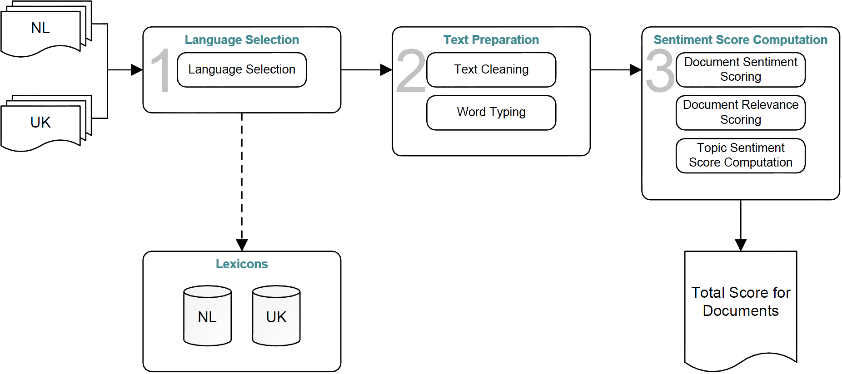
SAMP: Framework (1)
Notes:
The SAMP framework consists of three main components:
Language Selection: determines the language of the text. Selects either Dutch or English, based on the likelihood of the text to be written in the respective languages.
Text Preparation: consists of two parts. The first part is text cleaning. This involves replacing all capital letters with small letters, remove diacritics, etc. until a clean text remains. The second part involves word typing, i.e. finding the Part-Of-Speech (POS) of all words and determining whether each word exists in the lexicon to find the word category (i.e., opinion or modifier).
Sentiment Score Computation: is divided in three separate steps. The first step is document sentiment scoring: calculate the sentiment score of a document. The second step is document relevance scoring, i.e., determining the relevance of a document with respect to an arbitrary topic. Step three is topic sentiment score computation, which involves computing a weighted average of the relevance and sentiment score of a batch of documents with respect to the topic of this collection.

Slide 7
SAMP: Framework (2)
“The cat was happy.” → [The] [he˽] [e˽c] [˽ca] [cat] [at˽] [t˽w] [˽wa] [was] [as˽] [s˽h] [˽ha] [hap] [app] [ppy] [py.]
Language selection:
The language is determined document-wise using letter n-grams
Assumption: a document only has one language
Language with biggest likelihood is selected
Sentiment lexicons:
Dutch (provided by Teezir)
English (manual consensual translations by three experts)
Hence, we make use of two similar lexicons
Text preparation:
Removal of stop words (“a”, “an”, “the”, …)
Cleaning from diacritics (“ó”, “ë”, “ñ”, … → “o”, “e”, “n”, …)
Tagging with Part-of-Speech (POS)
Non-textual elements are not parsed!

Slide 8
SAMP: Framework (3)
Sentiment score computation:
Words and POS are compared to the lexicon, taking into account the word type:
Opinion term (“nice”, “good”, “ugly”, …)
Modifier term (“not”)
Sometimes POS determines classification (“The movie was pretty good” vs. “The blonde girl is very pretty”)
Lexicon contains for each word a POS, type, and score
Document sentiment is the mean of all opinion terms and their modifiers
Topic sentiment score is measured across documents, by weighting each document sentiment score for their associated document relevance to a topic, i.e., the query (based on PL-2 standard and document length normalization)
Notes:
Modifiers can amplify, weaken, or negate an opinion term
POS: pretty is adverb (modifier) or adjective (opinion)
PL-2 standard: based on 2 probabilities, i.e., 1-P2 × -log₂(P1)
P1 is the probability of term occurences in a document
P2 is obtained by observing only the set of all documents in which a term occurs

Slide 9
SAMP: Implementation (1)
C#-based pipeline for Dutch and English corpora
Lexicons:
Dutch version obtained from Teezir
English lexicon is a translation
POS tagging using a maximum-entropy based tagger
Three main user interfaces:
Specific result screen
General screen
Graph screen

Slide 10
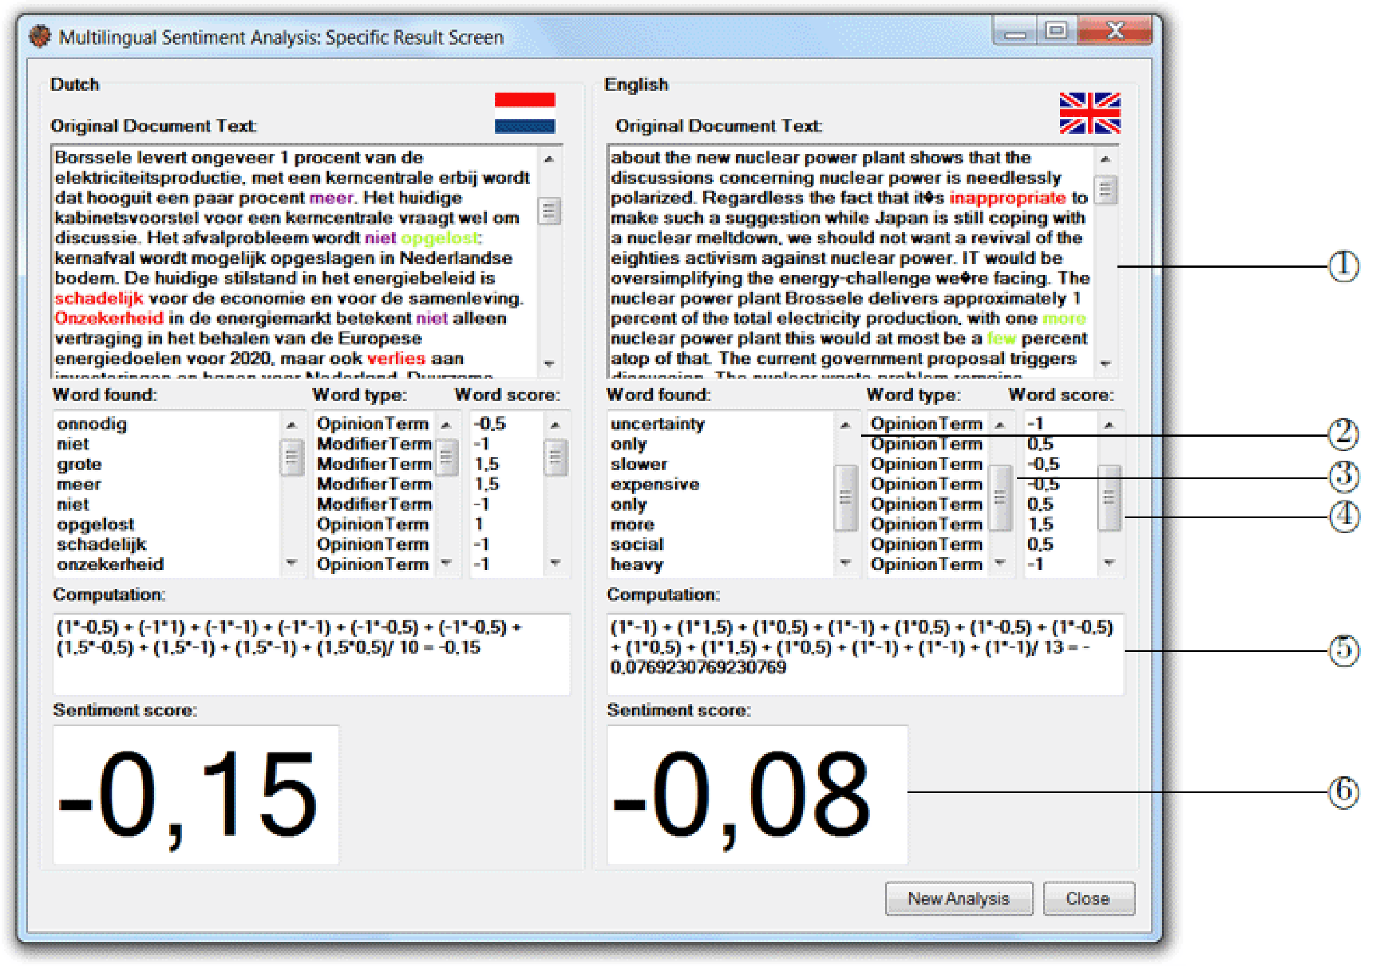
SAMP: Implementation (2)
1
2
3
4
5
6
Notes:
The specific result screen gives more insight in the process of classifying a text as positive or negative. The user can validate whether or not the correct words are flagged as sentiment words, the words have the correct score, and the computation of the document score is correct.
Elements:
1) Positive opinion: green, negative opinion: red, modifier: purple
#) Lists of matched sentiment words from the lexicon, with:
2) List with opinion and modifier words found
3) List with associated word types (so opinion term or modifier term)
4) List of associated word scores
5) Computation of score (modifier terms multiplied by opinion terms)
6) Document score

Slide 11
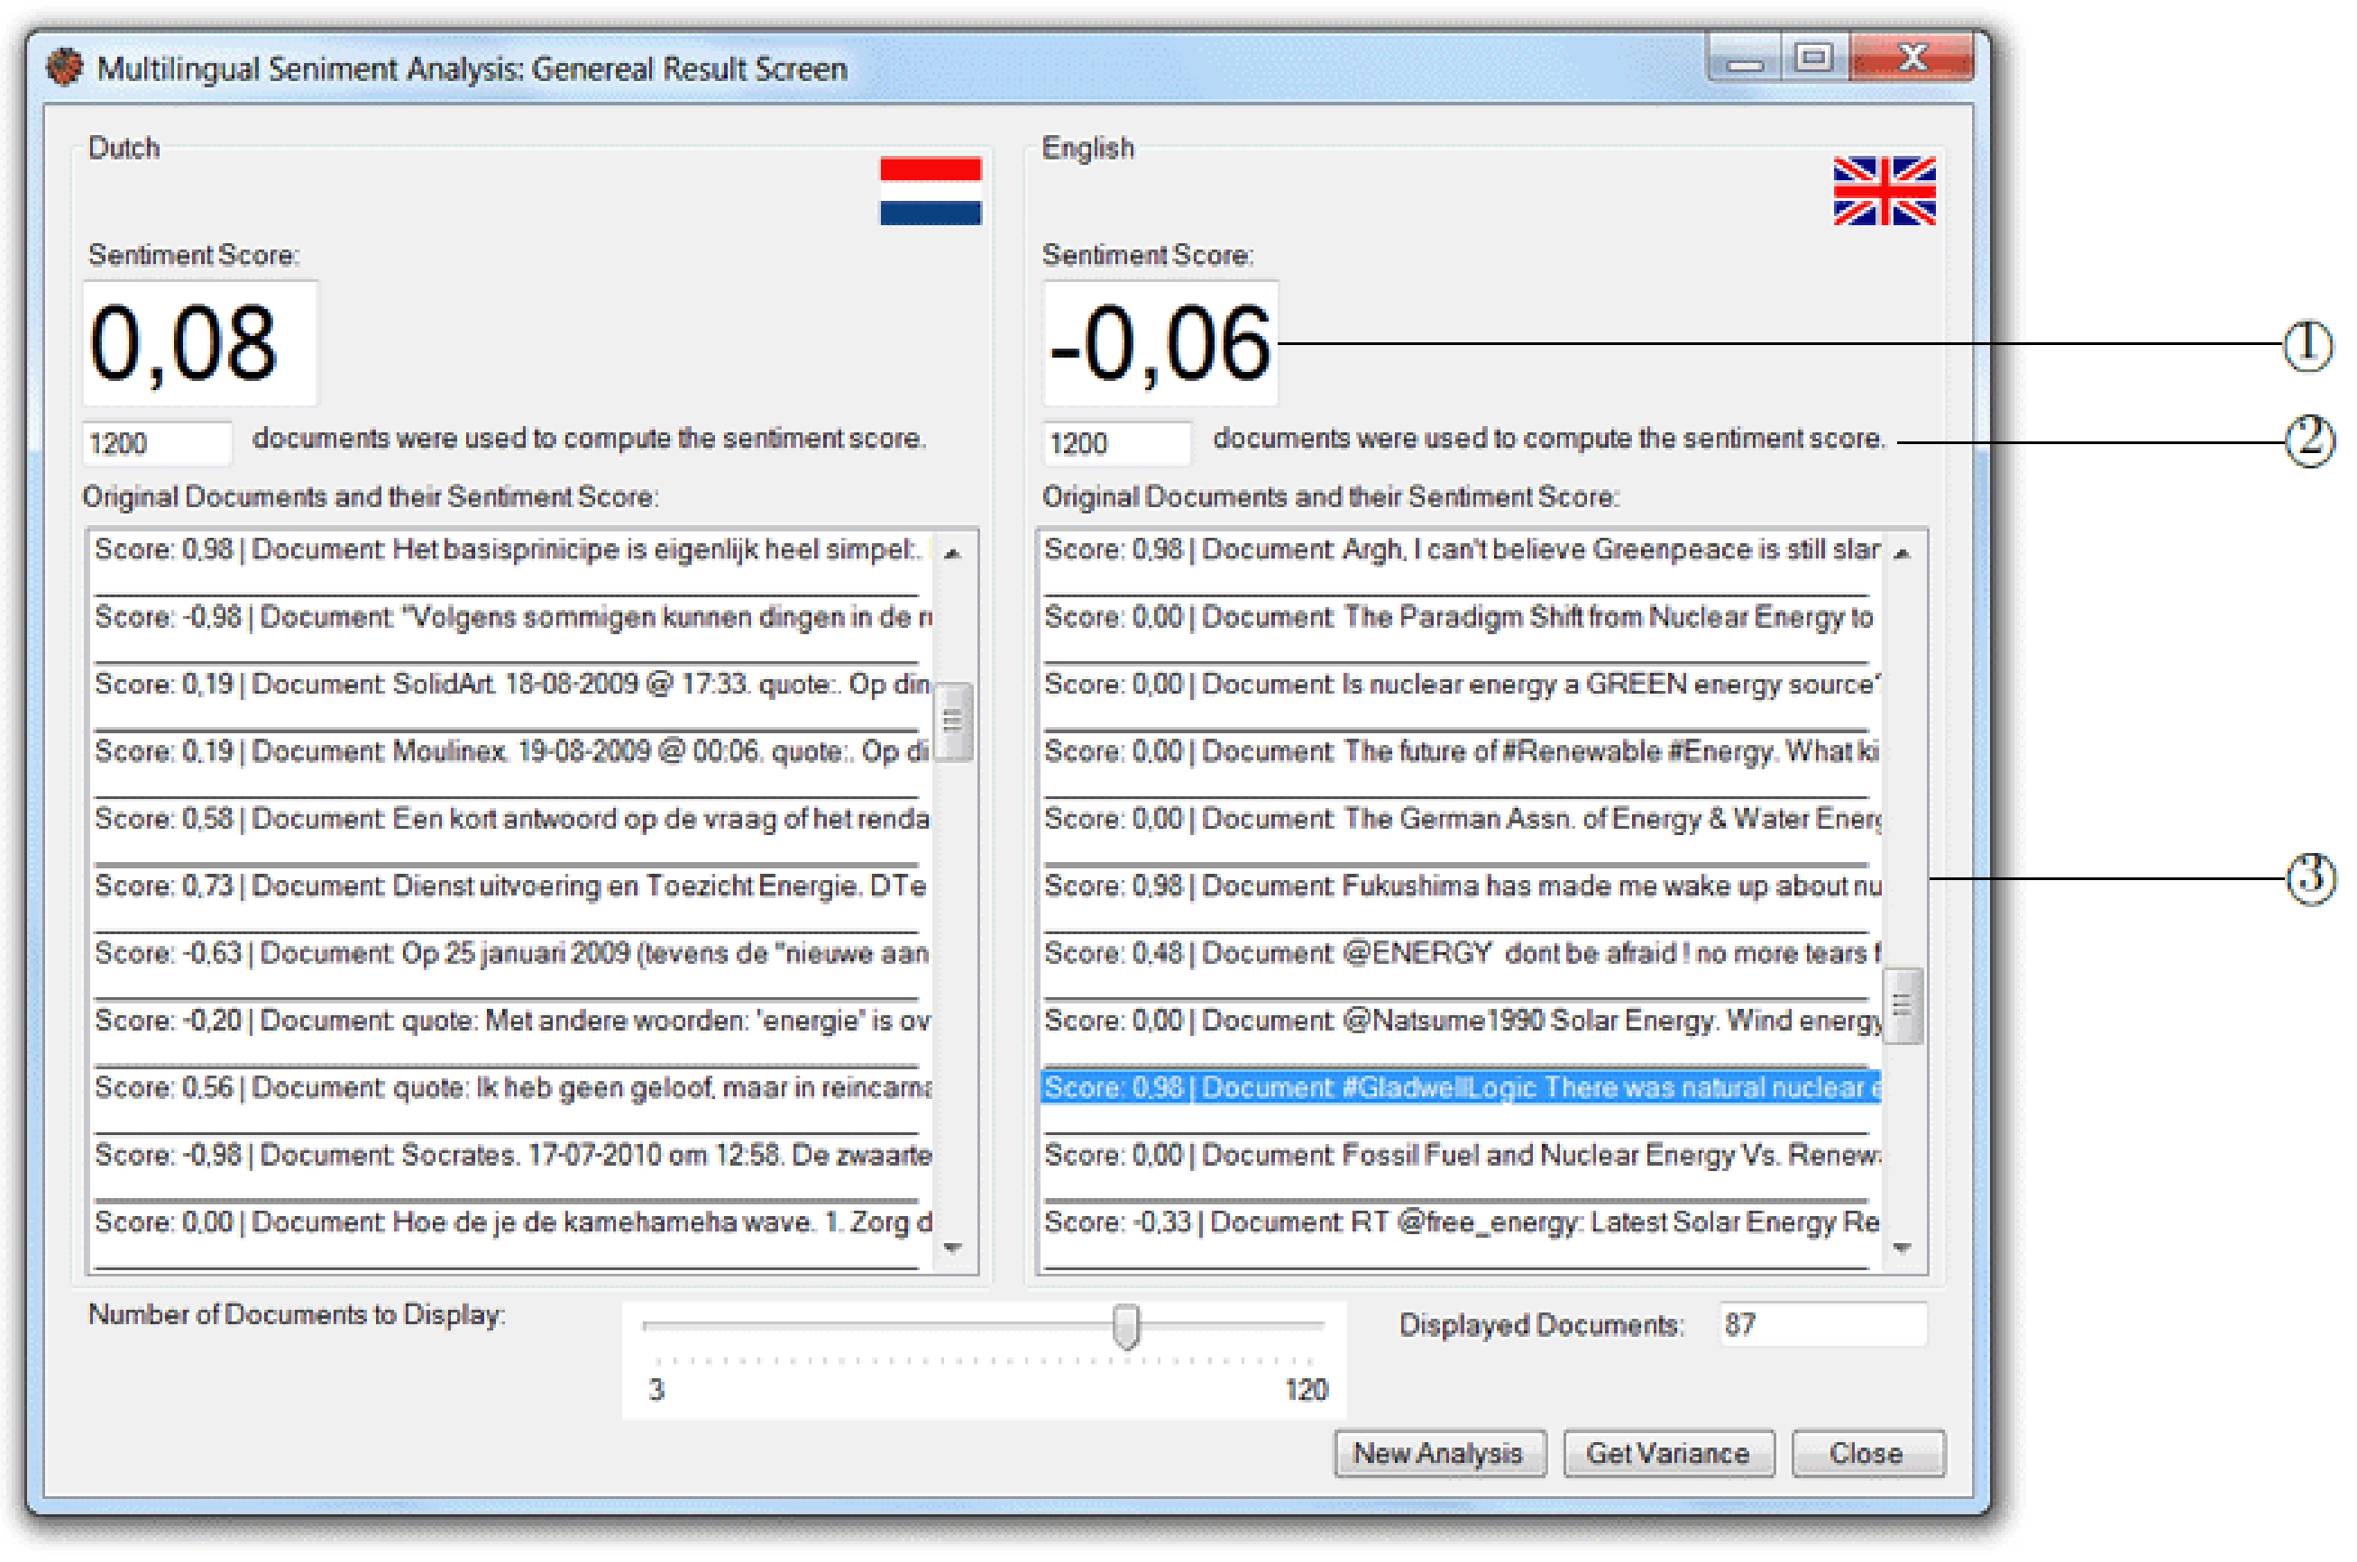
SAMP: Implementation (3)
1
2
3
Notes:
The general result screen gives more insight in the process of computing sentiment scores for batches of documents.
Elements:
Average score of the documents
How many documents constitute the score
A list of documents with their score, sorted on relevance

Slide 12
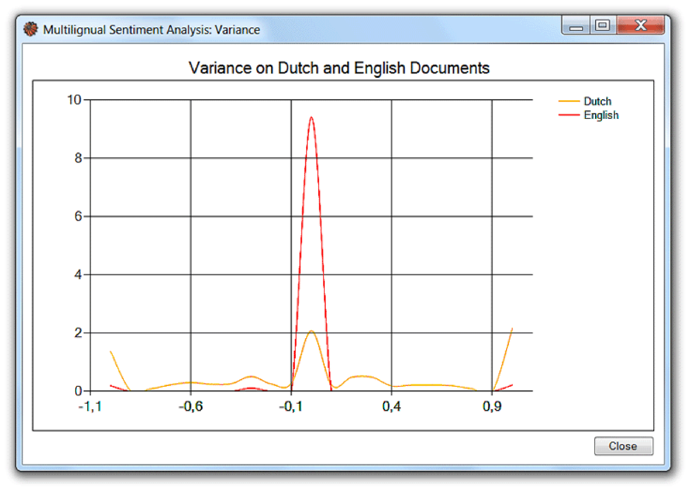
SAMP: Implementation (4)
Notes:
The graph screen visualizes the distribution of document-level sentiment scores in the corpus. This obviously gives more insight than a single sentiment score. For example, it might very well be that in the Dutch corpus, half of the texts result in a score of 0 and the other half results in a score of 1, while the English texts all yield a score of 0.5. When only considering the sentiment score, one would not be able to tell the difference between both corpora.

Slide 13
Evaluation (1)
Data consists of movie reviews:
75 Dutch reviews from FilmTotaal
75 English reviews from IMDb
Additionally, we evaluate Dutch and English forum posts on Xbox Kinect and nuclear power qualitatively
Measures:
Precision (+ / -)
Recall (+ / -)
F-measure (+ / -)
Accuracy
Macro F-measure
Notes:
Measures are based on star-classification of reviews. High star ratings are considered to be positive, the others are either neutral or negative. The demographics of the population of both data sets are more or less equal, meaning the results are comparable.

Slide 14
Evaluation (2)
 | + NL / UK | - NL / UK
+ | 36 / 31 | 7 / 15
- | 9 / 7 | 23 / 22
 | Precision + / - | Recall + / - | F-measure + / - | Accuracy | Macro F-measure
NL | 0.80 / 0.77 | 0.84 / 0.72 | 0.82 / 0.74 | 0.79 | 0.78
UK | 0.82 / 0.59 | 0.67 / 0.76 | 0.74 / 0.66 | 0.71 | 0.70
Notes:
The confusion matrix underlines that few classification mistakes have been made. This is also supported by the F-measures for both corpora. By the way, accuracy of language selection for both languages is about 95%, so these results seem to be very good!

Slide 15
Evaluation (3)
Difficulties:
Common expressions
Slang language
Difference in negation
Hidden semantics
Emoticons & abbreviations
Split verbs
English language is based on more explicitly mentioned sentiment
The Dutch tend to have a more reserved way of expressing themselves
BUT
Notes:
There is a big BUT. Based on a qualitative evaluation of the forum posts on Xbox Kinect and nuclear power, we found that there are some things distorting the results:
Common expressions are not recognized, e.g., “piece of cake”.
Slang language is ignored, e.g. “decors were blah”, “you will probably go gaga over this”.
In English, negation tends to be more ambiguous than in Dutch (“no” can be a negation keyword, but the Dutch equivalent cannot)
There are many hidden semantics in languages. It is for instance possible to express a rhetorical question which carries no direct sentiment. Conversely, it can suggest that the answer to the question would be negative, and therefore the sentence appears to the reader to have a negative sentiment.
Many acronyms like “lol”, “afaik”, but also emoticons or smilies like “:D”, “:’(“, etcetera have a great influence on the sentiment. Especially the recognition of sarcastic emoticons could improve the sentiment recognition in a text.
Especially in Dutch, verbs are often split (having a number of words in between them), leading to errors in the parser as it recognizes the related verb parts as individual words mainly due to their positioning.
Also it should be noted that the English language is based on more explicitly mentioned sentiment, whereas the Dutch tend to have a more reserved way of expressing themselves, leading to implicitly stored sentiment. This can also been seen in the graph I showed earlier.

Slide 16
Conclusions
SAMP framework:
Language-independent method for analyzing sentiment
Evaluated on Dutch and English data sets
High accuracy and F-measure values (±70-80%)
Differences in grammar and usage of language influence results, underlining the importance of research into multi-lingual sentiment analysis
Future work:
Detection mechanisms for common expressions, abbreviations & emoticons, negation differences, slang, etc.
Tackle challenges concerning semantics, sarcasm, irony, cynicism (very different per language)

Slide 17
Questions

