Slide 1
Addressing Scalability Issues in Semantics-Driven Recommender Systems
Mounir M. Bendouch, Flavius Frasincar and Tarmo Robal

Slide 2
Agenda
Introduction & Background
TF-IDF and Semantics-driven recommenders SF-IDF, SF-IDF+, CF-IDF, CF-IDF+, Bing-SF-IDF+, …
Up-scaling
Feature extraction
Domain ontology construction
Similarity model
Evaluation
Conclusions

Slide 3
Introduction
Information overload
Need for automated and accurate approach in Web to distinguish relevant and non-relevant
Recommender systems (RS) help users to plough through a massive and increasing amount of information
Automatically find relevant content based on:
user preferences, profiles, behaviour

Slide 4
Introduction
Recommender systems (RS):
Collaborative filtering
Content-based
Hybrid
Content-based RS:
Vary in features exploited and used for similarity calculations
Are often term-based
Common measure: Term Frequency – Inverse Document Frequency (TF-IDF) as proposed by [Salton and Buckley, 1988]
Users’ interests translated into vectors TF-IDF weights
Weights computed for every term within a document

Slide 5

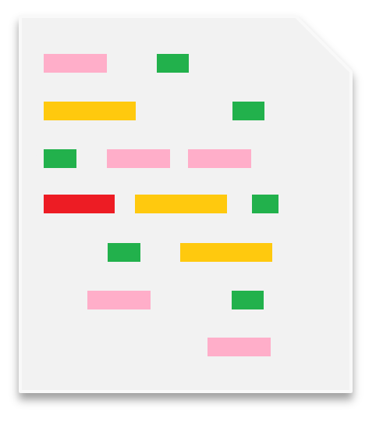

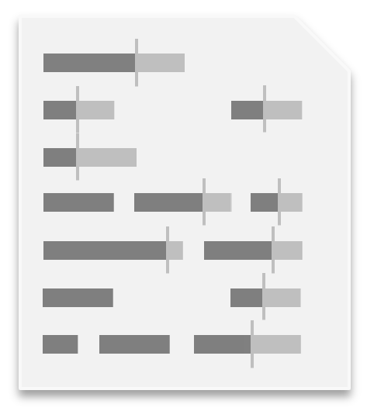
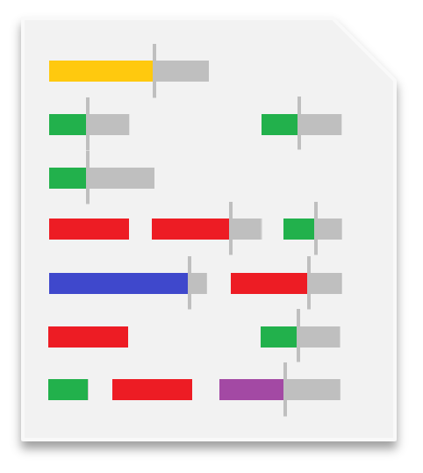
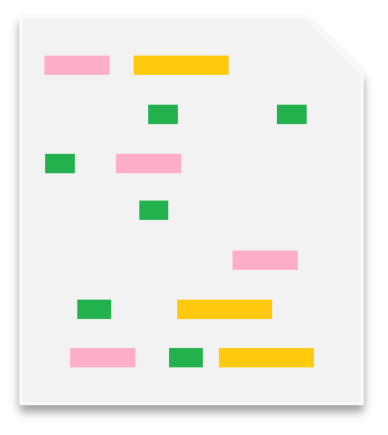
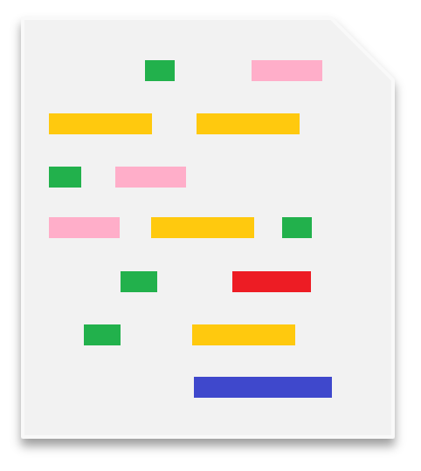
Introduction: TF-IDF
TF-IDF:
Pre-processed documents (stop words removal and stemming)
For each term, it takes into consideration:
The importance in a single document
The inverse of the general importance within a set of documents
IMPORTANT TERMS: red, purple, and blue
Irrelevant terms: yellow, green, and pink

Slide 6
Introduction: Motivation
Several RS build upon TF-IDF in the news recommendation domain
Concept Frequency – Inverse Document Frequency (CF-IDF)
Concepts from domain ontologies (CF-IDF)
Concepts and related concepts from domain ontologies (CF-IDF+)
Synset Frequency – Inverse Document Frequency (SF-IDF)
Terms, Synonyms from semantic lexicon (SF-IDF)
Synsets and their 27 semantic relationship types (SF-IDF+)
Extended with similarity between named entities on the Web (Bing-SF-IDF+)
Combined with domain concepts (Bing-CSF-IDF+)

Slide 7

Semantics-Driven Recommenders for News Recommendation
Semantic lexicon
SF-IDF
extend
SF-IDF+
extend
Bing-SF-IDF+
build on
Synsets
Synsets
+ Relationships
TF-IDF
(27 weights)
combines
Terms
Bing-CSF-IDF+
build on
extend
combines
CF-IDF
CF-IDF+
Concepts
Concepts
+ Relationships
(3 weights)
DOMAIN ONTOLOGY

Slide 8
Introduction
Good results obtained with SF/CF-IDF(+), Bing-(C)SF-IDF+ for News Article RS
Features from article text
Suitable for predicting similarity of any two texts
How about large-scale recommendations?
Can these methods be extended?

Slide 9
Research Questions
RQ1: Whether and how can semantics-driven recommenders be applied to a large-scale recommendation problem?
RQ2: How to scale the existing proven approach to large(r) datasets?
Domain: Movies
More complex
Information of different nature, not only text

Slide 10
Research Data
User ratings from MovieLens 20M dataset
20,000,000 user ratings (5-star) from 138,493 users
27,278 movies
10+ year period
Item level information
Title, year, genre labels, IMDB ID from MovieLens
Plots, Persons, genres from OMDb
Genres from both MovieLens and OMDb kept
Movies without at least one director, actor, writer, genre and plot are disregarded
Final dataset: 25,138 movies

Slide 11
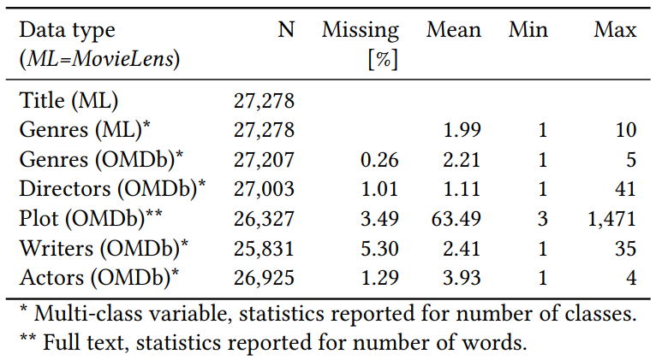
Research Data
Final dataset: 25,138 movies

Slide 12
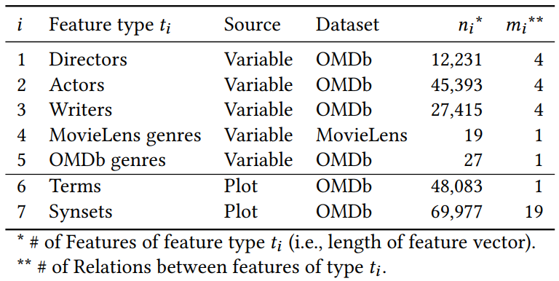
Feature Extraction
Some concepts readily available: Director, Writer, Actor, Genres
Terms and synsets extracted from plots
NLP + POS + Porter stemming
Adapted Lesk for WSD to extract synsets

Slide 13
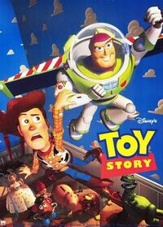
Feature Extraction
Directors: John Lasseter
Actors: Tom Hanks, Tim Allen, Don Rickles, …
Writers: Andrew Stanton, Joe Ranft, …
Genres (ML): Animation, Adventure, Family, Comedy
Genres (OMDb): Adventure, Computer Animation, Comedy
Terms: boy, toys, doll, birthday, …
Synsets
Variables
DOMAIN ONTOLOGY
Source: OMDb
A little boy named Andy loves to be in his room, playing with his toys, especially his doll named Woody. But, what do the toys do when Andy is not with them, they come to life. …
TERMS
Semantic Lexicon
Plot: 146 words
SYNSETS
Related SYNSETS

Slide 14
Domain Ontology
Usually external and need to be obtained or manually constructed for RS
Alternative general method to external domain ontologies
Solely based on dataset
Through series of matrix multiplications of binary matrices
12,231 Directors
45,393 Actors
292,857
bi-directional
movie-concept relations
25,138 Movies
27,415 Writers
19 Genres (ML)
Virtual ontology
27 Genres (OMDb)
CONCEPT CLASSES

Slide 15
Domain Ontology
k concept classes => k binary matrices M = z × n
Sum(row) = no of concepts in item; ≥ 1
Sum(col) = no of items with a concept; ≥ 1
Related concepts identified through matrix multiplications of k matrices M through any path length
k=5 (Directors, Actors, Writers, Genres_{ML}, Genres_{OMDb})
Method as an alternative to external ontology

Slide 16
Similarity Model
Traditional method IDF – applied to terms and synsets from plots
Exception for concepts – no IDF scaling
Not from text, frequencies {0, 1}
One vector of features from user profile
One vector of features from unseen item for consideration
Evaluation: cosine similarity
Increase CF-IDF+ parametric freedom:
Concepts of each class in separate vectors

Slide 17
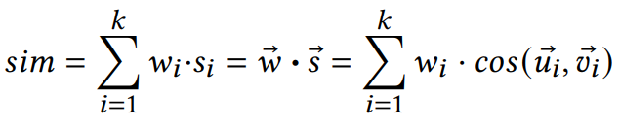
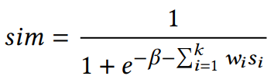
Similarity Model
Existing similarity model rewriten as a function of dot-products of feature vectors of individual items
Pre-computed before optimization
sim as score [0, 1]
Logloss over observed likes y∈{0,1} and predicted similarity sim ∈[0,1]
Similarity interpreted as probability of a like given in input data
User profile
Unseen item
Learnable bias

Slide 18
Experimental Setup
Similarity model trained on pairs of user-profiles and unseen items
Trained model used to recommend items where sim > threshold
Stochastic gradient descent (SGD) applied to optimize weights
Item considered to be liked if user rates it with score ≥ 4.5
Avg proportion of liked items: 19.2%
Avg number of liked items per user: 20.9

Slide 19
Experimental Setup
Users order shuffled in dataset
1000 as test dataset for evaluation
1000 as validation for the sim model for early stopping while training
136,493 as training set to optimize sim model
User profiles constructed by sampling p=5 liked items from a user
Unseen items defined as not in the user profile
Liked/disliked items sampled with equal probability
All discarded items considered to be seen – simulating the situation where RS detects user has liked p=5 items
Final set of user profiles: 809

Slide 20
Experimental Setup
Semantic-driven recommender models tested
T: as TF-IDF used as benchmark
S: as SF-IDF+ based on synsets from plots
C: as modified CF-IDF+ using features directly captured from variables
C+S: as combination of models C and S
Optimization implemented in Python v.2.7 using Keras and Theano libraries
Regular PC with NVIDIA GTX1060 GPU
Parallel computations of gradients

Slide 21
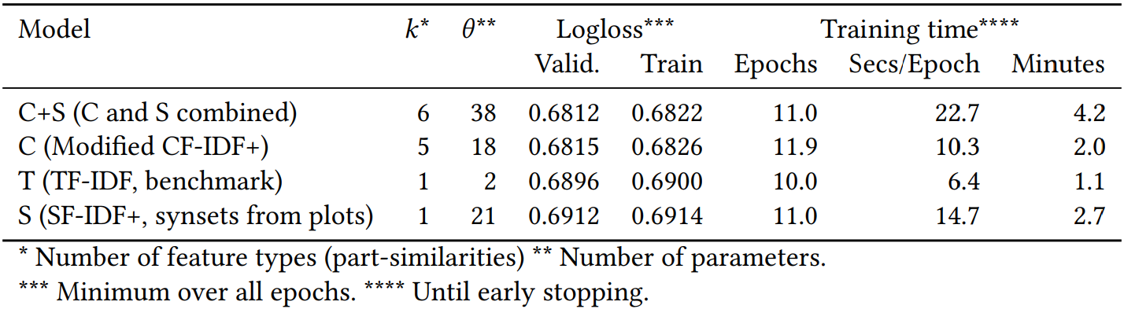
Results
10 random restarts, each model initiated with random weights
n_{valitation}=102,400; n_{train}=1,406976 observations
Lowered training time – important practical outcome
With the scalable approach (pre-computed dot-products) we can optimize the model in 4-5 minutes

Slide 22
Results
Performance calculated for all 809 user profiles
Not directly optimized towards the metrics
Unexpectedly low performance for SF-IDF+
Concepts alone outperform the benchmark T
Model | AUC |  | F₁ |  | 𝜅
 | ROC | PR | min𝑟 | max𝑟 | min𝑟 | max𝑟
T | 0.535 | 0.324 | 0.413 | 0.479 | 0.041 | 0.200
S | 0.531 | 0.319 | 0.411 | 0.477 | 0.038 | 0.198
C | 0.567 | 0.358 | 0.419 | 0.507 | 0.081 | 0.249
C+S | 0.570 | 0.361 | 0.419 | 0.509 | 0.083 | 0.251

Slide 23
Contributions
Method for extracting semantic features from complex domain information for semantics-driven RS
Method for devising domain ontology when no external ontology is readily available
Method to scale up existing semantics-driven RS for large-scale variable data with pre-computation of cosine similarities and gradient learning of the model
Semantics-driven RS can be scaled by rewriting the similarity model as a function of the dot-products of feature vectors of individual items
Fast optimization of models

Slide 24
Thank you!

