Slide 1
Fine-Tuning for Cross-Domain Aspect-Based Sentiment Classification
WI363
Stefan van Berkum
Sophia van Megen
Max Savelkoul
Pim Weterman
Flavius Frasincar

Slide 2
Introduction (1/3)
Why do we care about sentiment?
Chatbots
Review data
A lot of data available
Sentiment analysis: automatically process data such as reviews
We focus on Aspect-Based Sentiment Classification (ABSC)
Determine sentiment towards a pre-determined aspect
How is a restaurant doing with respect to food or customer service?

Slide 3
Introduction (2/3)
Not much labeled data available
Costly to acquire
Transfer learning
Pre-train on a domain that has a lot of labeled data available
Fine-tune using target domain data

Slide 4
Introduction (3/3)
LCR-Rot-hop++
Competitive performance when paired with ontology reasoning (Ont+LCR-Rot-hop++)
Layered structure
Diagnostic classification results
Lower layers: mainly general-language characteristics
Upper layers: more domain-specific information
Fix the lower layers during fine-tuning
Can substantially speed up model training

Slide 5
Data
Original domain
Restaurants – SemEval 2014
Used to train the neural network before fine-tuning
Target domains
Laptops – SemEval 2014
Books – Amazon/LibraryThing 2019
Hotels – SemEval 2015
Electronics (i.e., DVD players, digital cameras, MP3 players and cell phones) – Customer Review Data (CRD) 2014

Slide 6
Data Example
<sentence id="1206">
<text>The place is small and cramped but the food is fantastic.</text>
<aspectTerms>
<aspectTerm term="place" polarity="negative" from="4" to="9"/>
<aspectTerm term="food" polarity="positive" from="39" to="43"/>
</aspectTerms>
<aspectCategories>
<aspectCategory category="ambience" polarity="negative"/>
<aspectCategory category="food" polarity="positive"/>
</aspectCategories>
</sentence>
Aspect
Sentiment

Slide 7
Methodology
LCR-Rot-hop++
Fine-tuning
Notes:
We now move on to the methodology. The method we use is called LCR-Rot-hop++, and it makes use of quite a complex neural network. Therefore, we cannot go into detail too much, but our paper has an entire appendix devoted to the explanation of this method. For now, we’ll just briefly go over the LCR-Rot-hop++ method and then we’ll discuss our proposed fine-tuning approach.

Slide 8
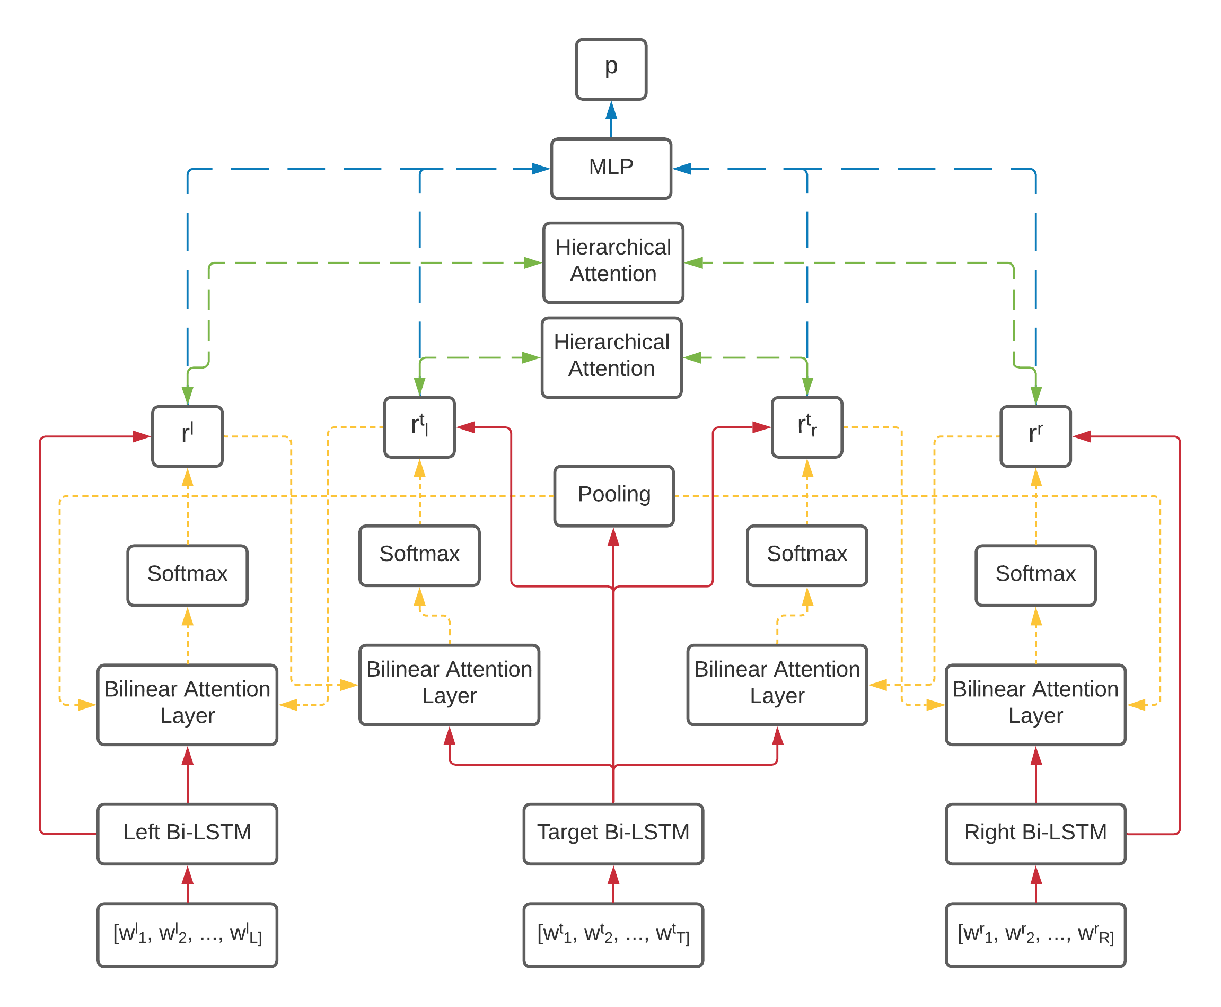
Sentiment Classification
Multilayer Perceptron
Hierarchical Attention
Rotary Attention Mechanism
Left-Center-Right Bi-LSTM
BERT Embedding
Input Sentence
Notes:
Input sentence is split into three parts, a target (in the middle) which is the aspect as explained by Pim earlier, and a left and right context.
Not shown explicitly in the figure, but a neural network requires vectors instead of words, and these are obtained using BERT word embeddings.
These are fed into a left, center and right Bi-LSTM, the LCR part of LCR-Rot-hop++.
These Bi-LSTMS produce hidden states which are then fed into a rotary attention mechanism, the Rot part of LCR-Rot-hop++.
This rotary attention mechanism works as follows:
The hidden states of the target Bi-LSTM in the middle is fed into a pooling operation to obtain a sort of average target representation (this is not a good representation).
This target representation is fed into the left and right context bilinear attention layer, which goes through a softmax to produce a left and right context representation.
The left context representation is then fed into the left context bilinear attention layer shown center left, and the right context representation is fed into the right context attention layer shown center right, to obtain a left- and right-aware target representation, respectively.
This mechanism is repeated for a given number of hops, by feeding these left- and right-aware target representations back into the left and right context bilinear attention layers, respectively. In our work, we use three hops. This is the hop part of LCR-Rot-hop++.
After each hop, the representations obtained from the rotary attention mechanism are weighted by a hierarchical attention module.
After all these hops over the rotary attention mechanism, the representations are weighted one more time and they are then fed into a multilayer perceptron to obtain sentiment classifications.

Slide 9
Fine-Tuning
Train on restaurant domain data
Fix Bi-LSTMs
Fine-tune on the remaining layers using target domain data
Compare with two benchmark approaches:
Off-the-shelf model
From-scratch model
Run for multiple subsets of the target domain data
Notes:
Our proposed approach is to apply fine-tuning to a pre-trained LCR-Rot-hop++ model.
For this purpose, we train the model on restaurant domain data, then we fix the Bi-LSTMs, so the bottom layer of the neural network which is depicted by the solid red arrows in the figure, and then we fine-tune the model by training the remaining layers using target domain data.
We compare our fine-tuning approach with two benchmark approaches.
The first one is the use of an off-the-shelf model, where we train the model on restaurant domain data and then just test it on the target domain. This performance will in most cases be very bad as we do not train the model on the target data at all.
The second approach is the use of a from-scratch model. This is a model which is trained from scratch on the target domain using the same data that was used for fine-tuning.
We run the fine-tuning and from-scratch model for multiple subsets of different sizes for each of the considered target domains. This allows us to identify patterns for varying sizes of target training set.

Slide 10
Results
Large Datasets (Laptops and Books)
Small Datasets (Hotels and Electronics)
Notes:
We now move on to the results. First, we’ll report the results for the large datasets (laptops and books) and then for the small datasets (hotels and electronics).

Slide 11
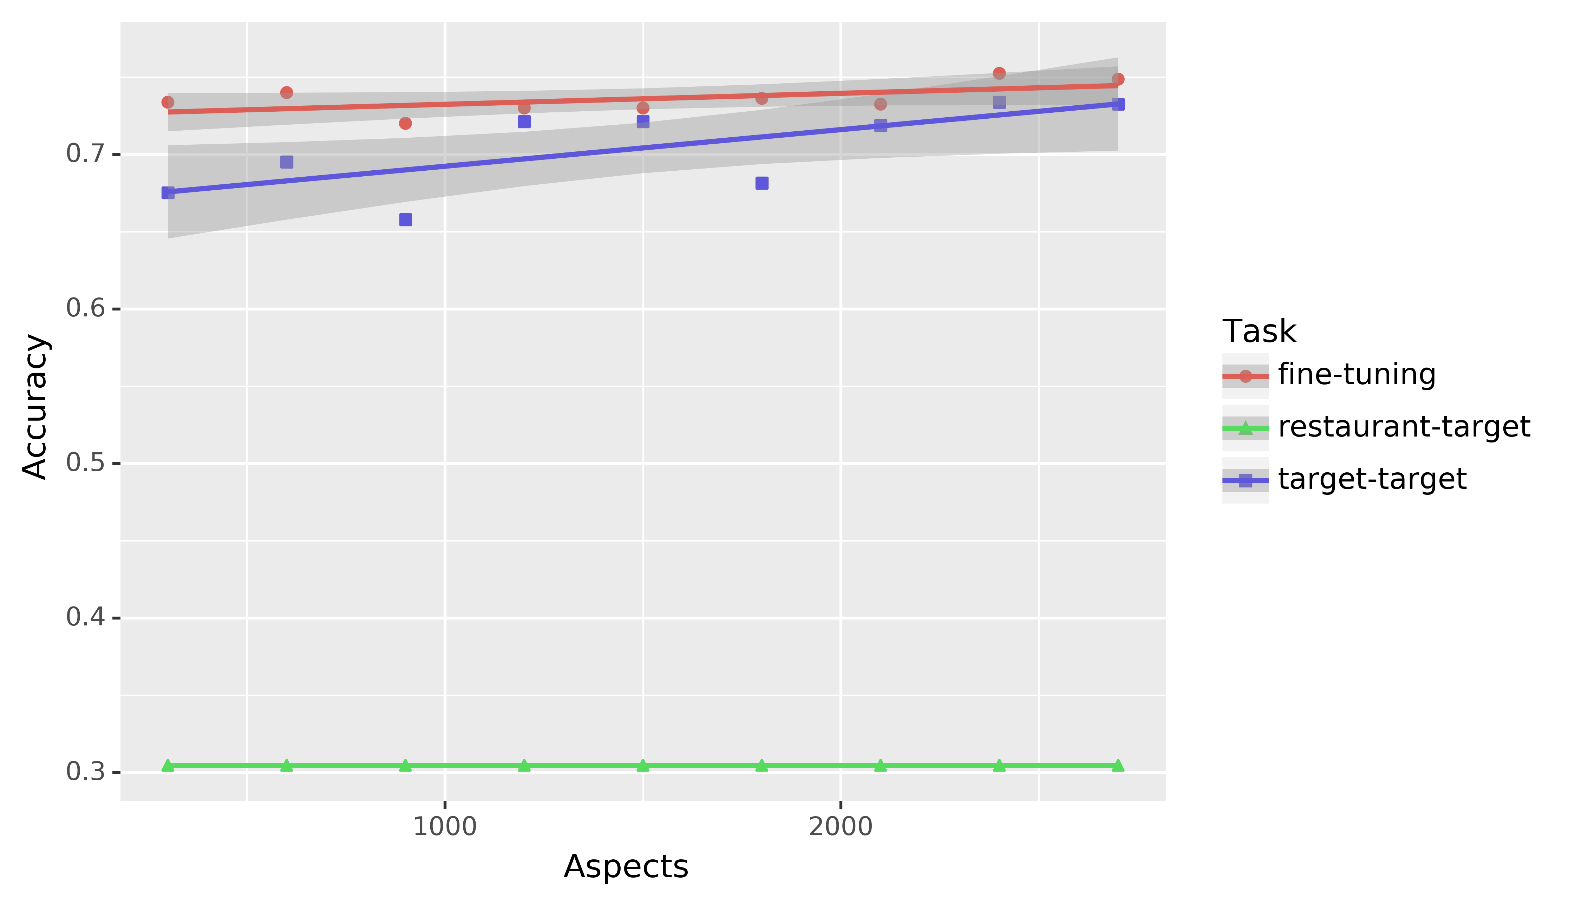
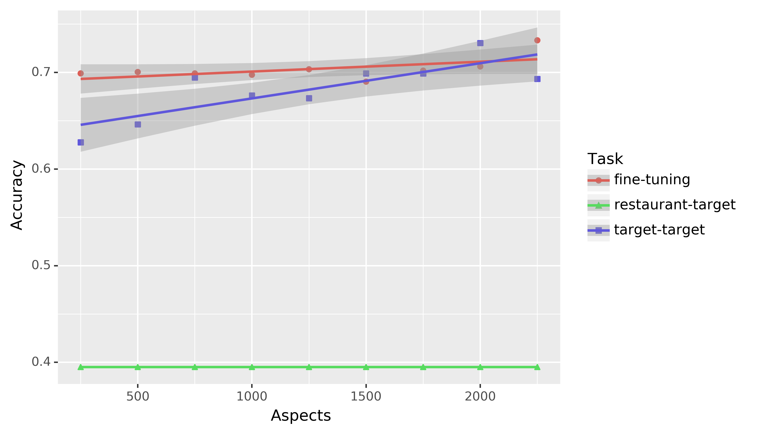
Large Datasets
Laptops
Books
Notes:
The two large datasets considered are laptops and books. The figures denote the obtained accuracies for different sizes of training subset. Our proposed fine-tuning approach is depicted by a red line, the from-scratch approach is depicted by a blue line and the off-the-shelf method is depicted by the green line.
First, we see that for both domains, the off-the-shelf approach (depicted by a green line in the figures), performs very poorly as we expected.
We also see a clear pattern for both domains regarding the fine-tuning and from-scratch approaches (depicted by the red and blue lines, respectively). We see that our proposed fine-tuning approach outperforms the from-scratch method when the training set is small, and that the from-scratch method overtakes the fine-tuning approach near the end where the full training set is used. This is also what we would expect, theoretically, if our fine-tuning approach would work.

Slide 12
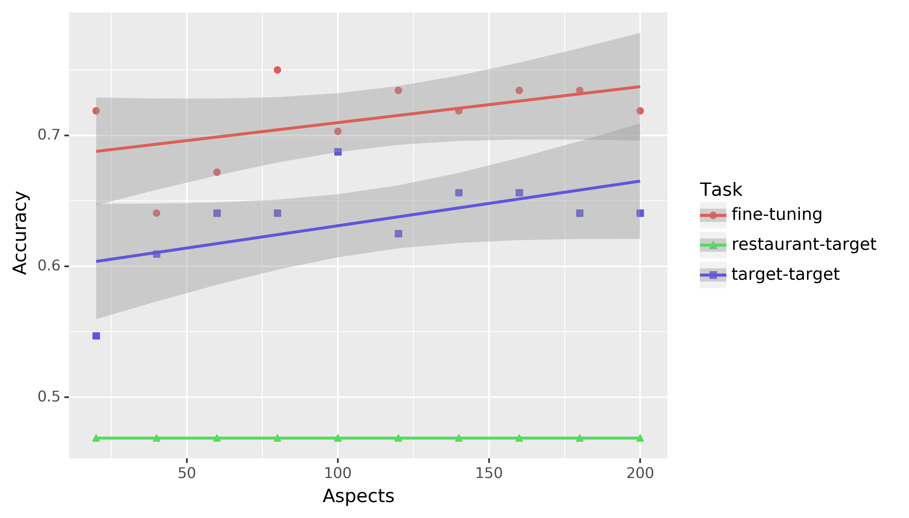
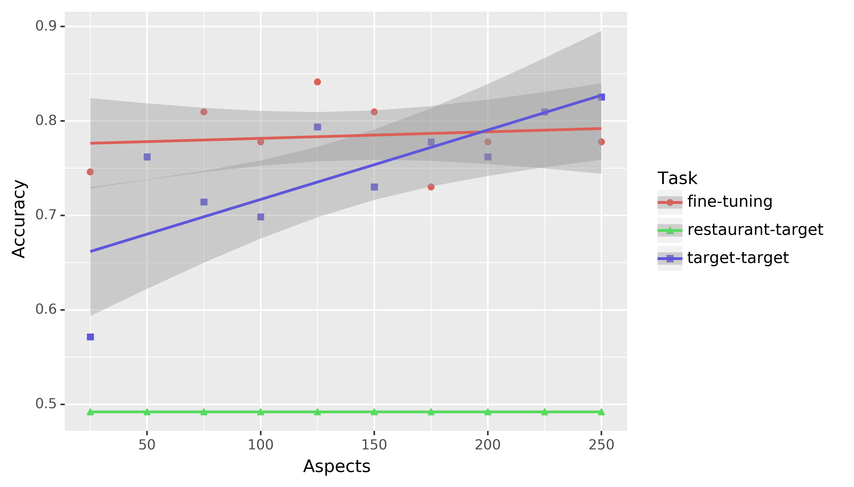
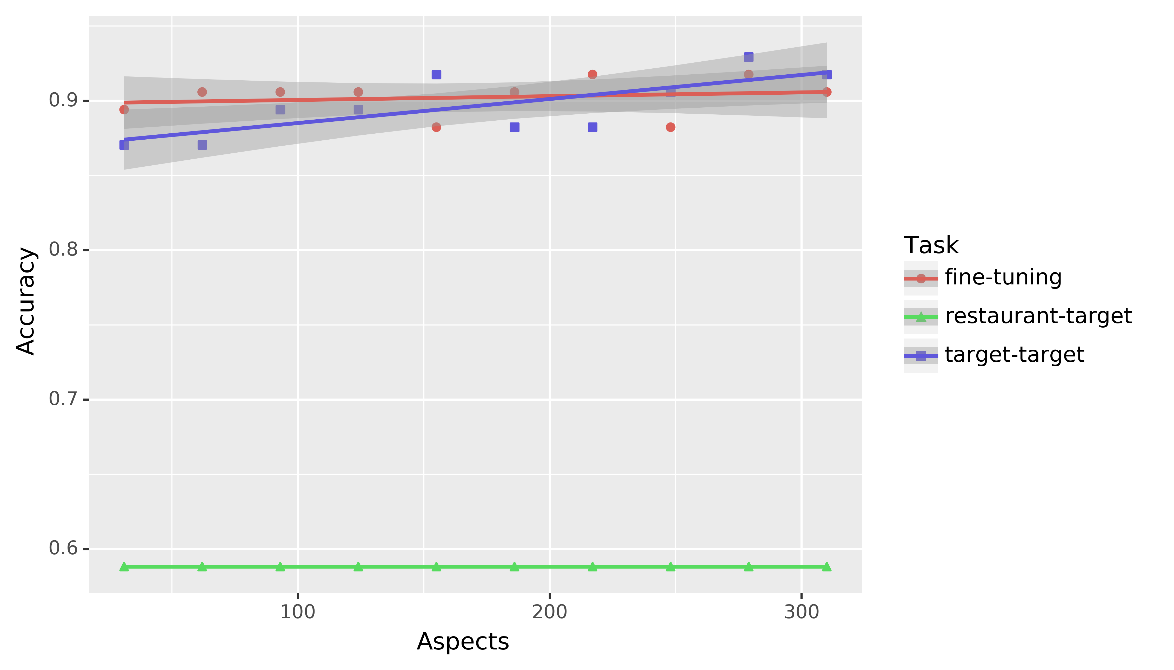
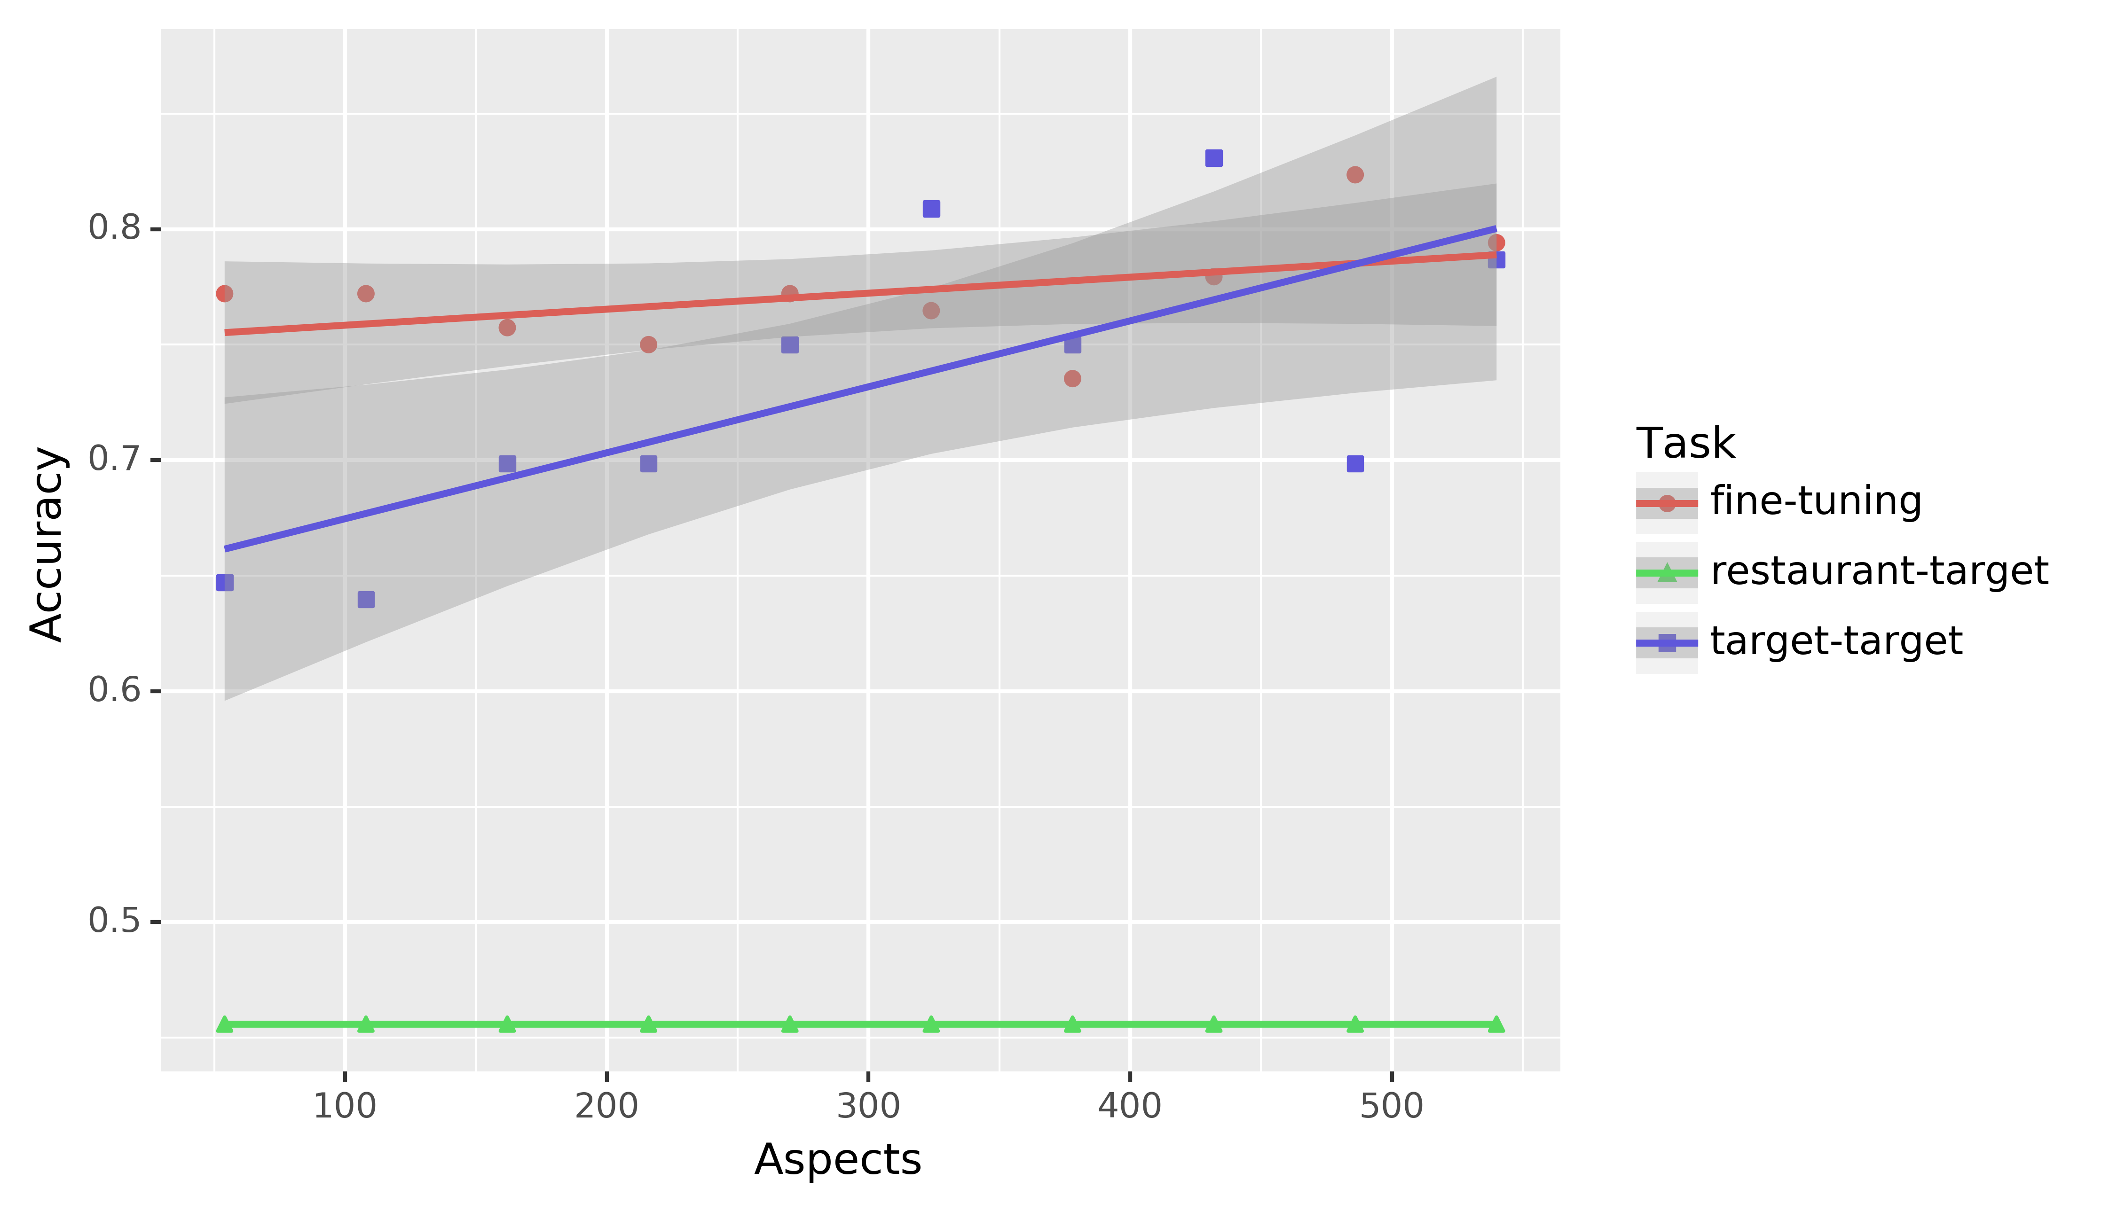
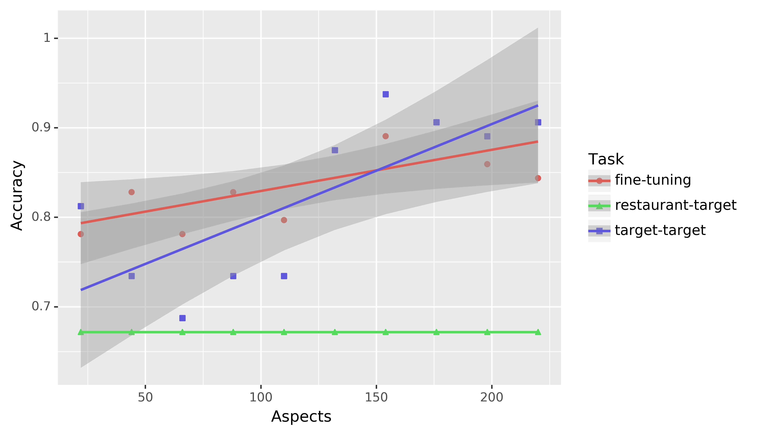
Small Datasets
Hotels
Electronics – DVD Players
Electronics – Digital cameras
Electronics – mp3 players
Electronics – cell phones
Notes:
For each of the small datasets depicted in the same way as before, we see a similar pattern: the fine-tuning approach outperforms the from-scratch approach when the training set is small. Later, as the training set size increases, the from-scratch approach overtakes the fine-tuning approach. This pattern is not visible for the hotel domain, but eventually these lines do intersect.

Slide 13
Conclusion
Similar pattern for all considered domains
Fine-tuning initially outperforms from-scratch training
Intersection when the training set is large
Fine-tuning approximately twice as fast
Future work:
Different ‘base’ model (e.g., laptops)
Combining the fine-tuning approach with other methods (e.g., masking)
Notes:
So, for all seven considered domains, we see a similar pattern where our fine-tuning approach initially outperforms from-scratch approach, and the from-scratch approach overtakes the fine-tuning approach when the training set gets large. This is exactly the pattern that we would expect when the fine-tuning approach is successful, so the fact that we see this for each of the considered domains suggests that our approach works for small training sets.
We also found that the fine-tuning approach is approximately twice as fast as the from-scratch approach and this difference in speed seems to get larger as the size of the training set increases. This could imply that our fine-tuning approach might be preferable even when the obtained accuracies are similar, due to time considerations.
Finally, some suggestions for future work include trying a different base model to initially train on. We used restaurant data now, but we could also try other domains such as laptops or books. Also, we could combine the fine-tuning approach with other methods. For example, one could mask domain-specific words when training the base model to improve its generalizability for fine-tuning.

Slide 14
Questions? E-mail: stefanvanberkum@gmail.com

