Slide 1
Addressing the Cold User Problem for Model-Based Recommender Systems
Flavius Frasincar*
frasincar@ese.eur.nl
* Joint work with Tomas Geurts

Slide 2
Contents
Motivation
Related Work
Methodology
Evaluation
Conclusion
Future Work

Slide 3

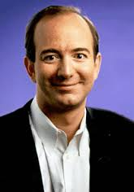
Motivation
Barry Schwartz, 2004 (American psychologist):
  “The Paradox of Choice - Why More Is Less”
  Eliminating consumer choices can greatly reduce anxiety for shoppers
Jeff Bezos, 2013 (CEO of Amazon.com)
  “We don’t make money when we sell things. We make money when we help customers make purchase decisions."

Slide 4
Motivation
Problem: information overload
Solution: recommender systems
Examples:
  Movie recommendations on Netflix
  Book recommendations on Amazon
  Friend recommendations on Facebook
Three types of recommender systems:
  Content-based recommenders (recommend similar content; address the cold item problem; suffer from cold user problem)
  Collaborative filtering recommenders (recommend content from similar users; suffer from both cold item and cold user problems; often provide better recommendations than the content-based ones)
  Hybrid recommenders (mix of content-based and collaborative filtering; accurate recommendations and no cold item problem)
Our focus:
  Collaborative filtering recommenders (address the cold user problem)

Slide 5
Motivation
Cold user problem: how to recommend items to new users (users for whom there is no previous information)?
Two types of collaborative filtering methods:
  Memory-based (aka neighborhood-based):
    K-Nearest Neighbour (kNN): no weighting
    Item-based: uses similarity (e.g., Pearson, cosine, etc.) between items for weighting
    User-based: uses similarity (e.g., Pearson, cosine, etc.) between users for weighting
  Model-based:
    Matrix Factorization: good accuracy in many studies (e.g., Netflix competition)
    Machine Learning (e.g., clustering, artificial neural networks, etc.)
Our focus:
  Matrix Factorization (address the cold user problem)

Slide 6
Motivation
Three solutions to address the cold user problems:
    Social information (often not available)
    Demographic information (often not available)
    Queried item preferences [our focus]
Active learning for collaborative filtering: Elicit preferences of the cold users using a minimum, but informative set of items
Two types of active learning for collaborative filtering (according to (Elahi et al., 2014)):
  Personalized (rank items using also cold user information)
  Non-personalized (rank items without using cold user information) [our focus]
Two types of user feedback:
  Explicit: e.g., rating items
  Implicit: e.g., buying/returning items [our focus]

Slide 7
Related Work
(Yu et al., 2004):
  Entropy-based strategy
  Probabilistic memory-based
  Number of shown items limited to 10
(Rashid et al., 2002):
  Popularity, entropy, and hybrid (popularity + entropy)
  Hybrid model is the best
  Memory-based
  Number of shown items limited to 30, 45, 60, or 90
Existing models work with explicit feedback
Our contribution:
  Use matrix factorization for recommending items
  Determine which active learning strategies work best in conjunction with matrix factorization
  Use a large real-world data set with user implicit feedback on items
  Experiment with various values for the number of shown items

Slide 8
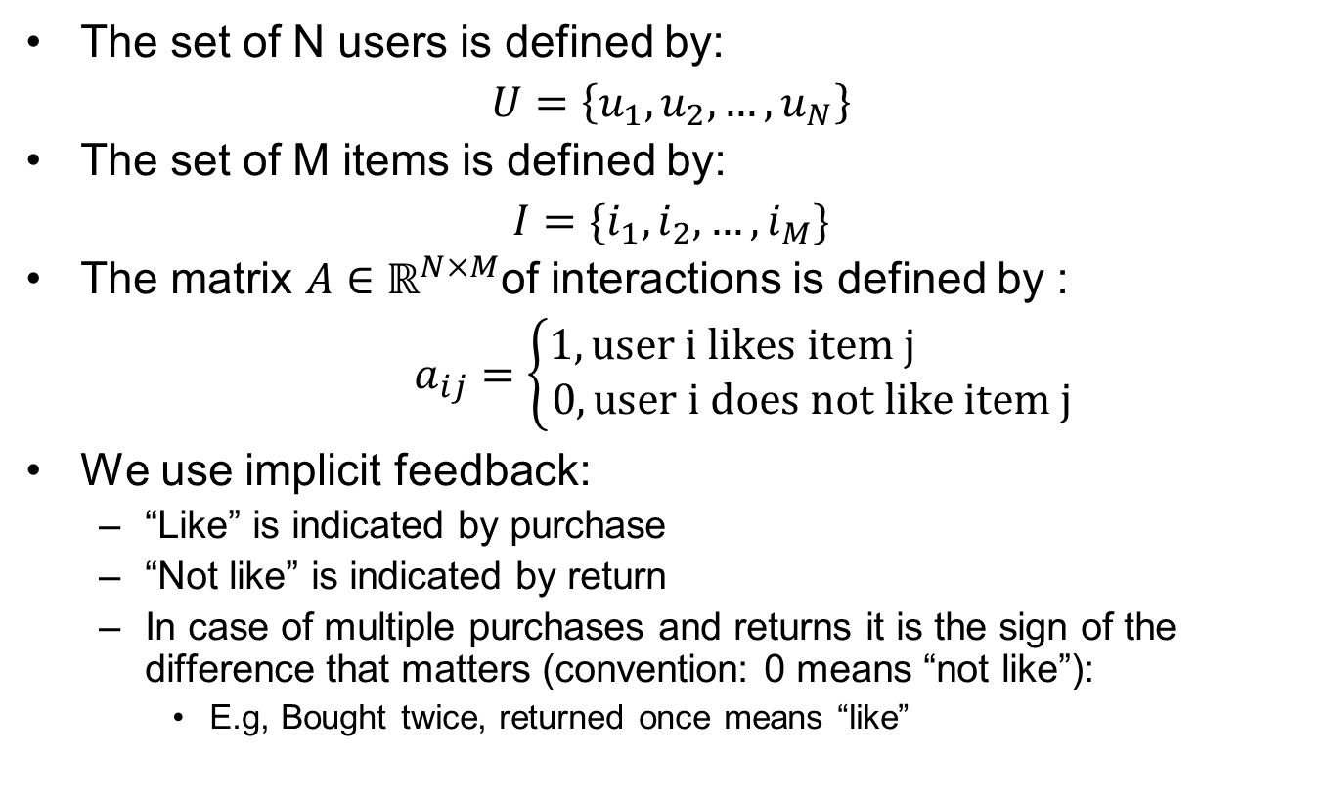
Methodology – Matrix Factorization
The set of N users is defined by:
$$U=\left\{u_{1},u_{2},…, u_{N}\right\}$$
The set of M items is defined by:
$$I=\{i_{1}, i_{2}, …, i_{M}\}$$
The matrix $A∈ℝ^{N×M}$of interactions is defined by :
$a_{ij}=\left\{\begin{matrix}1, user i likes item j \\ 0, user i does not like item j\end{matrix}\right.$
We use implicit feedback:
  “Like” is indicated by purchase
  “Not like” is indicated by return
  In case of multiple purchases and returns it is the sign of the difference that matters (convention: 0 means “not like”):
    E.g, Bought twice, returned once means “like”

Slide 9
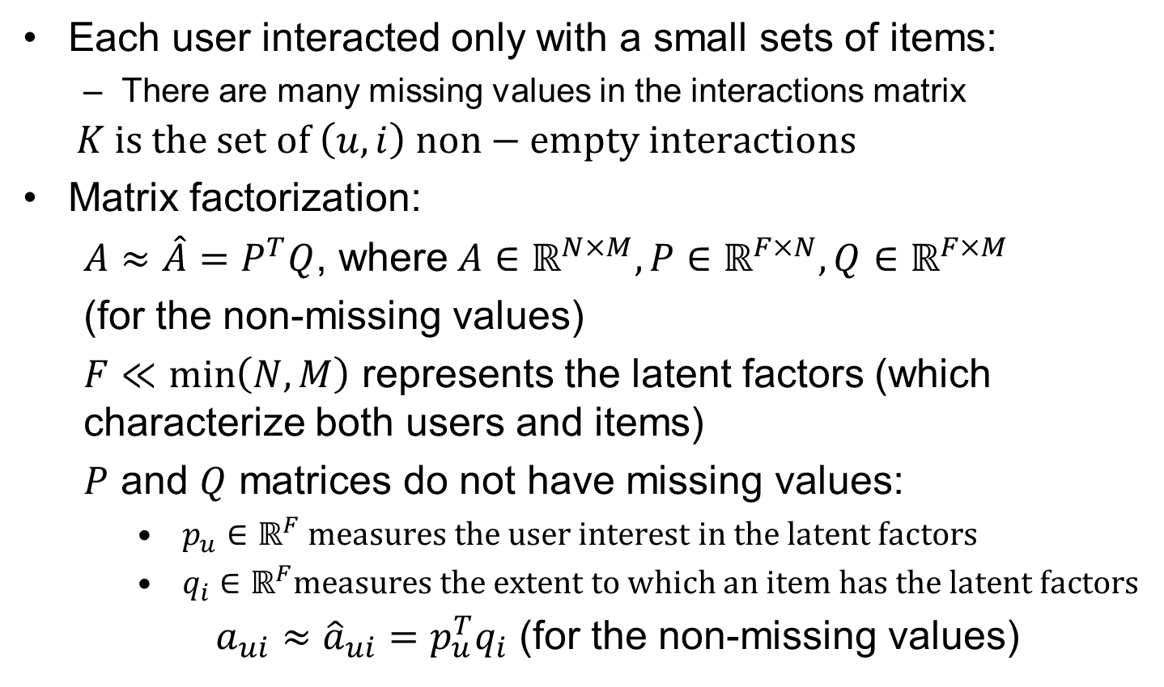
Methodology – Matrix Factorization
Each user interacted only with a small sets of items:
  There are many missing values in the interactions matrix
  $$K is the set of \left(u,i\right) non−empty interactions$$
Matrix factorization:
  $A≈\hat{A}=P^{T}Q$, where$A∈ℝ^{N×M},P∈ℝ^{F×N},Q∈ℝ^{F×M}$
  (for the non-missing values)
  $F≪\min\left(N,M\right)$ represents the latent factors (which characterize both users and items)
  $P$ and $Q$ matrices do not have missing values:
    $p_{u}∈ℝ^{F} measures the user interest in the latent factors$
    $q_{i}∈ℝ^{F}measures the extent to which an item has the latent factors$
  $a_{ui}≈{{\hat{a}}_{ui}=p}_{u}^{T}q_{i}$ (for the non-missing values)

Slide 10
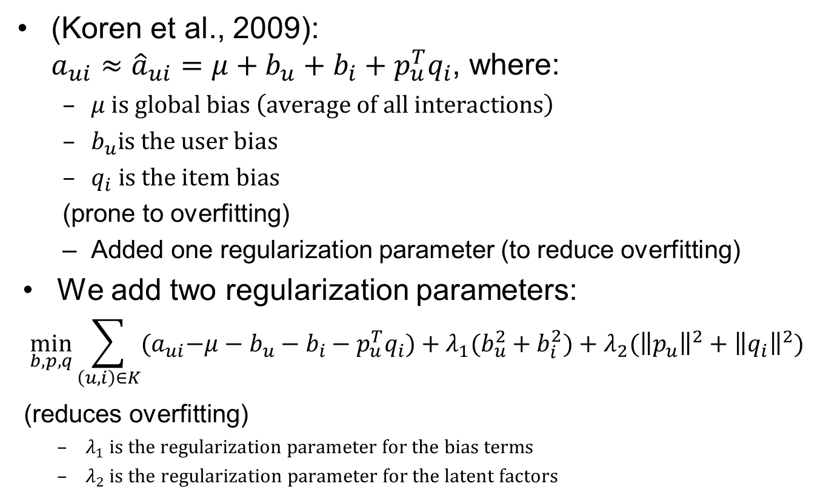
Methodology – Matrix Factorization
(Koren et al., 2009):
$a_{ui}≈{{\hat{a}}_{ui}=μ+b_{u}+b_{i}+p}_{u}^{T}q_{i}$, where:
  $μ is global bias \left(average of all interactions\right)$
  $b_{u}is the user bias$
  $q_{i} is the item bias$
  (prone to overfitting)
  Added one regularization parameter (to reduce overfitting)
We add two regularization parameters:
$$\min_{b,p,q}{\sum_{\left(u,i\right)∈K}{{(a}_{ui}−{μ−b_{u}−b_{i}−p}_{u}^{T}q_{i})}+λ_{1}(b_{u}^{2}+b_{i}^{2})+λ_{2}({\left\|p_{u}\right\|}^{2}+{\left\|q_{i}\right\|}^{2})}$$
(reduces overfitting)
  $λ_{1} is the regularization parameter for the bias terms$
  $λ_{2} is the regularization parameter for the latent factors$

Slide 11
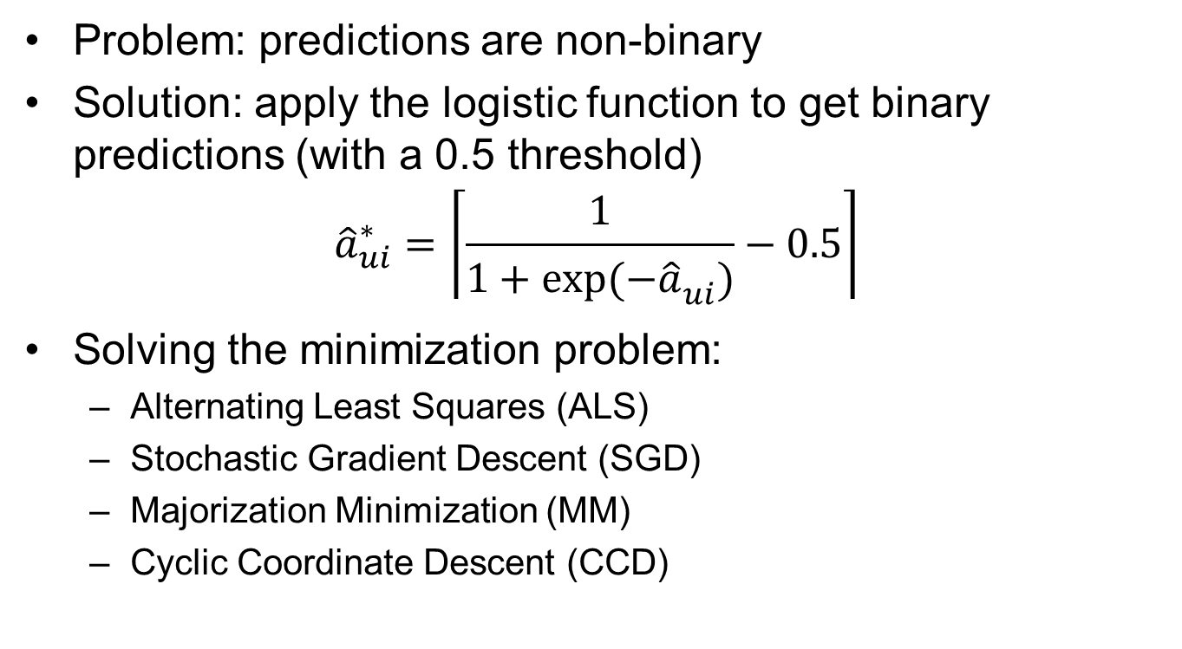
Methodology – Matrix Factorization
Problem: predictions are non-binary
Solution: apply the logistic function to get binary predictions (with a 0.5 threshold)
$${\hat{a}}_{ui}^{∗}=\left\lceil \frac{1}{1+exp⁡(−{\hat{a}}_{ui}^{})}−0.5\right\rceil$$
Solving the minimization problem:
  Alternating Least Squares (ALS)
  Stochastic Gradient Descent (SGD)
  Majorization Minimization (MM)
  Cyclic Coordinate Descent (CCD)

Slide 12
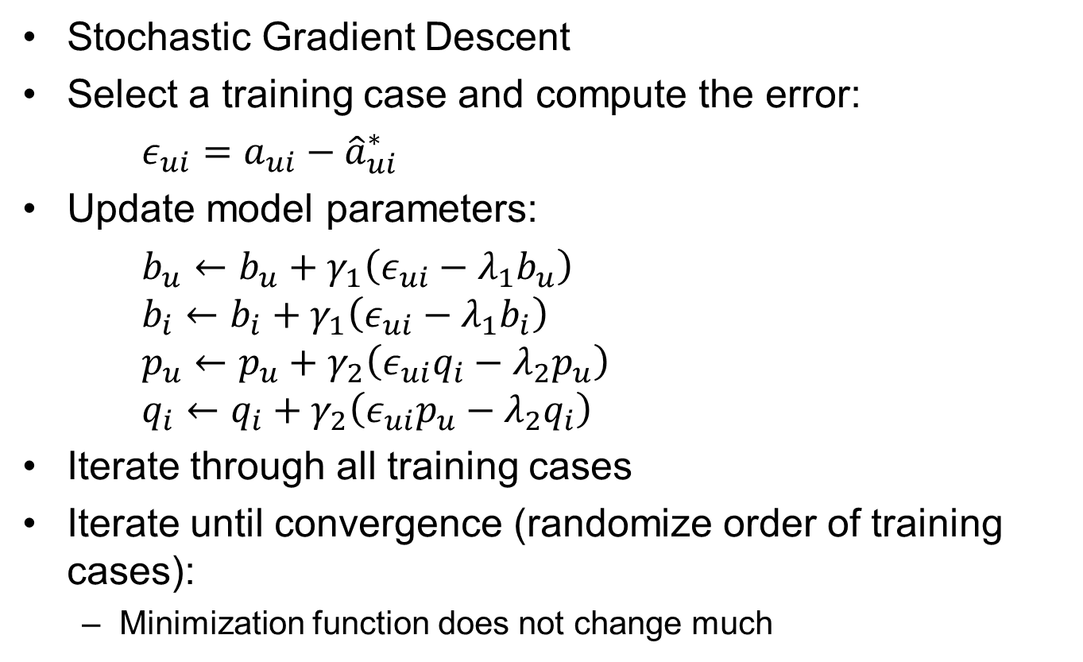
Methodology – Matrix Factorization
Stochastic Gradient Descent
Select a training case and compute the error:
$ε_{ui}=a_{ui}−{\hat{a}}_{ui}^{∗}$
Update model parameters:
$b_{u}←b_{u}+γ_{1}\left(ε_{ui}−λ_{1}b_{u}\right)$
$b_{i}←b_{i}+γ_{1}\left(ε_{ui}−λ_{1}b_{i}\right)$
$p_{u}←p_{u}+γ_{2}\left(ε_{ui}q_{i}−λ_{2}p_{u}\right)$
$q_{i}←q_{i}+γ_{2}\left(ε_{ui}p_{u}−λ_{2}q_{i}\right)$
Iterate through all training cases
Iterate until convergence (randomize order of training cases):
  Minimization function does not change much

Slide 13
Methodology – Item Ranking
Ask cold users to rate a set of items (the cardinality of this set should not be too high)
The set of items to rank should provide for the highest utility for making recommendations to cold users
The selection of the items to rank depends on a certain ranking
Our ranking strategies are non-personalized active learning strategies
Six strategies for item ranking:
  Random
  Popularity
  Gini
  Entropy
  PopGini
  PopEntropy

Slide 14
Methodology – Item Ranking
Random Strategy:
  Select items at random
  Taken as a baseline
  Advantage: Low correlation between items

Slide 15
Methodology – Item Ranking
Popularity Strategy:
  Single heuristic attention-based active learning strategy
  Depends on the amount of “attention” (popularity) an item receives
  Most popular items (items that have been interacted with by the largest number of distinct users) are ranked at the top
  Two disadvantages:
    The most popular items could be very similar (e.g., T-shirts of the same brand at the top, waste of effort for the user to rate all of them)
    Biases the recommender to recommend popular items (decreases the chance of long tail items to be recommended)

Slide 16
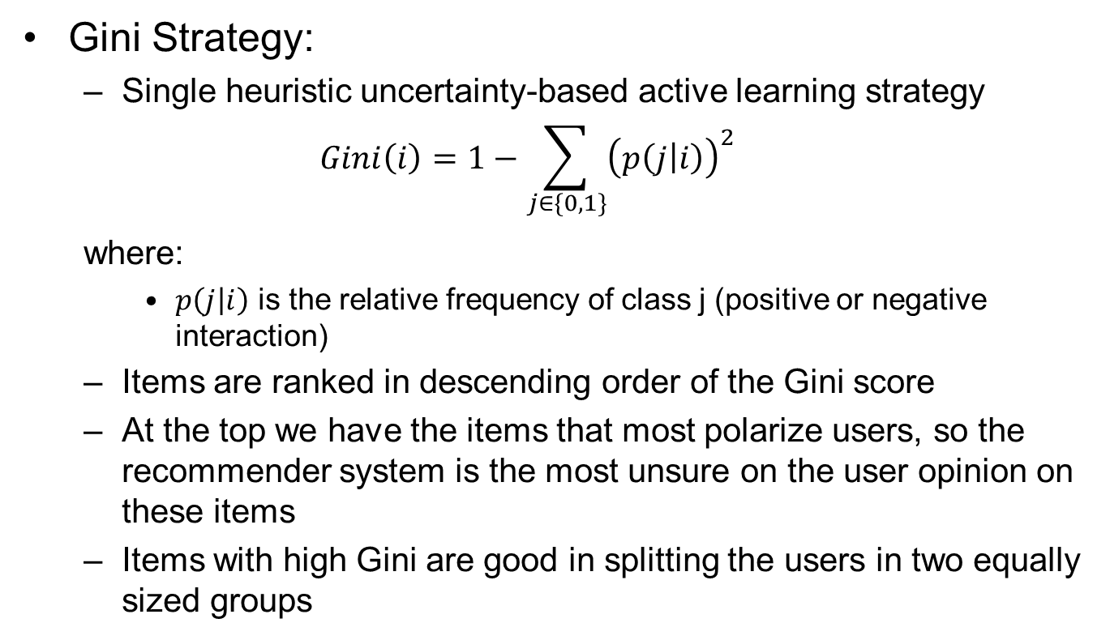
Methodology – Item Ranking
Gini Strategy:
  Single heuristic uncertainty-based active learning strategy
  $$Gini\left(i\right)=1−\sum_{j∈\{0,1\}}{{\left(p\left(j | i\right)\right)}^{2}}$$
  where:
    $p\left(j | i\right)$ is the relative frequency of class j (positive or negative interaction)
  Items are ranked in descending order of the Gini score
  At the top we have the items that most polarize users, so the recommender system is the most unsure on the user opinion on these items
  Items with high Gini are good in splitting the users in two equally sized groups

Slide 17
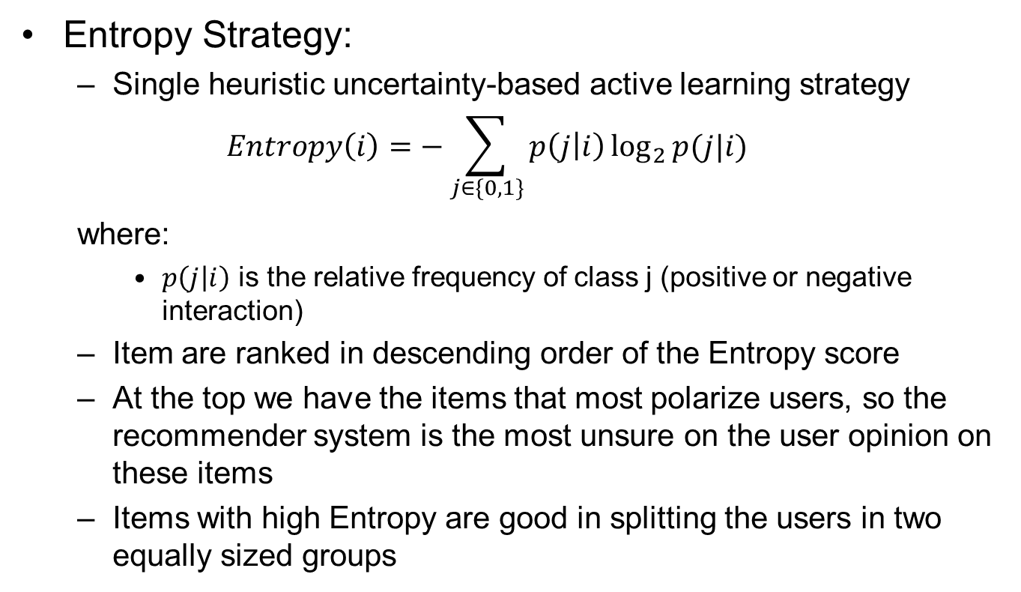
Methodology – Item Ranking
Entropy Strategy:
  Single heuristic uncertainty-based active learning strategy
  $$Entropy\left(i\right)=−\sum_{j∈\{0,1\}}{p\left(j | i\right)\log_{2}{p(j|i)}}$$
  where:
    $p\left(j | i\right)$ is the relative frequency of class j (positive or negative interaction)
  Item are ranked in descending order of the Entropy score
  At the top we have the items that most polarize users, so the recommender system is the most unsure on the user opinion on these items
  Items with high Entropy are good in splitting the users in two equally sized groups

Slide 18
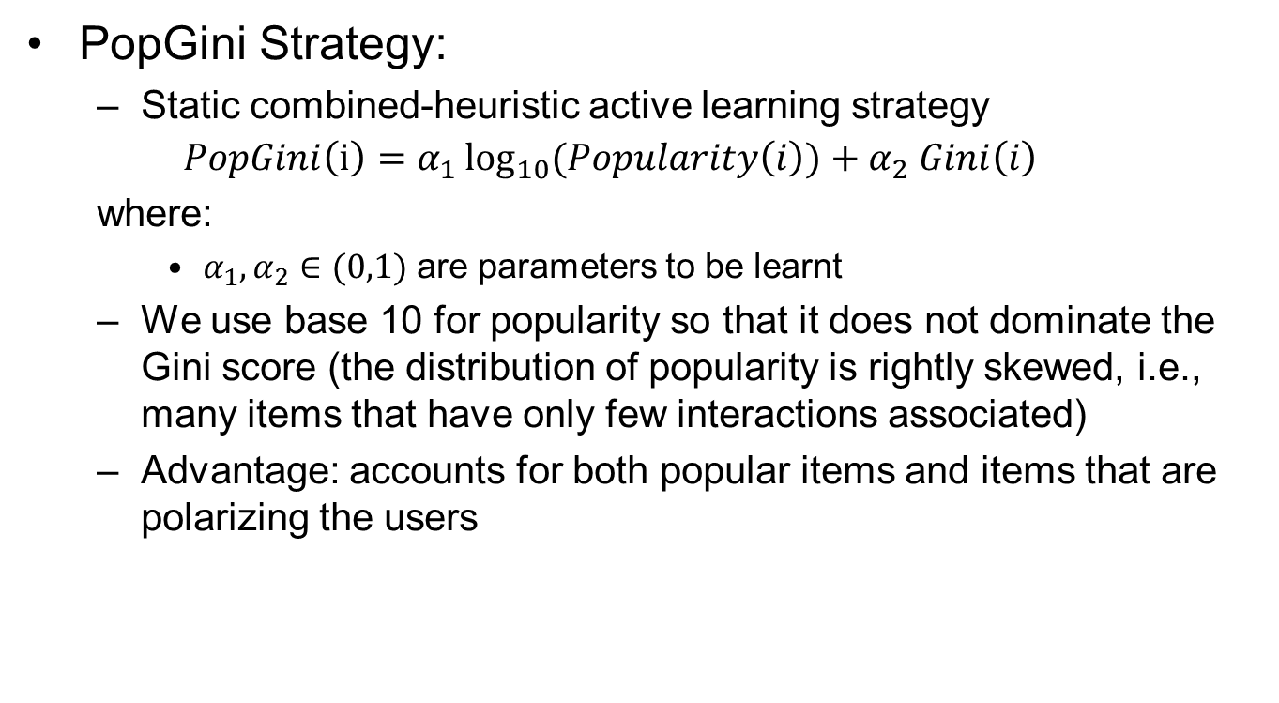
Methodology – Item Ranking
PopGini Strategy:
  Static combined-heuristic active learning strategy
  $$PopGini\left(i\right)=α_{1}\log_{10}{(Popularity\left(i\right))}+α_{2} Gini\left(i\right)$$
  where:
    $α_{1},α_{2}∈(0,1)$ are parameters to be learnt
  We use base 10 for popularity so that it does not dominate the Gini score (the distribution of popularity is rightly skewed, i.e., many items that have only few interactions associated)
  Advantage: accounts for both popular items and items that are polarizing the users

Slide 19
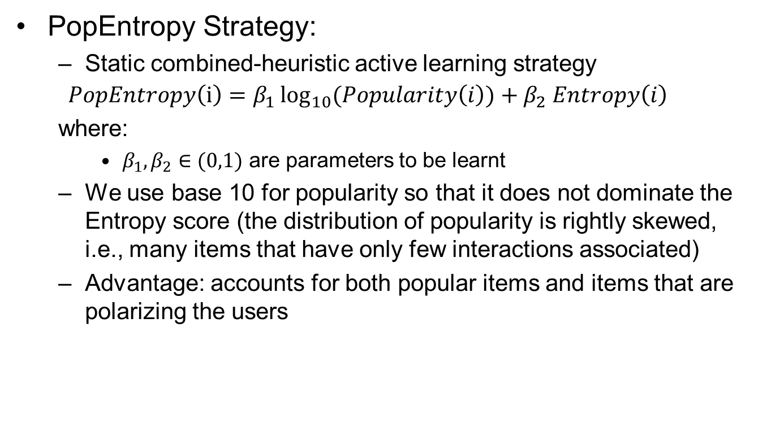
Methodology – Item Ranking
PopEntropy Strategy:
  Static combined-heuristic active learning strategy
  $$PopEntropy\left(i\right)=β_{1}\log_{10}{(Popularity\left(i\right))}+β_{2} Entropy\left(i\right)$$
  where:
    $β_{1},β_{2}∈(0,1)$ are parameters to be learnt
  We use base 10 for popularity so that it does not dominate the Entropy score (the distribution of popularity is rightly skewed, i.e., many items that have only few interactions associated)
  Advantage: accounts for both popular items and items that are polarizing the users

Slide 20
Evaluation – Data Set
Data set from the webshop of “de Bijenkorf”, a high end department store in the Netherlands:
  100,000+ unique visitors every day
  200,000+ unique products in the assortment
Data set contains all interactions between customers and products (purchases and returns) from 14 July 2015 to 13 July 2016 (1 year)
Data set characteristics:
  563,495 unique customers
  242,020 unique products
  2,563,878 unique interactions between customers and products
  (all interactions are dichotomized, i.e., 0 or 1)

Slide 21
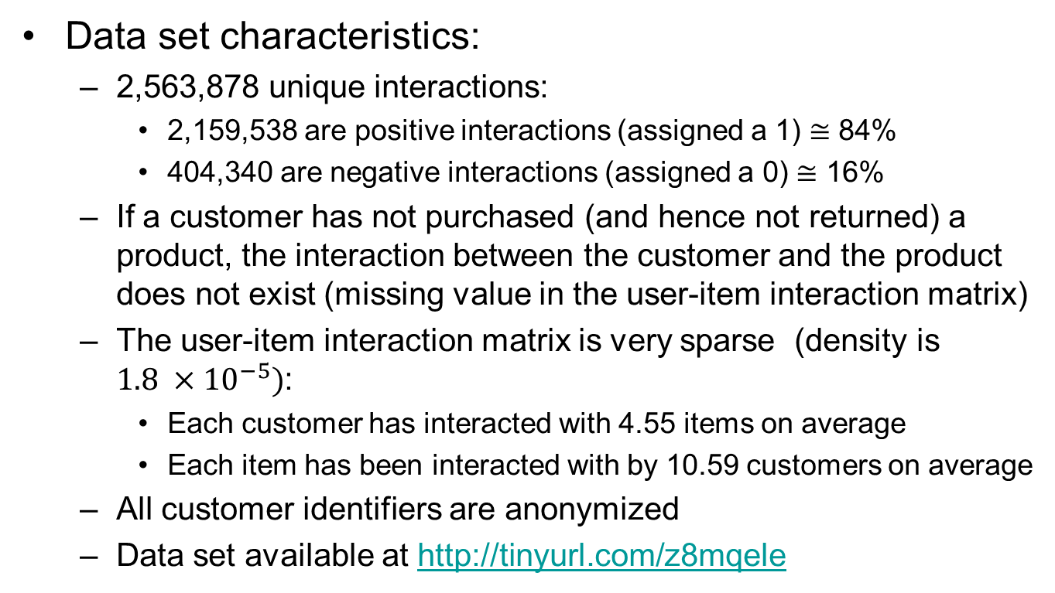
Evaluation – Data Set
Data set characteristics:
  2,563,878 unique interactions:
    2,159,538 are positive interactions (assigned a 1) $≅\text{84\%}$
    404,340 are negative interactions (assigned a 0) $≅\text{16\%}$
  If a customer has not purchased (and hence not returned) a product, the interaction between the customer and the product does not exist (missing value in the user-item interaction matrix)
  The user-item interaction matrix is very sparse (density is $1.8 ×{10}^{−5})$:
    Each customer has interacted with 4.55 items on average
    Each item has been interacted with by 10.59 customers on average
  All customer identifiers are anonymized
  Data set available at http://tinyurl.com/z8mqele

Slide 22
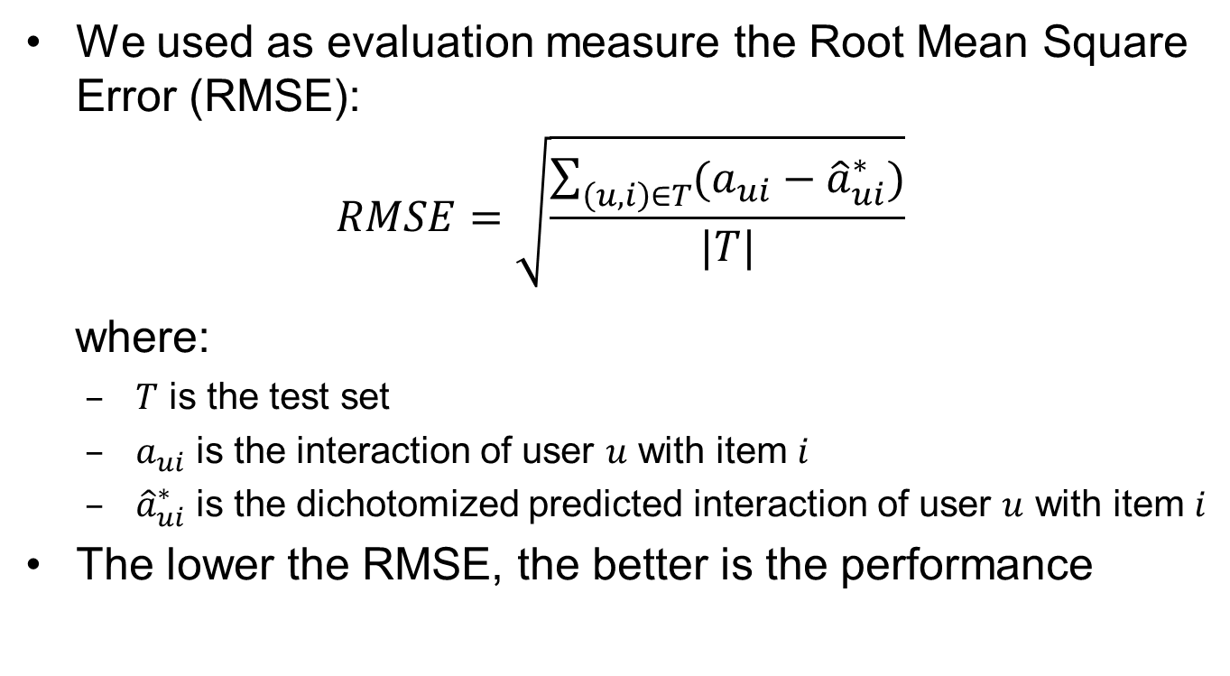
Evaluation – Setup
We used as evaluation measure the Root Mean Square Error (RMSE):
$$RMSE=\sqrt{\frac{\sum_{\left(u,i\right)∈T}{(a_{ui}−{\hat{a}}_{ui}^{∗})}}{|T|}}$$
where:
  $T$ is the test set
  $a_{ui}$ is the interaction of user $u$ with item $i$
  ${\hat{a}}_{ui}^{∗}$ is the dichotomized predicted interaction of user $u$ with item $i$
The lower the RMSE, the better is the performance

Slide 23
Evaluation – Setup
Size of the set of selected items (based on ranking) shown to the cold users: 10, 25, 50, and 100
25% of the users is randomly selected as cold users
Training set contains:
  All interactions of the non-cold users
  The interactions of the cold users only with the selected items
Test set contains:
  All remaining interactions of the cold users
Filter: only users that have interacted with at least one item in the shown items are included in the training and test set (otherwise there is nothing to learn about a cold user)

Slide 24
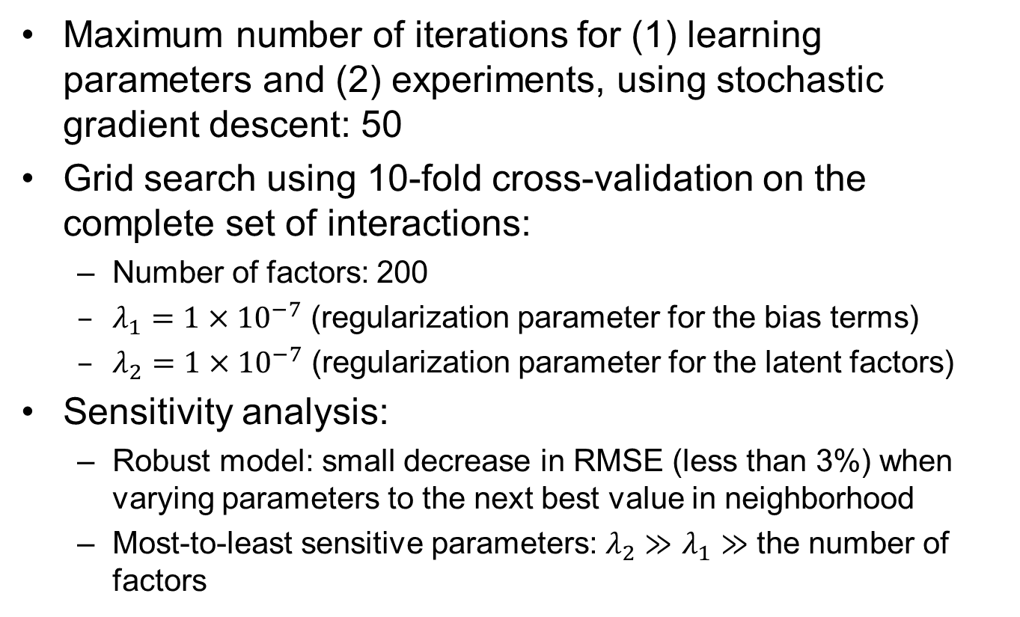
Evaluation – Model Parameters
Maximum number of iterations for (1) learning parameters and (2) experiments, using stochastic gradient descent: 50
Grid search using 10-fold cross-validation on the complete set of interactions:
  Number of factors: 200
  $λ_{1}=1×{10}^{−7}$ (regularization parameter for the bias terms)
  $λ_{2}=1×{10}^{−7}$ (regularization parameter for the latent factors)
Sensitivity analysis:
  Robust model: small decrease in RMSE (less than 3%) when varying parameters to the next best value in neighborhood
  Most-to-least sensitive parameters: $λ_{2}≫$ $λ_{1}≫$ the number of factors

Slide 25
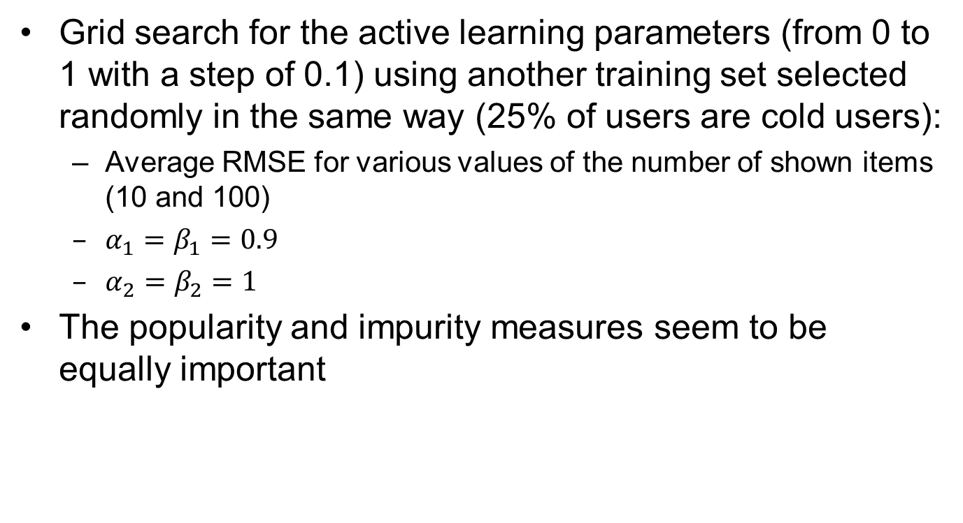
Evaluation – Model Parameters
Grid search for the active learning parameters (from 0 to 1 with a step of 0.1) using another training set selected randomly in the same way (25% of users are cold users):
  Average RMSE for various values of the number of shown items (10 and 100)
  $α_{1}=β_{1}=0.9$
  $α_{2}=β_{2}=1$
The popularity and impurity measures seem to be equally important

Slide 26
Evaluation – Platform
Software implemented in Python and available in github at http://tinyurl.com/z8mqele
Software library used: GraphLab Create (developed by Turi) with Python front-end and C++ backend
Hardware was a C4 instance of Amazon EC2:
  8 vCPU's (High frequency Intel Xeon E5-2666 v3 Haswell processors)
  15GB of RAM
Hardware and software suitable when working with large data sets

Slide 27
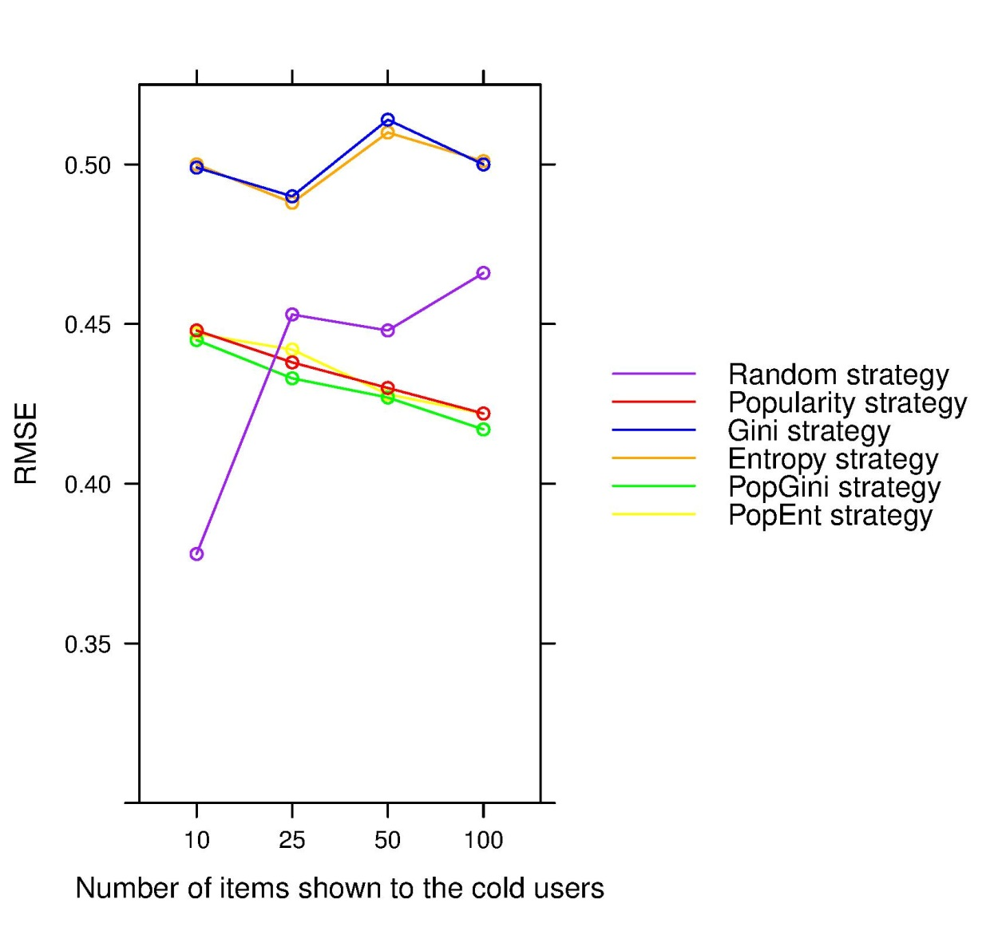
Evaluation – Results
10 items: the random strategy is the best (surprise)
25, 50, 100 items: the PopGini strategy is the best
Popularity strategy performs better than expected (users with strong opinions on popular items)
Entropy and Gini strategies are the worst performing (some polarizing items – ranked high – could be the ones with “issues”, so have little value)

Slide 28
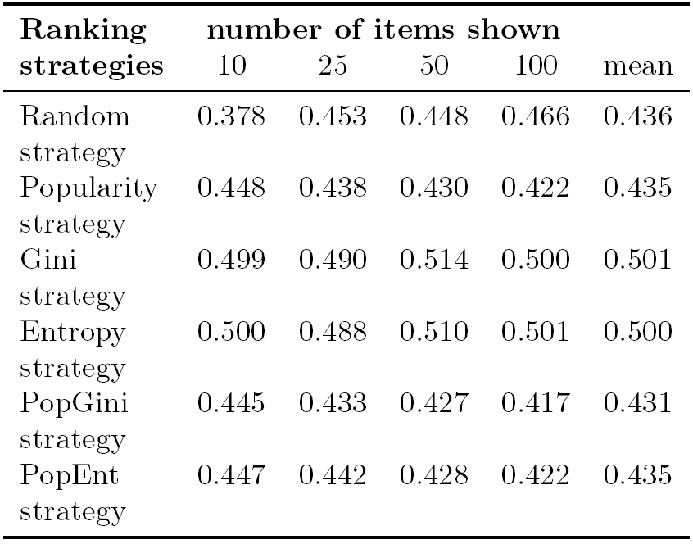
Evaluation – Results
PopGini is the best performing strategy (combination of item popularity, which is good in general, and item polarization)

Slide 29
Conclusion
We have investigated six non-personalized active learning strategies to address the cold user problem in the context of:
  Matrix factorization (collaborative filtering)
  User implicit feedback
Adapted the method of (Koren et al., 2009), with two regularization parameters instead of one (for bias and latent factors)
The best active learning strategy depends on the number of shown items to the users
The best active learning strategy overall is the PopGini, which combines the popularity of an item with its Gini impurity

Slide 30
Future Work
Experiment with other impurity measures (e.g., classification error), greedy measures (e.g., greedy extend: add incrementally items that provide for the best RMSE on the training data), etc.
Use a personalized active learning strategy where the item to be shown next depends on the previously seen items
Model parameters are currently learned during the setup for all users:
  Learn the model parameters for using (1) the cold-users only or (2) weight differently the errors made for cold users than the errors made for non-cold users (cost-based parameter learning)

