Slide 1
RCQ-ACS: RDF Chain Query Optimization Using an Ant Colony System
Alexander Hogenboom Erasmus University Rotterdam hogenboom@ese.eur.nl | Ewout Niewenhuijse Erasmus University Rotterdam ewoutnwn@gmail.com
 | Flavius Frasincar Erasmus University Rotterdam frasincar@ese.eur.nl
Frederik Hogenboom
Erasmus University Rotterdam
fhogenboom@ese.eur.nl

Slide 2
Introduction (1)
The Semantic Web allows for an ever-growing amount of data to be stored in many heterogeneous, yet interconnected sources
Fast query engines are needed for efficient querying of large amounts of data, typically represented by means of the Resource Description Framework (RDF)
Notes:
With the rise of the Semantic Web, an ever-growing amount of data is stored in many heterogeneous, yet interconnected sources. This data is typically represented by means of the Resource Description Framework (RDF), a World Wide Web Consortium (W3C) framework for describing and interchanging meta-data, which enable machine-interpretability by describing the context of data. Due to the interconnectivity of data rather than pages, the Semantic Web has the potential of addressing today’s typical users’ complex information needs in a more effective and efficient way than the current Web can.
RDF sources can be queried using SPARQL. In order to effectively and efficiently disclose the ever-growing amount of widely distributed RDF data to demanding users in real-time environments, fast RDF query engines are needed.

Slide 3
Introduction (2)
A major challenge lies in optimizing query paths: the order in which distinct parts of a query are evaluated
Existing solutions for Semantic Web:
Two-phase optimization (2PO):
Iterative Improvement (II)
Simulated Annealing (SA)
Genetic Algorithm (GA)
Ant Colony Optimization (ACO) appears to be a feasible alternative for the dynamic Semantic Web
Notes:
One of the problems here is the optimization of the join order of partial query results: query paths. The total query execution time depends on such query paths. A good algorithm for join order optimization in a query path can hence contribute to efficient querying. As the number of possible query paths grows exponentially with the query size, the optimization of RDF query paths is a big challenge.
Several methods have already been proposed to address this problem in the context of the Semantic Web. One of these methods
is a two-phase optimization (2PO) algorithm, consisting of an iterative improvement (II) method followed by simulated annealing (SA). More recently, a genetic algorithm (GA) has been shown to be a promising alternative.
As their design has been inspired by methods for query path optimization in traditional databases, existing approaches to RDF query path optimization have essentially been designed for more or less static environments – changes in the environment typically require the optimization to be run all over again. However, in the dynamic Semantic Web, data changes, sources come and go, and latency between sources may be volatile.
In this light, an ant colony optimization (ACO) approach may be a good alternative. ACO is a technique inspired by the foraging behavior of ant colonies. Its nature allows the algorithm to be run continuously and to adapt to changes in the environment in real time. Moreover, ACO has been shown to outperform GAs in solving complex problems such as scheduling and sequential ordering.
Therefore, we explore the applicability of ACO to query path optimization in an RDF environment and we compare its performance with the performance of existing RDF query optimization methods. As a first step, we focus on the performance of the considered algorithms when
optimizing a specific type of SPARQL queries, the so-called RDF chain queries, on a single source.

Slide 4
RDF and Query Paths (1)
An RDF model is a collection of facts declared in RDF
Facts are triples in the form of a node-arc-node link consisting of a subject, a predicate, and an object
RDF sources can be queried using SPARQL
Notes:
So, what exactly is query path determination in an RDF environment? Essentially, an RDF model is a collection of facts declared using RDF. These facts are triples in the form of a node-arc-node link consisting of a subject, a predicate, and an object. RDF sources can be queries using a specific query language: SPARQL.

Slide 5
RDF and Query Paths (2)
We consider a subset of SPARQL queries: chain queries, where a query path is followed by performing joins between its subpaths of length 1
Example RDF chain query: 1. PREFIX c: <http://www.daml.org/2001/09/countries/fips#> 2. PREFIX o: <http://www.daml.org/2003/09/factbook/factbook-ont#> 3. SELECT ?partner 4. WHERE { c:NL o:exportPartner ?expPartner .
5. ?expPartner o:country ?partner .
6. ?partner o:dependentArea ?area .
7. ?area o:internationalDispute ?conflict . 9. }
Notes:
Our research is still a work in progress. As a first step, we only consider a specific subset of SPARQL queries, where RDF sources are queried for matches with a set of chained node-arc-node patterns. These chained patterns resemble the chain-query concept from the field of relational databases; the nodes can be regarded as individual sources (e.g., tables) which are all related to a certain extent. When executing a chain query, a path is followed by performing joins between its subpaths of length 1.
Chain queries in an RDF environment can be illustrated using the following example. In our research, we consider an RDF model of the CIA World Factbook, containing data about approximately 250 countries in over 100,000 statements. This is an automatically populated ontology, which uses an existing schema. Because of the design of the schema, this rather big dataset offers enough opportunities for longer chain queries, which makes it useful for our current purpose. Suppose a financial risk analyst wants to identify the export partners of the Netherlands that have dependent areas (which are areas that do not possess full political independence or sovereignty) that are involved in an international conflict. This query can be expressed in SPARQL as shown in this example.
This query is a simple example of a chain query and can be subdivided into four subqueries: the query for information on the export partners of the Netherlands (line 4), the query for countries actually associated with other countries as export partners (line 5), the query for dependent areas (line 6), and finally the query for international disputes (line 7). In order to resolve the complete query, the results of these individual subqueries can be joined in any order. Here, the number of statements resulting from a join is equal to the number of statements compliant with both operands’ constraints.

Slide 6
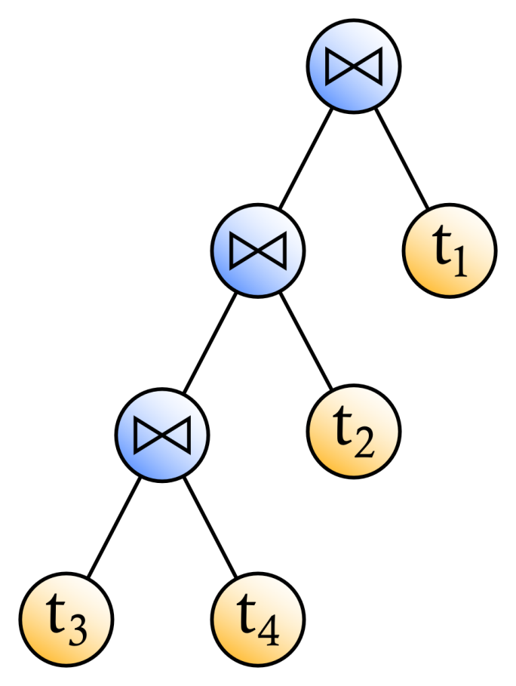
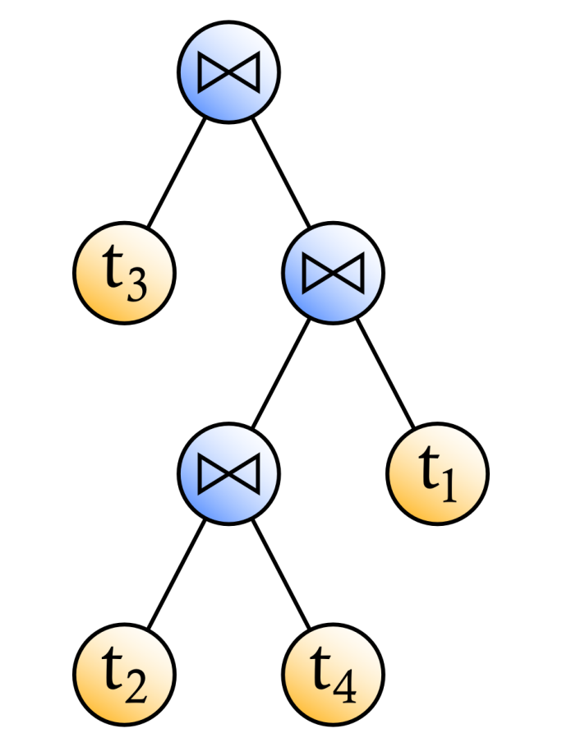
RDF and Query Paths (3)
Left-deep query tree
Bushy query tree
Notes:
An RDF query can be visualized using a tree. The leaf nodes of such a query tree represent inputs (sources), whereas the internal nodes represent algebra operations, which enable a user to specify basic retrieval requests on these sources. The nodes in a query tree can be ordered in many different ways, which all produce the same result. These solutions all depict an order in which operations are executed in order to retrieve the requested data and are referred to as query plans or query paths.
In an RDF context, bushy and left-deep query trees can be considered. In bushy trees, base relations (containing information from one source) as well as results of earlier joins can be joined. Left-deep trees, which are a subset of bushy trees, require the right-hand join operands to be base relations. Here are examples of a bushy tree and a left-deep tree, where matches with triple patterns t₁ to t₄ are joined. These triple patterns correspond with lines 4 through 7 from the example query, respectively.

Slide 7
RDF Query Path Optimization (1)
Challenge: determine the right order in which the joins should be computed
Optimize the overall response time
Explore a solution space with query paths
Solution space size exponential in number of concepts
Notes:
So, for one arbitrary query, many different possible query paths may exist, which all yield the same results. How then can we find an optimal query path? Over the years, several algebras and heuristics for optimization have been proposed. Some of these heuristics include moving selection and projection operations as far down the query tree as possible. This helps to reduce the number of elements considered early on, thus reducing processing and transmission costs. However, this does not fully solve the real problem. The real challenge in query optimization lies in optimizing the order and nature of the joins.
The order of joins of sub paths in a query path is variable and affects the time needed for executing the query. In this context, the join-order problem arises. The challenge is to determine the right order in which the joins should be computed, hereby optimizing the overall response time. A solution space can be considered, in which each solution represents a query path. The size of this solution space is exponential in the number of concepts considered in the RDF chain query.

Slide 8
RDF Query Path Optimization (2)
Solutions are associated with data transmission and processing costs
Data processing costs are the sum of all join costs, which are influenced by the cardinalities of each operand and the join method used (nested-loop)
Neighboring solutions in the solution space can be identified using transformation rules
Notes:
Each solution is associated with execution costs, which are mainly realized by the cost of data transmission from the source to the processor and the cost of processing these data. Data processing costs are the sum of costs associated with all joins within a solution. These join costs are influenced by the cardinalities of each operand and the join method used.
For now, we only consider nested-loop joins, because we envisage our approach to be applicable in environments with unsorted, unknown data, making hashing and indexing a priori impossible. Single loop joins, hash joins, or sort-merge joins would hence be rather infeasible, especially under time constraints. In an RDF environment where queries need to be optimized for new data on the fly, cardinalities of results from joins could be estimated and updated or cached on the fly.
Neighboring solutions can be identified using transformation. We consider 4 of such rules in our current work.

Slide 9
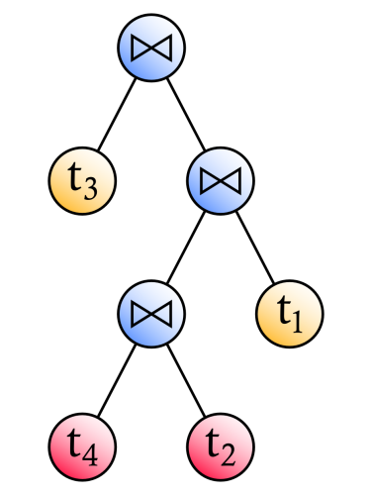
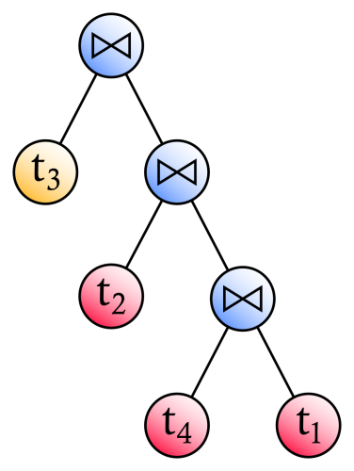
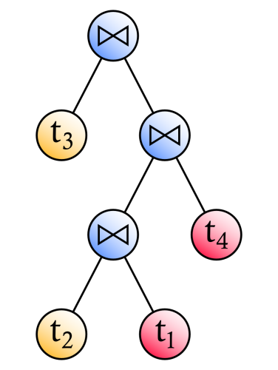
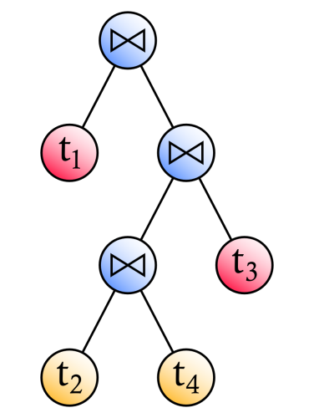
RDF Query Path Optimization (3)
Join commutativity
Join associativity
Left join exchange
Right join exchange
Notes:
Let us reconsider our bushy tree example. The first transformation rule we may apply is join commutativity. A join between triple pattern 2 and 4 is changed into a join between triple pattern 4 and 2. Another transformation is join associativity, where a join between triple pattern 2 and 4 and subsequently triple pattern 1 is changed into a join of triple pattern 4 and 1 and subsequently triple pattern 2. Furthermore, a triple pattern in the right-hand operand of a join may be interchanged with a triple pattern in the left-hand operand of the join. Finally, a triple pattern in the left-hand operand of a join may also be interchanged with a triple pattern in the right-hand operand.

Slide 10
RDF Query Path Optimization (4)
Exploring the solution space by means of 2PO:
Using II, local optima are found by walking through the solution space (from random starting points), while only taking steps yielding improvement in solution quality
The best local optimum thus found is used as starting point for SA: a walk through the solution space, where moves not yielding improvement are accepted with a declining probability
A GA has proven to outperform 2PO
As ACO has proven to outperform GAs in solving other complex problems and ACO can deal with continuously changing environments, ACO is a promising alternative
Notes:
The solution space can be explored in numerous ways. Existing work uses an II algorithm followed by SA, also referred to as the two-phase optimization (2PO) algorithm. The II algorithm randomly generates a set of initial solutions, which are used as starting points for a walk in the solution space. Each step in such a walk is a step to a neighboring solution in the solution space that yields improvement. At some point in a walk, a solution is reached for which no better neighbor can be found in a specified number of tries, in which case the current solution is assumed to be a local optimum. The number of times the algorithm tries to find a better neighbor (by randomly selecting a neighbor) is limited to the number of neighbors of that solution. The described process is repeated for all starting points.
The best local optimum thus found is subsequently used as a starting point for a SA algorithm, which tends to accept (with a declining probability) moves not yielding improvement. The latter algorithm thus searches the proximity of possibly sub-optimal solutions, hereby reducing the risk for a local optimum. Inspired by the natural process of annealing of crystals from liquid solutions, SA simulates a continuous temperature reduction, enabling the system to cool down completely from a specified starting temperature to a state in which the system is considered to be frozen. The probability of accepting moves not yielding improvement declines with the system’s temperature.
In previous work, we have proposed to use a GA as an alternative to 2PO for optimizing (large) RDF chain queries. A GA is an optimization approach in which biological evolution according to the principle of survival of the fittest is simulated. A population of chromosomes – representing solutions – is exposed to evolutionary operations, consisting of selection (where individual chromosomes are selected for proliferation in the next generation), crossovers (creating offspring by combining chromosomes), and mutations (randomly altering chromosomes). Evolution is simulated until the maximum number of iterations is reached or several generations have not yielded any improvement. The fitness of a chromosome determines the chances of its survival and is inversely proportional to the execution cost of the associated solution. Our results have demonstrated a promising performance compared to 2PO in terms of both execution time and solution costs, in particular for larger queries.
As existing RDF chain query path optimization approaches have been inspired by methods for optimization of query paths in traditional databases, their nature renders these approaches most applicable to more or less static environments. When something in the environment changes, existing optimization techniques typically need to be run all over again. Yet, in a dynamic Semantic Web environment, data continuously changes, data sources come and go, and transmission costs between sources may vary over time. Therefore, we propose to optimize RDF chain queries by using ant colonies, as ACO-based approaches can be run continuously and can adapt to changes in the environment in real time. Moreover, such approaches typically outperform GAs in solving complex problems such as scheduling and sequential ordering.

Slide 11
RDF Chain Query Optimization with Ants (1)
Artificial ants explore a solution space by iteratively:
Constructing a path from a starting point to an ending point
Updating pheromone traces marking their paths
Steps depend on pheromone traces and local heuristics
Ant Colony System (ACS) is a faster converging ACO variant, differing from classic ACO algorithms in that:
Ants occasionally simply take the step with the highest probability rather than possibly taking less likely steps
Pheromone traces are only deposited on parts of the best-so-far solution instead of on all paths taken by all ants
Pheromone evaporation only takes place on paths visited by ants, rather than on all paths
Notes:
ACO is an optimization method inspired by ant colonies’ foraging behavior, i.e., ants walk between their nest and a food source marking their paths with pheromone traces. Foraging ants make use of these traces, as they tend to follow paths where the pheromone concentration is highest. Over
time, shorter paths attract an increasing number of pheromone deposits, as they are traversed with increasing frequency because of their length as well as the pheromone traces on these paths. The ant colony thus converges to using a relatively short path.
Typically, each iteration of the ACO algorithm consists of two steps. First, every ant in the colony constructs a path from a start vertex to an end vertex in a graph. Second, when all ants have reached the end vertex, the edges of each path are marked with a pheromone quantity proportional to the observed quality of the path. Pheromone traces evaporate over time.
In ACO, an ant constructs a path by iteratively moving from its most recently visited vertex to another vertex that the ant has not visited yet. The probability for an ant to move from one vertex to another depends on the pheromone quantity on the edge between these vertices, as well as on local heuristics (the ant’s own estimation of the quality of a path).
The classic variant of ACO has known several successors, each with its specific focus. One of these variants is the Ant Colony System (ACS), which is typically faster converging and more efficient than the classic system. The ACS algorithm differs from the classic system in three ways. First, in ACS, ants occasionally simply select the edge with the highest probability instead of taking the full probability distribution into account. Second, in ACS, ants only deposit traces of pheromone on the edges that constitute the best-so-far solution, rather than on all edges visited by ants in the latest iteration. Third, in ACS, pheromone evaporation only takes place on those edges that have been visited by ants, rather than on all edges.

Slide 12
RDF Chain Query Optimization with Ants (2)
We model the solution space based on an ordinal number scheme for encoding chain queries
The encoding scheme iteratively joins two concepts in an ordered list of concepts, while saving the result on the position of first appearing concept
Example:
(t1, t2, t3, t4): join 2 and 4
(t1, t2t4, t3): join 2 and 1
(t2t4t1, t3): join 2 and 1
(t3t2t4t1)
Encoded solution: ((2,4),(2,1),(2,1))
Notes:
We model the solution space based on an ordinal number scheme for encoding chain queries. The algorithm iteratively joins two concepts in an ordered list of concepts. The result is saved on the position of the first appearing concept. Let us consider the example query again. First, we join the second and fourth concept. The result is saved on the second position. Then, we join the second and first concept in the remaining list. This results in a new ordered list of two concepts, one of which is the result of our previous joins. In this list, let us then join the second concept with the first again. We now have performed all joins and we have encoded our solution.

Slide 13
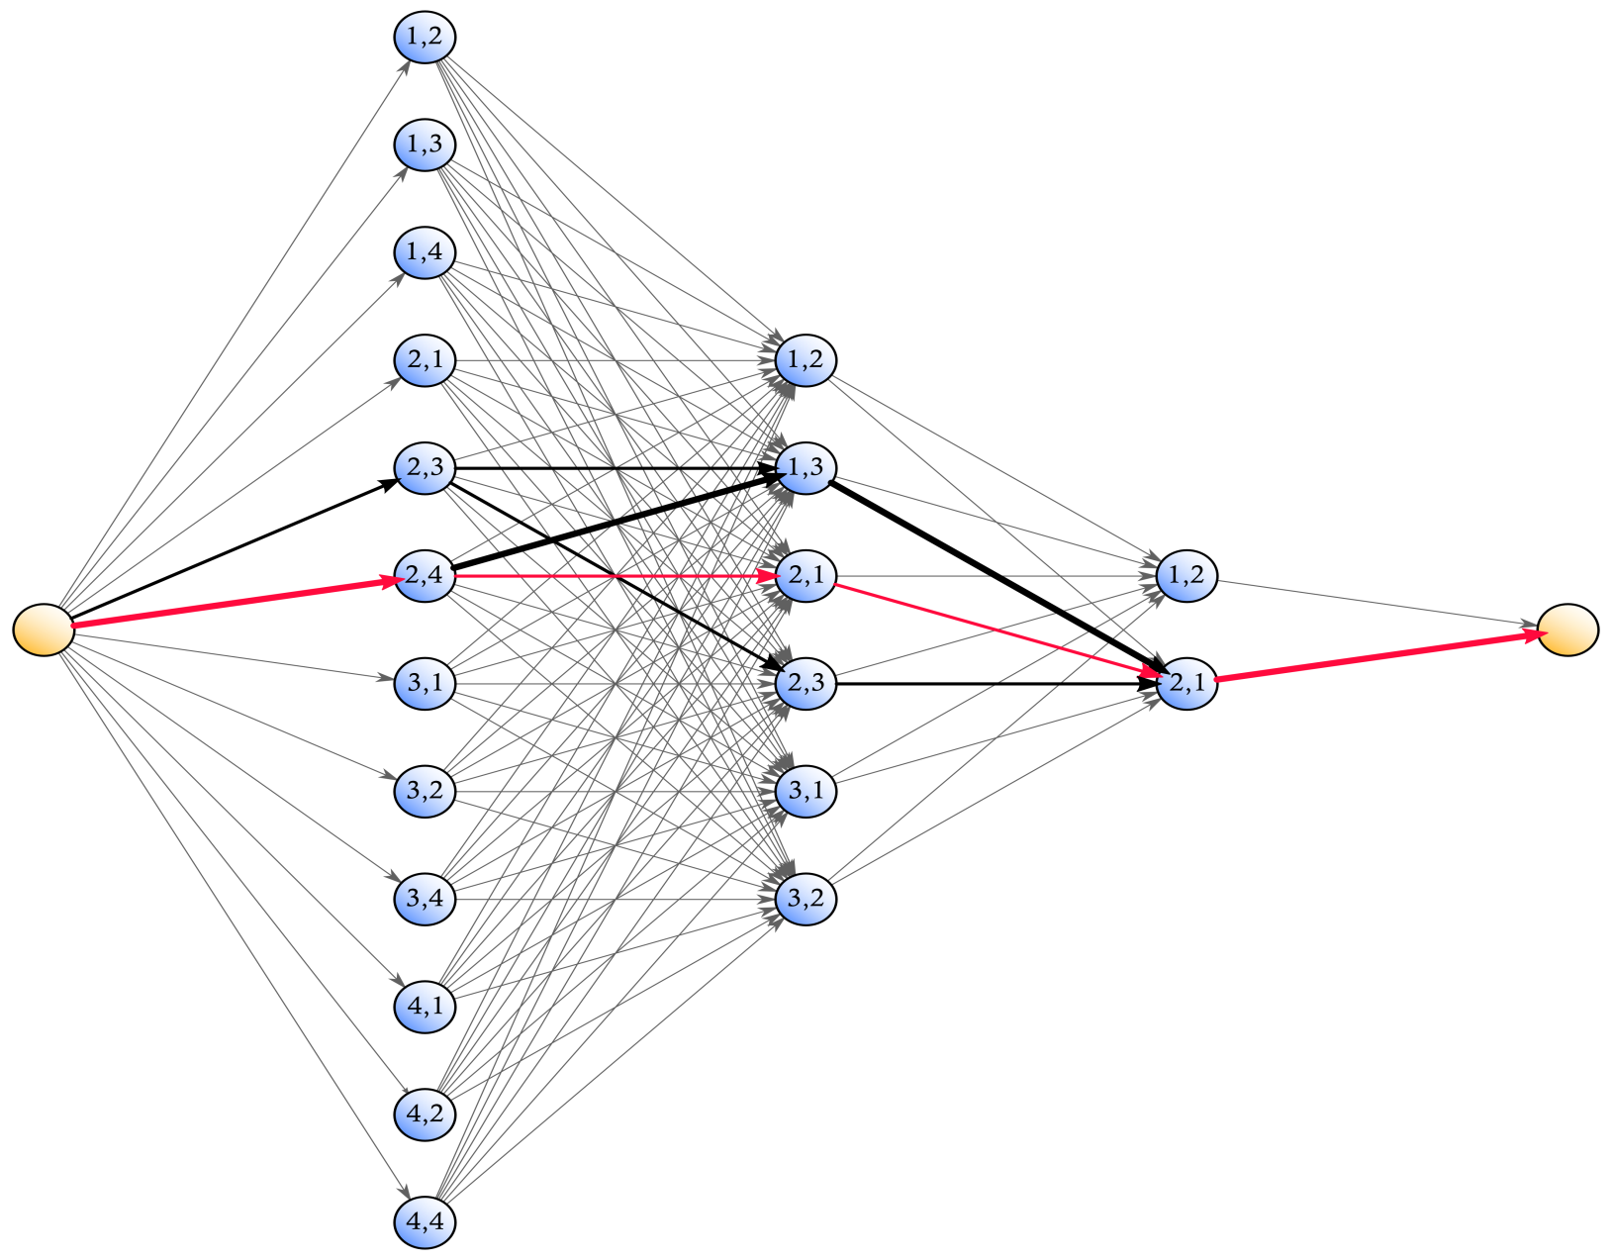
RDF Chain Query Optimization with Ants (3)
Notes:
In our representation, this is the graph that the ants need to find their way in. The ants walk from the yellow start vertex on the left, representing a situation in which no matches with triple patterns have been joined, to the yellow end vertex on the right, representing a situation in which all joins have been made. Each path represents a join sequence, with each step representing a join.
For an arbitrary join (visualized as a column of blue nodes in this figure), the vertices in the graph represent all valid combinations of indices of join operands, in accordance with our applied ordinal encoding scheme. An ant’s observed distance associated with an arbitrary edge connecting a vertex from one join with a vertex from the next join depends on the path taken up until the former join and represents the estimated additional costs of performing the next join.
At every iteration, new pheromone traces, which are inversely proportional to the associated paths’ total execution costs, are deposited on the best-so-far path and pheromone traces on all visited paths evaporate to a certain extent. When the ants have not encountered a better path in some number of iterations, the algorithm is considered to have been converged.
In this figure, the width of an edge reflects the pheromone quantities on this edge. This specific graph is a representation for an RDF chain query with 3 joins. The path representing our bushy query tree example is marked red.

Slide 14
Evaluation (1)
We evaluate RDF chain query optimization (RCQ) by means of 2PO, a GA, and ACS on an RDF version of the CIA World Factbook (over 100,000 triples)
The full solution space is considered
Each algorithm is assessed in terms of execution time and solution quality, for chain queries varying in length from 3 to 20 predicates (2 to 19 joins)
Each experiment is iterated 100 times
We assess significance of performance differences by means of a paired, two-sided Wilcoxon signed rank test
Notes:
We evaluate the performance of RDF chain query optimization by means of 2PO (RCQ-2PO), a GA (RCQ-GA), and our novel ACS (RCQ-ACS) on an RDF version of the CIA World Factbook.
We consider the complete solution space, which means that we include bushy query trees.
We evaluate our considered methods on RDF chain queries varying in length from 3 to 20 predicates, which implies we perform 2 to 19 joins. For each query length, we evaluate each method’s execution times until convergence and costs of found solutions over 100 random chain queries on our RDF data. Statistical significance of observed differences is assessed by means of a paired, two-sided Wilcoxon signed rank test, evaluating the null hypothesis that these differences are symmetrically distributed around a median equal to 0.

Slide 15
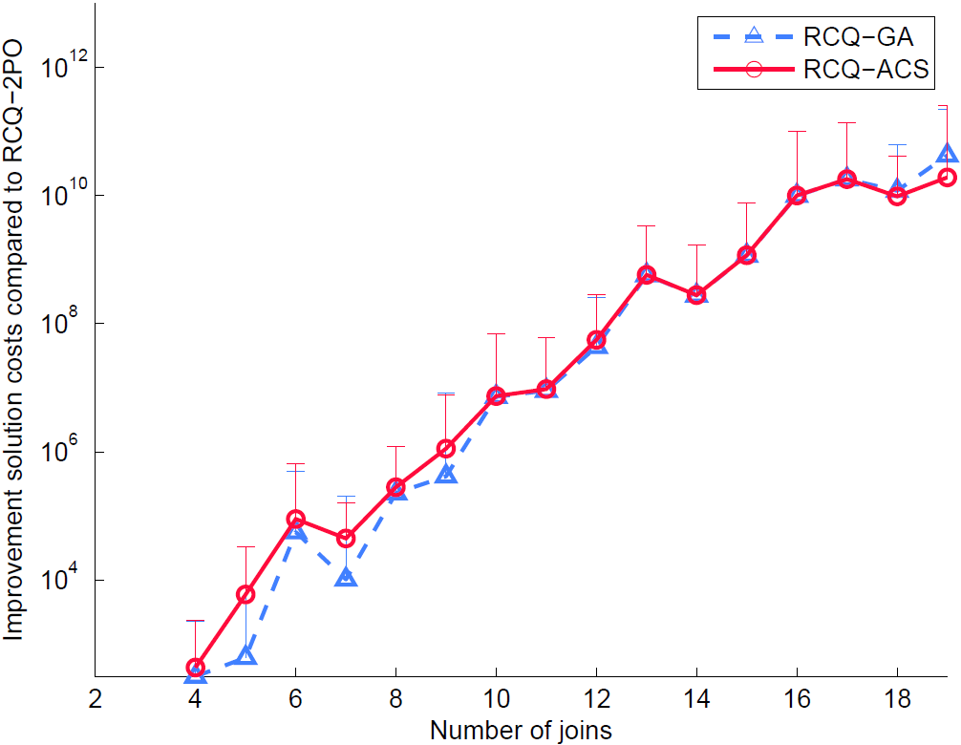
Evaluation (2)
Notes:
For RDF chain queries consisting of up to about ten joins, 2PO yields solutions of a similar quality as a GA. ACS on the other hand significantly outperforms both 2PO and the GA in terms of solution quality, albeit while obtaining relatively small improvements in solution costs. For RDF chain queries consisting of two and three joins, all considered algorithms produce solutions of similar quality.
For larger RDF chain queries, 2PO typically yields solutions of a significantly inferior quality, when compared to the solutions produced by both the GA and our novel ACS. Furthermore, for increasing query sizes, the solution quality of the GA moves towards the quality of solutions found by our novel ACS, leaving no significant difference for queries constituted by more than 12 joins.

Slide 16
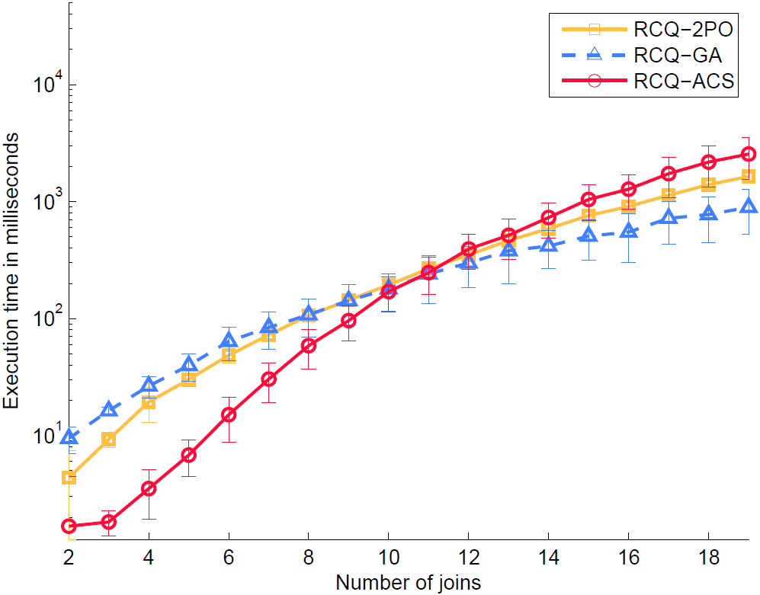
Evaluation (3)
Notes:
For RDF chain queries consisting of up to about ten joins, the GA is typically significantly outperformed by both 2PO and our novel ACS in terms of execution time. The GA needs up to approximately 120% more time to converge than 2PO, whereas our novel ACS is up to 80% faster than 2PO.
As the query size increases, the differences in mean execution times tend to decrease. For larger RDF chain queries, our novel ACS even needs up to 55% more time to converge than 2PO, which in turn needs up to over 80% more time to converge than the GA. As we have seen in the previous graph, the GA does however yield solutions of a quality comparably to those of our novel ACS.
As such, for larger chain queries (consisting of more than approximately ten joins), the existing GA offers the best trade-off between execution time and solution quality. However, for smaller (and more common!) queries, our novel ACS delivers significantly better solutions in significantly less execution time than existing approaches.

Slide 17
Conclusions
We have proposed an ACS approach in which artificial ants identify low-cost query paths guided by previously encountered solutions and local heuristics
Our approach significantly outperforms existing work when optimizing RDF chain queries consisting of up to approximately 10 joins
Notes:
We have demonstrated how an ACS approach can facilitate effective and efficient querying in a Semantic Web environment, by having artificial ants iteratively construct RDF chain query paths, partly guided by encountered low-cost solutions, and partly guided by local heuristics.
Our novel ACS for RDF chain query optimization turns out to be particularly useful for optimizing chain queries consisting of up to approximately ten joins. Our novel method significantly outperforms both the existing 2PO and GA approaches in terms of execution time and solution quality for such queries.

Slide 18
Future Work
Optimize parameters and perform a sensitivity analysis
Make our ACS approach more scalable
Evaluate our method in a real-world query execution engine in a dynamic, distributed setting
Notes:
As future work, we plan to optimize the parameters of our ACS approach and to perform a parameter sensitivity analysis. For now, we have only done a very limited exploration of the parameter space in order to find out which settings work best in terms of, for instance, the number of ants, the evaporation rate, the extent to which the ants are guided by pheromones, etcetera.
Another direction for future work lies in making our method more scalable, such that our ACS can be applied to large queries as well.
Last, we plan to evaluate our method in a real-world query execution engine, dealing with an ever-changing environment of multiple heterogeneous sources.

Slide 19
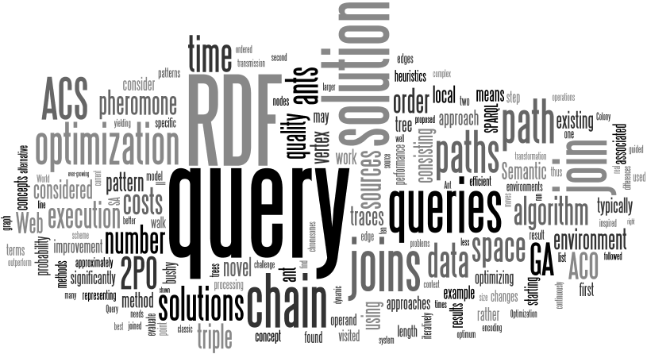
Questions?
Alexander Hogenboom Erasmus School of Economics Erasmus University Rotterdam P.O. Box 1738, NL-3000 DR Rotterdam, the Netherlands
hogenboom@ese.eur.nl

