Slide 1
Utilizing Textual Reviews in Latent Factor Models for Recommender Systems
Tatev Karen Aslanyan
Erasmus Univeristy Rotterdam
Data Scientist at Elsevier
tatevkaren@gmail.com
Flavius Frasincar
Erasmus Univeristy Rotterdam
Assistant Professor
frasincar@ese.eur.nl
36th ACM/SIGAPP Symposium on Applied Computing (SAC 2021)
Notes:
Hi everybody, Welcome to my presentation. I am Tatev Karen Aslanyan and I am a Data Scientist at Elsevier’s tech hub in the Netherlands. Today I will present you a paper about Utilizing Textual Reviews in Latent Factor Models for Recommender Systems. This is a joint work with Flavius Frasincar, Assitent Professor at Erasmus University Rotterdam, in the Netherlands.
The main focus of this presentation will be on a new Recommender System which we created and named LDA-LFM. This new hybrid recommender algorithm is based on textual reviews and ratings of items, and it also allows adding extra user and item specific information to generate qualitative recommendations. This approach is based on topic modelling technique, Latent Dirichlet Allocation, and rating-modelling technique, Latent Factor Model.

Slide 2
Outline
Motivation
Related Work
Methodology
Evaluation
Applied Data Analysis on Amazon Data
Conclusion and Future Work
(SAC 2021) Tatev Karen Aslanyan
Notes:
The outline of this showcase will be as follows. Firstly, I will present you the motivation behind this research. Secondly, I will give you a brief summary of the related work in this subject area. Then I will provide details about the methodology behind the proposed recommender algorithm and how it was evaluated. Next, I will present an application of this algorithm as an article recommender using Amazon Web Shop’s data. In the final part of the presentation I will discuss the conclusions based on this research and the future work.

Slide 3
Motivation
Due to efficiency and the ease of use, online shopping and services gained large popularity
During last 5 years e-commerce shares in global retail sales increased 7.4% → 20%
Large amount of online stores and product variations has led to information overload
Makes online shopping less pleasant and convenient
Businesses rely on Recommender Systems to solve information overload
Online stores have platforms to collect feedback from about their products and services
Ratings
Reviews
Customer characteristics (age, gender)
Product characteristics (genre, author, origin, color)
(SAC 2021) Tatev Karen Aslanyan
Notes:
During the last decade, the importance of the Web services as a tool for businesses and electronic transactions has increased drastically. Due to its efficiency and the ease of use, online shopping and services gained large popularity.
As a consequence, E-commerce has driven rapid transformation in the retail sector. For instance, during the last 5 years the share of E-commerce in the global retail sales went from 7.4% to 20%. And this percentage has only been increasing especially during the last year when many shops closed their doors because of the pandemic and opened online stores to sell products and services.
This increase in the number of online stores went in parallel with a massive increase in amount of product variations. At this point we may ask ouselves whether online shopping is actually as pleasant and time-saving as it used to be. And from experience, I think, most of us will agree that in some cases, when we are looking for a product that has thousands of variations, then the process of searching and choosing a single item can be incredibly tiring and time-consuming.
To address this information overload, very often online retailers rely heavily on Recommender Systems which help them to narrow down the amount of items they present to the customers from the front-end. Recommender systems of a good quality can have enormous positive impact not only on the user experience, but also on the amount of sales and loyal customers.
Majority of these online stores have a special platform dedicated to collecting feedback from their customers about their products or services by different means. For example, by 5-star ratings or by product reviews. Aside from this, online stores have also a large database where they store metadata about their customers and products. In case of customers, this features can be for instance user’s age or gender. In case of the products, this can be the color or the origin of the item.

Slide 4
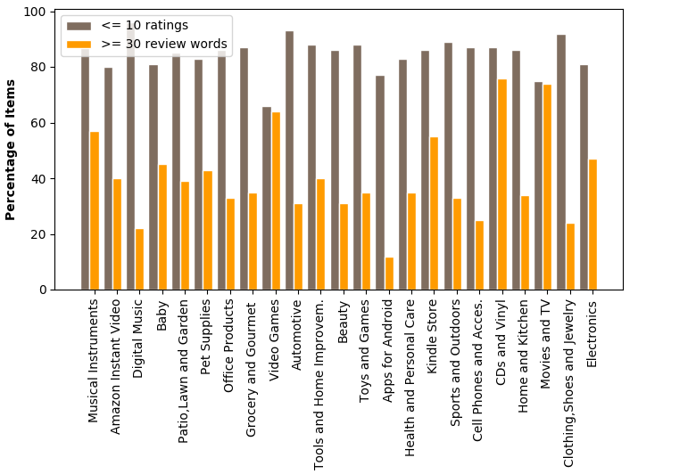
Motivation
Recomender Systems categories
Collaborative Filtering (rating based)
Content – Based (review based)
Hybrid (rating and review based)
Most of Recommender Systems
Rating based and not scalable
Reviews contain large amount of information
Can help to better predict customer preferences
Can complement the absence of product ratings
(SAC 2021) Tatev Karen Aslanyan
Notes:
For a recommender to make a selection out of a large amount of product variations, it needs to learn about the target user and about the available items. Based on this, the algorithm can predict whether the customer will likely be interested in a particular product or not.
Recommender Systems are usually clustered into three classes: Collaborative Filtering algorithms which are based only on product ratings, Content – Based algorithms based on the content. And the hybrid recommender algorithms that use both ratings and textual reviews to generate recommendations.
The existing Recommender Systems are mainly of Collaborative Filtering type and they use only the product ratings as a means of learning about the user preferences. Whereas, using additional sources of information such as product reviews or information about users and items can help to learn better about the customers and products, which will improve the quality of the recommendations. The textual reviews can even act as a complementary information for learning about the customers and products in case the ratings are not available.
Additionally, the existing recommenders systems that are based on both ratings and content, are unable to handle large datasets.
Let us look at this figure, which shows the percentage of products that have less than 10 ratings (the gray bars) and reviews with more than 30 words (the orange bars) per product category in the biggest web shop in the world, the Amazon.com.
From the figure, we can see that more than 80% of products have less than 10 ratings, whereas, over 40% of products have long reviews and this holds for all product categories. This means that for many items there are no ratings but there are long textual reviews which can be used as a valuable source of information for the recommender. So, this example illustrates that textual reviews can also be used as complementary information in case the product ratings are absent.

Slide 5
What We Do
New Recommender System LDA-LFM
Product ratings
Product reviews
Allows adding extra user or item characteristics
Scalable
Latent Dirichlet Allocation (LDA) topic modelling technique
Latent Factor Model (LFM) rating modelling technique
Generalization: LDA-LFM can also be applied to recommend online services
(SAC 2021) Tatev Karen Aslanyan
Notes:
To address all these shortcomings of the existing Recommender Systems, in this paper, we propose a new algorithm where our main goal is to have a scalable recommender system that uses both product ratings and textual reviews. And it allows adding extra user and item features for generating product recommendations.
This proposed algorithm which we named LDA-LFM, combines the topic-modelling technique, Latent Dirichlet Allocation, and the rating modelling technique, Latent Factor Model, to predict review and item features when generating recommendations.
For the recommender to allow adding extra user-and item characteristics, we propose an approach that will extend the LFM part of the model.
Note, that while in this work we focus on article recommendations, this algorithm can also be applied to service recommendations as well.

Slide 6
Related Work
Collaborative Filtering
(Koren et al., 2009): Recommender algorithm combining LFM and neighborhood based
approach to genereate item recommendations
Content-Based
(Mooney and Roy, 2000): One of the first content-based algorithms to generate book
recommendations
Hybrid Recommenders
(McAuley and Leskovec, 2013): Hidden Factors and Topic (HFT) hybrid recommender combining
LFM and LDA to generate article recommendation
(Ling et al., 2014): Ratings Meet Reviews (RMR) hybrid recommender combining LFM and LDA to
generate article recommendation
(SAC 2021) Tatev Karen Aslanyan
Notes:
The existing literature in the field of Recommender Systems can be classified into three categories. The first one is the category of Collaborative Filtering algorithms, the second one is about Content-Based algorithms and third one is about Hybrid Recommenders.
The work of Koren et. al. is one of such papers falling under the category of Collaborative Filtering algorithms. This work introduced a recommender based on the rating modelling technique LFM which in combination with neighborhood based approach produced item recommendations.
Another work that I would like to discuss today is the paper of McAuley and Leskovec, which introduced a hybrid recommender algorithm that combined rating modelling technique LFM and topic modelling technique LDA to learn about latent rating and latent review dimensions to generate article recommendations. This paper is highly related to our work, especially the way it combines the LDA and LFM methods.

Slide 7
Methodology
Building Blocks of LDA-LFM
Latent Factor Models (LFM)
(for modelling the ratings)
Latent Dirichlet Allocation (LDA)
(for modelling the reviews)
Combining LFM and LDA
Allowing to add extra user and item features
(SAC 2021) Tatev Karen Aslanyan
Notes:
Let us begin with the technical setting of our work.
The methodology of the proposed algorithm LDA-LFM consists of 4 building blocks and we will discuss them one by one.
In the upcoming slides, I will start with the Latent Factor Model that we used to model the product ratings.
Secondly, I will talk about the LDA method which we used to model the product reviews. Then, I will discuss the approach of combining these two methods.
Finally, I will present you the proposed approach of extending our hybrid recommender such that user- and item-specific characteristics can be added to the model.

Slide 8
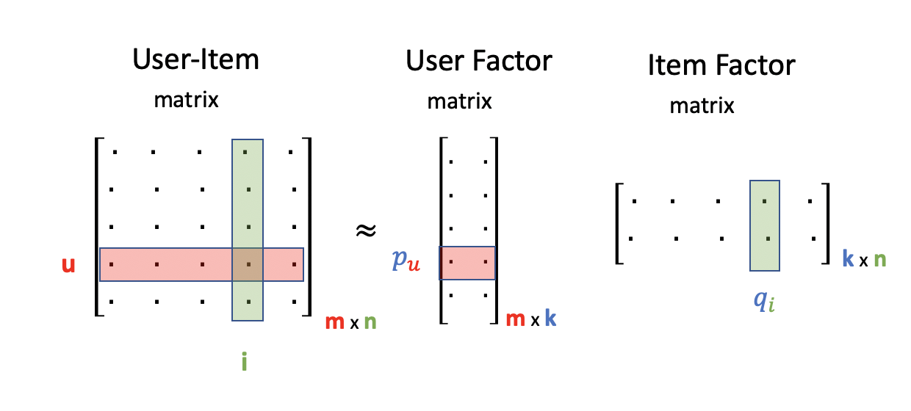
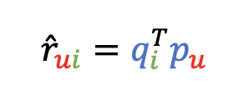
Latent Factor Model (LFM)
Rating modelling technique
User – Item rating matrix is sparse
m users and n items
Decomposing User – Item rating matrix into
2 smaller and denser matrices
User Factor matrix
Item Factor matrix
(SAC 2021) Tatev Karen Aslanyan
Notes:
Let us begin with the first part of the technical setting, the Latent Factor Model which is also known as Matrix Factorization method.
LFM is a rating modelling technique that uses dimensionality reduction to predict and fill in the missing ratings in the User-Item rating matrix. This matrix is usually very sparse with large amount of missing ratings and the rows of this matrix represent the users and the columns represent the items.
The goal of the LFM is to rotate the axis of this large and sparse matrix so that the pairwise correlations between the dimensions can be removed and it can be decomposed into two smaller and denser matrices with the same rank.
This figure describes this process of decomposing User-Item matrix into two smaller matrices with the same rank, where the rank is denoted here by the letter k. As you can see the original matrix in the left part of the figure, consists of m rows (m users) and n columns (items), so the dimension of this matrix is m by n and the element in the u^{th} row and i^{th} column represents the rating of the user u assigned to item i. So, the LFM model states that this large rating matrix can be approximated by the product of two smaller matrices, where the first matrix is the User Factor Matrix with m rows and k columns and the second matrix is the Item Factor Matrix with k rows and n columns. Here the rank which is denoted by k represents the number of latent factors in the model.
A row in User Factor matrix, which is denoted by p_u in this figure, represents the affinity of user u towards the user- item rating matrix whereas a column in Item Factor matrix, denoted by q_i, represents the affinity of item I towards the user-item rating matrix. So, if we look at a single pair of user and item rating, then according to the LFM model rating of user u for item i can be estimated by obtaining the dot product between the p_th vector and the transpose of the q_i vector, hence the rui_hat is equal to q_i transpose times p_u.

Slide 9

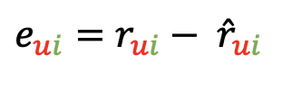
Latent Factor Model (LFM)
Some customers tend to give higher rates
User bias
Some products tend to be rated higher
Item bias
(SAC 2021) Tatev Karen Aslanyan
Notes:
But estimating the rating without taking into account common trends might lead to unreliable prediction results.
One of those common trends is that some customers tend to give higher rates to all the products they buy than other customers. For instance, there are some people who independent of the type of products will always be happy with that product as long as it doesn’t contain major defects.
Similarly, some items tend to be rated highly compared to other products. For instance, there are set of popular books on Amazon.com that tend to be rated much higher compared to other books. Neglecting the existence of such trends can result in inaccurate predictions.
Therefore, we extend the formula for the r_hat that we saw in the previous slide by adding to it, the general overage of all ratings, denoted by alpha, the bias of user u, denoted by b_u, and the bias of item i, denoted by b_i.
In other words, the rating of a user u for item is a simple function of global average of all ratings, user and item biases, and the dot product of user and item factors.
So, the goal of the LFM model is to estimate the rating of user u for item i such that it is very close to the actual rating. Basically, the goal is to minimize the error that is equal to the difference between the real rating and the estimated rating that user u assigns to item i where we denote the error corresponding to user u and item i by e_ui.

Slide 10
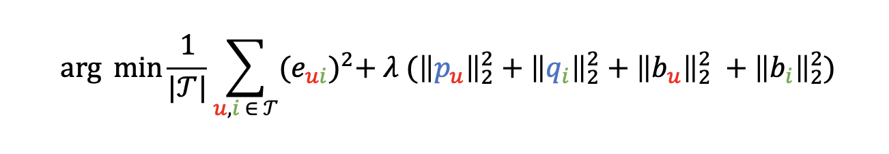
Latent Factor Model (LFM)
Generalization from one pair of user and item to the entire sample
Minimize the quadratic loss function
To solve the optimization problem, Adam Optimizer is used
Closely related to Stochastic Gradient Decent (SGD)
Faster and less prone to errors
(SAC 2021) Tatev Karen Aslanyan
Notes:
When generalizing this process of minimzing the prediction error of a single pair of user u and item i to an entire sample, then we get an optimization problem that can be expressed by the formula that you can see at the bottom of this slide.
This objective function can be seen a quadratic loss function where the Thau stands for the corpus of all ratings in the training data, the e_ui is the prediction error for user u and item i as introduced before, the lambda is the regularization parameter which defines the importance of the features and how hard the unimportant features are penalized.
The expression within the parenthesis that is multiplied with lambda is simply the sum of squared L_2 norms of user and item properties pu and qi, and user and item biases b_u, and b_i as mentioned before.
We use regularization to prevent the model from overfitting, given that there are many features included in the training data. To solve this optimization problem we use Adam Optimizer which is a more sophisticated version of the Stochastic Gradient Descent (SGD) algorithm and is suitable for handling large datasets.
Adam Optimizer is also faster and less prone to make errors such as finding local optima instead of global.

Slide 11
Latent Dirichlet Allocation
LDA relies on 4 concepts
Words carry strong semantic information
Documents discussing similar topics are likely to use similar words
Documents are probability distributions of words
Topics are probability distributions of words
Example of the topic about “animals”
Words “zoo” and “species” will have high probability
(SAC 2021) Tatev Karen Aslanyan
Notes:
Let us now discuss the second part of our technical setting, the Latent Dirichlet Allocation model which is used to uncover the hidden dimensions in the textual reviews.
LDA is based on the following main concepts: each word carries a strong semantic information, documents discussing similar topics are likely to contain similar words and these documents can be represented as probability distributions of these words.
Additionally, not only documents but also different topics can be described as probability distributions of words.
For example, in case the topic is about animals, then the likelihood of the words such as “zoo” or “species” will be very high simply because those words are very often used in the texts where the topic is regarding the animals.

Slide 12
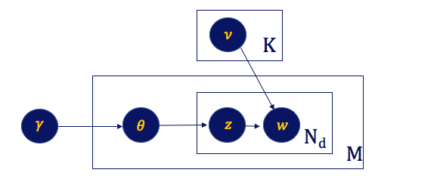
Latent Dirichlet Allocation
Corpus Entity
Collection of M documents
Document Entity
Sequence of N words
All reviews for single item
Word Entity
Each word in a document has its position
(SAC 2021) Tatev Karen Aslanyan
Notes:
There are three main entities in the LDA method, the Corpus entity, the Document entity, and the Word entity.
The first entity the entity of corpus represents a collection of all documents which in our case is the collection of all reviews
In this figure, which visualizes the LDA model, the corpus entity is represented by the large rectangle where the letter M refers to the number of documents that this corpora includes.
The second entity is the entity of documents which is a sequence of N words. In our setting we assumed that all reviews of a single item combined represent a single document. In the figure, the document entity is represented by the medium sized rectangle inside the large corpora entity where the Nd refers to the N words in document d.
The third and the last entity is the entity of word, represented by the circle in the right hand-side within the document entity, it is denoted by the letter w.
The idea is that each word gets assigned a position in a document.
Let us look the remaining parts of this figure. Next to the word entity, the circle with letter z refers to the topic z assigned to each word in document d. Next, the upper small rectangle represents the topic space with total of K topics, The theta circle inside the corpora represents the topic distribution of an item. The remaining 2 circles with letters gamma and nu are representing the parameters corresponding to the topic distribution and word distribution, respectively.

Slide 13
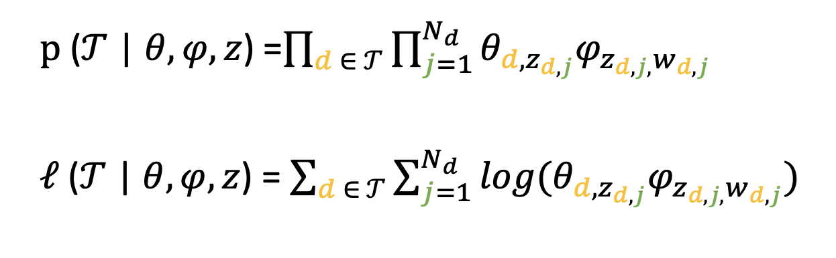
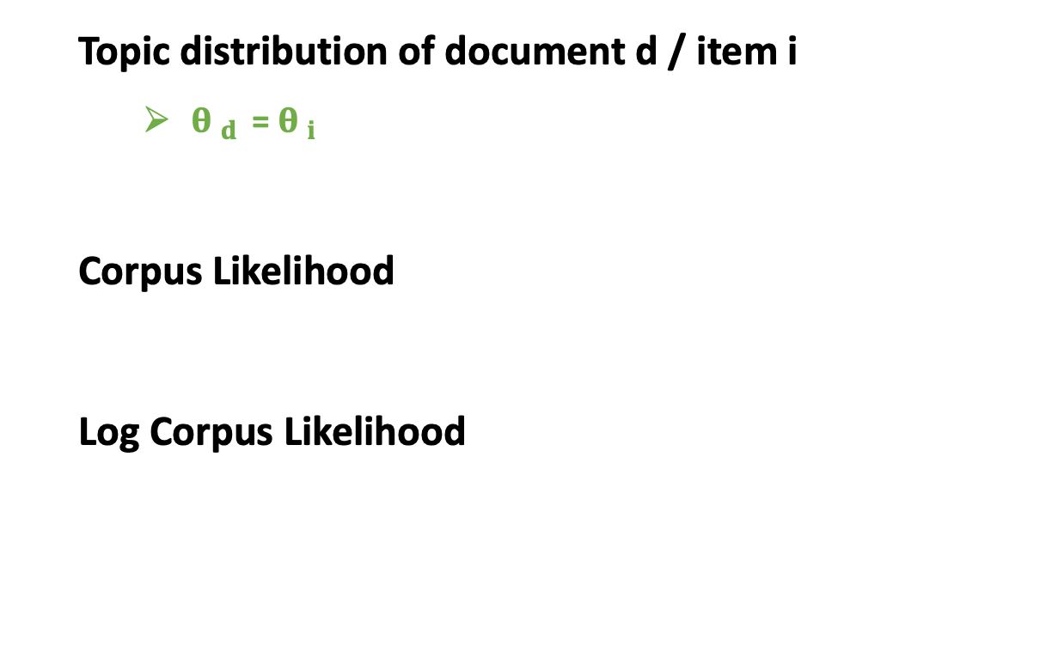
Latent Dirichlet Allocation
Topic distribution of document d / item i
${θ }_{d }$ = ${θ }_{i }$
Corpus Likelihood
Log Corpus Likelihood
(SAC 2021) Tatev Karen Aslanyan
Notes:
So, if we look at a single item, then theta_d stands for K-dimensional topic distribution of document d which is the same as item i, since we assumed that 1 document is collection of all review for item i. Thus, theta_i shows the extent to which each topic is discussed in all the reviews for item i.
When we generalize these entities to the entire training data consisting of reviews for many items or documents, then the conditional corpus likelihood can be described by the first expression.
So, the conditional corpus likelihood is equal to the cross product of the probability of a topic z being assigned to the jth word in document d, denoted by theta_d,zdj, and the probability of the jth word in document d conditional on selected topic.
Given that working with summations is more convenient than with products, we use the log-transformation of the Conditional Corpus likelihood function.

Slide 14
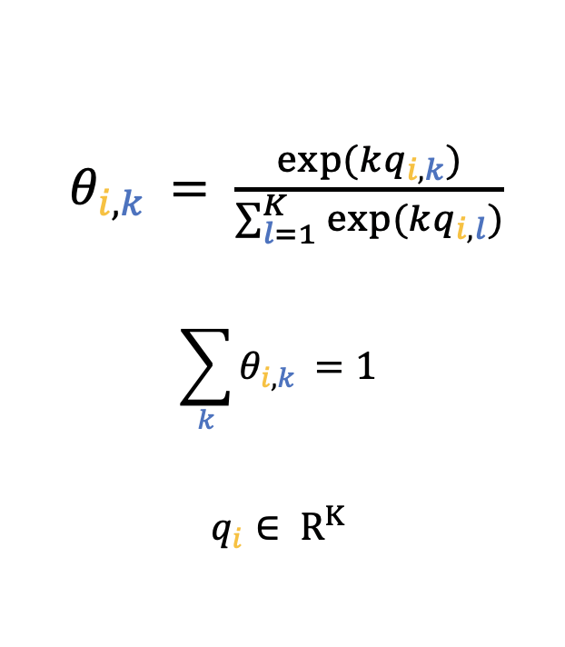
Combining LDA and LFM
Key assumption
Properties of a product correspond to certain topics
These topics will be discussed in product reviews
Positive correlation between item property and review topic
(SAC 2021) Tatev Karen Aslanyan
Notes:
Let us now discuss the third part of our methodology, where we combine the rating modelling technique LFM and the topic modelling technique LDA such that both ratings and textual reviews can be utilized when predicting all user-item ratings.
The key assumption is that if a product has a certain property, then it will correspond to a certain topic which will be discussed in the reviews of this item.
So, there is a positive correlation between the item property q_ik and review topic theta_ik but one can’t assume that the two are the same because the former can take arbitrary value while the latter is a stochastic vector. To do this, we use the following transformation to transform item features q_i to topic probability based on the fact that the original properties of both q_i and theta_i are satisfied: that is q_i is in R^K and sumoftheta_ik = 1.

Slide 15
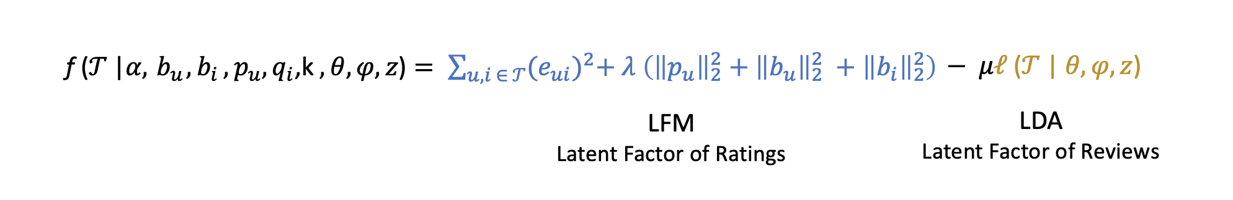
LDA-LFM
Objective function of LDA - LFM
(SAC 2021) Tatev Karen Aslanyan
Notes:
To summarize, let us look at the objective function of the proposed model that needs to be optimized. The left part of the expression corresponds to the Latent Factor Model whereas the right part of the expression corresponds to the log-likelihood of the corpus from LDA model.
So, we obviously make a trade-off between the importance of these two models and the parameter mu is portraying this trade-off. In some cases we might find textual reviews being a richer source of information than the ratings, or the other way around.

Slide 16
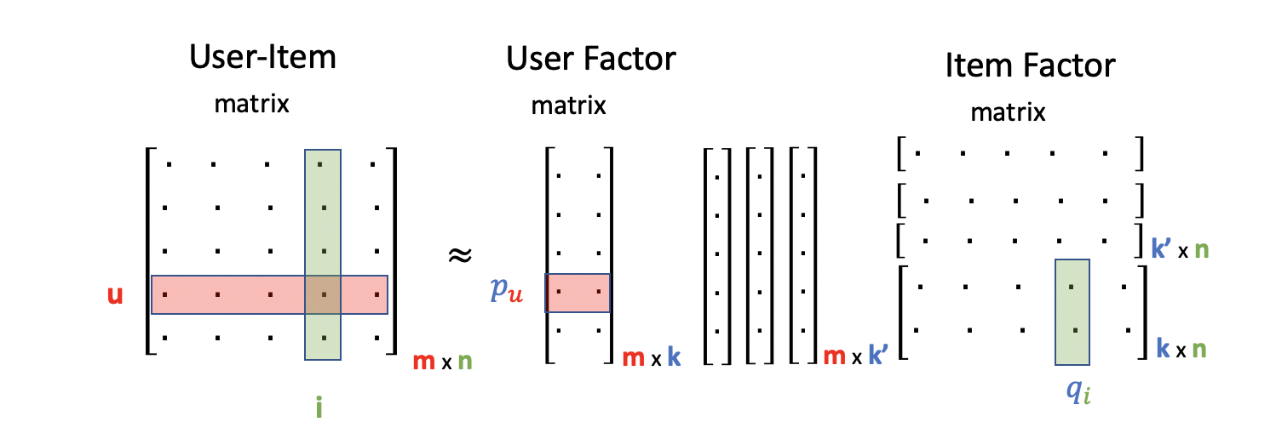

Adding extra user- and item-features
Extra features added to the LFM part of the model
$Extra user features added as extra columns$to User Factor Matrix
$Extra item features added as extra rows$to Item Factor Matrix
Number of extra user features shoud be equal to extra item features
(SAC 2021) Tatev Karen Aslanyan
Notes:
Let us now discuss the final technical part that forms the LDA-LFM hybrid recommender model, that is extending the algorithm in such a way that it will allow adding extra user and item specific features. For instance, in case of a movie recommender the genre of the movie or the director’s name can be considered as item features and information such as the age or gender of the customer can be considered as user features.
This figure illustrates an example of a case where 3 user-specific and 3 item-specific features are added to the model. So, what we propose is to add these extra information to the LFM part of the model. So, if we have 3 extra user characteristics we can represent them in the form of vectors, 3 vectors each with m rows for m customers which will act as additional 3 columns for the User Factor matrix. In case of item features, 3 rows with n columns will be added as additional rows to the Item Factor Matrix.
When generalizing this idea to random k’ extra features the idea stays the same, k’ user features can be added as extra columns to the User Factor Matrix and k’ item features can be added as extra rows to the Item Factor Matrix as long as the amount of extra user-features is equal to the extra item-features because of the underlying matrix multiplication between the User Factor and Item Factor matrices where the number of columns of the user matrix needs to be equal to the rows of the item matrix.

Slide 17
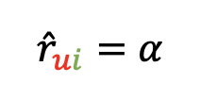
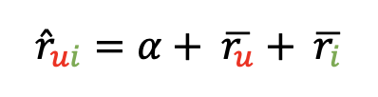
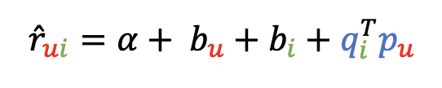
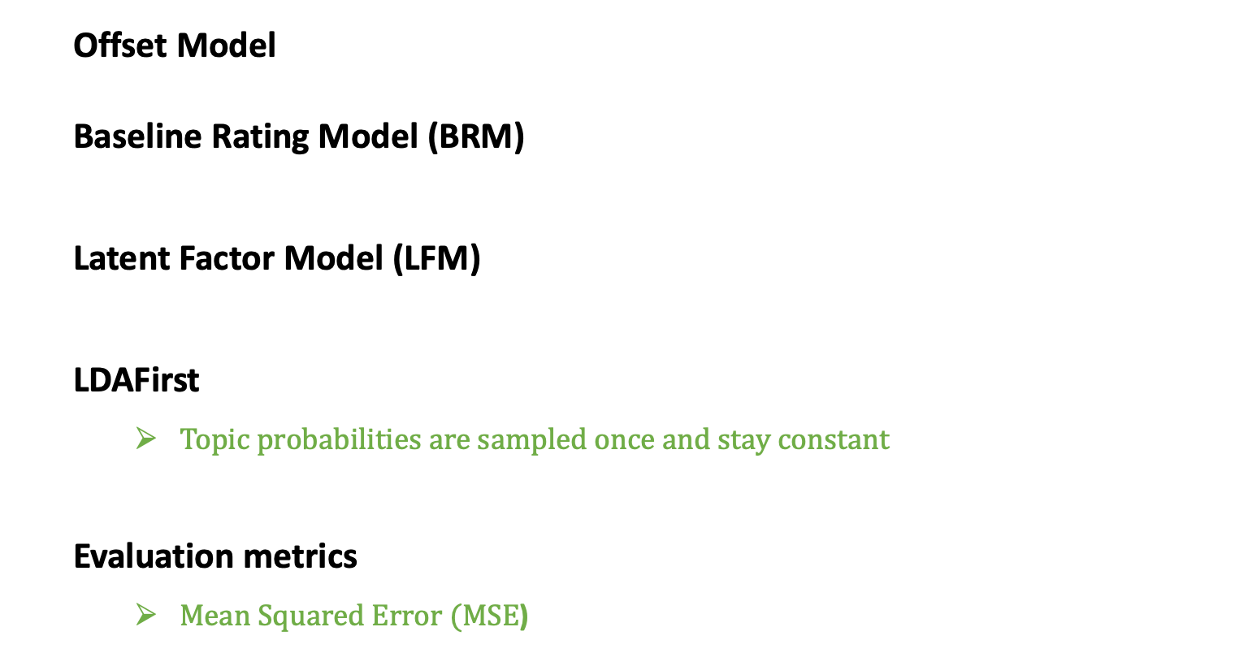
Evaluation
Offset Model
Baseline Rating Model (BRM)
Latent Factor Model (LFM)
LDAFirst
Topic probabilities are sampled once and stay constant
Evaluation metrics
$Mean Squared Error (MSE$)
(SAC 2021) Tatev Karen Aslanyan
Notes:
Having defined the proposed algorithm we also need ways to evaluate its performance. Firstly, we are interested in the prediction accuracy of the proposed model and we use Mean Squared Error as an accuracy measure. This accuracy measure takes only non-negative values and lower value of MSA is an indication of a better performing model.
To be able to judge the performance of the proposed algorithm, we compared it to 4 other baseline recommender algorithms. In the next few slides I will give the overview of these models.
The first baseline model is the Offset Model where the ratings are predicted by taking the global average of all ratings and are the same for all user and item combinations.
The second model that we use for the comparison purposes is the Baseline Rating Model where the rating for user u and item i is a function of global average ratings alpha, mean difference between the ratings of user u and the global average rating, and the mean difference between the ratings of user i and the global average rating.
The third baseline model, the LFM, is a standard Latent Factor model which we have seen before and discussed in detail as part of the proposed algorithm.
The fourth and final model that we use to compare it to the proposed LDA-LFM model is, the LDAFirst: this is a simpler version of the proposed algorithm based on topic modelling technique LDA and rating modeling technique LFM, with 1 key difference. In this method, as a starting point, the topic-probabilities per item are sampled from Dirichlet distribution, as it is done in a standard LDA, and these probabilities are used to determine item features qi. This process is done only once in the beginning. Hence also the name of the algorithm LDA First. So, the item properties stay constant during the optimization process and don’t get updated from iteration to iteration. Thus we don’t learn about item features during the iterative optimization process.

Slide 18
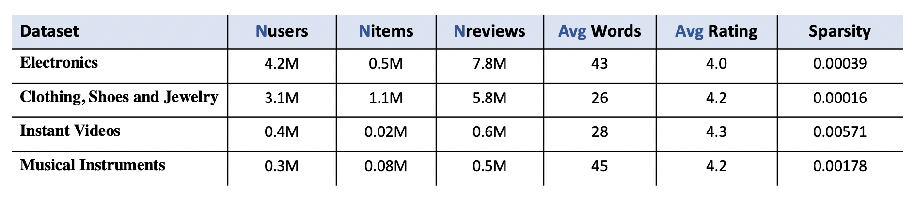
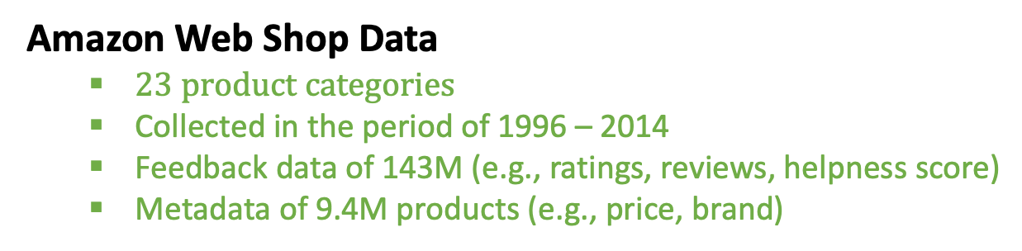
Applied Data Analysis on Amazon Data
Amazon Web Shop Data
$23 product categories$
Collected in the period of 1996 – 2014
Feedback data of 143M (e.g., ratings, reviews, helpness score)
Metadata of 9.4M products (e.g., price, brand)
(SAC 2021) Tatev Karen Aslanyan
Notes:
Having described our methodology and evaluation setting, let us now look at the data we used to perform the analysis. Our data comes from the largest e-commerce in the world, the Amazon web shop consisting of 23 product categories. Each of those 23 datasets consists of 2 parts:
Feedback Data consists of 143M products feedbacks in the form of ratings, textual reviews, and helpness score
and
Metadata about 9.4M products that describes various characteristics of these products such as: price, brand, etc.
The data is collected in the period of 18 years, from 1996 till 2014 and we filtered out the products with less than 5 customer feedback which left us with 42M products.
In general all datasets contain a large amount of missing ratings so the user-item ratings matrices are all very sparse. Let us look at this table which gives an overview of 2 largest and 2 smallest datasets corresponding to Amazon product categories used in this research. We can see that for instance the largest data set corresponding to the product category Electronics has 4.2 M users in it and 0.5 M items. This dataset also contains aropund 7.8M reviews with on avergae 43 words. The smallest dataset that corresponds to the prodict category Musical Instruments consists of 0.3M users and 0.08M items.This smallest dataset contains 0.5 M reviews with on average 45 words.

Slide 19
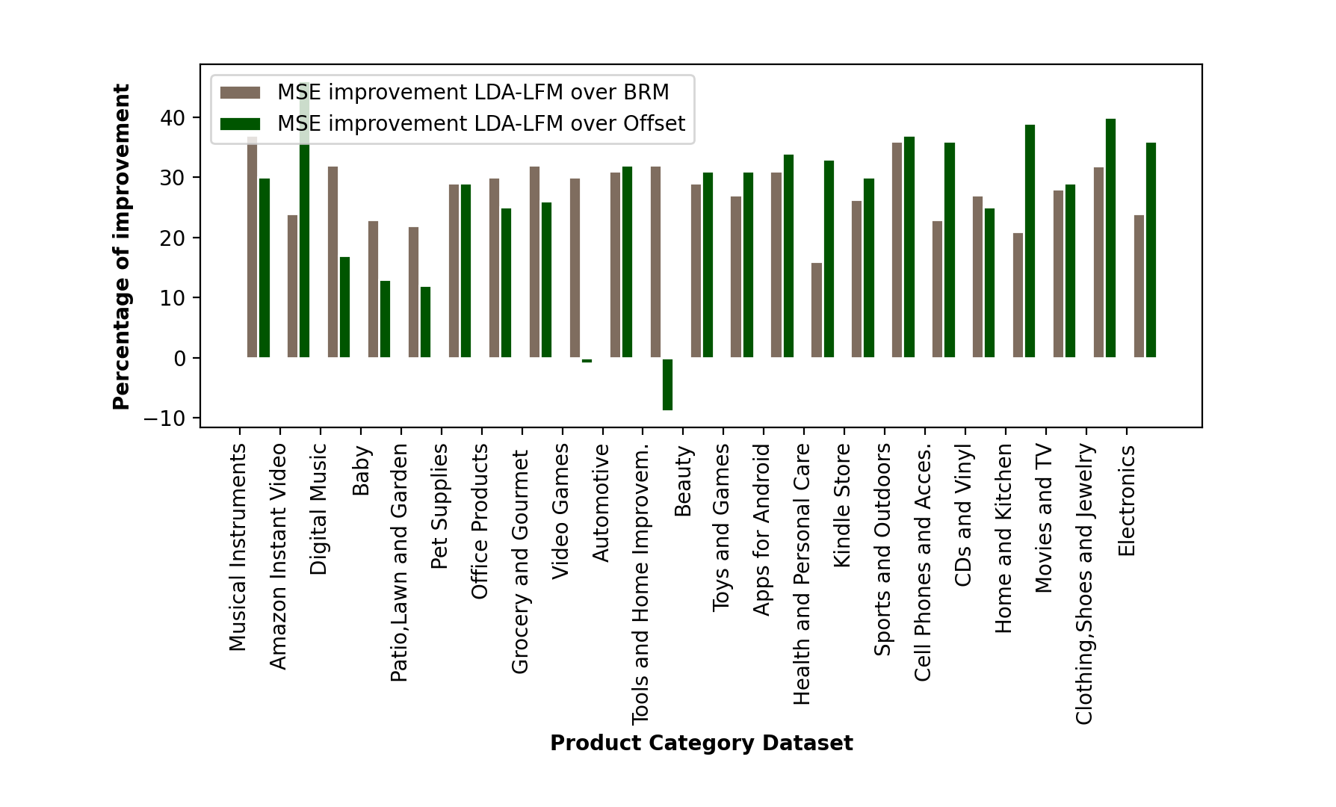
Performance of LDA – LFM
Comparing LDA-LFM to Offset
At least 10% improvement for all datasets except for Beauty
For some cases more than 30% improvement
Comparing LDA-LFM to BRM
At least 15% imrpovement for all datasets
For some cases more than 30% improvement
(SAC 2021) Tatev Karen Aslanyan
Notes:
Let us look at the performance of the proposed recommender algorithm LDA compared to the other 4 baseline models in terms of the MSE. We will firstly compare the proposed method to the first 2 baseline models, Offset and BRM. Then we will compare it to the remaining 2 baseline models, LFM and LDAFirst.
This figure shows the percentage decrease or improvement in MSE when comparing the proposed method LDA-LFM to the Offset model and BRM. Here the green bars show the percentage n MSE or improvement in prediction accuracy when using LDA-LFM instead of the Offset method, whereas the gray bars show the percentage decrease in MSE or improvement in the accuracy of the predictions when using LDA-LFM instead of the Baseline Rating Model. This is the case when we assume the number of latent factors is equal to 5. What we observe is that LDA-LFM improves the prediction accuracy with at least 10% compared to the Offset method for all datasets. When looking at the green bars we observe that for the majority of datasets the proposed method improves the accuracy of the predictions with at least 15% compared to the BRM model, and for the larger datasets this improvement can be more than 30% and even rich the 40% improvement.

Slide 20
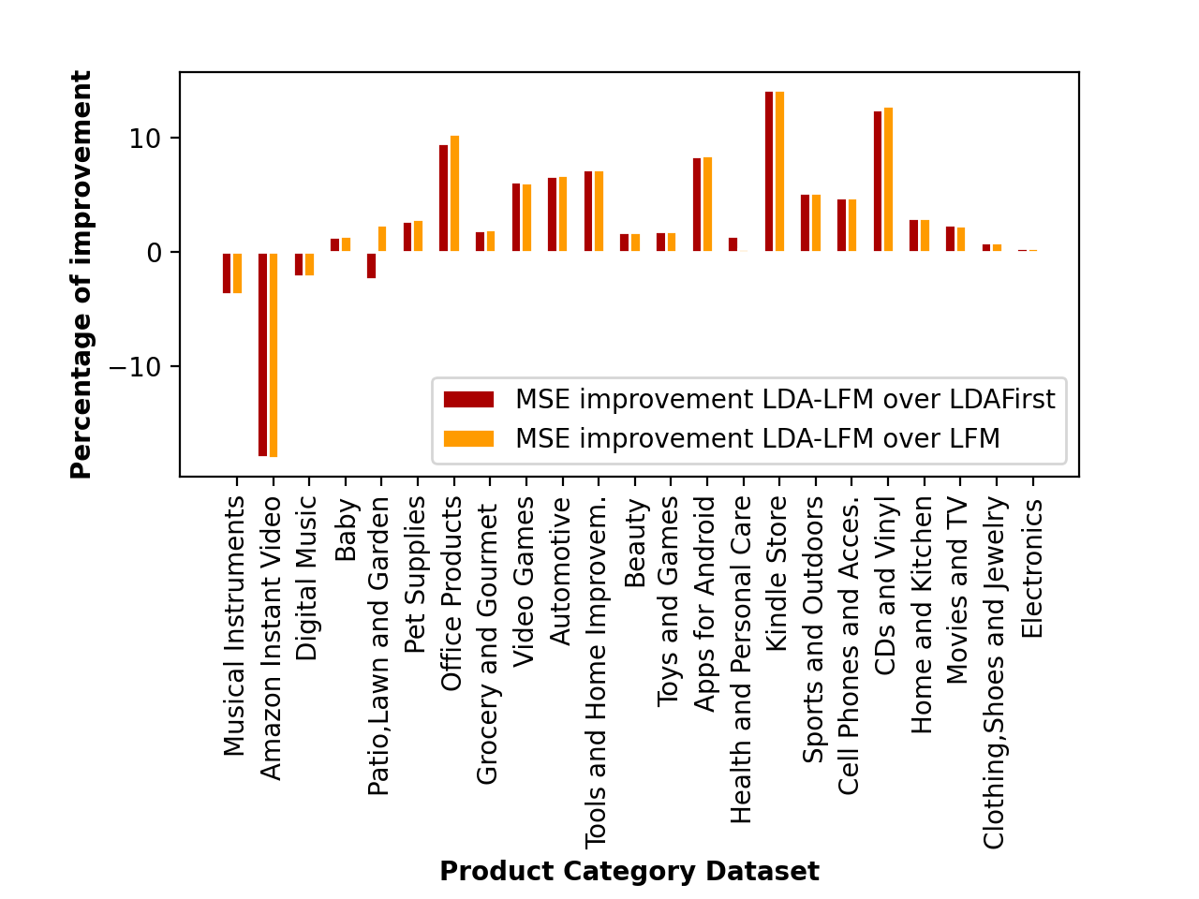
Performance of LDA – LFM
Comparing LDA-LFM to LFM
Improvement for all datasets except for smallest 3
Significant decrease in MSE for medium or large datasets (e.g. Kindle Store of 14%)
Comparing LDA-LFM to LDAFirst
Improvement for majority
Significant decrease in MSE for medium or large datasets (e.g. Kindle Store of 14%)
(SAC 2021) Tatev Karen Aslanyan
Notes:
Let us now look at the second part of the results represented by this figure which shows the percentage decrease in MSE or improvement in prediction accuracy when comparing the proposed method LDA-LFM to the standard LFM model and LDAFirst model. The orange bars show the percentage decrease in MSE when using LDA-LFM instead of the Standard LFM method, whereas the red bars show the percentage decrease in MSE when using LDA-LFM instead of the LDAFirst. What we observe that in both cases the majority of bars lie above the 0 level indication positive effect on the prediction accuracy when using the proposed method.
Looking at the orange bars we can see that for datasets except for smallest 3, Musical Instruments, Amazon Instant Video, Digital Music the LDA-LFM leads to increase in the prediction accuracy, in the case of Kindle Store dataset this improvement is 14%, which means that the proposed algorithm leads to 14% improvement in the prediction accuracy compared to the standard LFM model for this dataset. When looking at the red bars we observe that for almost all datasets except of the smallest 3 and Patio, Lawn and Garden, the LDA-LFM leads to improvement in the prediction accuracy compared to the LDAFirst method, and in some cases such as Kindle Store the improvement is 14%.
So, we see that the proposed model leads to an improvement in the prediction accuracy compared to the all 4 baseline cases for medium sized and large datasets. In this research we have also adding extra features to the model to find out whether adding extra user and item features leads to an improvement in the accuracy of the LDA-LFM model and we found that when adding extra features, then the proposed algorithm performs better than when no extra features are added.This again is especially true for medium and large datasets.

Slide 21
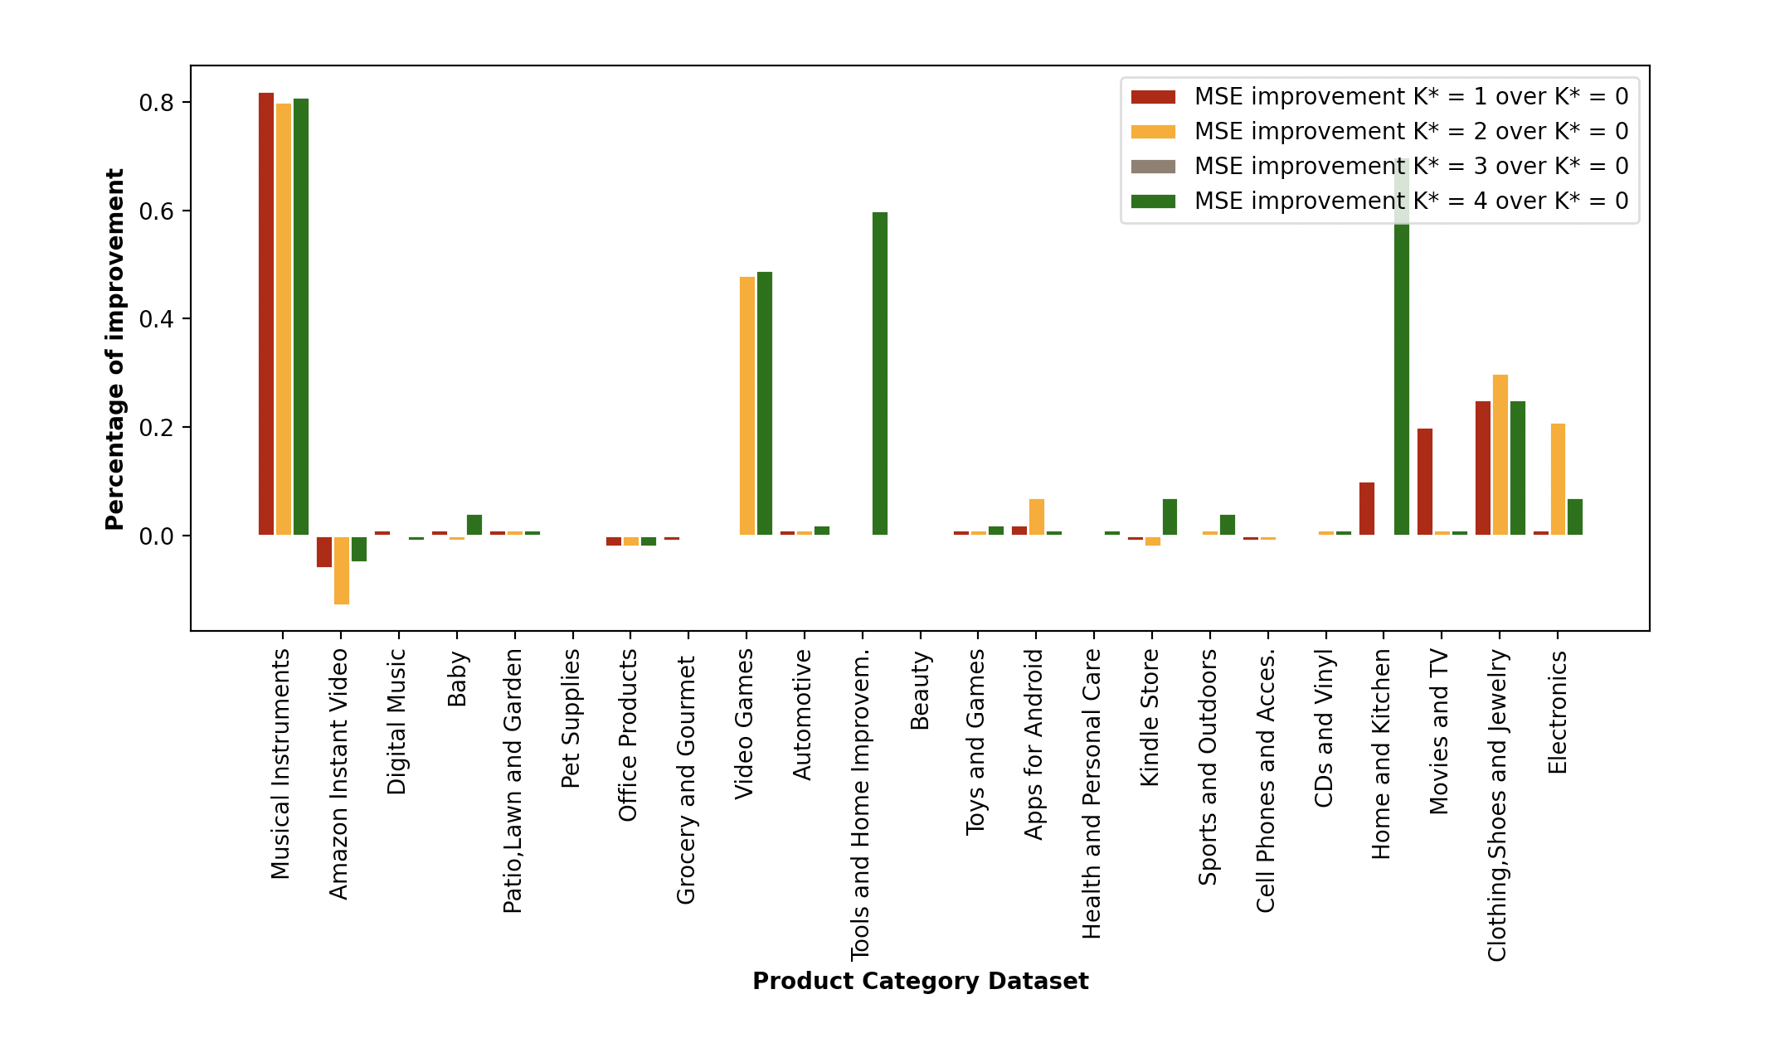
Performance of LDA – LFM
Adding extra features to LDA-LFM
Positive improvement for most of the datasets
More extra features have bigger impact for some datasets
(SAC 2021) Tatev Karen Aslanyan
Notes:
Now let’s look at the improvement in MSE when comparing the proposed LDA-LFM model with no extra features and with extra features. We added 1,2,3 and 4 features to see the impact of adding filters. This figure shows the improvement in the prediction accuracy compared to the base LDA-LFM model for those 4 different cases, the red bars correspond to the case when 1 extra feature is added to the model, orange when 2 extra features are added, gray when 3 features are added and green when 4 extra features are added. As we can see there are many positive bars which means that for all those cases it holds that adding extra features leads to higher prediction accuracy in terms of MSE. For almost all datasets we see positive effects or not very significant positive or negative effects. The green bars corresponding to the case where the most amount of extra features had been added are more visible suggesting that adding more features help to improve the prediction accuracy of the LDA-LFM model more.

Slide 22
Conclusion and Furture Work
Main Take-aways
Future Work
Using textual reviews improves the quality of the recommendations
Adding extra user- and item-features often improve recommendations
LDA-LFM is scalable (able to handle millions of observations)
Use sentiment analysis for textual review
(e.g., classifying topics-sentiments as positive or negative)
Combine implicit user and item features from reviews
(e.g., the gender or age of the reviewer)
(SAC 2021) Tatev Karen Aslanyan
Notes:
Today I presented to you the work where we proposed a new hybrid recommender system called LDA-LFM which utilizes the textual reviews in the Latent Factor Model, allowing to use ratings, textual reviews and adding extra user and item characteristics. Additionally, it is a scalable recommender able to handle millions of data points. We have seen evidence that this proposed algorithm performs better than other various type of algorithms both Collaborative Filtering type and Hybrid type.
We have seen that the model leads to more significant improvement in the prediction accuracy when the training data is of medium-sized or large.
Finally, we have found proposed an approach as part of the recommender algorithm that will allow adding extra user and item features.
As a continuation of this work one could consider using sentiment analysis for the textual reviews to further improve the quality of the recommendations by for instance classifying each topics-sentiments as negative or positive, by combining topic modelling, rating modelling, and sentiment analysis.
Additionally, one can combine implicit user and item features from reviews, which goes beyond the ratings.
Thank you for your attention.

Slide 23
References
Koren, Y., Bell, R., and Volinsky, C. (2009). Matrix factorization techniques for recommender systems. Computer, pages 30-37
Mooney, R., and Roy, L. (2000). Content-based book recommending using learning for text categorization. In the 5th ACM Conference on Digital Libraries (DL 2000), pages 195-204. ACM
McAuley, J. and Leskovec, J. (2013). Hidden factors and hidden topics: Understanding rating dimensions with review text. In 7th ACM Conference on Recommender Systems (RecSys 2013), pages 165-172. ACM
Ling, G., Lyu, M., and King, I. (2014). Ratings meet reviews, a combined approach to recommend. In 8th ACM Conference on Recomender Systems (RecSys 2014), pages 105-112. ACM
(SAC 2021) Tatev Karen Aslanyan

