Slide 1

Data Augmentation in a Hybrid Approach for Aspect-Based Sentiment Analysis
Tomas Liesting
Erasmus University Rotterdam
tomas.liesting@gmail.com
Flavius Frasincar
Erasmus University Rotterdam
fransincar@ese.eur.nl
Maria Trusca
Bucharest University of Economic Studies
maria.trusca@csie.ase.ro
Notes:
My name is Maria Trusca, I am Bucharest University of Economic Studies. The name of our work is “A Hybrid Approach for Aspect-Based Sentiment Analysis Using Deep Contextual Word Embeddings and Hierarchical Attention”. My colleagues are Daan Wassenberg, Flavius Frasincar and Rommert Dekker. They all are from Erasmus University Rotterdam

Slide 2
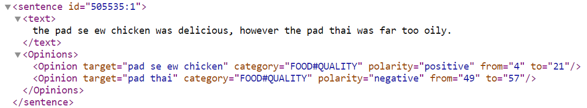
Introduction
Aspect-based sentiment analysis (ABSA) is described by tree major subtasks:
Aspect Category Detection;
Opinion Target Extraction;
Sentiment Classification.
Given that the most of the state-of-the-art methods for ABSA rely on supervised learning, data availability turns out to a significant issue, mitigated by:
Transfer learning;
Data augmentation.

Slide 3
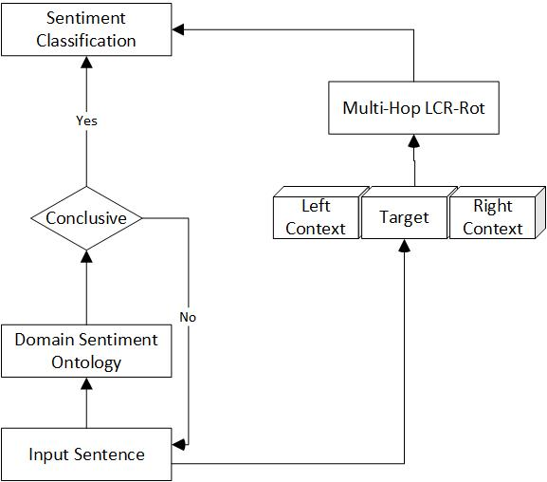
Two-step Approach
Domain Sentiment Ontology
Deep Neural Network

Slide 4
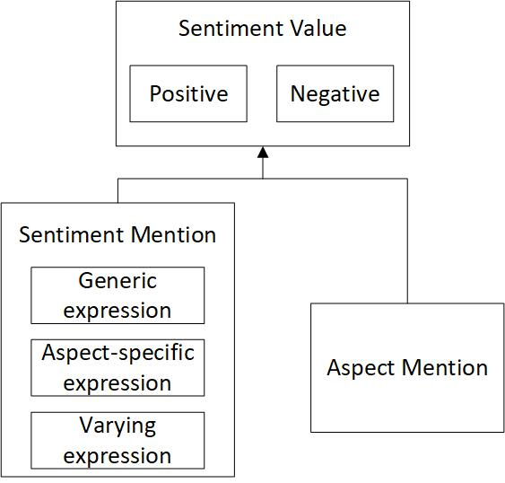
Domain Sentiment Ontology
The domain sentiment ontology has three main classes:
SentimentMention class represents sentiment expressions;
AspectMention class identifies aspects related to sentiment expressions;
SentimentValue class groups aspects in the Positive and Negative subclasses based on the type of sentiment expression.
Generic sentiment expression
Aspect-specific sentiment expression
Varying sentiment expression

Slide 5
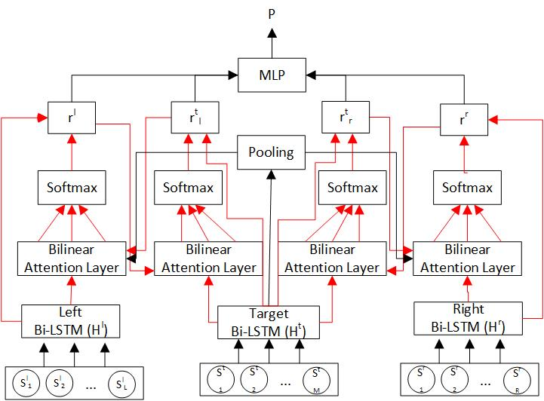
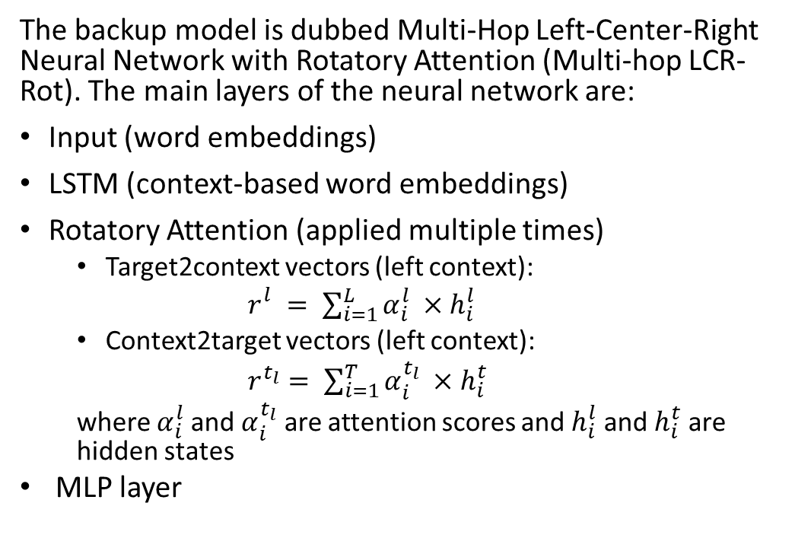
Deep Neural Network
The backup model is dubbed Multi-Hop Left-Center-Right Neural Network with Rotatory Attention (Multi-hop LCR-Rot). The main layers of the neural network are:
Input (word embeddings)
LSTM (context-based word embeddings)
Rotatory Attention (applied multiple times)
Target2context vectors (left context):
$r_{}^{l}= \sum_{i=1}^{L}{α_{i}^{l}} ×h_{i}^{l}$
Context2target vectors (left context):
$r^{t_{l}}= \sum_{i=1}^{T}{α_{i}^{t_{l}}} ×h_{i}^{t}$
where $α_{i}^{l}$ and $α_{i}^{t_{l}}$ are attention scores and $h_{i}^{l}$ and $h_{i}^{t}$ are hidden states
MLP layer

Slide 6
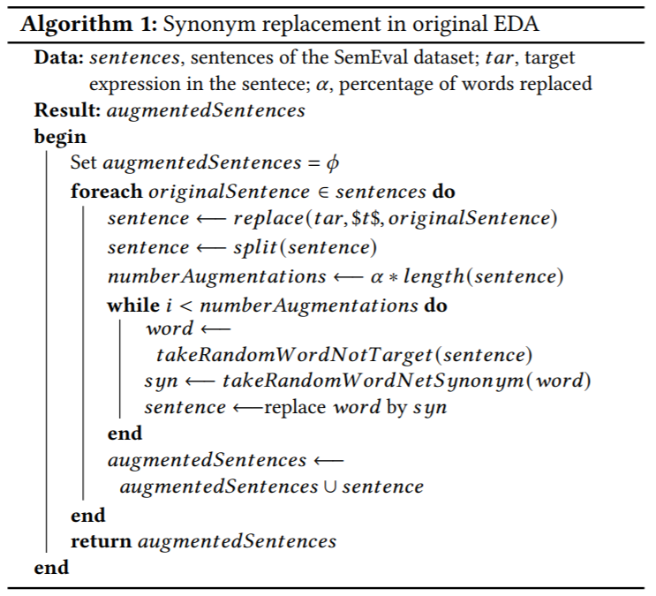
Easy data augmentation (EDA) for ABSA
Randomly inserting words:
Select a random word in a sentence;
Find a synonym in WordNet using NLTK;
Insert the synonym randomly.
Randomly deleting words:
Select a random word in a sentence and remove it.
Randomly swapping words:
Select two words in a sentence and swap them.
Synonym replacement:
Select a random word in a sentence;
Find a synonym in WordNet using NLTK;
Replace the selected word with the synonym.

Slide 7
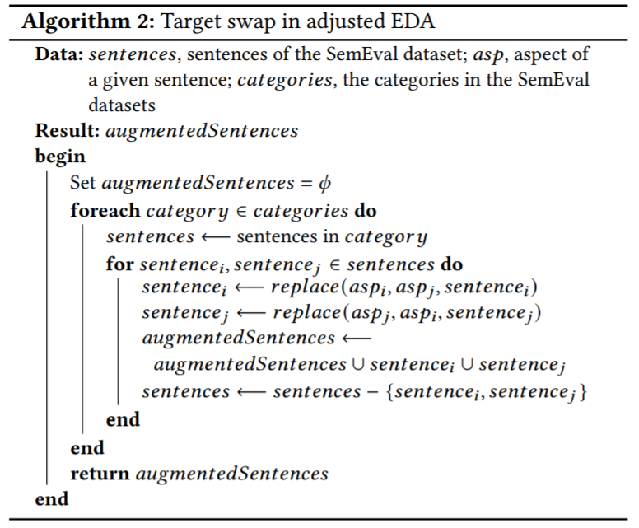
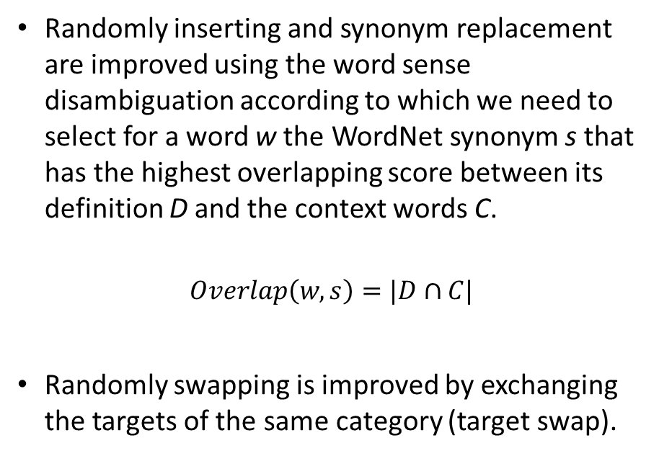
Adjusted EDA for ABSA
Randomly inserting and synonym replacement are improved using the word sense disambiguation according to which we need to select for a word w the WordNet synonym s that has the highest overlapping score between its definition D and the context words C.
$$Overlap\left(w,s\right)=|D∩C|$$
Randomly swapping is improved by exchanging the targets of the same category (target swap).

Slide 8
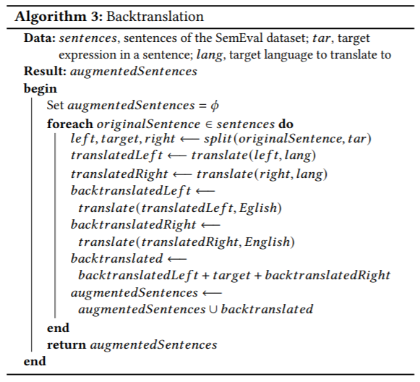
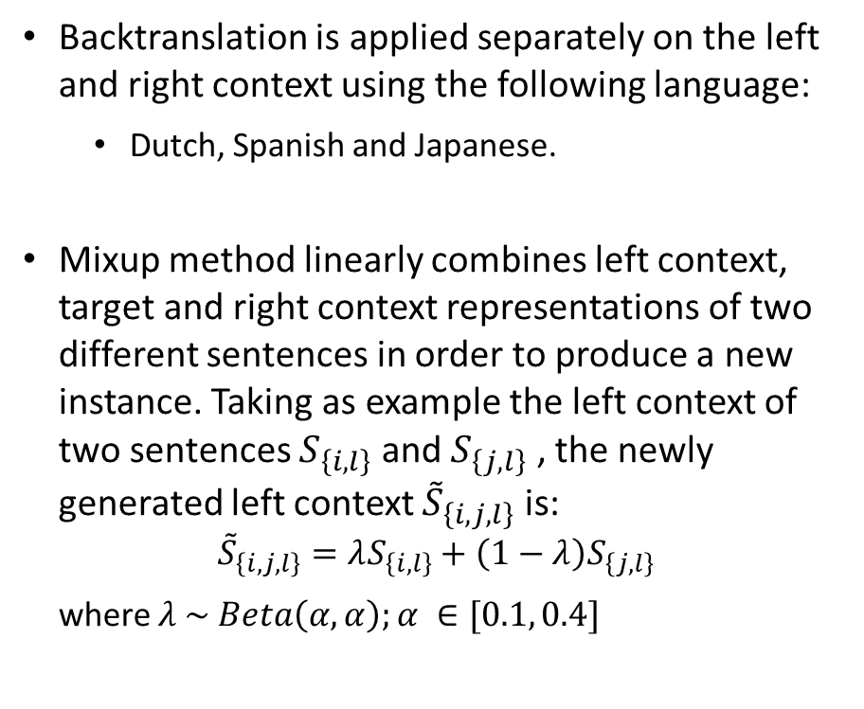
Backtranslation and Mixup for ABSA
Backtranslation is applied separately on the left and right context using the following language:
Dutch, Spanish and Japanese.
Mixup method linearly combines left context, target and right context representations of two different sentences in order to produce a new instance. Taking as example the left context of two sentences $S_{\left\{i,l\right\}}$ and $S_{\left\{j,l\right\}}$ , the newly generated left context ${\tilde{S}}_{\left\{i,j,l\right\}}$is:
$${\tilde{S}}_{\left\{i,j,l\right\}}=λS_{\left\{i,l\right\}}+\left(1−λ\right)S_{\left\{j,l\right\}}$$
where $λ \sim Beta\left(α,α\right);α ∈[0.1, 0.4]$

Slide 9
Results
Model | SemEval 2015 |  |  | Semeval 2016
 | Training acc. | Testing acc. | Augmented instances | Training acc. | Testing acc. | Augmented instances
HAABSA | 90.9 % | 77.9% | 0 | 85.7% | 83.9% | 0
HAABSA + EDA | 85.8% | 78.2% | 5116 | 96.2% | 84.1% | 7520
HAABSA + EDA adj. | 95.2% | 78.9% | 3837 | 96.5% | 84.4% | 5640
HAABSA + BT NL | 89.9% | 78.0% | 1278 | 78.9% | 83.8% | 1880
HAABSA + BT ES | 85.1% | 77.6% | 1278 | 82.0% | 84.3% | 1880
HAABSA + BT JA | 86.9% | 77.9% | 1278 | 81.3% | 84.4% | 1880
HAABSA mixup 𝛼 = 0.1 | 88.0% | 77.6% | 1278 | 80.8% | 83.8% | 1880
HAABSA mixup 𝛼 = 0.2 | 85.0 % | 77.9% | 1278 | 80.4% | 84.3% | 1880
HAABSA mixup 𝛼 = 0.3 | 89.2% | 77.9% | 1278 | 83.8% | 84.1% | 1880
HAABSA mixup 𝛼 = 0.4 | 82.8% | 77.9% | 1278 | 79.6% | 84.1% | 1880

Slide 10
Insights
Augmentation Type | Sentence 1 | Sentence 2
Original | The hostess is rude to the point of being offensive. | The waitress was very patient with us and the food is phenomenal!
EDA original random swap | Being hostess is rude to point of the offensive. | The waitress food very with patient us and the was is phenomenal!
EDA original synonym replacement | The hostess is rude to the breaker point of being nauseous. | The waitress was very patient with atomic number 92 and the food is phenomenal!
Adjusted EDA synonym replacement | The hostess is uncivil to the point of being unsavory. | The waitress was very patient with us and the nourishment is phenomenal!
Adjusted EDA Target Swap | Thee waitress is rude to the point of being offensive. | The hostess was very patient with us and the food is phenomenal!
Backtranslation Japanese | Of hostess it’s rude enough to cause discomfort. | Of waitress very patient and the food is amazing!
The original EDA methods usually seem to pollute the data;
The adjusted EDA methods mainly have the desired effect of creating new sentences with extra information;
The effectiveness of the backtranslation technique is limited by the translation engines that attempt to create a new sentence for each left / right context.

Slide 11
Conclusion
In this paper, we defined a data augmentation framework for ABSA. While techniques like backtranslation and mixup have modest performances, EDA and its adjusted version are more effective, increasing the testing accuracy as follows:
HAABSA + EDA: +0.3 p.p. (SemEval 2015), +0.2 p.p. (Semeval 2016);
HAABSA + adj. EDA: +1 p.p. (SemEval 2015), +0.5 p.p. (SemEval 2016).
Future work:
Identify sentences with the highest potential to increase the accuracy of augmentation techniques;
Improve the mixup technique (e.g., by means of selecting only sentences with similar lengths).

Slide 12

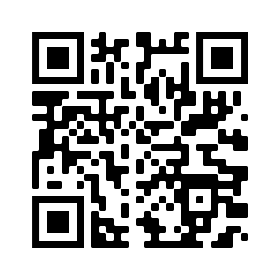
Thank you! For questions, please send an email to maria.trusca@csie.ase.ro

