Slide 1

Explaining a Neural Attention Model for Aspect-Based Sentiment Classification Using Diagnostic Classification
Lisa Meijer
Delft University of Technology
lhmeijer@tudelft.nl
Flavius Frasincar
Erasmus University Rotterdam
fransincar@ese.eur.nl
Maria Trusca
Bucharest University of Economic Studies
maria.trusca@csie.ase.ro
Notes:
My name is Maria Trusca, I am Bucharest University of Economic Studies. The name of our work is “A Hybrid Approach for Aspect-Based Sentiment Analysis Using Deep Contextual Word Embeddings and Hierarchical Attention”. My colleagues are Daan Wassenberg, Flavius Frasincar and Rommert Dekker. They all are from Erasmus University Rotterdam

Slide 2
Introduction
Aspect-based Sentiment Classification (ABSC): finds the sentiment label (positive, negative or neutral) at the aspect-level of the entity of interest.
Using Diagnostic Classification, we examine the inner working of a model designed for ABSC. Precisely, we check whether the internal layers of a model encode for each word of an opinion, relevant information.
We use a state-of-the-art ABSC model, the Left-Center-Right Rotatory Attention model with multiple hops (LCR-Rot-hop), proposed by Wallaart and Frasincar (2019).

Slide 3
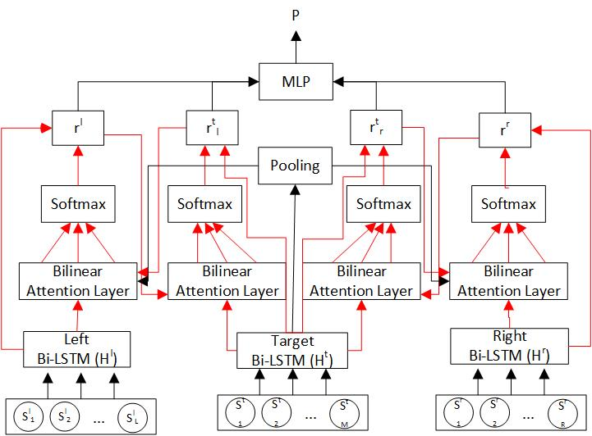
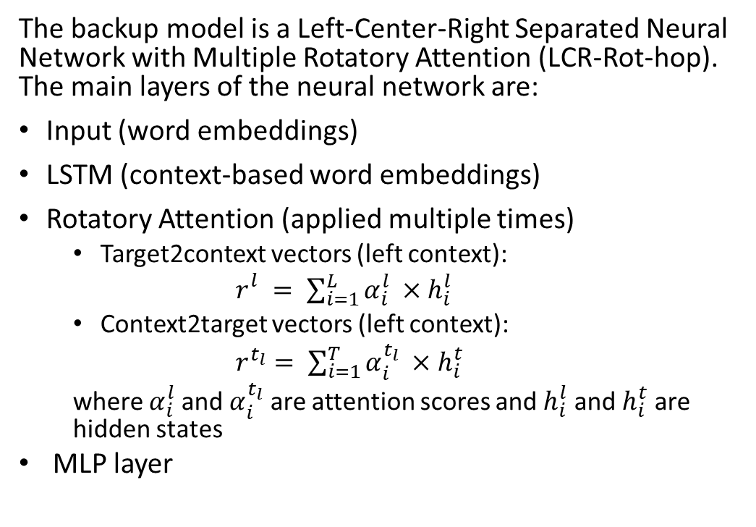
LCR-Rot hop
The backup model is a Left-Center-Right Separated Neural Network with Multiple Rotatory Attention (LCR-Rot-hop). The main layers of the neural network are:
Input (word embeddings)
LSTM (context-based word embeddings)
Rotatory Attention (applied multiple times)
  Target2context vectors (left context):
  $r_{}^{l}= \sum_{i=1}^{L}{α_{i}^{l}} ×h_{i}^{l}$
  Context2target vectors (left context):
  $r^{t_{l}}= \sum_{i=1}^{T}{α_{i}^{t_{l}}} ×h_{i}^{t}$
  where $α_{i}^{l}$ and $α_{i}^{t_{l}}$ are attention scores and $h_{i}^{l}$ and $h_{i}^{t}$ are hidden states
  MLP layer

Slide 4
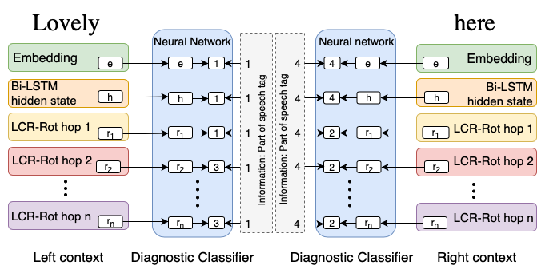
Diagnostic Classification
Using Diagnostic Classification, we keep track of the following information deemed useful at the word level for ABSC:
  part of speech;
  the presence of a relation with the aspect;
  the sentiment value;
  the sentiment value related to the aspect.
The context information is extracted from all the internal layers of the LCR-Rot-hop model:
  Embedding layer;
  Bi-LSTM hidden states;
  Context representations.

Slide 5
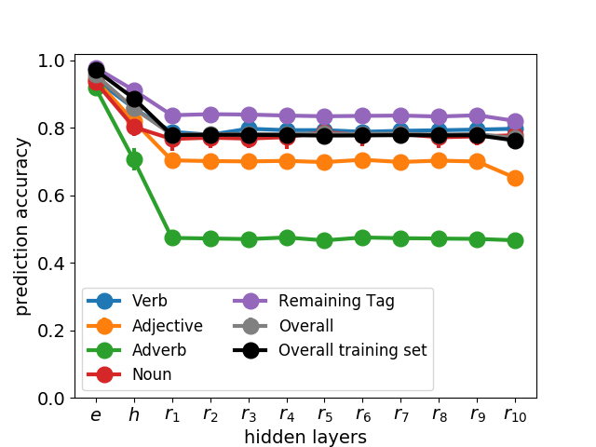
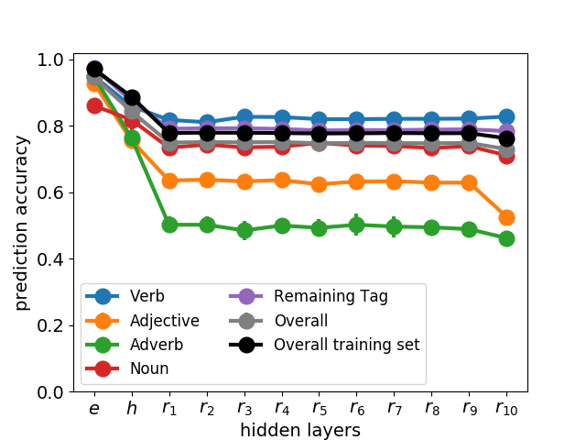
Diagnostic Classification for part-of-speech
Number of words per part-of-speech class
 | Correctly predicted training set | Correctly predicted test set | Incorrectly predicted test set
Noun | 4586 | 1211 | 278
Verb | 3631 | 1099 | 182
Adj. | 2058 | 569 | 128
Adv. | 4661 | 2338 | 264
Rem. | 14148 | 4848 | 908
Correctly predicted test set
Incorrectly predicted test set

Slide 6
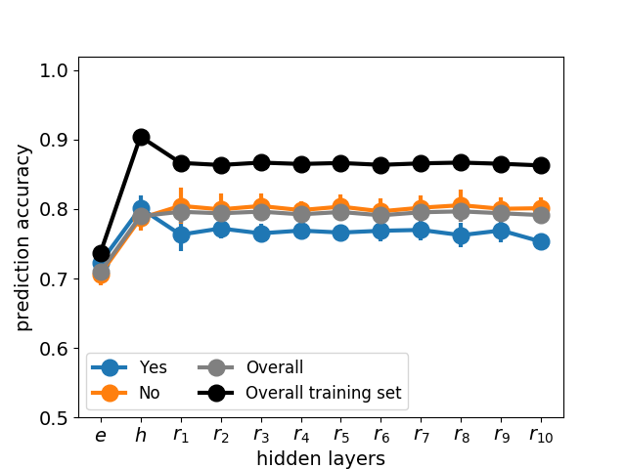
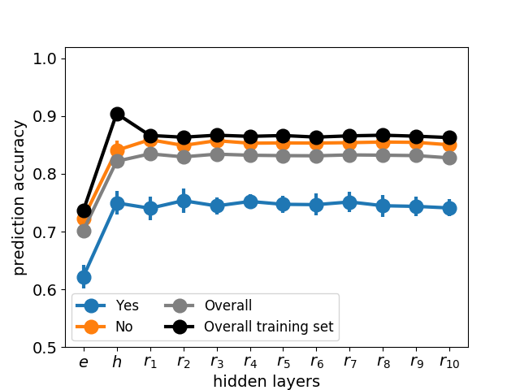
Diagnostic Classification for the presence of a relation with the aspect
Number of words per the presence of a relation with the aspect class
 | Correctly predicted training set | Correctly predicted test set | Incorrectly predicted test set
Yes | 6220 | 2070 | 364
No | 22864 | 7995 | 1397
Correctly predicted test set
Incorrectly predicted test set

Slide 7
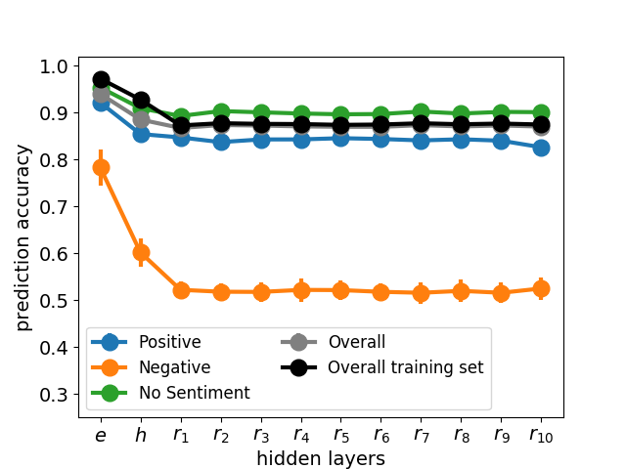
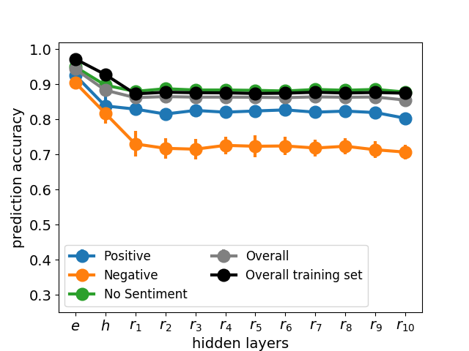
Diagnostic Classification for the sentiment value
Number of words per sentiment value class
 | Correctly predicted training set | Correctly predicted test set | Incorrectly predicted test set
Positive | 5583 | 1677 | 264
Negative | 1774 | 489 | 120
No Sentiment | 21727 | 7899 | 1377
Correctly predicted test set
Incorrectly predicted test set

Slide 8
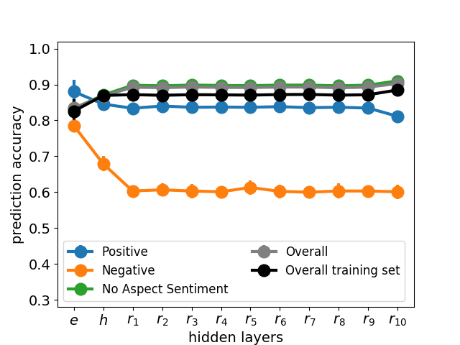
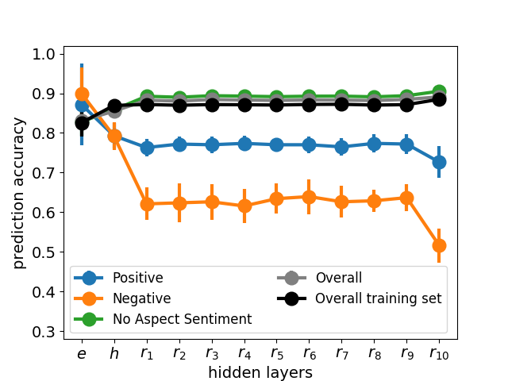
Diagnostic Classification for sentiment value of a word related to the aspect
Number of words per aspect-related sentiment value class
 | Correctly predicted training set | Correctly predicted test set | Incorrectly predicted test set
Positive | 1425 | 439 | 27220
Negative | 450 | 91 | 9524
No Sentiment | 57 | 38 | 1666
Correctly predicted test set
Incorrectly predicted test set

Slide 9
Conclusion
Using a state-of-the-art ABSC solution, we investigated how the model deals with the detection of the useful information for our task. We conclude that:
  The information like part-of-speech and the sentiment value is easier extracted by the first layers of the model;
  The more complex information like the presence of a relation with an aspect, and the aspect-related sentiment value is especially detected by the upper layers of the model.
Future work:
  Better specify the sentiment value, and the presence of a relation towards the aspect;
  Check more in-depth the effect of the sentiment-holder words, by running the LCR-Rot-hop model exclusively on them;
  Validate our inferences on other ABSC models and datasets.

Slide 10


Thank you!
For questions, please send an email to maria.trusca@csie.ase.ro

