Slide 1
Using Word Embeddings for Ontology-Driven Aspect-Based Sentiment Analysis
Flavius Frasincar*
frasincar@ese.eur.nl
* Joint work with Sophie de Kok
Notes:
Hi everybody! Welcome to my presentation. My name is Flavius Frasincar and I am an assistant professor at Erasmus University Rotterdam in the Netherlands. The title of my talk is Review-Level Aspect-Based Sentiment Analysis Using an Ontology and it presents joint work with Sophie de Kok, a master student from my university. In this talk I will describe a domain ontology-driven approach for aspect-based sentiment analysis at review-level. In order to extend the coverage of the domain ontology, I will extend our solution using word embeddings.

Slide 2
Contents
Motivation
Related Work
Data
Methodology
Evaluation
Conclusion
Notes:
The content of my talk has a classical structure. First I will motivate the need for this research, and after that I will present related work. Then I will explain the data used for our experiments and the proposed methodology to answer our research question. Last, I will give our evaluation results, main conclusions, and suggest ideas for future work.

Slide 3
Motivation
Due to the convenience of shopping online there is an increasing number of Web shops
Web shops often provide a platform for consumers to share their experiences, which lead to an increasing number of product reviews:
In 2014: the number of reviews on Amazon exceeded 10 million
Product reviews used for decision making:
Consumers: decide or confirm which products to buy
Producers: improve or develop new products, marketing campaigns, etc.
Notes:
I think most of us have used shopping online due to its convenience. Because of this, there is an increasing number of shops with a Web presence. These Web shops often have platforms to collect user experiences on their products and services by means of reviews. For example, in 2014, Amazon has collected more than 10 million reviews. This number is probably much larger for 2020. Reviews can be exploited for decision making. On the one hand reviews help consumers decide which products to buy and on the other hand they help producers improve their products or know on which popular product features to focus in marketing campaigns, just to give a few examples.

Slide 4
Motivation
Reading all reviews is time consuming, therefore the need for automation
Sentiment mining is defined as the automatic assessment of the sentiment expressed in text (in our case by consumers in product reviews)
Several granularities of sentiment mining:
Review-level
Sentence-level
Aspect-level (product aspects are sometimes referred to as product features): Aspect-Based Sentiment Analysis (ABSA):
Review-level [our focus here]
Sentence-level
Notes:
Because of the large number of reviews that are produced online, reading all these reviews, even for only one product, is not doable. Therefore the need to automate the extraction and summarization of information contained in reviews. A text mining field that has emerged in the last decade is sentiment mining, which means the automatic extraction and summarization of the sentiment expressed in text, in our case product reviews.
There are several granularities for sentiment mining, review-level, where the sentiment is computed for the whole review, sentence-level, where the sentiment is computed per sentence, and aspect-level, where the sentiment is computed per aspect of the entity of interest. The last one is called Aspect-Based Sentiment Analysis (or ABSA) and it can be of two types: review-level, where the sentiment is given per aspect in the whole review, and sentence-level, where the sentiment is given per aspect in a sentence. In this work we focus on Aspect-Based Sentiment Analysis at review-level.

Slide 5
Motivation
Aspect-Based Sentiment Analysis (ABSA) has two stages:
Aspect detection:
Explicit aspect detection: aspects appear literally in product reviews
Implicit aspect detection: aspects do not appear literally in the product reviews
Sentiment detection: assigning the sentiment associated to explicit or implicit aspects [our focus here]
Main problem:
In previous work we have proposed a hybrid approach to detect the sentiment for an aspect at sentence-level
How to find the sentiment for an aspect using a hybrid approach at review-level?
Notes:
Aspect-Based Sentiment Analysis has two stages. The first stage is aspect detection, which focuses on the extraction of aspects of the entity of interest from text. There are two types of aspect detection: explicit aspect detection, which extracts aspects that appear literally in the text; for example in the text “the screen is small”, the extracted aspect is “screen”, and implicit aspect detection, which extracts aspects that are implicit in the text; for example in the text “the phone is light”, the extracted aspect is <weight>. The second stage is sentiment detection, which is responsible for assigning the sentiment, for example positive or negative, associated to explicit or implicit aspects, and represents our main focus here.
In previous work, we have proposed a hybrid approach for aspect-based sentiment analysis at sentence-level, so in this work we focus on aspect-based sentiment analysis at review-level. Encouraged by the good results obtained by a hybrid solution in our previous work, the research question addressed here is: How to find the sentiment for an aspect using a hybrid approach at review-level?

Slide 6
Main Idea
Approach: A Two-Step Hybrid Approach for ABSA at review-level
Ontology-based reasoning
Machine learning (backup solution)
Ontologies advantages:
Deal with small training data
Use axioms to derive implicit information
But, ontologies have limited coverage:
Increase the hits of the ontology by exploiting similarities between lexical representations of ontology concepts and text words using their corresponding word embeddings
Notes:
As previously stated we focus on a hybrid approach for ABSA, more precisely on a two-step approach where the first step is ontology-based reasoning and the second step is machine learning, which acts as a backup solution for the first step.
We have opted for a domain ontology-based solution as domain ontologies present several advantages:
they are able to be used in contexts where there is little training data due to their ability to represent external domain knowledge;
and they make use of axioms that allow us to derive implicit information, that is information that is not explicitly present in text.
Nevertheless, domain ontologies also have limitations, for example they have limited coverage. In order to increase the ontology coverage, in this work, we propose to increase the number of ontology hits on text by computing similarities between lexical representations of ontology concepts and text words. For this purpose we use word embeddings, and if the cosine similarity between two word embeddings is higher than a certain threshold, a new ontology concept is found in text even if none of the concept lexical representations are present in text.

Slide 7
Related Work
(Aspect-Based) Sentiment Analysis [(AB)SA]:
Knowledge Base Reasoning:
(Agarwal et al., 2014): use a domain ontology extracted from a common-sense knowledge network (ConceptNet) and a semantic lexicon (WordNet), sentiment lexicons (SenticNet, SentiWordNet, and General Inquirer), and a dependency parser to link the previous two [review-level ABSA and review-level SA]
Machine Learning:
(Tang et al., 2016): use word embeddings and handcrafted features (e.g., capitalization, emoticons, elongations) in conjunction with a support vector machine (SVM) [Twitter-level SA]
Hybrid:
(Schouten and Frasincar, 2017): use a two-step approach, first a handcrafted domain ontology reasoning and, if this is inconclusive then an SVM (backup) employing a bag-of-words (BoW), current aspect, and Stanford sentence sentiment [sentence-level ABSA]
Notes:
Works on Aspect-Based Sentiment Analysis can be classified in three types. The first type is Knowledge Base Reasoning, for example, in the work by Agarwal et al. from 2014, a domain ontology is extracted from a common sense knowledge network, Concept Net, and a semantic lexicon, WordNet. In addition three sentiment lexicons, SenticNet, SentiWordNet, and General Inquirer, and a dependency parser that links the domain ontology with the sentiment lexicons is used to compute the sentiment per aspect at review-level first, and then aggregate these sentiments to obtain one global sentiment at review-level.
The second type is Machine Learning, for example the work by Tang et al. from 2016 uses word embeddings and handcrafted features as capitalization, emoticons, and elongations (that is repetition of characters) as features for a support vector machine to compute twitter-level sentiment.
The last type is Hybrid, for example in our previous work we have proposed a two-step approach where first a handcrafted domain ontology reasoning takes place and, in case that this is inconclusive, an SVM is used as backup with a bag-of words (BoW), the current aspect, and the Stanford sentence sentiment score as features to compute the aspect-based sentiment analysis at sentence-level.

Slide 8
Data
SemEval-2016 dataset: restaurants reviews
Training set:
335 reviews:
1,435 review-aspect pairs
Test set:
90 reviews:
404 review-aspect pairs
Each review-aspect pair is annotated with sentiment: positive, negative, neutral, or conflict
A review can contain multiple aspects
Task: detect the aspect-based sentiment at review-level
Notes:
In this work we make use of a standard dataset, the SemEval-2016 dataset, where SemEval is the International Workshop on Semantic Evaluation that organizes annually various text mining challenges. More precisely we make use of the Task 5, Subtask 2 of SemEval-2016 which aims to find the sentiment with respect to aspects at review-level.
The dataset is composed of restaurant reviews. In has been split in a training set that has 335 reviews containing 1,435 review-aspect pairs, and a test set that has 90 reviews containing 404 review-aspect pairs. Each review-aspect pair is annotated for sentiment: positive, negative, neutral, or conflict. The conflict sentiment is used where the dominant sentiment is unclear. Each review can have one or more aspects associated. The considered task is to detect the aspect-based sentiment at review-level.

Slide 9
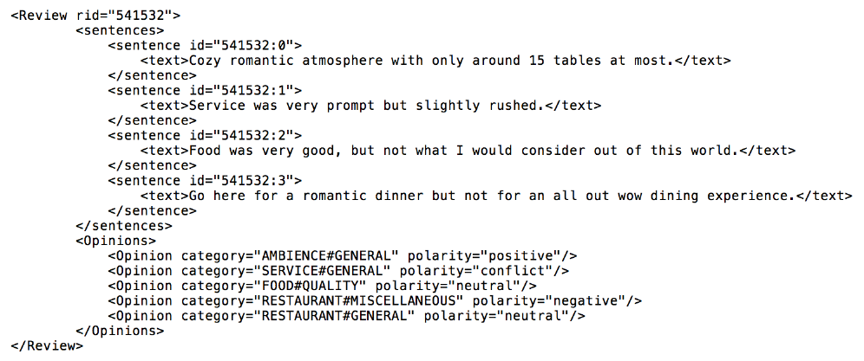
Example
Notes:
Here you can see an example of a review composed of four sentences and five opinions that represent the aspects, or better said, aspect categories found in the review and their associated sentiments. For example because of the sentence “Cozy romantic atmosphere with only around 15 tables at most.”, for the aspect category “AMBIENCE#GENERAL” the associated sentiment is “positive”, while because of the sentence “Service was very prompt but slightly rushed”, for the aspect category “SERVICE#GENERAL” the sentiment is “conflict” as obviously there is no clear dominant sentiment, the user expressing both positive and negative sentiment with respect to the experienced service.

Slide 10
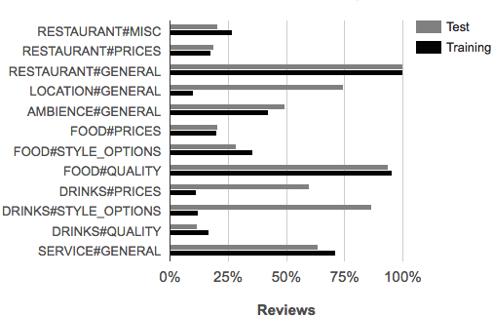
Frequencies of Aspects in Reviews
RESTAURANT#GENERAL is always present in all reviews
FOOD#QUALITY is also almost always present in all reviews
Notes:
In this graph you can see displayed the frequencies of aspects in the reviews for both the training and the test datasets. The first observation is that the aspect distributions for the training and test datasets are relatively similar. The second observation is that the frequencies of aspects are unbalanced, with the RESTAURANT#GENERAL aspect being present in all the reviews and being closely followed by the FOOD#QUALITY aspect, and the DRINK#QUALITY aspect being the least represented aspect in both training and test datasets.

Slide 11
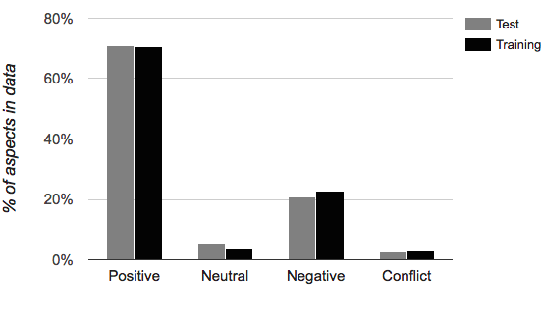
Frequencies of Sentiment in Reviews
Unbalanced sentiment distribution
Positive labels have frequency of approximately 70% of review-aspect pairs
Notes:
This is a graph about the frequencies of sentiment in reviews. One can notice that the sentiment distribution is unbalanced. The most represented sentiment is the positive sentiment with a frequency of approximatively 70% of the review-aspect pairs. The neutral and conflict sentiments are poorly represented in our dataset.

Slide 12
Word Embedding Data
Google News:
Pretrained word embeddings
100 billion words, 3 million word vectors (300 dimensions) using skip-gram word2vec
Yelp Dataset Challenge Round 9 (2017):
4.1 million reviews
Filter out:
Non-restaurant reviews (using business ID)
Non-English reviews (using language-detection software)
95,437 English restaurant reviews (1,779 restaurants) with 11 million words
Processed using the word2vec implementation of deeplearning4j (our code is written in Java)
Notes:
We have used two approaches to obtain word embeddings.
In the first approach we have employed the pretrained Google News word embeddings obtained using the skip-gram model of word2vec. These embeddings are based on 100 billion words and have been computed for 3 million words, each embedding having a dimension of 300. Please note that this is a large general text corpus.
In the second approach we have used the Yelp Dataset Challenge Round 9 from 2017. It is based on 4.1 million reviews from which we filtered out non-restaurant reviews using a solution based on looking up the business identifiers in the annotated data business categories. We also filtered out non-English reviews using language detection software as our domain ontology has lexical representations only for the English language. In total we have collected 95,437 English restaurant reviews from 1,779 restaurants containing 11 million words. As our code is written in Java we have used the word2vec implementation from deeplearning4j.

Slide 13
Methodology – Ontology
The domain ontology has three main classes:
Sentiment: has three main subclasses: Positive, Negative, and Neutral
AspectIndicator: has many subclasses, one for each aspect indicating expression (e.g., Waiter)
The aspect relation links an AspectIndicator class with its corresponding aspect (e.g., Waiter ⊑ ∃aspect.{‘SERVICE#GENERAL’})
The lex relation links an AspectIndicator to a lexical representation (e.g., ∃lex.{“waiter”} ⊑ Waiter)
SentimentWord: has four types of subclasses
Type 1: Words that have always the same sentiment and are independent of an aspect (e.g., ‘good’)
Type 2: Words that belong only to one aspect and have one sentiment (e.g., ‘helpful’ belongs only to ‘SERVICE#GENERAL’ and is positive)
Notes:
Our methodology has at its core a domain ontology that has three main classes. The first class is the Sentiment class and has three main subclasses: Positive, Negative, and Neutral. The second class is the AspectIndicator class, which has many subclasses, one for each aspect indicating expression, one example being Waiter. Each AspectIndicator is linked by means of the property aspect to the corresponding aspects. For example, the AspectIndicator Waiter is linked to the aspect SERVICE#GENERAL. Also, each AspectIndicator is linked by means of the lex property to the corresponding lexical representations. For example, the AspectIndicator Waiter is linked to the lexical representation “waiter”.
The third class is the SentimentWord and it represents the sentiment words grouped in four types: Type 1, which represents the words that have only one sentiment and apply to all aspects, for example “good”, Type 2, which represent words that are associated to only one aspect and have only one sentiment, for example ‘helpful’ is associated only to the aspect SERVICE#GENERAL and denotes only the positive sentiment.

Slide 14
Methodology – Ontology
Type 3: Words that belong to more aspects but not to all and are always positive, negative, or neutral (e.g., ‘delicious’ belongs to ‘DRINKS#QUALITY’ and ‘FOOD#QUALITY’ and is always positive)
Type 4: Remaining sentiment words, which are words that are positive, negative, or neutral depending on the context (e.g., Fries $⊔$ Cold ⊑ Negative and Beer $⊔$ Cold ⊑ Positive)
Ontology statistics:
3 Sentiments
95 AspectIndicators
141 SentimentWords
10 ontology sizes are created: 10%...100% where the ratio of AspectIndicators and SentimentWords is kept the same, in order to perform sensitivity analysis when word embeddings are also employed
Notes:
Type 3, which represents the words that are associated to more than one aspect but not all aspects, and are always positive, negative, or neutral, for example ‘delicious’ is associated to ‘DRINKS#QUALITY’ and ‘FOOD#QUALITY’, and denotes always positive sentiment, and last, Type 4, which represents the remaining sentiment words, which are words denoting positive, negative, or neutral sentiment depending on the context. For example, Fries in conjunction with Cold yields Negative sentiment, but Beer in conjunction with Cold yields Positive sentiment.
The ontology is composed of 3 Sentiments, 95 AspectIndicators, and 141 SentimentWords for the restaurant domain. We have also created 10 ontologies by sampling 10% until 100% of the ontology data in steps of 10% in order to perform sensitivity analysis with respect to the size of the ontology for the word embedding-based solutions. For the sampling process we kept the ratio of AspectIndicators and SentimentWords the same.

Slide 15
Methodology – Word Embedding
We used word2vec:
Continuous Bag-of-Words (CBOW): faster, better for frequent words
Skip-gram: works well with small amounts of data, better for infrequent words
Approximations of the loss function:
Hierarchical softmax: amenable to incremental learning (adding new data), better for infrequent words [our choice (in deeplearning4j)]
Negative sampling: better for frequent words, better for low dimensional vectors
Optimization:
Stochastic gradient descent (SGD) with backpropagation (BPP)
Notes:
To produce word embeddings we have used word2vec developed at Google by Tomas Mikolov and his team. Word2vec comes in two flavors: Continuous Bag-of-Words (which is abbreviated CBOW) and skip-gram, depending on the chosen context and prediction. CBOW is faster and better for frequent words, while skip-gram works better with small amounts of data and better copes with infrequent words.
In order to speedup calculations two approximations of the loss function have been proposed: hierarchical softmax, which is better amenable for incremental learning (by reusing the hierarchy) when new data is provided and better deals with infrequent words, and negative sampling, which is better coping with frequent words and low dimensional vectors. As our dataset has many infrequent words we have opted for hierarchical softmax as our loss function approximation. As optimization technique word2vec uses the stochastic gradient descent with backpropagation, which is a standard optimization technique employed in neural networks.

Slide 16
Methodology – Algorithm
The algorithm has two steps:
Ontology-based reasoning
Machine learning (backup solution)
Ontology-based reasoning:
Determine the ontology hits: words that represent ontology concepts or are related to words that represent ontology concepts (uses a similarity threshold $t$ for the cosine between word embeddings)
Determine the ontology scores:
For each sentiment word type $i$ we compute:
$p_{i}$: number of positive sentiment hits
$n_{i}$: number of negative sentiment hits
$t_{i}$: number of neutral sentiment hits
(based on previous work we flip the sentiment of a word if one of the previous two words is a negation word)
Notes:
The proposed algorithm has two steps: ontology-based reasoning and machine learning as the backup solution. I will first focus on the ontology-based reasoning step. The first step in ontology-based reasoning is to determine the ontology hits, where hits are given by text words that represent ontology concepts or are related to words that represent ontology concepts (for this last case we make use of a threshold $t$ and the cosine similarity between word embeddings). The second step is to determine the ontology scores, where, for each sentiment word type$i$ we compute $p_{i}$, the number of positive sentiment hits, $n_{i}$, the number of negative sentiment hits, and $t_{i}$, the number of neutral sentiment hits.
Using results from our previous work we flip the sentiment of a word if one of the previous two words is a negation word.

Slide 17
Methodology – Algorithm
The sentiment hits per sentiment word type are determined as follows:
Type 1: For each sentiment word of type 1 check if a grammatical dependencies-based word window of size 2$ω+1$ words centered at the current sentiment word (that is why $+1$) contains an aspect indicator referring to the current aspect; if yes, add the corresponding sentiment hit
Type 2: For each sentiment word of type 2 check if there is a grammatical dependency to an aspect indicator referring to the current aspect; if yes, add the corresponding sentiment hit
Type 3: For each sentiment word of type 3 check if there is a grammatical dependency to an aspect indicator referring to the current aspect; if yes, add the corresponding sentiment hit (same as for type 2)
Type 4: For each sentiment word of type 4 check if a word window of size 2$ω+1$ words centered at the current sentiment word (that is why $+1$) contains an aspect indicator referring to the current aspect (same as for type 1); if yes, use the ontology axioms to determine the corresponding sentiment hit
Notes:
The sentiment hits per sentiment word type $i$ are determined using the following procedure:
For each sentiment word of type 1, we analyse a grammatical dependencies-based word window of size $2ω+1$ words centered at the current sentiment word (1 represents the current sentiment word and we consider $ω$ words to the left of the current word and $ω$ words to the right of the current word in the grammatical dependency graph); if this window has an aspect indicator referring to the current aspect we add the corresponding sentiment hit;
For each sentiment word of type 2, we check if there is a grammatical dependency to an aspect indicator referring to the current aspect; if this is the case we add the corresponding sentiment hit;
For sentiment words of type 3 the procedure is the same as for the type 2 words;
For each sentiment word of type 4 we use a similar window as for type 1 around the sentiment word; if we find an aspect indicator referring to the current aspect in this window we employ the ontology axioms to determine the corresponding sentiment hit.

Slide 18
Methodology – Algorithm
For each sentiment class (positive, negative, and neutral) produce aggregated scores:
$$P=w_{1}p_{1}+w_{2}p_{2}+w_{3}p_{3}+w_{4}p_{4} \\ N={ϑ(w}_{1}n_{1}+w_{2}n_{2}+w_{3}n_{3}+w_{4}n_{4}) \\ T=w_{1}t_{1}+w_{2}t_{2}+w_{3}t_{3}+w_{4}t_{4}$$
where:
$w_{i}$: represents the weight associated to sentiment word type $i$ (positive real number)
$ϑ$: represents the effect of negative sentiment words with respect to positive words (positive real number)
Determine the ontology-based sentiment:
If $P≥N+ε$ then positive ($ε$ accounts for sentiment border cases)
If $P≤N−ε$ then negative ($ε$ accounts for sentiment border cases)
If $N−ε <P<N+ε$and $T≠0$ then neutral
Otherwise compute the sentiment using machine learning (backup)
Notes:
In the third step, we compute aggregated scores for each sentiment class (positive, negative, and neutral). These scores are weighted sums of the previously computed number of positive hits, negative hits, and neutral hits for each of the four sentiment word types. In addition to the weights denoted by $w$, we use the parameter $ϑ$ that represents the effect of negative sentiment words relative to the positive sentiment words as our classes are unbalanced. All weights and the parameter $ϑ$ are positive real numbers.
In the four and last step, we compute the ontology-based sentiment as follows:
If the $positive score is bigger or equal than the negative score+ε$ then we produce a positive label ($ε$ accounts for difficult cases at the border between the positive and negative classes);
If the $positive score is smaller or equal than the negative score−ε$ then we produce a negative label;
If the $positive score is between the negative score−ε and the negative score+ε$and $T$ is not null then we produce the neutral label;
In all other cases, we compute the sentiment using the machine learning approach which represents our backup solution.
One can note that in the ontology-based step we produce, by design, only three labels: positive, negative and neutral. The machine learning step is able to produce all four labels: positive, negative, neutral, and conflict.

Slide 19
Methodology – Algorithm
Machine learning (backup solution):
First solution: majority class classifier (positive for our dataset)
Second solution: SVM
Linear kernel: works well for text classification due to the large number of features compared to the number of training instances
Features:
BoW (all words present in reviews)
Current aspect
Number of sentences
The complexity parameter c (positive real number)
Predicts the four classes: positive, negative, neutral, and conflict
All hyperparameters are setup using F₁ using 10-fold cross validation on the training set
Notes:
Now it is time to focus on the machine learning step. We have two solutions for this step. The first solution is to use the majority class classifier, which for our dataset predicts only positive, as positive is the majority class. The second solution is to use an SVM with a linear kernel. We have chosen for a linear kernel as it has been shown to work well for a large number of features relative to the number of training instances, which is the case for our dataset. As features we use the bag-of-words which represent all words present in reviews, the current aspect, and the number of sentences. The SVM has one hyperparameter, the complexity c, which is a positive real number. As previously stated the machine learning approach is able to produce all four labels: positive, negative, neutral, and conflict.
All hyperparameters involved in the two steps are optimized using 10-fold cross validation on the training dataset. Using these optimal values the model is retrained on the full training dataset and the results are reported for both the training and the test datasets.

Slide 20
Evaluation
Four algorithms:
Default: majority class classifier
BoW: SVM with BoW
Ont: two-step classifier with the majority class classifier as backup
Ont+BoW: two-step classifier with the SVM classifier as backup
The backup algorithm is used in 40% of the instances
Optimal hyperparameters for Onto+BoW:
$ϑ=3.0$ shows that negative sentiment scores are important (dataset biased towards positive)
$w_{4}=1.5$ shows that type 4 sentiment words are important
Notes:
We have experimented with four algorithms:
The Default algorithm which represents the majority class classifier;
The BoW algorithm which is the SVM using the BoW features next to the current aspect and number of sentences;
The Ont algorithm which is the proposed two-step approach but with the majority classifier as backup;
The Ont+BoW algorithm which is the proposed two-step approach with the SVM as the backup classifier.
It important to note that the backup algorithm is active in only 40% of the instances, stressing the important role the domain ontology plays in our approach.
The optimal hyperparameters for Ont+BoW are given in the shown table. From this table three observations can be made:
The relatively high value of $ϑ$ suggests that the negative sentiment scores are important, which makes sense as our dataset is biased towards the positive class;
The relatively high value of $w_{4}$ indicates the importance of type 4 sentiment words stressing the significance of the ontology axioms related to this type of words;
3. The word window is small, we consider only 1 word to the left and 1 word to the right in the dependency graph related to a sentiment word of types 1 or 4.

Slide 21
Evaluation
All comparisons on the training set are statistically significant (two-tailed paired t-test)
Using the test data:
Ont+BoW better than Ont (approx. 1 percentage point) and BoW (approx. 3 percentage points)
Ont better than BoW (approx. 2 percentage points)
Compared to the SemEval-2016 Task 5 Subtask 2 competitors: F₁ of Ont+BoW (0.8168) ranks second after UWB (0.8193) and before ECNU (0.8144)
Notes:
In this table, in the last two columns, one can see the F₁ evaluation results for the training dataset (called in-sample) and the test dataset (called out-of-sample). In the first columns we give the average F₁, standard deviation, and p-values for the two-tailed paired t-test for the 10 fold cross-validation on the training dataset. Looking at the p-values, which are all smaller than 0.05, we see that all the comparisons are statistically significant.
Based on the F₁ scores in the test dataset, the Ont+BoW method is better than the Ont method by approximately 1 percentage point, and better than BoW method by approximately 3 percentage points. Also, the Ont method is better than the BoW method by approximately 2 percentage points. The default method is far behind all other methods, which means that the proposed methods are all indeed able to learn meaningful information.
We have also compared the F₁ score of 0.8168 of Ont+BoW with the ones of the top methods in the SemEval-2016 Task 5 Subtask 2 competition. Ont+BoW ranks second after UWB, which has an F₁ of 0.8193, and before ECNU, which has a score of 0.8144.

Slide 22
Evaluation
10 ontologies are created: 10%...100% of the original ontology as explained before
Experiments performed using the word embeddings learned on Yelp restaurant dataset and applied on the test dataset
25,894 (100 dimensions) word embeddings (for the test dataset)
The skip-gram word embeddings ($t=0.75$) works slightly better than the CBOW word embeddings ($t=0.85)$, which makes sense as the skip-gram works better for small datasets and infrequent words
Notes:
As explained before we have created 10 samples of the ontology in order to evaluate the performance of the word embedding models under different ontology sizes. We have applied the word embeddings obtained using the Yelp dataset on our SemEval test dataset. Due to the slowness of the algorithm for computing word embeddings, we have decided to make word embeddings of size 100. In total we have used 25,894 word embeddings learned using the Yelp dataset on our test dataset. The skip-gram word embeddings (with the threshold parameter $t=0.75)$ are slightly better than the CBOW word embeddings (with the threshold parameter $t=0.85)$ for our task, which was to be expected as the skip-gram model works better for smaller datasets and infrequent words as is the case in the used Yelp dataset. Therefore, from now on, we report only the results on the word embeddings using the skip-gram model.

Slide 23
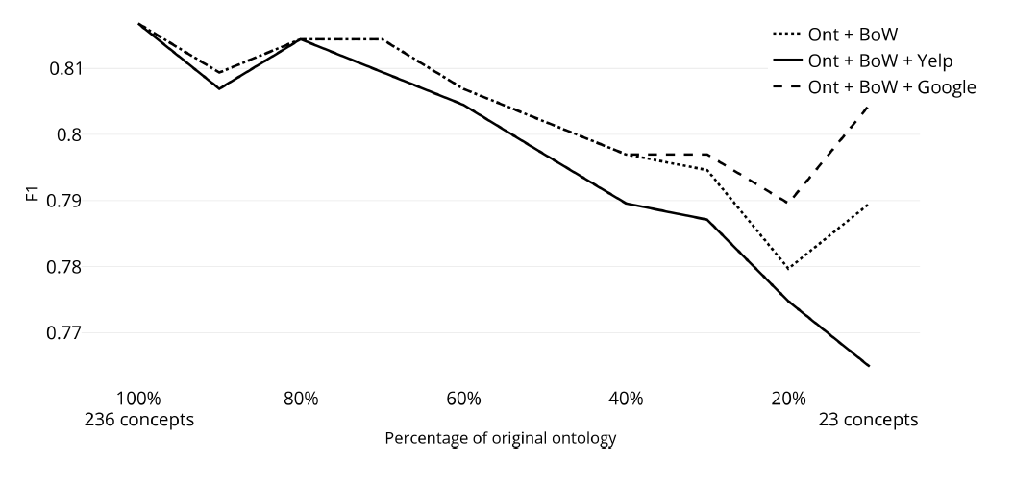
Evaluation
As the ontology size decreases the performance on the test dataset decreases as well
Notes:
In this plot one can see the performance (using again the F₁ measure) of the three models:
Ont+BoW: our approach without word embeddings;
Ont+BoW+Yelp: our approach with Yelp word embeddings (and threshold parameter $t=0.75$);
Ont+BoW+Google: our approach with Google word embeddings (and thereshold parameter $t=0.80$).
From this picture we can notice that the word embeddings do not improve the performance of our approach using the full ontology. Also, as the ontology size decreases, so does the performance, which is expected.

Slide 24
Evaluation
Three models:
Ont+BoW (no word embeddings)
Ont+BoW+Yelp (Ont+Bow+Yelp word embeddings):
$t=0.75$ (called Yelp model)
Ont+BoW+Google (Ont+BoW+Google word embeddings):
$t=0.80$ (called Google model)
Until 40% of the ontology size the Google model and Ont+BoW have the same F₁
For smaller ontologies the Google model does outperform Ont+BoW
The Yelp model never performs better than the Google (Yelp dataset is smaller than Google’s) and Ont+BoW models
The Google model is the best model
Notes:
Going further with our analysis we observe that until 40% of the ontology size, the Google model and the Ont+BoW model have the same F₁ scores. In addition, for smaller ontologies the Google model outperforms the Ont+BoW model showing the usefulness of word embeddings in our context. The Yelp model never performs better that the other two models. One reason for the inferior results of the Yelp model relative to the Google model is probably the much smaller size of the Yelp dataset compared to the Google dataset, despite the fact that the Yelp dataset is an in-domain dataset and the Google dataset is a general-domain dataset. Based on these results the Google model seems to be the best one.

Slide 25
Conclusion
We have proposed a Two-Step Hybrid Approach for ABSA at review-level:
Ontology-based reasoning
Machine learning (backup solution)
The proposed model works better than the ontology-based reasoning and machine learning solutions
Word embeddings beneficial only for small ontology sizes and Google word embeddings work better than Yelp word embeddings (Google data is not domain-specific but is larger)
Future work:
As 40% of the instances is used for the back-up model we plan to concentrate on better ontology coverage and reasoning
We also plan to weight higher sentiment words at the end of the review (where sentiment gravitates)
Notes:
To conclude, I have presented a two-step hybrid approach for ABSA at review-level. This approach has two steps:
The ontology-based reasoning step;
The machine learning step, which acts as the backup solution.
Considering each of these steps alone, the proposed approach works better than each one of them showing the complementarity of these solutions.
Also, we have shown that extending the text coverage of the ontology using word embeddings is beneficial for small ontology sizes and that the word embeddings learned using the Google general-domain dataset work better the ones learned using the Yelp in-domain dataset, which is probably due to the much larger size of the Google dataset.
As future work we would like to concentrate on further improving the ontology coverage and reasoning as only 40% of the instances is used by the back-up model. Also, we would like to experiment with a heavier weighting of the sentiment words located at the end of a review as, based on other works, it seems that the overall sentiment gravitates towards that part of the review.

Slide 26
References
Basant Agarwal, Namita Mittal, Pooja Bansal, and Sonal Garg. Sentiment Analysis Using Common-Sense and Context Information. Computational Intelligence and Neuroscience, 2015, 715730:1-715730:9, 2015.
Duyu Tang, Furu Wei, Bing Qin, Ting Liu, and Ming Zhou. Coooolll: A Deep Learning System for Twitter Sentiment Classification. 8th International Workshop on Semantic Evaluation (SemEval 2014), pages 208–212, ACL, 2014.
Kim Schouten and Flavius Frasincar. Ontology-Driven Sentiment Analysis of Product and Service Aspects. 15th Extended Semantic Web Conference (ESWC 2018), Lecture Notes in Computer Science, Volume 10843, pages 608-623, Springer, 2018.
Notes:
These are the references that are used in this presentation.
I thank you for your attention and, if you have any questions, do not hesitate to contact me.

