Slide 1
An Elastic Net Regularized Matrix Factorization
Technique for Recommender Systems
Flavius Frasincar*
frasincar@ese.eur.nl
* Joint work with Bianca Mitroi

Slide 2
Contents
Motivation
Related Work
Methodology
Evaluation
Conclusion

Slide 3
Motivation
Growing amount of online data
Difficult to find the items of interest
Recommender Systems: predict the user preference for a certain item
Recommender System Types:
  Collaborative Filtering:
    Memory-Based Approaches: Item-Based or User-Based
    Model-Based Approaches: Matrix Factorization [our focus here]
  Content-Based Filtering
  Hybrid: Mix of different recommender system types

Slide 4
Motivation
Matrix Factorization:
  Reduces the dimensionality of the problem
  Uses features that describe item characteristics and user preferences
Application Domain: Movies
Main Ideas:
  Generalize two existing algorithms proposed by Koren, Bell, and Volinksy (2009) [KBV] and Gogna and Majumdar (2014) [GM], respectively
  Make use of the elastic net regularization by Zou and Hastie (2005)
  Answer questions in relation to users and items on a movie dataset:
    Does a user have preferences for all item factors?
    Is an item characterized by all factors?

Slide 5
Related Work
KBV Approach
  Ridge regularization on the user factor loadings and item factor loadings
  The shrinking parameters for users and items are equal
  Two optimization methods:
    Alternating Least Squares (ALS): scales well for large and sparse datasets (using parallelism)
    Stochastic Gradient Descent (SGD): easy-to-implement and faster than ALS [our focus here]

Slide 6
Related Wok
GM Approach
  Ridge regularization on the user factor loadings
    Assumption 1: A user has preferences for all movie factors
  Lasso regularization on the item factor loadings
    Assumption 2: A movie is not characterized by all factors (assumes that factors represent genres)
  The shrinking parameters are not equal
  Optimization method:
    Majorization-Minimization (MM): applicable to non-differentiable functions but slower than SGD

Slide 7
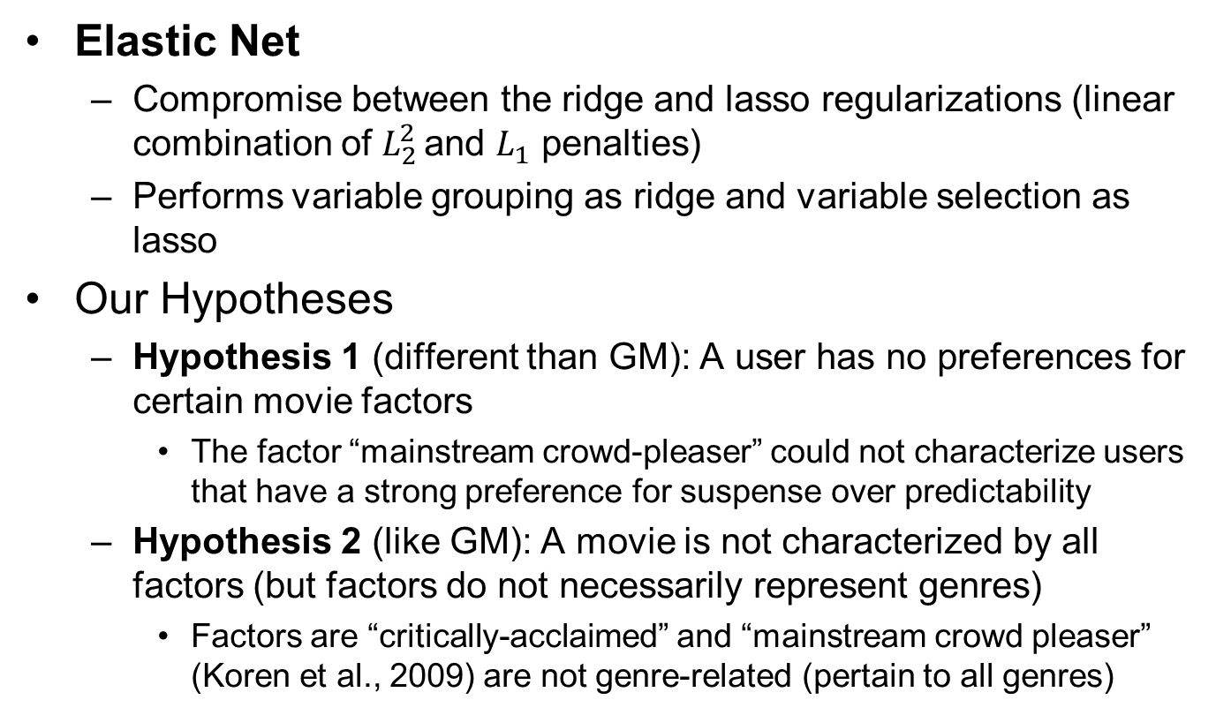
Related Work
Elastic Net
  Compromise between the ridge and lasso regularizations (linear combination of $L_{2}^{2}$ and $L_{1}$ penalties)
  Performs variable grouping as ridge and variable selection as lasso
Our Hypotheses
  Hypothesis 1 (different than GM): A user has no preferences for certain movie factors
    The factor “mainstream crowd-pleaser” could not characterize users that have a strong preference for suspense over predictability
  Hypothesis 2 (like GM): A movie is not characterized by all factors (but factors do not necessarily represent genres)
    Factors are “critically-acclaimed” and “mainstream crowd pleaser” (Koren et al., 2009) are not genre-related (pertain to all genres)

Slide 8
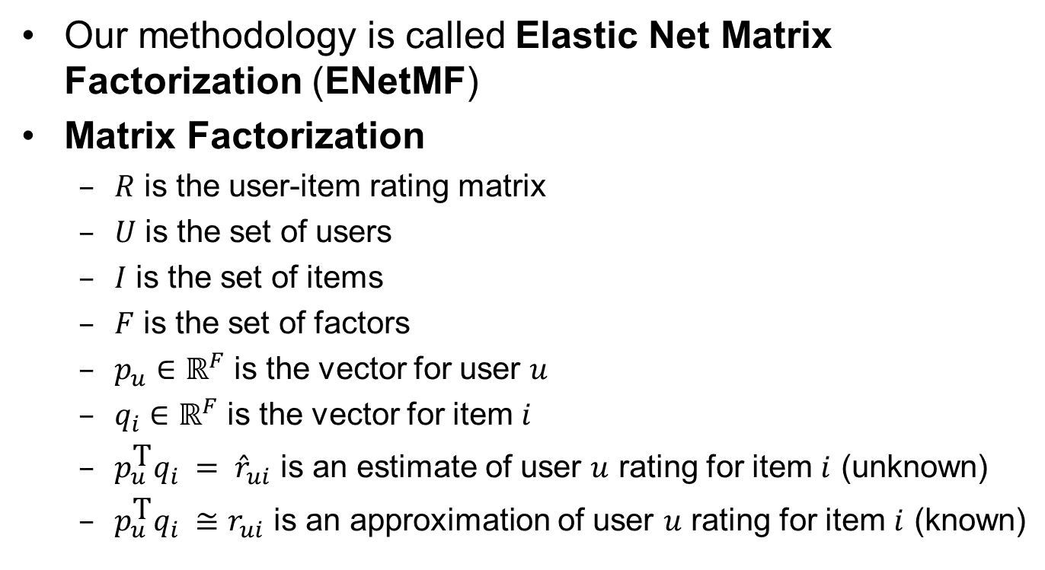
Methodology – Matrix Factorization
Our methodology is called Elastic Net Matrix Factorization (ENetMF)
Matrix Factorization
  $R$ is the user-item rating matrix
  $U$ is the set of users
  $I$ is the set of items
  $F$ is the set of factors
  $p_{u}∈ℝ^{F}$ is the vector for user $u$
  $q_{i}∈ℝ^{F}$ is the vector for item $i$
  $p_{u}^{\text{T}}q_{i} = {\hat{r}}_{ui}$ is an estimate of user $u$ rating for item $i$ (unknown)
  $p_{u}^{\text{T}}q_{i} ≅r_{ui}$ is an approximation of user $u$ rating for item $i$ (known)

Slide 9
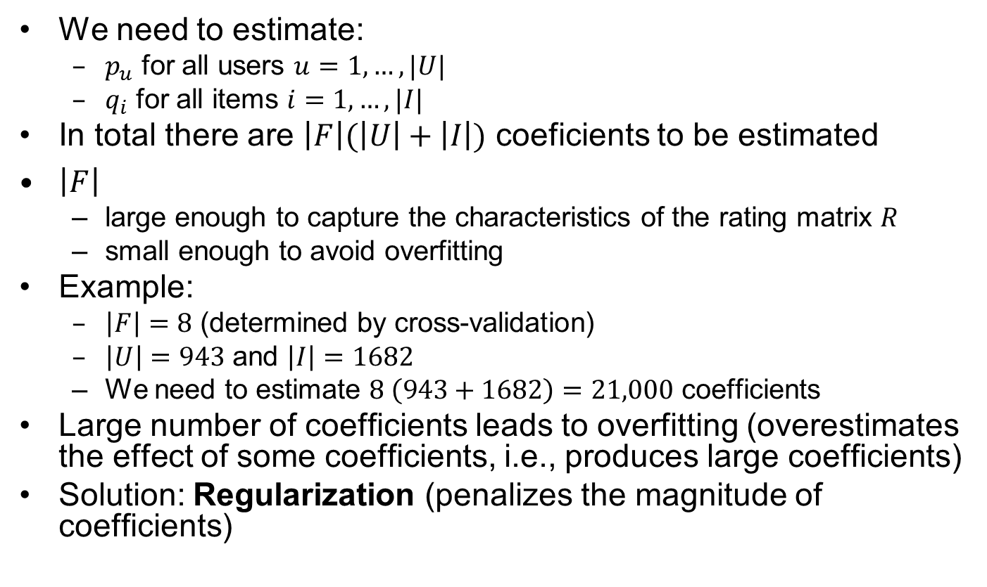
Matrix Factorization – Regularization
We need to estimate:
  $p_{u}$ for all users $u=1,…,|U|$
  $q_{i}$ for all items $i=1,…,|I|$
In total there are $\left|F\right|(\left|U\right|+\left|I\right|)$ coeficients to be estimated
$\left|F\right|$
  large enough to capture the characteristics of the rating matrix $R$
  small enough to avoid overfitting
Example:
  $\left|F\right|=8$ (determined by cross-validation)
  $\left|U\right|=943$ and $\left|I\right|=1682$
  We need to estimate $8 \left(943+1682\right)=21,000$ coefficients
Large number of coefficients leads to overfitting (overestimates the effect of some coefficients, i.e., produces large coefficients)
Solution: Regularization (penalizes the magnitude of coefficients)

Slide 10
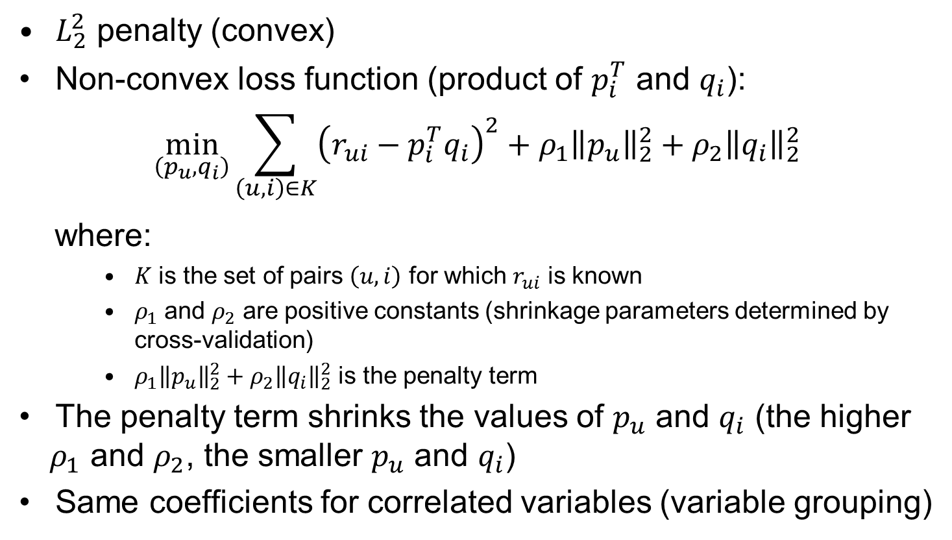
Matrix Factorization – Ridge
$L_{2}^{2}$ penalty (convex)
Non-convex loss function (product of $p_{i}^{T}$ and $q_{i}$):
$$\min_{\left(p_{u},q_{i}\right)}{\sum_{\left(u,i\right)∈K}{{\left(r_{ui}−p_{i}^{T}q_{i}\right)}^{2}}+ρ_{1}{\left\|p_{u}\right\|}_{2}^{2}+ρ_{2}{\left\|q_{i}\right\|}_{2}^{2}}$$
where:
    $K$ is the set of pairs $\left(u,i\right)$ for which $r_{ui}$ is known
    $ρ_{1}$ and $ρ_{2}$ are positive constants (shrinkage parameters determined by cross-validation)
    $ρ_{1}{\left\|p_{u}\right\|}_{2}^{2}+ρ_{2}{\left\|q_{i}\right\|}_{2}^{2}$ is the penalty term
The penalty term shrinks the values of $p_{u}$ and $q_{i}$ (the higher $ρ_{1}$ and $ρ_{2}$, the smaller $p_{u}$ and $q_{i}$)
Same coefficients for correlated variables (variable grouping)

Slide 11
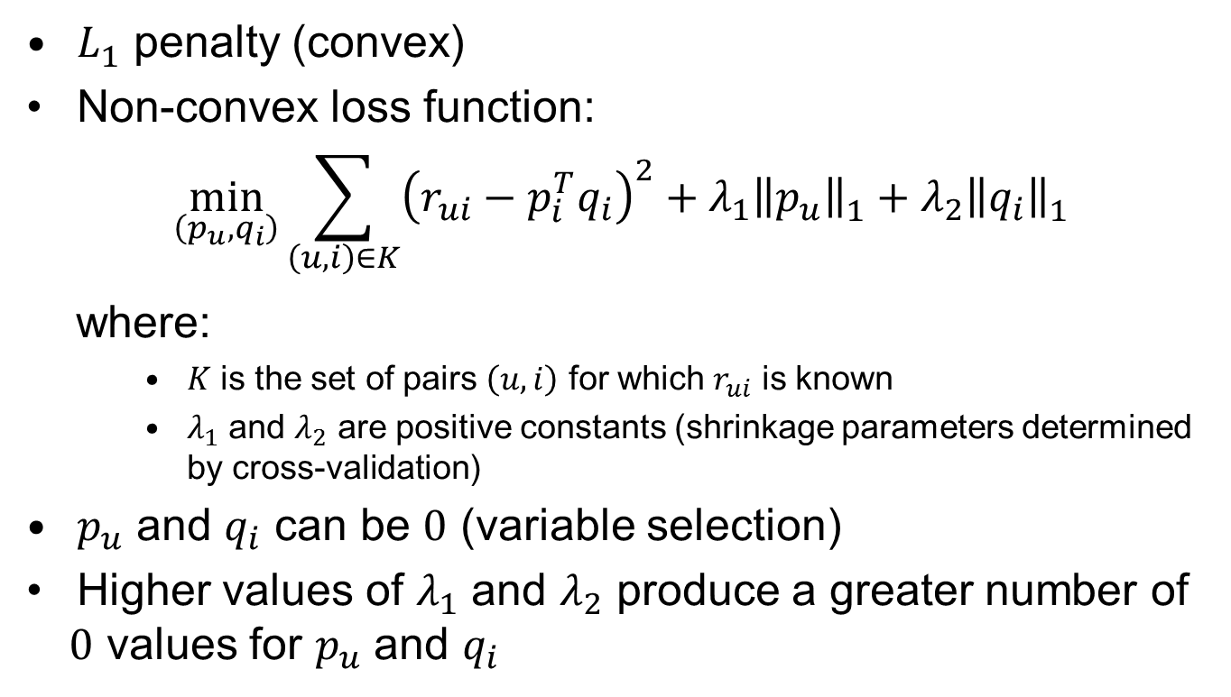
Matrix Factorization – Lasso
$L_{1}^{}$ penalty (convex)
Non-convex loss function:
$$\min_{\left(p_{u},q_{i}\right)}{\sum_{\left(u,i\right)∈K}{{\left(r_{ui}−p_{i}^{T}q_{i}\right)}^{2}}+λ_{1}{\left\|p_{u}\right\|}_{1}^{}+λ_{2}{\left\|q_{i}\right\|}_{1}^{}}$$
where:
    $K$ is the set of pairs $\left(u,i\right)$ for which $r_{ui}$ is known
    $λ_{1}$ and $λ_{2}$ are positive constants (shrinkage parameters determined by cross-validation)
$p_{u}$ and $q_{i}$ can be $0$ (variable selection)
Higher values of $λ_{1}$ and $λ_{2}$ produce a greater number of $0$ values for $p_{u}$ and $q_{i}$

Slide 12
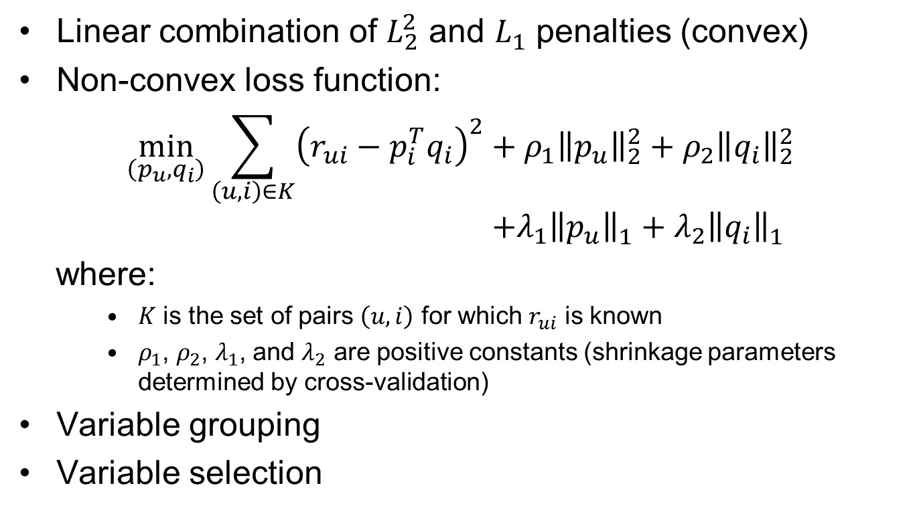
Matrix Factorization – Elastic Net
Linear combination of $L_{2}^{2}$ and $L_{1}^{}$ penalties (convex)
Non-convex loss function:
$$\min_{\left(p_{u},q_{i}\right)}{\sum_{\left(u,i\right)∈K}{{\left(r_{ui}−p_{i}^{T}q_{i}\right)}^{2}}+ρ_{1}{\left\|p_{u}\right\|}_{2}^{2}+ρ_{2}{\left\|q_{i}\right\|}_{2}^{2}} \\ +λ_{1}{\left\|p_{u}\right\|}_{1}^{}+λ_{2}{\left\|q_{i}\right\|}_{1}^{}$$
where:
    $K$ is the set of pairs $\left(u,i\right)$ for which $r_{ui}$ is known
    $ρ_{1}$, $ρ_{2}$, $λ_{1}$, and $λ_{2}$ are positive constants (shrinkage parameters determined by cross-validation)
Variable grouping
Variable selection

Slide 13
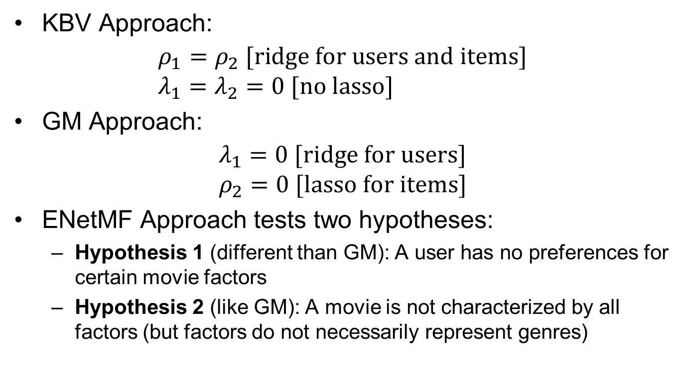
Methodology – Related Work
KBV Approach:
$${ρ_{1}=ρ}_{2} \text{[}\text{ridge} \text{for} \text{users} \text{and} \text{items}\text{]} \\ λ_{1}=λ_{2}=0 \text{[}\text{no} \text{lasso}\text{]}$$
GM Approach:
$$λ_{1}=0 \text{[}\text{ridge} \text{for} \text{users}] \\ ρ_{2}=0 \text{[}\text{lasso} \text{for} \text{items}\text{]}$$
ENetMF Approach tests two hypotheses:
  Hypothesis 1 (different than GM): A user has no preferences for certain movie factors
  Hypothesis 2 (like GM): A movie is not characterized by all factors (but factors do not necessarily represent genres)

Slide 14
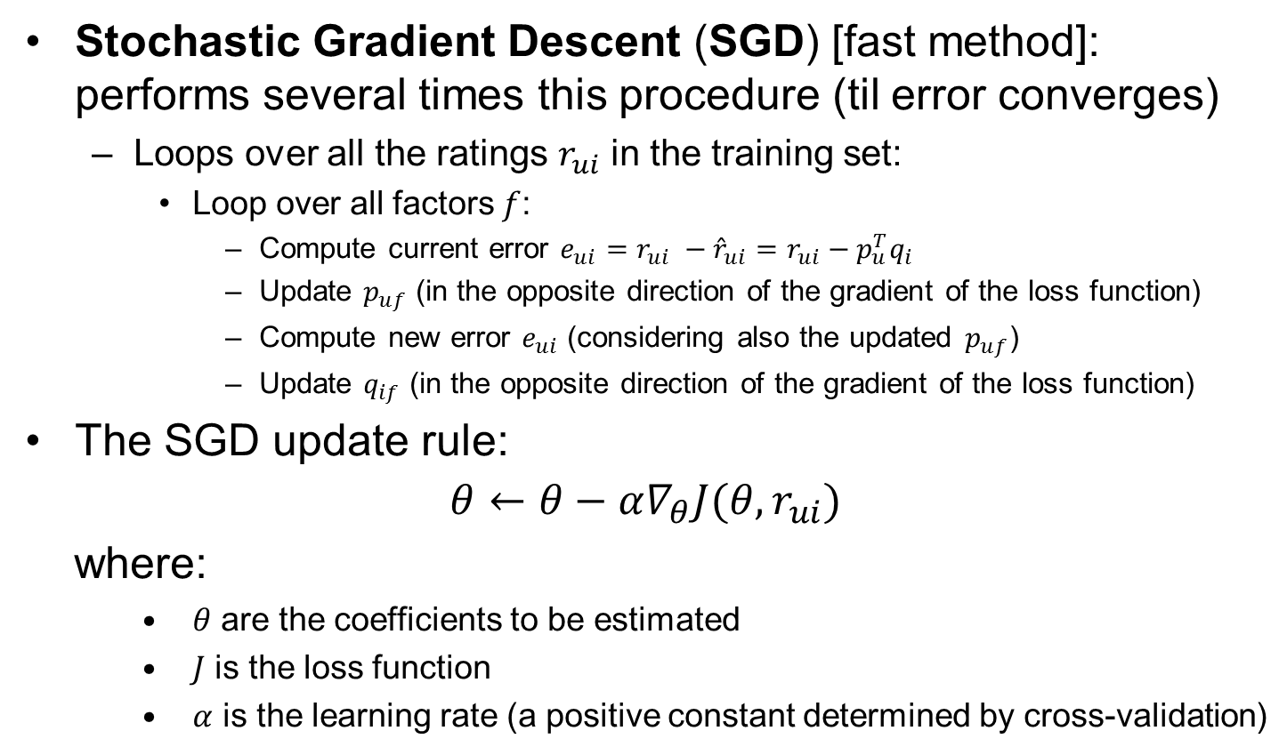
Methodology – Estimation
Stochastic Gradient Descent (SGD) [fast method]: performs several times this procedure (til error converges)
  Loops over all the ratings $r_{ui}$ in the training set:
    Loop over all factors $f$:
      Compute current error $e_{ui}=$ $r_{ui} −{\hat{r}}_{ui}=r_{ui}−p_{u}^{T}q_{i}$
      Update $p_{uf}$ (in the opposite direction of the gradient of the loss function)
      Compute new error $e_{ui}$ (considering also the updated $p_{uf}$)
      Update $q_{if}$ (in the opposite direction of the gradient of the loss function)
The SGD update rule:
$$θ←θ−α∇_{θ}J(θ,r_{ui})$$
where:
    $θ$ are the coefficients to be estimated
    $J$ is the loss function
    $α$ is the learning rate (a positive constant determined by cross-validation)

Slide 15
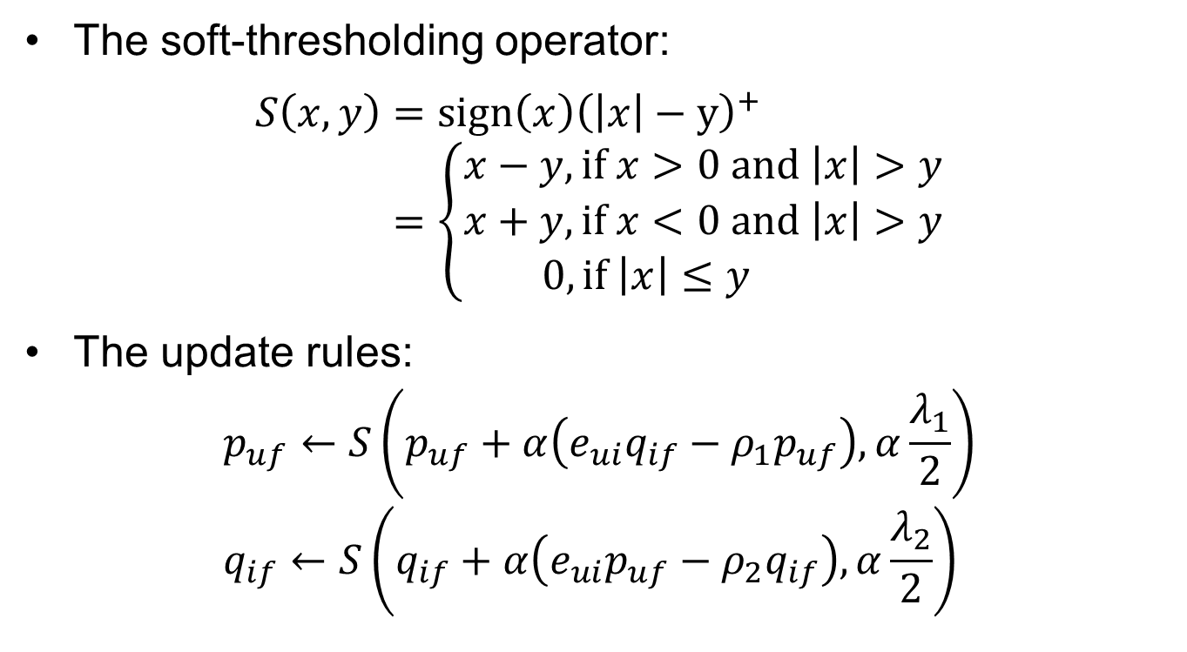
Methodology – Estimation
The soft-thresholding operator:
$$S\left(x,y\right)=sign\left(x\right){\left(\left|x\right|−y\right)}^{+} \\ =\left\{\begin{aligned}x−y, \text{if} x>0 \text{and} \left|x\right|>y \\ x+y,\text{if} x<0 \text{and} \left|x\right|>y \\ 0, if \left|x\right|≤y \end{aligned}\right.$$
The update rules:
$$p_{uf}←S\left(p_{uf}+α\left(e_{ui}q_{if}−ρ_{1}p_{uf}\right),α\frac{λ_{1}}{2}\right) \\ q_{if}←S\left(q_{if}+α\left(e_{ui}p_{uf}−ρ_{2}q_{if}\right),α\frac{λ_{2}}{2}\right)$$

Slide 16
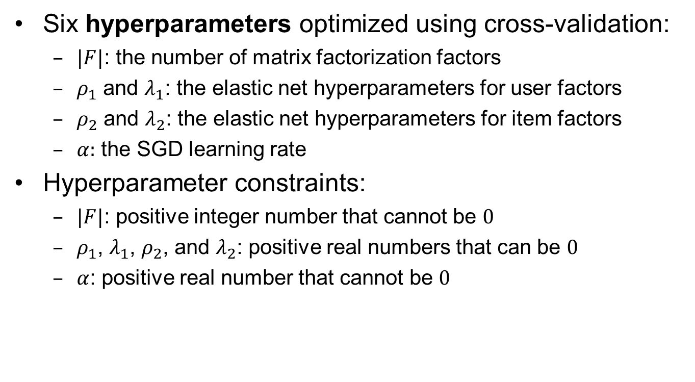
Methodology – Estimation
Six hyperparameters optimized using cross-validation:
  $|F|$: the number of matrix factorization factors
  $ρ_{1}$ and $λ_{1}$: the elastic net hyperparameters for user factors
  $ρ_{2}$ and $λ_{2}$: the elastic net hyperparameters for item factors
  $α:$ the SGD learning rate
Hyperparameter constraints:
  $|F|$: positive integer number that cannot be $0$
  $ρ_{1}$, $λ_{1}$, $ρ_{2}$, and $λ_{2}$: positive real numbers that can be $0$
  $α$: positive real number that cannot be $0$

Slide 17
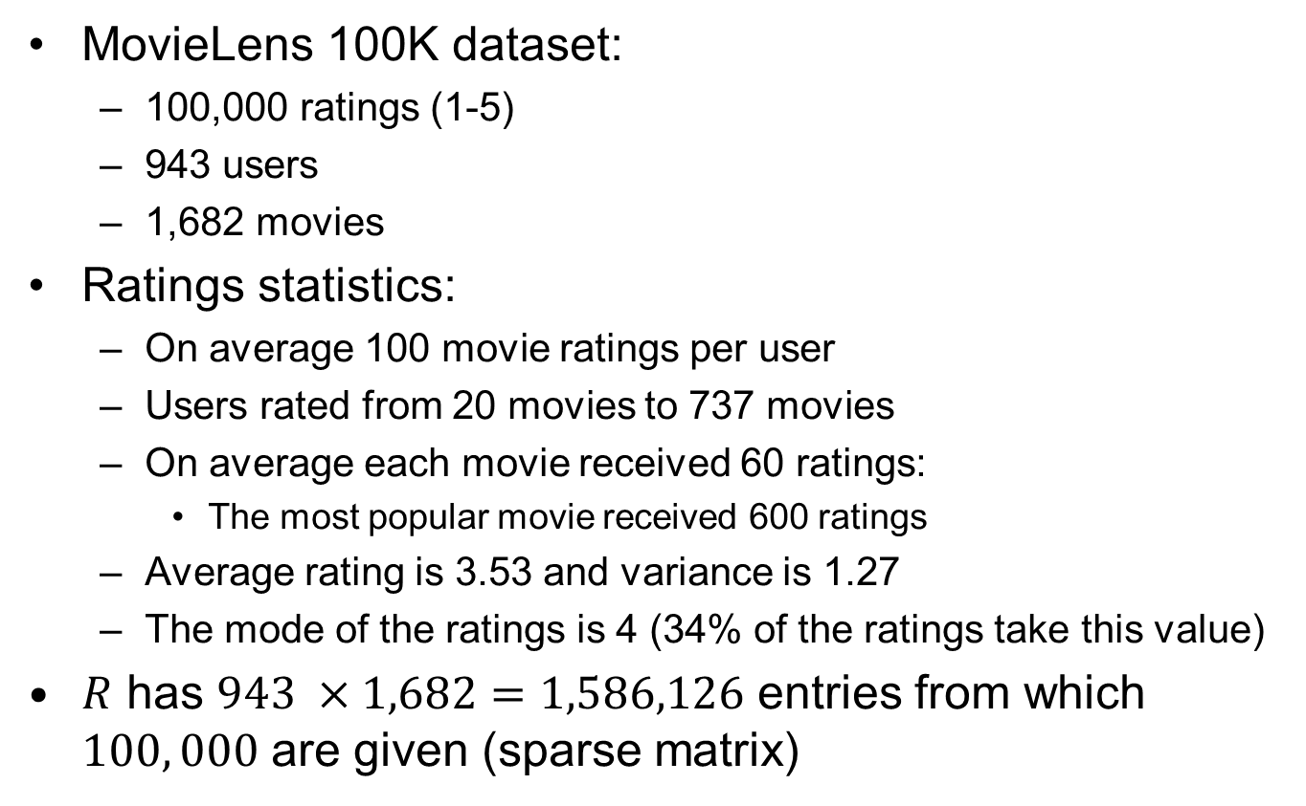
Evaluation – Dataset
MovieLens 100K dataset:
  100,000 ratings (1-5)
  943 users
  1,682 movies
Ratings statistics:
  On average 100 movie ratings per user
  Users rated from 20 movies to 737 movies
  On average each movie received 60 ratings:
    The most popular movie received 600 ratings
  Average rating is 3.53 and variance is 1.27
  The mode of the ratings is 4 (34% of the ratings take this value)
$R$ has $943 ×1,682=1,586,126$ entries from which $100, 000$ are given (sparse matrix)

Slide 18
Evaluation – Experimental Setup
Training dataset: 90% of the dataset
Test dataset: 10% of the dataset
Hyperparameters tuning: 10 fold cross-validation on the training dataset
  Decision based on the lowest average (10 folds) of the mean absolute error (MAE)
Build a model based on the best hyperparameters on the training dataset and report results on the test dataset
For fair comparison we have implemented:
  KBV
  GM
  ENetMF (our approach)

Slide 19
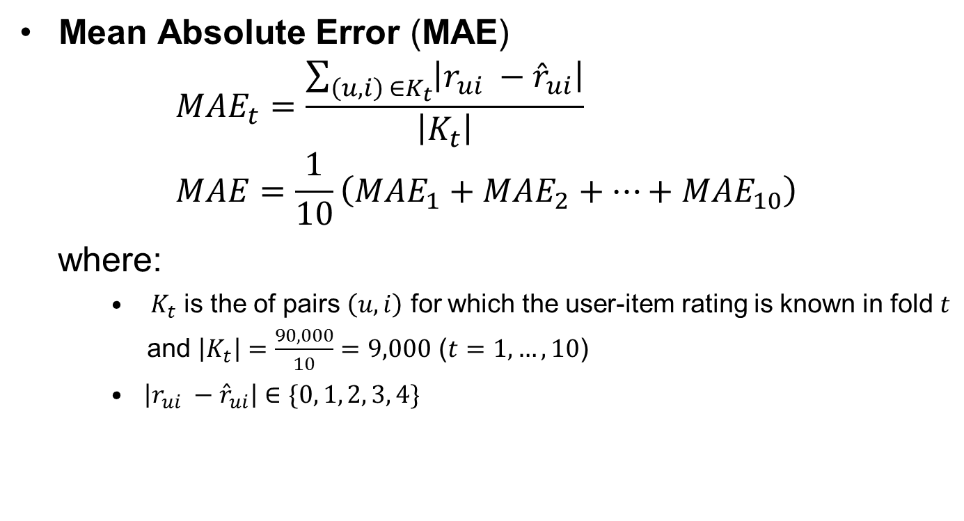
Evaluation – Experimental Setup
Mean Absolute Error (MAE)
$$MAE_{t}=\frac{\sum_{\left(u,i\right) ∈K_{t}}{\left|r_{ui} −{\hat{r}}_{ui}\right|}}{\left|K_{t}\right|} \\ MAE=\frac{1}{10}\left(MAE_{1}+MAE_{2}+…+MAE_{10}\right)$$
where:
    $K_{t}$ is the of pairs $\left(u,i\right)$ for which the user-item rating is known in fold $t$
    and $\left|K_{t}\right|=\frac{90,000}{10}=9,000$ ($t=1,…,10$)
    $\left|r_{ui} −{\hat{r}}_{ui}\right|∈\{0, 1, 2, 3, 4\}$

Slide 20
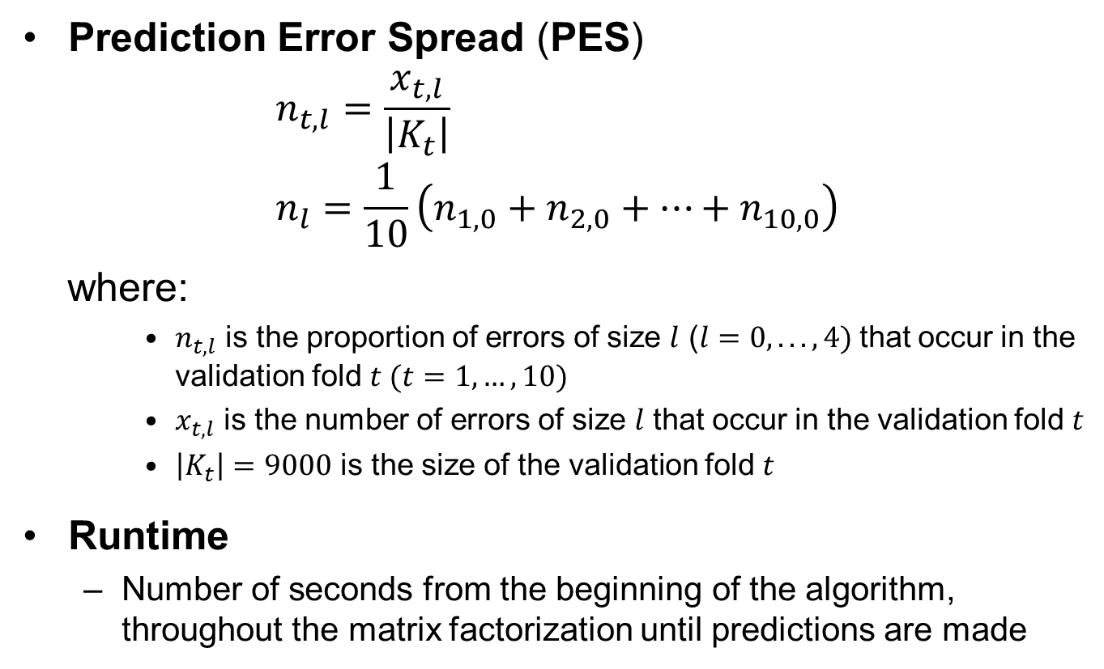
Evaluation – Experimental Setup
Prediction Error Spread (PES)
$$n_{t,l}=\frac{x_{t,l}}{\left|K_{t}\right|} \\ n_{l}=\frac{1}{10}\left(n_{1,0}+n_{2,0}+…+n_{10,0}\right)$$
where:
    $n_{t,l}$ is the proportion of errors of size $l$ ($l=0,...,4)$that occur in the validation fold $t (t=1,…,10)$
    $x_{t,l}$ is the number of errors of size $l$ that occur in the validation fold $t$
    $\left|K_{t}\right|=9000$ is the size of the validation fold $t$
Runtime
  Number of seconds from the beginning of the algorithm, throughout the matrix factorization until predictions are made

Slide 21
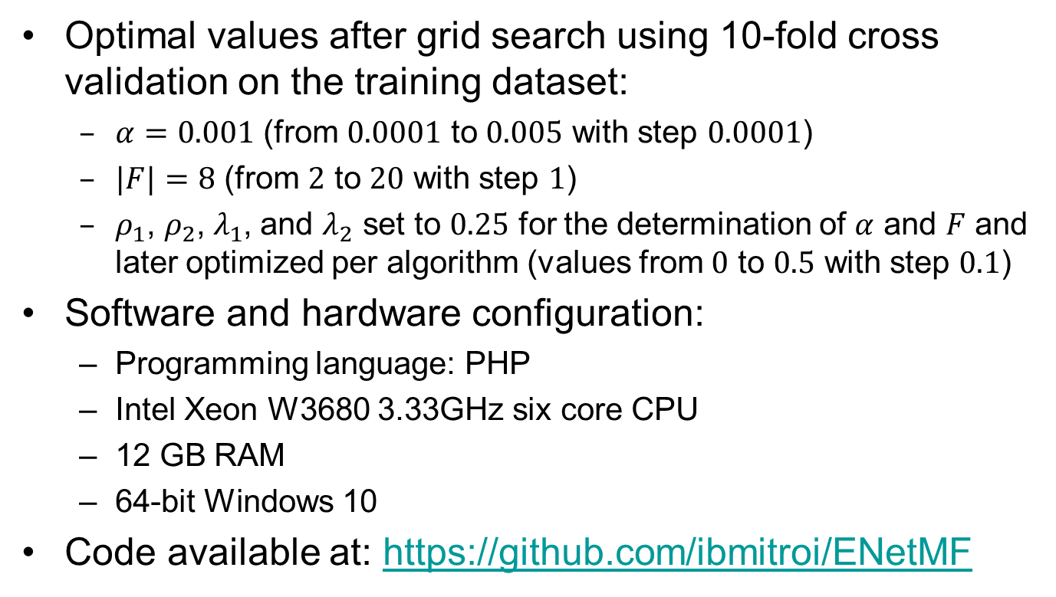
Evaluation – Hyperparameters Setup
Optimal values after grid search using 10-fold cross validation on the training dataset:
  $α=0.001$ (from $0.0001$ to $0.005$ with step $0.0001$)
  $|F|=8$ (from $2$ to $20$ with step $1$)
  $ρ_{1}$, $ρ_{2}$,${ λ}_{1}$, and $λ_{2}$ set to $0.25$ for the determination of $α$ and $F$ and later optimized per algorithm (values from $0$ to $0.5$ with step $0.1$)
Software and hardware configuration:
  Programming language: PHP
  Intel Xeon W3680 3.33GHz six core CPU
  12 GB RAM
  64-bit Windows 10
Code available at: https://github.com/ibmitroi/ENetMF

Slide 22
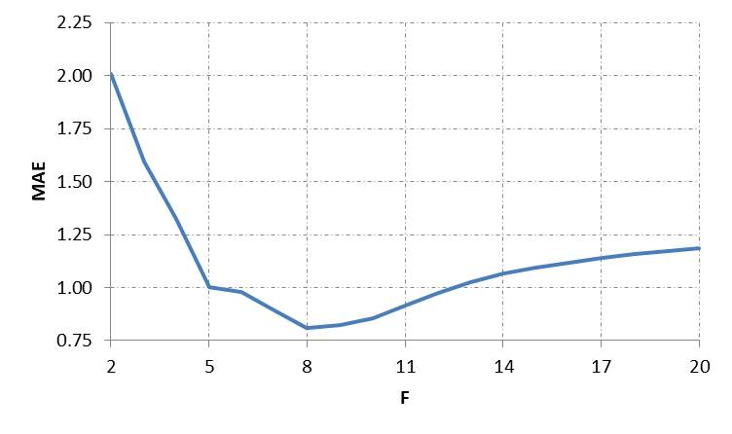
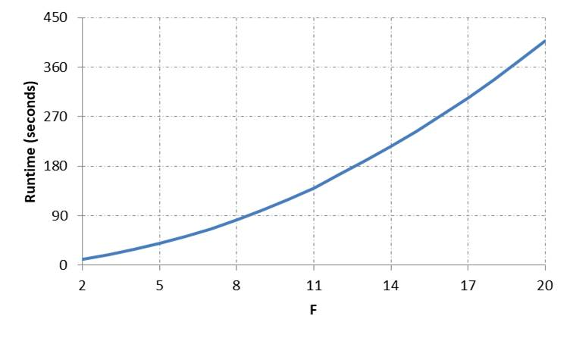
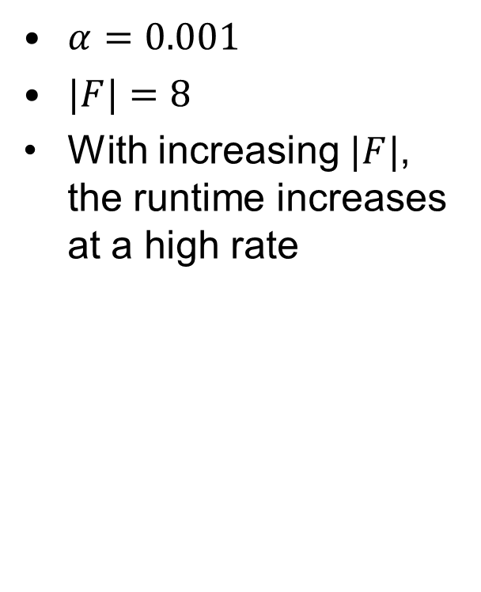
Evaluation – Hyperparameters Setup
$α=0.001$
$|F|=8$
With increasing $|F|$, the runtime increases at a high rate

Slide 23
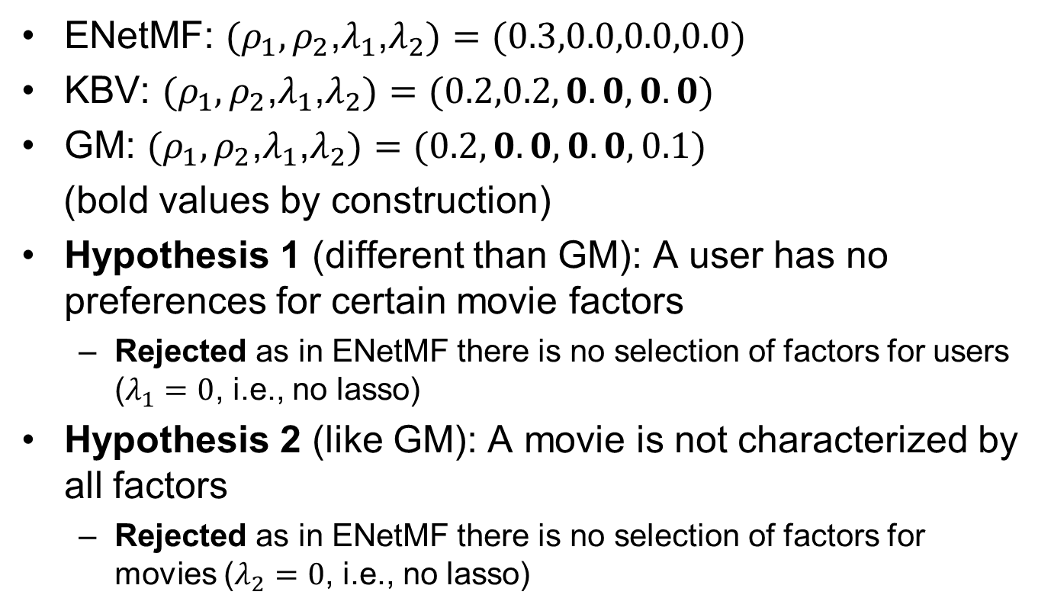
Evaluation – Results
ENetMF: ${(ρ}_{1},ρ_{2}$,$λ_{1}$,$λ_{2})=(0.3,0.0,0.0,0.0)$
KBV: ${(ρ}_{1},ρ_{2}$,$λ_{1}$,$λ_{2})=(0.2,0.2,0.0,0.0)$
GM: ${(ρ}_{1},ρ_{2}$,$λ_{1}$,$λ_{2})=(0.2,0.0,0.0,0.1)$
(bold values by construction)
Hypothesis 1 (different than GM): A user has no preferences for certain movie factors
  Rejected as in ENetMF there is no selection of factors for users ($λ_{1}=0$, i.e., no lasso)
Hypothesis 2 (like GM): A movie is not characterized by all factors
  Rejected as in ENetMF there is no selection of factors for movies ($λ_{2}=0$, i.e., no lasso)

Slide 24
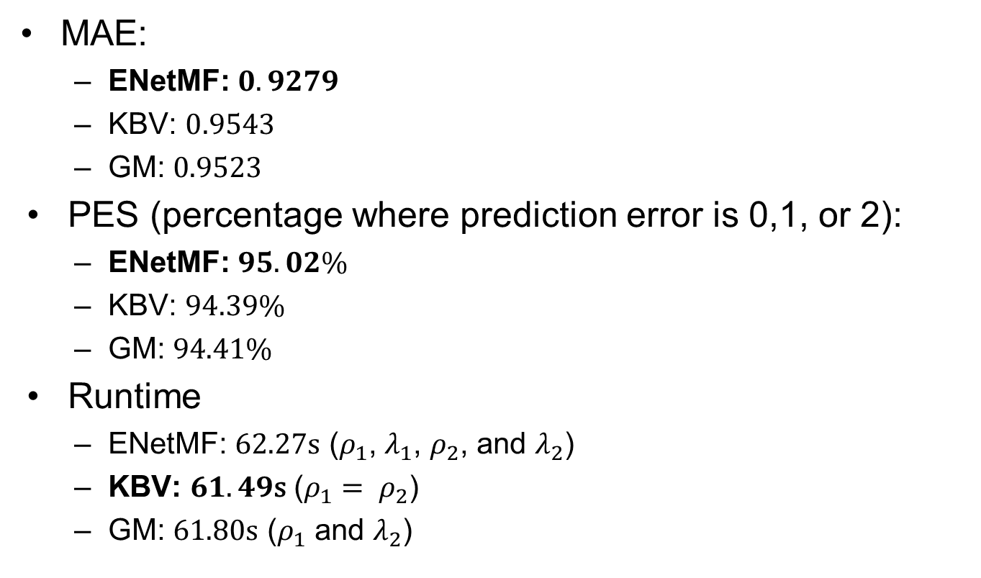
Evaluation – Results
MAE:
  ENetMF: $0.9279$
  KBV: $0.9543$
  GM: $0.9523$
PES (percentage where prediction error is 0,1, or 2):
  ENetMF: $95.02\%$
  KBV: $94.39\%$
  GM: $94.41\%$
Runtime
  ENetMF: $62.27\text{s}$ ($ρ_{1}$, $λ_{1}$, $ρ_{2}$, and $λ_{2}$)
  KBV: $61.49\text{s}$ ($ρ_{1}= ρ_{2}$)
  GM: $61.80\text{s}$ ($ρ_{1}$ and $λ_{2}$)

Slide 25
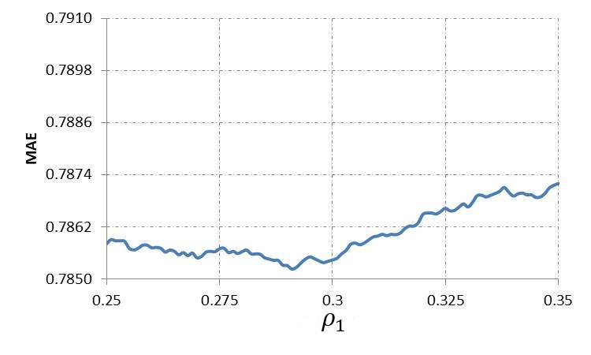
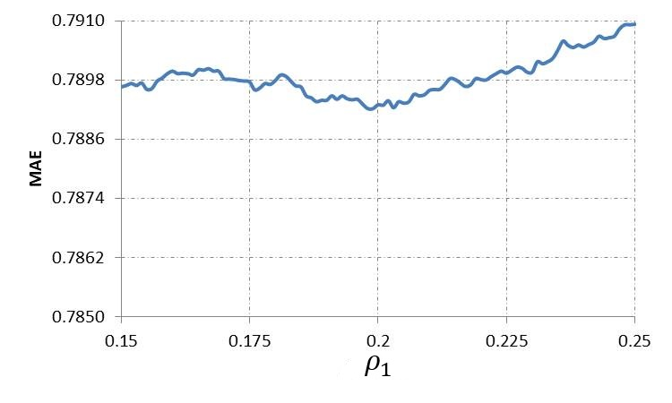
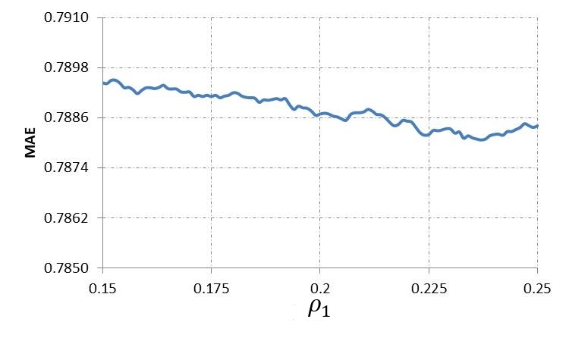
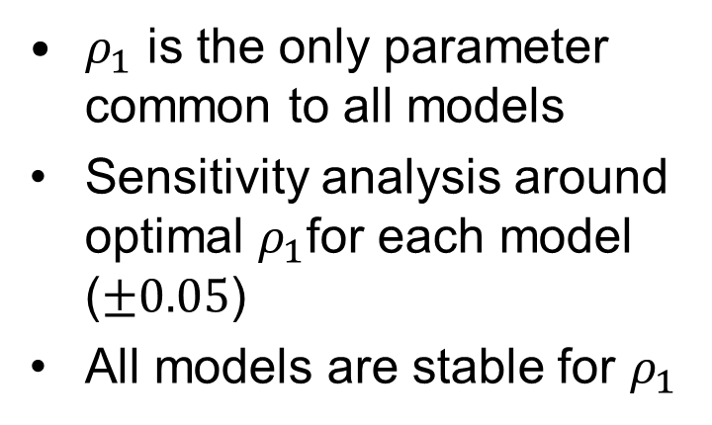
Evaluation – Results
$ρ_{1}$ is the only parameter common to all models
Sensitivity analysis around optimal $ρ_{1}$for each model ($±0.05$)
All models are stable for $ρ_{1}$
ENetMF
KBV
GM

Slide 26
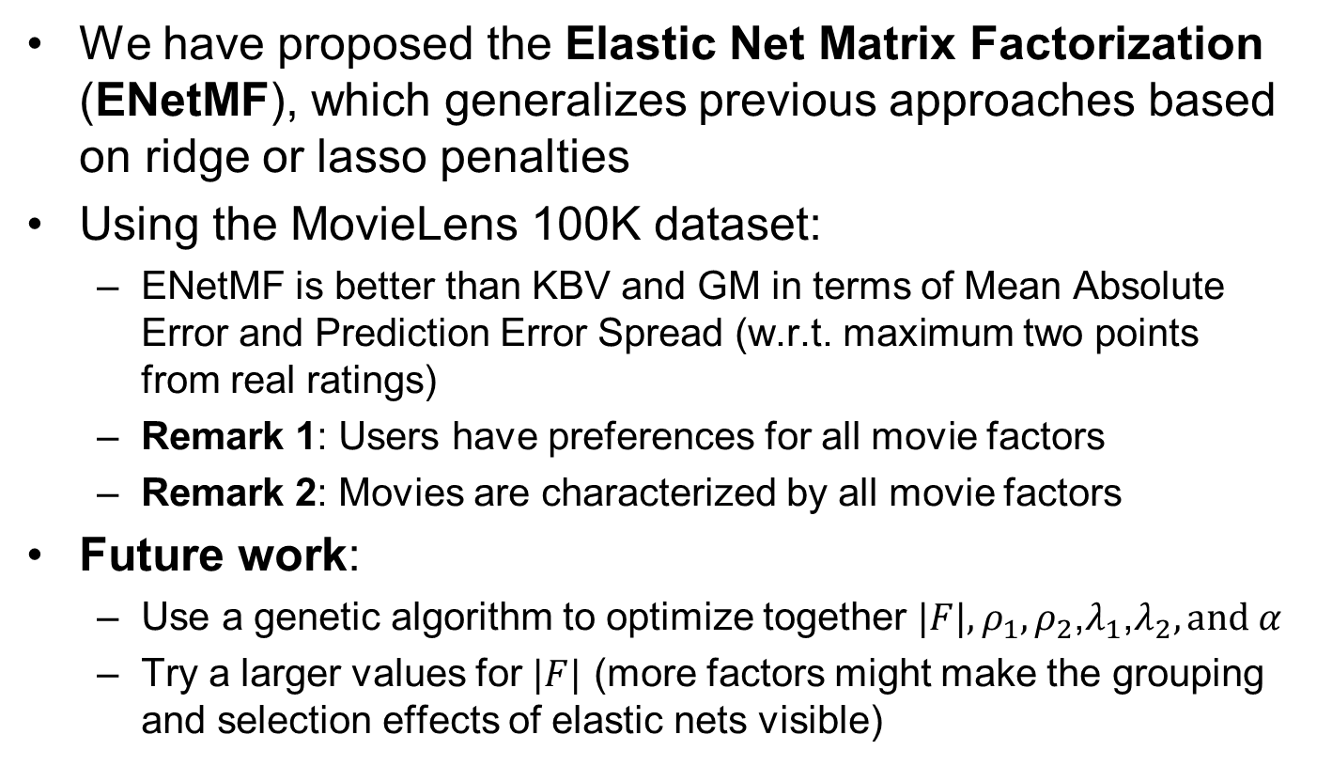
Conclusion
We have proposed the Elastic Net Matrix Factorization (ENetMF), which generalizes previous approaches based on ridge or lasso penalties
Using the MovieLens 100K dataset:
  ENetMF is better than KBV and GM in terms of Mean Absolute Error and Prediction Error Spread (w.r.t. maximum two points from real ratings)
  Remark 1: Users have preferences for all movie factors
  Remark 2: Movies are characterized by all movie factors
Future work:
  Use a genetic algorithm to optimize together ${|F|, ρ}_{1},ρ_{2}$,$λ_{1}$,$λ_{2},\text{and} α$
  Try a larger values for $|F|$ (more factors might make the grouping and selection effects of elastic nets visible)

Slide 27
References
Anupriya Gogna and Angshul Majumdar. Distributed elastic net regularized blind compressive sensing for recommender system design. 20th International Conference on Management of Data (COMAD 2014), pages 29-37. Computer Society of India, 2014.
Yehuda Koren, Robert Bell, and Chris Volinsky. Matrix factorization techniques for recommender systems. IEEE Computer Society, 42(8):30-37, 2009.
Hui Zou and Trevor Hastie. Regularization and variable selection via the elastic net. Journal of the Royal Statistical Society: Series B (Statistical Methodology), 67(2):301-320, 2005.

