Slide 1
Review-Level Aspect-Based Sentiment Analysis Using an Ontology
Flavius Frasincar*
frasincar@ese.eur.nl
* Joint work with Sophie de Kok, Linda Punt, Rosita van den Puttelaar, Karoliina Ranta, and Kim Schouten

Slide 2
Contents
Motivation
Related Work
Data
Methodology
Evaluation
Conclusion
Future Work

Slide 3
Motivation
Due to the convenience of shopping online there is an increasing number of Web shops
Web shops often provide a platform for consumers to share their experiences, which lead to an increasing number of product reviews:
In 2014: the number of reviews on Amazon exceeded 10 million
Product reviews used for decision making:
Consumers: decide or confirm which products to buy
Producers: improve or develop new products, marketing campaigns, etc.

Slide 4
Motivation
Reading all reviews is time consuming, therefore the need for automation
Sentiment mining is defined as the automatic assessment of the sentiment expressed in text (in our case by consumers in product reviews)
Several granularities of sentiment mining:
Review-level
Sentence-level
Aspect-level (product aspects are sometimes referred to as product features): Aspect-Based Sentiment Analysis (ABSA):
Review-level [our focus here]
Sentence-level

Slide 5
Motivation
Aspect-Based Sentiment Analysis (ABSA) has two stages:
Aspect detection:
Explicit aspect detection: aspects appear literally in product reviews
Implicit aspect detection: aspects do not appear literally in the product reviews
Sentiment detection: assigning the sentiment associated to explicit or implicit aspects [our focus here]
Main problem:
In previous work we have proposed an approach to detect the sentiment for an aspect at sentence-level
How to find the sentiment for an aspect at review-level?

Slide 6
Main Idea and Evaluation Result
Approach: Ontology-Driven Machine Learning (Multi-class classification with ontology-related features)
Ontologies advantages:
Deal with small training data
Use axioms to derive implicit information
Two solutions:
Use a classifier to predict the aspect-based sentiment at review level
Use a classifier to predict the aspect-based sentiment at sentence level and aggregate the sentiment

Slide 7
Main Idea and Evaluation Result
Collection of restaurant reviews from SemEval 2016
Evaluation result 1:
The review-level approach has an F₁ of 81.19% on test data
The sentence-level approach has an F₁ of 77.17% on test data
There is a 4.02 percentage points increase in F₁ for the review-level classifier compared to the sentence-level classifier
Evaluation result 2:
With ontology features the review-level approach F1 increases from 80.20% to 81.19% on test data
With ontology features the sentence-level approach F1 increases from 68.24% to 77.17% on test data
Using the ontology features both classifiers get a better F1 with a larger increase for the sentence-level classifier compared to the review-level classifier

Slide 8
Related Work
(Schouten et al., 2017):
Uses a sentiment ontology and an SVM for classification
Find ontology concepts associated for review words and related to the considered aspect, and add superclasses as ontology features
No treatment of synonyms and does only sentence-level ABSA
(Wei and Gulla, 2010):
Uses a Sentiment Ontology Tree (SOT) where aspect nodes form a hierarchy and there are two leaf nodes (positive and negative) for each internal node
Learns a classifier for each leaf node
(Lau et al., 2009):
Uses a sentiment ontology and manually crafted NLP rules for classification

Slide 9
Data
SemEval 2014 dataset: restaurants reviews
Training set:
335 reviews:
1435 review-aspect pairs
2455 sentence-aspect pairs
Test set:
90 reviews:
404 review-aspect pairs
859 sentence-aspect pairs
Each review-aspect pair is annotated with sentiment: positive, negative, neutral, or conflict
Each review-aspect pair is annotated with sentiment: positive, negative, or neutral
A sentence or review can contain multiple aspects
Task: detect the aspect-based sentiment at review-level

Slide 10
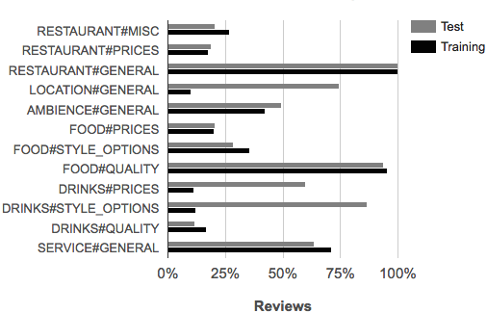
Relative Frequencies of Aspects in Reviews
RESTAURANT#GENERAL has a frequency of 100% (present in all reviews)

Slide 11
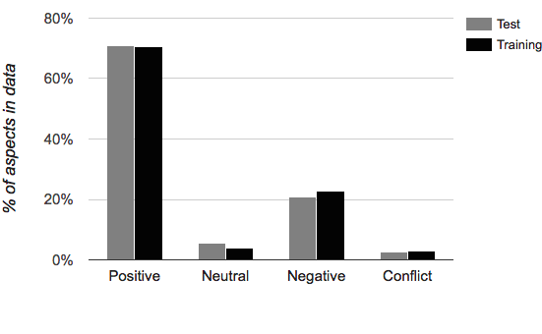
Relative Frequencies of Sentiment in Reviews
Unbalanced sentiment distribution (Positive labels are the most frequent)

Slide 12
Methodology
Multi-class classifier: linear SVM (shown to give good results for sentiment analysis in literature)
Review-level: 4 classes (positive, negative, neutral, and conflict)
Sentence-level: 3 classes (positive, negative, and neutral)
SVM implementation: Weka, one-versus-one
Data processing: Stanford CoreNLP Toolkit
Tokenization
Part-of-Speech
Lemmatization
Grammatical dependencies
Ontology gazeteering

Slide 13
Ontology
Available online: http://www.kimschouten.com/papers/sac2018-ontology.owl (manually created using the training set and three external resources http://quizlet.com , http://www.macmillandictionary.com/, and https://wordnet.princeton.edu/)
Three main classes:
Entity class with subclasses (noun aspect hierarchy): Ambience, Experience, Location, Person, Price, Restaurant, Service, StyleOptions, and Sustenance which have their own subclasses
The aspect relation links an entity class with its corresponding aspect (e.g., FOOD#QUALITY)
Property class (adjectives):
Generic properties (e.g., GenericPositiveProperty): general positive or negative properties related to many Entity classes
Entity-specific properties (e.g., AmbienceNegativeProperty): specific positive or negative properties for one Entity class (e.g., subclass of Property and subclass of Ambience)
Sentiment class with subclasses Positive, Negative, and Neutral

Slide 14
Ontology
Context specific sentiment properties: these properties (e.g., Cold) in combination with an entity (e.g., WarmDrinks) imply a subclass of sentiment (e.g., Negative)

Slide 15
Example
Let assume that the word “cramped” appears in text
∃lex.{“cramped”} ⊑ Cramped
Cramped ⊑ AmbienceNegativeProperty
AmbienceNegativeProperty ⊑ Ambience
AmbienceNegativeProperty ⊑ Negative
Ambience ⊑ ∃aspect.{“AMBIENCE#GENERAL”}
Thus “cramped” implies a negative sentiment about the aspect AMBIENCE#GENERAL

Slide 16
Two Algorithms
Use a linear SVM classifier to predict the aspect-based sentiment at review level:
Four classes: positive, negative, neutral, and conflict
Use a linear SVM classifier to predict the aspect-based sentiment at sentence level and aggregate the sentiment:
Three classes: positive (1), negative (-1), and neutral (0)
Aggregation:
Compute the average sentiment for an aspect
If both positive and negative sentiment is present for an aspect then the overall sentiment for this aspect is conflict
Otherwise:
If average sentiment for an aspect is 0 then the overall sentiment for this aspect is neutral
Otherwise the overall sentiment for this aspect is given by the sign of the average sentiment for an aspect (positive or negative)

Slide 17
Model Features
Feature Generators: create one or more features
[Ontology Independent]
Aspect: the aspects present in a sentence/review
Sentence count: the number of sentences in a review
Lemma: the words present in a sentence/review
[Ontology Dependent]
Ontology concepts: If a concept lexicalization is found in a sentence/review and one of the superclasses relates to the current aspect category then add all superclasses as features
Sentiment count: Whenever a concept lexicalization is found and the associated concept is a subclass of Positive or Negative, then increment the respective counter feature (positive or negative)

Slide 18
Model Features
Feature Adaptors: adapt existing features
[Ontology Dependent]
Ontology concept score: multiplies the ontology concept score with 1 (for superclasses that do not relate to the current aspect category) or m >1 (for superclasses that do relate to the current aspect category)
Negation handling: for the sentiment count, an ontology hit word that has a negation word in front of it negates the sentiment class of the associated concept
Synonyms: for the ontology concepts, use the WordNet synonyms in addition to a given concept lexicalization (for a given domain there is in general only one WordNet synset associated to a concept)

Slide 19
Model Features
Feature Adaptors: adapt existing features
[Ontology Dependent]
Weight: for the ontology concepts use the TF-IDF of the associated lexicalization of the superclasses of a found ontology concept
Word window: for the feature generators, when a concept lexical representation is found (including synonyms) we use as textual unit (context) the words at most k grammatical dependency steps away

Slide 20
Evaluation
Collection of restaurant reviews from SemEval 2016
We use the average F₁ score for 10-fold cross-validation on the training data to determine the parameters and set of features
Review-level approach:
base (no ontology features): feature generators aspect, sentence count, and lemma
final (with ontology features): feature generators aspect, sentence count, lemma, ontology concepts, and sentiment count, and feature adaptors: negation handling, synonyms, and weight
For both model the optimized complexity parameter was c=0.1

Slide 21
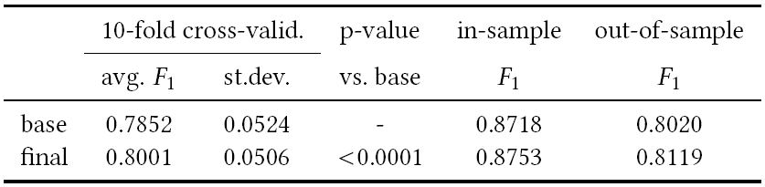
Evaluation
Review-level approach:
The final review-level model (i.e., w/ ontology features) performs better than the base review-level model (i.e., w/o ontology features) for both training and test sets

Slide 22
Evaluation
Sentence-level approach:
baseSL (no ontology features): feature generators aspect and lemma
ontSL (with ontology features): feature generators aspect, lemma, ontology concepts, and sentiment count, and feature adaptors: ontology concept score, negation handling, synonyms, weight, and word window
Parameters:
The ontology concept score parameter was m = 5
The word window parameter was k = 2
The optimized complexity parameter was c = 1 for baseSL and c = 0.1 for ontSL

Slide 23
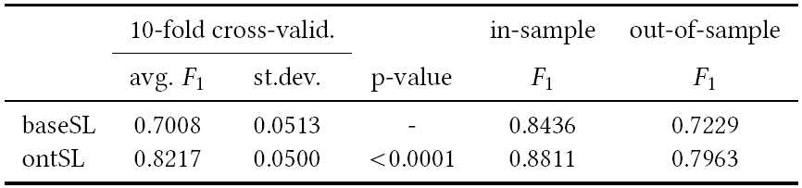
Evaluation
Sentence-level approach: sentence
The ontology-based sentence-level model performs better than the base sentence-level model (i.e., w/o ontology features) for both training and test sets at sentence level

Slide 24
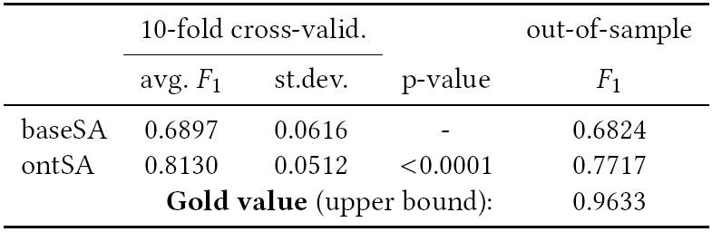
Evaluation
Sentence-level approach: review
The ontology-based sentence-level model performs better than the base sentence-level model (i.e., w/o ontology features) for both training and test sets at review level
The gold value is an upper bound of F₁ when using the gold annotations at sentence level

Slide 25
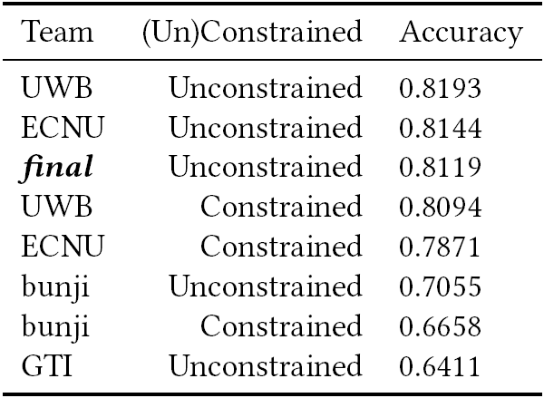
Evaluation
SemEval 2016 ranking (on test set):

Slide 26
Evaluation
There is a 4.02 percentage points increase in F₁ for the review-level classifier compared to the sentence-level classifier
Using the ontology features both classifiers get a better F₁ with a larger increase for the sentence-level classifier compared to the review-level classifier
The accuracy difference of the review-level classifier to the best performing SemEval 2016 classifier is less than 1 percentage points

Slide 27
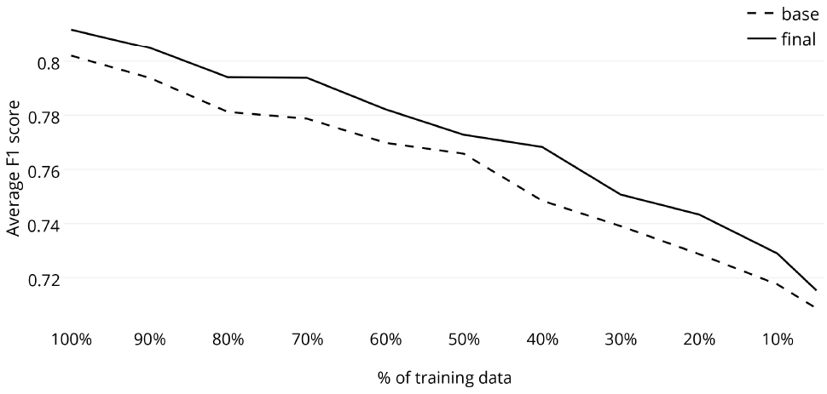
Evaluation
Data size sensitivity (on test set): 10 runs on training set
The ontology gives better results for all training data sizes
The ontology boost seems not to depend on the training data size

Slide 28
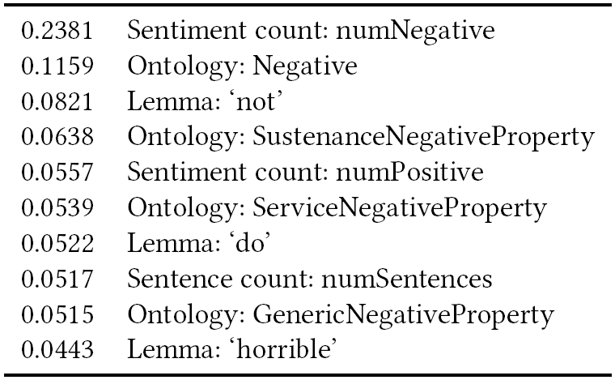
Evaluation
Top 10 most important features for the final review-level model based on to information gain (feature generator: feature)
Most features relate to the dominant class (Negative)
The top 80 features with the largest SVM weight are all ontology features such Negative, Boring, and Cozy

Slide 29
Conclusion
We proposed two algorithms for review-level aspect-based sentiment analysis:
Review-based algorithm
Sentence-based algorithm
The review-based algorithm performs better than the sentence-based algorithm
The use of ontology features boosts the performance of both algorithms
The ontology performance boost seem not to depend on the size of the training data

Slide 30
Future Work
Apply a two step approach:
Use ontology reasoning first
If ontology inconclusive, apply SVM without ontology features (worked well for sentence-based sentiment analysis, results to be presented at ESWC 2018)
Automatic creation of the ontology from text
Extend the ontology coverage using word embeddings
Extract the strength of a sentiment instead of just the polarity: positive, negative, neutral, and conflict
Replace the SVM classifier with a deep learning solution

