Slide 1
A Linked Open Data Schema-Driven Approach for Top-N Recommendations
Flavius Frasincar*
frasincar@ese.eur.nl
* Joint work with Thomas Wever

Slide 2
Contents
Motivation
Related Work
Methodology
Evaluation
Conclusion
Future Work

Slide 3
Motivation
Problem: information overload
Solution: recommender systems
Examples:
  Movie recommendations on Netflix
  Book recommendations on Amazon
  Friend recommendations on Facebook
Three types of recommender systems:
  Content-based recommenders (recommend similar content; address the cold item problem; suffer from cold user problem)
  Collaborative filtering recommenders (recommend content from similar users; suffer from both cold item and cold user problems; often provide better recommendations than the content-based ones)
  Hybrid recommenders (mix of content-based and collaborative filtering; accurate recommendations and no cold item problem)
Our focus:
  Hybrid recommenders

Slide 4
Motivation
Cold item problem: users liked some items, how can we recommend new items (that no one has liked so far)?
We rely on Linked Open Data (freely available semantic data on the Web) to provide information on a certain item (the content-based part of the recommender)
Example: If you like a movie with a certain director you might also like other movies directed by the same director
We rely on machine learning to learn user preferences (based on the collaborative and content-based data of the recommender)
Data sparsity problem: users liked just a few items

Slide 5
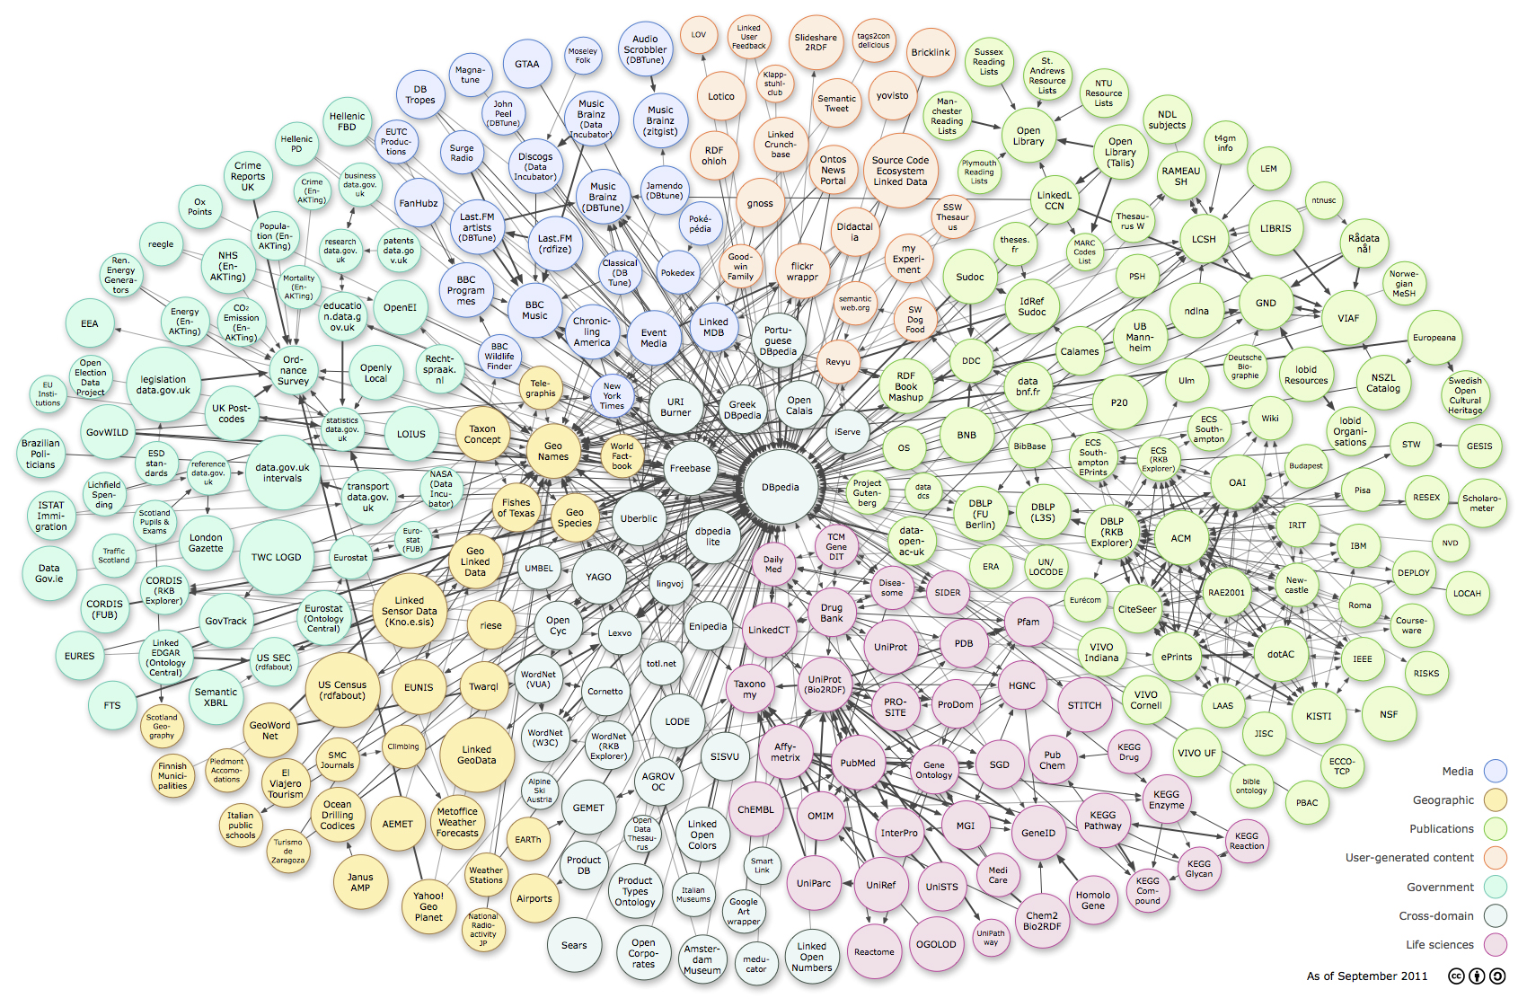
Motivation
Linked
Open
Data
(LOD)

Slide 6
Related Work
Cremonesi et al. (2010):
  Top-N recommender: recommend the most N relevant items (do not focus on rating predictions)
  Testing methodology: only one relevant item in the test set
Ostuni et al. (2013):
  LOD path-based approach: to identify features of movies (in relation to users) for machine learning
  Top-N recommender using a Learning-to-Rank algorithm based on BagBoo with Gradient Boosted Regression Trees (GBRT)
Sun et al. (2011):
  Network schema and meta-paths: schema level information for object similarity search in a network
  Elegant calculation of paths: using a matrix representation

Slide 7
Methodology – Graphs
Graph with nodes that represent:
  Users (e.g., John)
  Items (e.g., Minority Report)
  Entities (e.g., Steven Spielberg)
  and edges represent associations
Undirected graph: represent only the association, direction is not important
Information network: labeled graph
  Nodes are labeled by their type (“user”, “item”, and “entity”)
  Edges are labeled by their type (“likes”, and the various relationship types that exist in LOD, e.g., “starring”, “director”, etc.)
Network schema: graph labels and their constraints, i.e., between which node types a certain edge type is allowed

Slide 8
Methodology – Main Idea
Not all paths are useful for item recommendation
  Use of symmetric paths
  Example: if you like a movie because of its director, you would probably like another movie directed by the same person and not because this person is an actor in that other movie
  Use only paths with important path edges
  Example: the director of the movie is usually important, but the release place of a movie is usually not important
Advantages:
  Effectiveness: more accurate recommendations by eliminating “noisy” paths
  Efficiency: no need to compute all paths between a user and an item

Slide 9
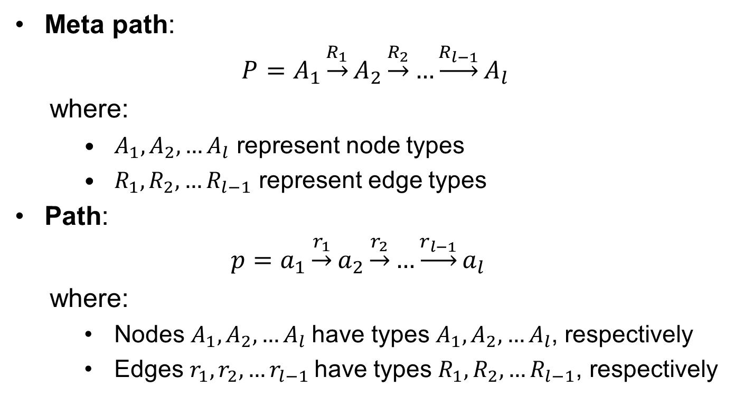
Methodology – Meta Paths
Meta path:
$$P=A_{1}\underset{→}{R_{1}}A_{2}\underset{→}{R_{2}}…{\underset{→}{R_{l−1}}A}_{l}$$
  where:
    $A_{1},A_{2},…A_{l}$ represent node types
    $R_{1},R_{2},…R_{l−1}$ represent edge types
Path:
  $$p=a_{1}\underset{→}{r_{1}}a_{2}\underset{→}{r_{2}}…{\underset{→}{r_{l−1}}a}_{l}$$
  where:
    Nodes $A_{1},A_{2},…A_{l}$have types $A_{1},A_{2},…A_{l}$, respectively
    Edges $r_{1},r_{2},…r_{l−1}$have types $R_{1},R_{2},…R_{l−1}$, respectively

Slide 10
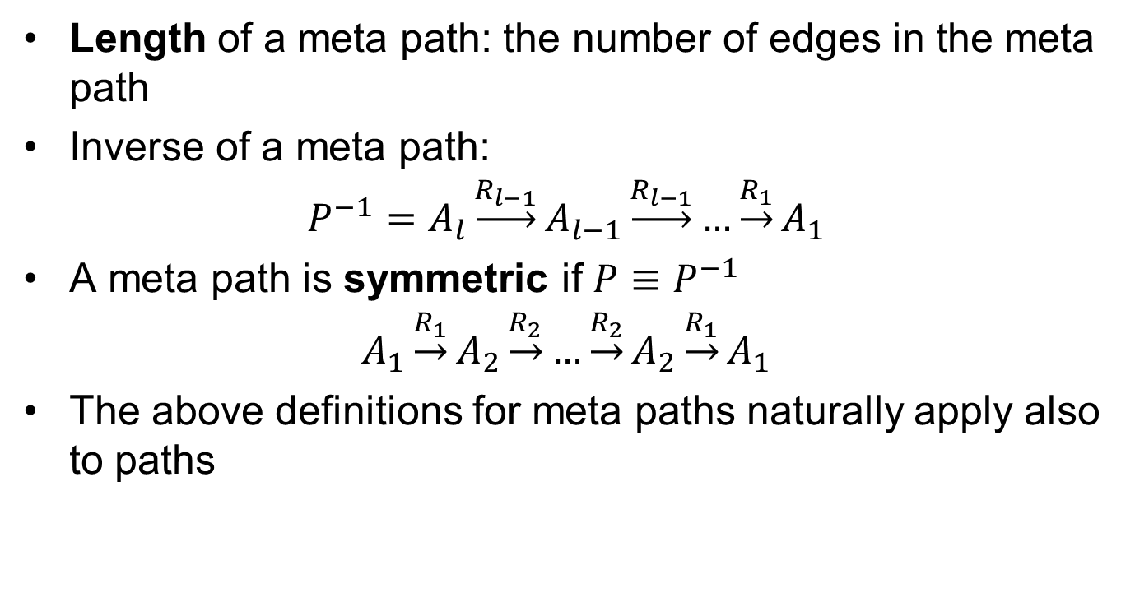
Methodology – Meta Paths
Length of a meta path: the number of edges in the meta path
Inverse of a meta path:
$$P^{−1}=A_{l}\underset{→}{R_{l−1}}A_{l−1}\underset{→}{R_{l−1}}…{\underset{→}{R_{1}}A}_{1}$$
A meta path is symmetric if $P≡P^{−1}$
$$A_{1}\underset{→}{R_{1}}A_{2}\underset{→}{R_{2}}…{\underset{→}{R_{2}}A}_{2}{\underset{→}{R_{1}}A}_{1}$$
The above definitions for meta paths naturally apply also to paths

Slide 11
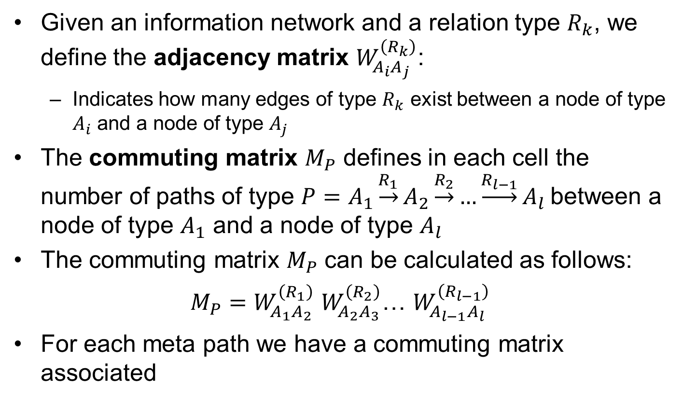
Methodology – Path Computations
Given an information network and a relation type $R_{k}$, we define the adjacency matrix $W_{A_{i}A_{j}}^{\left(R_{k}\right)}$:
  Indicates how many edges of type $R_{k}$ exist between a node of type $A_{i}$ and a node of type $A_{j}$
The commuting matrix $M_{P}$ defines in each cell the number of paths of type $P=A_{1}\underset{→}{R_{1}}A_{2}\underset{→}{R_{2}}…{\underset{→}{R_{l−1}}A}_{l}$between a node of type $A_{1}$ and a node of type $A_{l}$
The commuting matrix $M_{P}$ can be calculated as follows:
$M_{P}=W_{A_{1}A_{2}}^{\left(R_{1}\right)}$ $W_{A_{2}A_{3}}^{\left(R_{2}\right)}$… $W_{A_{l−1}A_{l}}^{\left(R_{l−1}\right)}$
For each meta path we have a commuting matrix associated

Slide 12
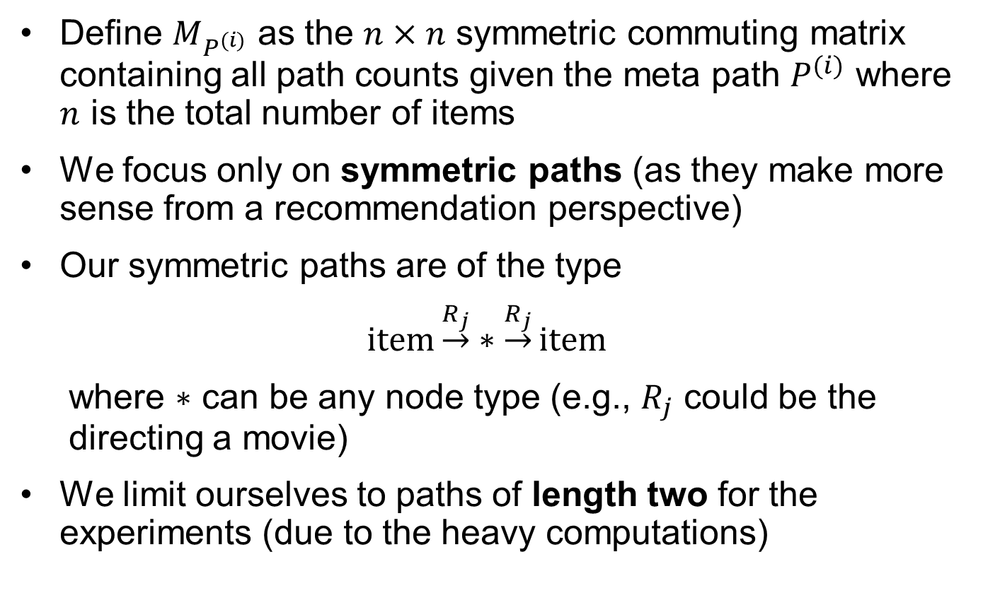
Methodology – Features Construction
Define $M_{P^{(i)}}$ as the $n×n$ symmetric commuting matrix containing all path counts given the meta path $P^{(i)}$ where $n$ is the total number of items
We focus only on symmetric paths (as they make more sense from a recommendation perspective)
Our symmetric paths are of the type
$$\text{item}\underset{→}{R_{j}}∗\underset{→}{R_{j}}\text{item}$$
where $∗$ can be any node type (e.g., $R_{j}$ could be the
directing a movie)
We limit ourselves to paths of length two for the experiments (due to the heavy computations)

Slide 13
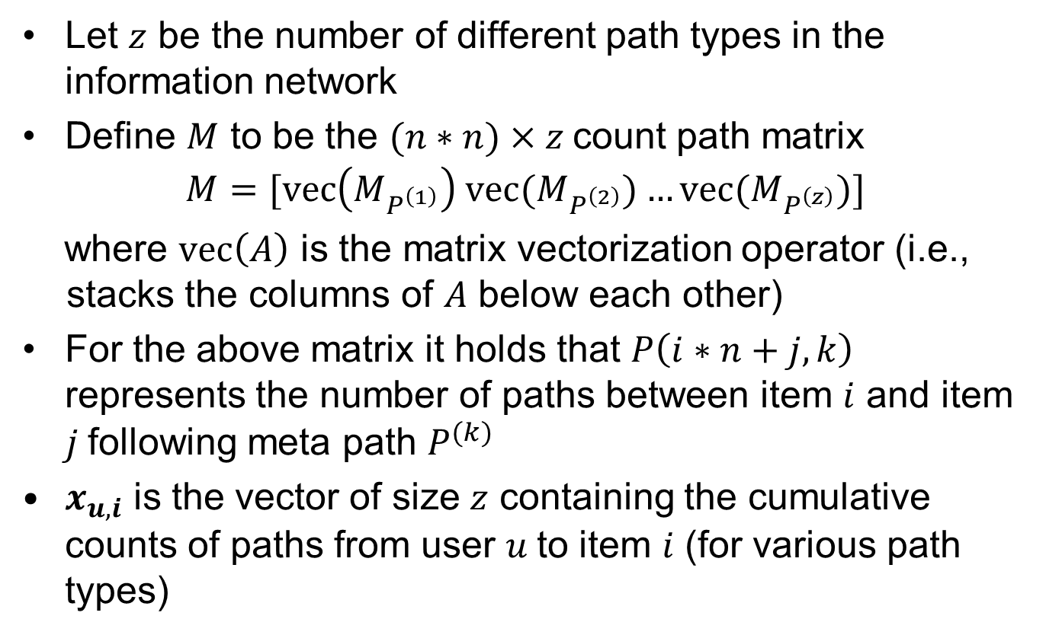
Methodology – Features Construction
Let $z$ be the number of different path types in the information network
Define $M$ to be the $(n∗n)×z$count path matrix
$$M=[\text{vec}\left(M_{P^{\left(1\right)}}\right) \text{vec}(M_{P^{\left(2\right)}})…\text{vec}(M_{P^{\left(z\right)}})]$$
where $\text{vec}\left(A\right)$ is the matrix vectorization operator (i.e., stacks the columns of $A$ below each other)
For the above matrix it holds that $P\left(i∗n+j,k\right)$ represents the number of paths between item $i$ and item $j$following meta path $P^{(k)}$
$x_{u,i}$ is the vector of size $z$ containing the cumulative counts of paths from user $u$to item $i$ (for various path types)

Slide 14
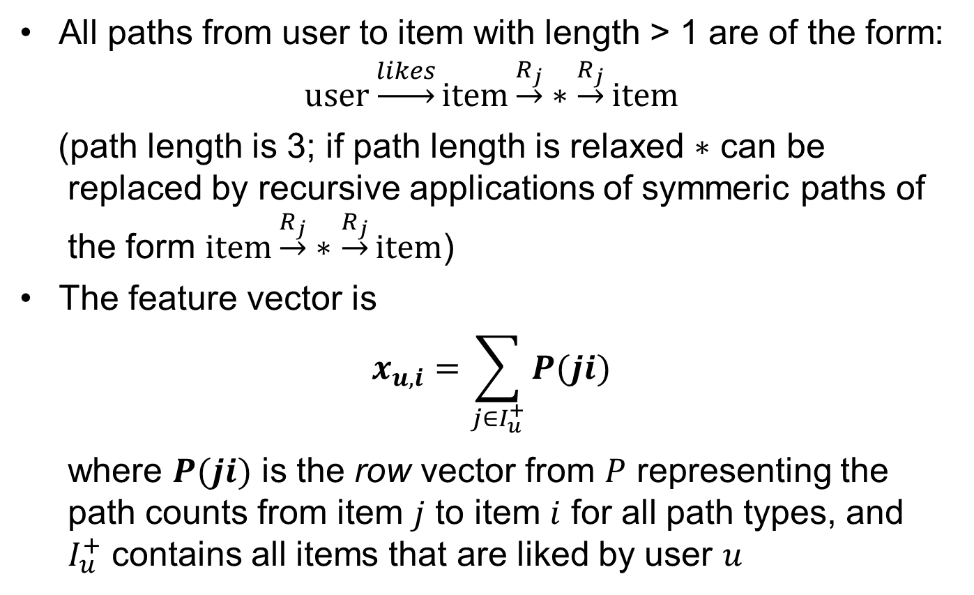
Methodology – Features Construction
All paths from user to item with length > 1 are of the form:
$$\text{user}\underset{→}{likes}item\underset{→}{R_{j}}∗\underset{→}{R_{j}}item$$
(path length is 3; if path length is relaxed $∗$ can be
replaced by recursive applications of symmeric paths of
the form $\text{item}\underset{→}{R_{j}}∗\underset{→}{R_{j}}\text{item}$)
The feature vector is
$$x_{u,i}=\sum_{j∈I_{u}^{+}}{P(ji)}$$
where $P(ji)$ is the row vector from $P$ representing the
path counts from item $j$ to item $i$ for all path types, and
$I_{u}^{+}$ contains all items that are liked by user $u$

Slide 15
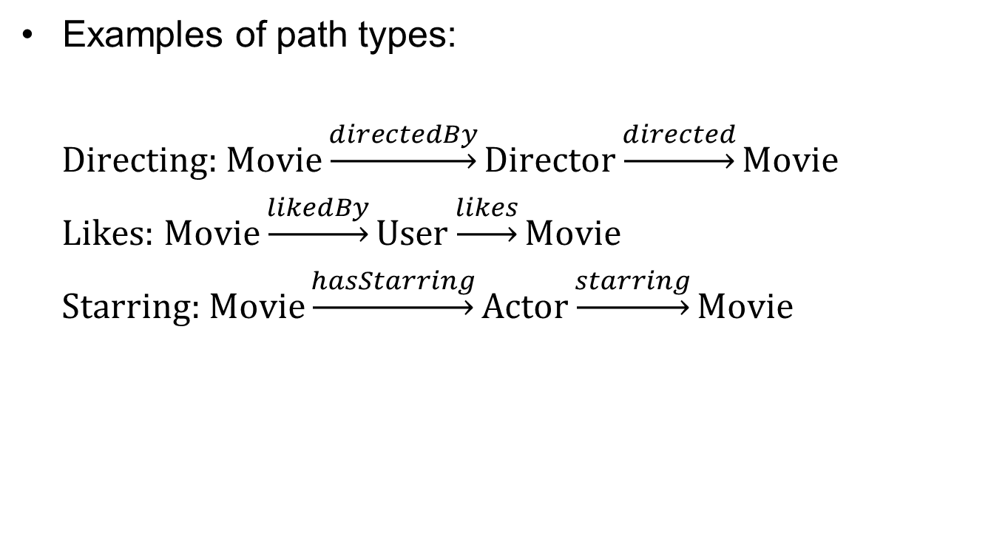
Methodology – Features Construction
Examples of path types:
$\text{Directing}\text{: }\text{Movie}\underset{→}{directedBy}\text{Director}\underset{→}{directed}\text{Movie}$
$\text{Likes}\text{: }\text{Movie}\underset{→}{likedBy}\text{User}\underset{→}{likes}\text{Movie}$
$\text{Starring}\text{: }\text{Movie}\underset{→}{hasStarring}\text{Actor}\underset{→}{starring}\text{Movie}$

Slide 16
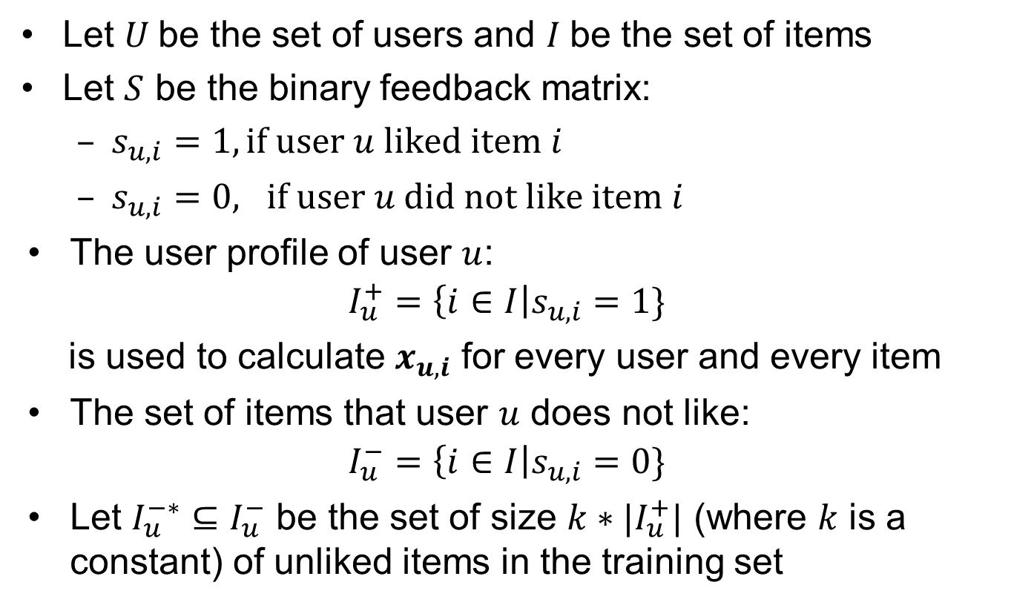
Methodology – Top-N Recommendations
Let $U$be the set of users and $I$be the set of items
Let $S$ be the binary feedback matrix:
  $s_{u,i}=1, \text{if} \text{user} u \text{liked} \text{item} i$
  $s_{u,i}=0, \text{if} \text{user} u \text{did} \text{not} \text{like} \text{item} i$
The user profile of user $u$:
$$I_{u}^{+}=\left\{i∈I\right|s_{u,i}=1\}$$
is used to calculate $x_{u,i}$ for every user and every item
The set of items that user $u$ does not like:
$$I_{u}^{−}=\left\{i∈I\right|s_{u,i}=0\}$$
Let $I_{u}^{−∗}⊆I_{u}^{−}$ be the set of size $k∗|I_{u}^{+}|$ (where $k$ is a constant) of unliked items in the training set

Slide 17
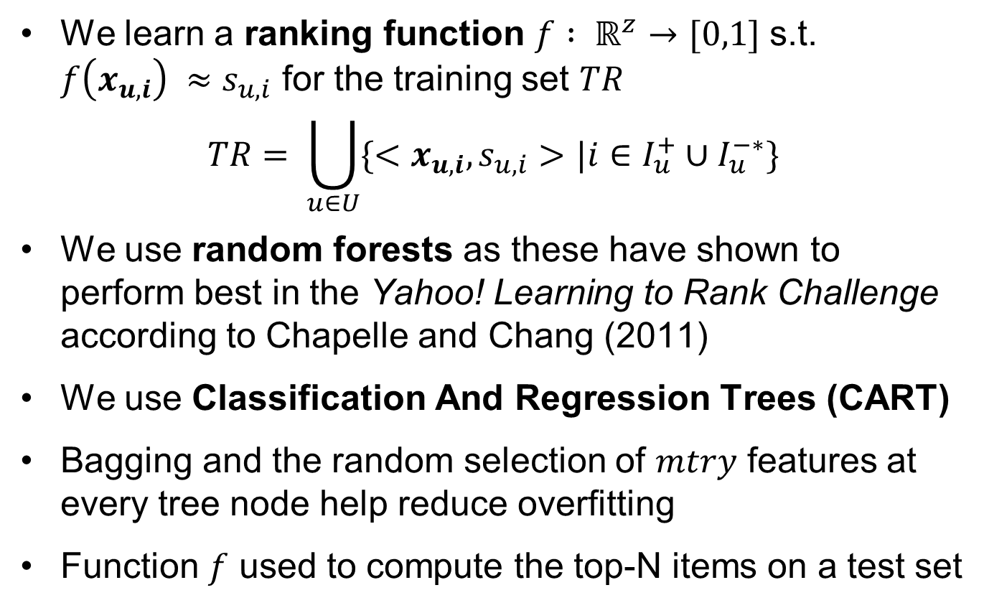
Methodology – Top-N Recommendations
We learn a ranking function $f : ℝ^{z}→[0,1]$ s.t. $f\left(x_{u,i}\right) ≈s_{u,i}$ for the training set $TR$
$$TR= \bigcup_{u∈U}{\{<x_{u,i}, s_{u,i}>|i∈I_{u}^{+}{∪I}_{u}^{−∗}\}}$$
We use random forests as these have shown to perform best in the Yahoo! Learning to Rank Challenge according to Chapelle and Chang (2011)
We use Classification And Regression Trees (CART)
Bagging and the random selection of $mtry$ features at every tree node help reduce overfitting
Function $f$ used to compute the top-N items on a test set
Notes:
A forest of 100 trees

Slide 18
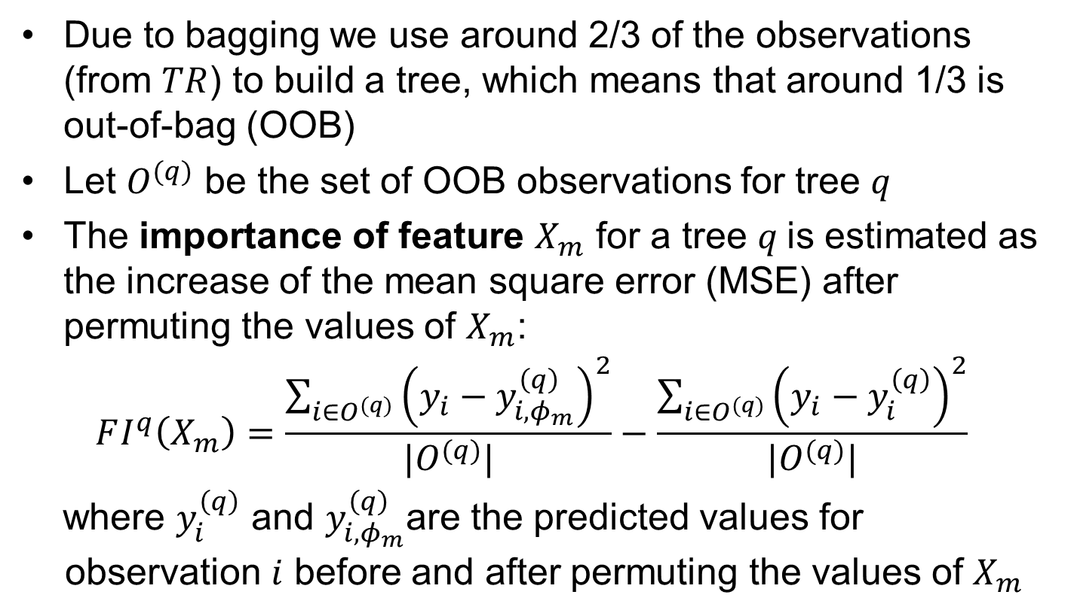
Methodology – Feature Importance
Due to bagging we use around 2/3 of the observations (from $TR$) to build a tree, which means that around 1/3 is out-of-bag (OOB)
Let $O^{(q)}$ be the set of OOB observations for tree $q$
The importance of feature $X_{m}$ for a tree $q$is estimated as the increase of the mean square error (MSE) after permuting the values of $X_{m}$:
$$FI^{q}\left(X_{m}\right)=\frac{\sum_{i∈O^{(q)}}{{\left(y_{i}−y_{i,φ_{m}}^{\left(q\right)}\right)}^{2}}}{|O^{(q)}|}−\frac{\sum_{i∈O^{(q)}}{{\left(y_{i}−y_{i}^{\left(q\right)}\right)}^{2}}}{|O^{(q)}|}$$
where $y_{i}^{\left(q\right)}$ and $y_{i,φ_{m}}^{\left(q\right)}$are the predicted values for observation $i$ before and after permuting the values of $X_{m}$

Slide 19
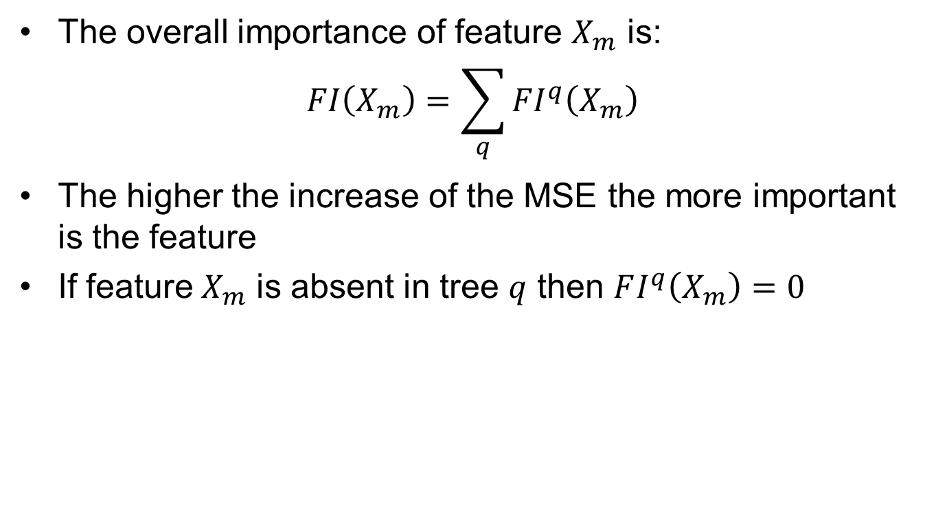
Methodology – Feature Importance
The overall importance of feature $X_{m}$ is:
$$FI\left(X_{m}\right)=\sum_{q}{{FI}^{q}\left(X_{m}\right)}$$
The higher the increase of the MSE the more important is the feature
If feature${ X}_{m}$ is absent in tree $q$ then $FI^{q}\left(X_{m}\right)=0$

Slide 20
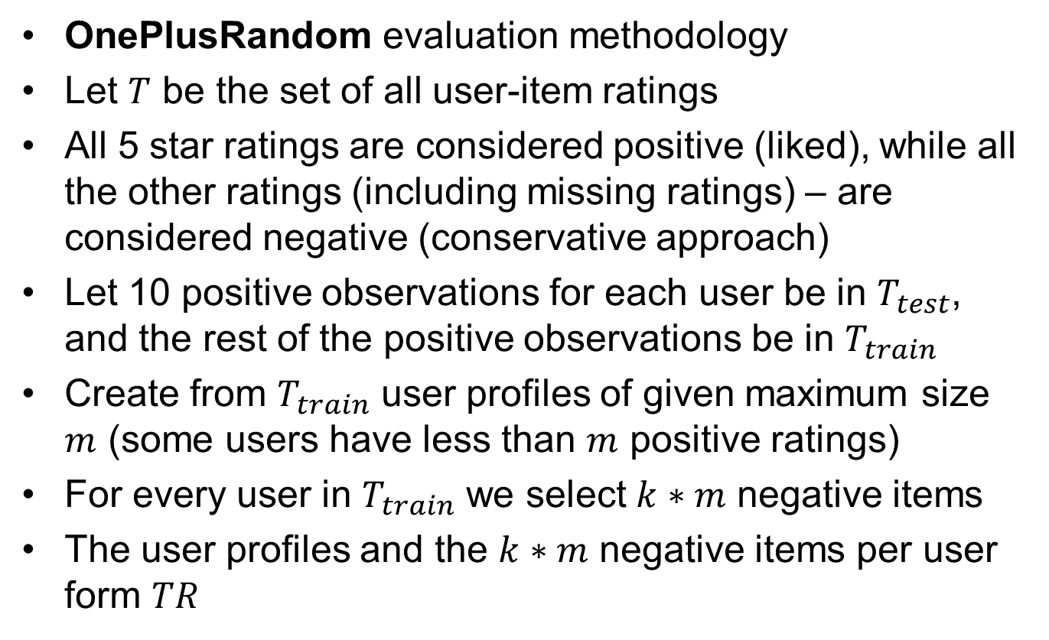
Evaluation
OnePlusRandom evaluation methodology
Let $T$ be the set of all user-item ratings
All 5 star ratings are considered positive (liked), while all the other ratings (including missing ratings) – are considered negative (conservative approach)
Let 10 positive observations for each user be in $T_{test}$, and the rest of the positive observations be in $T_{train}$
Create from $T_{train}$ user profiles of given maximum size $m$ (some users have less than $m$ positive ratings)
For every user in $T_{train}$ we select $k∗m$ negative items
The user profiles and the $k∗m$ negative items per user form $TR$

Slide 21
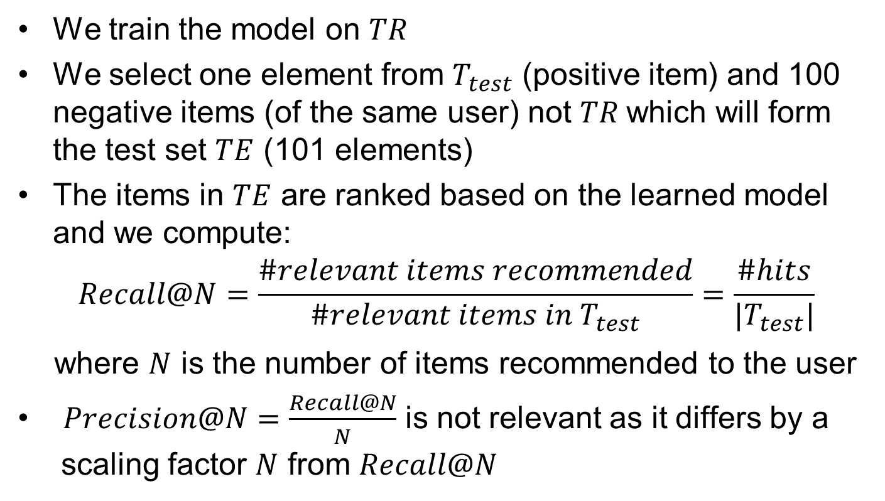
Evaluation
We train the model on $TR$
We select one element from $T_{test}$ (positive item) and 100 negative items (of the same user) not $TR$which will form the test set $TE$ (101 elements)
The items in $TE$ are ranked based on the learned model and we compute:
$$Recall@N=\frac{\#relevant items recommended}{\#relevant items in T_{test}}=\frac{\#hits}{|T_{test}|}$$
where $N$ is the number of items recommended to the user
$Precision@N=\frac{Recall@N}{N}$ is not relevant as it differs by a
scaling factor $N$ from $Recall@N$
Notes:
Pessimistic evaluation

Slide 22
Evaluation – Data
MovieLens 1M dataset:
  1,000,000 ratings ranging from 1 (terrible) to 5 (amazing)
  6,040 users (each user has at least 20 ratings)
  3,952 movies
DBpedia (Wikipedia on the LOD cloud)
Mapping between MovieLens and DBpedia:
  Movies need to have the same title and the same release year
  2,056 movies left
We considered users with at least 15 positive ratings:
  104,196 positive ratings from 2,731 users (38 positive ratings per user)

Slide 23
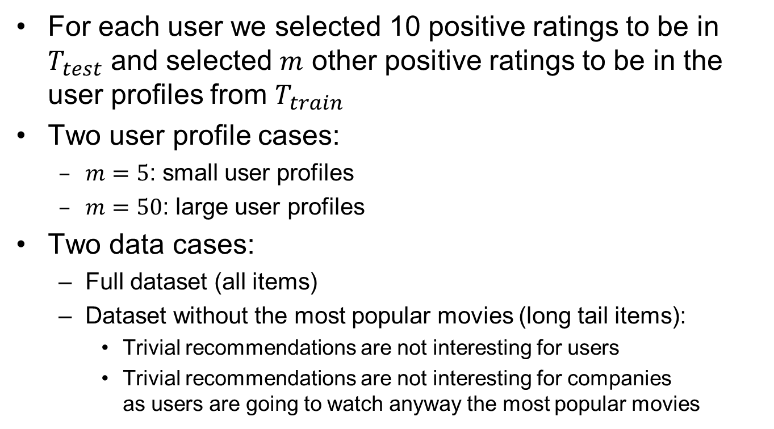
Evaluation – Data
For each user we selected 10 positive ratings to be in $T_{test}$ and selected $m$ other positive ratings to be in the user profiles from $T_{train}$
Two user profile cases:
  $m=5$: small user profiles
  $m=50$: large user profiles
Two data cases:
  Full dataset (all items)
  Dataset without the most popular movies (long tail items):
    Trivial recommendations are not interesting for users
    Trivial recommendations are not interesting for companies
    as users are going to watch anyway the most popular movies

Slide 24
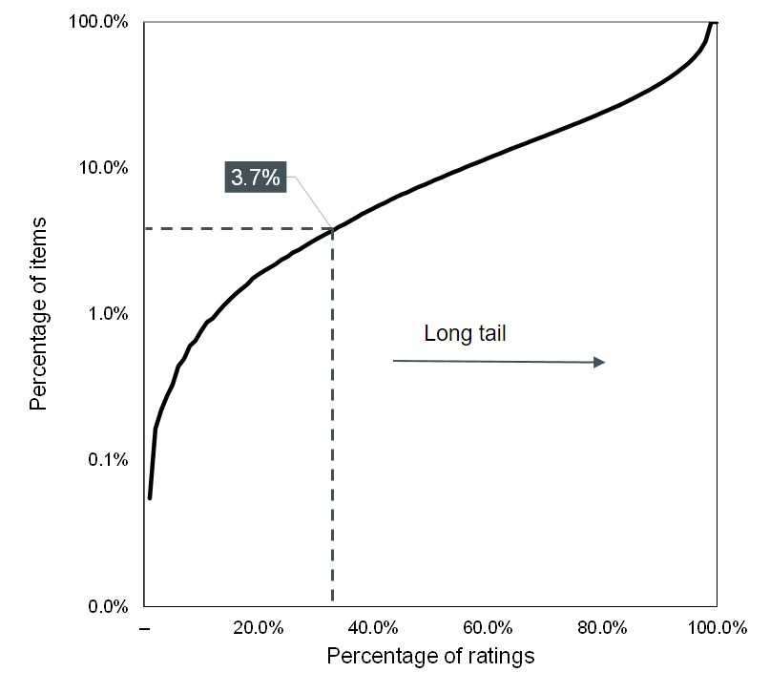
Evaluation – Most Popular Items
Remove 3.7% of the items which make up for 33% of the ratings (76 movies)
Keep the rest of the movies known as the long tail items

Slide 25
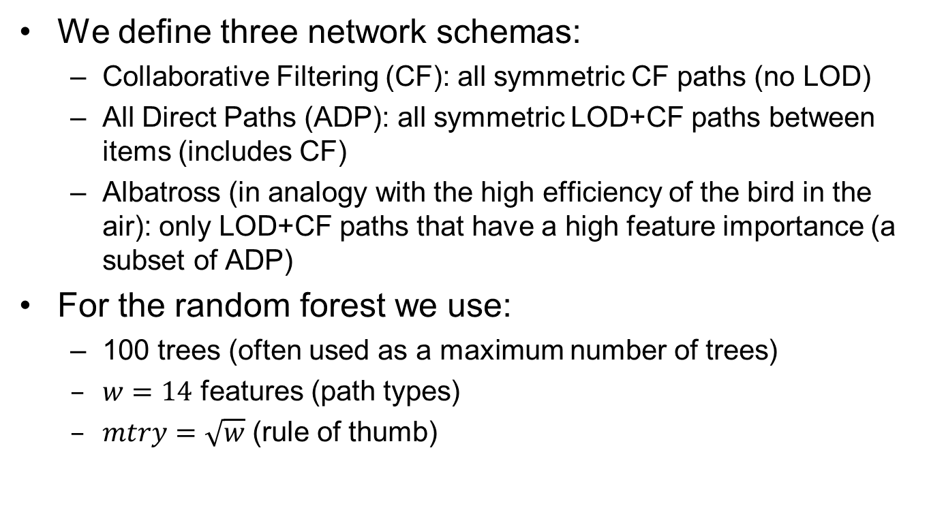
Evaluation – Network Schemas
We define three network schemas:
  Collaborative Filtering (CF): all symmetric CF paths (no LOD)
  All Direct Paths (ADP): all symmetric LOD+CF paths between items (includes CF)
  Albatross (in analogy with the high efficiency of the bird in the air): only LOD+CF paths that have a high feature importance (a subset of ADP)
For the random forest we use:
  100 trees (often used as a maximum number of trees)
  $w=14$ features (path types)
  $mtry=\sqrt{w}$ (rule of thumb)

Slide 26
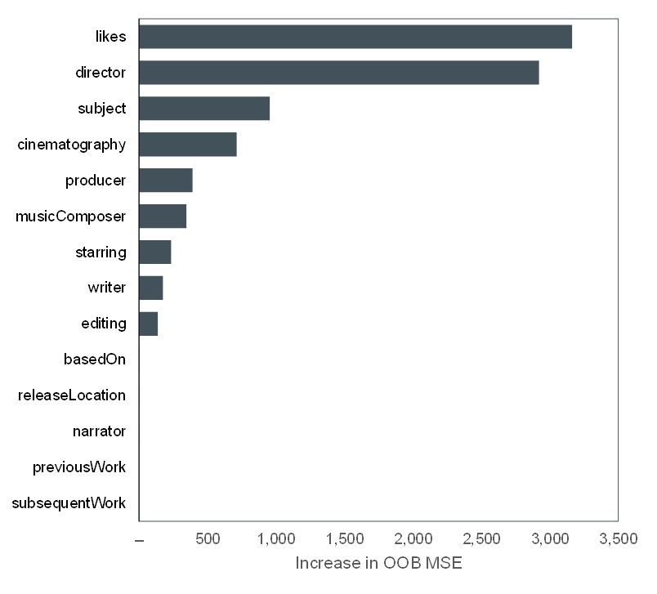
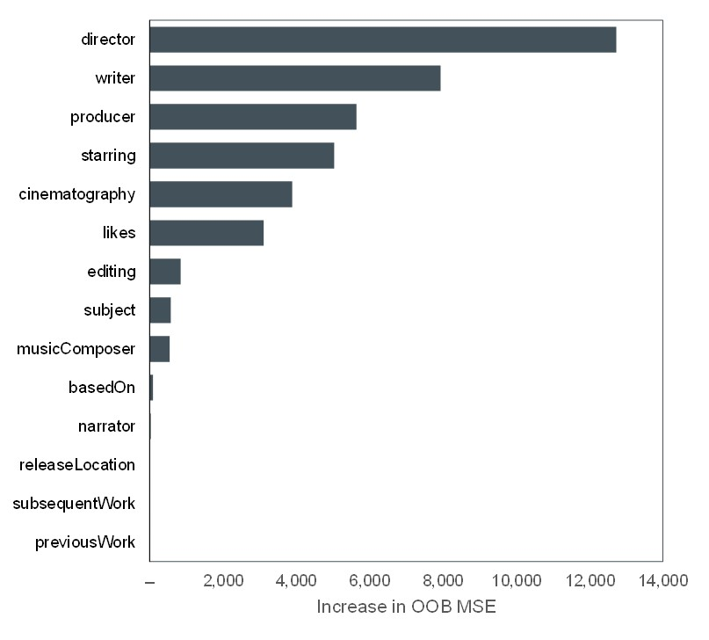


Evaluation – Feature Importance
Small user profiles ($\text{m}\text{ = 5}$)
Large user profiles ($\text{m}\text{ = 50}$)
Important features: likes, director, subject, cinematography, producer, musicComposer, starring, writer, and editing
“Noisy” features: basedOn, releaseLocation, narrator, previousWork, and subsequentWork
Important features are retained in Albatross
Higher importance scores for the more precise model (large user profile)
Notes:
M=50, more accurate model (higher values for feature importance)

Slide 27
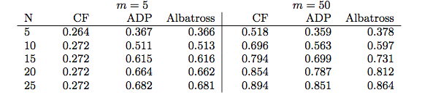
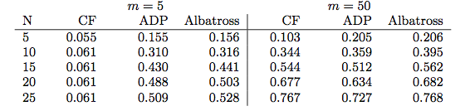
Evaluation – Recall@N
All items
Long tail
(most popular items cannot be recommended)
For long tail items performance is worse than for all items as the easy-to-predict popular movies are removed
For large profiles CF performs relatively good (especially in predicting popular items)

Slide 28
Evaluation – Recall@N
Small user profiles: LOD very useful
All items
Long tail
(most popular items cannot be recommended)

Slide 29
Evaluation – Recall@N
Large user profiles: LOD only useful for long tail items
All items
Long tail
(most popular items cannot be recommended)

Slide 30
Evaluation – Recall@N
Focusing on most promising path types good for performance
All items
Long tail
(most popular items cannot be recommended)

Slide 31
Conclusion
We proposed a hybrid recommender:
  Uses of symmetric path types from LOD
  Suggests Top-N recommendations using learning-to-rank
  Based on a random forest and path type importance scores
Main recommendations:
  Use of LOD (Linked Open Data) cloud in recommender systems is useful especially for small user profiles
  Use of LOD cloud for large user profiles only useful when the most popular items cannot be recommended
  Selecting only the most relevant data from the LOD cloud improves performance of the recommender system

Slide 32
Future Work
Sensitivity analysis of parameters:
  Number of trees
  Number of features per node
  Profile sizes
Extend the framework to paths of length larger than 3
Apply the framework to all types of paths (including cross-paths and not just symmetric paths)
Measure the efficiency of the Albatross method
Provide explanations of why a certain item is recommended (by visualizing the values of the most important features, i.e., path types)
Apply the framework to other datasets and domains

