Slide 1
Duplicate Detection in Web Shops Using LSH to Reduce the Number or Computations
Flavius Frasincar*
frasincar@ese.eur.nl
* Joint work with Iris van Dam, Gerhard van Ginkel, Wim Kuipers, Nikki Nijenhuis, and Damir Vandic

Slide 2
Contents
Motivation
Related Work
Multi-component Similarity Method with Preselection (MSMP)
Overview
Model Words
Min-hashing
Locality-Sensitive Hashing (LSH)
Multi-component Similarity Method (MSM)
Example
Evaluation
Conclusion

Slide 3
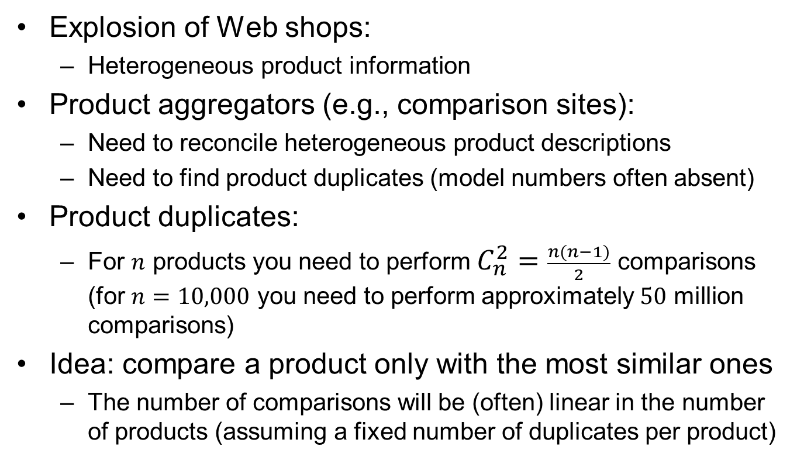
Motivation
Explosion of Web shops:
Heterogeneous product information
Product aggregators (e.g., comparison sites):
Need to reconcile heterogeneous product descriptions
Need to find product duplicates (model numbers often absent)
Product duplicates:
For $n$ products you need to perform $C_{n}^{2}=\frac{n(n−1)}{2}$ comparisons (for $n=10,000$ you need to perform approximately $50$ million comparisons)
Idea: compare a product only with the most similar ones
The number of comparisons will be (often) linear in the number of products (assuming a fixed number of duplicates per product)

Slide 4
Related Work
Highly Heterogeneous Information Spaces (HHIS):
Non-structured data
High level of noise
Large scale
Entity Resolution (ER):
Dirty ER: single collection
Clean-Clean ER: two clean (duplicate-free) collections [our focus]
Blocking = clustering of entities that need to be compared for duplicate detection (one block represents one cluster)
Token (schema agnostic): one block per token [our focus]
Attribute Clustering (schema-aware): cluster attributes by value similarity (k clusters per token)
Scheduling: rank blocks by utility (many duplicates, few comparisons blocks are first)

Slide 5
Multi-component Similarity Method with Preselection Overview
Extract Model Words
Products
Binary Product Vectors
Apply Locality-Sensitive Hashing
Nearest Neighbors
Apply Multi-component Similarity Method
DuplicateProducts

Slide 6
Model Words
For every product extract the model words present in title (title contains descriptive and distinctive information)
A model word is a string that contains both numeric as well as alphabetic or special characters
Model word regular expression:
[a-zA-Z0-9]*(([0-9]+[^0-9, ]+)|([^0-9, ]+[0-9]+))[a-zA-Z0-9]*
Examples of model words:
32”, 720p, 60Hz
Every product is represented as a binary vector indicating the presence/absence of a model word

Slide 7
Min-hashing
n is the number of min-hashes
P is the set of all product vectors
S is an empty signature matrix of size (n,|P|)
for all i = 1 to n do
for all v in P do
Determine for product v under permutation i the number of row containing the first 1, x S(i,v) = x
end for
end for
Jaccard similarity between two products is the same as the probability that two rows have the same value
Addresses the curse of dimensionality: smaller vectors (n)!

Slide 8
Locality-Sensitive Hashing
P is the set of all product vectors
Divide the signature matrix S into b bands, each containing r rows
for all b bands do
for all v in P do
Hash v to a bucket, based on the value of the hash function
end for
end for
for all buckets do
Label all pairs of products in this bucket as candidate neighbors
end for
Consider as possible duplicates only products in the same bucket!
Note that a product can appear in multiple buckets
Pairs previously marked as candidate neighbors are not reconsidered

Slide 9
Locality-Sensitive Hashing
The number of bands and rows: allows us to control for the desired Jaccard similarity!
Set of hash functions (one per band): We use as hash function (same for all bands) the number obtained by concatenating the row values corresponding to a band
Example:
2
3
5
8
band 1
(4 rows)
2358
5
3
1
2
band 2
(4 rows)
5312

Slide 10
Locality-Sensitive Hashing
Two products are considered candidate neighors if they are in the same bucket for at least one of the bands
Let t denote threshold above which the Jaccard similarity of two products determines them to be candidate neighbors
Pick number of bands b and number of rows per band r such that:
Tradeoff b and r is the tradeoff between false positives (FP) and false negatives (FN)
b x r = n (1) [the size n of signature vectors is given]
(1/b)^{(1/r)} = t (2) [ensure a small FP and FN for a given t]

Slide 11
Multi-component Similarity Method
Hybrid similarity function as weighted similarity of three components:
Key-Value Pairs (KVP) component (for matching keys)
Value component (for non-matching keys)
Title similarity
Adapted single linkage hierarchical clustering
(one similarity stop condition parameter ε)
The adaptation comes from three heuristics:
Products from the same Web shop have similarity 0
Products from different brands have similarity 0
Products not marked as candidate neighbors by LSH have similarity 0

Slide 12
Multi-component Similarity Method
Key-Value Pairs (KVP) component (for matching keys):
sim = avgSim=0
m = 0 {number of matching keys} w = 0 {weight of matching keys}
nmk_{i} = KVP_{i} {non-matching keys of product p_{i}}
nmk_{j} = KVP_{j} {non-matching keys of product p_{j}}
for all KVP q in KVP_{i} do
for all KVP r in KVP_{j} do
keySim = q-gramSim(key(q),key(r)) {Jaccard similarity for q-grams; q = 3}
if keySim > γ then
valueSim = q-gramSim(value(q),value(r))
weight = keySim
sim = sim + weight * valueSim
m = m + 1
w = w + weight
nmk_{i} = nmk_{i} - q
nmk_{j} = nmk_{j} - r
end if
end for
end for
if w > 0 then avgSim = sim/w endif

Slide 13
Multi-component Similarity Method
Key-Value Pairs (KVP) component (for non-matching keys):
mwPerc = mw(exMW(nmk_{i}),exMW(nmk_{j})) {percent. of matching model words from values}
Title component:
titleSim = TMWMSim(p_{i},p_{j},α,β)
Hybrid (global) similarity:
if titleSim = 0 then {no similarity according to title}
θ₁ = m/minFeatures(p_{i},p_{j})
θ₂ = 1- θ₁
hsim = θ₁ * avgSim + θ₂ * mwPerc
else
θ₁ = (1 - μ) * m/minFeatures(p_{i},p_{j})
θ₂ = 1 - μ - θ₁
hsim = θ₁ * avgSim + θ₂ * mwPerc + μ * titleSim
end if

Slide 14
Multi-component Similarity Method
Title component (reused old parameters σ and δ):
nameCosineSim = calcCosineSim(title_{i},title_{j})
if nameCosineSim > α then titleSim = 1 {output1}
else
mwTitle_{i} = exMW(title_{i})
mwTitle_{j} = exMW(title_{j})
if found pair where non-numeric part is approx. the same AND the numeric part is different(mwTitle_{i},mwTitle_{j}) then titleSim = 0 {output2} {approx. based on a threshold}
else
titleSim = σ * nameCosineSim + (1 - σ) * avgLvSim(title_{i},title_{j}) {output3}
if found pairs where non-numeric part is approx. the same AND the numeric part is the same(mwTitle_{i},mwTitle_{j}) then
titleSim = δ * avgLvSimMW(mwTitle_{i},mwTitle_{j}) + (1 - δ) * titleSim {output4}
end if
if titleSim < β then titleSim = 0 {output5}
end if
end if
end if

Slide 15
Example
5 products:
2 duplicates: (2,3) and (4,5)
Product ID | Title | Web shop
1 | SuperSonic 32" 720p LED HDTV SC-3211 | Newegg
2 | Samsung UN46ES6580 46-Inch 1080p 120Hz 3D HDTV | Amazon
3 | Samsung 46" 1080p 240Hz LED HDTV UN46ES6580 | Newegg
4 | Toshiba - 32" / LED / 720p / 60Hz / HDTV | Bestbuy
5 | Toshiba 32" 720p 60Hz LED-LCD HDTV 32SL410U | Newegg

Slide 16
Example
10 model words:
 |  |  | Product ID
Model word |  | 1 | 2 | 3 | 4 | 5
720p | 1 | 1 | 0 | 0 | 1 | 1
1080p | 2 | 0 | 1 | 1 | 0 | 0
60Hz | 3 | 0 | 0 | 0 | 1 | 1
120Hz | 4 | 0 | 1 | 0 | 0 | 0
240Hz | 5 | 0 | 0 | 1 | 0 | 0
3D | 6 | 0 | 1 | 0 | 0 | 0
SC-3211 | 7 | 1 | 0 | 0 | 0 | 0
UN46ES6580 | 8 | 0 | 1 | 1 | 0 | 0
46-inch | 9 | 0 | 1 | 0 | 0 | 0
32L410U | 10 | 0 | 0 | 0 | 0 | 1

Slide 17
Example
n = 4, we need 4 permutations
p1 | = | [1, 6, 2, 9, 3, 10, 8, 4, 5, 7]
p2 | = | [6, 1, 5, 9, 10, 3, 7, 2, 8, 4]
p3 | = | [5, 7, 8, 3, 6, 1, 2, 10, 4, 9]
p4 | = | [2, 7, 4, 3, 9, 8, 10, 5, 6, 1]
 |  | Product ID
Permutation | 1 | 2 | 3 | 4 | 5
p1 | 1 | 2 | 3 | 1 | 1
p2 | 2 | 1 | 3 | 2 | 2
p3 | 2 | 3 | 1 | 4 | 4
p4 | 2 | 1 | 1 | 4 | 4

Slide 18
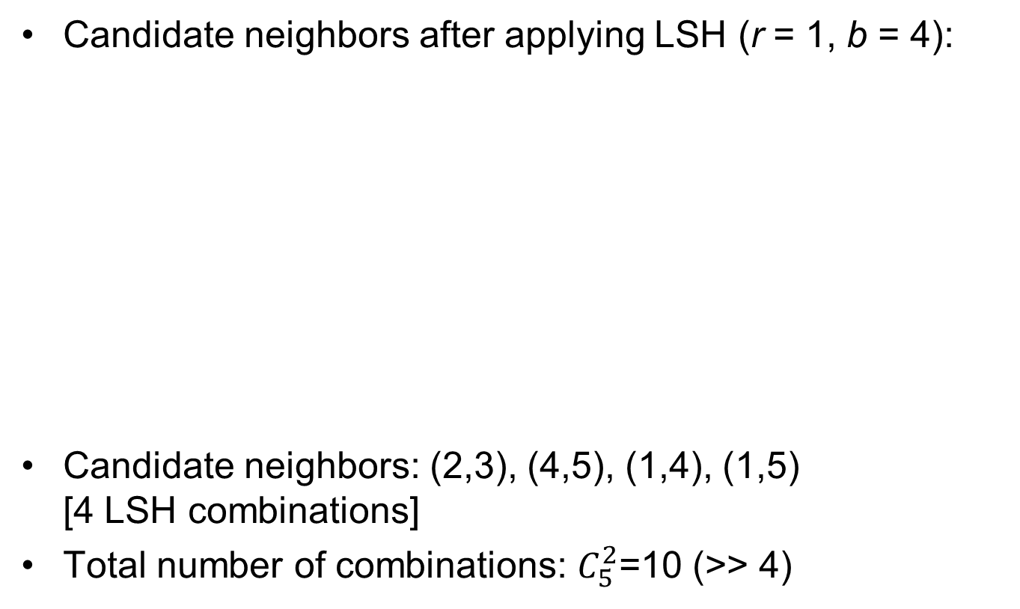
Example
Candidate neighbors after applying LSH (r = 1, b = 4):
Candidate neighbors: (2,3), (4,5), (1,4), (1,5) [4 LSH combinations]
Total number of combinations: $C_{5}^{2}$=10 (>> 4)
 |  | Product ID
Product ID | 1 | 2 | 3 | 4 | 5
1 | 0 | 0 | 0 | 1 | 1
2 |  | 0 | 1 | 0 | 0
3 |  |  | 0 | 0 | 0
4 |  |  |  | 0 | 1
5 |  |  |  |  | 0

Slide 19
Evaluation
Data set with 1624 TVs obtained from 4 webshops:
Amazon.com: 163 TVs
Newegg.com: 668 TVs
BestBuy.com: 773 TVs
TheNerds.net: 20 TVs
Duplicate clusters (golden standard):
Number of clusters of size 1: 933 (933 unique products)
Number of clusters of size 2: 300
Number of clusters of size 3: 25
Number of clusters of size 4: 4
Data set contains model numbers to define golden standard
On average a product has 29 Key-Value pairs

Slide 20
Evaluation
n = 50% of product vector length (size of the vectors do not considerably influence speed, computing MSM(P) similarities is the main bottleneck)
Two types of evaluation:
Quality of the blocking procedure
MSMP vs. MSM:
Bootstraps:
60-65% of the data
Around 1000 products
Parameters learned for one bootstrap and results reported for the remaining products
100 bootstraps
Performance: average among bootstraps

Slide 21
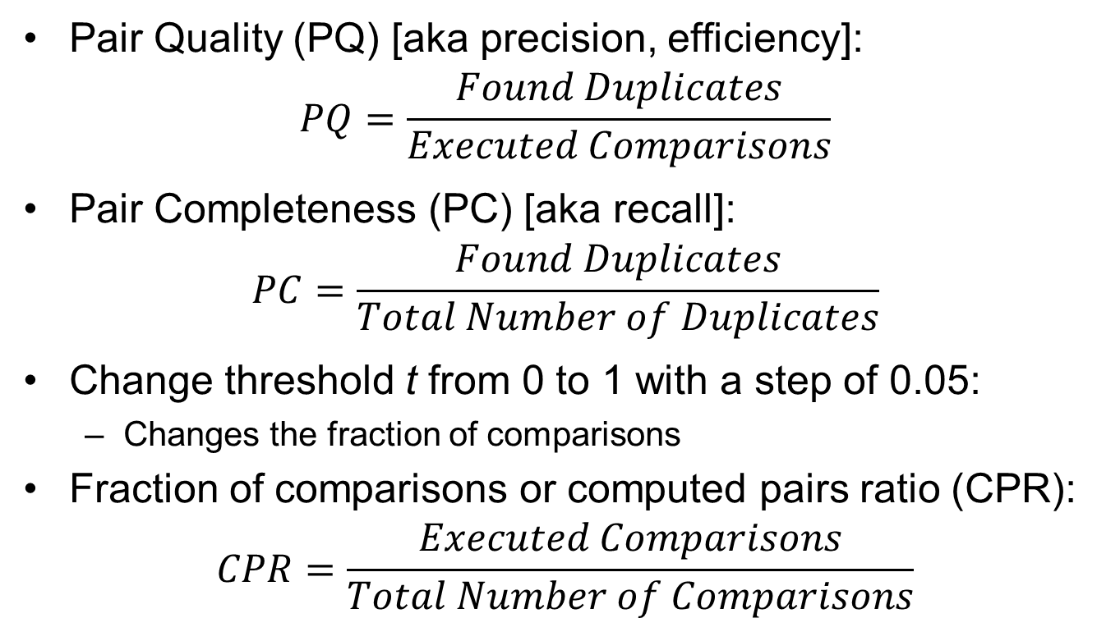
Blocking Quality
Pair Quality (PQ) [aka precision, efficiency]:
$$PQ=\frac{Found Duplicates}{Executed Comparisons}$$
Pair Completeness (PC) [aka recall]:
$$PC=\frac{Found Duplicates}{Total Number of Duplicates}$$
Change threshold t from 0 to 1 with a step of 0.05:
Changes the fraction of comparisons
Fraction of comparisons or computed pairs ratio (CPR):
$$CPR=\frac{Executed Comparisons}{Total Number of Comparisons}$$

Slide 22
Pair Completeness vs. Fraction of Comparisons
Performing 3% of
the comparisons
gives a recall of 0.53
Performing 18.3%
of the comparisons
gives a recall of 0.8
Performing 74.4%
of the comparisons
gives a recall of 0.95
High threshold t
Low threshold t

Slide 23
Pair Quality vs. Fraction of Comparisons
Performing 0.1% of
the comparisons
achieves a precision
of 0.25 (a duplicate is
found every 4
comparisons) and a
recall of 0.44 (almost
half the duplicates are
found)
Fast deterioration in
precision due to the
small number of
duplicates in the dataset
High threshold t
Low threshold t

Slide 24
MSMP vs. MSM
5 MSM parameters:
α,β [title similarity],
γ [KVP similarity],
μ [hybrid similarity],
ε [hierarchical clustering]
optimized using grid search using the Lisa computer cluster at SURFSara for each threshold t and each bootstrap
TP = pairs of items correctly found as duplicates
TN = pairs of items correctly found as non-duplicates
FP = pairs of items incorrectly found as duplicates
FN = pairs of items incorrectly found as non-duplicates

Slide 25
MSMP vs. MSM
MSM has an
F1-measure of 0.525
Performing 5% of the
comparisons MSMP
achieves an
F₁-measure of 0.477
(9% decrease in
F₁-measure
Compared to MSM)

Slide 26
Conclusions
Applying LSH reduces the number of comparisons for duplicate detection by considering only candidate neighbors
Performing 0.1% of the comparisons achieves a precision of 0.25 (a duplicate is found every 4 comparisons) and a recall of 0.44 (almost half the duplicates are found) with an ideal duplicate detector among candidate neighbors
Performing 5% of the comparisons MSMP results only 9% decrease in F₁-measure compared to the state-of-the-art duplicate detection method MSM

Slide 27
Future Work
Exploit in LSH the model words present in the values part of Key-Value Pairs of product descriptions
Simulate permutations by using adequate hash functions
Exploit additional token-based blocking schemes:
words
q-grams (parts of tokens)
n-tuples (groups of tokens)
Combinations (AND and OR) of words, model words, n-tuples, and q-grams (the last two applied to both words and/or model words)
Exploit other clustering algorithms in MSM (modularity-based clustering or spectral clustering)
Exploit map-reduce during blocking

