Slide 1
RDF Chain Query Optimization in a Distributed Environment
Alexander Hogenboom Erasmus University Rotterdam hogenboom@ese.eur.nl | Ewout Niewenhuijse Erasmus University Rotterdam ewoutnwn@gmail.com
Milan Jansen Erasmus University Rotterdam milanjansen@gmail.com | Flavius Frasincar Erasmus University Rotterdam frasincar@ese.eur.nl
Damir Vandic Erasmus University Rotterdam vandic@ese.eur.nl

Slide 2
Introduction (1)
The Semantic Web allows for an ever-growing amount of data to be stored in many heterogeneous, yet interconnected sources
Fast query engines are needed for efficient querying of large amounts of data, typically represented by means of the Resource Description Framework (RDF)
A major challenge lies in optimizing query paths: the order in which distinct parts of a query are evaluated

Slide 3
Introduction (2)
Existing solutions:
Two-phase optimization (2PO):
Iterative Improvement (II)
Simulated Annealing (SA)
Genetic Algorithm (GA)
Ant Colony Optimization (ACO)
Contributions:
Evaluation of these existing solutions in a distributed Semantic Web environment
Evaluation of the effects of various join methods

Slide 4
RDF and Query Paths (1)
An RDF model is a collection of facts declared in RDF
Facts are triples in the form of a node-arc-node link consisting of a subject, a predicate, and an object
RDF sources can be queried using SPARQL
We consider a subset of SPARQL SELECT queries: chain queries, where a query path is followed by performing joins between its subpaths
The WHERE statement joins sets of node-arc-node patterns resulting from SPARQL subqueries, such that one node set contains a mapping to the next node set

Slide 5
RDF and Query Paths (2)
SELECT DISTINCT ?artist WHERE { SERVICE <http://wordnet.rkbexplorer.com/sparql> { ?s wn:hyponymOf <http://wordnet.rkbexplorer.com/id/synset-comedy-noun-1> . ?s rdfs:label ?genres } SERVICE <http://data.linkedmdb.org/sparql> { ?id movie:film_genre_name ?genres . ?film movie:genre ?id . ?film movie:music_contributor ?con . ?con movie:music_contributor_name ?artist } SERVICE <http://dbpedia.org/sparql> { ?Person foaf:name ?artist . ?Person dbp-ont:birthPlace ?BirthPlace ; rdf:type dbp-ont:MusicalArtist . ?BirthPlace rdfs:label ?PlaceName } SERVICE <http://factforge.net/sparql> { ?place rdfs:label ?PlaceName . ?place dbp-prop:country ?country . ?country rdfs:label ?countryLabel FILTER(STR(?countryLabel)=“United States”) } }
Notes:
Consider four on-line RDF data sources, accessible through SPARQL endpoints, with triple amounts ranging up to a billion per source. Suppose one wants to know which musicians from the United States have contributed to comedy movie soundtracks. This query can be split into the following four local queries: (1) a query on WordNet for hyponyms of the literal “comedy” to capture genres marked by different but narrower terms (e.g., romantic comedy, black comedy, tragicomedy, etc.) too, (2) a query at LinkedMDB for the names of the music contributors for all soundtracks of all movies in all genres, (3) a query at DBpedia for the birth places of all persons, and (4) a query on FactForge for the places in the United States. In order to resolve the complete query, local queries can be sent to the mentioned data sources, and the local query results can be joined one-by-one in any order.

Slide 6
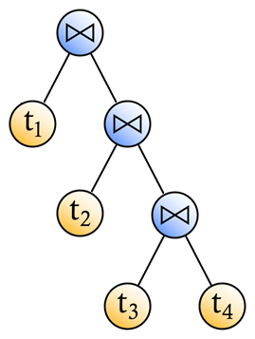
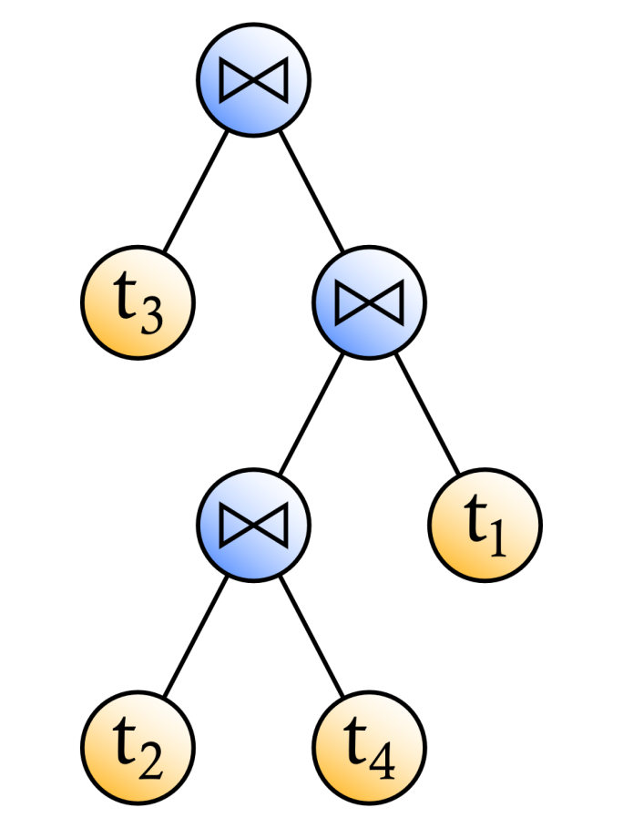
RDF and Query Paths (3)
Right-deep query tree
Bushy query tree

Slide 7
RDF Query Path Optimization (1)
Challenge: determine the right order in which the joins should be computed
Optimize the overall response time
Explore a solution space with query paths
Solution space size increases exponentially with the number of subqueries

Slide 8
RDF Query Path Optimization (2)
Solutions are associated with data transmission and processing costs incurred by performing the joins constituting the solutions
Transmission costs form a substantial part of join costs
Join costs depend on the join method used:
Nested-loop join
Bind join
Adaptive group join (AGJoin)
Neighboring solutions in the solution space can be identified by applying transformation rules

Slide 9
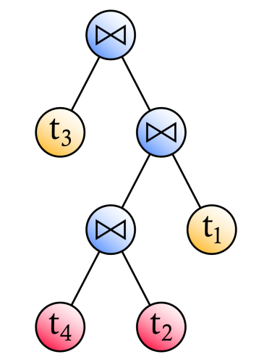
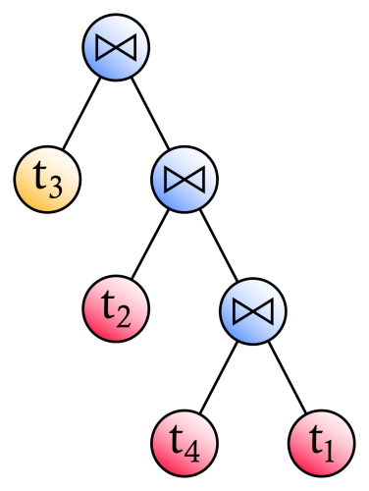

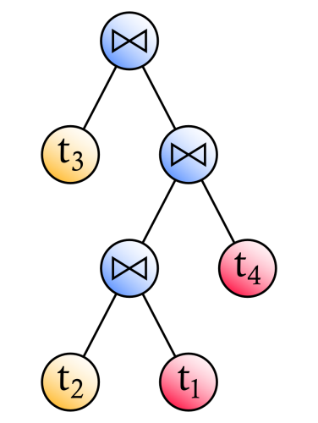
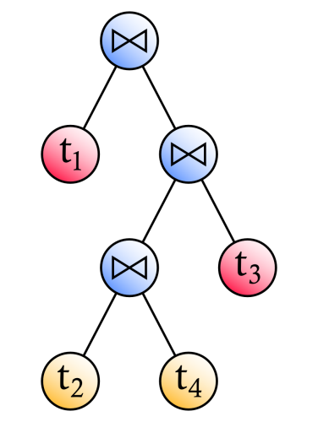
RDF Query Path Optimization (3)
Join commutativity
Join associativity
Left join exchange
Right join exchange

Slide 10
RDF Query Path Optimization with 2PO
Using II, local optima are found by walking through the solution space (from random starting points), while only taking steps yielding improvement in solution quality
The best local optimum thus found is used as starting point for SA: a walk through the solution space, where moves not yielding improvement are accepted with a declining probability

Slide 11
RDF Query Path Optimization with a GA (1)
A population of solutions is subject to a process of simulated evolution, adhering to the principle of survival of the fittest
Fitness of a solution is inversely proportional to its associated solution costs
Some of the fittest solutions are selected for proliferation in subsequent generations
The fittest solutions are randomly combined in order to generate offspring for subsequent generations
Solutions are randomly mutated as well

Slide 12
RDF Query Path Optimization with a GA (2)
We model the solution space based on an ordinal number scheme for encoding chain queries
The encoding scheme iteratively joins two concepts in an ordered list of concepts, while saving the result on the position of first appearing concept
Example:
(t1, t2, t3, t4): join 2 and 4
(t1, t2t4, t3): join 2 and 1
(t2t4t1, t3): join 2 and 1
(t3t2t4t1)
Encoded solution: ((2,4),(2,1),(2,1))

Slide 13
RDF Query Path Optimization with ACO (1)
Artificial ants explore a solution space by iteratively:
Constructing a path from a starting point to an ending point
Updating pheromone traces marking their paths
Pheromone traces evaporate over time
Steps depend on pheromone traces and local heuristics
Solutions are encoded by means of the ordinal number encoding scheme used for the GA
The solution space can thus be represented as a graph that is to be traversed by the artificial ants

Slide 14
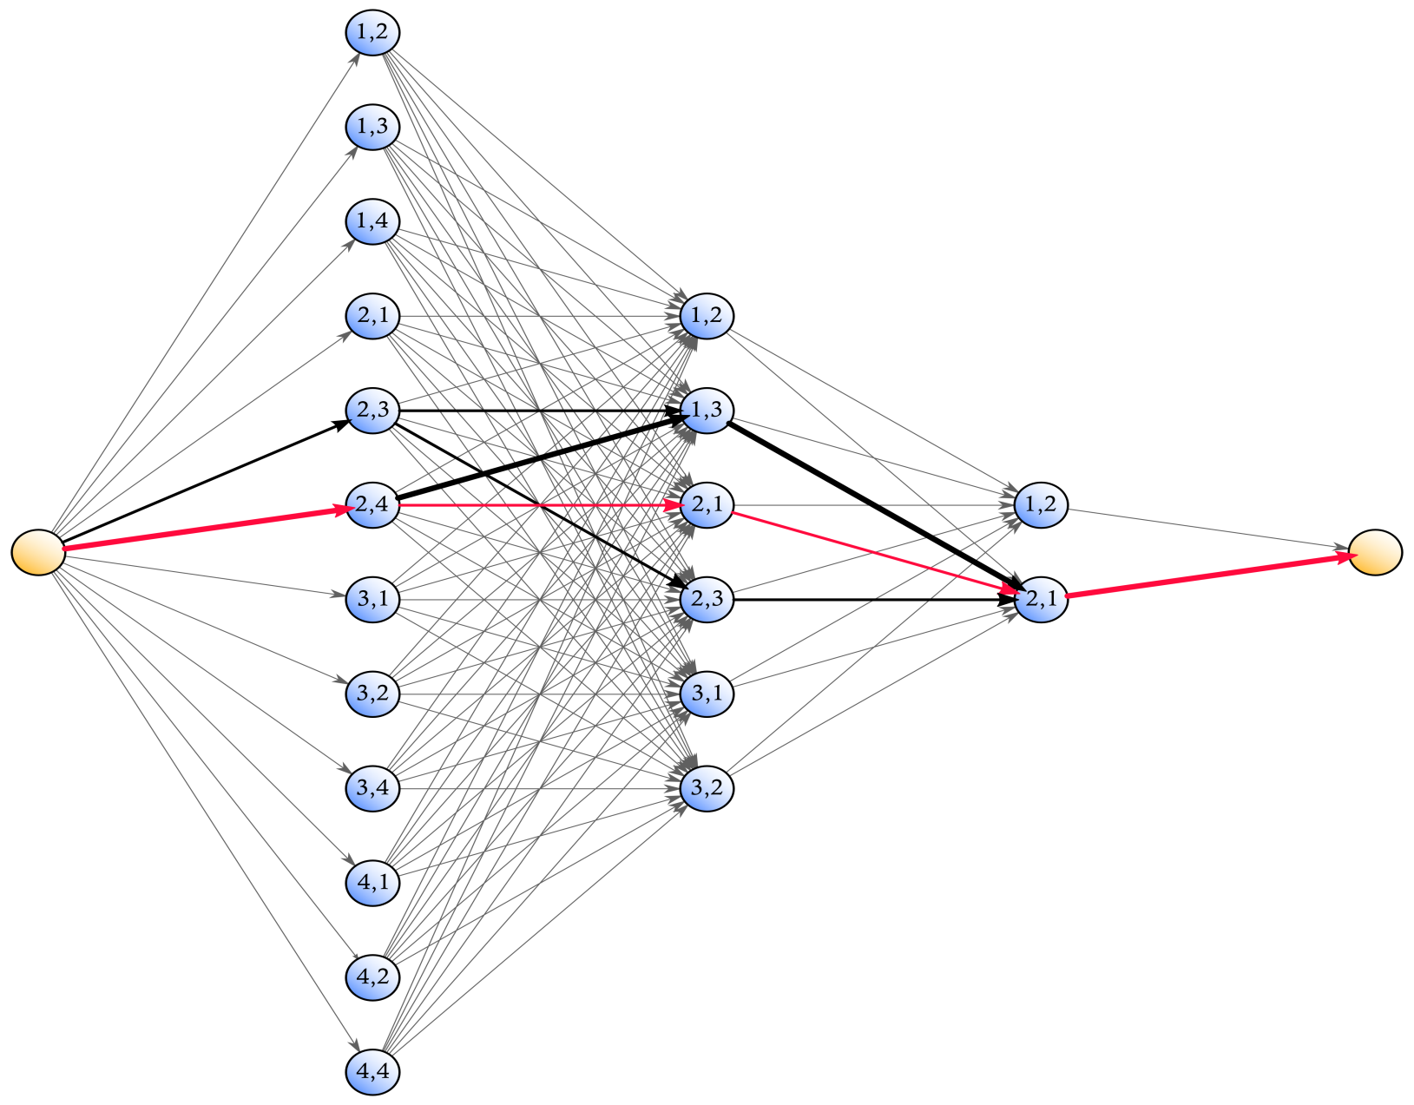
RDF Query Path Optimization with ACO (2)
Notes:
In our representation, this is the graph that the ants need to find their way in. The ants walk from the yellow start vertex on the left, representing a situation in which no matches with triple patterns have been joined, to the yellow end vertex on the right, representing a situation in which all joins have been made. Each path represents a join sequence, with each step representing a join.
For an arbitrary join (visualized as a column of blue nodes in this figure), the vertices in the graph represent all valid combinations of indices of join operands, in accordance with our applied ordinal encoding scheme. An ant’s observed distance associated with an arbitrary edge connecting a vertex from one join with a vertex from the next join depends on the path taken up until the former join and represents the estimated additional costs of performing the next join.
At every iteration, new pheromone traces, which are inversely proportional to the associated paths’ total execution costs, are deposited on the best-so-far path and pheromone traces on all visited paths evaporate to a certain extent. When the ants have not encountered a better path in some number of iterations, the algorithm is considered to have been converged.
In this figure, the width of an edge reflects the pheromone quantities on this edge. This specific graph is a representation for an RDF chain query with 3 joins. The path representing our bushy query tree example is marked red.

Slide 15
Evaluation
We evaluate RDF chain query optimization (RCQ) over 34 SPARQL endpoints by means of 2PO, a GA, and ACO, with nested-loop joins, bind joins, and AGJoins
Configuration of algorithms derived from literature
The full solution space is considered
Each algorithm is assessed in terms of execution time and solution quality, for chain queries varying in length from 3 to 20 predicates (2 to 19 joins)
For each length, we consider 1,000 random queries
Transmission times are drawn from empirically obtained transmission time distributions per endpoint

Slide 16
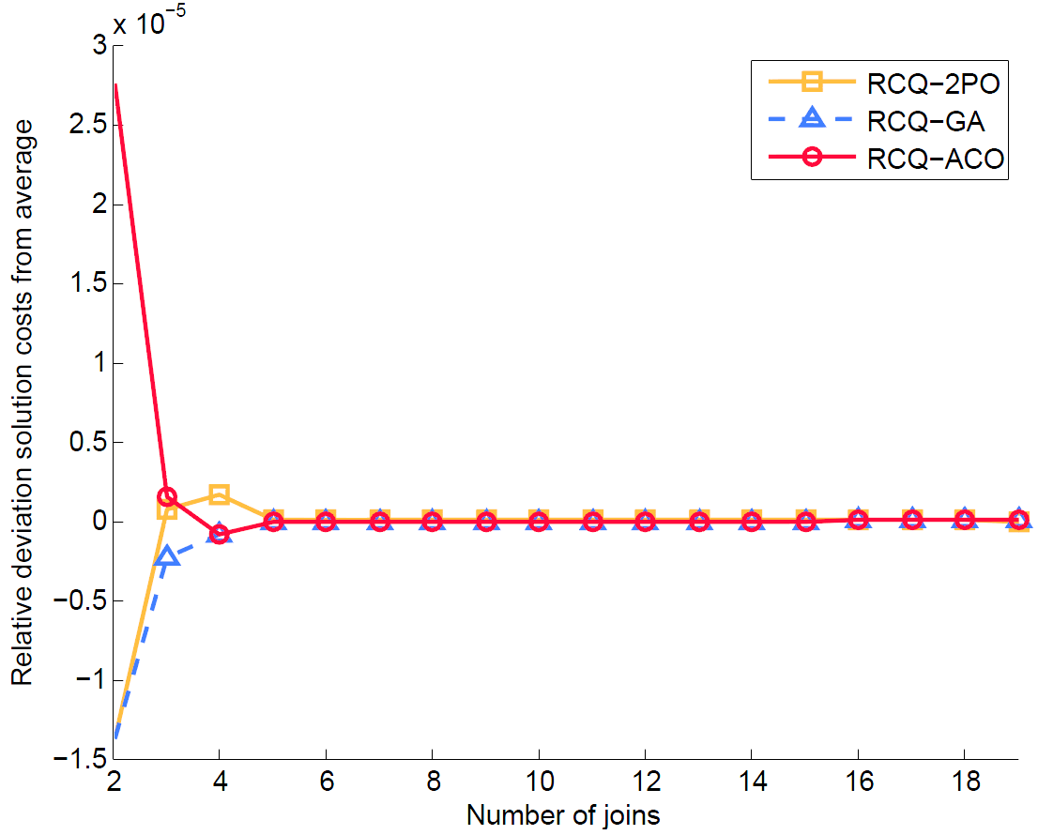
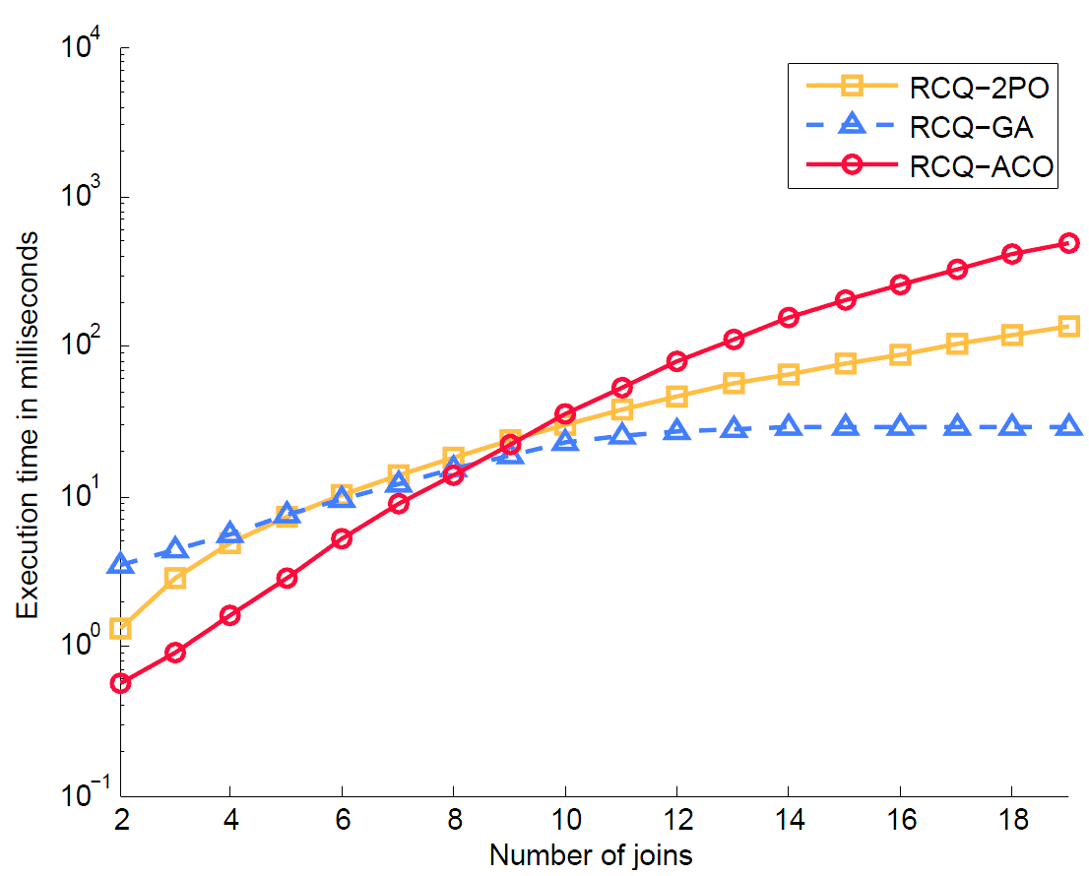
Performance for Nested-Loop Joins
Notes:
When using the naive nested-loop join method, the solutions produced by our considered algorithms hardly differ from one another in terms of solution costs, even though the RCQ-ACO method mostly tends to produce solutions of a marginally better quality. As such, when using the nested-loop join method, RCQ-ACO is the fastest algorithm that moreover produces the best results for most smaller queries. For larger queries, RCQ-GA is the fastest algorithm that produces solutions of a competitive quality.

Slide 17
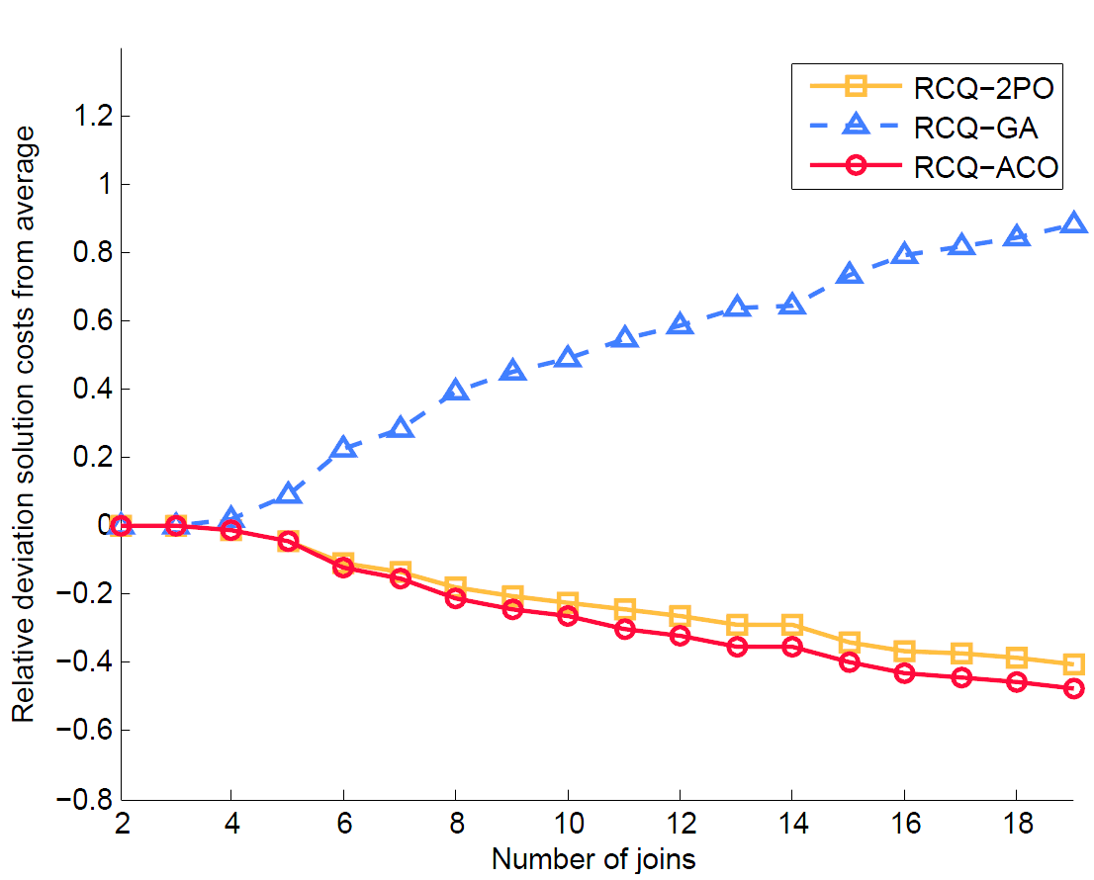
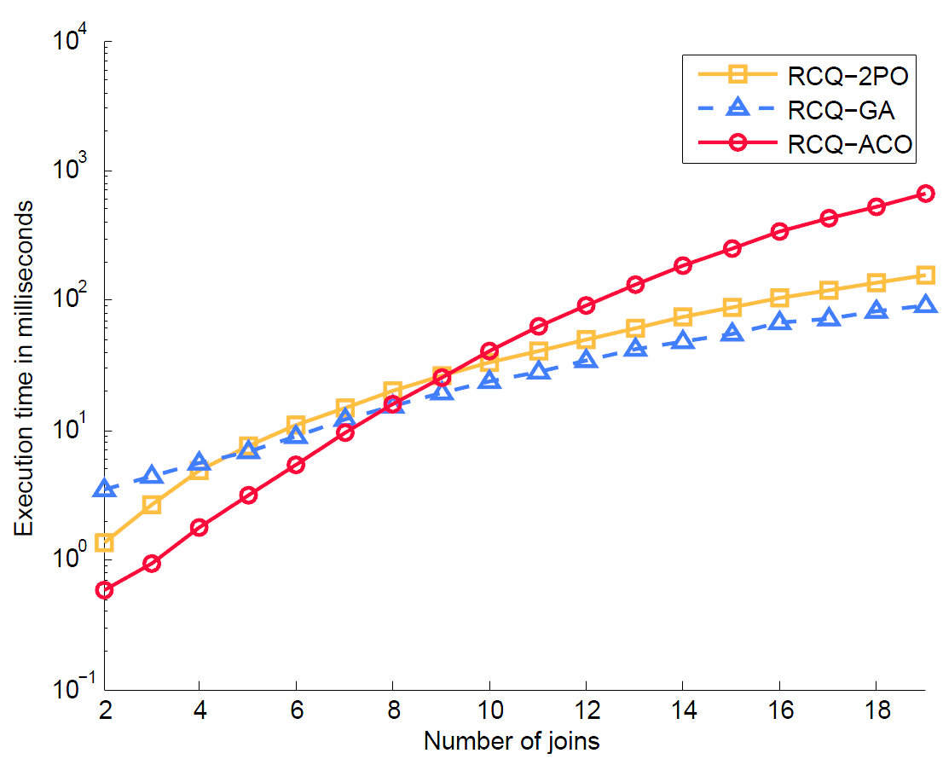
Performance for Bind Joins
Notes:
The quality of solutions produced by RCQ-GA is less competitive when using bind joins. Here, RCQ-ACO consistently produces the best results, whereas RCQ-2PO produces solutions of a quality inferior to RCQ-ACO, but superior to RCQ-GA. Therefore, for smaller queries, RCQ-ACO produces the best query paths with bind joins in the least amount of time. For larger queries, there is a trade-off between solution quality (RCQ-ACO) and execution time (RCQ-2PO).

Slide 18
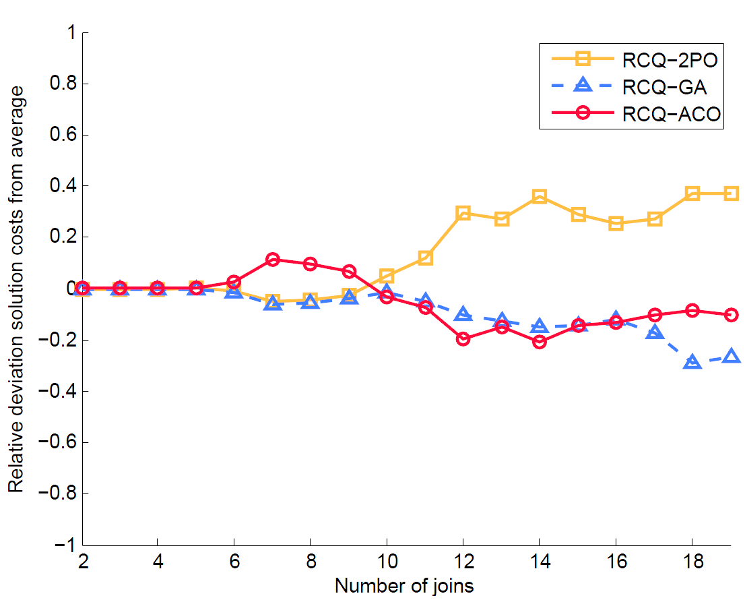
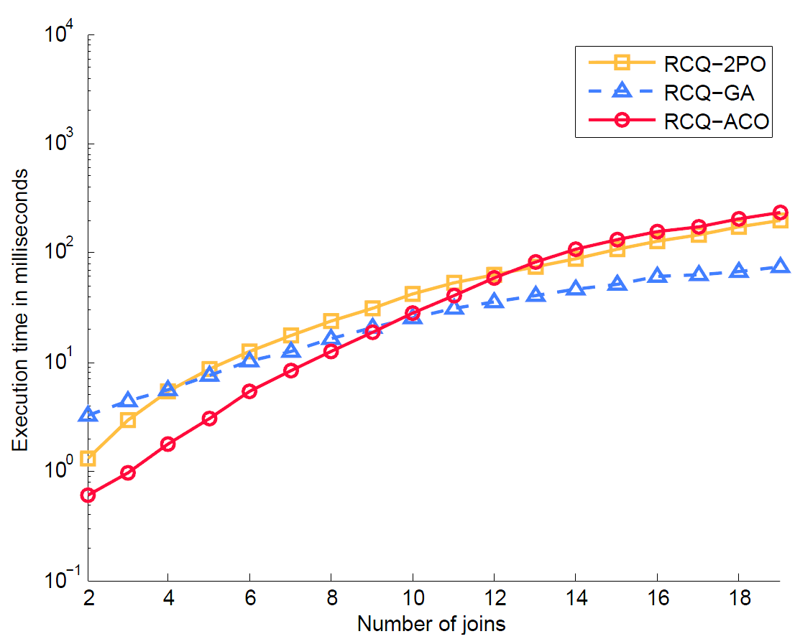
Performance for AGJoins
Notes:
When considering a space with solutions that use AGJoins, all algorithms tend to produce solutions of a comparable quality for queries consisting of up to ten joins. For larger queries, the solutions produced by RCQ-2PO are of an inferior quality, compared to RCQ-ACO and RCQ-GA. As such, for smaller queries, it is best to optimize the join order of RDF chain queries that use AGJoins by means of RCQ-ACO, as this algorithm is the fastest algorithm that produces solutions of a quality that is comparable with the quality of those produced by the alternative optimization algorithms. For larger queries that use AGJoins, RCQ-GA is the fastest algorithm with a competitive solution quality.

Slide 19
Conclusions
For smaller chain queries, ACO produces the best query plans in the least amount of time
For larger chain queries, a GA is typically the fastest optimization algorithm, that moreover produces competitive solutions
ACO tends to produce the best solutions for larger chain queries, but has scalability issues in terms of execution time

Slide 20
Future Work
Optimize the scalability of the ACO algorithm
Evaluate our methods in a setting in which the algorithms can be run continuously
Optimize other types of queries, e.g., star queries or cyclic queries

Slide 21
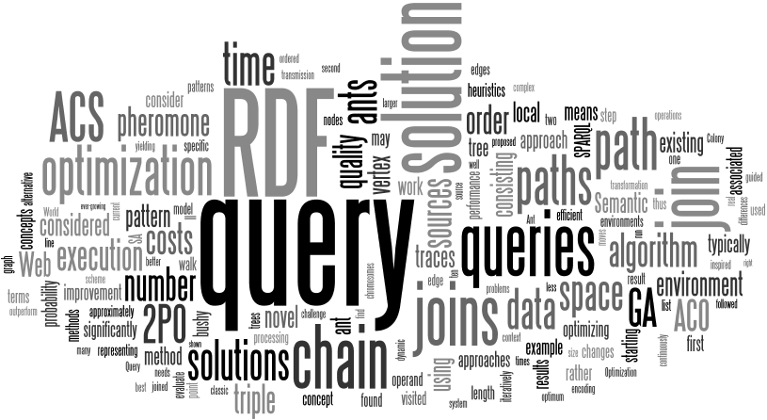
Questions?
Alexander Hogenboom Erasmus School of Economics Erasmus University Rotterdam P.O. Box 1738, NL-3000 DR Rotterdam, the Netherlands
hogenboom@ese.eur.nl

