Slide 1





Lexico-semantic Patterns for Information Extraction from Text
 | Frederik Hogenboom fhogenboom@ese.eur.nl
Erasmus University Rotterdam PO Box 1738, NL-3000 DR Rotterdam, the Netherlands In collaboration with: Flavius Frasincar, Uzay Kaymak, and Franciska de Jong

Slide 2
Introduction (1)
Increasing amount of (digital) data
Problem: utilizing extracted information in decision making processes becomes increasingly urgent and difficult:
  Too much data for manual extraction
  Yet most data is initially unstructured
  Data often contains natural language
Solution: automatically process and interpret information, yet automation is a non-trivial task

Slide 3
Introduction (2)
Information Extraction (IE)
  Multiple sources:
    News messages
    Blogs
    Papers
    …
  Text Mining (TM):
    Natural Language Processing (NLP)
    Statistics
    …
  Specific type of information that can be extracted: events

Slide 4
Events (1)
Steve Jobs resigns from Apple, Cook becomes CEO
(Reuters) - On Wednesday, Silicon Valley legend Steve Jobs resigned as chief executive of Apple Inc in a stunning move that ended his 14-year reign at the technology giant he co-founded in a garage.
Apple shares dived as much as 7 percent in after-hours trade after the pancreatic cancer survivor and industry icon, who has been on medical leave for an undisclosed condition since January 17, announced he will be replaced by COO and longtime heir apparent Tim Cook.
Apple stock price falls on news of Steve Jobs's death
(The Guardian) - Apple's stock price has risen more than 9,000% since Steve Jobs returned in 1997, and doubled in the past two years
News of Steve Jobs's death drove the Apple share price down more than 5% in Frankfurt on Thursday morning.
Apple shares are now trading 3.5% lower at €273, after hitting a low of €270 in Frankfurt. The shares are not traded in London. They are expected to open lower when Wall Street opens at 2.30pm London time.
Apple was briefly the most valuable company in the world in the summer, knocking oil giant Exxon Mobil off the top spot. Revenues have soared from $7.1bn (£4.6bn) in 1997 to $65.2bn a year now.
Google buys Motorola Mobility for $12.5B
(VentureBeat) - This morning, Google announced that it will buy Motorola Mobility — Moto’s mobile device arm — for $12.5 billion. Google will acquire Motorola Mobility for $40 per share in cash, a 63 percent premium over the company’s Friday closing price. Google says it will run Motorola Mobility as a separate business. Motorola spun off its business into two divisions last year, Mobility and Solutions (the data and telecom portion), as a response to declining profits.
Google shares were down around 1.5 percent, while Motorola Mobility’s stock jumped 57 percent. The company says Motorola Android phones won’t be receiving any special treatment as a consequence of the deal — but that’s a tough nut to swallow, since Google often plays favorites.

Slide 5
Events (2)
Event:
  Complex combination of relations linked to a set of empirical observations from texts
  Can be defined as:
    <subject> <predicate> e.g., <Person> <Resigns>
    <subject> <predicate> <object> e.g., <Company> <Buys> <Company>
Event extraction could be beneficial to IE systems:
  Personalized news
  Risk analysis
  Monitoring
  Decision making support

Slide 6
Events (3)
Common event domains:
  Medical
  Finance
  Politics
  Environment

Slide 7
Event Extraction
In analogy with the classic distinction within the field of modeling, we distinguish 3 main approaches:
  Data-driven event extraction:
    Statistics
    Machine learning
    Linear algebra
    …
  Expert knowledge-driven event extraction:
    Representation & exploitation of expert knowledge
    Patterns
  Hybrid event extraction:
    Combine knowledge and data-driven methods
Our focus: expert knowledge-driven event extraction through the usage of pattern languages

Slide 8
Existing Approaches
Various pattern-languages for:
  News processing frameworks (e.g., PlanetOnto)
  General purpose frameworks (e.g., CAFETIERE, KIM, etc.)
Language types:
  Lexico-syntactic
  Lexico-semantic
However:
  Limited syntax
  Weak semantics
  Cumbersome in use
  Extract entities, but not events

Slide 9
Semantics
Semantic Web:
  Collection of technologies that express content meta-data
  Offers means to help machines understand human-created data on the Web
Ontologies:
  Can be used to store domain-specific knowledge in the form of concepts (classes + instances)
  Also contain inter-concept relations

Slide 10
Pattern Language (1)
Basic syntax:
  LHS :- RHS
  LHS: subject, predicate, object (optional)
  RHS: pattern in which subject and object are assigned:
    Literals (text strings)
    Lexical categories (nouns, prepositions, verbs, etc.)
    Orthographic categories (capitalization)
    Labels (assigning subject and object)
    Logical operators (and, or, not)
    Repetition (≥0, ≥1, 0-1, {min,max})
    Wildcards (skip ≥0 or exactly 1 word)
    Ontological concepts

Slide 11
Pattern Language (2)
Provocation example (lexico-syntactic):
($sub, kb:provokes, $obj) :-
$sub:=(((JJ | NNS | NNP | NNPS | NN) &
(upperInitial | allCaps | mixedCaps)
)(‘.’ NNP ‘.’?)?)+
(!‘.’ & !‘(’ & !‘)’ & !‘-’){0,3}
(‘angers’ | ‘angered’ | ‘accuses’ | ‘accused’ |
‘insult’ | ‘insulted’ | ‘provokes’ | ‘provoked’ |
‘threatens’ | ‘threatened’)
(!‘.’ & !‘(’ & !‘)’ & !‘-’){0,3}
$obj:=(((JJ | NNS | NNP | NNPS | NN) &
(upperInitial | allCaps | mixedCaps)
)(‘.’ NNP ‘.’?)?)+

Slide 12
Pattern Language (3)
Provocation example (lexico-semantic):
($sub, kb:provokes, $obj) :-
$sub:=([kb:Country] | [kb:Continent] | [kb:Union])
(!‘.’ & !‘(’ & !‘)’ & !‘-’){0,3}
(kb:toAnger | kb:toAccuse | kb:toInsult |
kb:toProvoke | kb:toThreaten)
(!‘.’ & !‘(’ & !‘)’ & !‘-’){0,3}
$obj:=([kb:Country] | [kb:Continent] | [kb:Union])

Slide 13
Implementation (1)
The Hermes News Portal (HNP) is a stand-alone Java-based news personalization tool
We have implemented the Hermes Information Extraction Engine (HIEE) within the HNP
Pipeline-architecture is based on GATE components

Slide 14
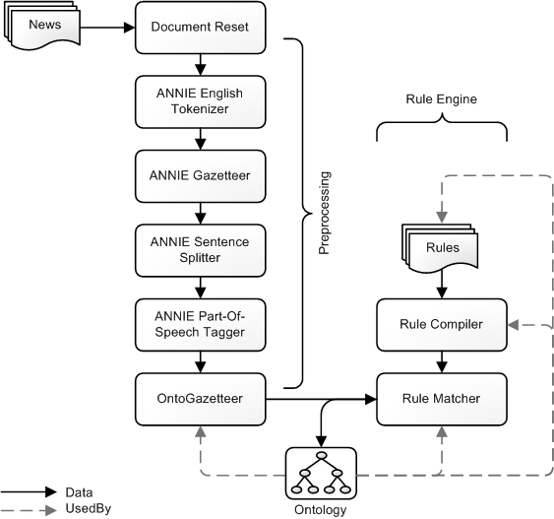
Implementation (2)

Slide 15
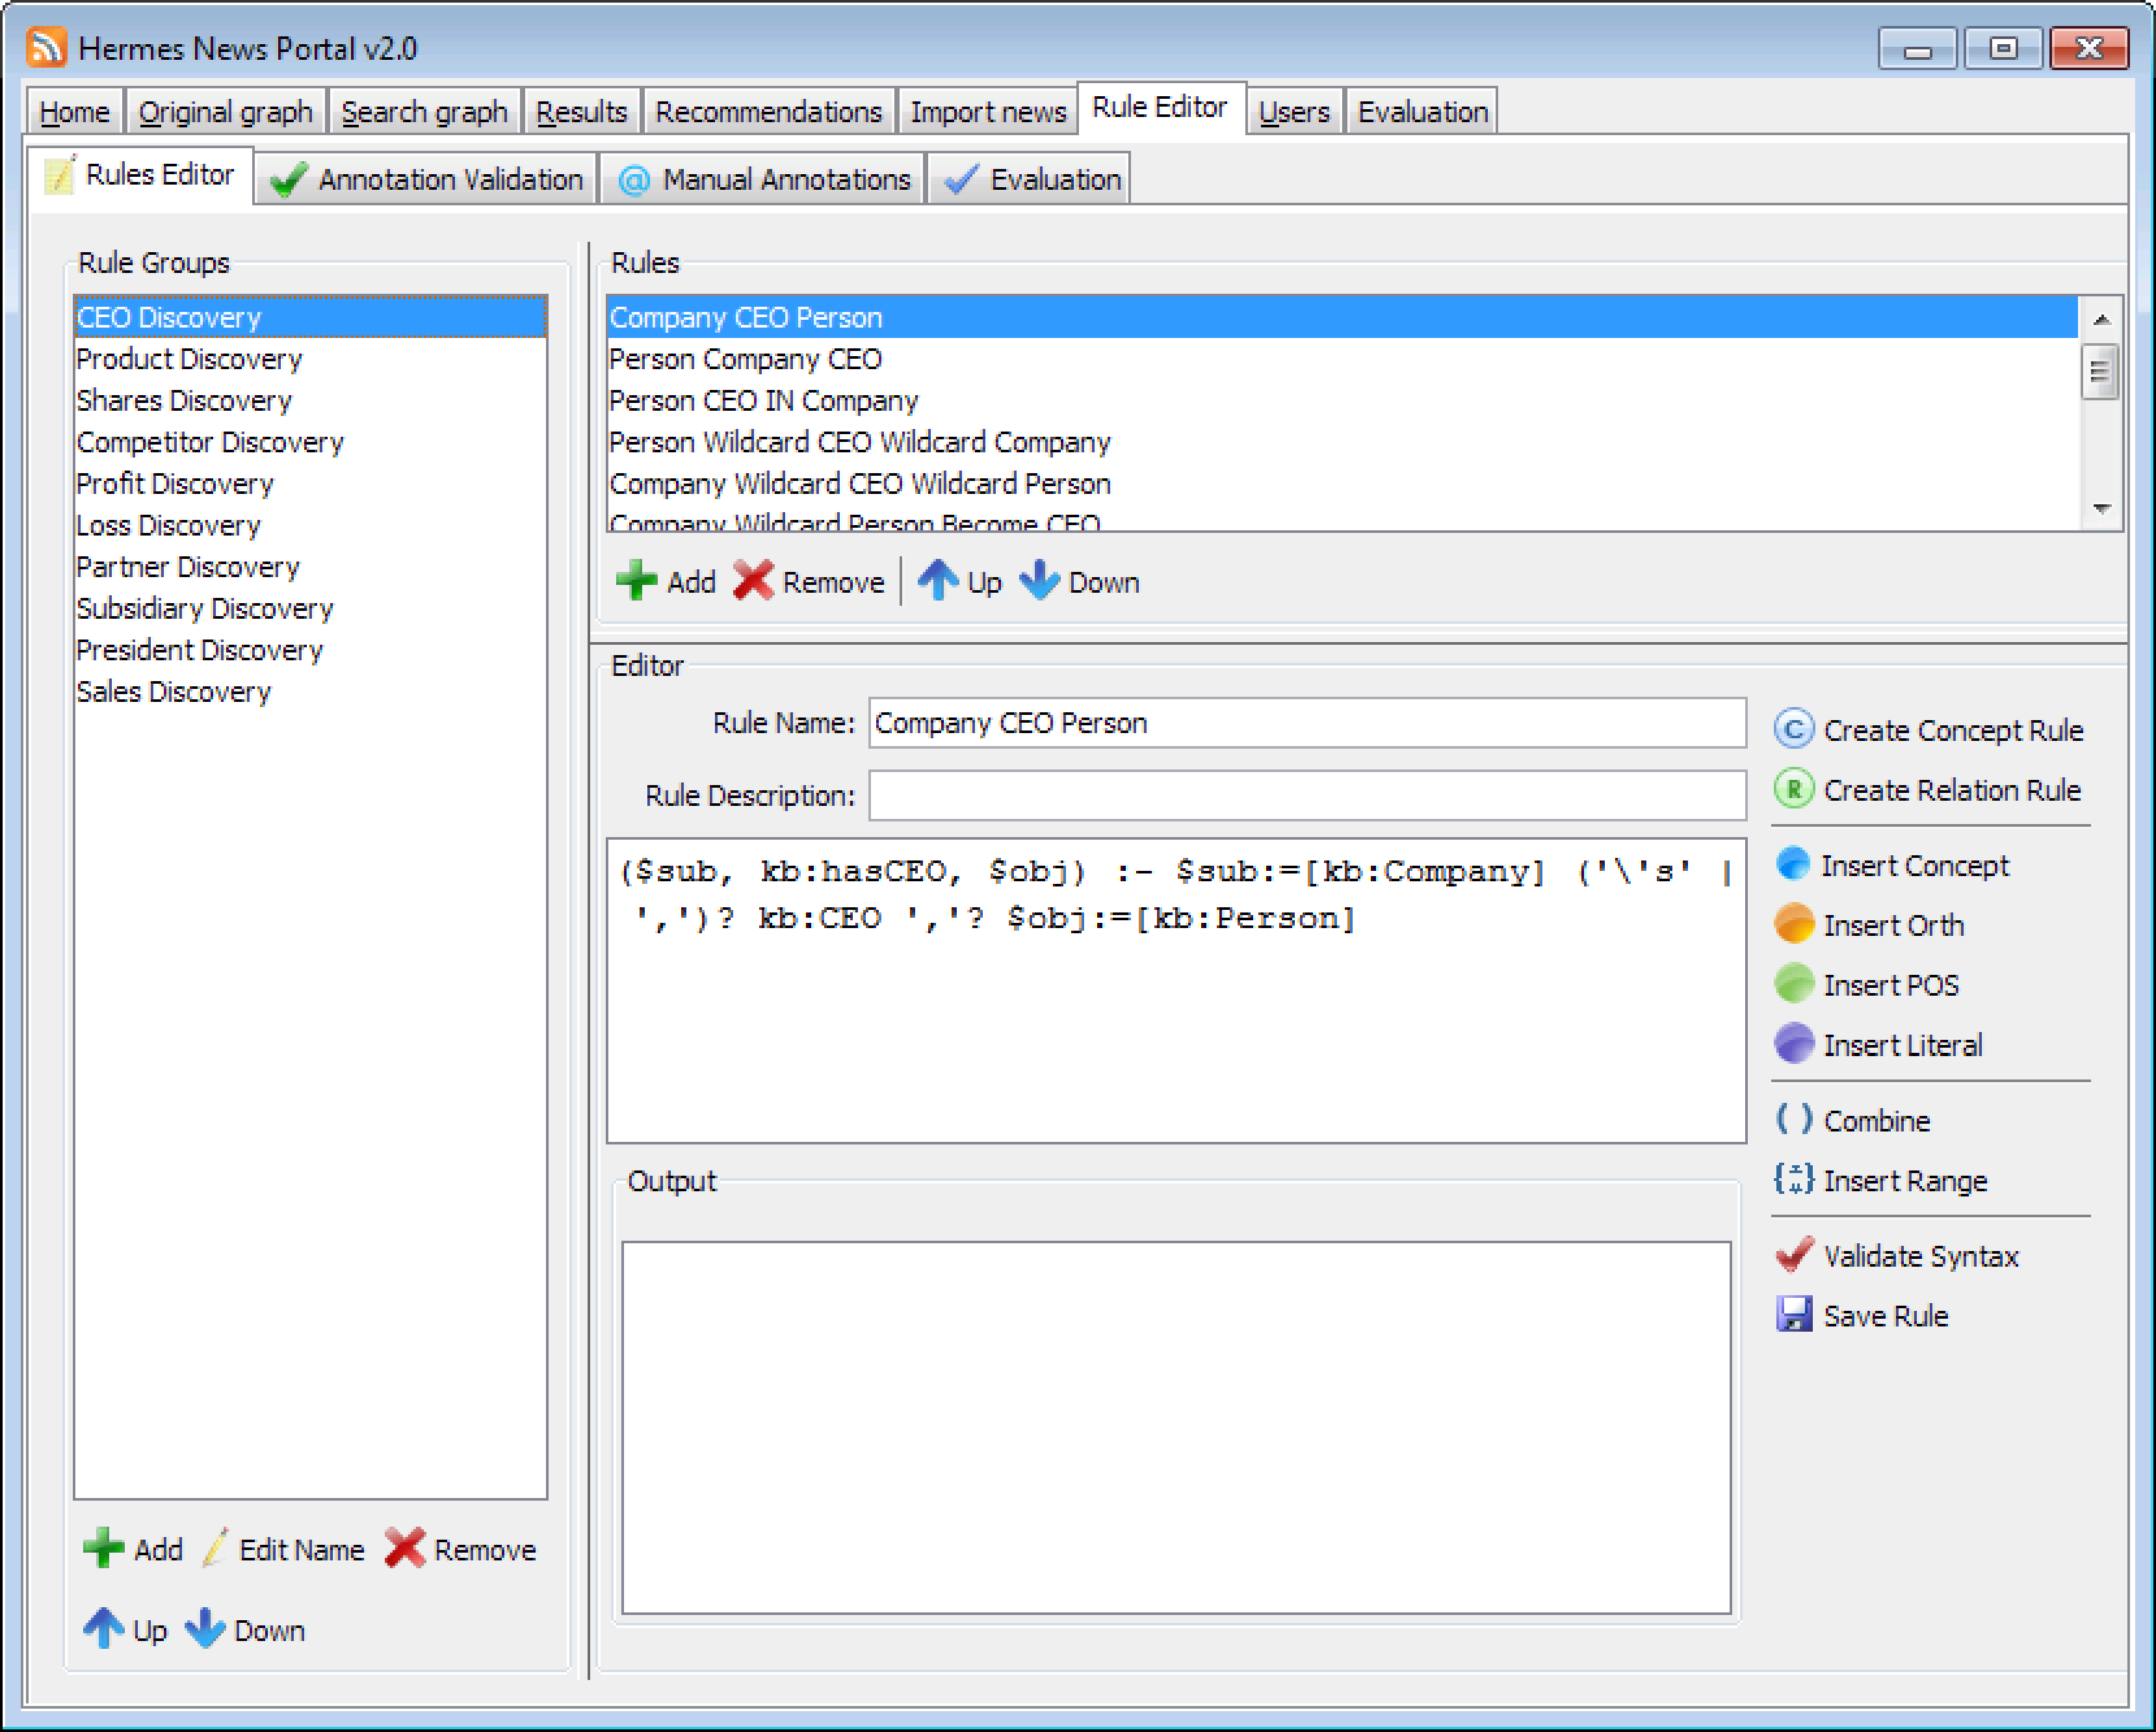
Implementation (3)

Slide 16
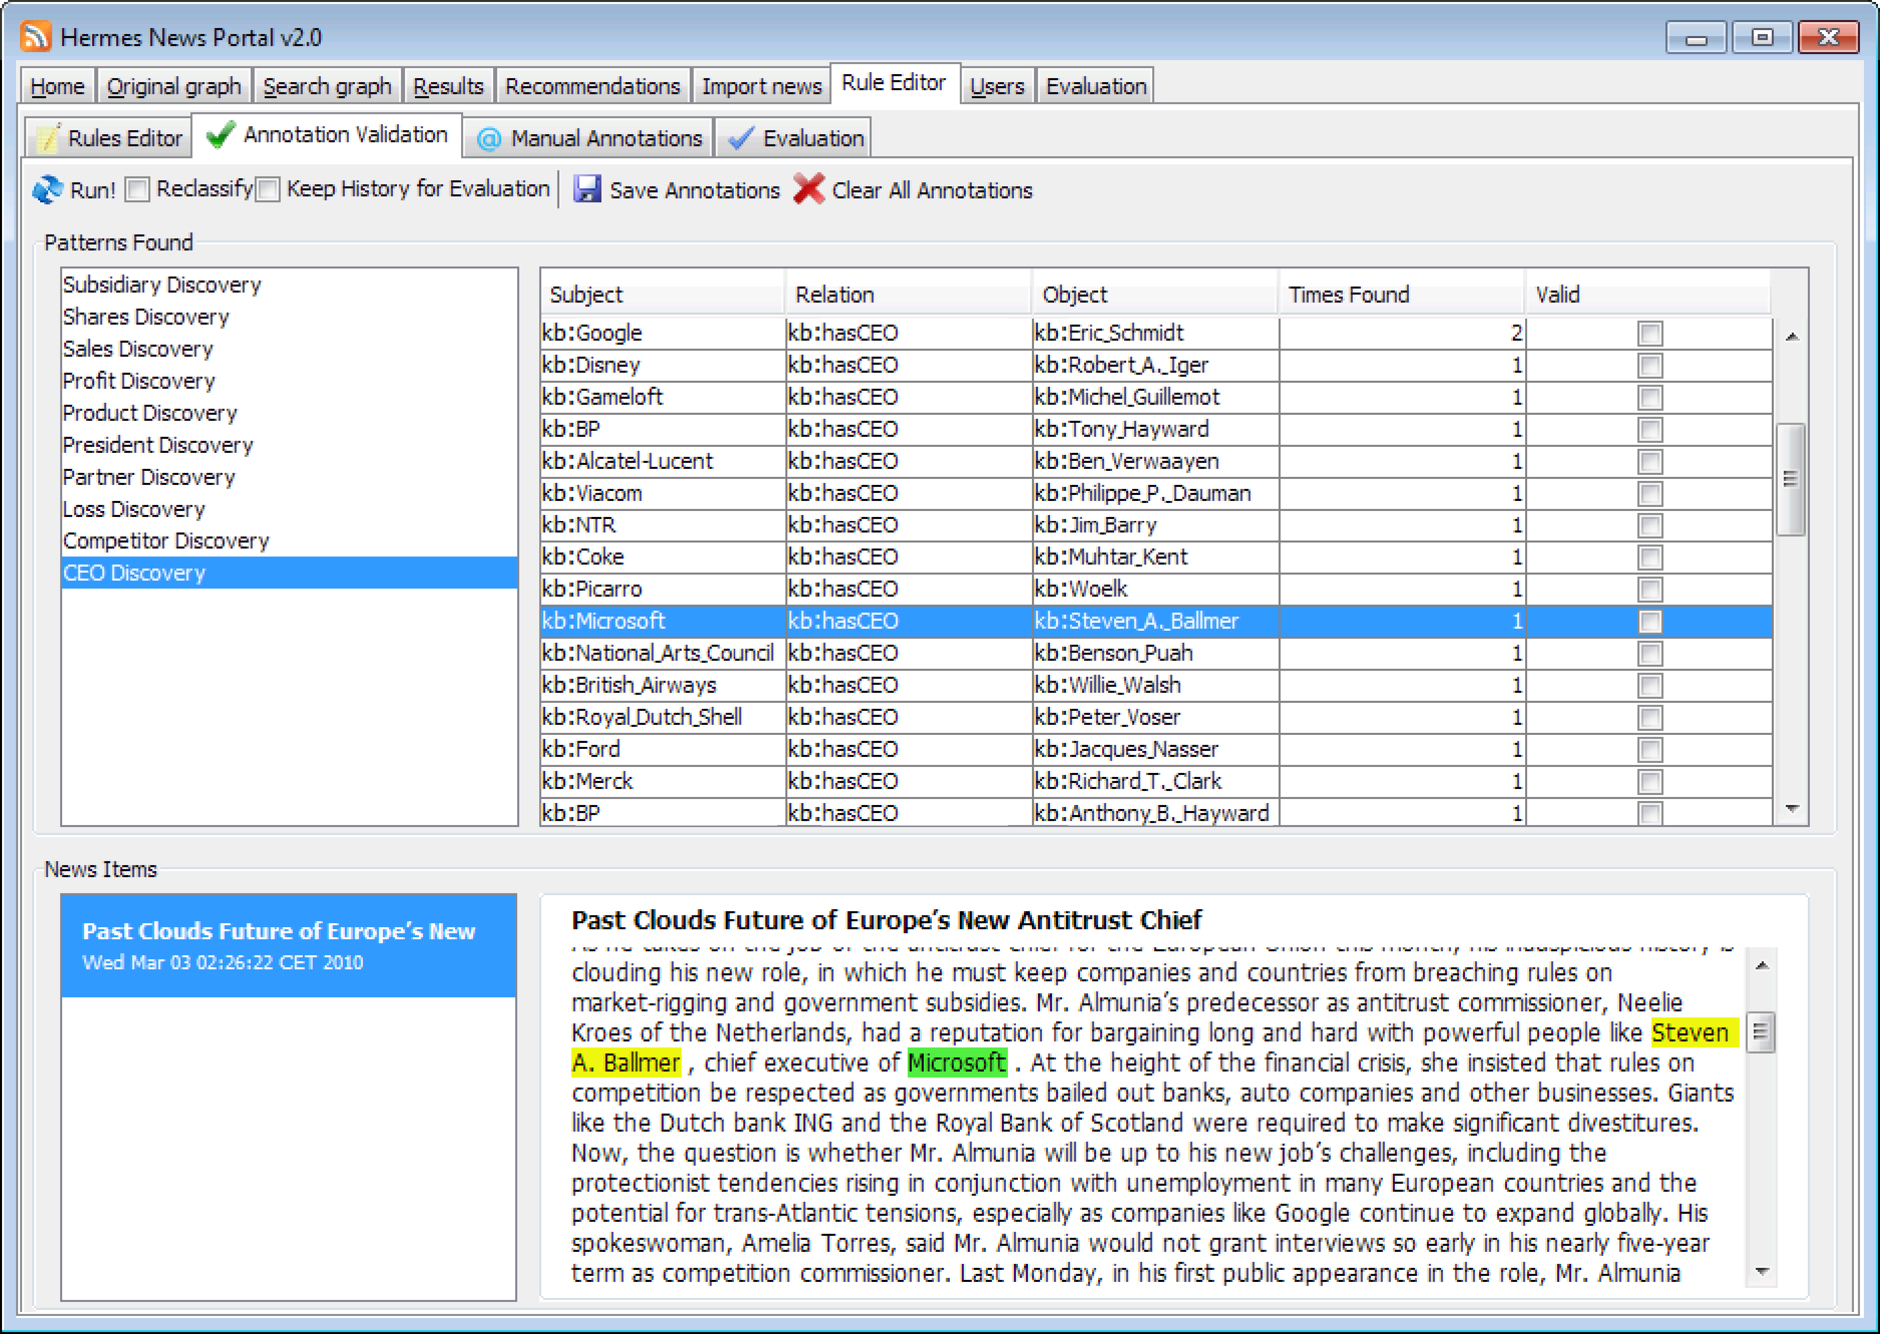
Implementation (4)

Slide 17
Evaluation (1)
We compare the performance of lexico-syntactic rules with lexico-semantic rules on two data sets:
  Economic events (500 news messages):
    CEO • Profit • President
    Product • Loss • Revenue
    Shares • Partner
    Competitor • Subsidiary
  Political events (100 news messages):
    Election • Resignation • Provocation
    Visit • Investment • Help
    Sanction • Riots
    Join • Collaboration
Performance is evaluated based on rule creation times and precision, recall, and F₁-measure.

Slide 18
Evaluation (2)
Creation times for F₁ ≥ 0.5: 90% improvement
Name | Lex-Syn | Lex-Sem |  | Name | Lex-Syn | Lex-Sem
CEO | 8424 | 281 |  | Election | 1517 | 232
Product | 9428 | 132 |  | Visit | 4238 | 543
Shares | 2403 | 648 |  | Sanction | 4013 | 419
Competitor | 9116 | 133 |  | Join | 3986 | 297
Profit | 1923 | 416 |  | Resignation | 1259 | 366
Loss | 5991 | 313 |  | Investment | 5162 | 781
Partner | 4924 | 185 |  | Riots | 1734 | 306
Subsidiary | 6620 | 776 |  | Collaboration | 1103 | 137
President | 4239 | 179 |  | Provocation | 1428 | 530
Revenue | 5317 | 498 |  | Help | 1987 | 211
Overall | 5839 | 356 |  | Overall | 2643 | 382

Slide 19
Evaluation (3)
Scores after maximum time (finance)
 | Lex-Syn |  |  |  | Lex-Sem
Name | Precision | Recall | F₁ |  | Precision | Recall | F₁
CEO | 0.5217 | 0.6000 | 0.5581 |  | 0.8966 | 0.8667 | 0.8814
Product | 0.6667 | 0.4118 | 0.5091 |  | 0.8607 | 0.7721 | 0.8140
Shares | 0.4286 | 0.6667 | 0.5218 |  | 0.9000 | 0.8000 | 0.8471
Competitor | 0.5333 | 0.4800 | 0.5052 |  | 0.7600 | 0.7600 | 0.7600
Profit | 0.7500 | 0.4545 | 0.5660 |  | 0.8800 | 0.6667 | 0.7586
Loss | 0.6471 | 0.4074 | 0.5000 |  | 0.8125 | 0.4815 | 0.6047
Partner | 0.3864 | 0.7391 | 0.5075 |  | 0.8000 | 0.8696 | 0.8333
Subsidiary | 0.7500 | 0.3913 | 0.5143 |  | 0.9063 | 0.6304 | 0.7436
President | 0.4333 | 0.5909 | 0.5000 |  | 0.6667 | 0.6364 | 0.6512
Revenue | 0.6429 | 0.4091 | 0.5000 |  | 0.7143 | 0.6818 | 0.6977
Overall | 0.5492 | 0.4935 | 0.5199 |  | 0.8390 | 0.7414 | 0.7872

Slide 20
Evaluation (4)
Scores after maximum time (politics)
 | Lex-Syn |  |  |  | Lex-Sem
Name | Precision | Recall | F₁ |  | Precision | Recall | F₁
Election | 0.4615 | 0.5455 | 0.5000 |  | 1.0000 | 0.8182 | 0.9000
Visit | 0.6774 | 0.4038 | 0.5060 |  | 0.7027 | 0.5000 | 0.5843
Sanction | 0.5263 | 0.4918 | 0.5085 |  | 0.7857 | 0.7213 | 0.7521
Join | 0.7222 | 0.4063 | 0.5200 |  | 0.8125 | 0.8125 | 0.8125
Resignation | 0.9091 | 0.3846 | 0.5405 |  | 0.8000 | 0.9231 | 0.8572
Investment | 0.5208 | 0.4808 | 0.5000 |  | 0.7778 | 0.6731 | 0.7217
Riots | 0.5200 | 0.5200 | 0.5200 |  | 0.7069 | 0.8200 | 0.7593
Collaboration | 0.4250 | 0.6538 | 0.5151 |  | 0.7143 | 0.7692 | 0.7407
Provocation | 0.7727 | 0.4250 | 0.5484 |  | 0.7857 | 0.5714 | 0.6616
Help | 0.5510 | 0.4737 | 0.5094 |  | 0.7541 | 0.8070 | 0.7797
Overall | 0.5664 | 0.4694 | 0.5134 |  | 0.7630 | 0.7164 | 0.7390

Slide 21
Conclusions
Compared to lexico-syntactic alternatives, our lexico-semantic patterns perform better in terms of precision, recall, F₁, and creation times
Also, our rules are more expressive and easier to use than their lexico-syntactic alternatives
Future work:
  Evaluate against existing lexico-semantic languages
  Evaluate on big data set
  Link events to trading algorithms instead of news personalization

Slide 22
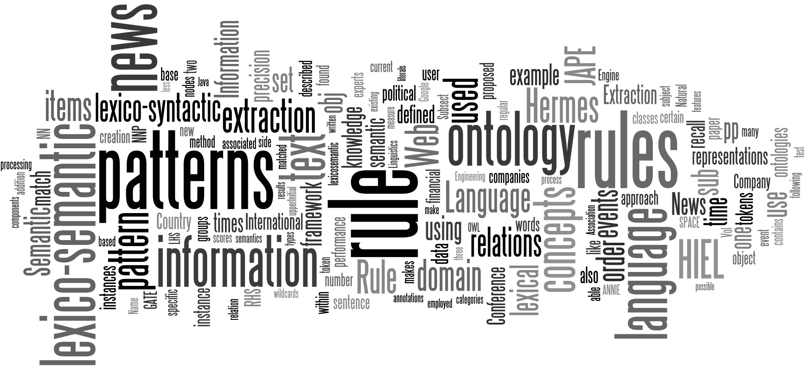
Questions

