Slide 1
Garamond
NLDB 2020
Pattern Learning for Detecting Defect Reports and Improvement Requests in App Reviews
Gino V. H. Mangnoesing
Erasmus University Rotterdam
gvh.sing@gmail.com
Maria Trusca
Bucharest University of Economic Studies
maria.trusca@csie.ase.ro
Flavius Frasincar
Erasmus University Rotterdam
fransincar@ese.eur.nl

Slide 2
Introduction
Main goal: detect actionable feedbacks in reviews using automatically learned and manual patterns

Slide 3
Introduction
Main goal: detect actionable feedbacks in reviews using automatically learned and manual patterns
Problem definition:
Let A = {A₁, …, A_{m}) be a range of mobile apps. Each A_{i} has m reviews R₁, …, R_{m} with two possible feedback types T₁ as defect reports and T₂ as improvement requests. Our problem is to identify the reviews with at least one of these two feedbacks.

Slide 4
Introduction
Main goal: detect actionable feedbacks in reviews using automatically learned and manual patterns
Problem definition:
Let A = {A₁, …, A_{m}) be a range of mobile apps. Each A_{i} has m reviews R₁, …, R_{m} with two possible feedback types T₁ as defect reports and T₂ as improvement requests. Our problem is to identify the reviews with at least one of these two feedbacks.
Research questions:
How to implement a mechanism for automatically learning patterns?
Which patterns are effective for classifying feedback as defect reports and improvement requests?
Can distantly-supervised SVM outperform simple supervised learning with patterns in the detection of actionable feedbacks?

Slide 5
Automatically Pattern Learning - Prerequisite
Choose a learning algorithm:
Requirements:
Interpretability;
Modifiability.
Evolutionary Algorithms:
Genetic Algorithm;
Genetic Programming.

Slide 6
Automatically Pattern Learning - Prerequisite
Choose a learning algorithm:
Function and terminal nodes
Requirements:
Interpretability;
Modifiability.
Evolutionary Algorithms:
Genetic Algorithm;
Genetic Programming.
Define a set of function and terminal nodes at the program or individual level:
Functions | Terminals
AND Operator | Literal
OR Operator | Part-of-Speech
NOT Operator | Wildcard
Sequence | Entity Type
Repetition

Slide 7
Automatically Pattern Learning
Initialisation: select N individuals using ramped-half-and-half method.

Slide 8
Automatically Pattern Learning
Initialisation: select N individuals using ramped-half-and-half method.
Define a pool of recommended terminal candidates: all entity types, the wildcard and the most frequent unigrams and bigrams of types Literal and Part-of-Speech.

Slide 9
Automatically Pattern Learning
Initialisation: select N individuals using ramped-half-and-half method.
Define a pool of recommended terminal candidates: all entity types, the wildcard and the most frequent unigrams and bigrams of types Literal and Part-of-Speech.
Criteria for termination:
maximum number of generations (termination for a single individual run);
maximum number of generations for which a pattern does not increase the fitness of the entire group (termination for the entire group of patterns).

Slide 10
Automatically Pattern Learning
Initialisation: select N individuals using ramped-half-and-half method.
Define a pool of recommended terminal candidates: all entity types, the wildcard and the most frequent unigrams and bigrams of types Literal and Part-of-Speech.
Criteria for termination:
maximum number of generations (termination for a single individual run);
maximum number of generations for which a pattern does not increase the fitness of the entire group (termination for the entire group of patterns).
Selection: create a population of individuals using the Tournament Selection method and prepare the individuals of the next generation using three genetic operations: Elitism, Crossover, and Mutation.

Slide 11
Automatically Pattern Learning
Initialisation: select N individuals using ramped-half-and-half method.
Define a pool of recommended terminal candidates: all entity types, the wildcard and the most frequent unigrams and bigrams of types Literal and Part-of-Speech.
Criteria for termination:
maximum number of generations (termination for a single individual run);
maximum number of generations for which a pattern does not increase the fitness of the entire group (termination for the entire group of patterns).
Selection: create a population of individuals using the Tournament Selection method and prepare the individuals of the next generation using three genetic operations: Elitism, Crossover, and Mutation.
Optimisation: learn a disjunctive set of rules through the Sequential Covering algorithm.

Slide 12
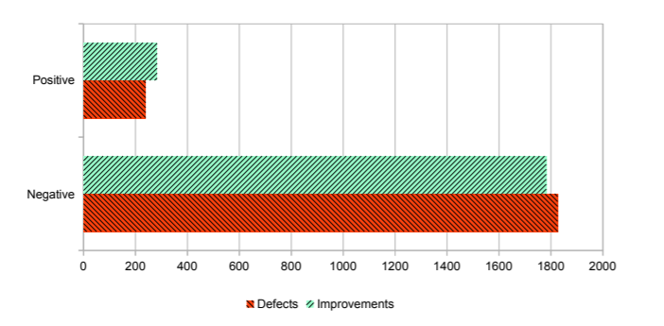
Data
Evernote mobile app (4470 reviews)
46% annotated data (CrowdFlower/Figure Eight)
26% training data;
20% testing data.
Inter-annotator agreement per task using Fleiss’ Kappa measure.
Question | Agreement%
Does this review contain a defect report? | 97.1
Does this review contain an improvement request? | 92.75

Slide 13
Patterns
Type | Pattern | Example
A(DR) | no (option|ability) to | No ability to copy or duplicate notes on mobile.
 | i can (n’t|not) | I can’t remove the numbers in lists anymore.
A (IR) | (an|the) option to | Would like to see an option to adjust the font size.
 | please VB | Please add Google now integration.
B (DR) | OR: |-Software Bug: Entity Type |-Software Update: Entity Type | The last few months of updates haven’t changed or lessened the lag you get when you edit notes.
 | OR: |-(however|but): Literal |-(not|n’t): Literal | However I cannot do so from the app which is very appalling
B (IR) | SEQ: |-please: Literal |-VB: Syn. Category | Please add automatic title from the rst sentence from notes instead of adding auto events...
 | SEQ: |-5: Literal |-stars: Literal | Colour coding of the notes and reminders for repetitive tasks can fetch 5 stars.
Defect report (DR):
5 manual patterns (type A);
2 generated patterns (type B).
Improvement requests (IR):
8 manual patterns (type A);
10 generated patterns (type B).

Slide 14
Patterns vs. distant supervised SVM
Task | Defect Classification |  |  | Improvement Classification
Method | Precision | Recall | F₁-measure | Precision | Recall | F₁-measure
Standard SVM | 0.39 | 0.59 | 0.47 | 0.78 | 0.54 | 0.64
Patterns A (manual) | 0.61 | 0.42 | 0.50 | 0.81 | 0.42 | 0.56
Patterns B (learned) | 0.91 | 0.39 | 0.54 | 0.79 | 0.51 | 0.62
SVM Distant Supervision A | 0.24 | 0.67 | 0.36 | 0.39 | 0.48 | 0.43
SVM Distant Supervision B | 0.41 | 0.59 | 0.49 | 0.46 | 0.44 | 0.45
Approach | Defect Patterns | Improvement Patterns | Total
Manual (per person) | 8.5 hours | 10.25 hours | 18.75 hours
Automated | 3.5 hours | 2.4 hours | 5.9 hours

Slide 15
Conclusion and Future Work
Comparing with the manual patterns, automatically generated patterns boost the performance (F₁-measure) as follows:
Defect reports:
Supervised learning: by 0.04 pp.
Distant supervised learning: by 0.05 pp.
Improvement requests:
Supervised learning: by 0.06 pp.
Distant supervised learning: by 0.02 pp.
and reduce 70% of the construction time.

Slide 16
Conclusion and Future Work
Comparing with the manual patterns, automatically generated patterns boost the performance (F₁-measure) as follows:
Defect reports:
Supervised learning: by 0.04 pp.
Distant supervised learning: by 0.05 pp.
Improvement requests:
Supervised learning: by 0.06 pp.
Distant supervised learning: by 0.02 pp.
and reduce 70% of the construction time.
Future work:
increase the flexibility of our patterns by considering more complex terminal structures;
explore the automatic generation of our domain-specific gazetteers lists to increase coverage and the framework applicability in other domains.

Slide 17

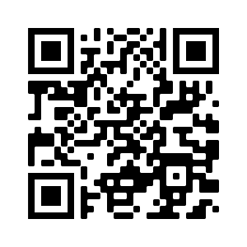
Thank you!
For questions, please send an email to maria.trusca@csie.ase.ro

