Slide 1
Connecting Customer Relationship
Management Systems to Social Networks
Hanno Zwikstra 265948jz@student.eur.nl | Frederik Hogenboom fhogenboom@ese.eur.nl
Damir Vandic vandic@ese.eur.nl | Flavius Frasincar frasincar@ese.eur.nl
Erasmus University Rotterdam PO Box 1738, NL-3000 DR Rotterdam, the Netherlands

Slide 2
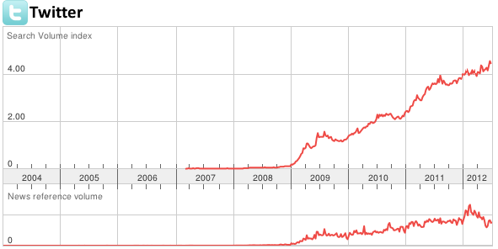
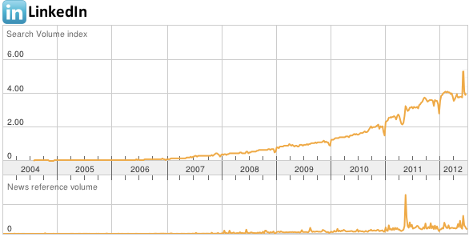
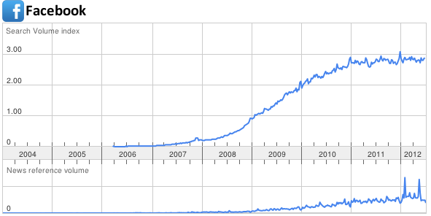
Introduction (1)
Social network:
  Social entities (e.g., people, organizations, etc.)
  Social relationships (e.g., friendship, co-working, etc.)
Social networks turn into digital networks:
  Twitter
  LinkedIn
  Facebook

Slide 3
Introduction (2)
Growth of digital social networks shows rich potential:
  Push information to target group (company advertisements, blogging, tweeting, etc.)
  Pull information from social networks into a Customer Relationship Management (CRM) system:
    Monitor social network sites for content in which a company or brand is mentioned provides valuable information and means to interact with customers
    Microsoft CRM provides add-on for Twitter
    Oracle Social CRM Applications
We propose the SocialCRMConnector framework, which is implemented as LinkedInFinder

Slide 4
Framework (1)
SocialCRMConnector framework retrieves profile data from social networks
Keypoints:
  Simplicity
  Control
  Up-to-date
Notes:
Simplicity: no fuss, execute business rules automatically without user input
Control: data is retrieved and can be processed by other applications
Up-to-date: real-time access to data facilitates up-to-date CRMs

Slide 5
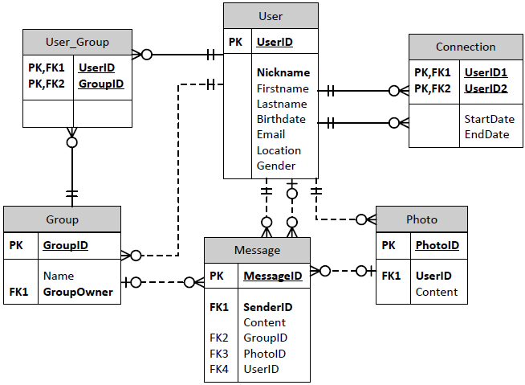
Framework (2)
Social network entities and relationships:
Notes:
Typical Entity-Relationship model for social networks, with the most common elements of a modern Web social network.
Users (people that have an account) are central here. Users can have inter-user connections (like friends) and belong to groups. Users post messages and have associated media, usually at least a photo.

Slide 6
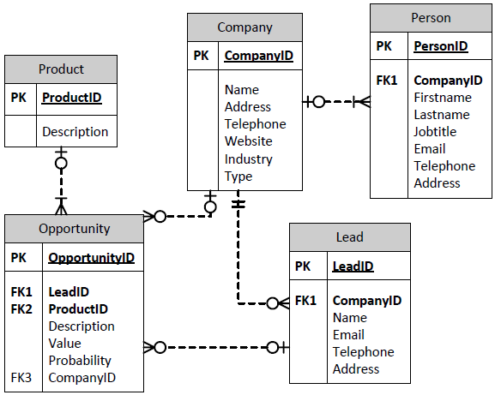
Framework (3)
CRM entities and relationships:
Notes:
CRM databases are obviously a lot more complex. If we focus solely on what is useful for social CRMs, the Person entity is an important entity.
It is associated with a Company, which is the actual central entity in a CRM system. A company has a certain type like competitor, customer, etc.
Leads are potential customers that do not yet have a relation with the company.
Opportunities are potential sales and are associated with Products.

Slide 7
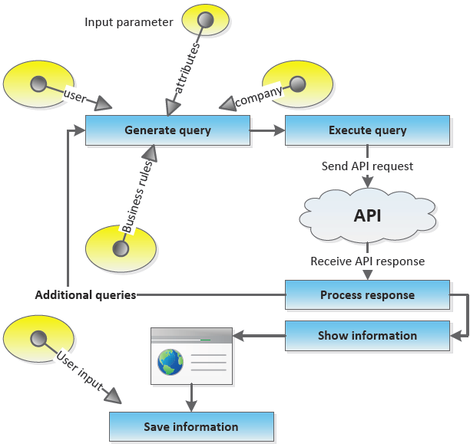
Framework (4)
Main steps:
Notes:
Main steps:
Generate query based on input parameters for retrieving profile information
Send request to API
Process response and perform additional queries if needed (e.g., grab related profiles recursively)
Show information to user
Store information in CRM system (if approved by user)

Slide 8
Implementation (1)
LinkedInFinder:
  Use case:
    Find people that have a job at specific companies that are not yet listed within the CRM and with whom the CRM owner would like to get in contact
    Leads are potential connections to companies of interest and are connected through first-degree connections of all CRM users
  Integrates Microsoft Dynamics CRM with LinkedIn:
    CRM add-in: when adding a company in the CRM, by a click of a button one could search for potential connections to the company
    LinkedIn app:
      Asks permission
      Retrieves user connections
      Displays information of selected connection
  Implementation in C# and ASP.NET: http://linkedin.hantheman.tk

Slide 9
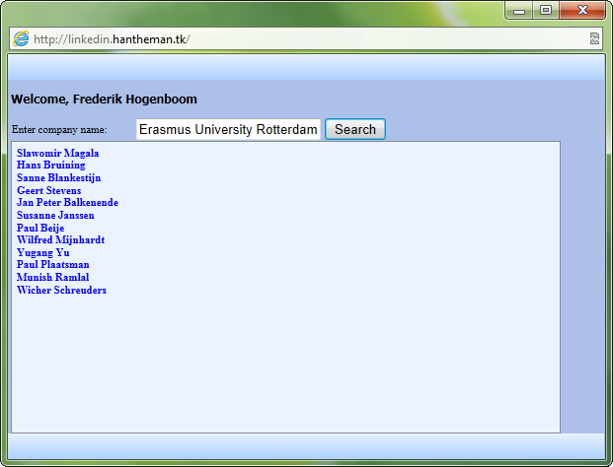
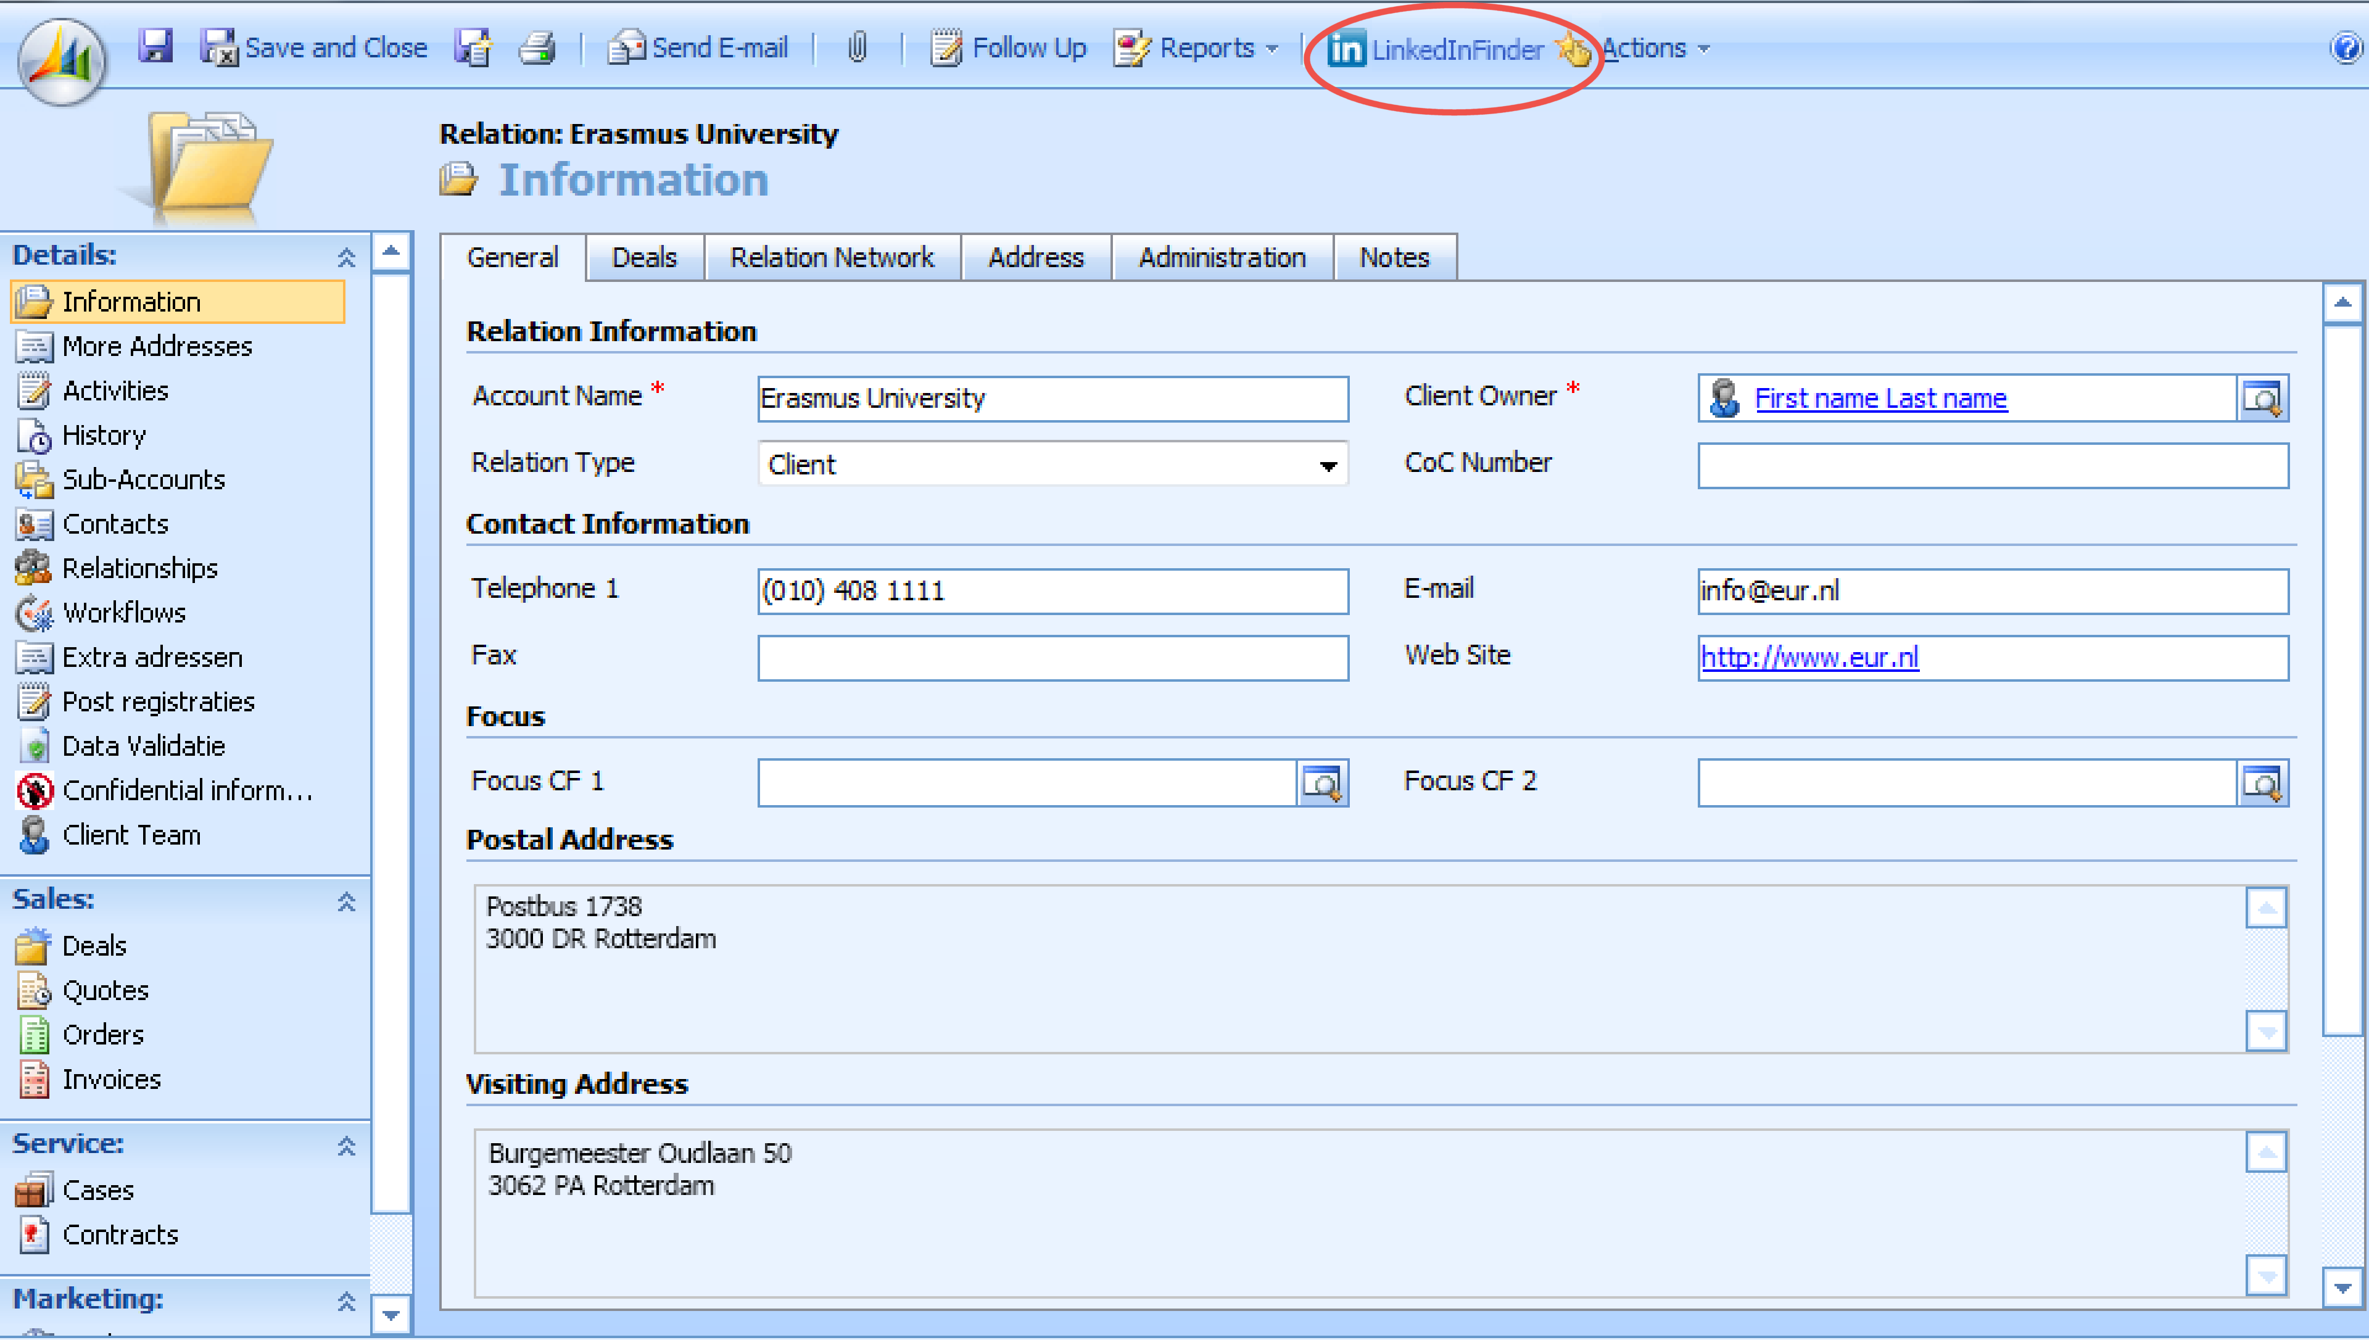
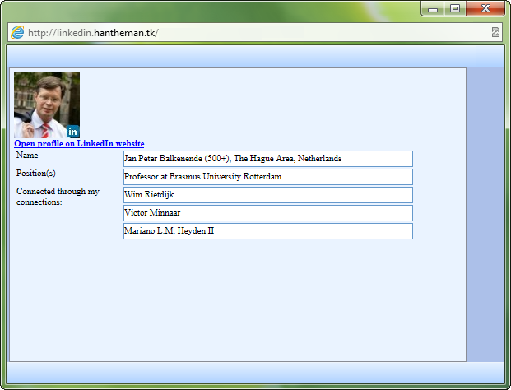
Implementation (2)

Slide 10
Implementation (3)
Search API request:
Profile API request:
http://api.linkedin.com/v1/people-search:(people:(id,
distance,first-name,last-name))?company-name=Erasmus& current-company=1&sort=relevance&start=0&count=10
http://api.linkedin.com/v1/people/id=nnl7Qkt7Kb:(last
-name,first-name,num-connections,num-connections-capp ed,phone-numbers,three-current-positions,picture-url,
location:(name),relation-to-viewer:(distance,num-rela
ted-connections,relatedconnections),positions:(title,
company:(name)))

Slide 11
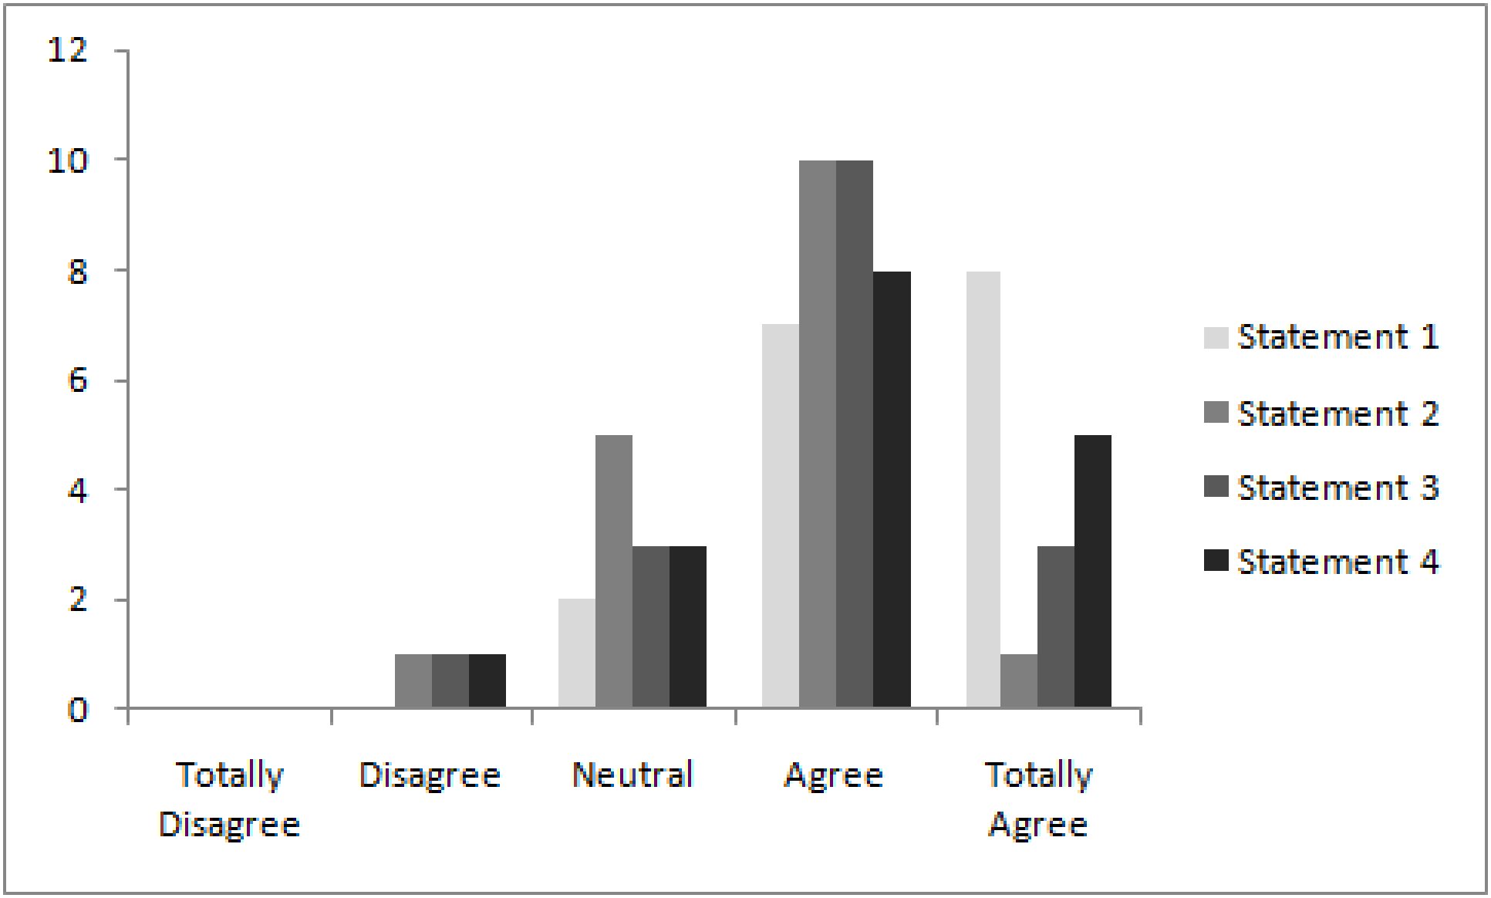
Evaluation
Validation of our results with the LinkedIn Web search engine:
  Search results identical with advanced search
  LinkedIn default search yields different ordering
17 Participants were asked to use LinkedInFinder and to assign points to 4 statements on a 5-point Likert scale:
  I find the application useful
  The application shows enough information to be useful
  The application offers enough functionality to be useful
  I would use the application for my job
Participants find the application useful and its design is considered to be adequate

Slide 12
Conclusions
We proposed the SocialCRMConnector framework which feeds CRM applications with social network data
Its implementation, LinkedInFinder, pulls data from LinkedIn into the Microsoft Dynamics CRM system
Results show that users find the application useful and adequately designed for the intended use
Future work:
  Implement other social networks
  Implement in other CRM systems
  Use social network data for other applications (personalization)

Slide 13
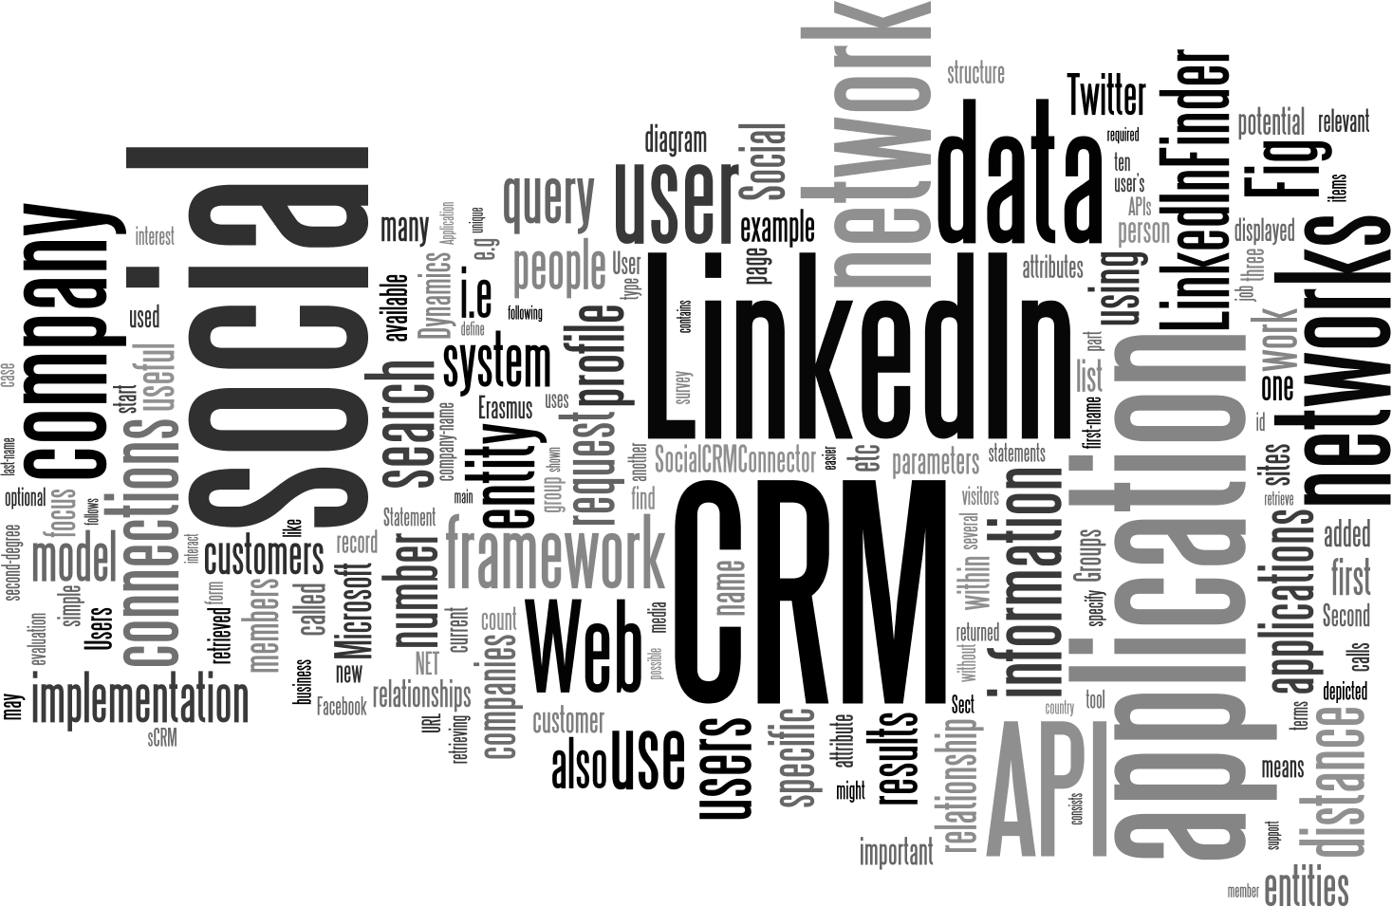
Questions

