Slide 1
A Linguistic Approach for Semantic Web Service Discovery
Jordy Sangers* jordysangers@hotmail.com |  | Flavius Frasincar* frasincar@ese.eur.nl |  | Frederik Hogenboom* fhogenboom@ese.eur.nl
 | Alexander Hogenboom* hogenboom@ese.eur.nl |  | Vadim Chepegin† vadim.chepegin@tieglobal.com
*Erasmus University Rotterdam PO Box 1738, NL-3000 DR Rotterdam, the Netherlands †Tie Kinetix PO Box 3053, NL-2130 KB Hoofddorp, the Netherlands

Slide 2
Introduction (1)
There is an emergence of Web services and Service Oriented Architectures (SOA), changing the management strategies related to business process components
Web services are commonly described via narrative Web pages in natural languages, i.e., in plain text without machine interpretable structure
Automatically processing descriptive Web service information is however desired due to the abundance of available services

Slide 3
Introduction (2)
Semantic languages (WSMO, WSMO-Lite, OWL-S) have been created to aid machines in processing Web service information
These languages rely on ontologies (describing Web services) for reasoning
Ontologies are human-created, and hence contain:
Machine-interpretable relations and concepts
Human-interpretable meta-data in natural language
Natural Language Processing (NLP) techniques can help overcome ambiguity problems between multiple ontologies

Slide 4
Introduction (3)
The Semantic Web Service Discovery (SWSD) framework:
Enables users to search with keywords for existing Web services, described by a Semantic Web language for service annotation
Steps include information extraction, word sense disambiguation, and matching user search context with Web service context by means of a similarity measure
Results in a ranked list of Web services matching search criteria

Slide 5
Framework (1)
We propose a keyword-based discovery process for searching Web services which are described using a semantic language
The framework incorporates NLP techniques, as names and non-functional elements from descriptions (e.g., capabilities, conditions, effects) help understanding the context and are written in natural language
It does not take into account logic-based semantics defined in the Web service descriptions, but uses the definitions of concepts stated in imported ontologies.
Three steps:
Service Reading
Word Sense Disambiguation
Match Making

Slide 6
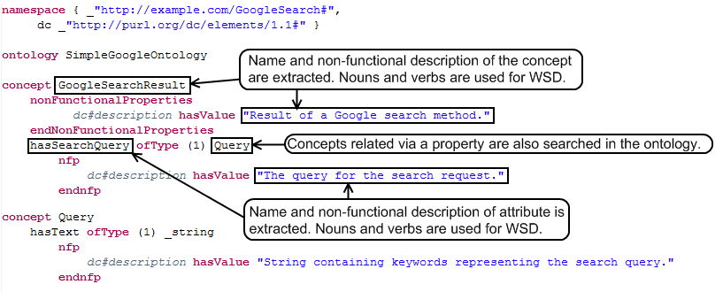
Framework (2)

Slide 7
Framework (3)
Service Reading:
WSMO, WSMO-Lite, and OWL-S descriptions assumed
NLP:
Parsing description using language-specific parser
Tokenization
Part-of-Speech tagging
Word Sense Disambiguation:
Words can have multiple meanings
We disambiguate senses using the SSI algorithm and a semantic lexicon (e.g., WordNet):
Find monosemous words to establish context
Based on context, iteratively disambiguate the least ambiguous word
Calculate pair-wise context sense similarities using a semantic distance measure (e.g., Jiang & Conrath)
Notes:
The SSI approach uses graphs to describe word groups and their context (word senses), as derived from a semantic lexicon. The senses are determined based on the number and type of detected semantic interconnections in a labeled directed graph representation of all senses of the considered word groups. We differ from SSI in that our algorithm considers the two most likely senses for each word group and iteratively disambiguates the word group with the highest confidence (i.e., weighted difference of the similarity of both senses to already disambiguated senses), rather than the word group with the greatest similarity for its best sense. Furthermore, in case an arbitrary word cannot be disambiguated, we default to the statistically most likely sense in our semantic lexicon, whereas the original SSI algorithm fails to provide a word sense. In our algorithm, we compute the similarity of a sense to already disambiguated senses as the sum of the inverse of the shortest path length between this sense and the disambiguated senses in the semantic graph.

Slide 8
Framework (4)
Sense Matching:
WSD results in a word and a sense set related to the user query and multiple word and sense sets for a Web service description:
ss_{u} = query senses • ws_{u} = query words
ss_{w} = description senses • ws_{w} = description words
We calculate Jaccard & Similarity matching scores for:
Disambiguated words (senses)
Non-disambiguated words (words)
Scores are weighted and summed
Notes:
Service descriptions have multiple sense sets, as some parts might be more important than others.
Jaccard index: by dividing the number of senses/words which appear in both sets by the total number
of senses/words in both sets, a similarity coefficient can be calculated.
Drawback of Jaccard: only fully similar senses/words count, but we also want the degree of similarity incorporated. Hence we also look at similarity matching scores.
So, for both sets, we calculate for each sense the sense similarity and sum their average. The similarity of a sense with a sense set is calculated as their maximum similarity. The similarity senseNorm is based on the Jiang and Conrath similarity (sim).
For words the same holds, yet we do not take into account the sense similarity, but the Levenshtein distance, i.e., the number of changes needed to convert one word to another. We additionally take into account word length, making it more reliable.

Slide 9
Implementation
SWSD is implemented in the Java-based Semantic Web Service Discovery Engine
WSMO web service and ontology readers
Seven levels of information with different weights:
Non-functional description and name of Web service (7/27)
Non-functional descriptions and names of concepts used by Web Service (5/27)
Non-functional descriptions of properties of capabilities of the Web Service (4/27)
Non-functional descriptions and names of superconcepts of the concepts used by the Web service (4/27)
Non-functional descriptions and names of subconcepts of the concepts used by the Web service (3/27)
Non-functional descriptions and names of attributes of concepts used by the Web service (1/27)

Slide 10
Evaluation (1)
Data: 14 WSMO annotated Web services
Three matching algorithms:
Simple
Jaccard
Similarity matching
Metrics:
Precision
Recall
Testing based on lists of two to five preferred Web services
We distinguish between exact and similar results
Notes:
Simple: Jaccard but only on lexical representations, i.e., no NLP

Slide 11
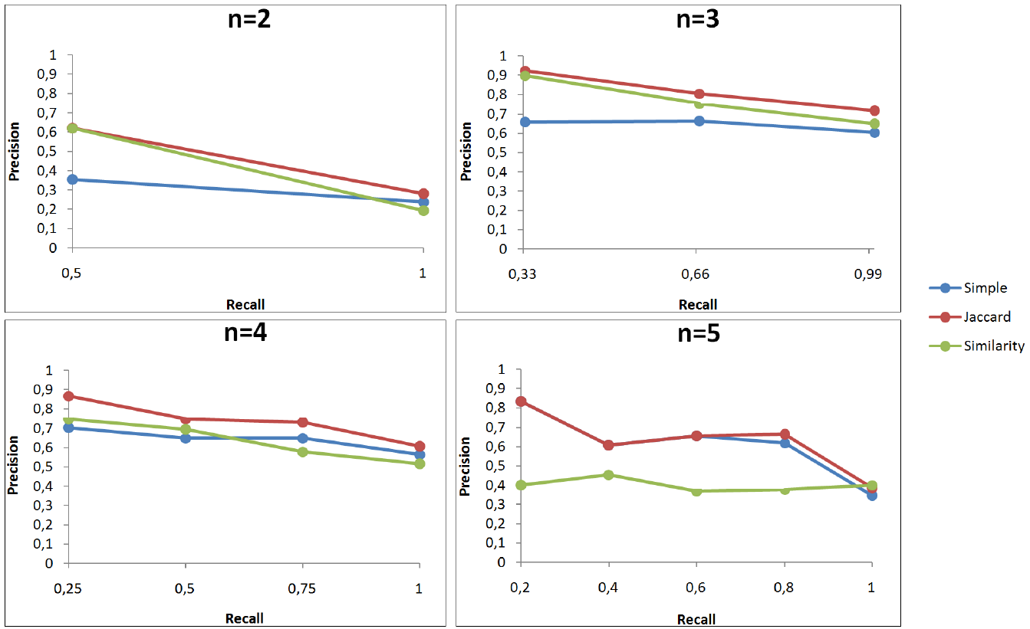
Evaluation (2)
When observing exact matches:
Jaccard outperforms Simple and Similarity matching
Precision converges when approaching maximum recall
The larger the number of preferred Web services, the worse Similarity matching performs

Slide 12
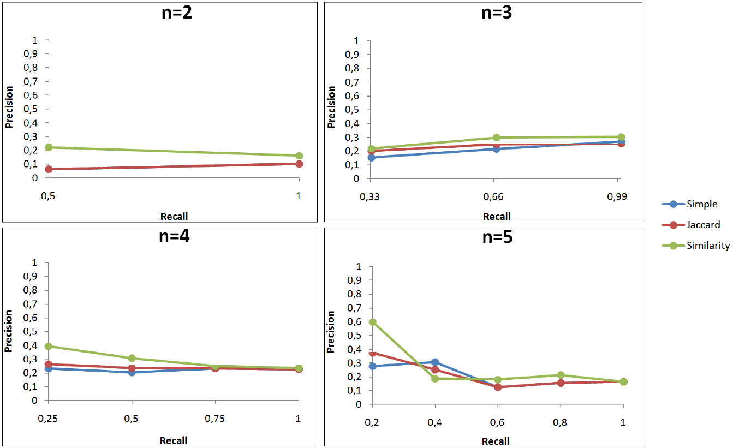
Evaluation (3)
When observing non-exact matches:
Similarity matching outperforms Jaccard and Simple matching
Precision values are higher due to the nature of Similarity matching
Non-exact matching is a more realistic application of the framework, hence making Similarity matching the best performing algorithm

Slide 13
Conclusions
SWSD framework:
A keyword-based discovery process for searching Web services that are described using semantically enriched annotations
Makes use of NLP
Employs a semantic lexicon for measuring keyword similarity
Implemented in the Semantic Web Service Discovery Engine for WSMO annotated services
Experiments:
Jaccard matching performs best for exact matches
Similarity-based matching gives best results for non-exact matches
Future work:
Extend implementation to languages like WSMO-Lite
Determine weights using neural networks, Bayesian networks, etc.

Slide 14
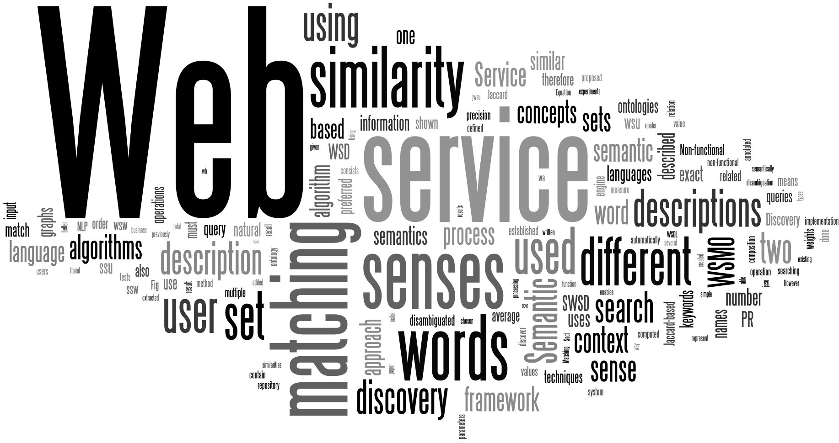
Questions

