Slide 1
A News-Based Approach for Computing Historical Value-at-Risk
Frederik Hogenboom fhogenboom@ese.eur.nl | Michael de Winter m.r.dewinter88@live.nl
Flavius Frasincar frasincar@ese.eur.nl | Alexander Hogenboom hogenboom@ese.eur.nl
Erasmus University Rotterdam PO Box 1738, NL-3000 DR Rotterdam, the Netherlands

Slide 2
Introduction (1)
Value-at-Risk (VaR):
Threshold value for a given portfolio, confidence, and time horizon, such that the probability that the loss on the portfolio over the given time horizon does not exceed this value, is at the given confidence level
Assumes normal market conditions, i.e., no sudden (unexpected) trend breaks
Limitations:
Meaningful on normally distributed losses
Difficult optimization
…
Still a widely used risk measure in financial markets for quantifying the risk of loss on a portfolio of financial equities

Slide 3
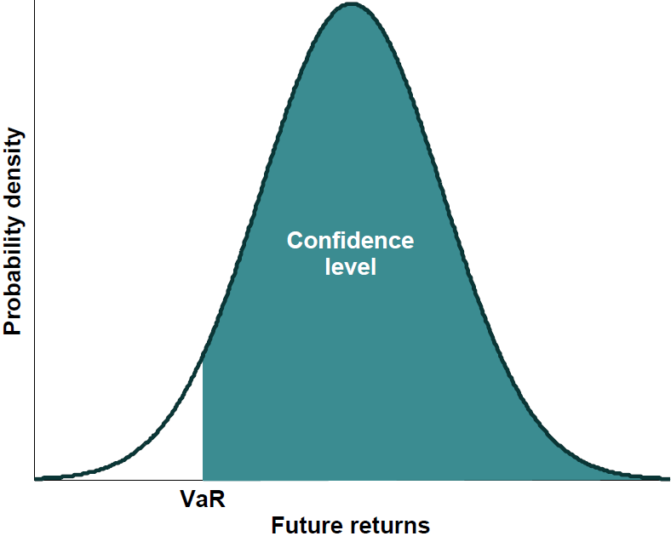
Introduction (1)
Value-at-Risk (VaR) is a threshold value, such that the probability of future returns exceeding this threshold is at a given confidence level
VaR is a widely used risk measure in financial markets for quantifying the risk of loss on a portfolio of financial equities
Limitation: assumption of normal market conditions, i.e., no sudden (unexpected) trend breaks

Slide 4
Introduction (2)
Real world: news causes derivations from trends
Steve Jobs resigns from Apple, Cook becomes CEO
(Reuters) - On Wednesday, Silicon Valley legend Steve Jobs resigned as chief executive of Apple Inc in a stunning move that ended his 14-year reign at the technology giant he co-founded in a garage.
Apple shares dived as much as 7 percent in after-hours trade after the pancreatic cancer survivor and industry icon, who has been on medical leave for an undisclosed condition since January 17, announced he will be replaced by COO and longtime heir apparent Tim Cook.
Apple stock price falls on news of Steve Jobs's death
(The Guardian) - Apple's stock price has risen more than 9,000% since Steve Jobs returned in 1997, and doubled in the past two years
News of Steve Jobs's death drove the Apple share price down more than 5% in Frankfurt on Thursday morning.
Apple shares are now trading 3.5% lower at €273, after hitting a low of €270 in Frankfurt. The shares are not traded in London. They are expected to open lower when Wall Street opens at 2.30pm London time.
Apple was briefly the most valuable company in the world in the summer, knocking oil giant Exxon Mobil off the top spot. Revenues have soared from $7.1bn (£4.6bn) in 1997 to $65.2bn a year now.
Google buys Motorola Mobility for $12.5B
(VentureBeat) - This morning, Google announced that it will buy Motorola Mobility — Moto’s mobile device arm — for $12.5 billion. Google will acquire Motorola Mobility for $40 per share in cash, a 63 percent premium over the company’s Friday closing price. Google says it will run Motorola Mobility as a separate business. Motorola spun off its business into two divisions last year, Mobility and Solutions (the data and telecom portion), as a response to declining profits.
Google shares were down around 1.5 percent, while Motorola Mobility’s stock jumped 57 percent. The company says Motorola Android phones won’t be receiving any special treatment as a consequence of the deal — but that’s a tough nut to swallow, since Google often plays favorites.

Slide 5
Introduction (3)
How to incorporate news in VaR calculations?
Historical VaR:
Based on historical returns
Changes in the past are predictive for the future
We can ignore noisy data around the time financial events are reported in news
Data from ViewerPro software:
2010 data for 363 equities and 119 financial event types (acquisition, profit announcement, CEO change, …)
Per equity hourly stock rates and ± 50 – 75 events

Slide 6
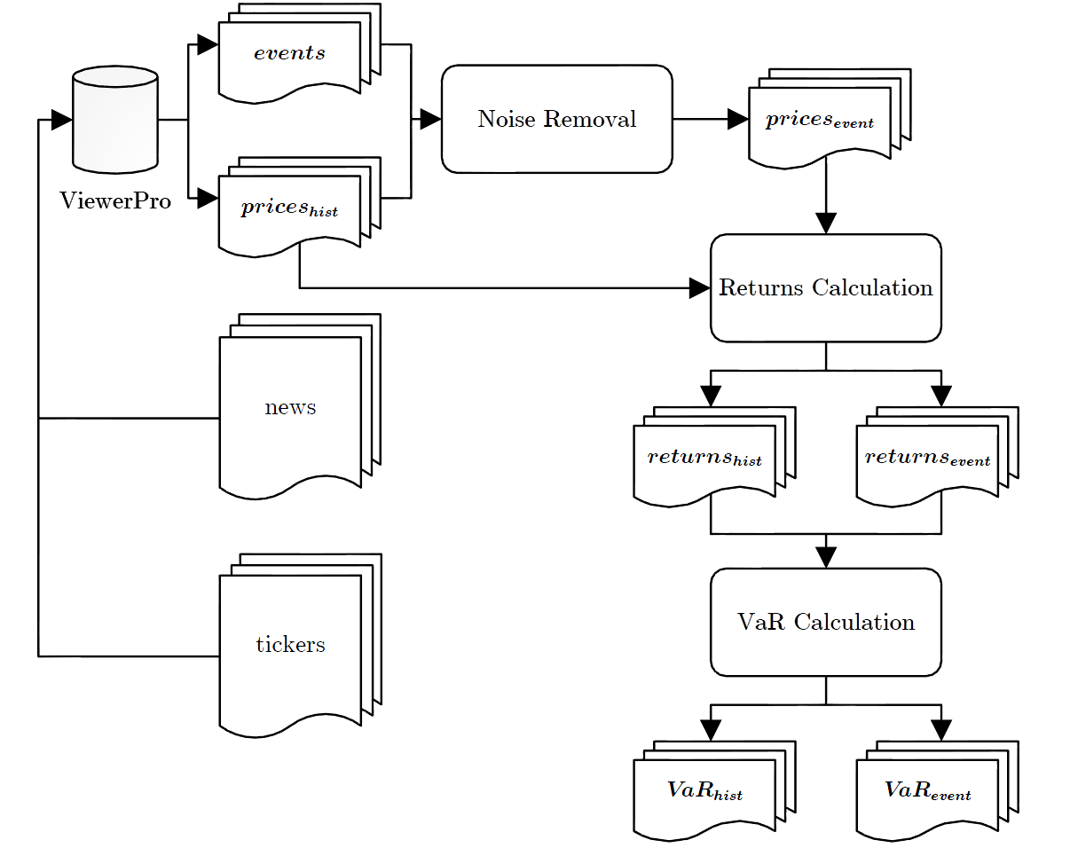
Framework (1)

Slide 7
Framework (2)
Data processing:
ViewerPro collects ticker data and news
Data is converted to chronologically ordered historical prices and financial events
Noise removal:
Historical prices are cleaned from noise caused by infrequently occurring events (identified through a Poisson distribution)
For this, the subsequent prices are set to the previous price for a specific amount of time
Time window is optimized
Cleaned prices are stored in a separate list

Slide 8
Framework (3)
Return calculation:
Return is to be interpreted as the profit that can be obtained if a share is bought at time t and sold at time t+1
Both sets of prices are converted to returns:
VaR calculation:

Slide 9
Framework (4)
Example: 21 prices, event at t=6, window=8, α=0.95
prices |  |  |  | returns |  |  |  | returns'
t | hist | event |  | t | hist | event |  | hist | event
1 | 0.35 | 0.35 |  | 1 | 0.14 | 0.14 |  | 2.50 | 0.44
2 | 0.40 | 0.40 |  | 2 | 0.07 | 0.07 |  | 0.48 | 0.14
3 | 0.43 | 0.43 |  | 3 | -0.37 | -0.37 |  | 0.44 | 0.08
4 | 0.27 | 0.27 |  | 4 | 0.44 | 0.44 |  | 0.36 | 0.07
5 | 0.39 | 0.39 |  | 5 | -0.03 | -0.03 |  | 0.14 | 0.05
6 | 0.38 | 0.38 |  | 6 | -0.68 | 0.00 |  | 0.14 | 0.05
7 | 0.12 | 0.38 |  | 7 | 2.50 | 0.00 |  | 0.07 | 0.00
8 | 0.42 | 0.38 |  | 8 | 0.36 | 0.00 |  | 0.05 | 0.00
9 | 0.57 | 0.38 |  | 9 | -0.39 | 0.00 |  | 0.05 | 0.00
10 | 0.35 | 0.38 | → | 10 | -0.23 | 0.00 | → | -0.02 | 0.00
11 | 0.27 | 0.38 |  | 11 | 0.48 | 0.00 |  | -0.03 | 0.00
12 | 0.40 | 0.38 |  | 12 | -0.08 | 0.00 |  | -0.03 | 0.00
13 | 0.37 | 0.38 |  | 13 | -0.03 | 0.00 |  | -0.03 | 0.00
14 | 0.36 | 0.38 |  | 14 | 0.14 | 0.08 |  | -0.08 | 0.00
15 | 0.41 | 0.41 |  | 15 | 0.05 | 0.05 |  | -0.08 | -0.02
16 | 0.43 | 0.43 |  | 16 | -0.02 | -0.02 |  | -0.10 | -0.03
17 | 0.42 | 0.42 |  | 17 | -0.10 | -0.10 |  | -0.23 | -0.03
18 | 0.38 | 0.38 |  | 18 | 0.05 | 0.05 |  | -0.37 | -0.08
19 | 0.40 | 0.40 |  | 19 | -0.08 | -0.08 |  | -0.39 | -0.10
20 | 0.37 | 0.37 |  | 20 | -0.03 | -0.03 |  | -0.68 | -0.37
21 | 0.36 | 0.36

Slide 10
Evaluation (1)
Using our 2010 data set, we compare outcomes of historical VaR calculations against event-based historical VaR
First, we determine the optimal fixed window size by evaluating various metrics
Additionally, we evaluate the performance of VaR calculations with variable window sizes:
Large percentile differences (> 50%) from the mean stock rate per equity after an event occurrence indicate noise that should be removed
The length of the period in which large differences occur differs per event

Slide 11
Evaluation (2)
Metrics:
Mean Squared Error (MSE):
OutPerformed Total (OPT):
Overconfident Predictions (CONF):

Slide 12
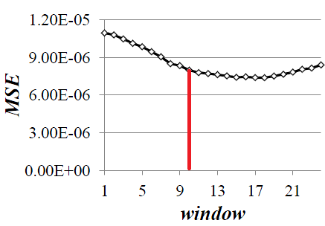
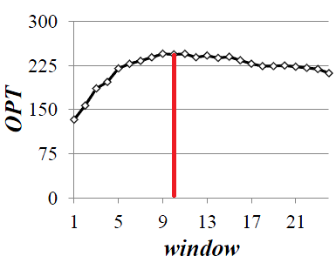
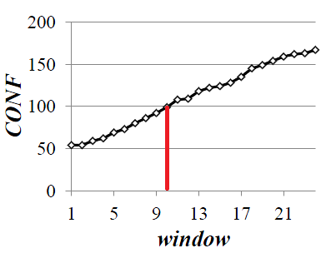
Evaluation (3)
The optimal fixed window size of the adjusted (event-based) historical method is set to 10 after minimizing MSE, maximizing OPT, and minimizing CONF

Slide 13
Evaluation (4)
Using a fixed window size results in a 31.73% lower MSE and 71.72% of the event-based VaR predictions outperform the traditional ones
Using variable window sizes results in a 35.47% lower MSE and 71.01% of the event-based VaR predictions outperform the traditional ones
Results are significant (with p-value of 0.0027)
 | window = 10 |  |  | window = event-based
Measure | hist | event |  | hist | event
MSE | 1.1220E-05 | 7.6600E-06 |  | 1.1220E-05 | 7.2400E-06
OPT | 96 | 249 |  | 100 | 245

Slide 14
Conclusions
We proposed a way to enhance the historical calculation and prediction of VaR by:
Taking into consideration rare events from news causing noise in stock prices through over- and under reactions
Introducing a price denoisation process linked to these events
Using the cleaned prices for the calculation of returns and VaR
Results show that event-based VaR outperforms historical VaR calculation in 70% of the cases (i.e., the MSE drops significantly with 30-35%)
Future work:
Account for type of news events (rumors, announcements, …)
Account for general stock market events (crisis, …)
Expand to other financial risk measurements (cVaR, …)

Slide 15

Questions

