Slide 1
Explaining a Deep Neural Model with Hierarchical Attention for Aspect-Based Sentiment Classification Using Diagnostic Classifiers
Kunal Geed
Erasmus University Rotterdam
kunalgeed15@gmail.com
Flavius Frasincar
Erasmus University Rotterdam
fransincar@ese.eur.nl
Maria Trusca
Bucharest University of Economic Studies
maria.trusca@csie.ase.ro
Notes:
My name is Maria Trusca, I am Bucharest University of Economic Studies. The name of our work is “A Hybrid Approach for Aspect-Based Sentiment Analysis Using Deep Contextual Word Embeddings and Hierarchical Attention”. My colleagues are Daan Wassenberg, Flavius Frasincar and Rommert Dekker. They all are from Erasmus University Rotterdam

Slide 2
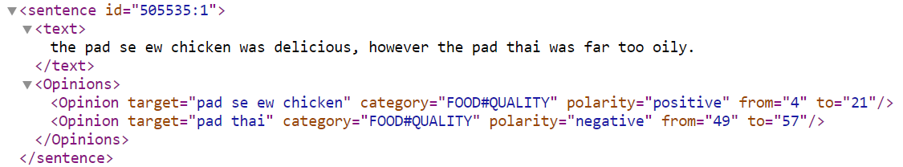
Introduction
Aspect-based sentiment analysis (ABSA) is described by tree major subtasks:
Aspect Category Detection;
Opinion Target Extraction;
Aspect-based Sentiment Classification (ABSC).
Using Diagnostic Classification, we examine the inner working of a model designed for ABSC. Precisely, we check whether the internal layers of a model encode for each word of an opinion, relevant information.

Slide 3
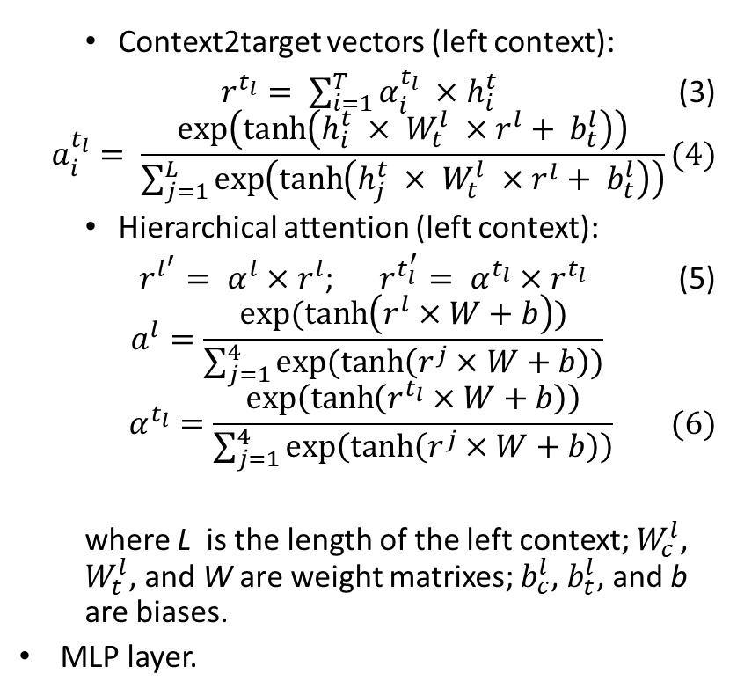
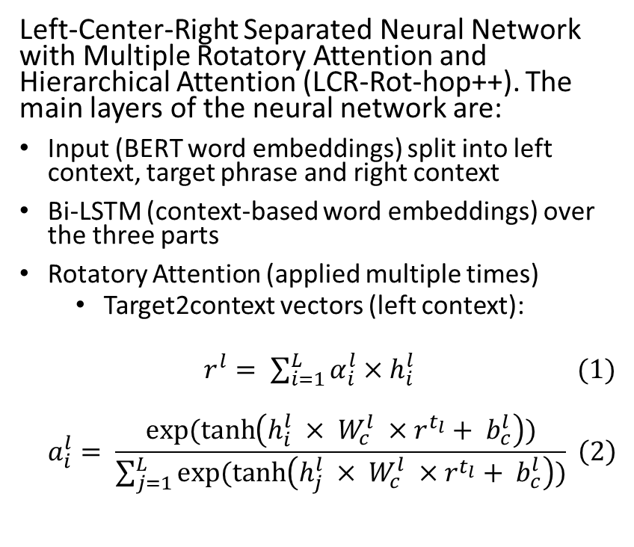
LCR-Rot hop++
Left-Center-Right Separated Neural Network with Multiple Rotatory Attention and Hierarchical Attention (LCR-Rot-hop++). The main layers of the neural network are:
Input (BERT word embeddings) split into left context, target phrase and right context
Bi-LSTM (context-based word embeddings) over the three parts
Rotatory Attention (applied multiple times)
Target2context vectors (left context):
$r^{l}= \sum_{i=1}^{L}{α_{i}^{l}}×h_{i}^{l}$ (1)
$$a_{i}^{l}= \frac{exp⁡(\tanh\left(h_{i}^{l} × W_{c}^{l} ×r^{t_{l}}+ b_{c}^{l}\right))}{\sum_{j=1}^{L}{exp⁡(\tanh\left(h_{j}^{l} × W_{c}^{l} ×r^{t_{l}}+ b_{c}^{l}\right))}} \left(2\right)$$
Context2target vectors (left context):
$r^{t_{l}}= \sum_{i=1}^{T}{α_{i}^{t_{l}}} ×h_{i}^{t}$ (3)
$$a_{i}^{t_{l}}= \frac{\exp\left(\tanh\left(h_{i}^{t} × W_{t}^{l} ×r^{l}+ b_{t}^{l}\right)\right)}{\sum_{j=1}^{L}{\exp\left(\tanh\left(h_{j}^{t} × W_{t}^{l} ×r^{l}+ b_{t}^{l}\right)\right)}}(4)$$
Hierarchical attention (left context):
$r^{l^{′}}= α^{l}×r^{l}$; $r^{t_{l}^{′}}= α^{t_{l}}×r^{t_{l}}$ (5)
$$a^{l}=\frac{exp⁡(\tanh\left(r^{l}×W+b\right))}{\sum_{j=1}^{4}{exp⁡(\tanh\left(r^{j}×W+b\right))}}$$
$$α^{t_{l}}=\frac{\exp\left(\tanh\left(r^{t_{l}}×W+b\right)\right)}{\sum_{j=1}^{4}{\exp\left(\tanh\left(r^{j}×W+b\right)\right)}} (6)$$
where L is the length of the left context; $W_{c}^{l}$, $W_{t}^{l}$, and W are weight matrixes; $b_{c}^{l}$, $b_{t}^{l}$, and b are biases.
MLP layer.

Slide 4
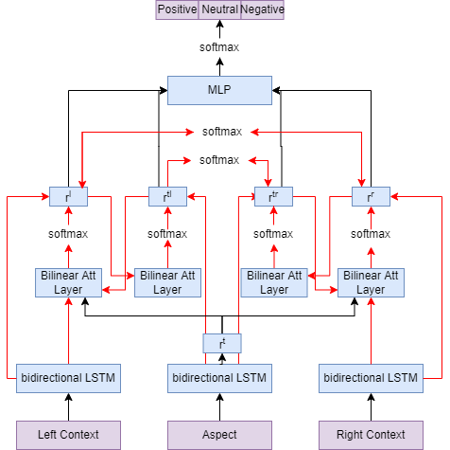
LCR-Rot hop++
MLP
Rotatory Attention
Bi-LSTM
Input

Slide 5
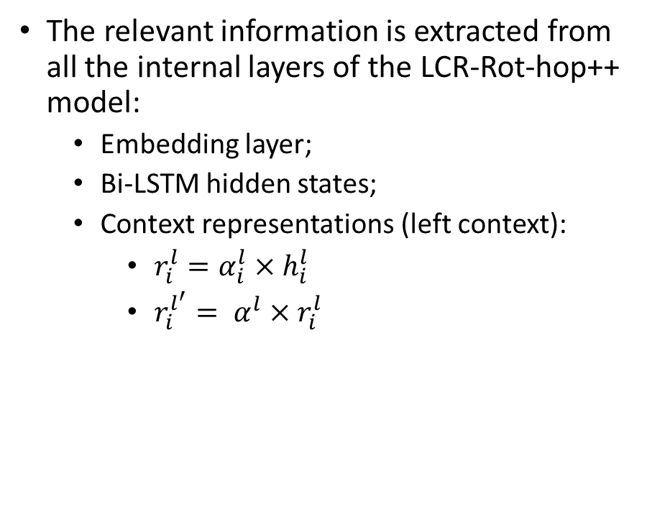
Diagnostic Classification
Using Diagnostic Classification, we keep track of the following information deemed useful at the word level for ABSC:
the presence of a relation with the aspect;
the sentiment value;
the sentiment value related to the aspect;
part-of-speech;
the presence of the aspects encoded by a domain ontology.
The presence of the target information is checked using a single layer MLP
The relevant information is extracted from all the internal layers of the LCR-Rot-hop++ model:
Embedding layer;
Bi-LSTM hidden states;
Context representations (left context):
$r_{i}^{l}=α_{i}^{l}×h_{i}^{l}$
$r_{i}^{l^{′}}= α^{l}×r_{i}^{l}$

Slide 6
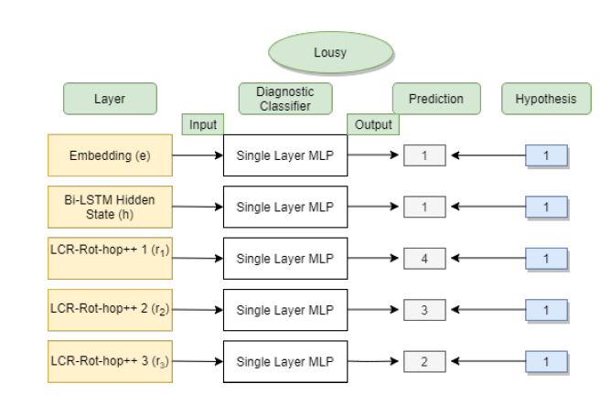
Diagnostic Classification - Example
Evaluation of the word “lousy” for the POS hypothesis.
Knowing that each word is assigned a label that ranges between 0 and 4 for POS tags: Nouns, Adjectives, Adverbs, Verbs, or “Remaining” words, we notice that the adjective “lousy” is properly classified only by the first layers of the model.

Slide 7





Diagnostic Classification – Tested hypothesis
POS Tagging: checks if the neural network can understand the structure of a sentence and its various components.
Aspect Relation Classification: checks if the neural network is encoding information about the relationship between a context word and the target.
Word Sentiment Classification: checks if the neural network can correctly detect the sentiment of the word.
Aspect-Related Sentiment Classification: checks if the neural network can identify the words that have a relation to the target and what sentiment they hold.
Aspect Mention Tagging: check if the neural network can identify various aspects present in the domain ontology.

Slide 8
Diagnostic Classification for POS Tagging
The training relies on the labels provided by the Stanford POS tagger (5 classes).
The results shows that the accuracy is highest for the embedding layer but falls as we move deeper into the neural network. A similar trend is shown by the F1 scores.
Overall, the embedding layer tends to best encode information about the structure of the sentence, while the information is lost or becomes less pronounced in the data as it moves deeper into the network.
Layer | Accuracy (%) | F1 (%) | Number of Neurons
Embedding | 65.51% | 69.96% | 500
Hidden State | 58.18% | 63.58% | 700
Hierarchical Weighted State 1 | 55.57% | 61.53% | 500
Hierarchical Weighted State 2 | 55.54% | 61.62% | 500
Hierarchical Weighted State 3 | 56.50% | 62.19% | 700

Slide 9
Diagnostic Classification for Aspect Relation Classification
The diagnostic classifier is trained using the word relations with respect to the aspect target indicated by the Stanford Dependency Parser (2 classes).
The accuracy and the F1 score suggests that the model can identify words related to the aspect better as we move deeper into the neural network.
Although there is a small drop moving into the hierarchical layers, the model is able to identify words related to the aspect relatively well. A possible reason for the hidden state performing better than the hierarchical layers could be that some words are related to the aspect but have no sentiment value.
Layer | Accuracy (%) | F1 (%) | Number of Neurons
Embedding | 73.06% | 78.03% | 700
Hidden State | 82.38% | 84.04% | 900
Hierarchical Weighted State 1 | 80.85% | 82.79% | 500
Hierarchical Weighted State 2 | 81.89% | 83.53% | 1100
Hierarchical Weighted State 3 | 80.66% | 82.58% | 900

Slide 10
Diagnostic Classification for Word Sentiment Classification
The training labels are specified by the domain sentiment ontology and the SentiWordNet lexicon (backup) (3 classes).
The results prove that as we go deeper into the neural network, the accuracy and the weighted F1 score fall.
The higher performance of the BERT embedding layer is probably due to the nature of word embeddings that can hold information about their context, alleviating the problem of sentiment detection.
Layer | Accuracy (%) | F1 (%) | Number of Neurons
Embedding | 77.03% | 80.81% | 900
Hidden State | 67.84% | 73.69% | 900
Hierarchical Weighted State 1 | 66.82% | 72.95% | 700
Hierarchical Weighted State 2 | 63.13% | 70.27% | 1100
Hierarchical Weighted State 3 | 66.00% | 72.01% | 900

Slide 11
Diagnostic Classification for Aspect-Related Sentiment Classification
The training labels used to test this hypothesis are obtained by combining the labels of the previous two hypotheses (3 classes).
The accuracy and F1 score are highest in the hidden state layer and fall as we move deeper into the neural network, before rising again in the final layer.
As this hypothesis is a combination of the previous two hypotheses, its trend can be explained through them.
Layer | Accuracy (%) | F1 (%) | Number of Neurons
Embedding | 76.88% | 85.27% | 500
Hidden State | 78.05% | 87.22% | 700
Hierarchical Weighted State 1 | 76.05% | 85.58% | 700
Hierarchical Weighted State 2 | 75.38% | 85.10% | 1100
Hierarchical Weighted State 3 | 77.28% | 85.61% | 500

Slide 12
Diagnostic Classification for Aspect Mention Tagging
According to the results, the accuracy falls as we move deeper into the model meaning that the information is to some extent lost (9 classes, including No Aspect).
While the BERT embedding layer has the highest accuracy, the hierarchical weighted layers are the least effective. The trend of the F1 score is similar.
Due to the limited size of the ontology, the size of the training dataset is much more limited than the others, leading to poorer results.
Layer | Accuracy (%) | F1 (%) | Number of Neurons
Embedding | 79.50% | 61.91% | 500
Hidden State | 77.08% | 61.99% | 900
Hierarchical Weighted State 1 | 73.49% | 60.40% | 700
Hierarchical Weighted State 2 | 73.37% | 59.68% | 500
Hierarchical Weighted State 3 | 73.15% | 58.22% | 500

Slide 13
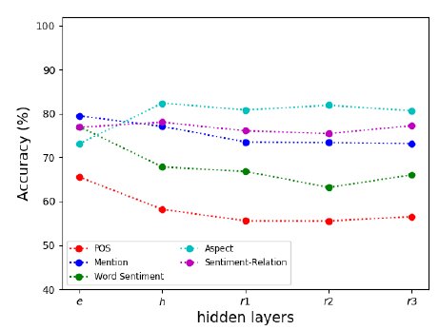
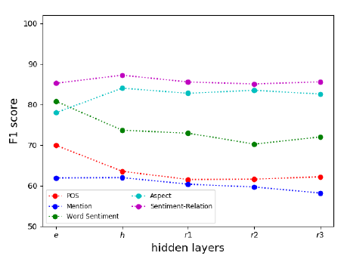
Diagnostic Classification - Overview
The model is successful at learning about:
Aspect Relations;
Word Sentiments;
Aspect-Related Word Sentiment.
And less successful at learning:
POS tagging;
Aspect Mention Tagging.
These results are to be expected as the last two tasks are not important for ABSC, as identifying the sentiment supersedes POS tagging and the Aspect Mentions are usually already identified.

Slide 14
Conclusion
Using a state-of-the-art ABSC solution, we investigated how the model deals with the detection of useful information for our task. We conclude that:
POS tagging:
The information is captured especially by the BERT word embeddings;
The remaining layers tend to lose this information.
Aspect Mention tags:
The information is stored mainly by the first two internal layers;
We lose information as we proceed deeper into the network.
Aspect Relation Classification:
The relations of words to the aspect are properly captured by the entire LCR-Rot hop++ model;
The deeper layers prove to be more effective than the initial ones.
Word Sentiment Classification:
The ability to identify the sentiment of a word fell as we went deeper into the neural network;
Most information was captured by the embedding layer.
Aspect-Related Sentiment Classification:
Similar to capturing relations of words with respect to the aspects;
The aspect-related word sentiment information is again better captured by the deeper layer of the LCR-Rot hop++ model.

Slide 15
Future work
Refine the extraction of aspect mention information by considering the possibility of each word to refer to more than one aspect.
Explore how and where the neural network learns other concepts represented in the ontology besides the aspect mention (e.g., sentiment expressions).
Validate our inferences on other ABSC models and datasets.
Solve the imbalanced classification problem using more advanced re-sampling techniques, such as Condensed Nearest Neighbor or oversampling techniques, such as SMOTE.

Slide 16
Thank you! For questions, please send an email to maria.trusca@csie.ase.ro

