Slide 1
Predicting User
Flight Preferences
In an Airline E-shop

Slide 2
Predicting User
Flight Preferences
Gabriel Budel, Lennart Hoogenboom,
Wouter Kastrop, Nino Reniers, and
Flavius Frasincar

Slide 3

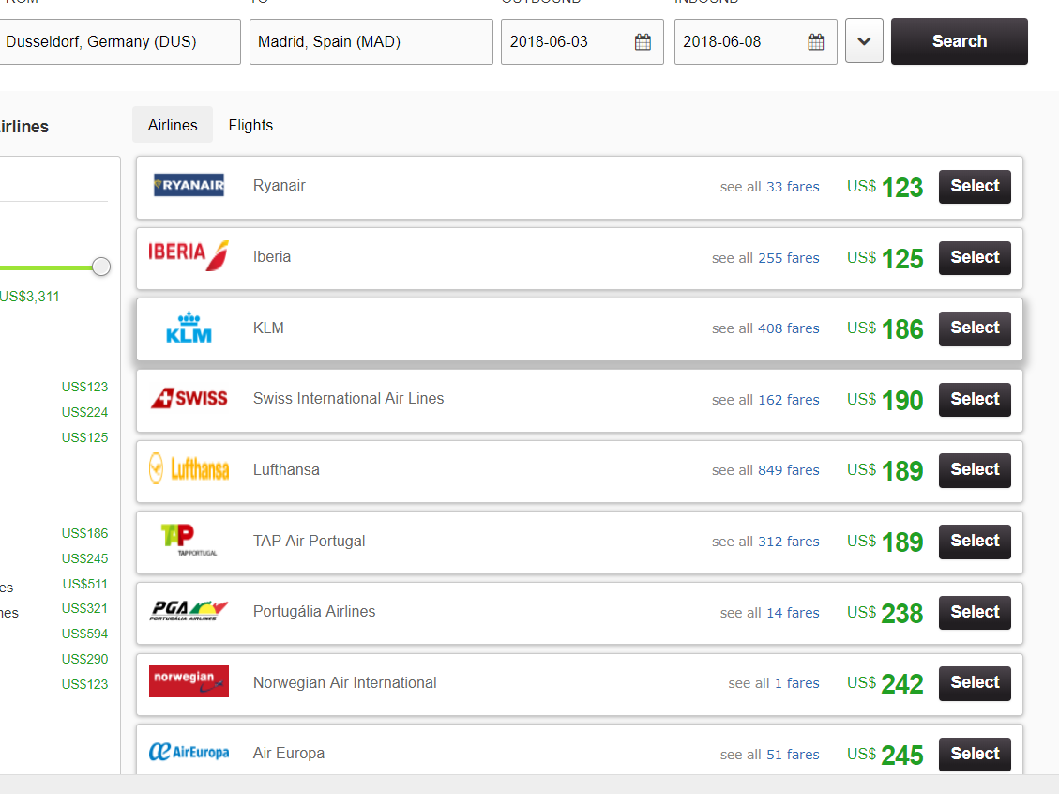
Airline E-shop

Slide 4
Ranking of Flights
Engage visitors
Personal customer experience
→ Personalized ranking of flights

Slide 5

Ranking of Flights
Applicable methods
Dynamic assortment
Cold starts
Limited feedback
Customer characteristics
Clickstream data
Real-time ranking
Different motivations
?
Notes:
*Customer characteristics do not differ among flights in a search result

Slide 6
Ranking of Flights
Ranking of items
Customer characteristics
Machine learning

Slide 7
Ranking of Flights
Ranking of items
Customer characteristics
Machine learning
→ Learning to rank
（LETOR)

Slide 8
LETOR
Documents
Features
Approaches
  Pointwise
  Pairwise
  Listwise

Slide 9
Method
Ranking SVM
Trained on partial feedback
Flight-specific features
Customer characteristics
→ Optimized ranking

Slide 10
Cross-terms
Flight-specific variables
Customer-specific variables
Cross-terms
Price
Number of children
×

Slide 11
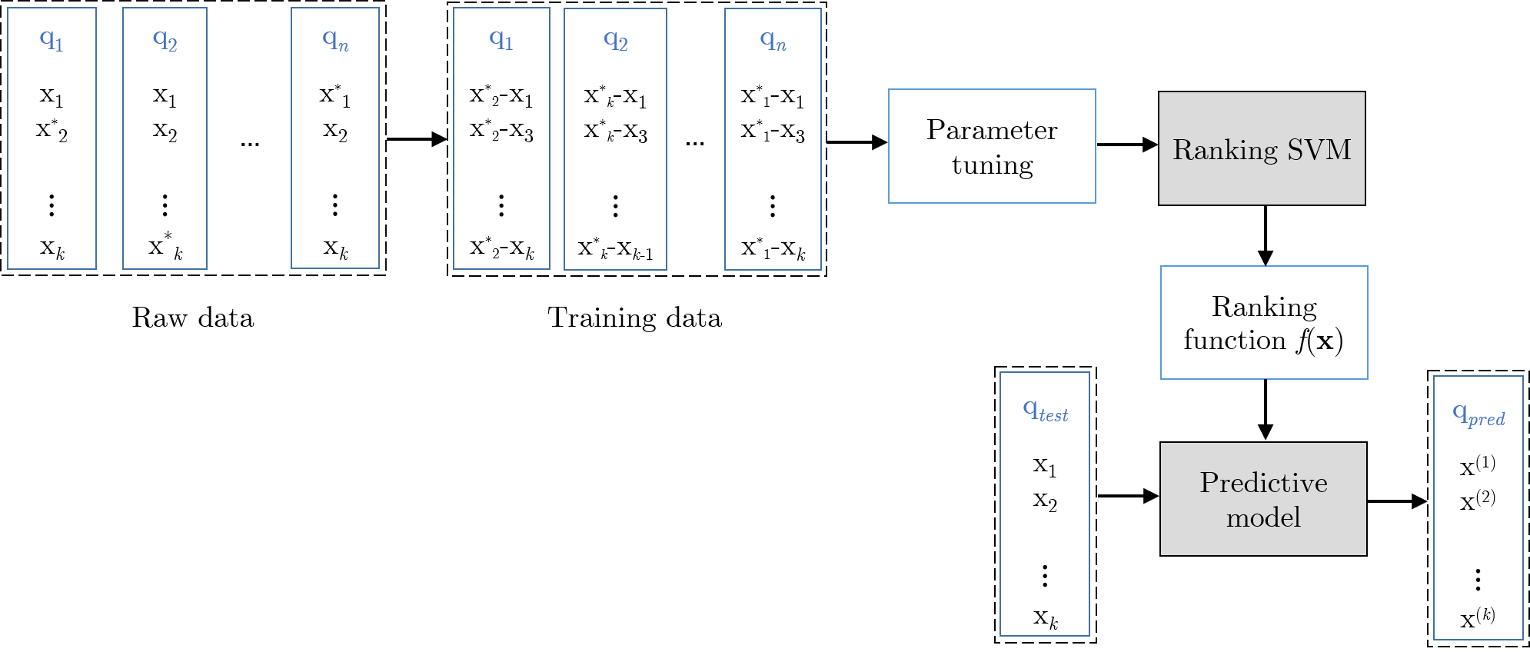
Ranking SVM

Slide 12
Ranking SVM
Training and tuning
Real-time ranking
Clickstream data

Slide 13
Implementation – Learning
Off-line training
Off-line parameter tuning
Fast ranking function
Notes:
Dot product met feature vector

Slide 14
Implementation – Comparability
Different magnitudes
Standardization with z-score
Flight-specific numerics

Slide 15
Implementation – Scaling
Interpretability
Scaling to [0,1]
Min-Max normalization
Important: Min/Max training set
Notes:
Wrong scaling distorts relative importance features

Slide 16
Implementation – Scaling
×
×
×
|
|
×
×
×
-2.83
0
1
2.45

Slide 17
Implementation – Scaling
|
|
×
×
×
×
×
×
0
1
×
×
×
|
×
×
×
×
×
-2.83
0
2.45
3.77

Slide 18
Implementation – Scaling
|
|
×
×
×
×
×
×
0
1
×
×
×
|
|
×
×
×
×
×
-2.83
0
1
3.77

Slide 19
Implementation – Scaling
1.25
|
|
×
-2.83
0
1
3.77

Slide 20
Implementation – Scaling
Interpretability
Scaling to [0,1]
Min-Max normalization
Important: Min/Max training set
Z-scores
Cross-terms
Notes:
Wrong scaling distorts relative importance features

Slide 21


Ranking SVM
Item pairs
Feature vectors
$$x_{i}^{\left(q\right)}=ψ(i,q)$$
$w∙x_{i}^{(q)}≥w∙x_{j}^{(q)}$+ 1

Slide 22

Ranking SVM
$$w∙\left(x_{i}^{\left(q\right)}{−x}_{j}^{\left(q\right)}\right)≥1−ξ_{i,j}^{\left(q\right)}$$

Slide 23

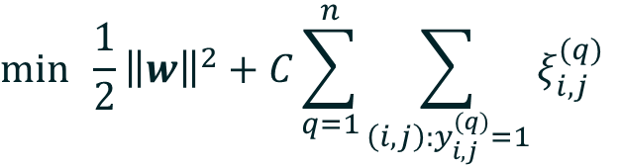



Ranking SVM
$$\min{\frac{1}{2}{\left\|w\right\|}^{2}+C\sum_{q=1}^{n}{\sum_{\left(i,j\right):y_{i,j}^{(q)}=1}{ξ_{i,j}^{(q)}}}}$$
$$\text{s}\text{.}\text{t}\text{.}$$
$$w∙\left(x_{i}^{\left(q\right)}{−x}_{j}^{\left(q\right)}\right)≥1−ξ_{i,j}^{\left(q\right)}$$
$$if y_{i,j}^{\left(q\right)}=1$$
$$ξ_{i,j}^{(q)}≥0$$

Slide 24

Ranking SVM – Ranking
Items no longer in pairs
Distance to hyperplane
Projection onto weight vector
$$\left\|{proj}_{w}x\right\|=\left\|x\right\|cos⁡(θ_{xw})$$

Slide 25
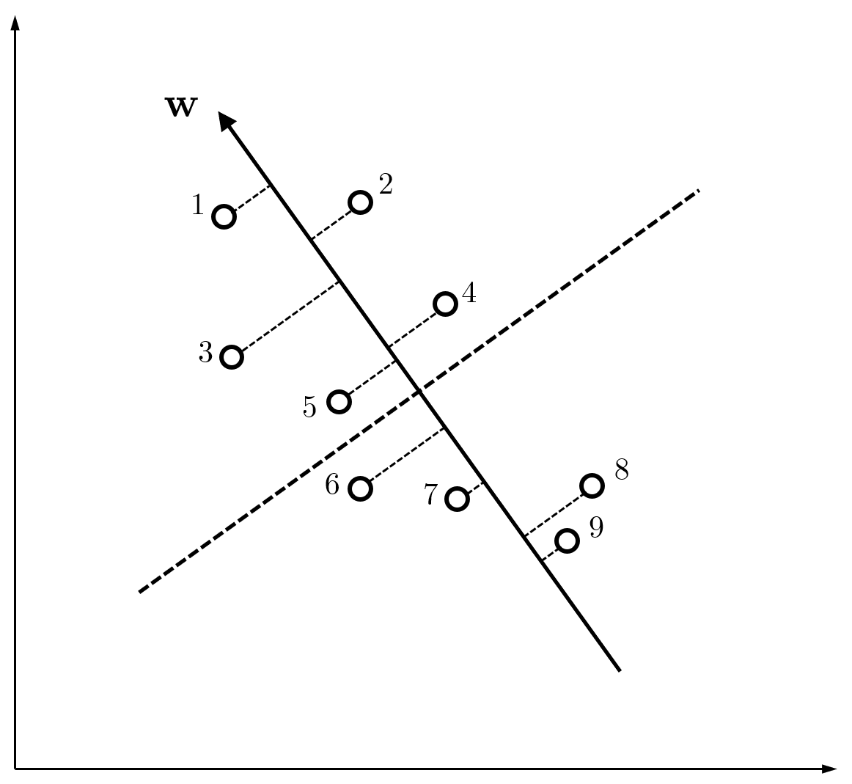

Slide 26
Ranking SVM – Ranking
Items no longer in pairs
Distance to hyperplane
Projection onto weight vector
$$\left\|{proj}_{w}x\right\|=\left\|x\right\|cos⁡(θ_{xw})$$
$$x∙w=\left\|x\right\|\left\|w\right\|\cos\left(θ_{xw}\right)=\left\|w\right\|\left\|{proj}_{w}x\right\|$$

Slide 27
Data
European airline
Website clickstream data
Presented ranking missing
2016 Q1
Purchases only
16,239 queries
Random 2/3 training sample

Slide 28
Data
Flight-specific | Customer-specific
Price | Number of adults
Number of stops | Number of children
Journey duration | Economy class
Departure in night | Log in
Departure in morning | Business page
Departure in afternoon | Promotional page
Departure in evening | Booking orientation page
 | Number of clicks
 | Apple device
 | Europe

Slide 29
Data
Flight-specific | Customer-specific
Price | Number of adults
Number of stops | Number of children
Journey duration | Economy class
Departure in night | Log in
Departure in morning | Business page
Departure in afternoon | Promotional page
Departure in evening | Booking orientation page
 | Number of clicks
 | Apple device
 | Europe

Slide 30
Data
Flight-specific | Customer-specific
Price | Number of adults
Number of stops | Number of children
Journey duration | Economy class
Departure in night | Log in
Departure in morning | Business page
Departure in afternoon | Promotional page
Departure in evening | Booking orientation page
 | Number of clicks
 | Apple device
 | Europe

Slide 31
Evaluation
Flights per query: up to 31 flights
Less than 4 flights
Winner-loser pairs
Subset of losers
Feature selection
Success@15%
Notes:
Maximum of 6 objects (theory), 6 → 1, 7 → 2, 14 → 3

Slide 32
Evaluation – Results
Success@15%: 75.54%
Naive ranking: 62.41%
Improvement of 13.14 percentage points
Only flight-specific: 73.43%
Improvement of 2.11 percentage points

Slide 33
Evaluation – Results
Price -2.945
Price × Economy -2.644
Journey duration -2.700
Journey duration × Europe +0.607

Slide 34
Concluding Remarks
Personalized ranking
Cross-terms
Impact

Slide 35
Future Work
A/B test
Continuous training
Past purchase behavior

