Slide 1
Ontology-Enhanced Aspect-Based Sentiment Analysis
Kim Schouten, Flavius Frasincar, and Franciska de Jong

Slide 2
What is sentiment analysis?
Many people freely express their opinions on the Web
Extract sentiment from unstructured text
Useful:
For consumers when making a purchase decision
For producers to assess the impact of marketing campaigns, success of product launches, etc.
Many companies in business analytics include some form of sentiment analysis
Notes:
Lexalytics, Brandwatch, startups: Wonderflow, Vita.io

Slide 3
Why aspect-based?
Finer level of analysis
Directly link expressed sentiment to actual topic or aspect
Useful when topic is not known beforehand, or when there can be multiple topics
Two main tasks:
Aspect detection
Sentiment analysis for aspects

Slide 4
Data Snippet
<sentence id="1032695:1">
<text>Everything is always cooked to perfection , the service is excellent , the decor cool and understated .</text>
<Opinions>
<Opinion target="NULL" category="FOOD#QUALITY" polarity="positive" from="0" to="0"/>
<Opinion target="service" category="SERVICE#GENERAL" polarity="positive" from="47" to="54"/>
<Opinion target="decor" category="AMBIENCE#GENERAL" polarity="positive" from="73" to="78"/>
</Opinions>
</sentence>

Slide 5
Data Snippet
<sentence id="1032695:1">
<text>Everything is always cooked to perfection , the service is excellent , the decor cool and understated .</text>
<Opinions>
<Opinion target="NULL" category="FOOD#QUALITY" polarity="positive" from="0" to="0"/>
<Opinion target="service" category="SERVICE#GENERAL" polarity="positive" from="47" to="54"/>
<Opinion target="decor" category="AMBIENCE#GENERAL" polarity="positive" from="73" to="78"/>
</Opinions>
</sentence>

Slide 6
Data Snippet
<sentence id="1032695:1">
<text>Everything is always cooked to perfection , the service is excellent , the decor cool and understated .</text>
<Opinions>
<Opinion target="NULL" category="FOOD#QUALITY" polarity="positive" from="0" to="0"/>
<Opinion target="service" category="SERVICE#GENERAL" polarity="positive" from="47" to="54"/>
<Opinion target="decor" category="AMBIENCE#GENERAL" polarity="positive" from="73" to="78"/>
</Opinions>
</sentence>

Slide 7
Data Snippet
<sentence id="1032695:1">
<text>Everything is always cooked to perfection , the service is excellent , the decor cool and understated .</text>
<Opinions>
<Opinion target="NULL" category="FOOD#QUALITY" polarity="positive" from="0" to="0"/>
<Opinion target="service" category="SERVICE#GENERAL" polarity="positive" from="47" to="54"/>
<Opinion target="decor" category="AMBIENCE#GENERAL" polarity="positive" from="73" to="78"/>
</Opinions>
</sentence>
Task 1: Aspect Detection

Slide 8
Data Snippet
<sentence id="1032695:1">
<text>Everything is always cooked to perfection , the service is excellent , the decor cool and understated .</text>
<Opinions>
<Opinion target="NULL" category="FOOD#QUALITY" polarity="positive" from="0" to="0"/>
<Opinion target="service" category="SERVICE#GENERAL" polarity="positive" from="47" to="54"/>
<Opinion target="decor" category="AMBIENCE#GENERAL" polarity="positive" from="73" to="78"/>
</Opinions>
</sentence>

Slide 9
Data Snippet
<sentence id="1032695:1">
<text>Everything is always cooked to perfection , the service is excellent , the decor cool and understated .</text>
<Opinions>
<Opinion target="NULL" category="FOOD#QUALITY" polarity="positive" from="0" to="0"/>
<Opinion target="service" category="SERVICE#GENERAL" polarity="positive" from="47" to="54"/>
<Opinion target="decor" category="AMBIENCE#GENERAL" polarity="positive" from="73" to="78"/>
</Opinions>
</sentence>
Task 2: Sentiment Analysis for Aspects

Slide 10

Motivation and Setup

Slide 11
Why use external knowledge?
Using external knowledge alleviates the need for data
Good for resource sparse languages / domains
Use machine learning for its high performance
Our setup:
Use linear SVM
Basic linguistic features (lemmas/synsets)
Add features and/or adjust feature weights based on external knowledge

Slide 12
Ontology as external knowledge
An ontology is
a formal representation of knowledge
usually created manually by domain experts
An ontology allows
easy sharing of knowledge (e.g. LOD)
reasoning to derive (new) facts
Our ontology describes a part of the restaurant domain
56 sentiment expressions
3 sentiment values
185 target concepts
Notes:
5:00

Slide 13
Ontology Snippet
Notes:
5:00

Slide 14
Setup for Aspect Detection
Linear SVMs, one classifier per aspect category (13 in total)
Input features:
Basic binary features: lemmas and synsets
Binary ontology features:
For each concept: include all its types
When we find “Heineken”, we include the presence of Beer, Drink, Food, and Target in our input feature vector
For each sentiment word: include types of its target
When we find “delicious”, we include the types of its target: Food and Target

Slide 15
Setup for Aspect Sentiment Classification
Single linear multiclass SVM to find positive, neutral, and negative
Input features:
Aspect category
Stanford sentiment tool for
Overall sentence sentiment value
Sentiment value of the phrase that contains aspect (if applicable)
Word-based features:
lemmas, synsets, and ontology concepts

Slide 16
Setup for Aspect Sentiment Classification
Instead of binary input features for lemma, synset, and ontology concepts, assign weights to these word-based features
Weight = avg. sentiment value * distance factor
Features get an average sentiment value by checking these three sources for the originating word:
Stanford Sentiment tool
NRC Canada’s Yelp Restaurant Review sentiment word list
Our own ontology
Feature weights are factored based on grammatical distance from the aspect (if applicable)

Slide 17
Context Dependent Sentiment
Sentiment values in our ontology are context dependent
The aspect text is checked for ontology concepts
The SentimentExpression has to relate to one of these concepts
Then the positive and negative concepts are translated to a +1 and -1 sentiment score, resp.

Slide 18
Context Dependent Sentiment - Example
“food was delicious, staff was rude”
Two ontology Target concepts are found here: Food and Staff
“delicous” has target Food, so its positive value is only used when doing the sentiment analysis for the FOOD#QUALITY aspect
“rude” has target Person, which is the superclass of Staff, so its negative value is only used when doing the sentiment analysis for the SERVICE#GENERAL aspect

Slide 19
Context Dependent Sentiment - Example
<sentence>
<text>Food was delicious, staff was rude</text>
<Opinions>
<Opinion target="Food" category="FOOD#QUALITY" polarity="positive" from="0" to="4"/>
<Opinion target="staff" category="SERVICE#GENERAL" polarity="negative" from="20" to="25"/>
</Opinions>
</sentence>

Slide 20
Context Dependent Sentiment - Example
<sentence>
<text>Food was delicious, staff was rude</text>
<Opinions>
<Opinion target="Food" category="FOOD#QUALITY" polarity="positive" from="0" to="4"/>
<Opinion target="staff" category="SERVICE#GENERAL" polarity="negative" from="20" to="25"/>
</Opinions>
</sentence>

Slide 21
Results

Slide 22
Results – Aspect Detection
Average over 10 runs with 10-fold cross-validation
Aspect Detection |  |  | p-values of two-sided paired t-test
 | Avg. F₁ | St.dev. | base | +S | +O
Base | 0.5749 | 0.0057
+S | 0.6317 | 0.0039 | <0.0001
+O | 0.6870 | 0.0026 | <0.0001 | <0.0001
+SO | 0.6981 | 0.0040 | <0.0001 | <0.0001 | <0.0001

Slide 23
Results – Aspect Sentiment Classification
Average over 10 runs with 10-fold cross-validation
Sentiment Classification |  |  | p-values of two-sided paired t-test
 | Avg. F1 | St.dev. | base | +S | +O
base | 0.7823 | 0.0079
+S | 0.7862 | 0.0049 | 0.0294
+O | 0.7958 | 0.0069 | 0.0002 | 0.0008
+SO | 0.7995 | 0.0063 | <0.0001 | <0.0001 | <0.0001

Slide 24
Results
Single run on training and test data
Aspect Detection
 | In-sample F₁ (on training data) | Out-of-sample F₁ (on test data)
base | 0.803 | 0.5392
+S | 0.896 | 0.5728
+O | 0.858 | 0.6135
+SO | 0.920 | 0.6281
Sentiment Classification
 | In-sample F₁ (on training data) | Out-of-sample F₁ (on test data)
base | 0.831 | 0.7372
+S | 0.847 | 0.7349
+O | 0.863 | 0.7479
+SO | 0.884 | 0.7527

Slide 25
Data size sensitivity analysis
Keep the test set the same
Use only n% of available training data
Set n to 10:100 with step size 10
Performed for both aspect detection and aspect sentiment classification

Slide 26
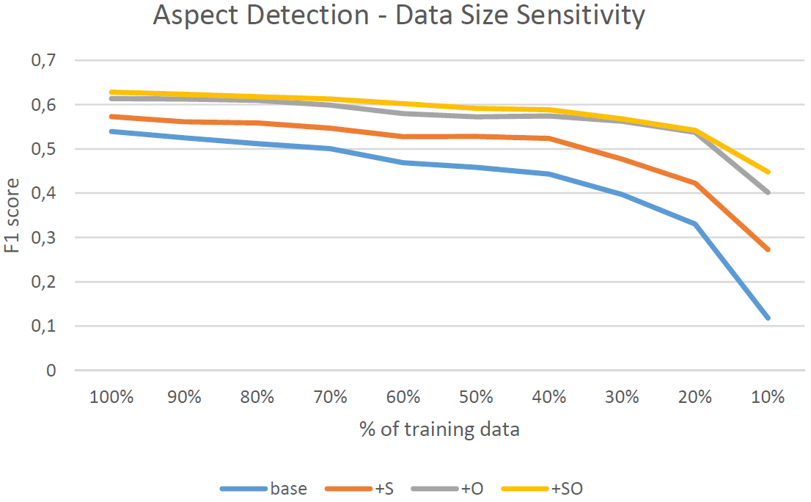

Slide 27
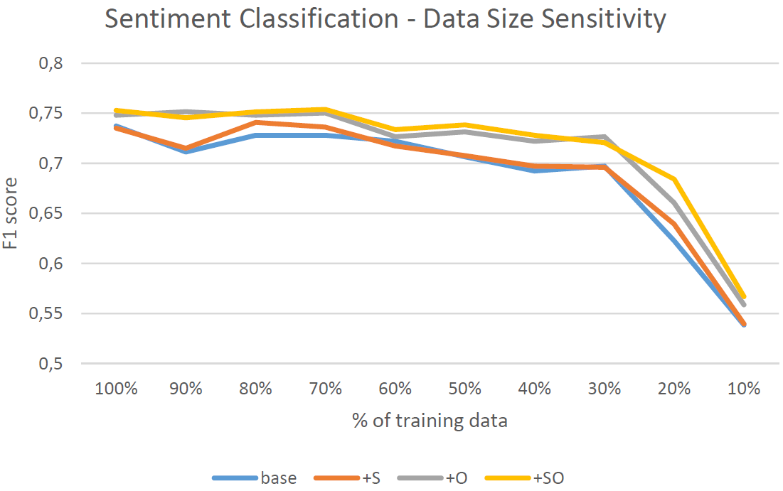

Slide 28
Feature analysis
Investigate the weights assigned by SVM to input features
Gives a measure of how important a feature is
Interpretation of these weights is only feasible with binary input values
Hence, it is only performed for the aspect detection task
Two success stories, one failure

Slide 29
Feature analysis for Aspect Detection
Aspect: DRINK#STYLE_OPTIONS
SVM Weight | Feature
0.369 | Ontology Concept: Menu
0.356 | Ontology Concept: Drink
0.307 | Synset: list
0.265 | Synset: enough

Slide 30
Feature analysis for Aspect Detection
Aspect: DRINK#PRICES
SVM Weight | Feature
0.428 | Ontology Concept: Price
0.303 | Ontology Concept: Drink
0.232 | Synset: drink
0.204 | Lemma: drink
0.184 | Lemma: at
0.180 | Lemma: price
0.176 | Synset: wine

Slide 31
Feature analysis for Aspect Detection
Aspect: RESTAURANT#GENERAL
SVM Weight | Feature
0.636 | Lemma: worth
0.505 | Lemma: love
0.487 | Lemma: back
0.419 | Lemma: wrong
0.406 | Lemma: return
0.402 | Lemma: up
0.399 | Lemma: again
0.368 | Lemma: overall
0.360 | Lemma: favorite
0.355 | Lemma: recommend

Slide 32
Conclusions & Future Work

Slide 33
Conclusions
External knowledge improves aspect-based sentiment analysis
Especially aspect detection is improved
Better overall performance
Less data is needed when using ontology
Ontology coverage is important, as shown in feature analysis
Sentiment analysis is less impacted by ontology
Could be due to coverage
Could be due to already using external knowledge in form of sentiment dictionaries

Slide 34
Future Work
Include more sentiment expressions
Improve reasoning
Investigate best way to combine sentiment and distance information
Locate aspects within sentence
Investigate the use of domain relations
Automate ontology population

Slide 35
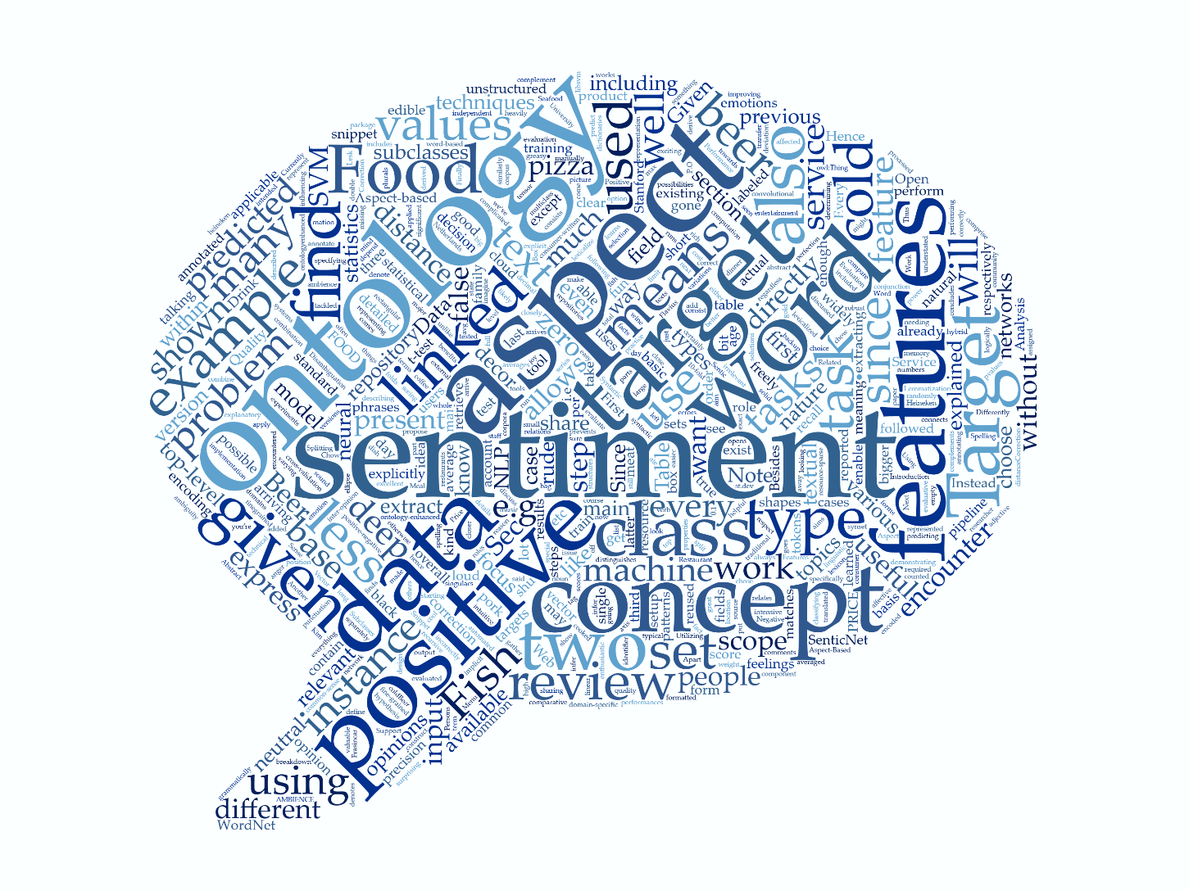
Discussion

Slide 36
Bonus slides: Data Analysis

Slide 37
Natural Language Processing

Slide 38
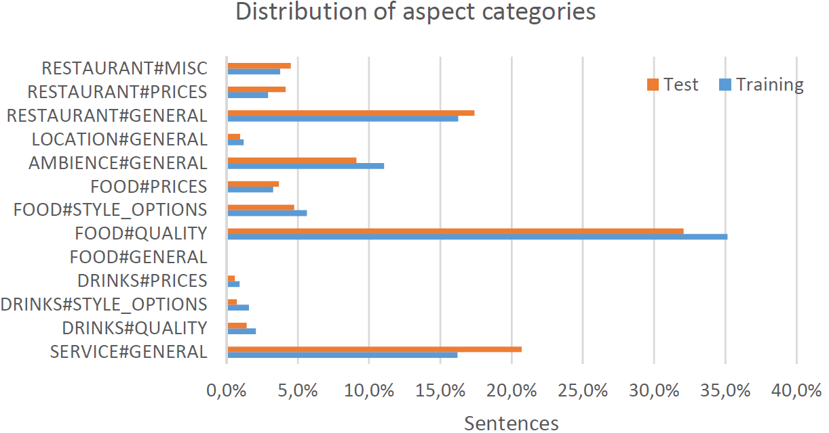
Aspect Statistics

Slide 39
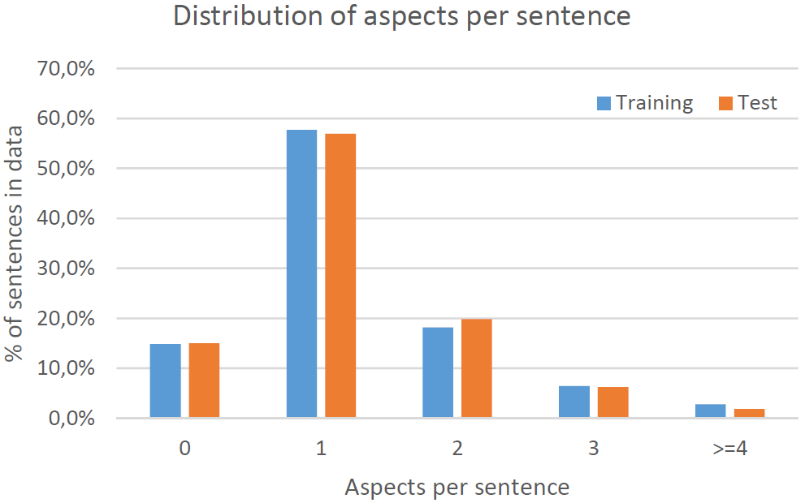
Aspect Statistics

Slide 40
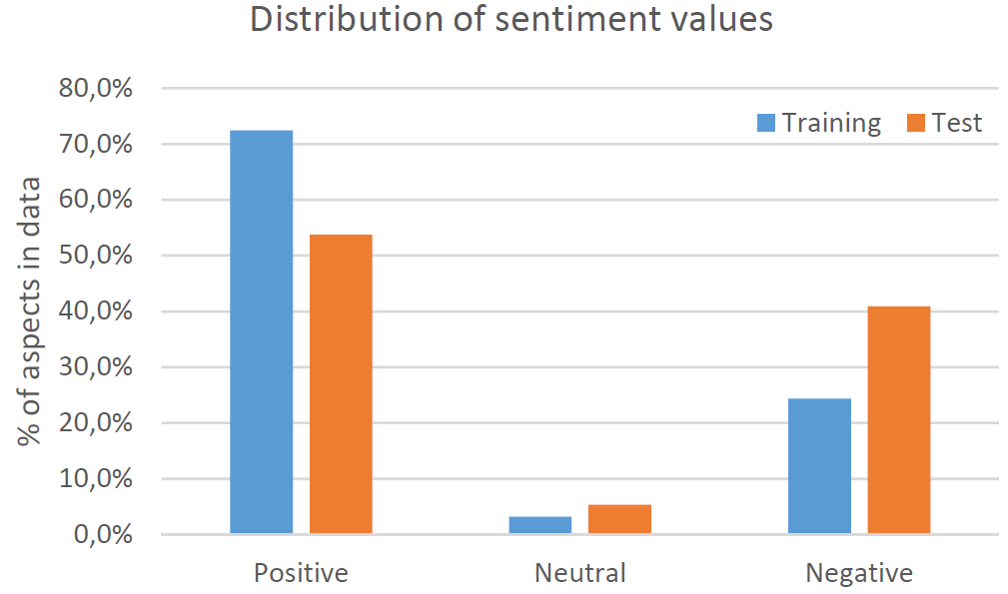
Sentiment Statistics

Slide 41
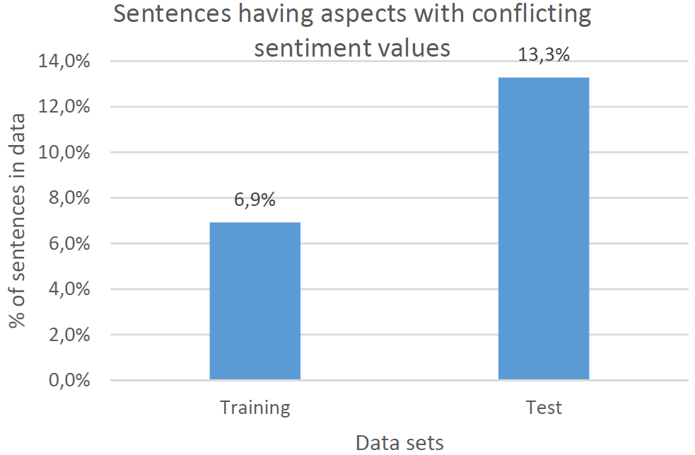
Sentiment Statistics

