Slide 1
Aspect-Based Sentiment Analysis on the Web using Rhetorical Structure Theory
Rowan Hoogervorst¹, Erik Essink¹, Wouter Jansen¹, Max van den Helder¹ Kim Schouten¹, Flavius Frasincar¹, and Maite Taboada²
¹Erasmus University Rotterdam, the Netherlands
²Simon Fraser University, Canada

Slide 2
Aspect-Based Sentiment Analysis on the Web
Sentiment Analysis -> extract sentiment from text
Sentiment can be defined as polarity (positive/negative)
Or as something more complex (numeric scale or set of emotions)
Useful for consumers to know what other people think
Useful for producers to gauge public opinion w.r.t. their product

Slide 3
Aspect-Based Sentiment Analysis on the Web
Nowadays the Web is filled with opinion and sentiment
People freely share their thoughts on basically everything
Useful, but lot of noise
Need automatic methods to sift through this much data
Our scope is consumer reviews

Slide 4
Aspect-Based Sentiment Analysis on the Web
Sentiment Analysis has a scope, for instance a document
More interesting however is the aspect level
An aspect is a characteristic or feature of a product or service being reviewed
This can range from general things like price and size of a product, to very specific aspects like wine selection for restaurants or battery life for laptops

Slide 5
Rhetorical Structure Theory
A theory that looks at the discourse structure of text
Divides text into logical discourse units that are linked to each other

Slide 6
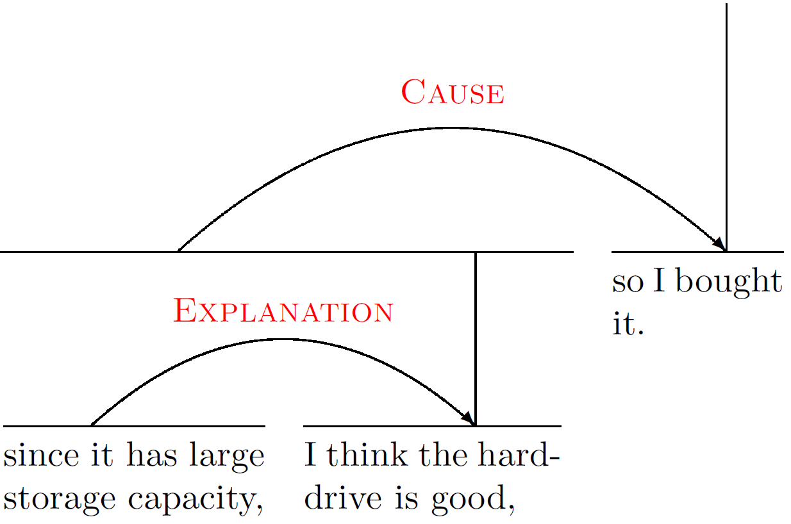
Rhetorical Structure Theory

Slide 7
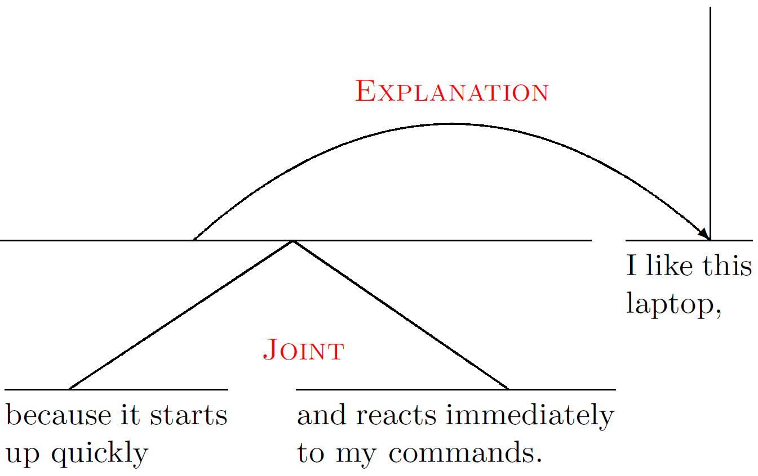
Rhetorical Structure Theory

Slide 8
Using Rhetorical Structure Theory for ABSA
The discourse tree shows how the various parts are related
We can use it to determine which part of the text is relevant w.r.t. the current aspect -> context tree
We can assign weights to the relations to distinguish between important parts of the text and less important ones
Propagate sentiment over the context tree using these weights

Slide 9
Algorithm Setup

Slide 10
Algorithm Setup – Construct Discourse Tree

Slide 11
Algorithm Setup – Construct Discourse Tree

Slide 12
Algorithm Setup – Construct Discourse Tree

Slide 13
Algorithm Setup – Construct Discourse Tree

Slide 14
Algorithm Setup – Construct Discourse Tree

Slide 15
Algorithm Setup

Slide 16
Algorithm Setup – Find Context Tree
Satellites add information to nuclei
But not the other way around
This information asymmetry naturally leads to a context tree

Slide 17
Algorithm Setup – Find Context Tree
I've been to at Cafe Spice probably 5-8 times, it is probably still the best Indian restaurant around Union Square.
To sum it up: Service varies from good to mediorce, depending on which waiter you get; generally it is just average Ok.
Seating is always prompt, though the restaurant does fill up in the evening.
Food is usually very good, though ocasionally I wondered about freshmess of raw vegetables in side orders.
As many other reviewers noticed, your order is often slow to arrive - this is particularly true in the evening but is not a problem during lunch time.
The decor is vibrant and eye-pleasing with several semi-private boths on the right side of the dining hall, which are great for a date.

Slide 18
Algorithm Setup – Find Context Tree

Slide 19
Algorithm Setup – Find Context Tree

Slide 20
Algorithm Setup – Find Context Tree

Slide 21
Algorithm Setup

Slide 22
Algorithm Setup – Word Sentiment Scoring
Lesk is used as a basic Word Sense Disambiguation step
Result: words are linked to WordNet synsets
We use the SentiWordNet dictionary to get scores for synsets
The sentiment of a leaf node is the sum of the sentiment of the words in that leaf

Slide 23
Algorithm Setup – Word Sentiment Scoring

Slide 24
Algorithm Setup

Slide 25
Algorithm Setup – Get Aspect Sentiment
Sentiment of a leaf is computed as follows:
Weights are optimized using a Genetic Algorithm
Take the sum of the sentiment scores of all leaf nodes that are in the context tree to get aspect sentiment
A trained threshold epsilon is used to divide the scores into positive/negative classes

Slide 26
Algorithm Setup – Get Aspect Sentiment

Slide 27
Algorithm Setup – Get Aspect Sentiment

Slide 28
Evaluation – Data sets
Restaurant data and laptop data from the SemEval 2015 and 2014 competitions
Restaurant 2015 and 2014 data have target expressions
The laptop 2015 and restaurant 2015 data are organized by review
The restaurant 2014 data are organized by sentence

Slide 29
Evaluation – Data sets
Type Reviews | SemEval year | Organized by | Targets | # Sentences | # Aspects
Laptops | 2015 | Review | No | 1739 | 1974
Restaurants | 2015 | Review | Yes | 1315 | 1654
Restaurants | 2014 | Review | Yes | 3041 | 3693

Slide 30
Evaluation – Data snippet

Slide 31
Evaluation – Baseline
The baseline model uses a word window around the aspects to get the context instead of RST when target is known
Otherwise, context is formed by all words in sentence
Sums up sentiment from words in context to get aspect sentiment
Same SentiWordNet lexicon

Slide 32
Evaluation – Performance – Laptops 2015

Slide 33
Evaluation – Performance – Restaurants 2015

Slide 34
Evaluation – Performance – Restaurants 2014

Slide 35
Conclusion
RST successfully used in sentiment analysis, but not on aspect level
RST is used to define the context for each aspect
And RST is used to logically combine sentiment from various parts of the text
Baseline model with simple word-distance context is outperformed
Address current shortcomings such as negations, better sentiment lexicon, better aspect sentiment computation
Further research could include combining RST with classification algorithms (such as SVM)

Slide 36
Questions?

Slide 37
Failure Analysis
No neutral case
Context tree is not always correct (too large)
Negations and amplifiers are not handled
Aspect sentiment computed w.r.t. root of context tree mostly ignores contrasting relations

Slide 38
Failure Analysis– Example

Slide 39
Failure Analysis – Example

Slide 40
Failure Analysis – Example

