Slide 1
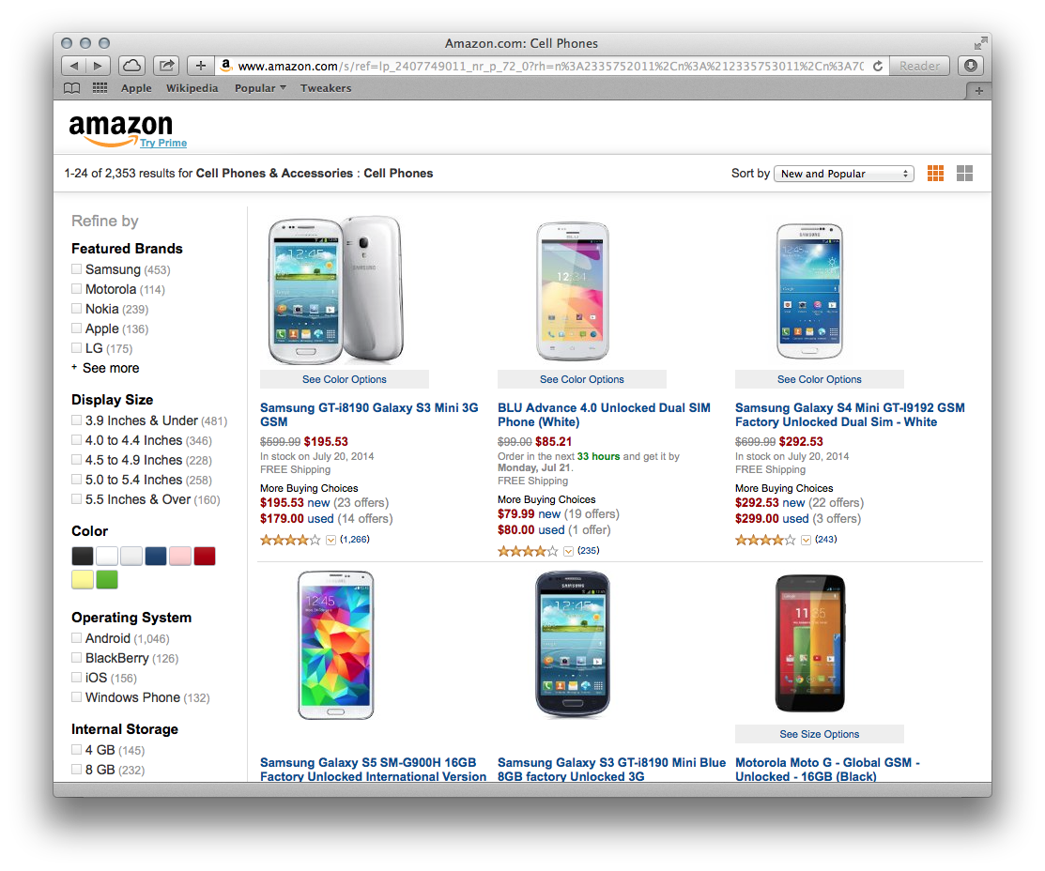



Dynamic Facet Ordering for Faceted Product Search Engines*
Introduction
Many of the current Web shops that use faceted search have a manual, expert-based selection procedure for displaying product facets. Figure 1 shows an example of displaying such facets for Amazon.com. However, such approaches fail to consider that after each query the resulting set of products changes, and thus the previously fixed ordering of facets might not be that relevant any more.
Facet Ordering Algorithm
Figure 2 shows the main flow in a user search session in our approach. The user may not know the name of the product (s)he is looking for, but knows the characteristics of the desired product. At the beginning, the user is presented with the complete set of products available in the Web shop. Our solution computes the property scores and the facet scores in parallel, after which the user is presented an ordered list of properties and, per property, an ordered list of facets. If the result set is too large, the user performs a drill-down (by selecting additional properties and their corresponding facets) and thus the query is updated triggering a new search iteration. If the result set is small enough, the user scans the returned products. If the desired product is not found, the user performs a roll-up (deselecting properties or selecting additional facets) and thus the query is updated again, triggering a new iteration. On the other hand, if the product is found, the search session ends.
Figure 3 shows the steps taken to compute the property score (one of the steps in Figure 2). If the property is a qualitative property, our approach computes the disjoint facet count for this property. Using the disjoint facet count a temporary property score (as a measure of specificity) is computed based on the Gini impurity measure. If the property is a quantitative property, in order to exploit the ratio scale of this data, we compute the Gini coefficient, which represents the temporary property score (as a measure of dispersion). The temporary scores are weighted based on the property popularity among products to favour properties that have facets spread among many products and to better cope with missing facets in the dataset. At the end, the properties are sorted in the descending order of the property scores. The facets associated to a qualitative property are sorted in the descending order of the disjoint facet counts.
Evaluation
For our experiments, we have gathered data from Tweakers Pricewatch. The complete catalogue contains 794 mobile phones, 53 properties, and 1,816 facets, from which 348 are qualitative and 1,468 are quantitative. We performed a large-scale simulation study based on 3 drill-down models (Least Scanning, Best Facet, and Combined Model), 4 ordering schemes (Expert-based, Greedy Count, Kim et al. (2014), and our approach), 794 target products, and 50 repetitions for the Combined Model. Our approach has the lowest number of clicks, has the lowest number of roll-ups, and has the highest percentage of successful sessions. In addition to the simulation study, we also performed a user experiment with 27 real users that were given 10 tasks to find products that match given product descriptions. Each user performed half of the experiments with our system and half of the experiments with the expert-based fixed facets system. Again the experiments show that the users need less clicks to find the desired product using our system.
*Damir Vandic, Steven S. Aanen, Flavius Frasincar, and Uzay Kaymak, “Dynamic Facet Ordering for Faceted Product Search Engines,” IEEE Transactions on Knowledge and Data Engineering, vol. 29, no. 5, pp. 1004–1016, 2017.
Figure 1. Fixed facet search in Amazon.com.
Figure 3. Activity diagram describing the property score computation.
Figure 2. Activity diagram describing the main flow of a search session.
Damir Vandic, Steven S. Aanen, Flavius Frasincar, and Uzay Kaymak

