Slide 1
DCWEB-SOBA: Deep Contextual Word Embeddings-Based Semi-Automatic Ontology Building for Aspect-Based Sentiment Classification
Flavius Frasincar*
frasincar@ese.eur.nl
* Joint work with Roos van Lookeren Campagne, David van Ommen, Mark Rademaker, and Tom Teurlings

Slide 2
Contents
Motivation
Related Work
Data
Methodology
Evaluation
Conclusion

Slide 3
Motivation
Growing number of reviews:
  In 2020: the number of reviews on Amazon around 250 million
Growing importance of reviews:
  80% of the consumers read online reviews
  75% of the consumers consider reviews important
Reading all reviews is time consuming, therefore the need for automation

Slide 4
Motivation
Sentiment mining is defined as the automatic assessment of the sentiment expressed in text (in our case by consumers in product reviews)
Several granularities of sentiment mining:
  Review-level
  Sentence-level
  Aspect-level (product aspects are sometimes referred to as product features): Aspect-Based Sentiment Analysis (ABSA):
    Review-level
    Sentence-level [our focus here]

Slide 5
Motivation
Aspect-Based Sentiment Analysis (ABSA) has two stages:
  Aspect detection:
    Explicit aspect detection: aspects appear literally in product reviews
    Implicit aspect detection: aspects do not appear literally in the product reviews
  Sentiment detection: assigning the sentiment associated to explicit or implicit aspects [our focus here]
Three approaches for ABSA:
  Knowledge Representation (KR)
  Machine Learning (ML)
  Hybrid: current state-of-the-art, e.g., A Hybrid Approach for Aspect-Based Sentiment Analysis++ (HAABSA++) proposed by Trusca, Wassenberg, Frasincar, and Dekker (2020)

Slide 6
Motivation
HAABSA++ is a two-step approach for ABSA at sentence-level:
  Ontology-based reasoning
  Deep learning (backup solution)
The domain sentiment ontology is manually constructed:
  Available only for some domains (restaurants and laptops)
  Limited coverage
Research question: How to build in a semi-automatic manner a domain sentiment ontology for ABSA at sentence-level?
In addition we aim to extend the ontology representation by means of adverbs (e.g., “carefully” in “carefully prepared” denotes positive sentiment) and make use of contextual word embeddings during ontology building

Slide 7
Related Work – ABSA
There are several hybrid approaches for ABSA:
  Ont+BoW by Schouten and Frasincar (2018): a two-step approach with ontology-based reasoning and an SVM classifier as backup
  Ont+LCR-Rot-hop (HAABSA) by Wallaart and Frasincar (2019): a two-step approach with ontology-based reasoning and a neural network with rotatory attention performed in multiple hops using GloVe embeddings (context-independent) as backup
  Ont+LCR-Rot-hop++ (HAABSA++) by Trusca, Wassenberg, Frasincar, and Dekker (2020): a two-step approach with ontology-based reasoning and a neural network with rotatory and hierarchical attention performed in multiple hops using BERT embeddings (context-dependent) as backup

Slide 8
Related Work – Ontology Building
The ontology building is based on (sentiment annotated) domain corpora
There are several approaches to build ontologies for ABSA:
  SOBA by Zhuang, Schouten, and Frasincar (2020): uses word co-occurences
  SASOBUS by Dera, Frasincar, Schouten, and Zhuang (2020): uses word and synset co-occurences (synsets deal with polysemous words)
  WEB-SOBA by ten Haaf, Claassen, Enschauzier, Tjan, Buijs, Frasincar, and Schouten (2021): uses word2vec representations (context-independent)
    WEB-SOBA outperforms SASOBUS on accuracy and time-efficiency (SASOBUS not used in the evaluation)

Slide 9
Data
Domain corpus: Yelp Open Dataset for restaurants
  2,000 restaurant reviews
  200,000 unique words
  Each review has text and star rating (1 to 5)
BERT base (uncased) which is trained on:
  BookCorpus (800M words)
  Wikipedia (2500M words)
Remove review sentences containing negation words (e.g., “not”, “never”, etc.), so 10.4% of review sentences are removed (so that word embeddings reflect true word polarity)

Slide 10
Data
Training and testing data: SemEval 2016, Task 5, Subtask 1, Slot 3 for restaurants
  3,365 opinions (target, aspect, and sentiment polarity, i.e., negative, neutral, and positive)
  Training data:
    350 reviews
    2000 sentences
    1879 opinions (after removal of opinions with implicit aspects)
  Test data:
    90 reviews
    676 sentences
    650 opinions (after removal of opinions with implicit aspects)

Slide 11
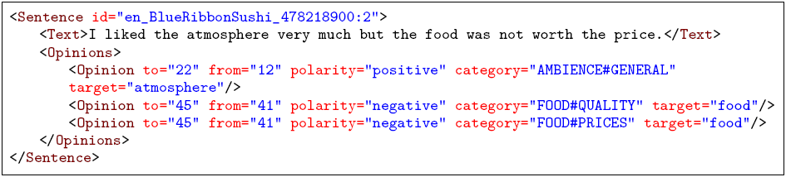
Data
Example:
Aspect categories: FOOD, AMBIENCE, DRINKS, LOCATION, RESTAURANT, EXPERIENCE, and SERVICE
Aspect attributes: PRICES, QUALITY, STYLE&OPTIONS, GENERAL, and MISCELLANEOUS

Slide 12
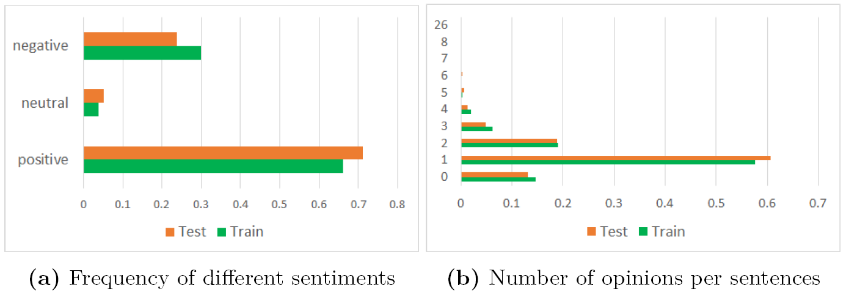
Data
The most dominant sentiment is positive
Almost all sentences have between 0 and 3 opinions

Slide 13
Methodology
Deep Contextual Word Embedding-Based Semi-Automatic Ontology Builder for Aspect-Based Sentiment Analysis (DCWEB-SOBA)
  Word Embeddings Construction
  Skeletal Ontology Building
  Term Selection
  Sentiment Term Clustering
  Aspect Term Clustering

Slide 14
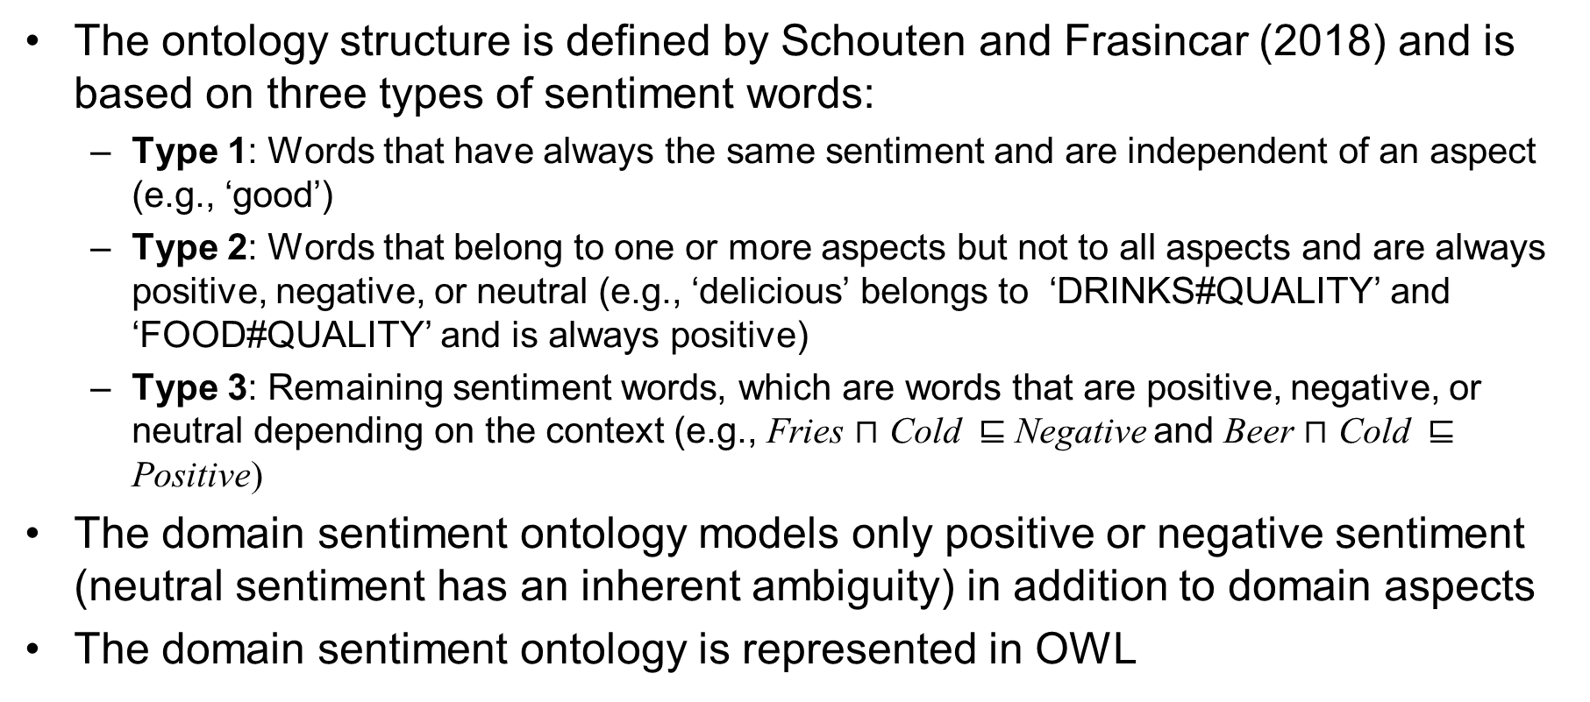
Ontology Structure
The ontology structure is defined by Schouten and Frasincar (2018) and is based on three types of sentiment words:
  Type 1: Words that have always the same sentiment and are independent of an aspect (e.g., ‘good’)
  Type 2: Words that belong to one or more aspects but not to all aspects and are always positive, negative, or neutral (e.g., ‘delicious’ belongs to ‘DRINKS#QUALITY’ and ‘FOOD#QUALITY’ and is always positive)
  Type 3: Remaining sentiment words, which are words that are positive, negative, or neutral depending on the context (e.g., Fries $⊓$ Cold ⊑ Negative and Beer $⊓$ Cold ⊑ Positive)
The domain sentiment ontology models only positive or negative sentiment (neutral sentiment has an inherent ambiguity) in addition to domain aspects
The domain sentiment ontology is represented in OWL
Notes:
Most of the existing approaches to ontology learning directly build on the text words. In this work we chose a different approach where we use synsets instead of words for our ontology building process. Only for words that do not have synsets associated we employ these instead of synsets in the construction process.
The ontology structure has been proposed by Schouten and Frasincar in 2018 at this conference. It distinguishes between three types of sentiment words: Type 1, which represents the words that have only one sentiment and apply to all aspects, for example “good”, Type 2, which represents the words that are associated to one or more aspects, but not all aspects, and are always positive, negative, or neutral, for example ‘delicious’ is associated to ‘DRINKS#QUALITY’ and ‘FOOD#QUALITY’, and denotes always positive sentiment, and last, Type 3, which represents the remaining sentiment words, which are words denoting positive, negative, or neutral sentiment depending on the context. For example, Fries in conjunction with Cold yields Negative sentiment, but Beer in conjunction with Cold yields Positive sentiment.
We have used OWL 1 to represent the domain sentiment ontology.

Slide 15
Word Embeddings Construction
BERT base (uncased): takes in account polysemous words
Three variants:
  Pre-trained: BookCorpus and Wikipedia
    Uses general word semantics
  Post-trained: 50,000 reviews from the Yelp dataset
    Takes domain word semantics into account
  Fine-tuned: 100,000 reviews from the Yelp dataset
    Takes domain word polarity into account
Use 2D t-SNE diagrams to qualitatively evaluate the quality of the word embeddings
BERT post-trained did not separate well the word meanings possibly due to the limited domain corpus

Slide 16
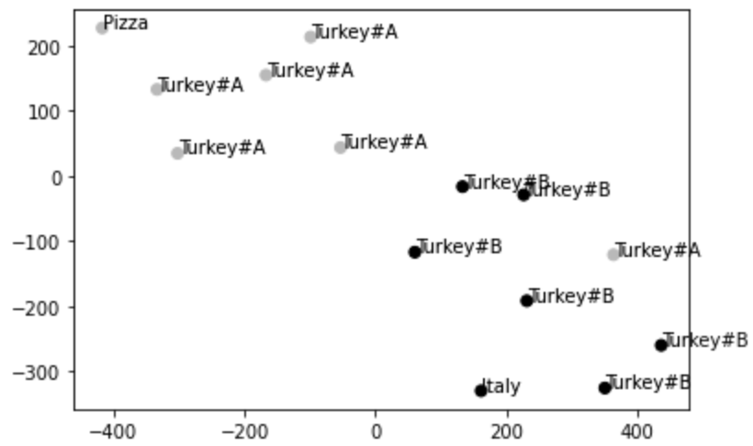
Polysemy-Aware Word Embeddings
Pre-trained BERT
Good separation of “Turkey#A” (animal) and “Turkey#B” (country)
“Pizza” is near “Turkey#A” and “Italy” is near “Turkey#B” (as expected)

Slide 17
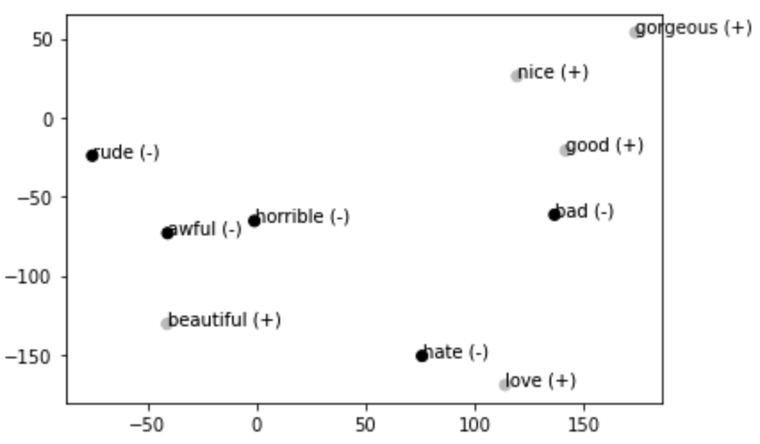
Sentiment-Aware Word Embeddings
Pre-trained BERT
Poor separation of “hate” and “love”

Slide 18
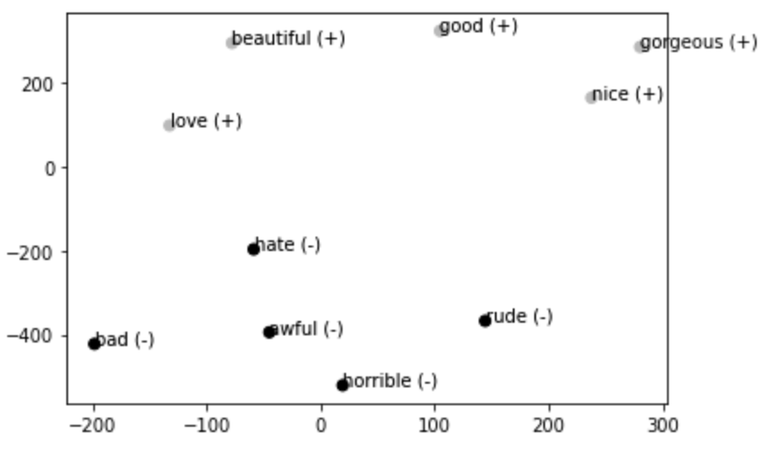
Sentiment-Aware Word Embeddings
Fine-tuned BERT
Good separation of words with different polarity

Slide 19
Skeletal Ontology Building
The ontology has two main classes:
  SentimentValue has two subclasses: Positive and Negative
  Mention has four subclasses:
    ActionMention: represents verbs
    EntityMention: represents nouns
    PropertyMention: represents adjectives
    ModifierMention: represents adverbs
Each Mention class has two subclasses (where <Type> denotes Action, Entity, Property, or Modifier):
  GenericPositive<Type>: also a subclass of Positive
  GenericNegative<Type>: also a subclass of Negative

Slide 20
Skeletal Ontology Building
Each aspect has the form CATEGORY#ATTRIBUTE and for each <Type>Mention we generate two subclasses:
  <Category><Type>Mention
  <Attribute><Type>Mention
We consider all seven aspect categories: FOOD, AMBIENCE, DRINKS, LOCATION, RESTAURANT, EXPERIENCE, and SERVICE
We consider only three attributes: PRICES, QUALITY, STYLE&OPTIONS (split in STYLE and OPTIONS), as GENERAL, MISCELLANEOUS are too general
For each <Category/Attribute><Type>Mention we add two subclasses:
  <Category/Attribute>Positive<Type>
  <Category/Attribute>Negative<Type>
Notes:
Each aspect in the dataset is represented by a combination of an aspect category and an aspect attribute. Based on this representation we generate for each <Type>Mention two subclasses <Category><Type>Mention and <Attribute><Type>Mention.
There are 6 categories in total in the given dataset and we consider all of them: FOOD, AMBIENCE, DRINKS, LOCATION, RESTAURANT, and SERVICE.
There are 5 attributes in total in the given dataset but we consider only 3 attributes PRICES, QUALITY, and STYLE&OPTIONS as GENERAL and MISCELLANEOUS are too general. Not all combinations of categories and attributes are possible.
For each <Category/Attribute><Type>Mention we add two subclasses: <Category/Attribute>Positive<Type> and <Category/Attribute>Negative<Type> in relation to the two sentiment classes.

Slide 21
Skeletal Ontology Building
To each <Category/Attribute><Type>Mention we attach two properties:
  lex: denotes an associated lexical representation
  aspect: denotes a corresponding aspect of the format CATEGORY#ATTRIBUTE
GenericPositive<Type> and GenericNegative<Type> have initially defined subclasses that denote concepts associated to general concepts that have lexical representations such as ‘hate’, ‘love’, ‘good’, ‘bad’, ‘disappointment’, and ‘satisfaction’

Slide 22
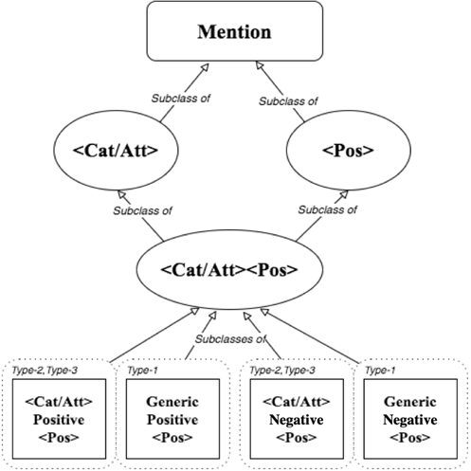
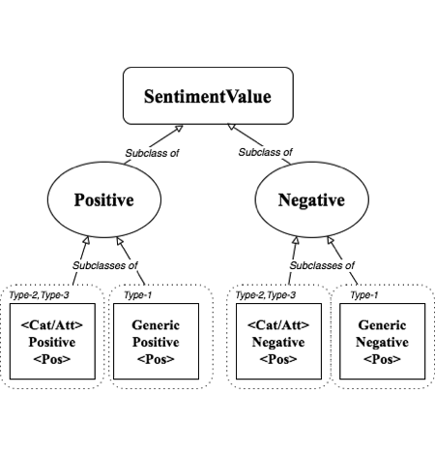
Skeletal Ontology Building

Slide 23
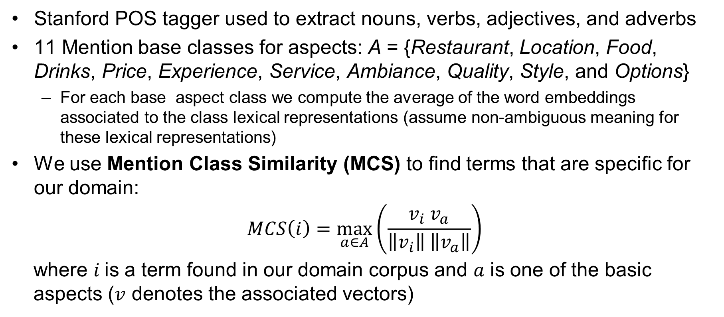
Term Selection
Stanford POS tagger used to extract nouns, verbs, adjectives, and adverbs
11 Mention base classes for aspects: A = {Restaurant, Location, Food, Drinks, Price, Experience, Service, Ambiance, Quality, Style, and Options}
  For each base aspect class we compute the average of the word embeddings associated to the class lexical representations (assume non-ambiguous meaning for these lexical representations)
We use Mention Class Similarity (MCS) to find terms that are specific for our domain:
$$MCS\left(i\right)=\max_{a∈A}\left(\frac{v_{i} v_{a}}{\left\|v_{i}\right\| \left\|v_{a}\right\|}\right)$$
where $i$is a term found in our domain corpus and $a$ is one of the basic
aspects ($v$ denotes the associated vectors)

Slide 24
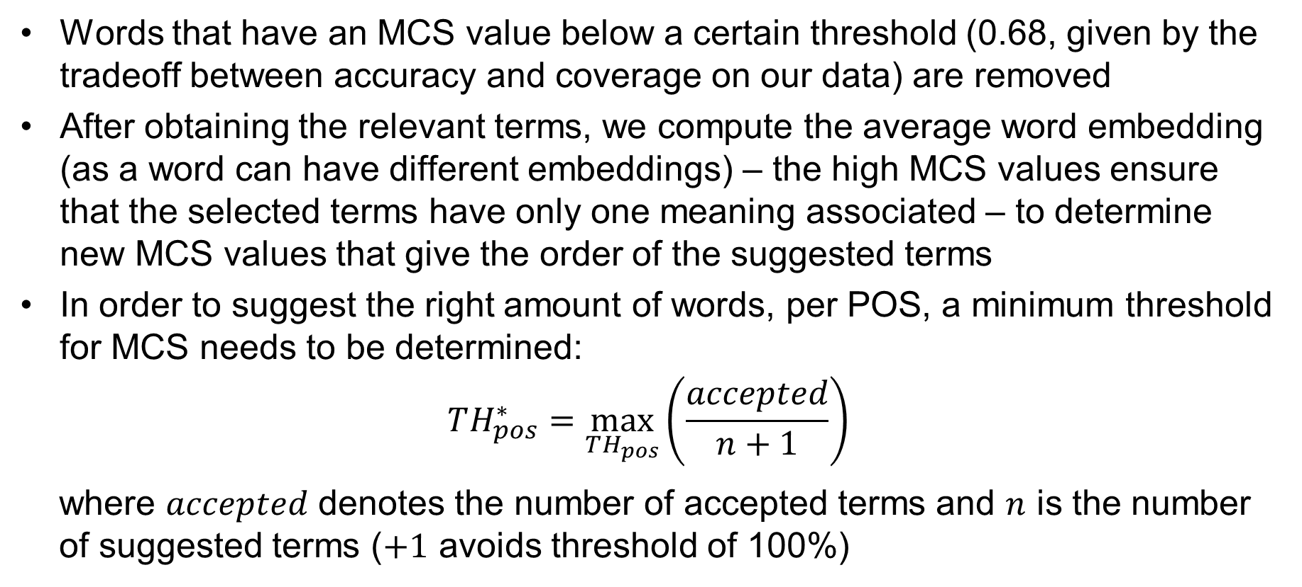
Term Selection
Words that have an MCS value below a certain threshold (0.68, given by the tradeoff between accuracy and coverage on our data) are removed
After obtaining the relevant terms, we compute the average word embedding (as a word can have different embeddings) – the high MCS values ensure that the selected terms have only one meaning associated – to determine new MCS values that give the order of the suggested terms
In order to suggest the right amount of words, per POS, a minimum threshold for MCS needs to be determined:
$$TH_{pos}^{∗}=\max_{TH_{pos}}\left(\frac{accepted}{n+1}\right)$$
where $accepted$ denotes the number of accepted terms and $n$ is the number
of suggested terms ($+1$ avoids threshold of 100%)

Slide 25
Term Selection
If a term is a noun or a verb:
  The user decides if it is an Aspect Mention or a Sentiment Mention
If a term is an adjective or an adverb:
  The term is automatically designated as a SentimentMention
If a term is a SentimentMention:
  The user decides if it is:
    Type 1 SentimentMention
    Type 2 SentimentMention
    Type 3 SentimentMention
For each accepted word we add all similar words that have a cosine similarity higher than a certain threshold (0.7) to the ontology, as well

Slide 26
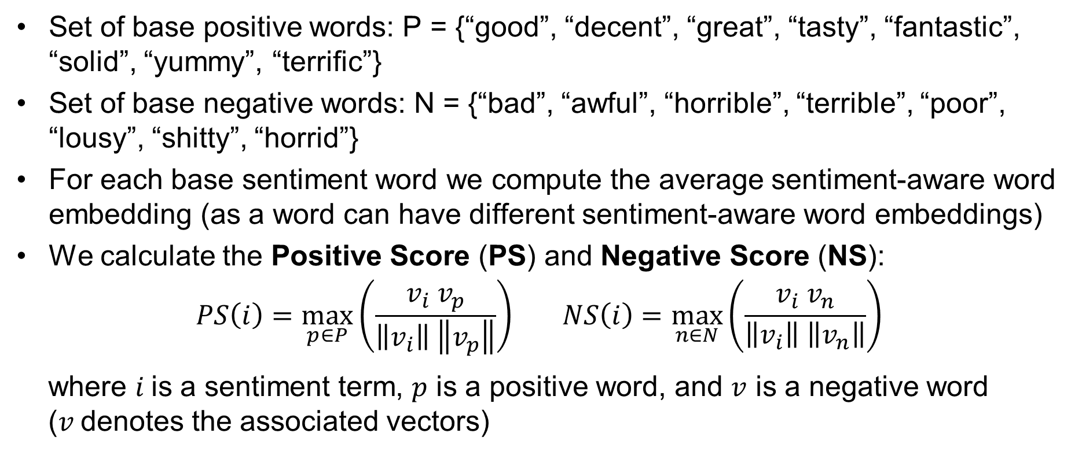
Sentiment Term Clustering
Set of base positive words: P = {“good”, “decent”, “great”, “tasty”, “fantastic”, “solid”, “yummy”, “terrific”}
Set of base negative words: N = {“bad”, “awful”, “horrible”, “terrible”, “poor”, “lousy”, “shitty”, “horrid”}
  For each base sentiment word we compute the average sentiment-aware word embedding (as a word can have different sentiment-aware word embeddings)
  We calculate the Positive Score (PS) and Negative Score (NS):
$$PS\left(i\right)=\max_{p∈P}\left(\frac{v_{i} v_{p}}{\left\|v_{i}\right\| \left\|v_{p}\right\|}\right) NS\left(i\right)=\max_{n∈N}\left(\frac{v_{i} v_{n}}{\left\|v_{i}\right\| \left\|v_{n}\right\|}\right)$$
where $i$is a sentiment term, $p$ is a positive word, and $v$ is a negative word
($v$denotes the associated vectors)

Slide 27
Sentiment Term Clustering
The largest value between PS and NS indicates the corresponding sentiment
The user:
  For Type-1 sentiment words, decides if the sentiment is correct and, and, if wrong, makes correction
  For Type-2 and Type-3 sentiment words, which are aspect-specific, checks the closest <Category/Attribute><Type>Mention using the cosine similarity:
    If accepted, the user checks the polarity, and, if wrong, makes correction and continues to the next more similar <Category/Attribute><Type>Mention
    If rejected, the current sentiment word is fully processed
Interestingly, Type-2 and Type-3 sentiment words are treated in the same way, as only the parent sentiment class changes for Type-3 sentiment words based on user sentiment corrections

Slide 28
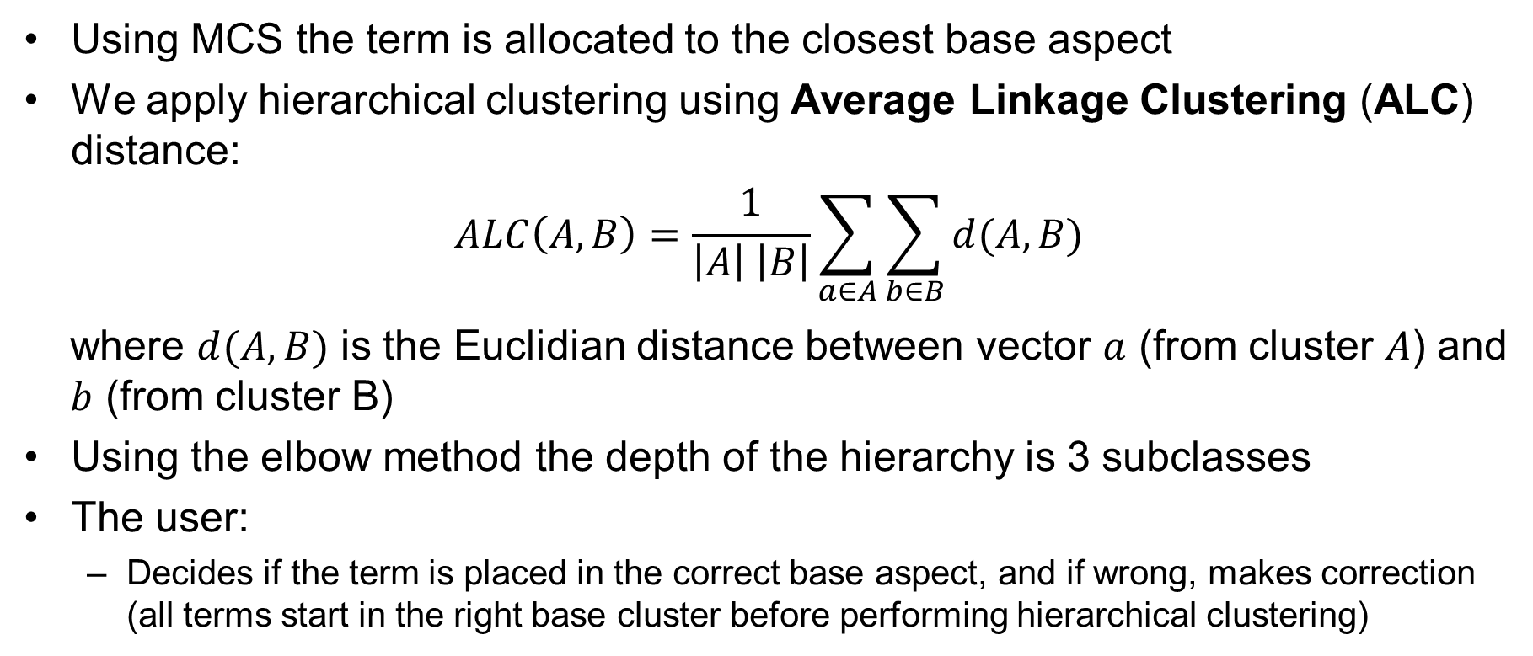
Aspect Term Clustering
Using MCS the term is allocated to the closest base aspect
We apply hierarchical clustering using Average Linkage Clustering (ALC) distance:
$$ALC\left(A,B\right)=\frac{1}{\left|A\right| \left|B\right|}\sum_{a∈A}{\sum_{b∈B}{d(A,B)}}$$
where $d(A,B)$ is the Euclidian distance between vector $a$ (from cluster $A$) and
$b$ (from cluster B)
Using the elbow method the depth of the hierarchy is 3 subclasses
The user:
  Decides if the term is placed in the correct base aspect, and if wrong, makes correction (all terms start in the right base cluster before performing hierarchical clustering)

Slide 29
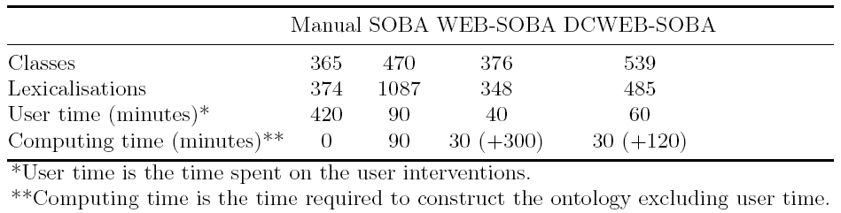
Evaluation
DCWEB-SOBA has the largest amount of classes and second largest number of lexicalizations (due to adverbs and word polysemy)
DCWEB-SOBA requires more user time than WEB-SOBA
DCWEB-SOBA requires less computing time than WEB-SOBA as fine-tunning BERT embeddings (120 minutes) is faster than building word2vec embeddings (300 minutes)

Slide 30
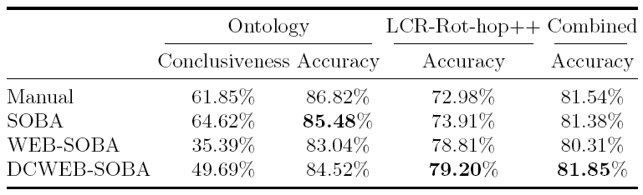
Evaluation
DCWEB-SOBA is conclusive in more cases than WEB-SOBA, but less than the other methods
DCWEB-SOBA has a better accuracy than WEB-SOBA for ontology reasoning (on the conclusive cases)
DCWEB-SOBA has the best accuracy for the combing approach (HAABSA++)

Slide 31
Conclusion
We have proposed DCWEB-SOBA, a semi-automatic method for domain sentiment ontology construction using deep contextual word embeddings (BERT) for ABSA at sentence-level:
  Word Embeddings Construction
  Skeletal Ontology Building
  Term Selection
  Sentiment Term Clustering
  Aspect Term Clustering
We have used two restaurant datasets:
  Yelp Open Dataset for ontology building
  SemEval 2016, Task 5, Subtask 1, Slot 3 data for measuring performance
We have employed BERT base (uncased), pre-trained on BookCorpus and Wikipedia

Slide 32
Conclusion
We have shown that DCWEB-SOBA (based on deep contextual word embeddings) ontology is more conclusive, more accurate, and requires less time to build than WEB-SOBA (based on context-independent word embeddings)
DCWEB-SOBA ontology gives the best accuracy in a hybrid approach (HAABSA++)
Future work:
  Apply DCWEB-SOBA to other domains (e.g., laptops) in addition to restaurants
  Fine-tune the BERT model on aspect sentiment instead of review sentiment
  Experiment with other deep contextual word embeddings like RoBERTa (trained on a 10 times larger dataset than BERT)

Slide 33
References – ABSA
Kim Schouten and Flavius Frasincar. Ontology-Driven Sentiment Analysis of Product and Service Aspects. 15th Extended Semantic Web Conference (ESWC 2018), LNCS, Volume 10843, pages 608-623, Springer, 2018.
Olaf Wallaart and Flavius Frasincar. A Hybrid Approach for Aspect-Based Sentiment Analysis Using a Lexicalized Domain Ontology and Attentional Neural Models. 16th Extended Semantic Web Conference, LNCS, Volume 11503, pages 363-378, Springer, 2019.
Maria Mihaela Trusca, Daan Wassenberg, Flavius Frasincar, and Rommert Dekker. A Hybrid Approach for Aspect-Based Sentiment Analysis Using Deep Contextual Word Embeddings and Hierarchical Attention. 20th International Conference on Web Engineering, LNCS, Volume 12128, pages 365-380, Springer, 2020.

Slide 34
References – Ontology Building
Lisa Zhuang, Kim Schouten, and Flavius Frasincar. SOBA: Semi-Automated Ontology Builder for Aspect-Based Sentiment Analysis, Journal of Web Semantics, Volume 60, Article 100544, 2020.
Ewelina Dera and Flavius Frasincar. SASOBUS: Semi-automatic Sentiment Domain Ontology Building Using Synsets. 17th Extended Semantic Web Conference, LNCS, Volume 12123, pages 105-120, Springer, 2020.
Fenna ten Haaf, Christopher Claassen, Ruben Eschauzier, Joanne Tjan, Daniël Buijs, Flavius Frasincar, and Kim Schouten. WEB-SOBA: Word Embeddings-Based Semi-automatic Ontology Building for Aspect-Based Sentiment Classification, 18th Extended Semantic Web Conference, LNCS, Volume 12731, pages 340-355, Springer, 2021.

