Slide 1
SASOBUS: Semi-automatic Sentiment Domain Ontology Building Using Synsets
Flavius Frasincar*
frasincar@ese.eur.nl
* Joint work with Ewelina Dera, Kim Schouten, and Lisa Zhuang
Notes:
Hi everybody! Welcome to my presentation. My name is Flavius Frasincar and I am an assistant professor at Erasmus University Rotterdam in the Netherlands. My talk is entitled SASOBUS: Semi-automatic Sentiment Domain Ontology Building Using Synsets and presents joint work with Ewelina Dera, Kim Schouten, and Lisa Zhuang from Erasmus University Rotterdam. In this talk I will describe a semi-automatic approach for learning a domain sentiment ontology for aspect-based sentiment analysis at sentence-level.

Slide 2
Contents
Motivation
Related Work
Data
Methodology
Evaluation
Conclusion
Notes:
The content of my talk has a classical structure. First I will motivate the need for this research, and after that I will present related work. Then I will explain the data used for our experiments and the proposed methodology to answer our research question. Last, I will give our evaluation results, main conclusions, and suggest ideas for future work.

Slide 3
Motivation
Growing number of reviews:
In 2014: the number of reviews on Amazon exceeded 10 million
Growing importance of reviews:
80% of the consumers read online reviews
75% of the consumers consider reviews important
Reading all reviews is time consuming, therefore the need for automation
Notes:
Today we have a growing number of reviews being posted on the Web. For example, in 2014 Amazon had more than 10 million reviews.
In addition the importance of reviews for both producers and consumers is also growing. For example, 80% of the consumers read online reviews, while 75% of the consumers consider reviews important for their buying decision.
Reading all the reviews is time consuming, if not impossible, therefore there is a high need for automation, where information gets automatically extracted, filtered, and summarized from reviews.

Slide 4
Motivation
Sentiment mining is defined as the automatic assessment of the sentiment expressed in text (in our case by consumers in product reviews)
Several granularities of sentiment mining:
Review-level
Sentence-level
Aspect-level (product aspects are sometimes referred to as product features): Aspect-Based Sentiment Analysis (ABSA):
Review-level
Sentence-level [our focus here]
Notes:
A text mining field that has emerged in the last decade is sentiment mining, which means the automatic extraction and summarization of the sentiment expressed in text, in our case product reviews.
There are several granularities for sentiment mining, review-level, where the sentiment is computed for the whole review, sentence-level, where the sentiment is computed per sentence, and aspect-level, where the sentiment is computed per aspect of the entity of interest. The last one is called Aspect-Based Sentiment Analysis (or ABSA) and it can be of two types: review-level, where the sentiment is given per aspect in the whole review, and sentence-level, where the sentiment is given per aspect in a sentence. In this work we focus on Aspect-Based Sentiment Analysis at sentence-level.

Slide 5
Motivation
Aspect-Based Sentiment Analysis (ABSA) has two stages:
Aspect detection:
Explicit aspect detection: aspects appear literally in product reviews
Implicit aspect detection: aspects do not appear literally in the product reviews
Sentiment detection: assigning the sentiment associated to explicit or implicit aspects [our focus here]
Three approaches for ABSA:
Knowledge Representation (KR)
Machine Learning (ML)
Hybrid: current state-of-the-art, e.g., A Hybrid Approach for Aspect-Based Sentiment Analysis (HAABSA) proposed by Wallaart and Frasincar (2019) at ESWC 2019
Notes:
Aspect-Based Sentiment Analysis has two stages. The first stage is aspect detection, which focuses on the extraction of aspects of the entity of interest from text. There are two types of aspect detection: explicit aspect detection, which extracts aspects that appear literally in the text; for example in the text “the screen is small”, the extracted aspect is “screen”, and implicit aspect detection, which extracts aspects that are implicit in the text; for example in the text “the phone is light”, the extracted aspect is <weight>. The second stage is sentiment detection, which is responsible for computing the sentiment, for example positive or negative, associated to explicit or implicit aspects, and represents our main focus here.
In the literature we find three main approaches for ABSA: Knowledge Representation, which is logic-based, Machine Learning, which is statistics-based, and Hybrid, which combines the strengths of the first two approaches, giving state-of-the-art results. One hybrid approach is the two-step method entitled HAABSA proposed by Wallart and Frasincar last year at this conference.

Slide 6
Motivation
HAABSA is a two-step approach for ABSA at sentence-level:
Ontology-based reasoning
Machine learning (backup solution)
The domain sentiment ontology is manually constructed:
Available only for some domains (restaurant and laptops)
Limited coverage
Research question: How to build in a semi-automatic manner a domain sentiment ontology for ABSA at sentence-level?
In addition we aim to extend the ontology-representation by means of synsets (sets of synonyms) to increase ontology coverage
Notes:
HAABSA is a two-step approach for ABSA at sentence-level where first the sentiment for an aspect is computed based on reasoning using a domain sentiment ontology, and if this is inconclusive, a machine learning approach (in this case a neural attention model) acts as a backup solution. The domain sentiment ontology models only the positive and the negative sentiment (the neutral sentiment is left out on purpose due to its intrinsic ambiguity), and the machine learning solution models all three types of sentiment: positive, neutral, and negative.
As the domain sentiment ontology is manually constructed it is suitable only for the domains it was made for, and, in addition, has limited coverage. In this work we aim to build in a semi-automatic manner a domain sentiment ontology for ABSA at sentence-level. In addition we plan to enhance the ontology representation with synsets, which represent sets of synonyms that we attach to the modeled concepts. The aim of this research is to support new domains and improve the ontology coverage.

Slide 7
Related Work – ABSA
There are several approaches that we consider for ABSA:
Ontology (Ont) by Schouten and Frasincar (2018): a two-step approach with ontology-based reasoning and a majority classifier as backup
Content Attention Based Aspect-Based Sentiment Classification Model (CABASC) by Liu et al. (2018): combines two attention mechanisms, one that considers the relation between words, aspects, and the sentence, and one that considers word order
Left-Center-Right separated neural network with Rotatory attention and multi-hops (LCR-Rot-hop) by Wallaart and Frasincar (2019): computes attention for left context, target, and right context in an iterative manner and using multiple hops
and combinations of these, e.g., HAABSA is Ont+LCR-Rot-hop, where the majority classifier is replaced by the neural attention model LCR-Rot-hop (state-of-the-art 88% accuracy on the test data of SemEval 2016)
Notes:
There are several related works that we consider in our research. The first pillar of related work is represented by ABSA-based solutions. We distinguish the Ont method proposed by Schouten and Frasincar in 2018, which is a two-step approach with the first step being ontology-based reasoning and the second step being the majority classifier. Then, we have the CABASC method proposed by Liu et al. in 2018, which combines two attention mechanisms: one that considers the relation between words, aspects, and the current sentence, and another one that accounts for the word order in a sentence. Last, we consider the LCR-Rot-hop method, which like CABASC is a neural attention model, but differently than CABASC it uses four attention mechanisms: one for the left context, two for the target (based on the left context and the right context), and one for the right context and everything is repeated a number of hops (the optimal number of hops was found to be 3).
We also consider combinations of these models like Ont+LCR-Rot-hop which is known as HAABSA, where the majority classifier of Ont is replaced with the neural attention method LCR-Rot-hop. HAABSA has a state-of-the-art accuracy of 88% on the test data of the Semantic Evaluation Workshop known as SemEval organized in 2016.

Slide 8
Related Work – Ontology Building
Ont without backup is used on 60% of the data instances, and gives an accuracy of 89% on the SemEval 2016 test data
There are many approaches to build domain ontologies from domain corpora but none which targets the specifics of sentiment
We follow the seminal work on ontology construction by Buitelaar et al. (2005):
Term Selection: using domain pertinence and domain consensus with synsets by Meijer et al. (2014)
Concept Formation: using user feedback
Concept Hierarchy Construction: using the subsumption method by Sanderson and Croft (1999)
Notes:
The second pillar of related work is given by ontology building solutions. First it is important to remark that the ontology alone is used in 60% of the test data instances of SemEval 2016 and obtains an accuracy of 89%.
There are many approaches for ontology building from domain and contrastive corpora but none which targets domain sentiment ontologies.
In our research we follow the seminal work of Buitelaar et al. from 2005: where we first identify terms using the domain pertinence and domain consensus with synsets as proposed by Meijer et al. in 2014, then we form concepts using feedback from the user, and last we organize the concepts in a hierarchy using the subsumption method proposed by Sanderson and Croft in 1999.

Slide 9
Data
Domain corpus: Yelp Dataset Challenge 2017 data for restaurants
5,001 restaurant reviews
47,734 sentences
Each review has text and star rating (0 to 5)
Contrastive corpora: six popular and freely available English books from Project Gutenberg
Alice's Adventures in Wonderland by Lewis Carrol
Pride and Prejudice by Jane Austen
The Adventures of Sherlock Holmes by Arthur Conan Doyle
The Adventures of Tom Sawyer by Mark Twain
Great Expectations by Charles Dickens
Notes:
For learning the domain sentiment ontology we use the Yelp data from the Yelp Dataset Challenge 2017 as our working domain is represented by restaurants. This dataset contains 5,001 restaurants composed of 47,734 sentences. Each review contains text and a star annotation from 0 stars to 5 stars. Our approach is not limited to the restaurant domain, it has a generic nature and can be applied to any domain for which there is a text corpus available.
When learning a domain ontology there is a need for contrastive corpora as one wants to differentiate between domain specific concepts and general concepts. For this purpose we used 6 popular and freely available English books from the Project Gutenberg: Alice's Adventures in Wonderland, Pride and Prejudice, The Adventures of Sherlock Holmes, The Adventures of Tom Sawyer, and Great Expectations.

Slide 10
Data
Training and testing data: SemEval 2016, Task 5, Subtask 1, Slot 3 for restaurants
3,365 opinions (target, aspect, and sentiment polarity, i.e., negative, neutral, and positive)
Training data:
350 reviews
2000 sentences
1879 opinions (after removal of opinions with implicit aspects)
Test data:
90 reviews
676 sentences
650 opinions (after removal of opinions with implicit aspects)
Notes:
We used for training and testing hybrid approaches using domain sentiment ontologies, the SemEval 2016, Task 5, Subtask 1, Slot 3 restaurant dataset. The dataset has 3,365 opinions where an opinion is a triple composed of the target, the aspect, and the sentiment polarity, and the sentiment polarity can be negative, neutral, or positive.
The training dataset is larger than the test dataset and it has 350 reviews. These reviews contain 2000 sentences, which in their turn contain 1870 opinions after we remove the opinions with implicit aspects, that is opinions for which the target is null. Similarly, the test dataset has 90 reviews. These reviews contain 676 sentences, which in their turn contain 650 opinions after we remove the opinions with implicit aspects.

Slide 11
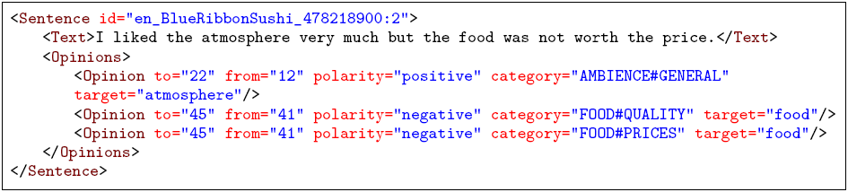
Data
Example:
Aspect categories: FOOD, AMBIENCE, DRINKS, LOCATION, RESTAURANT, and SERVICE
Aspect attributes: PRICES, QUALITY, STYLE&OPTIONS, GENERAL, and MISCELLANEOUS
Notes:
Here is an example of a sentence in XML format from our dataset. It contains three opinions. For the first opinion the target
word is ‘atmosphere’ (spans from the ‘12’th character to the ‘22’nd character in the text), the aspect is ‘AMBIENCE#GENERAL’, and the sentiment
polarity is ‘positive’. One can note that the aspect is composed of two parts first is the aspect category, ‘AMBIENCE’ and then is the aspect attribute ‘GENERAL’. In the data set we have 6 categories: FOOD, AMBIENCE, DRINKS, LOCATION, RESTAURANT, and SERVICE, and 5 attributes: PRICES, QUALITY, STYLE&OPTIONS, GENERAL, and MISCELLANEOUS. Not all combinations are possible.

Slide 12
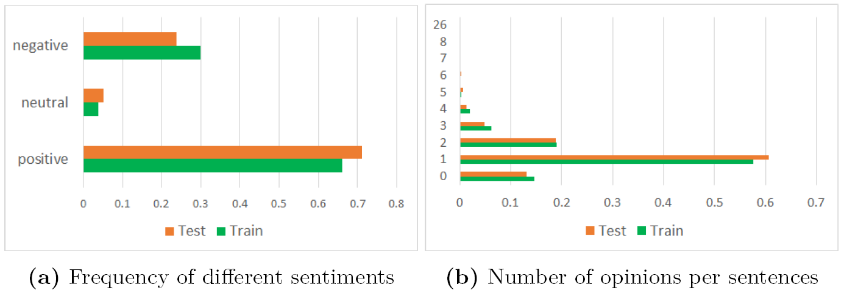
Data
The most dominant sentiment is positive
Almost all sentences have between 0 and 3 opinions
Notes:
In the left-hand side graph we observe that the positive sentiment is the dominant one with a frequency of 65% in the training dataset and 70% in the test dataset. The negative sentiment is found considerably less with a frequency of 30% in the training dataset and 25% in the test dataset. The neutral sentiment is the least represented one in our dataset.
In the right-hand side graph we observe that almost all sentences have between 0 and 3 opinions. As an extreme case there is one sentence in the test dataset with 26 opinions.

Slide 13
Methodology
Semi-automatic Sentiment Domain Ontology Building Using Synsets (SASOBUS)
SASOBUS implementation in Java: https://github.com/EJDera/SASOBUS
HAABSA implementation in Python: https://github.com/ofwallaart/HAABSA
Stanford CoreNLP 3.8.0 for sentence splitting, tokenization, lemmatization, and part-of-speech tagging
Java API for WordNet Searching (JAWS) for obtaining synsets
Word sense disambiguation (WSD) using the Simplified Lesk algorithm as it offers a good trade-off between accuracy and speed:
The word sense associated to the synset with the gloss that has the largest overlap with the other words in the sentence is chosen as the disambiguated synset for the current word (if there is not overlap the most frequent synset is chosen)
Notes:
The methodology that we propose for building domain sentiment ontologies is called SASOBUS and stands for Semi-automatic Sentiment Domain Ontology Building Using Synsets. The implementation of SASOBUS is done in Java (due to the good support in Java for Semantic Web technologies) and is made freely available at the first indicated github link. The HAABSA implementation is done in Python (due to the good support in Python for Deep Learning technologies) and is made freely available as well at the second indicated github link.
For sentence splitting (which is needed for our external corpora), tokenization, lemmatization, and part-of-speech tagging we have used the Stanford CoreNLP library. For obtaining synsets we have used the JAWS library. For performing word sense disambiguation we employed the Simplified Lesk algorithm due to the good trade-off it offers between accuracy and speed, as we need to process large amounts of data for our considered corpora while keeping the accuracy at an adequate level. The Simplified Lesk algorithm associates to a word the word sense corresponding to a synset that has the highest overlap between the synset gloss and the context words. In case of no overlap the most frequent synset is chosen.

Slide 14
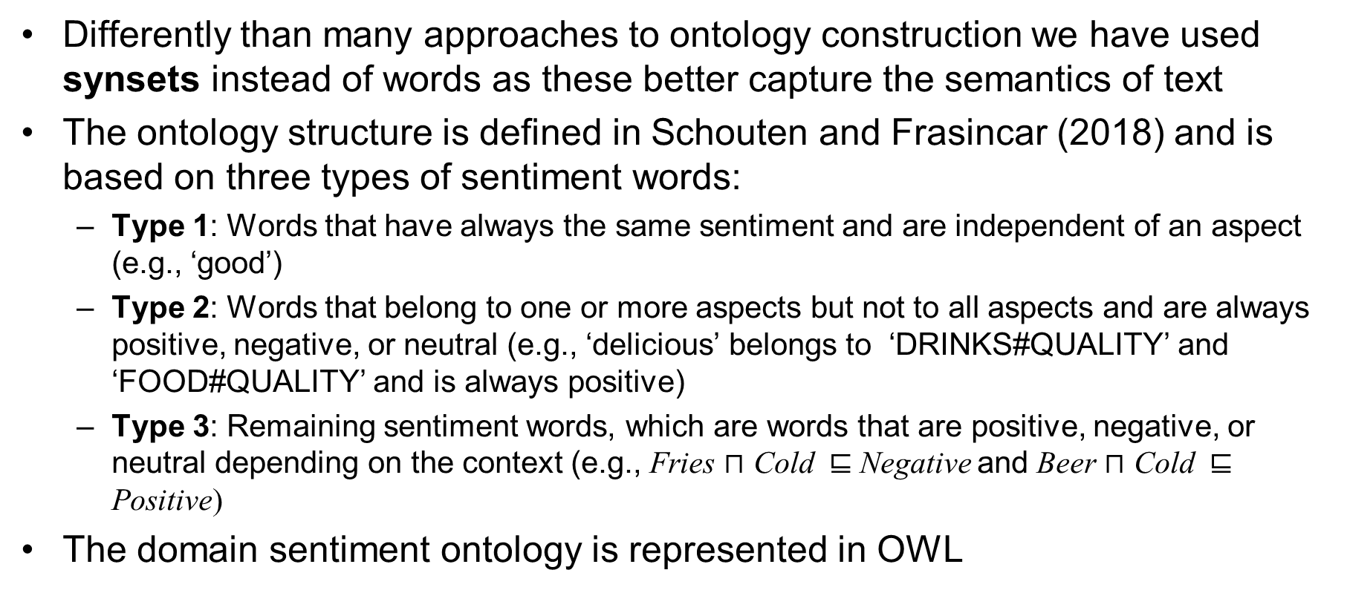
Methodology – Ontology Structure
Differently than many approaches to ontology construction we have used synsets instead of words as these better capture the semantics of text
The ontology structure is defined in Schouten and Frasincar (2018) and is based on three types of sentiment words:
Type 1: Words that have always the same sentiment and are independent of an aspect (e.g., ‘good’)
Type 2: Words that belong to one or more aspects but not to all aspects and are always positive, negative, or neutral (e.g., ‘delicious’ belongs to ‘DRINKS#QUALITY’ and ‘FOOD#QUALITY’ and is always positive)
Type 3: Remaining sentiment words, which are words that are positive, negative, or neutral depending on the context (e.g., Fries $⊓$ Cold ⊑ Negative and Beer $⊓$ Cold ⊑ Positive)
The domain sentiment ontology is represented in OWL
Notes:
Most of the existing approaches to ontology learning directly build on the text words. In this work we chose a different approach where we use synsets instead of words for our ontology building process. Only for words that do not have synsets associated we employ these instead of synsets in the construction process.
The ontology structure has been proposed by Schouten and Frasincar in 2018 at this conference. It distinguishes between three types of sentiment words: Type 1, which represents the words that have only one sentiment and apply to all aspects, for example “good”, Type 2, which represents the words that are associated to one or more aspects, but not all aspects, and are always positive, negative, or neutral, for example ‘delicious’ is associated to ‘DRINKS#QUALITY’ and ‘FOOD#QUALITY’, and denotes always positive sentiment, and last, Type 3, which represents the remaining sentiment words, which are words denoting positive, negative, or neutral sentiment depending on the context. For example, Fries in conjunction with Cold yields Negative sentiment, but Beer in conjunction with Cold yields Positive sentiment.
We have used OWL 1 to represent the domain sentiment ontology.

Slide 15
Methodology – Ontology Structure
The ontology skeleton has two main classes:
Sentiment has two subclasses: Positive and Negative
Mention has three subclasses:
ActionMention: represents verbs
EntityMention: represents nouns
PropertyMention: represents adjectives
Each Mention class has two subclasses (where <Type> denotes Action, Entity, or Property):
GenericPositive<Type>: also a subclass of Positive
GenericNegative<Type>: also a subclass of Negative
GenericPositive<Type> and GenericNegative<Type> have initially defined subclasses that denote concepts associated to general synsets that use words such as ‘hate’, ‘love’, ‘good’, ‘bad’, ‘disappointment’, and ‘satisfaction’
Notes:
The ontology skeleton is defined before adding concepts based on the used corpora. It contains two main classes: Sentiment and Mention. The Sentiment class has two subclasses Positive and Negative. The Mention class has three subclasses: ActionMention (which represents verbs), EntityMention (which represents nouns), and PropertyMention (which represents adjectives).
Each Mention class has two subclasses GenericPositive<Type> and GenericNegative<Type>, where <Type> denotes Action, Entity, or Property. GenericPositive<Type> is a subclass of Positive and GenericNegative<Type> is a subclass of Negative.
We initialize GenericPositive<Type> and GenericNegative<Type> with a few subclasses that denote concepts associated to general synsets that use words such as ‘hate’, ‘love’, ‘good’, ‘bad’, ‘disappointment’, and ‘satisfaction’.

Slide 16
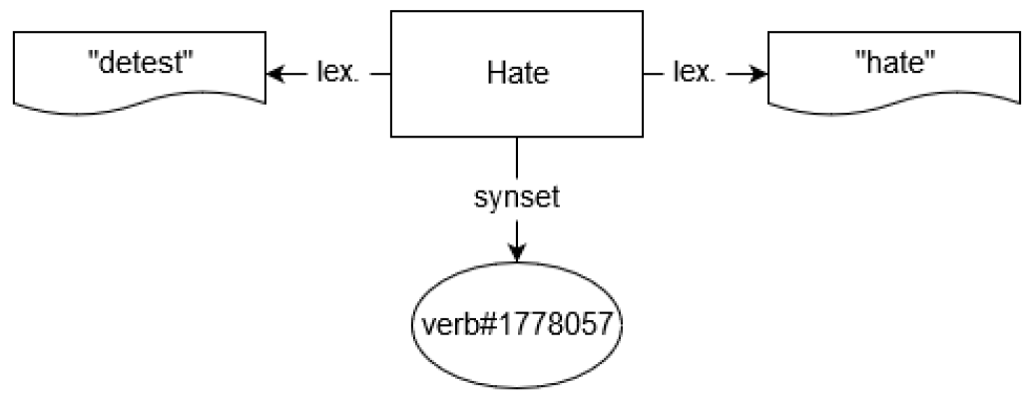
Methodology – Ontology Structure
Concepts have two properties associated:
lex: denotes an associated lexical representation
synset: denotes an associated synset
Notes:
Concepts have two properties associated: lex, which denotes one of the lexical representations associated to the concept, and synset which denotes one of the synsets associated to the concept. In the picture you can see the concept Hate which has two lexical representations attached “hate” and “detest” and one synset with two parts: the part-of-speech, in this case “verb”, and a number.

Slide 17
Methodology – Ontology Structure
Each aspect has the form CATEGORY#ATTRIBUTE and for each <Type>Mention we generate two subclasses:
<Category><Type>Mention
<Attribute><Type>Mention
We consider all six aspect categories: FOOD, AMBIENCE, DRINKS, LOCATION, RESTAURANT, and SERVICE
We consider only three attributes: PRICES, QUALITY, STYLE&OPTIONS, as GENERAL, MISCELLANEOUS are too general
For each <Category/Attribute><Type>Mention we add two subclasses:
<Category/Attribute>Positive<Type>
<Category/Attribute>Negative<Type>
Notes:
Each aspect in the dataset is represented by a combination of an aspect category and an aspect attribute. Based on this representation we generate for each <Type>Mention two subclasses <Category><Type>Mention and <Attribute><Type>Mention.
There are 6 categories in total in the given dataset and we consider all of them: FOOD, AMBIENCE, DRINKS, LOCATION, RESTAURANT, and SERVICE.
There are 5 attributes in total in the given dataset but we consider only 3 attributes PRICES, QUALITY, and STYLE&OPTIONS as GENERAL and MISCELLANEOUS are too general. Not all combinations of categories and attributes are possible.
For each <Category/Attribute><Type>Mention we add two subclasses: <Category/Attribute>Positive<Type> and <Category/Attribute>Negative<Type> in relation to the two sentiment classes.

Slide 18
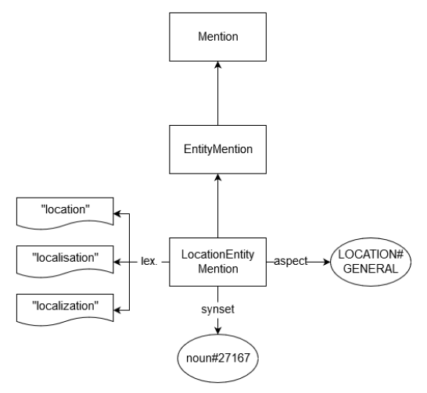
Methodology – Ontology Structure
To each <Category/Attribute><Type>Mention we attach three properties:
lex: denotes an associated lexical representation
synset: denotes an associated synset
aspect: denotes a corresponding aspect of the format CATEGORY#ATTRIBUTE
There is a disjointWith relation between:
<Category/Attribute>Positive<Type>
<Category/Attribute>Negative<Type>
Notes:
In addition to the previously mentioned lex and synset properties, each <Category/Attribute><Type>Mention has one or more aspects associated by means of the aspect property. In this picture for example the LocationEntityMention, where Location is a Category and Entity is a Type, has the aspect LOCATION#GENERAL associated, where the Category is LOCATION and the Attribute is GENERAL.
In our ontology we have modeled a disjointWith relation between the classes <Category/Attribute>Positive<Type> and <Category/Attribute>Negative<Type>.

Slide 19
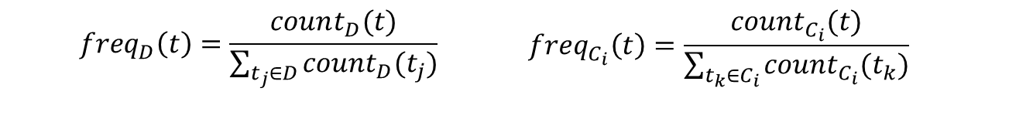
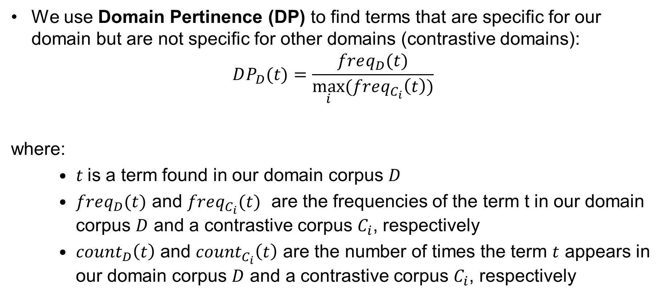
Methodology – Term Selection
We use Domain Pertinence (DP) to find terms that are specific for our domain but are not specific for other domains (contrastive domains):
$$DP_{D}(t)=\frac{freq_{D}(t)}{\max_{i}{(freq_{C_{i}}\left(t\right))}}$$
where:
$t$is a term found in our domain corpus $D$
$freq_{D}(t)$ and $freq_{C_{i}}(t)$ are the frequencies of the term t in our domain corpus $D$ and a contrastive corpus $C_{i}$, respectively
$count_{D}\left(t\right)$ and $count_{C_{i}}\left(t\right)$ are the number of times the term $t$ appears in our domain corpus $D$ and a contrastive corpus $C_{i}$, respectively
$$freq_{D}\left(t\right)=\frac{count_{D}(t)}{\sum_{t_{j}∈D}{count_{D}(t_{j})}}$$ | $$freq_{C_{i}}\left(t\right)=\frac{count_{C_{i}}(t)}{\sum_{t_{k}∈C_{i}}{count_{C_{i}}(t_{k})}}$$
Notes:
The first step of our methodology is Term Selection. We aim to select terms that have a high Domain Pertinence, which means terms that appear more often in our domain than in other domains. We compute the domain pertinence as the ratio between the frequency of the term t in our domain corpus D and the maximum frequency of the term t in a contrastive corpus $C_{i}$. The frequency of a term in a corpus is defined as the ratio between the number of times the term appears in the corpus and the total number of times all terms appear in the corpus.

Slide 20
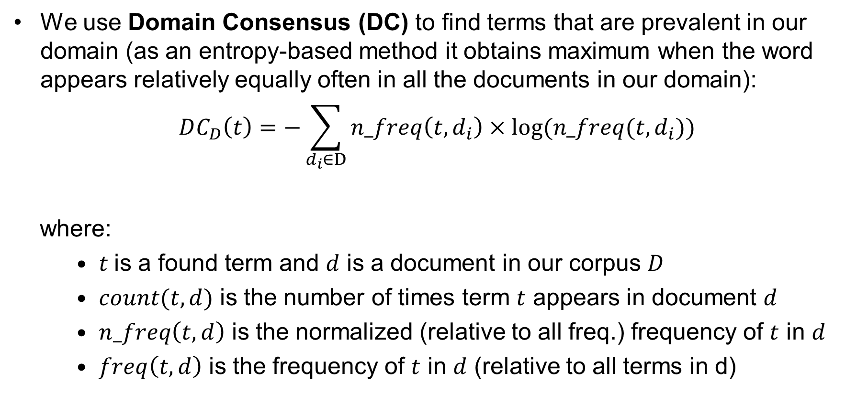
Methodology – Term Selection
We use Domain Consensus (DC) to find terms that are prevalent in our domain (as an entropy-based method it obtains maximum when the word appears relatively equally often in all the documents in our domain):
$$DC_{D}\left(t\right)=−\sum_{d_{i}∈D}{n_freq\left(t,d_{i}\right)×log⁡(n_freq(t,d_{i}))}$$
where:
$t$is a found term and $d$ is a document in our corpus $D$
$count(t,d)$ is the number of times term $t$ appears in document $d$
$n_freq\left(t,d\right)$ is the normalized (relative to all freq.) frequency of $t$ in $d$
$freq\left(t,d\right)$ is the frequency of $t$ in $d$ (relative to all terms in d)
$$n_freq\left(t,d\right)=\frac{freq(t,d)}{\sum_{d_{j}∈D}{freq(t,d_{j})}}$$ | $$freq\left(t,d\right)=\frac{count(t,d)}{\sum_{t_{k}∈d}{count(t_{k},d)}}$$
Notes:
The second measure that we use is Domain Consensus which aims to find terms that appear often across the documents in our domain corpus D. For this we employ the entropy with respect to the normalized frequencies of the term t in the documents $d_{i}$ that make up our domain corpus. The normalized frequency for the term t in the document d is defined as the frequency of term t in document d divided by the sum of all frequencies of term t in all the documents $d_{j}$ in our domain corpus D. The frequency of a term in a document is defined as the ratio between the number of times the term appears in the document and the total number of times all terms appear in the document.

Slide 21
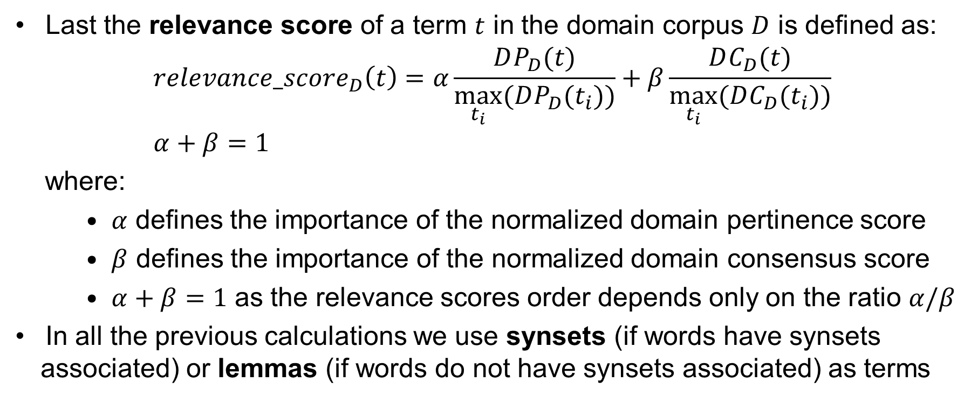
Methodology – Term Selection
Last the relevance score of a term $t$ in the domain corpus $D$ is defined as:
$$relevance_score_{D}\left(t\right)=α\frac{DP_{D}(t)}{\max_{t_{i}}{(DP_{D}(t_{i}))}}+β\frac{DC_{D}(t)}{\max_{t_{i}}{(DC_{D}(t_{i}))}} \\ α+β=1$$
where:
$α$ defines the importance of the normalized domain pertinence score
$β$ defines the importance of the normalized domain consensus score
$α+β=1$ as the relevance scores order depends only on the ratio $α/β$
In all the previous calculations we use synsets (if words have synsets associated) or lemmas (if words do not have synsets associated) as terms
Notes:
Last we compute the relevance score of a term t as a weighted average of the normalized domain pertinence score and the normalized domain consensus score. The normalized versions of our scores are computed with respect to the maximum values of these scores. As the relevance scores order depends only on the ratio of the weighting factors $α$ and $β$, we impose the restriction that the sum of these weights should be 1.
In all the previous calculations we use synsets of words if words have synsets associated and these are obtained through a word sense disambiguation procedure, or lemmas of words if words do not have synsets associated. In this way we deal better with the semantics of words in our computations.

Slide 22
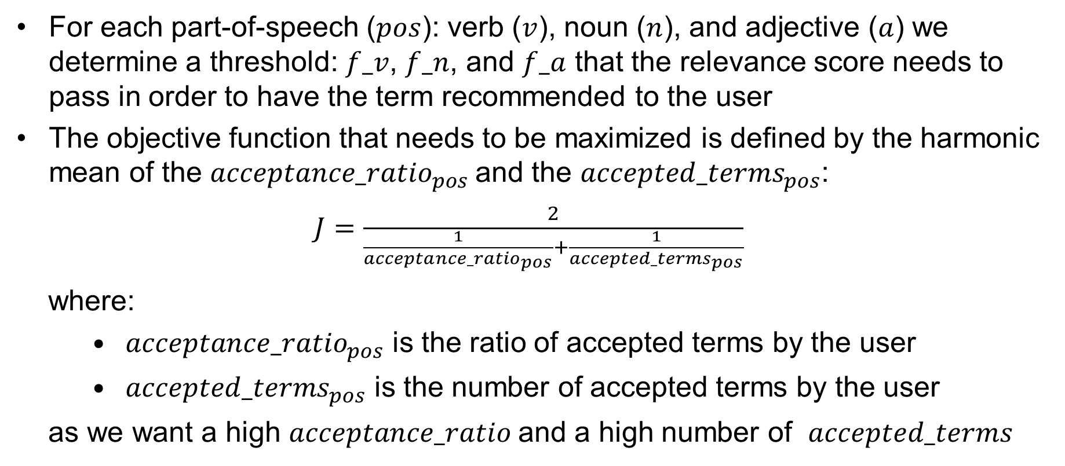
Methodology – Term Selection
For each part-of-speech ($pos$): verb ($v$), noun ($n$), and adjective ($a$) we determine a threshold: $f_v$, $f_n$, and $f_a$ that the relevance score needs to pass in order to have the term recommended to the user
The objective function that needs to be maximized is defined by the harmonic mean of the ${acceptance_ratio}_{pos}$and the ${accepted_terms}_{pos}$:
$J=\frac{2}{\frac{1}{{acceptance_ratio}_{pos}}+\frac{1}{{accepted_terms}_{pos}}}$
where:
${acceptance_ratio}_{pos}$ is the ratio of accepted terms by the user
${accepted_terms}_{pos}$ is the number of accepted terms by the user
as we want a high $acceptance_ratio$and a high number of $accepted_terms$
Notes:
For each of the considered part-of-speeches, that is verbs, nouns, and adjectives we determine a corresponding threshold f that the relevance score of a term needs to pass in order to recommend to the user this term. Please note that each part-of-speech has its own threshold.
The objective function that we maximize, denoted with J in this slide is the harmonic mean between the ratio of accepted terms by the user and the number of accepted terms by the user, as we want both these measures to be as high as possible in order to best utilize the user input, and, in the same time, have a good lexical coverage for our domain sentiment ontology.

Slide 23
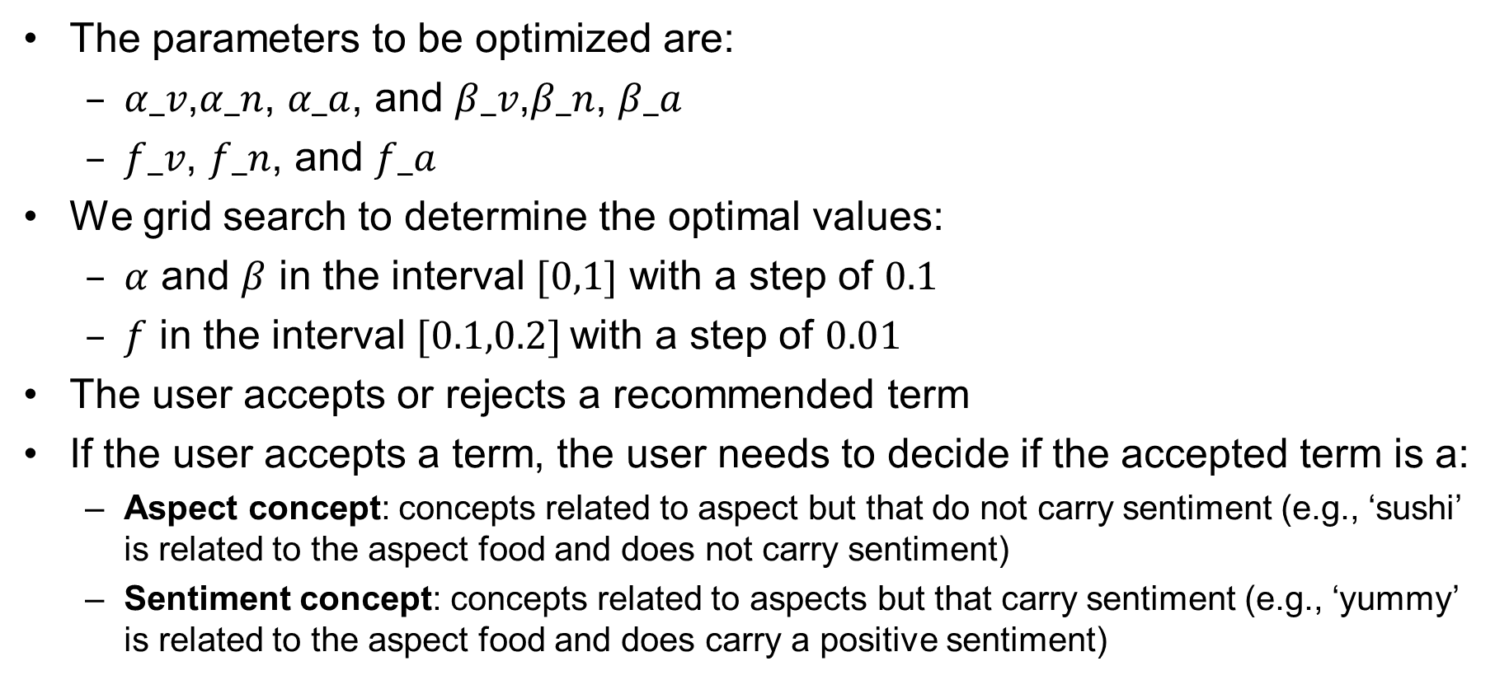
Methodology – Concept Formation
The parameters to be optimized are:
$α_v\text{,}α_n\text{, }α_a$, and $β_v\text{,}β_n\text{, }β_a$
$f_v\text{, }f_n\text{, }\text{and} f_a$
We grid search to determine the optimal values:
$α$ and $β$ in the interval $[0,1]$ with a step of $0.1$
$f$ in the interval $[0.1,0.2]$with a step of $0.01$
The user accepts or rejects a recommended term
If the user accepts a term, the user needs to decide if the accepted term is a:
Aspect concept: concepts related to aspect but that do not carry sentiment (e.g., ‘sushi’ is related to the aspect food and does not carry sentiment)
Sentiment concept: concepts related to aspects but that carry sentiment (e.g., ‘yummy’ is related to the aspect food and does carry a positive sentiment)
Notes:
The parameters to optimize are the $α$, $β$, and $f$ for each of the three considered parts-of-speech: verbs, nouns, and adjectives.
We use a grid search procedure to optimize our objective function for each of the considered parts-of-speech.
For $α and$ $β$ we use values between 0 and 1 with a step of 0.1 and for f we use values between 0.1 and 0.2 with a step of 0.01 (based on preliminary empirical results).
The user accepts or rejects a recommended term by the system. If the user accepts a term, the user needs to decide if the accepted term represents an aspect concept, that is if the term carries no sentiment (for example ‘sushi’ is an aspect term that does not carry sentiment) or the accepted term represents a sentiment concept, that is if the term carries sentiment (for example ‘yummi’ carries a positive sentiment).

Slide 24
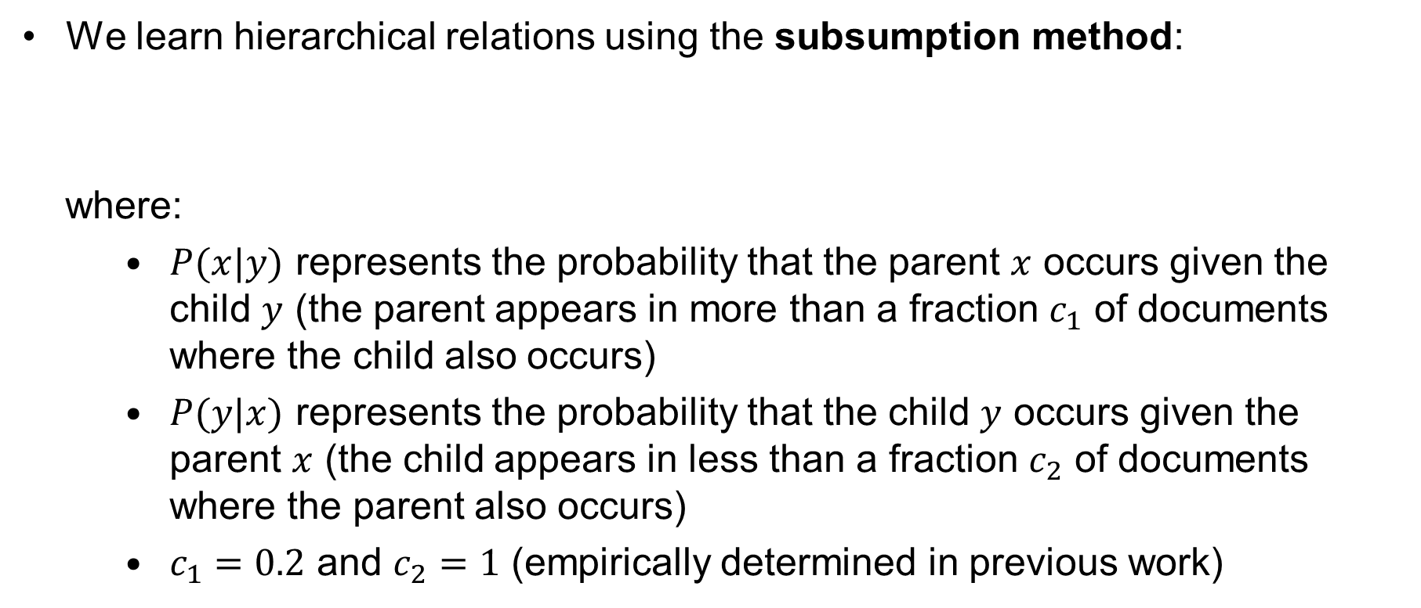
Methodology – Concept Hierarchy Construction
We learn hierarchical relations using the subsumption method:
where:
$P(x|y)$ represents the probability that the parent $x$ occurs given the child $y$ (the parent appears in more than a fraction $c_{1}$ of documents where the child also occurs)
$P(y|x)$ represents the probability that the child $y$ occurs given the parent $x$ (the child appears in less than a fraction $c_{2}$ of documents where the parent also occurs)
$c_{1}=0.2$ and $c_{2}=1$ (empirically determined in previous work)
$$P(x|y)≥c_{1}$$ | $$P\left(y | x\right)<c_{2}$$
Notes:
After all the aspect and sentiment concepts are determined we use the subsumption method to find the parent concept of a certain concept. For this we expect that the parent appears in more than a certain fraction $c_{1}$ of documents where the child occurs and that the child appears in less than a fraction $c_{2}$ of documents where the parent also appears. The thresholds $c_{1}=0.2$ and $c_{2}=1$ have been empirically determined in previous work.

Slide 25
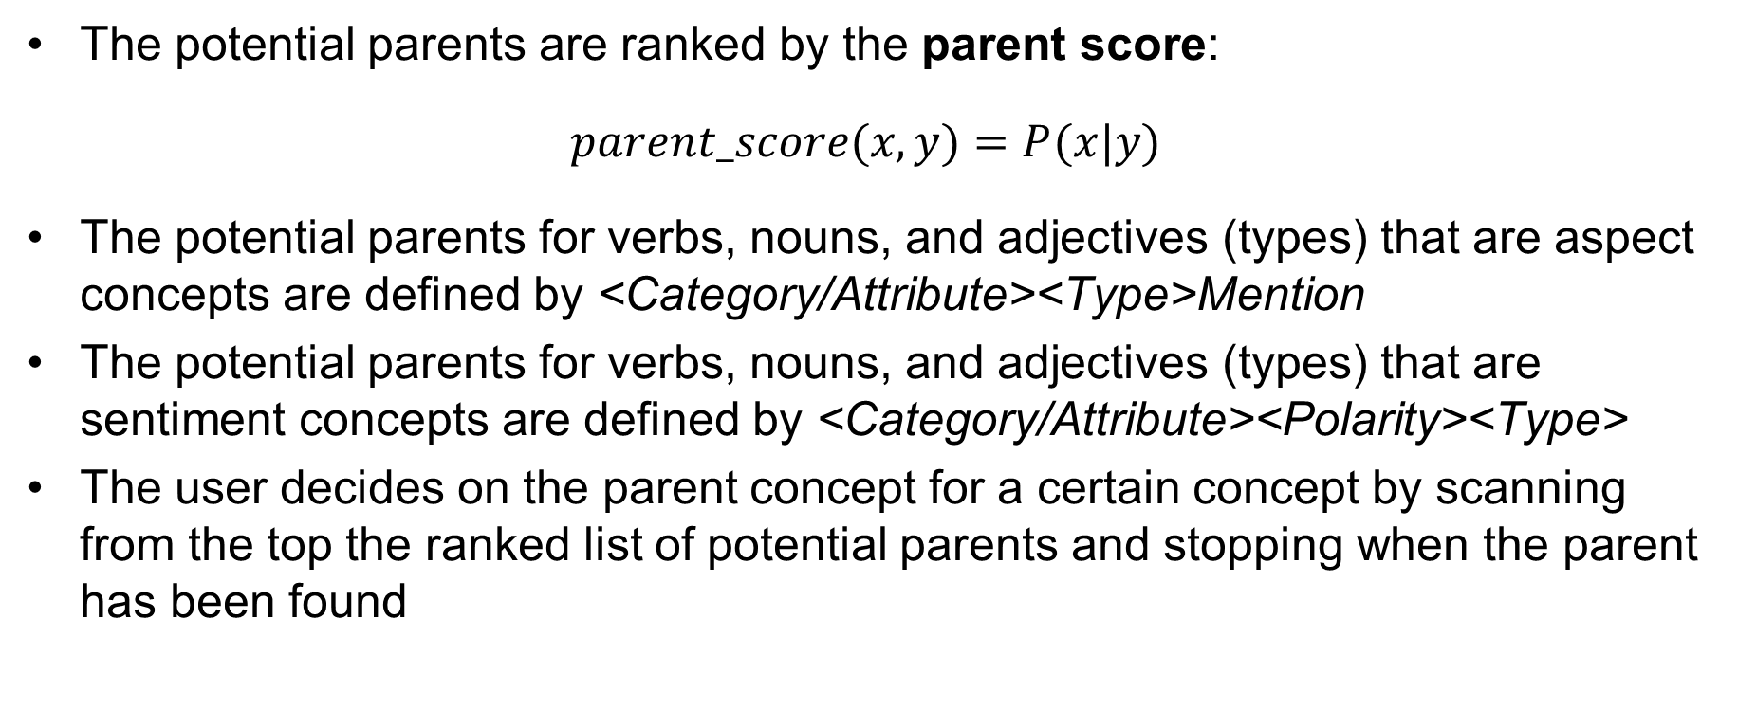
Methodology – Concept Hierarchy Construction
The potential parents are ranked by the parent score:
$parent_score(x,y)=P(x|y)$
The potential parents for verbs, nouns, and adjectives (types) that are aspect concepts are defined by <Category/Attribute><Type>Mention
The potential parents for verbs, nouns, and adjectives (types) that are sentiment concepts are defined by <Category/Attribute><Polarity><Type>
The user decides on the parent concept for a certain concept by scanning from the top the ranked list of potential parents and stopping when the parent has been found
Notes:
The potential parents are ranked descendingly based on the parent score which is given by the probability to encounter the parent concept in a document that contains the current child concept.
Inline with the ontology skeleton, the potential parents for verbs, nouns, and adjectives (these parts-of-speech denote types) that represent aspect concepts are given by <Category/Attribute><Type>Mention and the potential parents for verbs, nouns, and adjectives that represent sentiment concepts are given by <Category/Attribute><Polarity><Type>.
It is up to the user to decide which one of these potential parent concepts represent the true parent of the current concept in the ontology by scanning the ranked list from the top and stopping when the parent has been found.

Slide 26
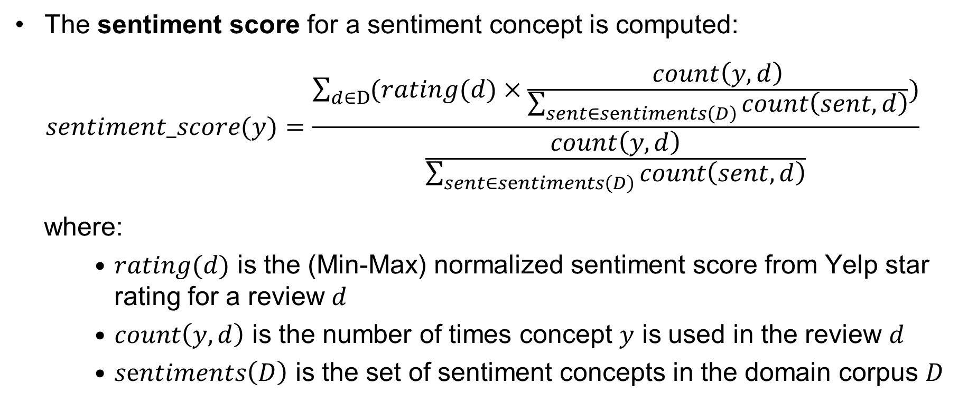
Methodology – Concept Hierarchy Construction
The sentiment score for a sentiment concept is computed:
$$sentiment_score(y)=\frac{\sum_{d∈D}{(rating(d)×\frac{count\left(y,d\right)}{\sum_{sent∈sentiments\left(D\right)}{count\left(sent,d\right)}})}}{\frac{count\left(y,d\right)}{\sum_{sent∈sentiments\left(D\right)}{count\left(sent,d\right)}}}$$
where:
$rating(d)$ is the (Min-Max) normalized sentiment score from Yelp star rating for a review $d$
$count\left(y,d\right)$ is the number of times concept $y$ is used in the review $d$
$sentiments\left(D\right)$ is the set of sentiment concepts in the domain corpus $D$
Notes:
For sentiment concepts we compute, in addition to the parent score, also the sentiment score using a pseudo-expected sentiment value based the indicated formula. It is basically a weighted average of the sentiment of the documents in which the sentiment concept appears weighted by the frequency of the sentiment concept in these documents. The sentiment of the documents was transformed from the Yelp star ratings to the interval [0,1] using Min-Max normalization in order to keep the range of both document sentiment and concept sentiment in the unit interval.

Slide 27
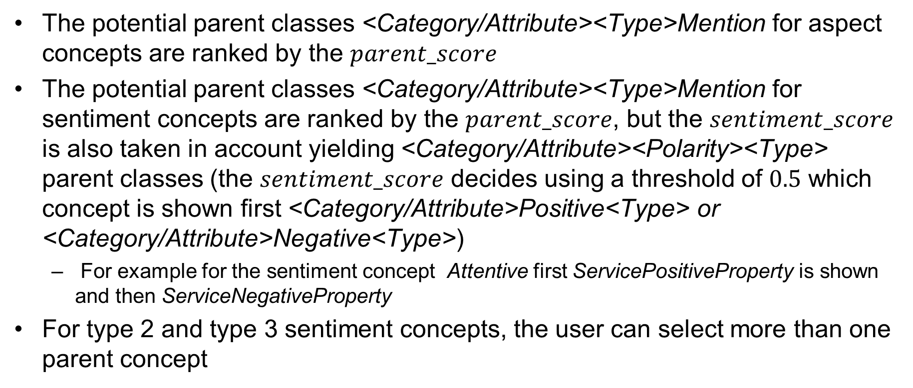
Methodology – Concept Hierarchy Construction
The potential parent classes <Category/Attribute><Type>Mention for aspect concepts are ranked by the $parent_score$
The potential parent classes <Category/Attribute><Type>Mention for sentiment concepts are ranked by the $parent_score$, but the $sentiment_score$ is also taken in account yielding <Category/Attribute><Polarity><Type> parent classes (the $sentiment_score$ decides using a threshold of $0.5$ which concept is shown first <Category/Attribute>Positive<Type> or <Category/Attribute>Negative<Type>)
For example for the sentiment concept Attentive first ServicePositiveProperty is shown and then ServiceNegativeProperty
For type 2 and type 3 sentiment concepts, the user can select more than one parent concept
Notes:
As previously said for both aspect concepts and sentiment concepts the potential parents are ranked using the $parent_score$. For sentiment concepts we also make use of the $sentiment_score$ to decide which sentiment carrying parent concepts to show first, if the $sentiment_score$ is smaller than 0.5 we use the negative sentiment concept, otherwise we use the positive sentiment concept. For example for the sentiment concept Attentive, which is a Property and is related to the aspect category Service, we show first ServicePositiveProperty and then ServiceNegativeProperty.
For the type 2 and type 3 sentiment concepts, the user selects more than one parent concept as the sentiment aspect corresponds to more than one aspect concept in our domain.

Slide 28
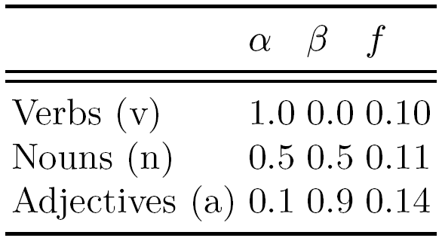

Evaluation
We have optimized the ontology learning parameters using grid search having as objective the harmonic mean of the ${acceptance_ratio}_{pos}$and the ${accepted_terms}_{pos}$ on the Yelp Dataset Challenge 2017 for restaurants:
Notes:
As previously mentioned we have optimized the ontology learning parameters using the grid search method having as objective the harmonic mean of the acceptance ratio and accepted terms per part-of-speech. As parts-of-speech we have used verbs, nouns, and adjectives. We have the parameters $α$ and $β$ that control the trade-off between Domain Pertinence and Domain Consensus, and the parameter f that defines the threshold value for the relevance_score of a term in order to have the term proposed to the user. Interestingly for verbs Domain Pertinence is more important than Domain Consensus and for adjectives it is the other way around. All thresholds have values around 0.1. These values have been obtained using the Yelp Dataset Challenge 2017 data for restaurants.

Slide 29
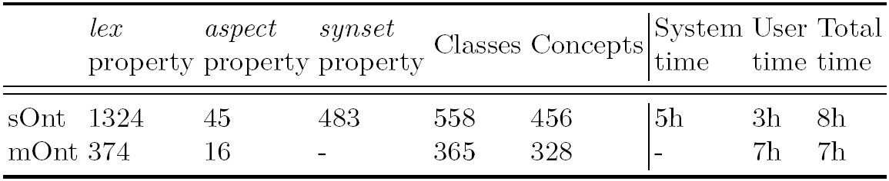
Evaluation
sOnt represents the semi-automatically built ontology
mOnt represents the manually built ontology by Schouten and Frasincar (2018)
‘Classes’ denote all ontology classes and ‘Concepts’ denoted accepted terms
Notes:
In this table one can see a comparison between various features of sOnt, which is the semi-automatically built ontology, and mOnt, which is the manually built ontology by Schouten and Frasincar in 2018. In this table Classes represent all ontology classes and Concepts represent the terms accepted by the user. The Classes set includes the user accepted Concepts as well as the Classes that have been predefined in the ontology skeleton.

Slide 30
Evaluation
Observations:
sOnt has more lexicalizations (around 3 per concept) than mOnt (around one per concept)
sOnt has more synsets than concepts (there are concepts with more than one synset)
E.g., the concept Atmosphere has two synset properties (two relevant meanings):
‘a particular environment or surrounding influence’
‘a distinctive but intangible quality surrounding a person or thing’
The total time needed to create sOnt is larger than the total time needed to create mOnt
The system time is mainly due to the used WSD algorithm (difficult to improve), but the system time is not really a problem as the computations can happen offline (user is not present)
The user time needed to create sOnt is less than half the time needed to create mOnt and this is relevant in practice (the ‘user’ part is the most expensive part in the system)
Notes:
There are a few observations to be made:
- sOnt has more lexicalizations than mOnt. sOnt has around 3 lexicalizations per concept while mOnt has only 1. This is expected as sOnt benefits from more lexicalization provided by the use of the WordNet synonyms.
- sOnt has more synsets than concepts, which is due to the fact that there are concepts that have more than 1 synset attached. For example the concept Atmosphere has two synsets attached for the two possible meanings of the word ‘atmosphere’ that are relevant for this concept: ‘a particular environment or surrounding influence’ and ‘a distinctive but intangible quality surrounding a person or thing’.
- the total time needed to create sOnt is larger than the total time needed to create mOnt; this is mainly due the system time dominated by the word sense disambiguation phase. Nevertheless we consider this not to be problematic as calculations done by the computer can happen offline, that is without requiring the user presence.
- The most important observation is that the user time needed to create sOnt is less than half the time needed to create mOnt and this result is very relevant in practice as the user time is the most costly part of our system.

Slide 31
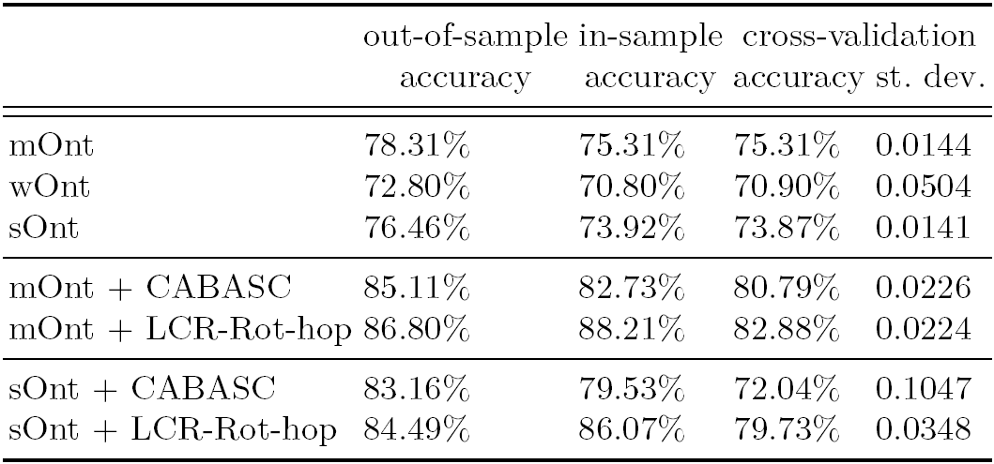
Evaluation
wOnt represents a semi-automatically built ontology with same method as sOnt but using words instead of synsets as terms
Notes:
We have used the SemEval 2016, Task 5, Subtask 1, Slot 3 dataset for restaurants to evaluate the quality of the built ontologies using the Two-Step Hybrid approach for ABSA at sentence-level proposed by Schouten and Frasincar in 2018.
In this table one can see the out-of-sample accuracy, the in-sample accuracy and the cross-validation accuracy and standard deviation for various two-step hybrid approaches for performing ABSA at the sentence-level.
The first three methods are the ontology-based solutions with the majority classifier as backup. We have named them after the type of the ontology that they are using, more precisely, mOnt stands for the manually built ontology, wOnt stands for the semi-automatically built ontology with words, and sOnt stands for the semi-automatically built ontology with synsets.
The next two methods are the hybrid methods using mOnt and as backup CABASC or LCR-Rot-hop, and the last two methods are the hybrid methods using sOnt and the very same two deep learning models as backup.

Slide 32
Evaluation
We use SemEval 2016, Task 5, Subtask 1, Slot 3 dataset for restaurants
Observations:
sOnt has lower accuracy (both out-of-sample and in-sample) than mOnt (~ 2% points) [as expected]
wOnt has lower accuracy (both out-of-sample and in-sample) than sOnt (~ 3% points)
Each hybrid method involving deep learning with sOnt has lower accuracy (both out-of-sample and in-sample) than a hybrid method with mOnt (~ 2% points)
The hybrid methods based on CABASC have lower accuracy (both out-of-sample and in-sample) than the hybrid methods based on LCR-Rot-hop with both sOnt and mOnt [the results using mOnt are a confirmation of the findings of Wallaart and Frasincar (2019)
Limitations:
Used dataset for learning
NLP components (especially the WSD algorithm) performance
Notes:
There are a few observations that can be derived from the previous graph:
- sOnt has lower accuracy (both out-of-sample and in-sample) than mOnt. The difference is approximately 2 percentage points. This is expected as the quality of the manually built domain ontology cannot be rivaled by a semi-automatic approach
- wOnt has lower accuracy (both out-of-sample and in-sample) than sOnt. The difference is approximately 3 percentage points. This is expected as the use of synsets allows for more precise counting by employing word meanings than using plain words.
- Each of the considered hybrid solutions involving deep learning with sOnt has lower accuracy (both out-of-sample and in-sample) than the same type of hybrid method with mOnt. The difference is approximately 2 percentage points and inline with our previous observation on the simple hybrid methods.
- Using the CABASC method as the backup solution provides a lower accuracy than using the LCR-Rot-hop as the backup method. The mOnt-based results confirm the findings of Wallaart and Frasincar in 2019.
These results are limited by the used dataset for learning the ontology and the used NLP components, especially the word sense disambiguation algorithm.

Slide 33
Conclusion
We have proposed SASOBUS, a semi-automatic method for domain sentiment ontology construction with synsets for ABSA at sentence-level:
Term Selection
Concept Formation
Concept Hierarchy Construction
We have used two restaurant datasets in our evaluation:
Yelp Dataset Challenge 2017 data for ontology building
SemEval 2016, Task 5, Subtask 1, Slot 3 data for measuring performance
While the accuracy obtained using the semi-automatically built ontology has slightly decreased (~ 2% points) compared to the accuracy obtained using the manually built ontology, the user time is significantly lower (less than half)
Notes:
In conclusion I have presented SASOBUS, a semi-automatic method for domain sentiment ontology construction with synsets for ABSA at sentence-level. The proposed method has three main components: Term Selection, Concept Formation, and Concept Hierarchy Construction, for which we have provided customized solutions. For evaluating the proposed method we used two restaurant datasets: the Yelp Dataset Challenge 2017 data for ontology building and the SemEval 2016, Task 5, Subtask 1, Slot 3 data for measuring performance.
Despite the fact that the accuracy slightly dropped by approximately 2% points when using the semi-automatically built ontology compared to the manually built ontology, the user time has become significantly lower (less than half).

Slide 34
Conclusion
We have shown that using synsets instead of words improves the accuracy (~ 3% points)
SASOBUS is useful for building domain sentiment ontologies for domains that to know have this knowledge resource
Future work:
Apply SASOBUS to other domains (e.g., laptops) in addition to restaurants
Experiment with alternative approaches for the concept hierarchy construction (e.g., using word embeddings and clustering algorithms)
Investigate alternative approaches for Word Sense Disambiguation (e.g., Adapted Lesk algorithm)
Explore other solutions for computing the sentiment of a concept (e.g., neural networks)
Notes:
We have also shown that using synsets instead of words in the ontology construction and representation process improves the accuracy of the hybrid approach by approximately 3 percentage points.
As application, we envisage SASOBUS to be extremely useful for building sentiment ontologies for domains that do not have such a knowledge resource yet, but for which there is a text corpus available.
As future work we plan to apply SASOBUS to other domains than restaurants like the laptops domain which is also supported by SemEval.
Also, we aim to experiment with other approaches for the concept hierarchy construction like for example using word embeddings in conjunction with a hierarchical clustering algorithm.
Given that the word sense disambiguation component is the current bottleneck in terms of accuracy and speed we plan to investigate other solutions like the Adapted Lesk algorithm.
Last, we aim to explore alternative approaches for determining the sentiment of a concept as in a recently proposed solution for learning sentiment lexicons using neural networks.

Slide 35
References – ABSA
Kim Schouten and Flavius Frasincar. Ontology-Driven Sentiment Analysis of Product and Service Aspects. 15th Extended Semantic Web Conference (ESWC 2018), Lecture Notes in Computer Science, Volume 10843, pages 608-623, Springer, 2018.
Qiao Liu, Haibin Zhang, Yifu Zeng, Ziqi Huang, and Zufeng Wu. Content Attention Model for Aspect Based Sentiment Analysis. 2018 World Wide Web Conference (WWW 2018), pages 1023-1032. ACM, 2018.
Olaf Wallaart and Flavius Frasincar. A Hybrid Approach for Aspect-Based Sentiment Analysis Using a Lexicalized Domain Ontology and Attentional Neural Models. 16th Extended Semantic Web Conference, Lecture Notes in Computer Science, Volume 11503, pages 363-378, Springer, 2019.
Notes:
These are the references that are used in this presentation for ABSA methods.

Slide 36
References – Ontology Building
Mark Sanderson and Bruce Croft. Deriving Concept Hierarchies from Text. 22nd Annual International ACM SIGIR Conference on Research and Development in Information Retrieval (SIGIR 1999), 206-213, ACM, 1999.
Paul Buitelaar, Philipp Cimiano, and Bernado Magnini. Ontology Learning from Text: Methods, Evaluation and Applications, IOS Press, 2005.
Kevin Meijer, Flavius Frasincar, and Frederik Hogenboom. A Semantic Approach for Extracting Domain Taxonomies from Text. Decision Support Systems, Volume 62, 78-93, 2014.
Notes:
And these are the references that are used for ontology building.
I thank you for your attention and, if you have any questions, please do not hesitate to ask me.

