Slide 1
An Overview of Event Extraction from Text
;)
Frederik Hogenboom fhogenboom@ese.eur.nl | Flavius Frasincar frasincar@ese.eur.nl
Uzay Kaymak kaymak@ese.eur.nl | Franciska de Jong fdejong@ese.eur.nl
Erasmus University Rotterdam PO Box 1738, NL-3000 DR Rotterdam, the Netherlands
Notes:
Introduction: name, research topic, link with this
Topic: what is it, who are the other people

Slide 2
Introduction (1)
Increasing amount of (digital) data
Utilizing extracted information in decision making processes becomes increasingly urgent and difficult:
  Too much data for manual extraction
  Yet most data is initially unstructured
  Data often contains natural language
  Automation is a non-trivial task
Notes:
With the increasing amount of data and the exploding number of digital data sources, utilizing extracted information in decision making processes becomes increasingly urgent and difficult. An omnipresent problem is the fact that most data is initially unstructured, i.e., the data format loosely implies its meaning and is described using natural, human-understandable language, which makes the data limited in the degree in which it is machine-interpretable. This problem thwarts the automation of for example vital information retrieval (IR) and information extraction (IE) processes -- used for decision making -- when involving large amounts of data.

Slide 3
Introduction (2)
Information Extraction (IE)
  Multiple sources:
    News messages
    Blogs
    Papers
    …
  Text Mining (TM): information learning from pre-processed text:
    Natural Language Processing (NLP)
    Statistics
    …
  Specific type of information that can be extracted: events
Notes:
Information extraction can be performed on a heterogeneous collection of data, for example news, blogs, etcetera. It involves the usage of text mining techniques. Text mining boils down to information learning from pre-processed text, e.g., parts of speech have been determined, words have been stemmed, and so on. Text mining is usually done by means of natural language processing or statistics, but also combinations of the two techniques are quite common.

Slide 4
Events (1)
Steve Jobs resigns from Apple, Cook becomes CEO
(Reuters) - On Wednesday, Silicon Valley legend Steve Jobs resigned as chief executive of Apple Inc in a stunning move that ended his 14-year reign at the technology giant he co-founded in a garage.
Apple shares dived as much as 7 percent in after-hours trade after the pancreatic cancer survivor and industry icon, who has been on medical leave for an undisclosed condition since January 17, announced he will be replaced by COO and longtime heir apparent Tim Cook.
Apple stock price falls on news of Steve Jobs's death
(The Guardian) - Apple's stock price has risen more than 9,000% since Steve Jobs returned in 1997, and doubled in the past two years
News of Steve Jobs's death drove the Apple share price down more than 5% in Frankfurt on Thursday morning.
Apple shares are now trading 3.5% lower at €273, after hitting a low of €270 in Frankfurt. The shares are not traded in London. They are expected to open lower when Wall Street opens at 2.30pm London time.
Apple was briefly the most valuable company in the world in the summer, knocking oil giant Exxon Mobil off the top spot. Revenues have soared from $7.1bn (£4.6bn) in 1997 to $65.2bn a year now.
Google buys Motorola Mobility for $12.5B
(VentureBeat) - This morning, Google announced that it will buy Motorola Mobility — Moto’s mobile device arm — for $12.5 billion. Google will acquire Motorola Mobility for $40 per share in cash, a 63 percent premium over the company’s Friday closing price. Google says it will run Motorola Mobility as a separate business. Motorola spun off its business into two divisions last year, Mobility and Solutions (the data and telecom portion), as a response to declining profits.
Google shares were down around 1.5 percent, while Motorola Mobility’s stock jumped 57 percent. The company says Motorola Android phones won’t be receiving any special treatment as a consequence of the deal — but that’s a tough nut to swallow, since Google often plays favorites.
Notes:
Examples of events. Because of my project, I am interested in pretty much all financial events. These events are widely available in the news these days, as most news messages are rich of various types of events.

Slide 5
Events (2)
Event:
  Complex combination of relations linked to a set of empirical observations from texts
  Can be defined as:
    <subject> <predicate> e.g., <Person> <Dies>
    <subject> <predicate> <object> e.g., <Company> <Buys> <Company>
Event extraction could be beneficial to IE systems:
  Personalized news
  Risk analysis
  Monitoring
  Decision making support
Notes:
So, what exactly is an event?

Slide 6
Events (3)
Common event domains:
  Medical
  Finance
  Politics
  Environment
Which Text Mining techniques are appropriate for event extraction?
Notes:
Events can be applied in various domains. Explain that almost all events can be used for algorithmic trading (the use of computer programs for entering trade orders with algorithms deciding aspects like timing, price, and quantity of an order), as financial markets are usually extremely sensitive to many types of events in news (see also examples of earlier).
So, I think by now it is clear that events are useful. Text mining, information extraction, and natural language processing are quite mature fields, and also event extraction is maturing. This made me wonder: which text mining techniques are appropriate for event extraction?

Slide 7
Aims
Provide general guidelines on selecting the proper text mining techniques for specific event extraction tasks, taking into account the user and its context
Focus:
  Event extraction from text
  No space/time event dimensions
Criteria:
  Required amount of data
  Required amount of domain knowledge
  Required amount of user expertise
  Interpretability of results
High / medium / low
Notes:
Of course, it would be virtually impossible to cover all works, yet I try to discuss the major ones.

Slide 8
Event Extraction
In analogy with the classic distinction within the field of modeling, we distinguish 3 main approaches:
  Data-driven event extraction:
    Statistics
    Machine learning
    Linear algebra
    …
  Expert knowledge-driven event extraction:
    Representation & exploitation of expert knowledge
    Patterns
  Hybrid event extraction:
    Combine knowledge and data-driven methods
Notes:
First, let us discuss the main approaches to event extraction. We distinguish between three main approaches to event extraction, in analogy with the classic distinction that is made in the field of modeling. First, there are data-driven approaches, which aim to convert data to knowledge through the usage of statistics, machine learning, linear algebra, etc. Second, we distinguish expert knowledge-driven methods, which extract knowledge through representation and exploitation of expert knowledge, usually by means of pattern-based approaches. Finally, the hybrid event extraction combine knowledge and data-driven methods.

Slide 9
Data-Driven Event Extr. (1)
Facts:
  Commonly used
  Rely solely on quantitative methods to discover relations
  Require large text corpora for developing models that approximate linguistic phenomena
  Methods:
    Statistical reasoning:
      Word frequencies
      Ranking (TF-IDF)
      N-grams
      Clustering
    Probabilistic modeling
    Information theory
    Linear algebra

Slide 10
Data-Driven Event Extr. (2)
Examples:
Considerations:
  Meaning is not dealt with explicitly
  Large amount of data required
  No linguistic resources are required
  No expert (domain) knowledge is needed
Approach | Method | Events | Data | Know. | Exp. | Int.
Okamoto et al. (2009) | Hierarchical clustering | Local | Med | Low | Low | Low
Liu et al. (2008) | Graphs, clustering | News | High | Low | Low | Low
Tanev et al. (2008) | Clustering | Violence & disaster news | Med | Low | Low | Low
Lei et al. (2005) | Support Vector Machines | News | High | Low | Low | Low
Notes:
Several examples of the usage of data-driven text mining approaches for event extraction can be found in literature. For instance, in their 2009 work, Okamoto et al. elaborate on a framework for detection of occasional or local events, which employs hierarchical clustering techniques. While clustering itself could already yield promising results for event extraction, Liu et al. make use of a combination of weighted undirected bipartite graphs and clustering in order to extract key entities and significant events from daily web news. Clustering techniques are also employed by Tanev et al., who also aim for real-time news event extraction, but focus especially on violence and disaster events. The authors make use of automatic tagging of words and the presented framework is designed to automatically learn patterns from discovered events. Lastly, Lei et al. also employ word-based statistical text mining in their work from 2005. The authors elaborate on a framework aimed at news event detection, based on support vector machines.

Slide 11
Knowledge-Driven Event Extr. (1)
Facts:
  Often based on manually created / discovered patterns that express rules representing expert knowledge
  Based on linguistic, lexicographic, and human knowledge
  Lexico-syntactic (frequent) vs. lexico-semantic patterns (less frequent)
Notes:
Semantics are usually added by means of gazetteers, which use the linguistic meaning of text, or by means of ontologies.

Slide 12
Knowledge-Driven Event Extr. (2)
Examples:
Approach | Method | Events | Data | Know. | Exp. | Int.
Nishihara et al. (2009) | Lexico-Syntactic | Personal experiences | Low | Med | High | Med
Aone et al. (2000) | Lexico-Syntactic | General | Low | High | High | Med
Yakushiji et al. (2001) | Lexico-Syntactic | Biomedical | Low | Med | High | Med
Hung et al. (2010) | Lexico-Syntactic | Commonsense knowledge | Low | Med | High | Med
Xu et al. (2006) | Lexico-Syntactic | Prize award | Low | Med | High | High
Li et al. (2002) | Lexico-Semantic | Financial | Low | High | High | Med
Cohen et al. (2009) | Lexico-Semantic | Biomedical | Med | High | High | High
Vargas-Vera et al. (2004) | Lexico-Semantic | KMi news | Low | High | High | High
Notes:
I’ll not bore you with all the individual details, as they are slightly irrelevant now, even more because most approaches are pretty similar, yet only use slightly different patterns. What is relevant, is the distinction between lexico-syntactic and lexico-semantic approaches. After evaluating the frameworks as presented here, a pattern emerges. The interpretability of the lexico-semantic patterns is somewhat higher than that of the lexico-syntactic methods, yet on the down side, also more expert knowledge is required. For all knowledge-driven approaches holds that the amount of required expertise is quite high.

Slide 13
Knowledge-Driven Event Extr. (3)
Considerations:
  Lexical knowledge and/or prior domain knowledge required
  Definition and maintenance of patterns is more difficult (consistency and costs)
  Less training data required than for data-driven approaches
  Powerful expressions with lexical, syntactical, and semantic elements make results easily interpretable and traceable
  Patterns are useful when one needs to extract very specific information

Slide 14
Hybrid Event Extr. (1)
Facts:
  Difficult to stay within boundaries of event extraction approach
  Usually, an approach can be considered as mainly data-driven or mainly knowledge-driven
  However, an increasing number of researchers equally combine both approaches
  Most systems are knowledge-driven, aided by data-driven methods:
    Solve the lack of expert knowledge
    Apply bootstrapping

Slide 15
Hybrid Event Extr. (2)
Examples:
Considerations:
  Large amount of data required
  Increased complexity requires expertise
  Less domain knowledge needed
  Interpretability of results
Approach | Method | Events | Data | Know. | Exp. | Int.
Jungermann et al. (2008) | Lexico-Syntactic, graphs | German parliament | Med | Med | High | Med
Piskorski et al. (2007) | Lexico-Semantic, clustering | Violent news | High | Med | Med | Med
Chun et al. (2004) | Lexico-Syntactic, co-occurences | Biomedical | Med | Med | Med | Med
Lee et al. (2003) | Ontology-based POS tagging | Chinese news | N/A | Med | Med | Low
Notes:
Jungermann and Morik combine lexico-syntactic patterns with conditional random fields (depicted as undirected graphs), in order to extract events from the minutes of plenary sessions of the German parliament. An example of bootstrapping lexical techniques with statistics is given in the work of Piskorski et al. Here, the authors bootstrap a weakly supervised pattern learning algorithm with clusters, in order to be able to extract violence incidents from online news with high precision and recall, as well as storing these in knowledge bases. Chun et al. extract events from biomedical literature by means of lexico-syntactic patterns, combined with term co-occurrences. Finally, aiming for ontology-based fuzzy event extraction for Chinese e-news summarization, Lee et al. employ a grammar-based statistical method to text mining, i.e., part-of-speech tagging. However, tagging is based on domain knowledge that is stored in ontologies, thus making the event extraction a hybrid process.
In hybrid event extraction systems, due to the usage of data-driven methods, the amount of required data increases, yet typically remains less than is the case with purely data-driven methods. Compared to a knowledge-driven approach, complexity -- and hence required expertise -- increases due to the combination of multiple techniques. On the other hand, the amount of expert knowledge that is needed for effective and efficient event discovery is generally less than for pattern-based methods, because of the fact that lack of domain knowledge can be compensated by the use of statistical methods. As for the interpretability, attributing results to specific parts of the event extraction is more difficult due to the addition of data-driven methods. Yet, interpretability still benefits from the use of semantics. Disadvantages of hybrid approaches are mostly related to the multidisciplinary aspects of hybrid systems.

Slide 16
Discussion
Data requirements:
  Data-driven: > 10,000 documents
  Knowledge-driven: 100 – 1,000 documents
  Hybrid methods: < 10,000 documents
Interpretability:
  Data-driven: low
  Knowledge-driven: high (especially lexico-semantic patterns)
  Hybrid: medium
Domain knowledge & expertise:
  Data-driven approaches require less than knowledge-driven and hybrid methods

Slide 17
Conclusions
Knowledge-driven approaches:
  For casual users (e.g., students)
  Interactive, query-driven approach
  Domain knowledge and expertise should be readily available
  Patterns close to natural language
  Little statistical details & model fine-tuning
Data-driven & hybrid approaches:
  For advanced users (e.g., researchers)
  Less restrictions by, for example, grammars
Notes:
As a general guideline for selecting a suitable technique for event extraction, based on the results of our survey, we suggest the usage of knowledge-based techniques for casual users (e.g., students) that prefer an interactive, query-driven approach to event extraction, assuming domain knowledge and expertise to be readily available. Users can easily specify patterns in a language that is close to their own natural language, without being bothered with statistical details and model fine-tuning. On the other hand, users like (academic) researchers would benefit from both hybrid and data-driven approaches, as these are less restricted by, for example, grammars.

Slide 18
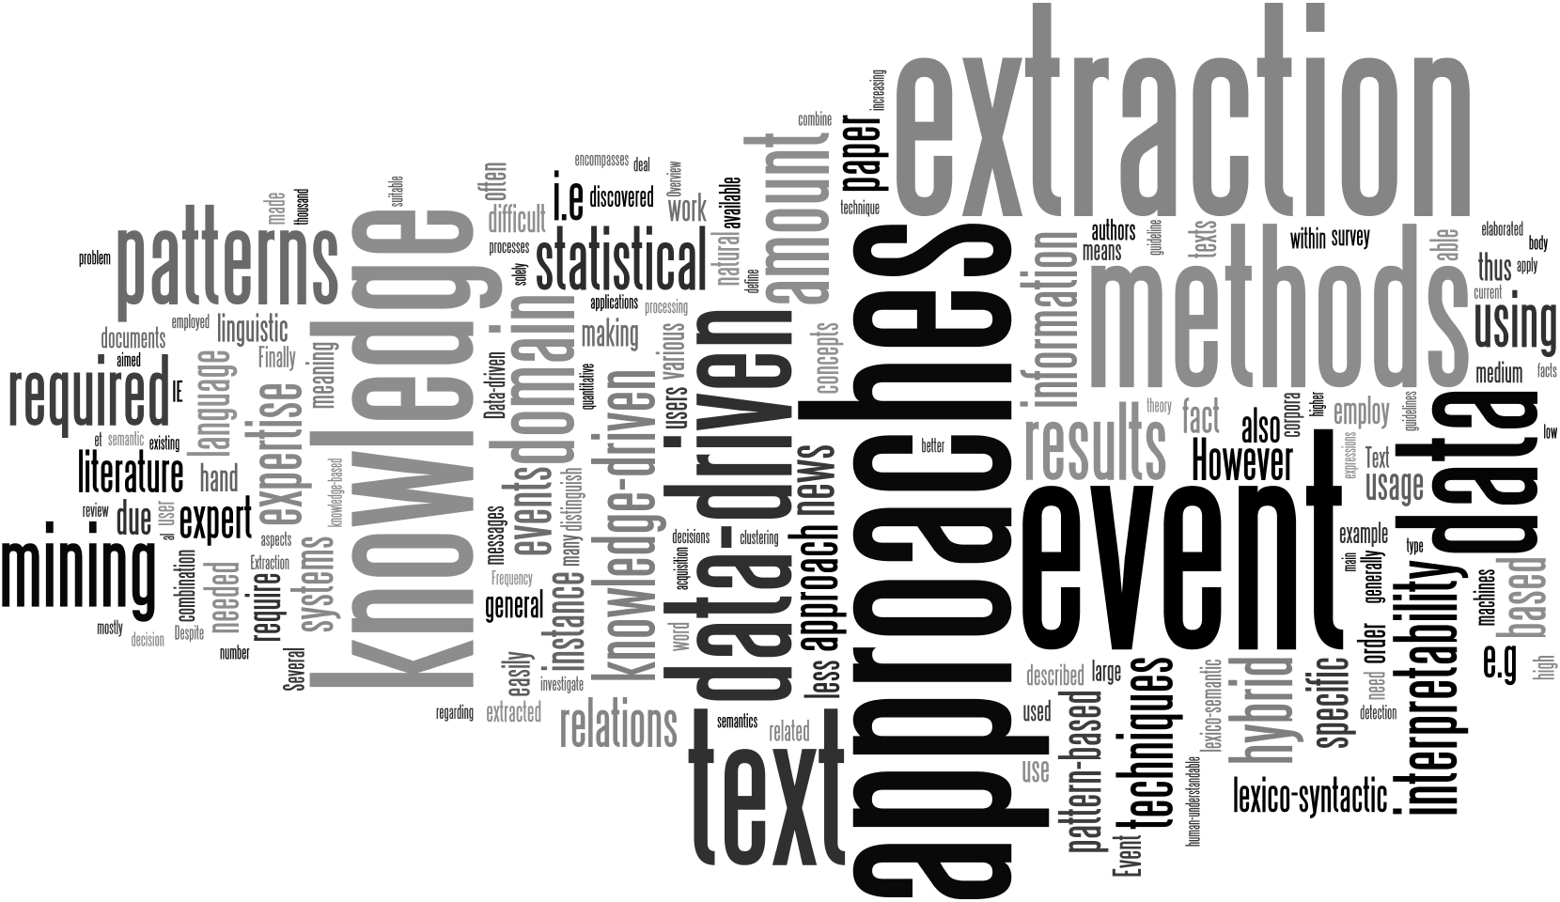
Questions

