Slide 1
Ontology-Based Aspect Detection for Sentiment Analysis
Kim Schouten, Flavius Frasincar, and Franciska de Jong

Slide 2
What is sentiment analysis?
Many people freely express their opinions on the Web
Extract sentiment from unstructured text
Useful:
For consumers when making a purchase decision
For producers to assess the impact of marketing campaigns, success of product launches, etc.
Many companies in business analytics include some form of sentiment analysis
Notes:
Lexalytics, Brandwatch, startups: Wonderflow, Vita.io

Slide 3
Why aspect-based?
Finer level of analysis
Directly link expressed sentiment to actual topic or aspect
Useful when topic is not known beforehand, or when there can be multiple topics
Two main tasks:
Aspect detection
Sentiment analysis for aspects

Slide 4
Data Snippet
<sentence id="1032695:1">
<text>Everything is always cooked to perfection , the service is excellent , the decor cool and understated .</text>
<Opinions>
<Opinion target="NULL" category="FOOD#QUALITY" polarity="positive" from="0" to="0"/>
<Opinion target="service" category="SERVICE#GENERAL" polarity="positive" from="47" to="54"/>
<Opinion target="decor" category="AMBIENCE#GENERAL" polarity="positive" from="73" to="78"/>
</Opinions>
</sentence>

Slide 5
Motivation and Setup

Slide 6
Why use external knowledge?
Using external knowledge alleviates the need for data
Good for resource sparse languages / domains
Use machine learning for its high performance

Slide 7
Setup
Use linear SVM, one for each aspect category
Basic linguistic features (lemmas/synsets)
Add features based on external knowledge
Find concepts based on lexicalization
Once concept is found, also add all its superclasses

Slide 8
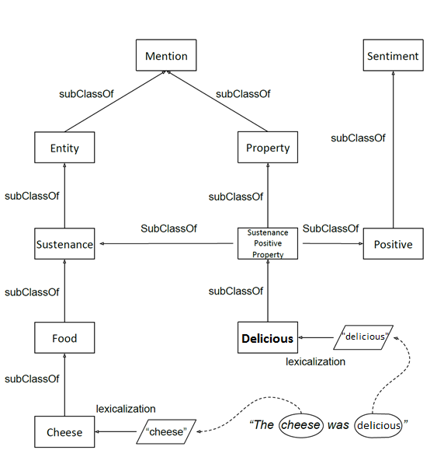
Ontology Snippet
Notes:
5:00

Slide 9
Results

Slide 10
Results
 | Avg. F₁ | St.dev. | In-sample F | Out-of-sample F
base | 0.575 | 0.0057 | 0.803 | 0.539
+Synsets | 0.632 | 0.0039 | 0.896 | 0.5728
+Ontology | 0.687 | 0.0026 | 0.858 | 0.613
+Synsets and +Ontology | 0.698 | 0.0040 | 0.920 | 0.628

Slide 11
Data size sensitivity analysis
Keep the test set the same
Use only n% of available training data
Set n to 10:100 with step size 10
Performed for both aspect detection and aspect sentiment classification

Slide 13
Conclusions & Future Work

Slide 14
Conclusions
External knowledge improves aspect detection for sentiment analysis
Better overall performance
Less data is needed when using ontology
Ontology coverage is important

Slide 15
Discussion

Slide 16
Bonus slides: Data Analysis

Slide 17
Natural Language Processing

Slide 18
Aspect Statistics

Slide 19
Aspect Statistics

Slide 20
Sentiment Statistics

Slide 21
Sentiment Statistics

Slide 22
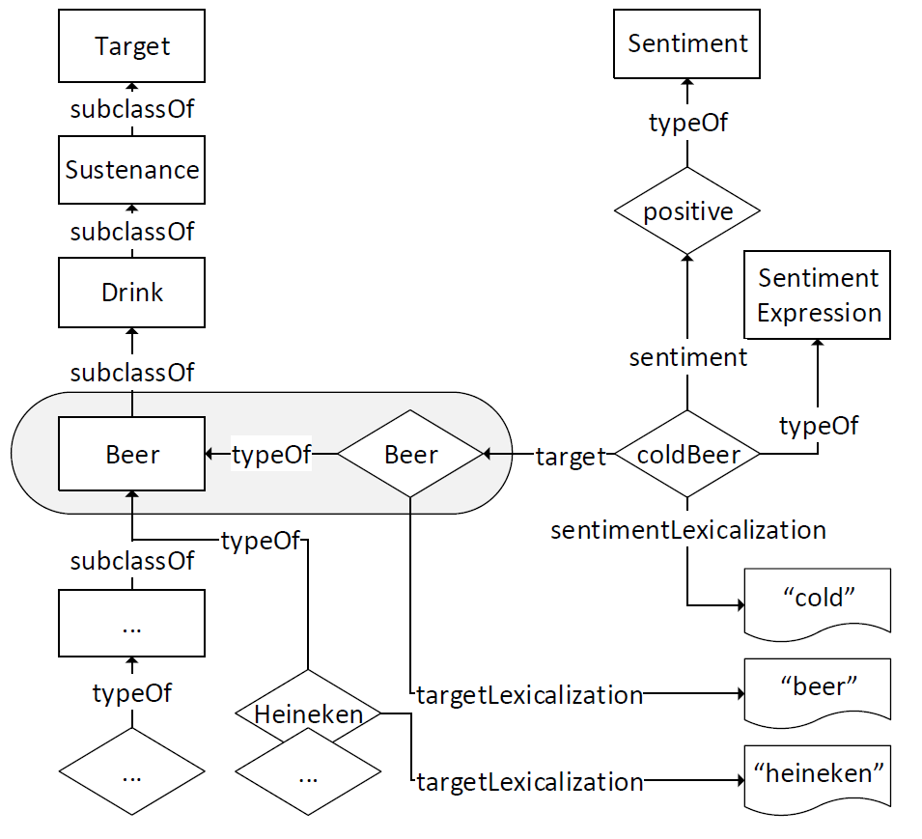
Ontology Snippet
Notes:
5:00

Slide 23
Ontology as external knowledge
An ontology is
a formal representation of knowledge
usually created manually by domain experts
An ontology allows
easy sharing of knowledge (e.g. LOD)
reasoning to derive (new) facts
Our ontology describes a part of the restaurant domain
56 sentiment expressions
3 sentiment values
185 target concepts
Notes:
5:00

