Slide 1



Web News Sentence Searching
Using Linguistic Graph Similarity
Kim Schouten & Flavius Frasincar
schouten@ese.eur.nl frasincar@ese.eur.nl

Slide 2
Problem
Most text search methods are word-based
Often, the context is lost for the sake of simplicity
However, the meaning of a word is defined by both word and context.
How can we include context information of words into the search algorithm?

Slide 3
Graph-based Approach
Grammatically parsing a sentence yields a graph
Words are the nodes
Grammatical relations between words are the edges
Set of relations of a word can then be used as context.
NLP pipeline transforms both query and news sentences into graphs.

Slide 4
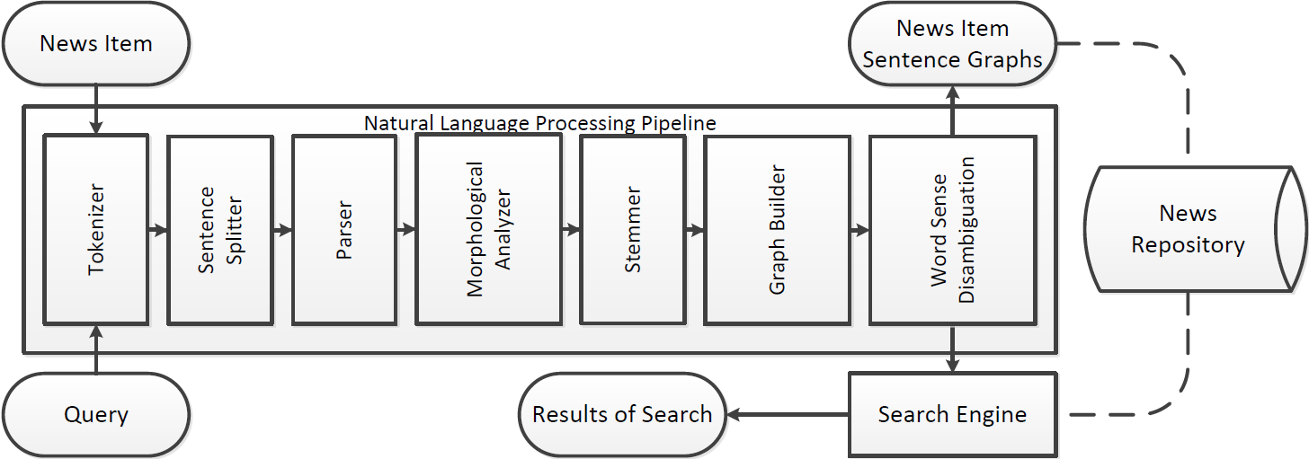
Pipeline

Slide 5
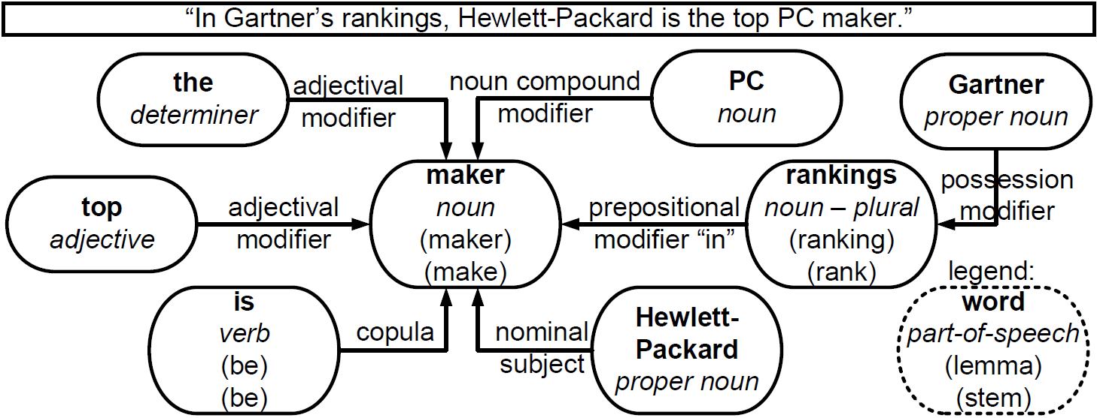
Graph representation of sentence

Slide 6
Graph comparison
Problem is similar to graph isomorphism
But partial similarity makes it much harder
Nodes may be missing on either side
Nodes may be only partially similar (pc <> workstation)
Relation labels may be different for similar nodes
Hence, output is not binary but a real-valued similarity score

Slide 7
Graph comparison
Nodes are compared on:
Basic and full part-of-speech (POS) label
Stem, lemma, and fully inflected word
If POS is the same, but word is not then check for:
Synonymy
Hypernymy (1 / steps in hypernym tree)
Correct for word frequency

Slide 8
Graph comparison
We can recursively go through both graphs
Compare nodes and edges to assign score
However, a starting position within both graphs is needed:
Using all possibilities is inefficient
Always starting at root is inaccurate
Use index of stemmed words (nouns/verbs)
Only the best scoring starting position is kept

Slide 9
Search algorithm

Slide 10
Search algorithm

Slide 11
Search algorithm

Slide 12
Search algorithm

Slide 13
Search algorithm

Slide 14
Search algorithm

Slide 15
Search algorithm

Slide 16
Data set
A set of ~1000 sentences
Extracted from news items
News items are on roughly the same topic
10 sentences are designated as queries
At least three human annotators annotated the similarity between each of the queries and each of the news sentences
Similarity score of 0,1,2, or 3

Slide 17
Score optimization
Each comparison of two nodes or two edges contributes to total similarity score.
The exact score that each feature can yield is optimized using genetic optimization.
5 queries and related data are used for training
Other 5 queries and related data are used for testing
This is repeated 32 times, with different splits
For each query a ranked list of sentences is given

Slide 18
Evaluating ranked lists
Three metrics: MAP, Spearman’s Rho, and nDCG
MAP measures to what extent the top of the ranking contains only similar/relevant items
MAP assumes binary similarity
System outputs real-valued similarity scores
Converted to binary using cut-off value(s)
Cut-off values from 0 to 3 with stepsize 0.1
Reported MAP score is average of these

Slide 19
Evaluating ranked lists
Spearman’s Rho measures correlation of whole list
Only top part of results is used in practice
nDCG measures whether the most similar items are in the top of the ranking
Every result contributes its similarity value to final score, discounted by position in ranking
Most appropriate
Focuses on top part of the ranking
Uses real-valued similarity values

Slide 20
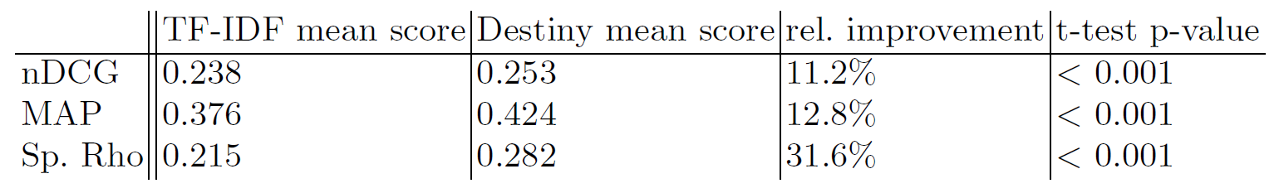
Performance
Results are averages over all 32 splits.
t-statistics are computed over the 32 results for each metric.
Note that TF-IDF is on average twice as fast

Slide 21
Scalable?
Linear in the number of documents
Graph comparison is a large ‘constant’ factor
Depends on:
# nodes in query
# edges in query
Average # nodes in documents
Average # edges in documents
How similar the query is to the documents

Slide 22
Conclusions
Our proposed method has several improvements over traditional text searching:
By representing text as a graph, the original semantics are preserved, which can be used to leverage search results.
Word sense disambiguation allows for synonym and hypernym detection.

Slide 23
Open Issues
More intelligent way to find start positions
Co-reference resolution
Non-literal expressions
Mitigate problems with varying graph sizes
“Microsoft is expanding its online corporate offerings to include a full version of Office”
“Microsoft includes Office into its online corporate offerings”

Slide 24
Thank you for your attention!
?
Questions?

