Slide 1
Detection of Multiple Implicit Features per Sentence in Consumer Review Data
Flavius Frasincar*
frasincar@ese.eur.nl
Erasmus University Rotterdam
The Netherlands
* Joint work with Nikoleta Dosoula, Roel Griep, Rick den Ridder, Rick Slangen and Kim Schouten

Slide 2
Contents
Motivation
Related Work
Method
Data
Evaluation
Conclusion

Slide 3
Motivation
Due to the convenience of shopping online there is an increasing number of Web shops
Web shops often provide a platform for consumers to share their experiences, which lead to an increasing number of product reviews:
  In 2014: the number of reviews on Amazon exceeded 10 million
Product reviews used for decision making:
  Consumers: decide or confirm which products to buy
  Producers: improve or develop new products, marketing campaigns, etc.

Slide 4
Motivation
Reading all reviews is time consuming, therefore the need for automation
Sentiment mining is defined as the automatic assessment of the sentiment expressed in text (in our case by consumers in product reviews)
Several granularities of sentiment mining:
  Review-level
  Sentence-level
  Aspect-level (product aspects are sometimes referred to as product features): Aspect-Based Sentiment Mining (ABSA) [our focus here]

Slide 5
Motivation
Aspect-Based Sentiment Mining has two stages:
  Aspect detection:
    Explicit aspect detection: aspects appear literally in product reviews [relatively easy]
    Implicit aspect detection: aspects do not appear literally in the product reviews [our focus here]
  Sentiment detection: assigning the sentiment associated to explicit or implicit aspects
Main problem:
  In previous work we have proposed an approach to detect at most one implicit feature per sentence, but a sentence can have more than one aspect
  How to find all product aspects mentioned in a review sentence?

Slide 6
Main Idea and Evaluation Result
Two step approach:
  Use a classifier to predict the presence of multiple (more than one) features in a sentence
  Extend our previous approach to predict more than one implicit feature in a sentence
Evaluation result:
  Collection of restaurant reviews from SemEval 2014
  The old approach has an F₁ of 62.9%
  We obtain an F₁ of 64.5%
  There is a 1.6 percentage points statistically significant increase in F₁ (p < 0.01)

Slide 7
Related Work
Explicit Features available:
  Use the co-occurrence (per sentence) matrix between explicit features and other words from training data
  Compute a score per sentence for each explicit feature by summing up its co-occurences with the words in the considered test sentence
  The explicit feature with the largest score and which passes a (learned) threshold is detected as an implicit feature
Disadvantage:
  You need explicit features annotations
  An implicit feature is selected from the list of explicit features

Slide 8
Related Work
Implicit Features available:
  Use the co-occurrence (per sentence) matrix between implicit features and other words from training data
  Compute a score per sentence for each implicit feature (from training data) by summing up its co-occurences with the words of the considered test sentence
  The implicit feature with the largest score and which passes a (learned) threshold is detected as an implicit feature
Advantage:
  Do no need explicit feature annotations
  An implicit feature does not have to appear as an explicit feature

Slide 9
Main Problem
The previous approaches are able to find at most one feature per sentence
Example of sentence with multiple features:
“The fish is great, but the food is very expensive” has:
‘quality’ feature with sentiment word ‘great’
‘price’ feature with sentiment word ‘expensive’
How to update the second approach (where implicit features are available) to cope with multiple features per sentence?

Slide 10
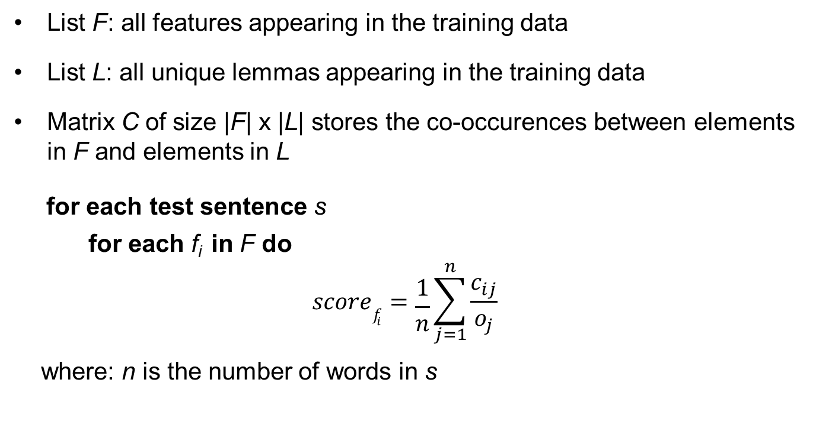
Method
List F: all features appearing in the training data
List L: all unique lemmas appearing in the training data
Matrix C of size |F| x |L| stores the co-occurences between elements in F and elements in L
for each test sentence s
for each f_{i} in F do
$$scoref_{i}=\frac{1}{n}\sum_{j=1}^{n}{\frac{c_{ij}}{o_{j}}}$$
where: n is the number of words in s

Slide 11
Method
Approach 1:
  Select all features that have a score that exceeds a learned threshold
  Disadvantage: for data sets with few implicit features too many will be selected
Approach 2:
  Use a classifier to determine the number of features
  Based on this number assign the top scoring features to the sentence
  Disadvantage: Difficult to predict the exact number of features (hard task)
Solution: use a simpler classifier

Slide 12
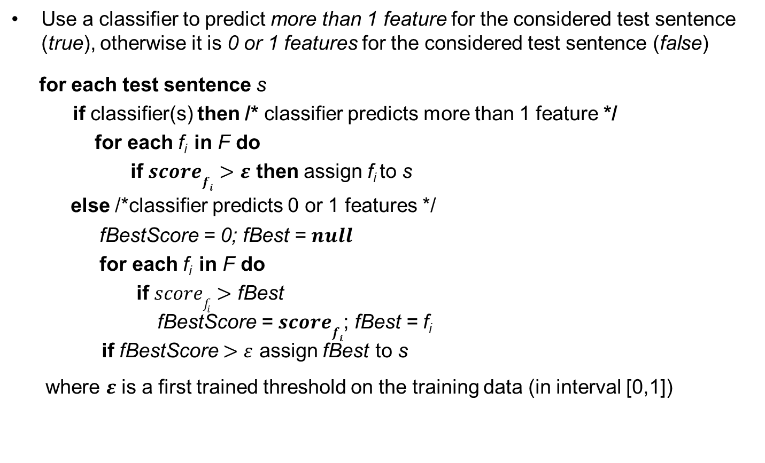
Method
Use a classifier to predict more than 1 feature for the considered test sentence (true), otherwise it is 0 or 1 features for the considered test sentence (false)
for each test sentence s
if classifier(s) then /* classifier predicts more than 1 feature */
for each f_{i} in F do
  if $scoref_{i}>ε$ then assign f_{i} to s
else /*classifier predicts 0 or 1 features */
fBestScore = 0; fBest = $null$
for each f_{i} in F do
  if $scoref_{i}>\text{fBest}$
  fBestScore = $scoref_{i}$; fBest = f_{i}
  if fBestScore $>ε$ assign fBest to s
where $ε$ is a first trained threshold on the training data (in interval [0,1])

Slide 13
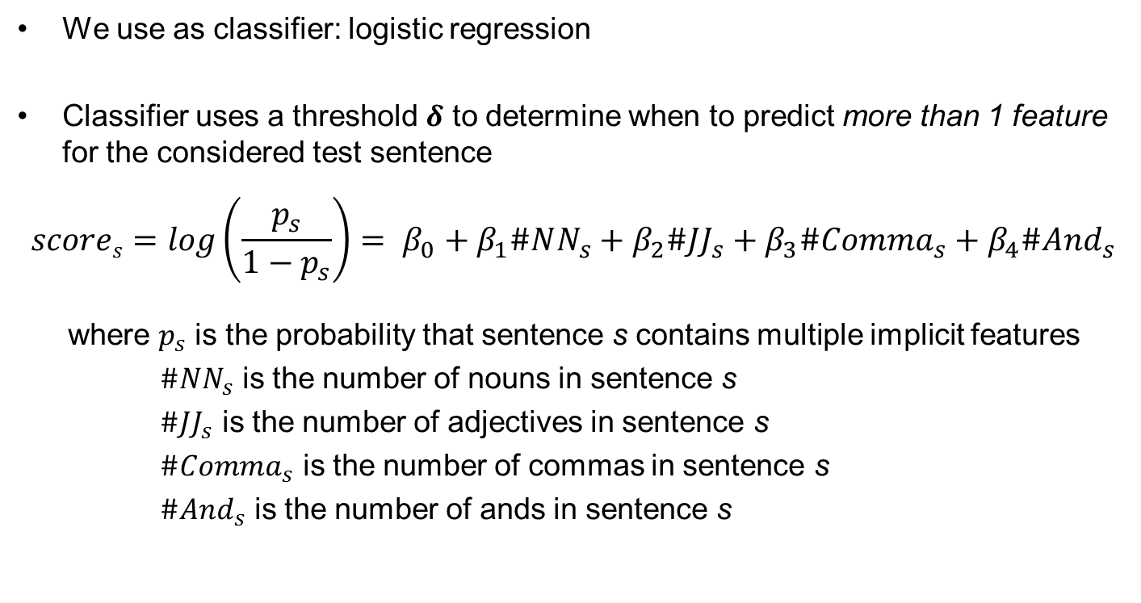
Method
We use as classifier: logistic regression
Classifier uses a threshold $δ$ to determine when to predict more than 1 feature for the considered test sentence
$$scores=log\left(\frac{p_{s}}{1−p_{s}}\right)= β_{0}+β_{1}\#NN_{s}+β_{2}\#JJ_{s}+β_{3}\#Comma_{s}+β_{4}\#And_{s}$$
where $p_{s}$ is the probability that sentence s contains multiple implicit features
$\#NN_{s}$ is the number of nouns in sentence s
$\#JJ_{s}$ is the number of adjectives in sentence s
$\#Comma_{s}$ is the number of commas in sentence s
$\#And_{s}$ is the number of ands in sentence s

Slide 14
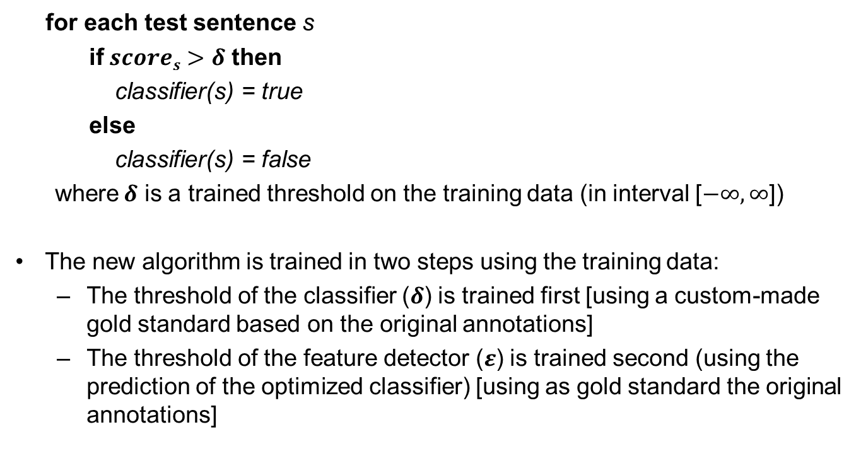
Method
for each test sentence s
if $scores>δ$ then
classifier(s) = true
else
classifier(s) = false
where$δ$ is a trained threshold on the training data (in interval [$−∞,∞$])
The new algorithm is trained in two steps using the training data:
  The threshold of the classifier ($δ$) is trained first [using a custom-made gold standard based on the original annotations]
  The threshold of the feature detector ($ε$) is trained second (using the prediction of the optimized classifier) [using as gold standard the original annotations]

Slide 15
Data
  Collection of restaurant reviews from SemEval 2014
Every review sentences is annotated with at least one of five implicit features:
  ‘food’
  ‘service
  ‘ambience’
  ‘price’
  ‘anecdotes/miscellaneous’
All 3,044 sentences contain at least one implicit feature
  The ‘anecdotes/miscellaneous’ carries little semantics so we remove it from the data set:
    We have only four implicit features
    Some sentences have now no implicit features (which fits well our setup)

Slide 16
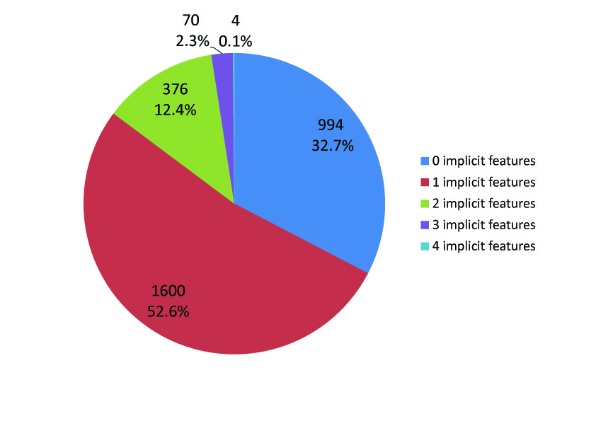
Data
Distribution of the number of implicit features contained per sentence
14.8% of the sentences contain more than one implicit feature
32.7% of the sentences contain no implicit feature
52.6% of the sentences contain one implicit feature (a small majority)

Slide 17
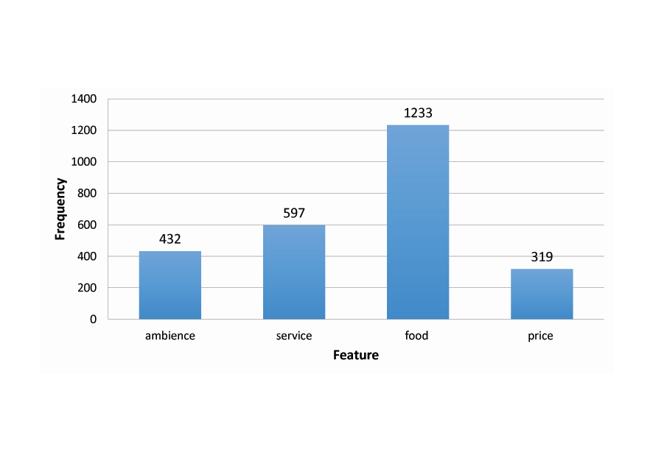
Data
‘food’ is the most frequent, followed by ‘service’ (half), then ‘ambience’ and then ‘price’
Frequencies of the four unique features

Slide 18
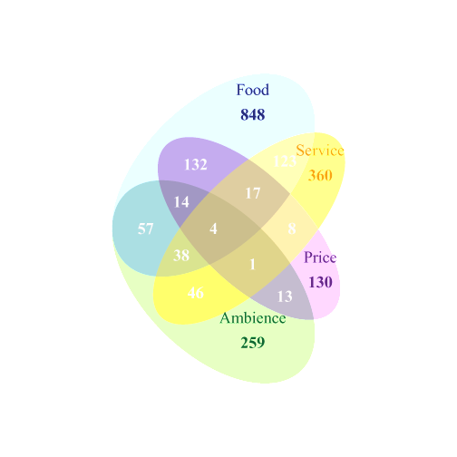
Data
Co-occurrence frequencies of the four unique features
More than 4% of the sentences refer to both ‘food’ and ‘price’, and almost the same percentage corresponds to ‘food’ and ‘service’ (most of the sentences contain only one implicit feature)

Slide 19
Evaluation
10-fold cross validation
Coefficients of logistic regression for the classifier (full data set)
All variables are significant for p-value < 0.01
We have also tried (but did not achieve statistical significance):
  Number of words in a sentence (some info already captured by #NN_{s} and #JJ_{s})
  Number of subjects in a sentence (the subject is often the product instead of a feature)
Predictor Variable | Coefficient | p-value
Constant | -3.019479 | 0.0000
#NN_{s} | 0.116899 | 0.0002
#JJ_{s} | 0.335530 | 0.0000
Comma_{s} | 0.216417 | 0.0004
And_{s} | 0.399415 | 0.0000

Slide 20
Evaluation
Specifications of 1000 logistic regressions on 90% subsamples
Constant excluded as it does not influence the results with a trained threshold
Variable | Mean | Median | Std. dev.
#NN_{s} | 0.117361 | 0.11768 | 0.011342
#JJ_{s} | 0.335538 | 0.33536 | 0.014345
Comma_{s} | 0.216409 | 0.21672 | 0.023185
And_{s} | 0.399507 | 0.39892 | 0.023409

Slide 21
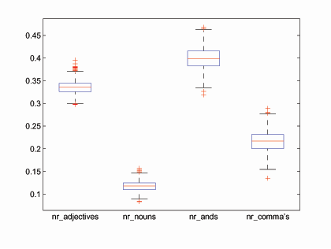
Evaluation
Box-plot of the coefficients of 1000 logistic regressions on 90% samples

Slide 22
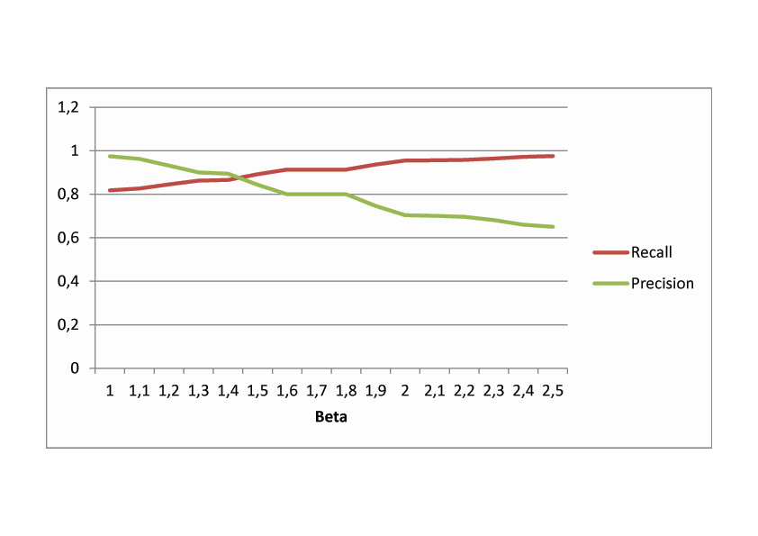
Evaluation
Classifier uses F_{β} where β = 1.8
Almost 2 times more importance given to recall than precision
Recall is more important than precision, as some of the low precision can be corrected by the feature detector
After β = 1.8 there is a sharp decrease in precision, while recall increases only a little bit
β

Slide 23
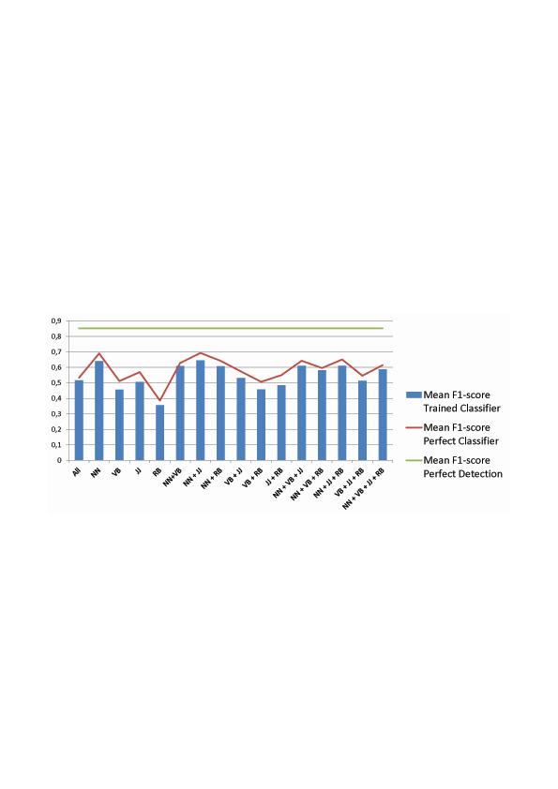
Evaluation
Mean F₁-scores with different part-of-speech filters
maximum possible percentage points improvement for the classifier is 1.6/(69.3-62.9) = 25%
error due to the feature detector
The old algorithm had an F₁ = 62.9%, the new one has an F₁ = 64.5%, hence an improvement of 1.6 percentage points
error due to classifier
85.2%
69.3%
64.5%
The best part-of-speech is NN+JJ (F₁ = 64.5%), but difference is very small compared to NN (F₁ = 64.1%)

Slide 24
Conclusion
Implicit feature detection
Two step approach:
  Classifier: classify sentences with more than 1 feature or not
  Feature detector: detect features per sentence
    Case 1: select all features that pass a threshold
    Case 2: select at most one feature, i.e., the best feature if it passes the threshold
Classifier uses features as:
  Number of nouns in a sentence
  Number of adjectives in a sentence
  Numbers of commas in a sentence
  Number of ands in a sentence

Slide 25
Conclusion
Future work:
  Use of more advanced classifiers as Support Vector Machines or Random Forests
  Learn the number of implicit features per sentence (a more advanced form of our current classifier)
  Improve the feature detector using a multi-label classifier for a sentence (a more advanced form of our current rule-based feature detector)
  Computing the sentiment associated to:
    Explicit features
    Implicit features
    (determining the scope of features and weighting sentiment words in relation to features)

