Slide 1



Linguistic Graph Similarity
for News Sentence Searching
Kim Schouten & Flavius Frasincar
schouten@ese.eur.nl frasincar@ese.eur.nl
Web News Sentence Searching Using Linguistic Graph Similarity, Kim Schouten and Flavius Frasincar. In Proceedings of the 12th International Baltic Conference on Databases and Information Systems (DB&IS 2016), pages 319-333, Springer, 2016

Slide 2
Problem
Most text search methods are word-based
Often, the context is lost for the sake of simplicity
However, the meaning of a word is defined by both word and context
How can we include context information of words into the search algorithm?
Can we not search by sentence instead of words, and retrieve sentences with similar meaning?

Slide 3
Graph-based Approach
Grammatically parsing a sentence yields a graph
Words are the nodes
Grammatical relations between words are the edges
Set of relations of a word can then be used as context
NLP pipeline transforms both query and news sentences into graphs

Slide 4
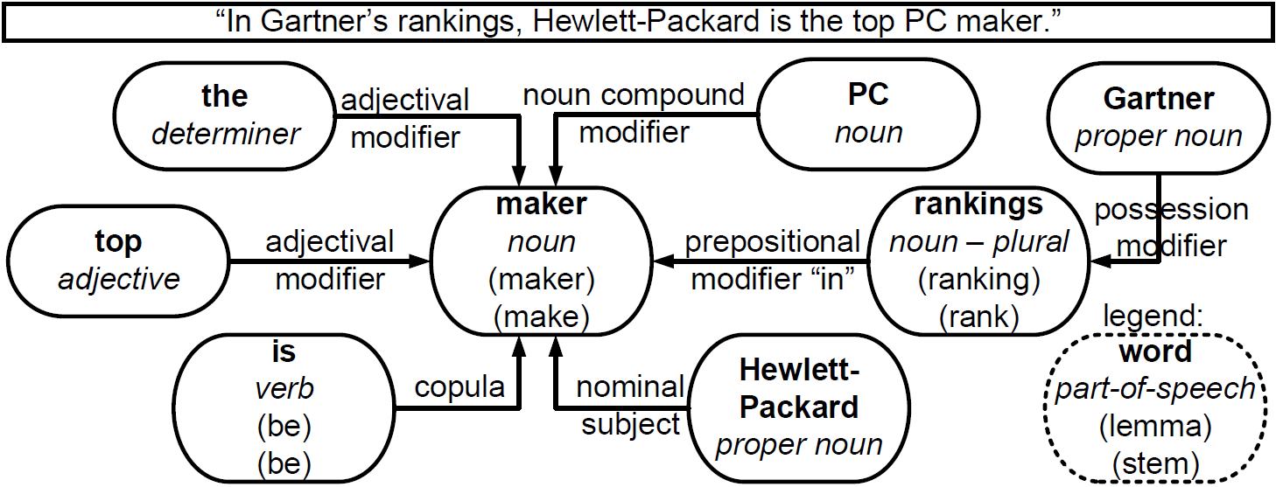
Graph representation of sentence

Slide 5
Graph comparison
Problem is similar to graph isomorphism
But partial similarity makes it much harder
Nodes may be missing on either side
Nodes may be only partially similar (pc <> workstation)
Relation labels may be different for similar nodes
Hence, output is not binary but a real-valued similarity score

Slide 6
Graph comparison
Nodes are compared on:
Basic and full part-of-speech (POS) label
Stem, lemma, and fully inflected word
If POS is the same, but word is not then check for:
Synonymy
Hypernymy (1 / steps in hypernym tree)
Correct for word frequency

Slide 7
Graph comparison
We can recursively go through both graphs
Compare nodes and edges to assign score
However, a starting position within both graphs is needed:
Using all possibilities is inefficient
Always starting at root is inaccurate
Use index of stemmed words (nouns/verbs)
Only the best scoring starting position is kept

Slide 8
Search algorithm

Slide 9
Search algorithm

Slide 10
Search algorithm

Slide 11
Search algorithm

Slide 12
Search algorithm

Slide 13
Search algorithm

Slide 14
Search algorithm

Slide 15
Data set
A set of ~1000 sentences
Extracted from news items
News items are on roughly the same topic
10 sentences are designated as queries
Three human annotators annotated the similarity between each of the queries and each of the news sentences
Similarity score of 0,1,2, or 3
Inter-annotator agreement: 0.1721 std.dev. in score

Slide 16
Score optimization
Each comparison of two nodes or two edges contributes to total similarity score
The exact score that each feature can yield is optimized using genetic optimization
5 queries and related data are used for training
Other 5 queries and related data are used for testing
This is repeated 32 times, with different splits
For each query a ranked list of sentences is produced according to similarity

Slide 17
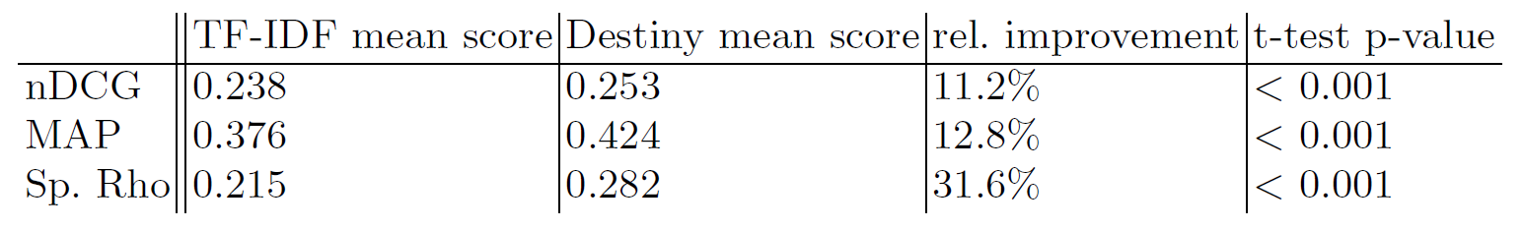
Performance
Results are averages over all 32 splits
t-statistics are computed over the 32 results for each metric

Slide 18
Conclusions
Our proposed method has several improvements over traditional text searching:
By representing text as a graph, the original semantics are preserved, which can be used to leverage search results
Words are not only compared lexically, but also semantically, by looking for synonyms and hypernyms

Slide 19
Thank you for your attention!
?
Questions?

Slide 20
Backup slides

Slide 21
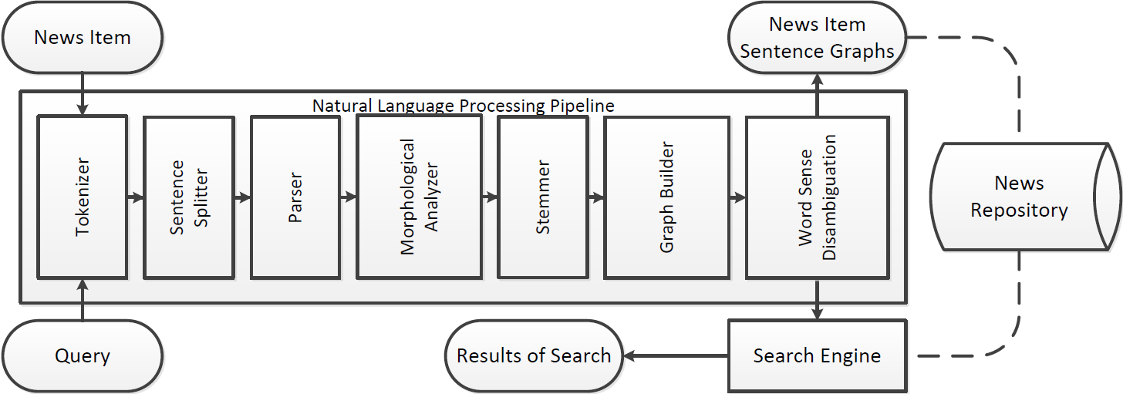
Pipeline

Slide 22
Evaluating ranked lists
Three metrics: MAP, Spearman’s Rho, and nDCG
MAP measures to what extent the top of the ranking contains only similar/relevant items
MAP assumes binary similarity
System outputs real-valued similarity scores
Converted to binary using cut-off value(s)
Cut-off values from 0 to 3 with stepsize 0.1
Reported MAP score is average of these

Slide 23
Evaluating ranked lists
Spearman’s Rho measures correlation of whole list
Only top part of results is used in practice
nDCG measures whether the most similar items are in the top of the ranking
Every result contributes its similarity value to final score, discounted by position in ranking
Most appropriate
Focuses on top part of the ranking
Uses real-valued similarity values

Slide 24
Scalable?
Linear in the number of sentences
Graph comparison is a large ‘constant’ factor
Depends on:
# nodes in query
# edges in query
Average # nodes in sentences
Average # edges in sentences

Slide 25
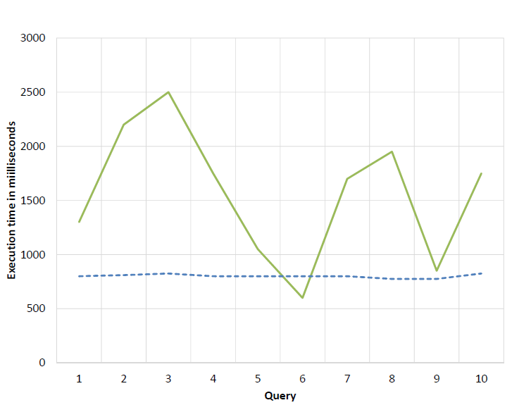
Performance
TF-IDF is on average twice as fast

Slide 26
Open Issues
More intelligent way to find start positions
Co-reference resolution
Non-literal expressions
Mitigate problems with varying graph sizes
“Microsoft is expanding its online corporate offerings to include a full version of Office”
“Microsoft includes Office into its online corporate offerings”

