Slide 1





Learning Semantic Information Extraction Rules from News
 | Frederik Hogenboom fhogenboom@ese.eur.nl
Erasmus University Rotterdam PO Box 1738, NL-3000 DR Rotterdam, the Netherlands In collaboration with: Flavius Frasincar and Wouter IJntema

Slide 2
Introduction (1)
Increasing amount of (digital) data
Problem: utilizing extracted information in decision making processes becomes increasingly urgent and difficult:
  Too much data for manual extraction
  Yet most data is initially unstructured
  Data often contains natural language
Solution: automatically process and interpret information, yet automation is a non-trivial task

Slide 3
Introduction (2)
Information Extraction (IE)
  Multiple sources:
    News messages
    Blogs
    Papers
    …
  Text Mining (TM):
    Natural Language Processing (NLP)
    Statistics
    …
  Specific type of information that can be extracted: events

Slide 4
Events (1)
Steve Jobs resigns from Apple, Cook becomes CEO
(Reuters) - On Wednesday, Silicon Valley legend Steve Jobs resigned as chief executive of Apple Inc in a stunning move that ended his 14-year reign at the technology giant he co-founded in a garage.
Apple shares dived as much as 7 percent in after-hours trade after the pancreatic cancer survivor and industry icon, who has been on medical leave for an undisclosed condition since January 17, announced he will be replaced by COO and longtime heir apparent Tim Cook.

Slide 5
Events (1)
Steve Jobs resigns from Apple, Cook becomes CEO
(Reuters) - On Wednesday, Silicon Valley legend Steve Jobs resigned as chief executive of Apple Inc in a stunning move that ended his 14-year reign at the technology giant he co-founded in a garage.
Apple shares dived as much as 7 percent in after-hours trade after the pancreatic cancer survivor and industry icon, who has been on medical leave for an undisclosed condition since January 17, announced he will be replaced by COO and longtime heir apparent Tim Cook.
Apple stock price falls on news of Steve Jobs's death
(The Guardian) - Apple's stock price has risen more than 9,000% since Steve Jobs returned in 1997, and doubled in the past two years
News of Steve Jobs's death drove the Apple share price down more than 5% in Frankfurt on Thursday morning.
Apple shares are now trading 3.5% lower at €273, after hitting a low of €270 in Frankfurt. The shares are not traded in London. They are expected to open lower when Wall Street opens at 2.30pm London time.
Apple was briefly the most valuable company in the world in the summer, knocking oil giant Exxon Mobil off the top spot. Revenues have soared from $7.1bn (£4.6bn) in 1997 to $65.2bn a year now.

Slide 6
Events (1)
Steve Jobs resigns from Apple, Cook becomes CEO
(Reuters) - On Wednesday, Silicon Valley legend Steve Jobs resigned as chief executive of Apple Inc in a stunning move that ended his 14-year reign at the technology giant he co-founded in a garage.
Apple shares dived as much as 7 percent in after-hours trade after the pancreatic cancer survivor and industry icon, who has been on medical leave for an undisclosed condition since January 17, announced he will be replaced by COO and longtime heir apparent Tim Cook.
Apple stock price falls on news of Steve Jobs's death
(The Guardian) - Apple's stock price has risen more than 9,000% since Steve Jobs returned in 1997, and doubled in the past two years
News of Steve Jobs's death drove the Apple share price down more than 5% in Frankfurt on Thursday morning.
Apple shares are now trading 3.5% lower at €273, after hitting a low of €270 in Frankfurt. The shares are not traded in London. They are expected to open lower when Wall Street opens at 2.30pm London time.
Apple was briefly the most valuable company in the world in the summer, knocking oil giant Exxon Mobil off the top spot. Revenues have soared from $7.1bn (£4.6bn) in 1997 to $65.2bn a year now.
Google buys Motorola Mobility for $12.5B
(VentureBeat) - This morning, Google announced that it will buy Motorola Mobility — Moto’s mobile device arm — for $12.5 billion. Google will acquire Motorola Mobility for $40 per share in cash, a 63 percent premium over the company’s Friday closing price. Google says it will run Motorola Mobility as a separate business. Motorola spun off its business into two divisions last year, Mobility and Solutions (the data and telecom portion), as a response to declining profits.
Google shares were down around 1.5 percent, while Motorola Mobility’s stock jumped 57 percent. The company says Motorola Android phones won’t be receiving any special treatment as a consequence of the deal — but that’s a tough nut to swallow, since Google often plays favorites.

Slide 7
Events (2)
Event:
  Complex combination of relations linked to a set of empirical observations from texts
  Can be defined as:
    <subject> <predicate> e.g., <Person> <Resigns>
    <subject> <predicate> <object> e.g., <Company> <Buys> <Company>
Event extraction could be beneficial to IE systems:
  Personalized news
  Risk analysis
  Monitoring
  Decision making support

Slide 8
Events (3)
Common event domains:
  Medical
  Finance
  Politics
  Environment

Slide 9
Event Extraction
In analogy with the classic distinction within the field of modeling, we distinguish 3 main approaches:
  Data-driven event extraction:
    Statistics
    Machine learning
    Linear algebra
    …
  Expert knowledge-driven event extraction:
    Representation & exploitation of expert knowledge
    Patterns
  Hybrid event extraction:
    Combine knowledge and data-driven methods
Our focus: expert knowledge-driven event extraction through the usage of pattern languages

Slide 10
Existing Approaches
Various pattern-languages for:
  News processing frameworks (e.g., PlanetOnto)
  General purpose frameworks (e.g., CAFETIERE, KIM, etc.)
Language types:
  Lexico-syntactic
  Lexico-semantic
However:
  Limited syntax
  Weak semantics
  Cumbersome in use
  Extract entities, but not events

Slide 11
Semantics
Semantic Web:
  Collection of technologies that express content meta-data
  Offers means to help machines understand human-created data on the Web
Ontologies:
  Can be used to store domain-specific knowledge in the form of concepts (classes + instances)
  Also contain inter-concept relations

Slide 12
Pattern Language (1)
Basic syntax:
  LHS :- RHS
  LHS: subject, predicate, object (optional)
  RHS: pattern in which subject and object are assigned:
    Literals (text strings)
    Lexical categories (nouns, prepositions, verbs, etc.)
    Orthographic categories (capitalization)
    Labels (assigning subject and object)
    Logical operators (and, or, not)
    Repetition (≥0, ≥1, 0-1, {min,max})
    Wildcards (skip ≥0 or exactly 1 word)
    Ontological concepts

Slide 13
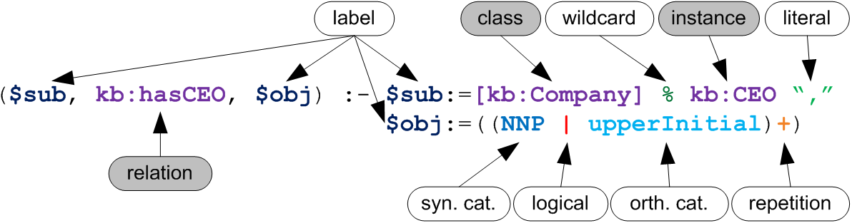
Pattern Language (2)
Example:

Slide 14
Rule Creation
Groups of rules extract specific events
Creating such groups is cumbersome, error-prone and time-consuming
If the language is implemented using tree structures, a genetic programming approach can be employed for learning rules automatically

Slide 15
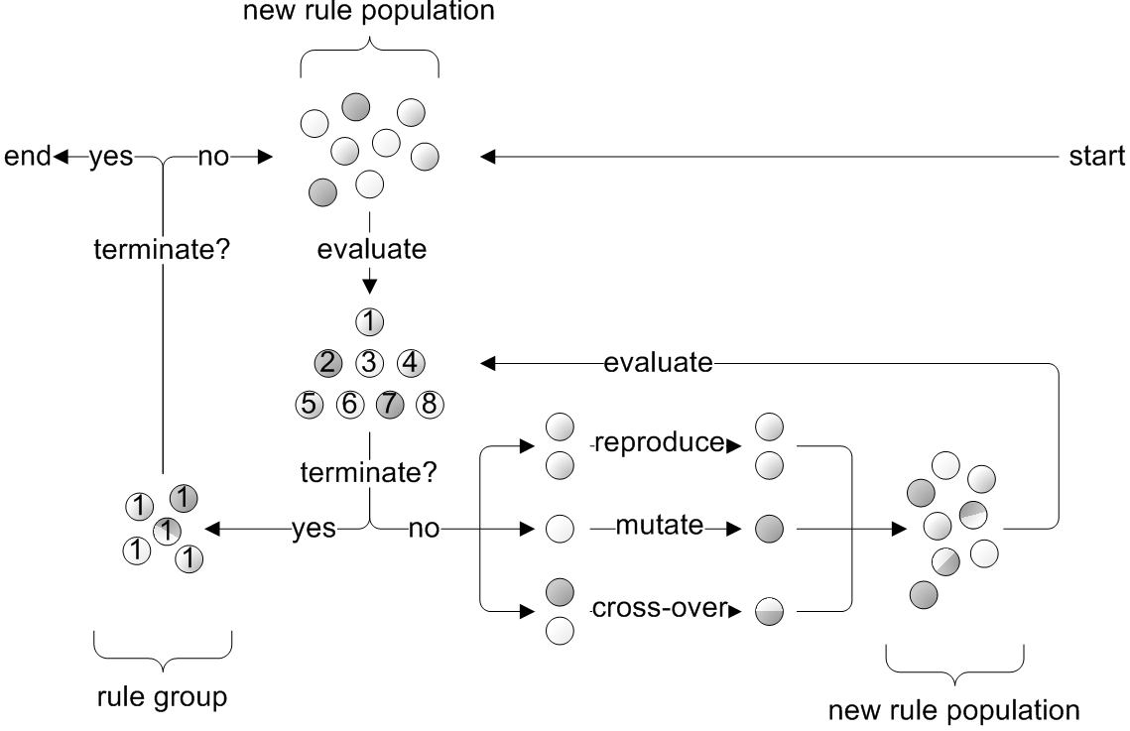
Rule Learning

Slide 16
Implementation
The Hermes News Portal (HNP) is a stand-alone Java-based news personalization tool
We have implemented the Hermes Information Extraction Engine (HIEE) within the HNP
Pipeline-architecture is based on GATE components

Slide 17
Evaluation (1)
We compare the performance of rule learning versus manually creating rules:
  Using a data set on economic events (500 news messages):
    CEO • Profit • President
    Product • Loss • Revenue
    Shares • Partner
    Competitor • Subsidiary
  By allowing for 5 hours of construction time per rule group (including reading, thinking, writing, …)
  Based on the Precision, Recall, and F₁-measure

Slide 18
Evaluation (2)
 | Automatic Learning |  |  |  | Manual Creation
Name | Precision | Recall | F₁ |  | Precision | Recall | F₁ | Δ%
Competitor | 0.667 | 0.508 | 0.577 |  | 0.875 | 0.280 | 0.424 | 36.0%
Loss | 0.905 | 0.613 | 0.731 |  | 0.818 | 0.333 | 0.474 | 54.3%
Partner | 0.808 | 0.356 | 0.494 |  | 0.450 | 0.391 | 0.419 | 18.0%
Subsidiary | 0.698 | 0.309 | 0.429 |  | 0.611 | 0.239 | 0.344 | 24.8%
CEO | 0.904 | 0.904 | 0.904 |  | 0.824 | 0.700 | 0.757 | 19.5%
President | 0.821 | 0.793 | 0.807 |  | 0.833 | 0.455 | 0.588 | 37.2%
Product | 0.788 | 0.793 | 0.791 |  | 0.862 | 0.596 | 0.704 | 12.3%
Profit | 0.960 | 0.522 | 0.676 |  | 1.000 | 0.273 | 0.429 | 57.7%
Sales | 0.900 | 0.450 | 0.600 |  | 0.455 | 0.455 | 0.455 | 32.0%
ShareValue | 0.939 | 0.805 | 0.867 |  | 0.530 | 0.778 | 0.631 | 37.5%
Total | 0.839 | 0.605 | 0.703 |  | 0.726 | 0.450 | 0.555 | 26.6%

Slide 19
Conclusions
We presented HIEL, a lexico-semantic rule language for event extraction
Rule creation is cumbersome, and hence a genetic programming-based learning approach is proposed
Lexico-semantic rule learning performs better than the manual alternative in terms of precision, recall, and F₁
Future work:
  Evaluate approach for existing lexico-semantic languages
  Evaluate on other domains
  Link events to trading algorithms instead of news personalization

Slide 20
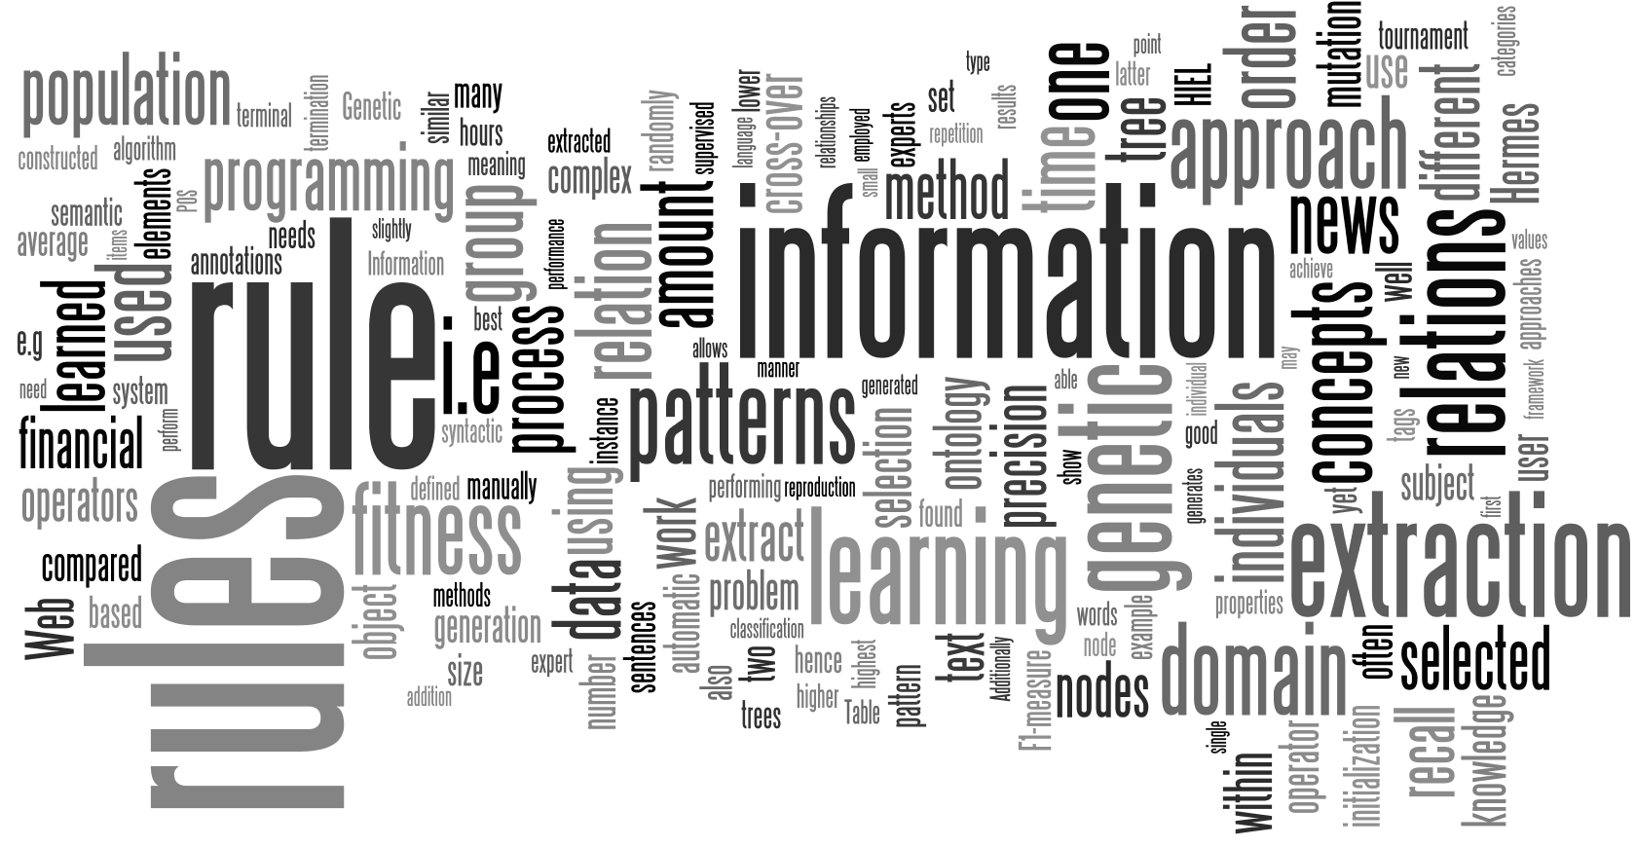
Questions

