Slide 1
Polarity Analysis of Texts using
Discourse Structure
Bas Heerschop Erasmus University Rotterdam basheerschop@gmail.com | Frank Goossen Erasmus University Rotterdam frank.goossen@xs4all.nl
Flavius Frasincar Erasmus University Rotterdam frasincar@ese.eur.nl | Uzay Kaymak Eindhoven University of Technology u.kaymak@ieee.org | Franciska de Jong Universiteit Twente f.m.g.dejong@utwente.nl
Alexander Hogenboom
Erasmus University Rotterdam
hogenboom@ese.eur.nl

Slide 2
Outline
Introduction
Sentiment Analysis
Exploiting Structural Aspects of Text
Framework
Evaluation
Conclusions
Future Work

Slide 3


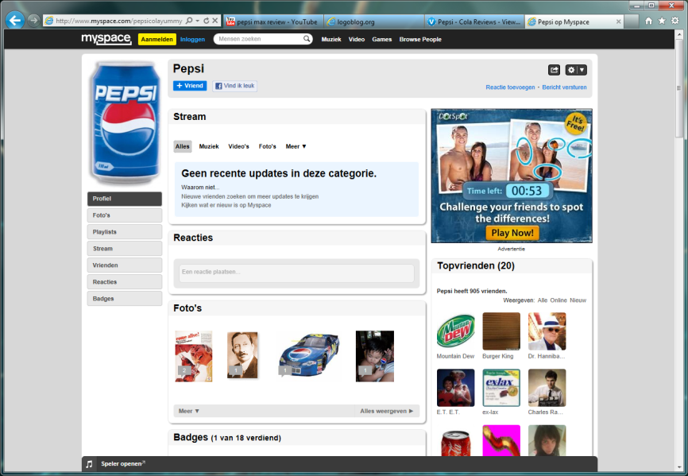

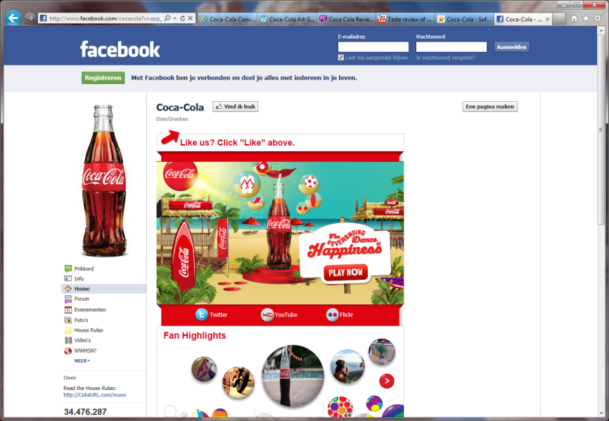
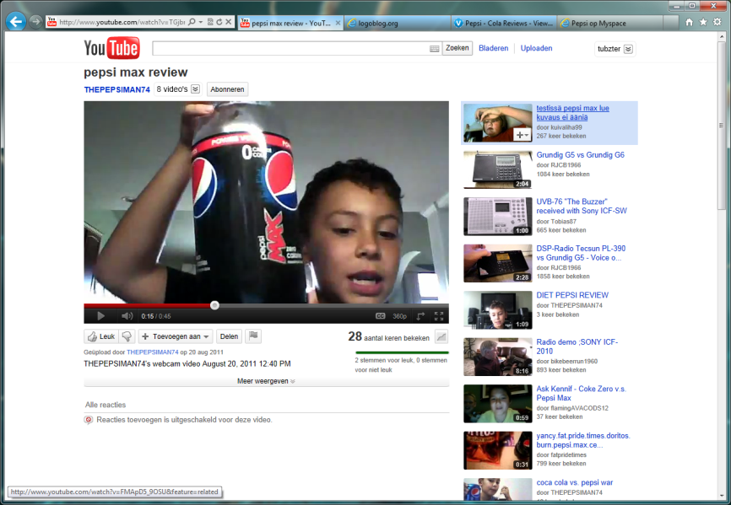
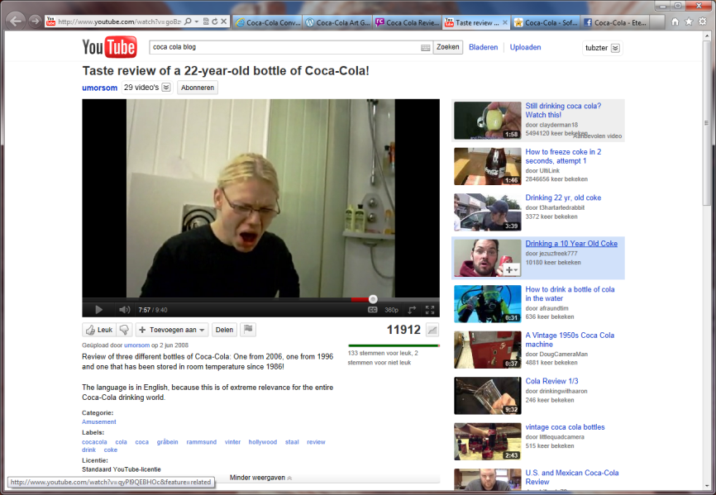
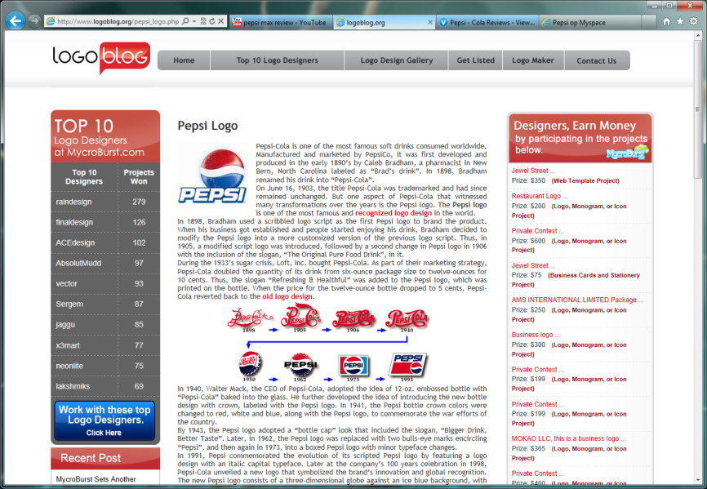
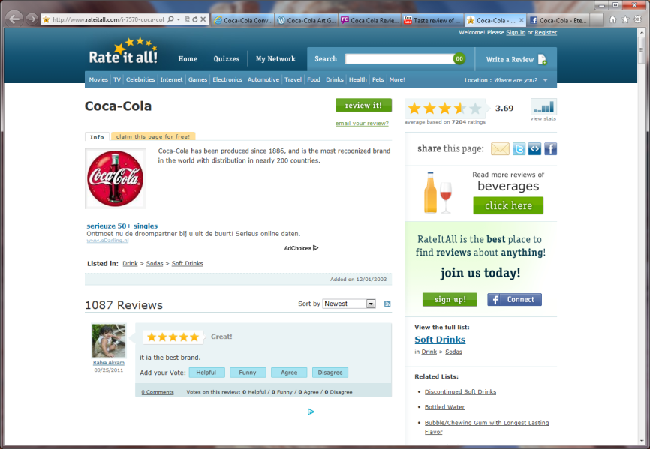

Introduction (1)
Need for information monitoring tools for tracking sentiment in today’s complex systems
The Web offers an overwhelming amount of textual data, containing traces of sentiment

Slide 4
Introduction (2)
An intuitive approach to sentiment analysis involves scanning a text for cues signaling its polarity
Let us consider the following negative review:
  Example: Although Brad Pitt’s well-deserved fall off a cliff
  was quite entertaining, this movie was terrible!
How can structural aspects of natural language text be exploited when determining its polarity?
Although Brad Pitt’s well-deserved fall off a cliff was quite entertaining,

Slide 5
Sentiment Analysis
5
Sentiment analysis is typically focused on determining the polarity of natural language text
Applications in summarizing reviews, determining a general mood (consumer confidence, politics)
State-of-the-art approaches classify polarity of natural language text by analyzing vector representations using, e.g., machine learning techniques
Alternative approaches are lexicon-based, which renders them robust across domains and texts and enables linguistic analysis at a deeper level
Notes:
5

Slide 6
Exploiting Structural Aspects of Text (1)
6
Early approaches involve accounting for segments’ positions in a text or their semantic cohesion
Recent work exploits discursive relations by applying the Rhetorical Structure Theory (RST)
RST can be used to split a text into a hierarchical structure of rhetorically related segments
Nucleus segments form the core of a text, whereas satellites support the nuclei
Many types of relations between segments exist, e.g., background, elaboration, explanation, contrast, etc.
Notes:
6

Slide 7
Exploiting Structural Aspects of Text (2)
7
1-2
Contrast
Although Brad Pitt’s well-deserved fall off a cliff was quite entertaining,
this movie was terrible!
Existing work differentiates between important and less important segments w.r.t. the overall sentiment
Previously proposed method assigns different weights to nuclei and satellites
We propose to differentiate among rhetorical roles, i.e., RST relation types
Notes:
7

Slide 8
Framework (1)
8
Lexicon-based document-level polarity classification
Based on its lemma, Part-of-Speech (POS), and disambiguated word sense (Lesk-based), each individual word is scored in the range [-1,1] by using sentiment scores from SentiWordNet 3.0
Word scores are aggregated and corrected for a bias towards positivity in order to classify text as positive (corrected score ≥ 0) or negative (corrected score < 0)
Discourse parsing is applied in order to determine appropriate weights for word scores in this process
Notes:
8

Slide 9
Framework (2)
9
Simple discourse parsing: weights proportional to position of words in full text
Sentence-level PArsing of DiscoursE (SPADE):
  SPADE I:
    Assign top-level RST nuclei weights of 1
    Assign top-level RST satellites weights of 0
  SPADE II:
    Assign top-level RST nuclei weights of 1.5
    Assign top-level RST satellites weights of 0.5
  SPADE X:
    Our novel, extended SPADE-based approach
    Assign top-level RST nuclei and satellite types different weights in the range [-2, 2], optimized by means of a genetic algorithm
Notes:
9

Slide 10
Evaluation (1)
10
Implementation in Java, OpenNLP POS tagger, Java WordNet Library (JWNL) API for lemmatization, SentiWordNet 3.0 sentiment lexicon
Corpus of 500 positive and 500 negative manually classified English movie reviews (60% training set, 40% test set)
Baselines:
  All words assigned weight of 1
  Simple discourse parsing (position-based)
  SPADE I
  SPADE II
Notes:
10

Slide 11
Evaluation (2)
11
Alternative: SPADE X
Optimized weight for nuclei equals 0.771
Most significant RST relation weights:
  Elaboration: 1.400
  Enablement: 0.956
  Attribution: 0.451
  Contrast: - 0.660
Notes:
11

Slide 12
Evaluation (3)
12
 | Positive |  |  | Negative |  |  | Overall
Method | Prec. | Rec. | F1 | Prec. | Rec. | F1 | Acc. | F1
Baseline | .687 | .690 | .688 | .688 | .685 | .687 | .688 | .687
Simple | .647 | .660 | .654 | .653 | .640 | .647 | .650 | .650
SPADE I | .668 | .695 | .681 | .682 | .655 | .668 | .675 | .675
SPADE II | .683 | .690 | .687 | .687 | .680 | .683 | .685 | .685
SPADE X | .732 | .695 | .713 | .710 | .745 | .727 | .720 | .720
Notes:
12

Slide 13
Conclusions
Recent sentiment analysis methods consider more and more aspects of content other than word frequencies
We identify important and less important text segments and weight them accordingly when analyzing sentiment
Both nuclei and satellites appear to play an important role in conveying sentiment, whereas satellites have until now been deemed predominantly irrelevant
Significantly improved overall polarity classification accuracy and macro-level F1 w.r.t. not accounting for structural aspects of content comes at a cost of increased processing times

Slide 14
Future Work
Explore other (faster) methods of identifying discourse structure in natural language text
Perform document-level analysis of structure rather than sentence-level analysis
Account for not only the type but also the position of text segments in a discourse (RST) tree
Evaluate our findings on different corpora
Investigate our findings’ applicability to vector-based machine learning approaches to sentiment analysis

Slide 15
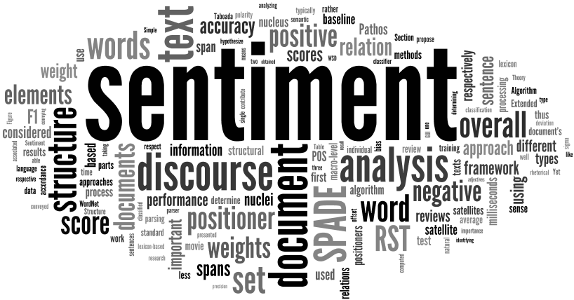
Questions?
  Alexander Hogenboom
  Erasmus School of Economics
  Erasmus University Rotterdam
  P.O. Box 1738, NL-3000 DR
  Rotterdam, the Netherlands
  hogenboom@ese.eur.nl

