Slide 1
Enhancing Semantics-Driven Recommender Systems with Visual Features
Mounir M. Bendouch¹, Flavius Frasincar¹ and Tarmo Robal²
¹Erasmus University Rotterdam, The Netherlands
²Tallinn University of Technology, Estonia
tarmo.robal@taltech.ee

Slide 2
Agenda
Recommender systems
Semantics-driven recommenders
Enhancing semantics-driven recommender systems
Research data
Feature extraction
Domain ontology
Similarity model
Experiments

Slide 3
Introduction
Information overload
Need for automated and accurate approach in Web to distinguish relevant and non-relevant
Recommender systems (RS) help users to plough through a massive and increasing amount of information
Products, news, movies, music, …
Automatically find relevant content based on: user preferences, profiles, behaviour

Slide 4
Recommender systems (RS)
Recommender Systems (RS) are software tools and techniques providing suggestions for items to be of use to a user [Ricci et al.]
Recommender systems (RS):
Collaborative filtering
Content-based
Vary in features exploited and used for similarity calculations
Machines do not understand the content
Are often term-based
Common measure: Term Frequency – Inverse Document Frequency (TF-IDF) as proposed by [Salton and Buckley, 1988]
Hybrid

Slide 5

Connected paper
Addressing Scalability Issues in Semantics-Driven Recommender Systems
Mounir M. Bendouch, Flavius Frasincar and Tarmo Robal
WI-IAT 2021: The 20th IEEE/WIC/ACM International Conference on Web Intelligence and Intelligent Agent Technology, December 14-17, 2021, Melbourne, Australia
DOI: https://doi.org/10.1145/3486622.3493963

Slide 6
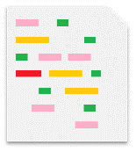


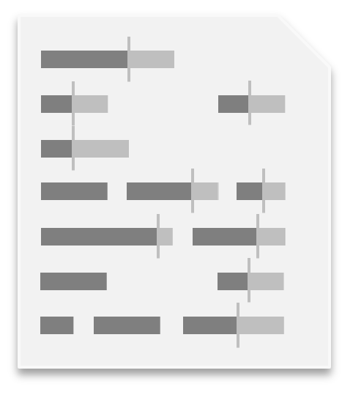
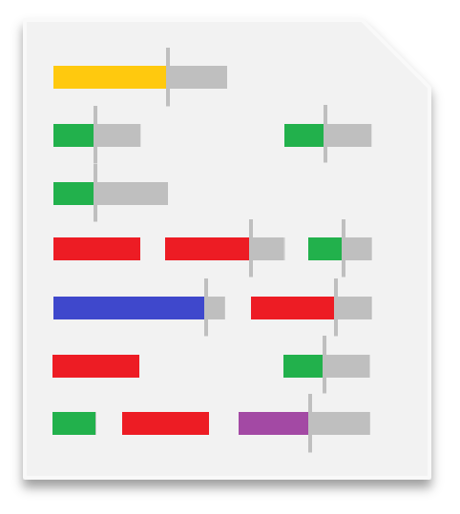
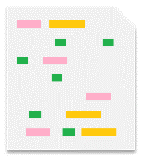

TF-IDF
Pre-processed documents (stop words removal and stemming)
For each term, it takes into consideration:
The importance in a single document
The inverse of the general importance within a set of documents
IMPORTANT TERMS: red, purple, and blue
Irrelevant terms: yellow, green, and pink

Slide 7
TF-IDF
Term Frequency (TF): the occurrence of a term t_{i} in a document d_{j}∈D:
Inverse Document Frequency: the occurrence of a term t_{i} in a set of documents D:
TF-IDF:
Users’ interests translated into vectors TF-IDF weights
Weights computed for every term within a document

Slide 8
TF-IDF and Semantics-driven recommenders
Several RS build upon TF-IDF in the news recommendation domain:
Concept Frequency – Inverse Document Frequency (CF-IDF)
Concepts from domain ontologies (CF-IDF)
Concepts and related concepts from domain ontologies (CF-IDF+)
Synset Frequency – Inverse Document Frequency (SF-IDF)
Terms, Synonyms from semantic lexicon (SF-IDF)
Synsets and their 27 semantic relationship types (SF-IDF+)
Extended with similarity between named entities on the Web (Bing-SF-IDF+)
Combined with domain concepts (Bing-CSF-IDF+)

Slide 9

TF-IDF and Semantics-driven recommenders
Successful for News recommendations
Semantic lexicon
SF-IDF
extend
SF-IDF+
extend
Bing-SF-IDF+
build on
Synsets
Synsets
+ Relationships
TF-IDF
(27 weights)
combines
Terms
Bing-CSF-IDF+
build on
CF-IDF
extend
CF-IDF+
combines
Concepts
Concepts
+ Relationships
(3 weights)
DOMAIN ONTOLOGY

Slide 10
Semantics-driven recommenders
Good results obtained with SF/CF-IDF(+), Bing-(C)SF-IDF+ for news article recommendation
Features from news article text
Suitable for predicting similarity of any two texts
How about large-scale recommendations?
Semantic features from information of different nature?
Can these methods be extended?

Slide 11
Semantics-driven recommenders
News recommendation
Movie recommendation
Small-scale domain
Text-only content for semantics-driven RS
Large-scale domain
Semantic features from various item descriptions
Features captured also from images
Devision of a domain ontology
Movies + User ratings available

Slide 12
Semantics-driven recommenders
A picture may be worth more than a thousand words!

Slide 13
RQs
Whether and how can semantics-driven recommenders be applied to a large-scale recommendation problem?
How to extract features from information of different nature?
How to extract and apply semantic features from digital images for recommendations?
Do features from digital images contribute to recommendations made?

Slide 14
Research data
User ratings from MovieLens 20M dataset
20,000,000 user ratings (5-star) from 138,493 users
27,278 movies
10+ year period
Item level information
Title, year, genre labels, IMDB ID from MovieLens
Plots, Persons, genres from OMDb
Genres from both MovieLens and OMDb kept
Movie posters from TMDb
Movies without at least one director, actor, writer, genre and plot are disregarded
Final dataset: 25,138 movies

Slide 15
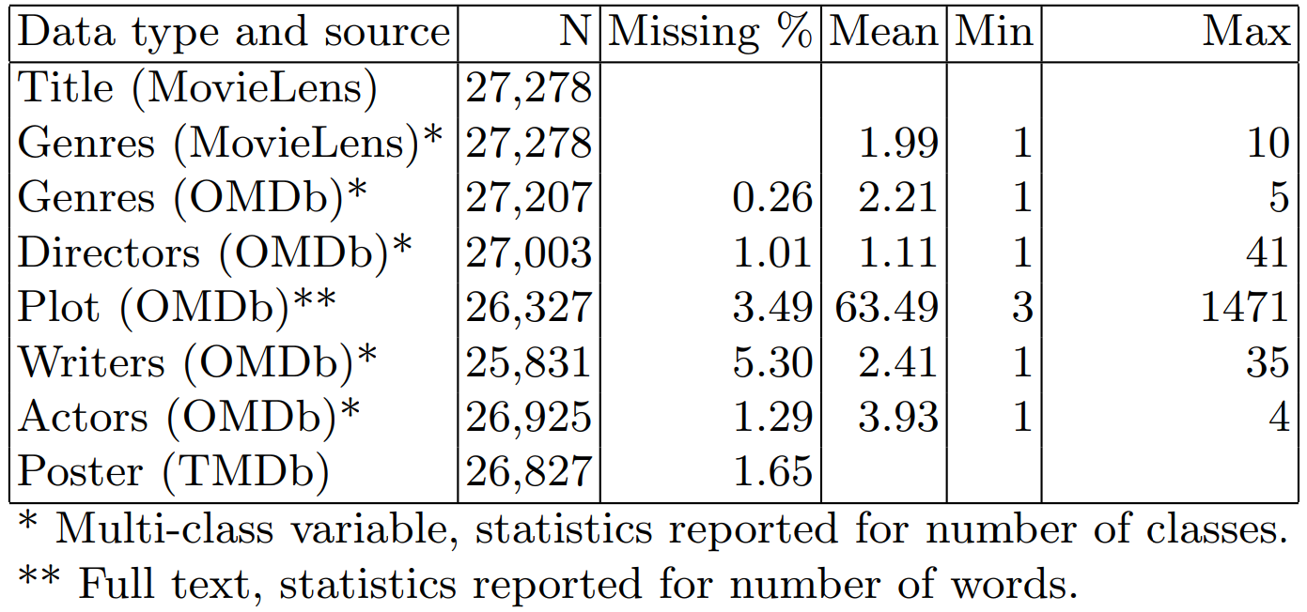
Research data
Final dataset: 25,138 movies

Slide 16
Feature extraction from textual information
Semantic information extracted from movie data as terms, concepts and synsets
Some concepts readily available: Director, Writer, Actor, Genres
Their relationships used for ontology construction
Terms and synsets extracted from movie plots
NLP + POS + Porter stemming
Adapted Lesk WSD to extract synsets

Slide 17

Feature extraction from textual information
Directors: John Lasseter
Actors: Tom Hanks, Tim Allen, Don Rickles, …
Writers: Andrew Stanton, Joe Ranft, …
Genres (ML): Animation, Adventure, Family, Comedy
Genres (OMDb): Adventure, Computer Animation, Comedy
Terms: boy, toys, doll, birthday, …
Synsets
WSD
Source: OMDb
A little boy named Andy loves to be in his room, playing with his toys, especially his doll named Woody. But, what do the toys do when Andy is not with them, they come to life. …
Splitting
TERMS
Semantic Lexicon
Tokenization
POS
Plot: 146 words
Porter Stemming
SYNSETS
Related SYNSETS

Slide 18
Feature extraction from graphical information
Posters made to advertise movies
Typically show characters and the setting
Contain fewer irrelevant elements than plots
Images represented as 3 × h × w matrixes
RGB images
PNG format
CNN and computer vision used to extract
A vector of synset probabilities (VGG19)
A vector of visual-semantic embedding (VSE)
„toys“
„cowboy“
„astronaut“
Source: OMDb

Slide 19
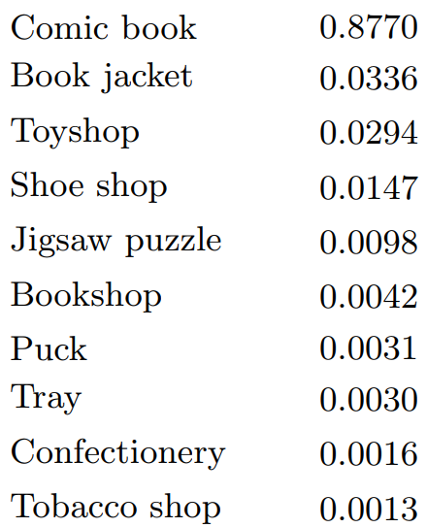
Feature extraction from graphical information
VGG19 – image categorisation
Publicly trained model used
Input 224 × 224 px
Posters scaled down and an overlapping window applied
Pre-trained VGG19 on ImageNet Challenge via transfer learning
Output: feature vector of 1,000 synset values
VSE – image captioning
Pre-trained matrix used on VGG19 visual feature vectors for posters’ visual-semantic embeddings
Publicly available 1,024 dim. VSE matrix
Trained on pairwise ranking loss
cos for poster similarity

Slide 20
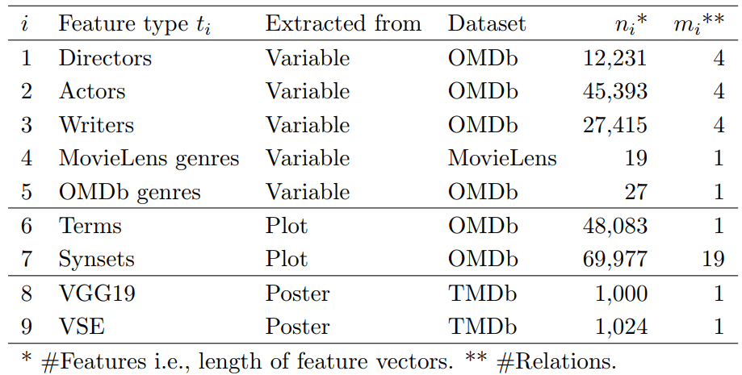
Feature extraction

Slide 21
Domain ontology
Usually external, manually constructed
Alternative general method to external domain ontologies
Solely based on dataset
Through series of matrix multiplications of binary matrices
12,231 Directors
45,393 Actors
292,857
bi-directional
movie-concept relations
25,138 Movies
27,415 Writers
19 Genres (ML)
Virtual ontology
27 Genres (OMDb)
CONCEPT CLASSES

Slide 22
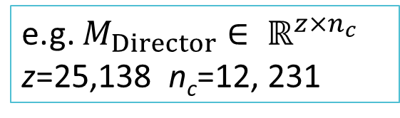
Domain ontology
k concept classes => k binary matrices M = z × n_{c} , M_{i,j}∈ {0,1}
classes = {Directors, Actors, Writers, Genres_{ML}, Genres_{OMDb}}, k=5
Sum(row) = no. of concepts in item; ≥ 1
Sum(col) = no. of items with a concept; ≥ 1
Related concepts identified through matrix multiplications of k matrices M through any path length
Method as an alternative to external ontology, where related concepts of an item found through item-concept occurrences
e.g. $M_{Director}∈ ℝ^{z×n_{c}}$ z=25,138 n_{c}=12, 231

Slide 23
Similarity model
Traditional method IDF – applied to terms and synsets from plots
Exception for concepts – no IDF scaling applied
Not from text, frequencies {0, 1} → CF-IDF+ modified
VGG and VSE scaled through optimization
Semantic-driven RS construct:
A vector of features from user profile u_{i}
A vector of features from unseen item for consideration v_{i}
Similarity evaluation: cos(u_{i},v_{i})

Slide 24
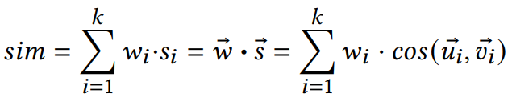
Similarity Model
To scale the recommendations, for all items in each feature type (k=9) similarity of item pairs is pre-computed
sim as score [0, 1]
Optimal parameters for weights w_{i} learned with loss function:
Logloss over observed likes y∈{0,1} and predicted similarity sim∈[0,1]
Similarity interpreted as probability of a like given in input data
User profile
Unseen item
$$L=y\log\left(sim\right)+\left(1−y\right)\log{(1−sim)}$$

Slide 25
Experimental setup
sim model trained on pairs of user-profiles and unseen items
Trained model used to recommend items where sim > threshold
Stochastic gradient descent (SGD) applied to optimize the part-similarity weights and relationship weights
Item considered to be liked if user rates it with score ≥ 4.5
Avg proportion of liked items: 19.2%
Avg number of liked items per user: 20.9

Slide 26
Experimental Setup
Users order shuffled in dataset
1000 as test dataset for evaluation
1000 as validation for the sim model for early stopping while training
136,493 as training set to optimize the sim model
User profiles constructed by sampling p=5 liked items from a user
Unseen items defined as not in the user profile
Liked/disliked items sampled with equal probability
All discarded items considered to be seen – simulating the situation where RS detects user has liked p=5 items
Final set of user profiles: 809

Slide 27
Experimental setup – the models
Model | k | Description
T | 1 | TF-IDF used as benchmark
C | 5 | modified CF-IDF+ using features directly captured from variables
S | 1 | SF-IDF+ based on synsets from plots
C+S | 6 | Combination of models C and S
VG | 1 | VGG19
VS | 1 | VSE
VG_{L} | 1 | VG visual feature scaling learned together with the rest of parameters
VS_{L} | 1 | VS visual feature scaling learned together with the rest of parameters
C+S+VG | 7 | Combination of C and S and VG
C+S+VG_{L} | 7 | Combination of C and S and VG_{L}
C+S+VG_{R} | 7 | Scaling pretained on VG_{L} (different restarts) and transferred
C+S+VG_{A} | 7 | Scaling pretained on VG_{L}, average scaling over 10 restarts, transferred
k – # feature types (part-similarities)

Slide 28
Experimental Setup
Optimization implemented in Python v.2.7 using Keras and Theano libraries
Regular PC with NVIDIA GTX1060 GPU
Parallel computations of gradient updates in batches of 1,024 observations

Slide 29
Results
10 random restarts, each model initiated with random weights
n_{valitation}=102,400; n_{train}=1,406,976 observations
15x reduction in seconds per epoch
VG (pre-computed dot-products) compared to VG_{L} (traditional)
Training of the heaviest model C+S+VG_{L} takes a bit less than 70 minutes
Lowered training time – important practical outcome
With the scalable approach (pre-computed dot-products) model optimized in 4-5 minutes

Slide 30
Results
Performance calculated for all 809 user profiles
Not directly optimized towards the metrics
Model | AUC |  | F₁ |  | 𝜅
 | ROC | PR | min𝑟 | max𝑟 | min𝑟 | max𝑟
T | 0.535 | 0.324 | 0.413 | 0.479 | 0.041 | 0.200
S | 0.531 | 0.319 | 0.411 | 0.477 | 0.038 | 0.198
C | 0.567 | 0.358 | 0.419 | 0.507 | 0.081 | 0.249
C+S | 0.570 | 0.361 | 0.419 | 0.509 | 0.083 | 0.251
VG | 0.525 | 0.308 | 0.415 | 0.476 | 0.036 | 0.189
VS | 0.508 | 0.299 | 0.415 | 0.472 | 0.018 | 0.176
VG_{L} | 0.605 | 0.347 | 0.429 | 0.519 | 0.110 | 0.262
VS_{L} | 0.605 | 0.370 | 0.422 | 0.517 | 0.115 | 0.268
C+S+VG | 0.574 | 0.362 | 0.419 | 0.510 | 0.087 | 0.253
C+S+VG_{L} | 0.624 | 0.385 | 0.431 | 0.531 | 0.131 | 0.289
C+S+VG_{R} | 0.624 | 0.386 | 0.432 | 0.532 | 0.128 | 0.286
C+S+VG_{A} | 0.634 | 0.391 | 0.435 | 0.537 | 0.137 | 0.298

Slide 31
Results
Unexpectedly low performance for SF-IDF+
Concepts alone (C) outperform the benchmark T
No need to train scaling together with the model as a whole
Model | AUC |  | F₁ |  | 𝜅
 | ROC | PR | min𝑟 | max𝑟 | min𝑟 | max𝑟
T | 0.535 | 0.324 | 0.413 | 0.479 | 0.041 | 0.200
S | 0.531 | 0.319 | 0.411 | 0.477 | 0.038 | 0.198
C | 0.567 | 0.358 | 0.419 | 0.507 | 0.081 | 0.249
C+S | 0.570 | 0.361 | 0.419 | 0.509 | 0.083 | 0.251
VG | 0.525 | 0.308 | 0.415 | 0.476 | 0.036 | 0.189
VS | 0.508 | 0.299 | 0.415 | 0.472 | 0.018 | 0.176
VG_{L} | 0.605 | 0.347 | 0.429 | 0.519 | 0.110 | 0.262
VS_{L} | 0.605 | 0.370 | 0.422 | 0.517 | 0.115 | 0.268
C+S+VG | 0.574 | 0.362 | 0.419 | 0.510 | 0.087 | 0.253
C+S+VG_{L} | 0.624 | 0.385 | 0.431 | 0.531 | 0.131 | 0.289
C+S+VG_{R} | 0.624 | 0.386 | 0.432 | 0.532 | 0.128 | 0.286
C+S+VG_{A} | 0.634 | 0.391 | 0.435 | 0.537 | 0.137 | 0.298

Slide 32
Results
VG outperforms VS
1,000 synset feature values more suitable than 1,024 VSEs
Optimized scaling provides large performance increase
VG vs VG_{L}
VS vs VS_{L}
VSE does not improve RS performance over synset vectors
Model | AUC |  | F₁ |  | 𝜅
 | ROC | PR | min𝑟 | max𝑟 | min𝑟 | max𝑟
T | 0.535 | 0.324 | 0.413 | 0.479 | 0.041 | 0.200
S | 0.531 | 0.319 | 0.411 | 0.477 | 0.038 | 0.198
C | 0.567 | 0.358 | 0.419 | 0.507 | 0.081 | 0.249
C+S | 0.570 | 0.361 | 0.419 | 0.509 | 0.083 | 0.251
VG | 0.525 | 0.308 | 0.415 | 0.476 | 0.036 | 0.189
VS | 0.508 | 0.299 | 0.415 | 0.472 | 0.018 | 0.176
VG_{L} | 0.605 | 0.347 | 0.429 | 0.519 | 0.110 | 0.262
VS_{L} | 0.605 | 0.370 | 0.422 | 0.517 | 0.115 | 0.268
C+S+VG | 0.574 | 0.362 | 0.419 | 0.510 | 0.087 | 0.253
C+S+VG_{L} | 0.624 | 0.385 | 0.431 | 0.531 | 0.131 | 0.289
C+S+VG_{R} | 0.624 | 0.386 | 0.432 | 0.532 | 0.128 | 0.286
C+S+VG_{A} | 0.634 | 0.391 | 0.435 | 0.537 | 0.137 | 0.298

Slide 33
Results
VG outperforms VS
1,000 synset feature values more suitable than 1,024 VSEs
Optimized scaling provides large performance increase
VG vs VG_{L}
VS vs VS_{L}
VSE does not improve RS performance over synset vectors
Model | AUC |  | F₁ |  | 𝜅
 | ROC | PR | min𝑟 | max𝑟 | min𝑟 | max𝑟
T | 0.535 | 0.324 | 0.413 | 0.479 | 0.041 | 0.200
S | 0.531 | 0.319 | 0.411 | 0.477 | 0.038 | 0.198
C | 0.567 | 0.358 | 0.419 | 0.507 | 0.081 | 0.249
C+S | 0.570 | 0.361 | 0.419 | 0.509 | 0.083 | 0.251
VG | 0.525 | 0.308 | 0.415 | 0.476 | 0.036 | 0.189
VS | 0.508 | 0.299 | 0.415 | 0.472 | 0.018 | 0.176
VG_{L} | 0.605 | 0.347 | 0.429 | 0.519 | 0.110 | 0.262
VS_{L} | 0.605 | 0.370 | 0.422 | 0.517 | 0.115 | 0.268
C+S+VG | 0.574 | 0.362 | 0.419 | 0.510 | 0.087 | 0.253
C+S+VG_{L} | 0.624 | 0.385 | 0.431 | 0.531 | 0.131 | 0.289
C+S+VG_{R} | 0.624 | 0.386 | 0.432 | 0.532 | 0.128 | 0.286
C+S+VG_{A} | 0.634 | 0.391 | 0.435 | 0.537 | 0.137 | 0.298

Slide 34
Results
The combined model of C+S+VG_{L} outperforms:
The benchmark
All other models
Model | AUC |  | F₁ |  | 𝜅
 | ROC | PR | min𝑟 | max𝑟 | min𝑟 | max𝑟
T | 0.535 | 0.324 | 0.413 | 0.479 | 0.041 | 0.200
S | 0.531 | 0.319 | 0.411 | 0.477 | 0.038 | 0.198
C | 0.567 | 0.358 | 0.419 | 0.507 | 0.081 | 0.249
C+S | 0.570 | 0.361 | 0.419 | 0.509 | 0.083 | 0.251
VG | 0.525 | 0.308 | 0.415 | 0.476 | 0.036 | 0.189
VS | 0.508 | 0.299 | 0.415 | 0.472 | 0.018 | 0.176
VG_{L} | 0.605 | 0.347 | 0.429 | 0.519 | 0.110 | 0.262
VS_{L} | 0.605 | 0.370 | 0.422 | 0.517 | 0.115 | 0.268
C+S+VG | 0.574 | 0.362 | 0.419 | 0.510 | 0.087 | 0.253
C+S+VG_{L} | 0.624 | 0.385 | 0.431 | 0.531 | 0.131 | 0.289
C+S+VG_{R} | 0.624 | 0.386 | 0.432 | 0.532 | 0.128 | 0.286
C+S+VG_{A} | 0.634 | 0.391 | 0.435 | 0.537 | 0.137 | 0.298

Slide 35
Summary
Method for extracting semantic features from complex domain information for semantics-driven RS
Method for devising domain ontology when no external ontology is readily available
Method to scale up existing semantics-driven RS for large-scale variable data with pre-computation of cosine similarities and gradient learning of the model
Method for large-scale semantics-driven recommendations based on concepts and synsets extracted from text (plots), and synsets extracted from digital images using computer vision for the task

Slide 36
Thank you!
Questions

