Slide 1
Bing-CF-IDF+: A Semantics-Driven News Recommender System
Emma Brocken, Aron Hartveld, Emma de Koning, Thomas van
Noort, Frederik Hogenboom, Flavius Frasincar,
and Tarmo Robal

Slide 2
Introduction (1)
Recommender systems help users to plough through a massive and increasing amount of information
Recommender systems:
  Content-based
  Collaborative filtering
  Hybrid
Content-based systems are often term-based
Common measure: Term Frequency – Inverse Document Frequency (TF-IDF) as proposed by [Salton and Buckley, 1988]
Notes:
In today’s data intensive world, most people experience - or suffer from - an information overload. Recommender systems lend a hand in distinguishing between interesting and non-interesting products, news articles, etcetera. Based on for example user preferences or characteristics, possibly captured in user profiles or derived from browsing behavior, recommendations can be made.
Three types:
Content-based recommenders: content (FOCUS)
Collaborative filtering recommenders: user similarity
Hybrid recommenders (combination)
Traditionally, content-based recommenders are term-based, and hence operate on term frequencies.
When employing user profiles that describe users' interest based on the previously browsed items, these can be translated into vectors of TF-IDF weights. With a measure like cosine similarity, one can calculate how interesting a new item might be based on user profiles. For this, TF-IDF weights are computed on every term within a document.

Slide 3

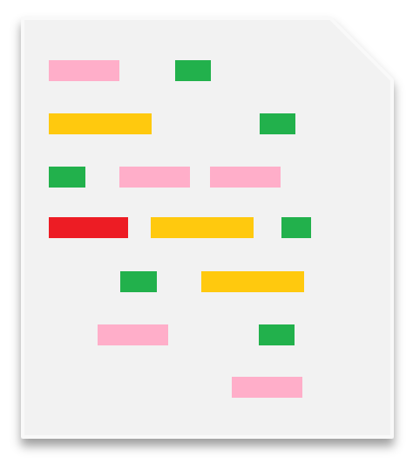

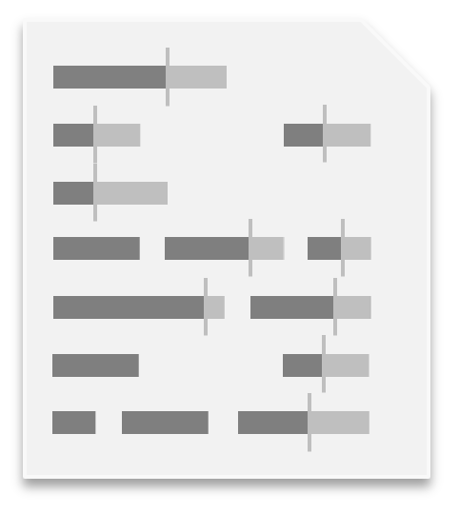
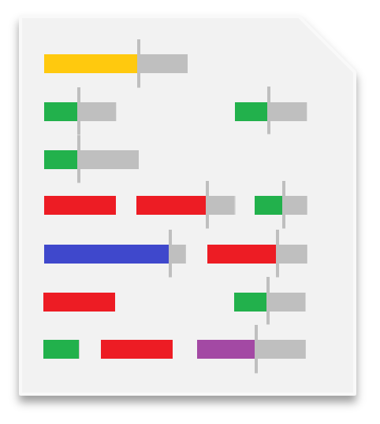
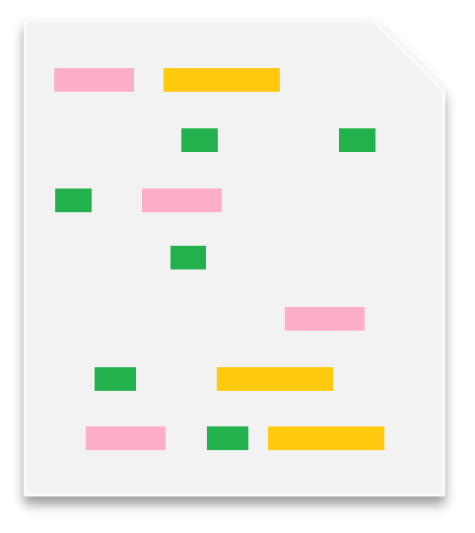
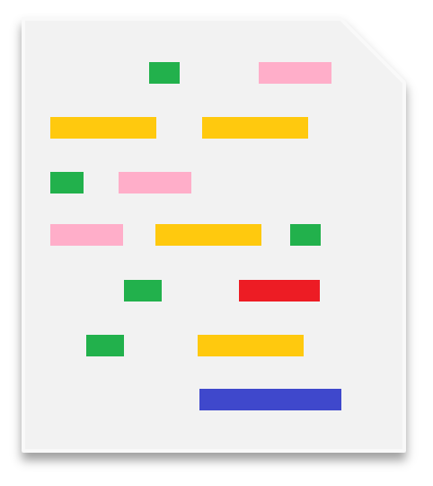
Introduction (2)
TF-IDF:
  Preprocessed documents (stop words removal and stemming)
  For each term, it takes into consideration:
    The importance in a single document
    The inverse of the general importance within a set of documents
TF-IDF performance tends to decrease as documents get larger
The red, purple, and blue terms are important, whereas the yellow, green, and pink terms are irrelevant
Notes:
TF-IDF can be summarized as a computation on a preprocessed set of documents, where stop words are removed, and the remaining words are stemmed.
Stemmer (reduces words to root form) example: `processor' and `processing' are reduced to `process’.
The TF-IDF method considers terms that appear frequently in a document, but rarely appear in other documents as highly important or specific for the document at hand, while terms that appear frequently in a document, but also in the rest of the corpus are treated as generic terms, and hence are considered to be less important.
Details and specifics on computation of TF-IDF will follow shortly.
A major drawback of TF-IDF, is that its performance decreases as documents get larger.

Slide 4

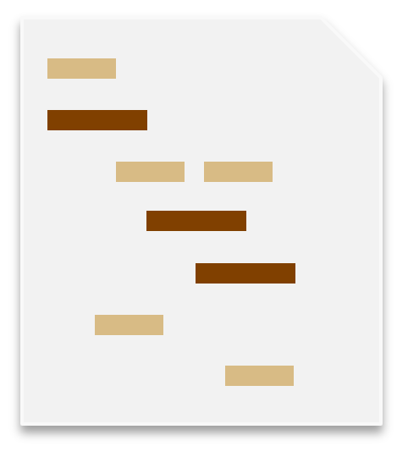
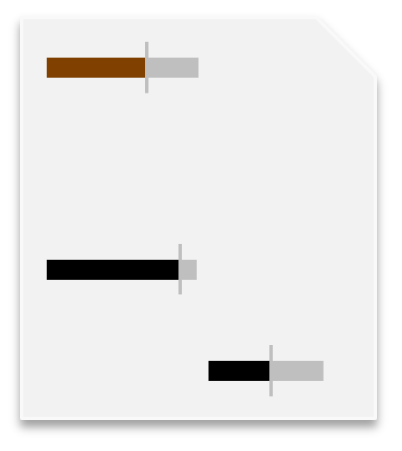
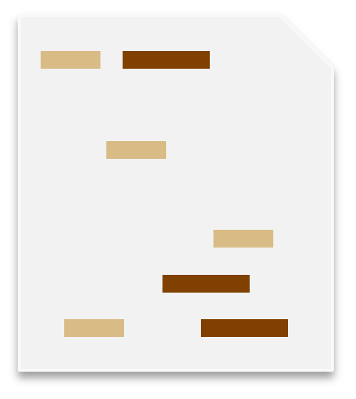
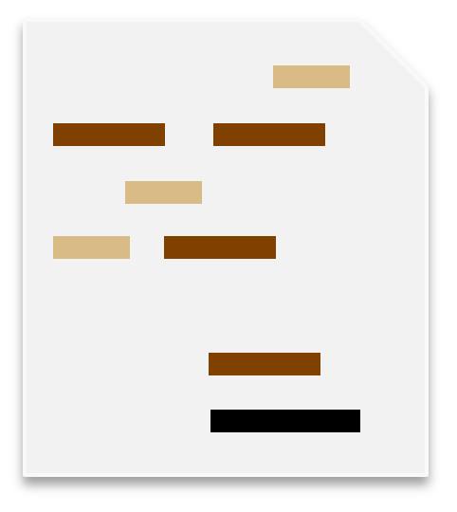
Introduction (3)
Utilizing concepts instead of terms:
  Reduces noise caused by non-meaningful terms
  Yields less terms to evaluate
  Allows for semantic features, e.g., synonyms
Therefore, in 2011 we proposed Concept Frequency – Inverse Document Frequency (CF-IDF), showing an improvement over regular TF-IDF [Goossen et al., 2011]
The black concepts are important, while the brown and beige concepts are irrelevant
Notes:
But… lately, methods have been developed to find key concepts in a text. The Semantic Web offers new opportunities. Why wouldn’t we make use of semantics? Why wouldn’t we look at only the most relevant terms that contain most of the important information?
Advantages:
Reduce noise, but also grouping similar terms
Less terms because only concepts are considered
Allow use of semantic features like synonyms
Example
Therefore, back in 2011 we proposed CF-IDF, which is analogous to TF-IDF. The acronym stands for Concept Frequency – Inverse Document Frequency. Instead of counting term frequencies, we counted frequencies of specific concepts. This approach seemed to perform pretty well when compared to regular TF-IDF. Key in this approach is proper Word Sense Disambiguation.

Slide 5
Introduction (4)
Research has shown that semantic relationships provide structure and improved interpretability
Hence, we coined CF-IDF+ [de Koning et al., 2018]
The black concepts have become less important due to their relationship with beige concepts
Notes:
Semantic relations: also ”hasName”, “worksAt”, etc.

Slide 6

Introduction (5)
News items contain many named entities
Concept-based recommenders such as CF-IDF+ neglect entities that are not present in their underlying ontologies
Solution: use page-counts for those entities not covered by ontologies
The Bing-CF-IDF+ recommender is implemented in Ceryx (an extension to Hermes [Frasincar et al., 2009], a news processing framework)
Notes:
Named entity: real-world instantiation of object, e.g., person, location, …

Slide 7
Introduction (6)
Earlier work has been done:
  CF-IDF-like methods: [Baziz et al., 2005], [Yan and Li, 2007]
  Frameworks: OntoSeek [Guarino et al., 1999], Quickstep [Middleton et al., 2004], News@hand [Cantador et al., 2008]
Although some work shows overlap:
  Methods are not thoroughly compared with TF-IDF
  Often, WSD and synonym handling is lacking

Slide 8
TF-IDF
Term Frequency: the occurrence of a term t_{i} in a document d_{j}, i.e.,
Inverse Document Frequency: the occurrence of a term t_{i} in a set of documents D:
And hence
Notes:
Now let’s quickly discuss some details on TF-IDF. I guess to some – or most of you – this is known, so I’ll briefly skim through this, as this helps to show the differences between TF-IDF, CF-IDF, and CF-IDF+.

Slide 9
CF-IDF
Concept Frequency: the occurrence of a concept c_{i} in a document d_{j}, i.e.,
Inverse Document Frequency: the occurrence of a concept c_{i} in a set of documents D:
And hence
Notes:
CF-IDF works quite similar to TF-IDF. We replace terms by concepts, which can be defined in ontologies. Concepts are synsets which contain lexical representations of the described concept and their considered sense.

Slide 10
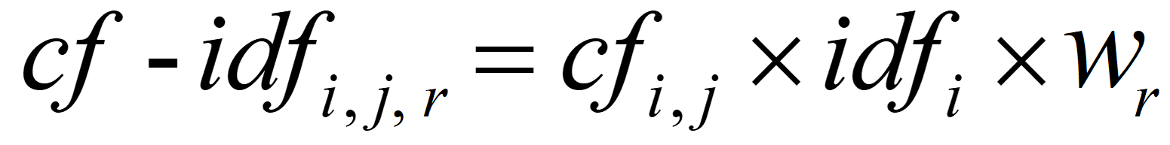
CF-IDF+
Each concept c from set C has a set of related concepts R(c)
A related concept r is associated with a weight w_{r}
We focus on domain ontologies, and identify 3 different weights for superclasses, subclasses, and domain relationships
For concept c_{i} and related concept r_{i} ∈ R(c_{i}) with weight w_{r} in document d_{j} ∈ D, CF-IDF+ is computed as

Slide 11
Bing-CF-IDF+
Similarity:
  Point-Wise Mutual Information (PMI)
  Calculated for each pair of entities in a document and the user profile
  Based on: co-occurrences of document and profile entities, occurrences of document entity, and occurrences of profile entity
  Corrected for the number of indexed Web pages (～15bn)
Final score is a weighted average of Bing similarities and CF-IDF+ scores

Slide 12
Recommendations
Ontology contains a set of concepts and relations
User profile consists of (a subset of) these concepts and relations, and named entities
Each article is represented as:
  TF-IDF: a set containing all terms
  CF-IDF: a set containing all concepts
  CF-IDF+: a set containing all concepts and related concepts
  Bing-CF-IDF+: a set containing all named entities, concepts, and related concepts
Then, for each article, weights are calculated, and new articles are compared to the user profile using cosine similarity

Slide 13
Implementation: Hermes
Hermes News Portal (HNP):
  News personalization service
  Ontology-based
  Java / OWL / SPARQL / Jena / GATE / WordNet
Input: RSS feeds of news items
Internal processing:
  Classification
  News querying
Output: news items
Notes:
The Hermes framework is utilized for building a news personalization service. Its implementation is called Hermes News Portal, or simply HNP.
The Hermes news personalization framework provides a semantic-based approach for retrieving news items related, directly or indirectly, to the concepts of interest from a domain ontology. Hermes stores its knowledge base and the list of classified news items in separate ontologies. The knowledge base describes the general domain the user is interested in. The knowledge base is maintained using discovered information in news items.
HNP takes RSS feeds of news items as input. For classification, Hermes employs an advanced Natural Language Processing (NLP) engine that uses techniques like tokenization, part-of-speech tagging, word sense disambiguation, gazetteering, etc. This prepares the news item for querying. During the classification, the system searches through the news item to find all knowledge base concepts. The news item is then stored with annotations in a news ontology, so that future queries can be done in a fast and direct way, without going through the NLP steps again. All concepts of interest are stored in the domain ontology (knowledge base) and are represented by ontology concepts. An ontology concept is a class or instance from the domain ontology. Each concept has a lexical representation derived from a semantic lexicon like WordNet.
News querying is done by expressing the topics of interest using concepts from the domain ontology. The results returned are presented in the order of their relevance for the user. For this purpose, for each returned news item a relevance degree is computed based on all the hits between the news item and the concepts of interest.

Slide 14
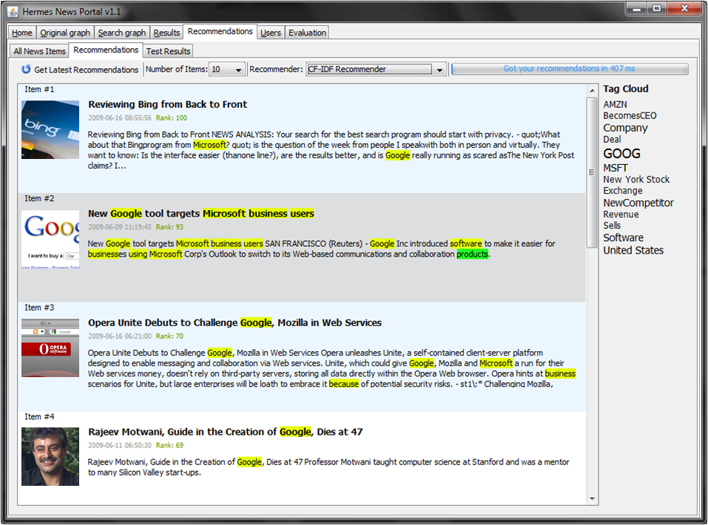
Implementation: Ceryx
Ceryx is a plug-in for HNP
Main focus is on recommendation support
User profiles are constructed
TF-IDF (using a stemmer as proposed in [Krovetz, 1993]), CF-IDF, CF-IDF+, and Bing-CF-IDF+ recommendation calculations (using Lesk Word Sense Disambiguation [Jensen and Boss, 2008]) can be performed

Slide 15



Evaluation (1)
Experiment:
  Cut-off values: {0, 0.01, 0.02, …, 1}
  For each cut-off value, relationship weights are optimized to maximize F₁-scores:
    Subclass relations receive low weights (too specific)
    Superclass relations receive higher weights (somewhat generic)
    Domain relations receive highest weights (just about right)
  Also, weight distribution of Bing and CF-IDF+ is optimized (Bing < CF-IDF+)
Experts
3
Profiles
8
News items
100
Notes:
In our experiment, we let 3 domain experts evaluate 100 news items from a Reuters feed for their appropriateness to 8 user profiles, such as countries in Asia, financial markets, or Google and its competitors.
We evaluate performance for various cut-off values, which are the minimum scores for news messages for them to be recommended.
For each of these cut-off values, we optimize the relationship weights for CF-IDF+, maximizing on F₁-scores. In general, subclass relations and superclass relations receive lower weights then domain relations, such as for example “isProducedBy”, or “hasUpdate”.
Furthermore, we optimize the weights of the Bing and CF-IDF+ parts similarly. Generally, Bing entities receive a lower weight than CF-IDF+ concepts due to the higher informational value of concepts.

Slide 16
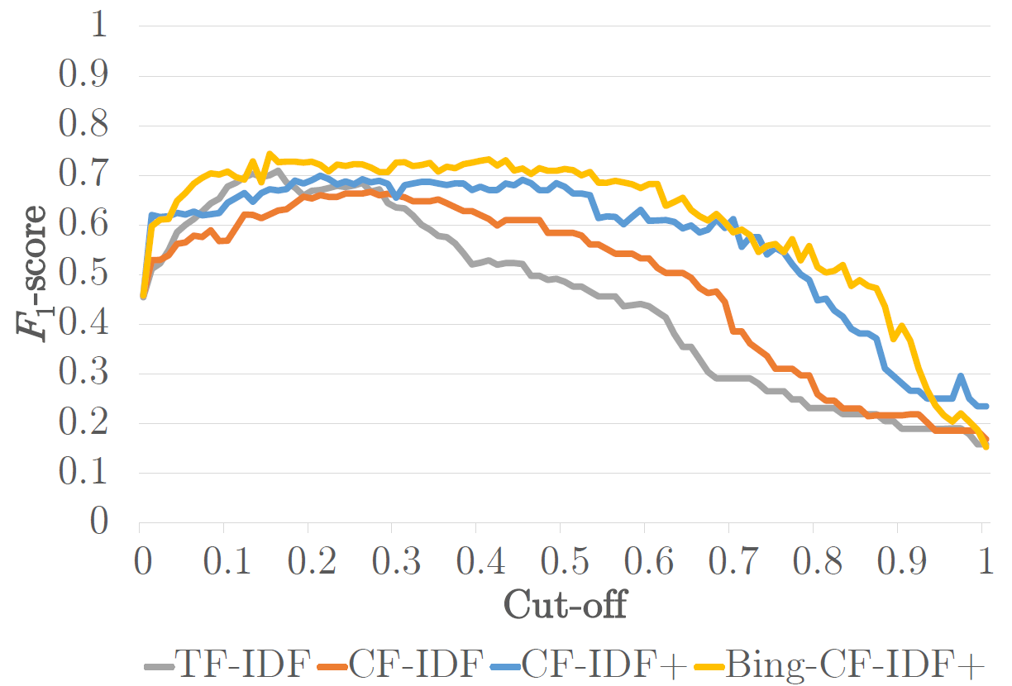
Evaluation (2)
Bing-CF-IDF+ clearly outperforms all other recommenders throughout the range of cut-off values
For high cut-off values (the tougher nuts to crack), CF-IDF+ and Bing-CF-IDF+ are true winners due to their restricted nature.
Bing-CF-IDF+ shows significantly higher precision at a slightly higher recall when compared to CF-IDF+

Slide 17
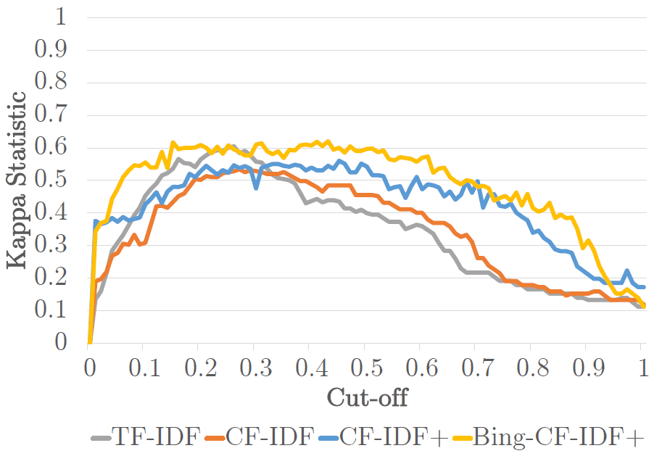
Evaluation (3)
Bing-CF-IDF+ consistently has a higher classification power (Kappa statistic) than its predecessor CF-IDF+
Unlike CF-IDF(+), Bing-CF-IDF+ also outperforms TF-IDF in the lower cut-off values
Notes:
This plot shows the results of the Kappa statistic for the various cutoff values. The closer to 1, the more classification power a recommender has. Negative values indicate recommenders perform worse than random guessing. Bing-CF-IDF+ seems to outperform all other methods.

Slide 18
Conclusions
For both strict and loose recommendation settings, Bing-CF-IDF+ outperforms CF-IDF+, CF-IDF and TF-IDF significantly
Especially classification power and precision show vast improvements
Hence, using key concepts and semantic relations, as well as named entities could be beneficial for recommender systems
Future work:
  Invest in a more fine-grained weight learning procedure
  Include a larger collection of relationships
  Evaluate on a larger set of news items

Slide 19
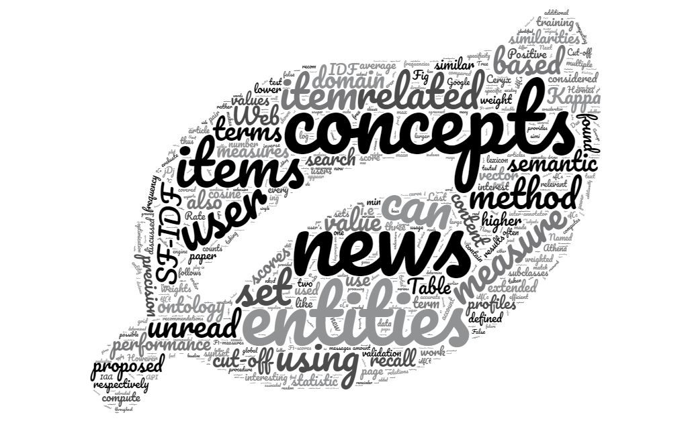
Questions?

