Slide 1
Explaining a Deep Learning Model for Aspect-Based Sentiment Analysis Using SHAP
Finn van der Knaap*
* Joint work with Kelvin Z. Yeung and Flavius Frasincar

Slide 2
Contents
Motivation
Related Work
Data
Methodology
Evaluation
Conclusion

Slide 3
Motivation
The mass integration of the Social Web into consumer markets has drastically altered interactions between businesses and consumers
Specifically, reviews have had a significant impact as a form of customer value co-creation:
From the consumer’s point of view:
Informed decision-making
Personalized recommendations
From the producer’s point of view:
Product improvement
Building brand credibility

Slide 4
Motivation
Consequently, academic research into reviews has seen a huge increase in coverage, mainly on sentiment analysis
Sentiment analysis deals with the automatic evaluation of opinions or emotions expressed in text data (which are customer reviews in this work)
Several applications of sentiment analysis:
Sentiment classification: unable to capture all complexities of human language
Aspect-Based Sentiment Analysis (ABSA): deals with context through the relevant aspect

Slide 5
Motivation
State-of-the-art ABSA models often combine various techniques:
Less transparency -> black box models
Reduces comprehension and may lead to wrong reasoning
Two different types of interpretability:
Local: Concentrate on explanations of single instances
Global: Concentrate on overall model behavior
Main problem:
Previews work has proposed the Hybrid Approach for ABSA with BERT embeddings and hierarchical attention (HAABSA++) model
To what extent can we correctly interpret and explain the behavior of the HAABSA++ model?

Slide 6
Main Idea
Approach: A SHapley Additive exPlanations (SHAP) approach for interpretability and explainability.
SHAP advantages:
Provides both local and global interpretation
No need for a surrogate model

Slide 7
Related Work
Understanding black box models:
Local interpretability:
(Miron et al., 2023): analyze local model predictions by focusing on surrogate models, creating two sampling methods that feed an interpretability algorithm based on Local Interpretable Model-Agnostic Explanations (LIME)
Global interpretability:
(Geed et al., 2022): attempt to increase global interpretation of the LCR-Rot-hop++ model using diagnostic classifiers, testing various hypotheses to break down whether certain layers of the model encode specific types of information

Slide 8
Data
SemEval 2016 dataset: restaurant reviews
Training set:
1880 review-aspect pairs
Test set:
650 review-aspect pairs
Each review-aspect pair is annotated with a sentiment: positive, neutral, or negative
Task of the ABSA model: detect the sentiment of each aspect-review pair

Slide 9
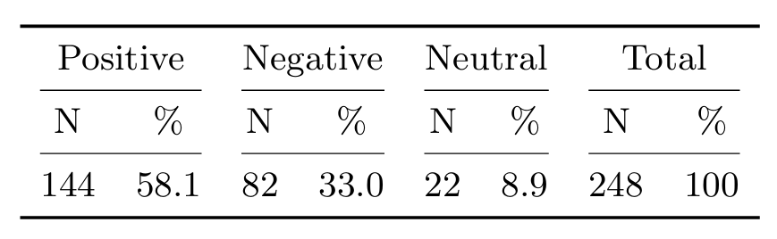
Data
HAABSA++ is a two-step approach: focus on the deep learning model
Ontology predicts 402 out of the 650 sentiment-labeled aspects in the test set -> remaining 248 instances is where the deep learning model is utilized
Positive label still dominates the distribution, although less than the full test set

Slide 10
Methodology – HAABSA++
The model has two-steps:
Ontology
LCR-Rot-hop++
Ontology:
Designed to find possible sentiment expression of a word
LCR-Rot-hop++:
Back-up method in case ontology fails
BERT word embeddings (768 dimensions) to generate contextual word representations
Sentence is divided into three parts based on the target phrase
Fed into Bi-LSTM networks, after which a two-step rotatory attention mechanism is utilized

Slide 11
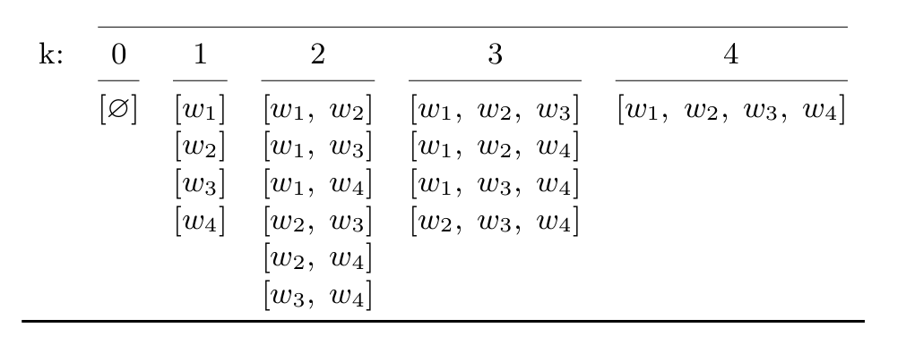
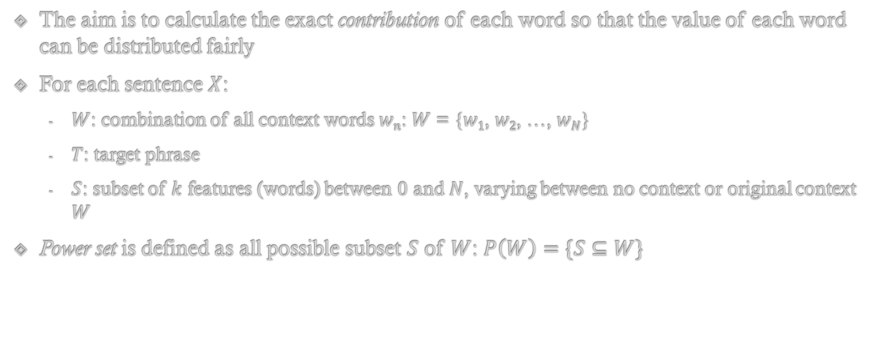
Methodology – SHAP
The aim is to calculate the exact contribution of each word so that the value of each word can be distributed fairly
For each sentence $X$:
$W$: combination of all context words $wn$: $W$ = {$w1$, $w2$, …, $wN$}
$T$: target phrase
$S$: subset of $k$ features (words) between $0$ and $N$, varying between no context or original context $W$
Power set is defined as all possible subset $S$ of $W$: $P\left(W\right)=\{S⊆W\}$

Slide 12
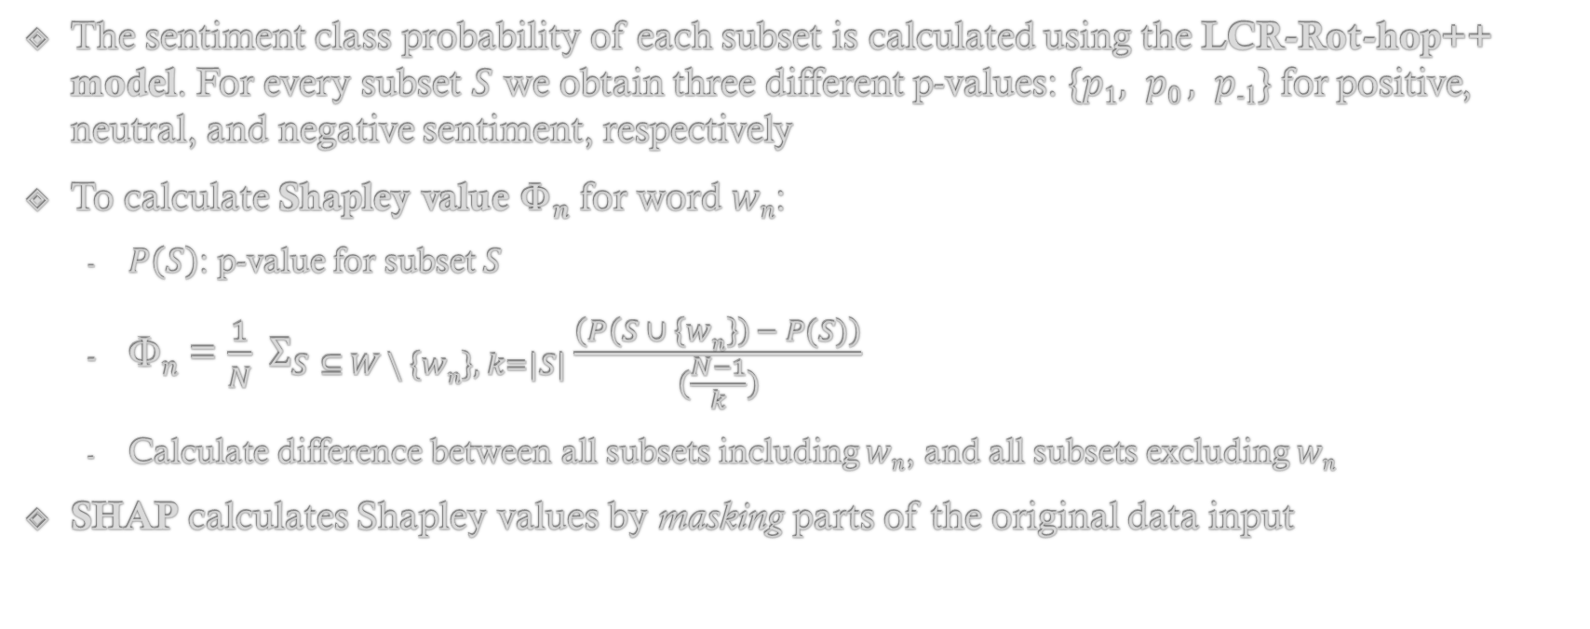
Methodology – SHAP
The sentiment class probability of each subset is calculated using the LCR-Rot-hop++ model. For every subset $S$ we obtain three different p-values: $\{p1, p0 , p$₋₁$\}$for positive, neutral, and negative sentiment, respectively
To calculate Shapley value Φ$n$ for word $wn$:
$P\left(S\right)$: p-value for subset $S$
Φ$n$ = $\frac{1}{N} Σ_{S⊆⊆ W \backslash \left\{wn\right\}, k=\left|S\right|}\frac{\left(P\left(S ∪ \left\{wn\right\}\right) − P(S)\right)}{(\frac{N−1}{k})}$
Calculate difference between all subsets including $wn$, and all subsets excluding $wn$
SHAP calculates Shapley values by masking parts of the original data input

Slide 13
Methodology - SHAP
SHAP model 1: apply SHAP only to the LCR-Rot-hop++ model after word embeddings are generated using BERT. The subsets are created after BERT word embeddings are generated, measuring the contribution of each embedded word to the sentiment prediction
SHAP model 2: apply SHAP before BERT word embeddings are created, which means that new word embeddings are created for all subsets of the sentence. The final SHAP values measure the contribution of each word on the final sentiment classification, accounting for a change in context as a result of SHAP masking part of the sentence

Slide 14
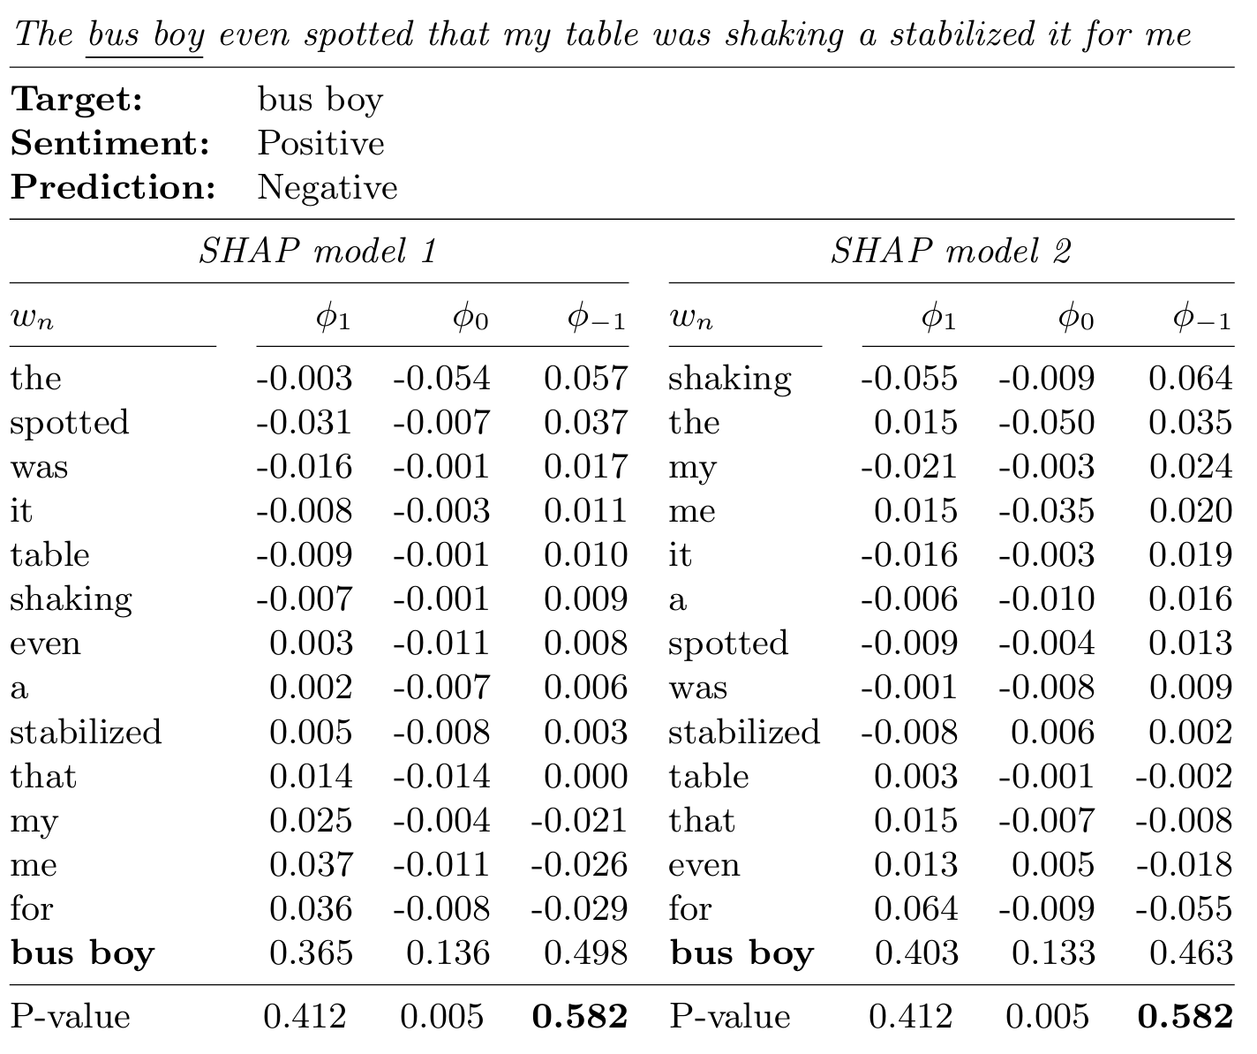
Evaluation – Local Interpretability
Sentence that is incorrectly classified by the model, sorted by sentiment class prediction
The columns show the SHAP values of each word, indicating their contribution towards a positive, neutral, and negative sentiment prediction, respectively
For the target word `bus boy’, the values are the base values when all context words are masked
SHAP model 1: ‘the’, ‘spotted’, and ‘was’ contribute most:
- Compute word embeddings from complete sentence and embeddings thus capture context
SHAP model 2: ‘shaking’ contributes most:
- Embeddings are created for every subset, capturing different contexts each time

Slide 15
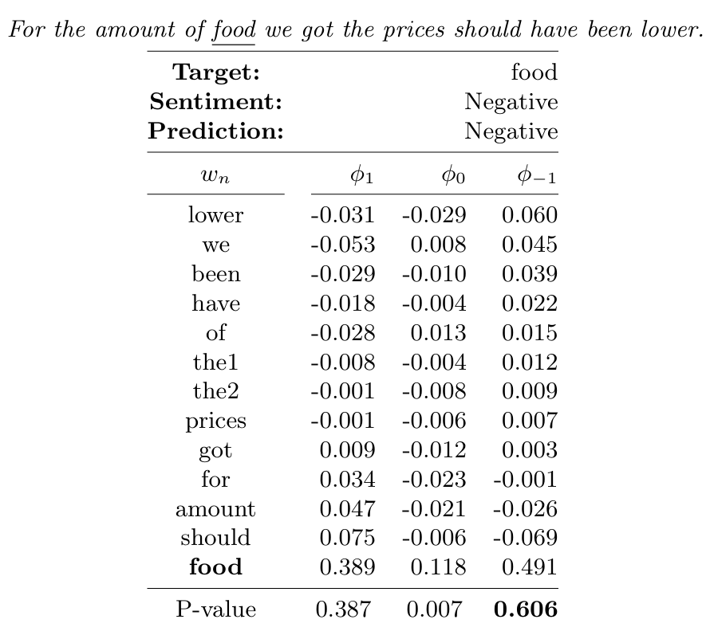
Evaluation – Local Interpretability
As SHAP model 2 is presumed to assign contribution more towards individual words, we present one more local interpretation using SHAP model 2
Sentence that is correctly classified by the model, sorted by sentiment class prediction
‘lower’ is attributed the highest contribution towards a negative sentiment
The other words are weak in meaning
Since they still represent a large part of the contribution towards a negative sentiment it implies that they add important information about the context

Slide 16
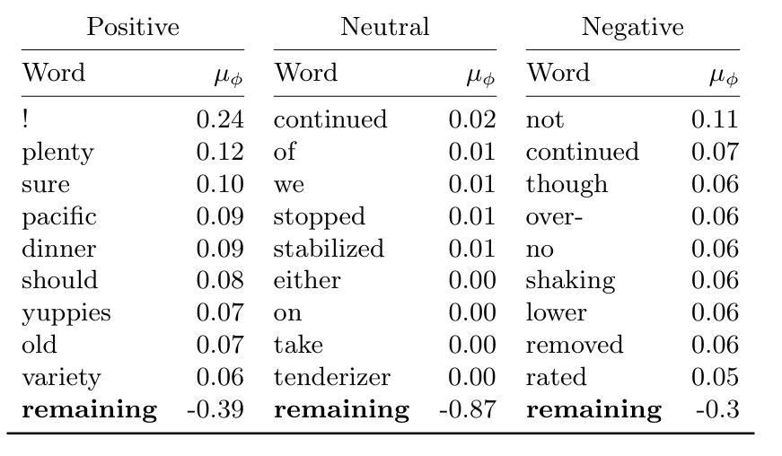
Evaluation – Global Interpretability
5% of dataset is randomly sampled to demonstrate capabilities of SHAP due to long computational time
As SHAP model 2 is better at capturing the contribution of adding individual words, we aggregate words only for SHAP model 2
The highest contributions belong to ‘!’, ‘plenty’, ‘sure’, and ‘not’, whereas only ‘not’ belongs to a negative sentiment classification -> positive being the majority class

Slide 17
Conclusion
We have proposed a SHAP approach for interpretability of the HAABSA++ model:
SHAP model 1: compute SHAP after word embeddings
SHAP model 2: compute SHAP before word embeddings
The proposed SHAP model 2 works better
Better at capturing the contribution of specific words rather than the specific contexts
Future work:
Removing function words before feeding them to the SHAP model to avoid dilution of the meaning of other words
Explore methods that only estimate Shapley values instead of precise calculations to reduce computation time (Aas et al., 2021)

Slide 18
References
Miron, V., Frasincar, F., Trusca, M.M.: Explaining a deep learning model for aspect-based sentiment classification using post-hoc local classifiers. In: 28th International Conference on Applications of Natural Language to Information Systems (NLDB 2023). LNCS, vol. 13913, pp. 79–93. Springer (2023
Geed, K., Frasincar, F., Trusca, M.M.: Explaining a deep neural model with hierarchical attention for aspect-based sentiment classification using diagnostic classifiers. In: 22nd International Conference on Web Engineering (ICWE 2022). LNCS, vol. 13362, pp. 268–282. Springer (2022)
Aas, K., Jullum, M., Løland, A.: Explaining individual predictions when features are dependent: More accurate approximations to Shapley values. Artificial Intelligence 298, 103502 (2021)

