Slide 1
Knowledge Injection from a Domain Sentiment Ontology in an Attention Neural Network for Aspect-Based Sentiment Classification
Charlotte Visser*
471231cv@student.eur.nl
* Joint work with Flavius Frasincar

Slide 2
Contents
Motivation
Related Work
Data
Methodology
Evaluation
Conclusion

Slide 3
Motivation
Due to the growth of opinionated web texts there is an increasing need for sentiment analysis
Understanding customer opinions on specific product aspects helps decision-makers such as businesses and researchers
Automating sentiment extraction and analysis saves time and reduces costs, making it easier to respond to customer needs

Slide 4
Motivation
Sentiment Analysis is defined as the process of automatically extracting the sentiment and opinions towards entities from text
Different granularities of Sentiment Analysis:
  Document-level
  Paragraph-level
  Sentence-level
  Aspect-level: Aspect-Based Sentiment Analysis (ABSA)
    Document-level
    Paragraph-level
    Sentence-level

Slide 5
Motivation
Aspect-Based Sentiment Analysis (ABSA) has two stages:
  Aspect detection
  Sentiment detection (Aspect-Based Sentiment Classification (ABSC))
Main problem:
  In previous work, knowledge was injected into a neural network, obtaining LCR-Rot-hop-ont++
  How to leverage knowledge in a neural network for ABSC?
Notes:
Assumption: aspects are explicit and predefined

Slide 6
Main Idea
Approach:
  Extend the LCR-Rot-hop-ont++ neural network model by:
    Multi-hop Knowledge Injection
      Inject domain-specific knowledge from an ontology.
    Hop Weighting Mechanism:
      Regulate the influence of knowledge based on its distance (hops) in the ontology.
Key Advantages:
  Combines strengths of ontology-based reasoning and neural networks
  Addresses small dataset limitations by leveraging domain-specific knowledge
  Limit knowledge noise using techniques like soft-positioning and visibility matrix.

Slide 7
Related Work
Aspect-Based Sentiment Classification (ABSC):
  Knowledge-Based
  Machine Learning
    LCR-Rot-hop++ (Trusca et al., 2020) : A neural network which uses contextual embeddings and a rotatory attention mechanism to align left/right context and target phrases for sentiment prediction.
  Hybrid Models
    HAABSA++ (Trusca et al., 2020): A two-stage hybrid model. In the first stage, sentiment is predicted using a domain ontology. When the result of the first stage is ambiguous, LCR-Rot-hop++ is used as a backup neural network.
    LCR-Rot-hop-ont++ (Dekker et al., 2023): A hybrid model that uses a domain sentiment ontology simultaneously with the LCR-Rot-hop++ framework by directly injecting knowledge in the form of synonyms for the current words. Knowledge injection is facilitated using K-BERT (Liu et al., 2020) and relies on a domain sentiment ontology developed by (Schouten et al., 2017).
Notes:
Knowledge based: Use predefined knowledge bases for sentiment prediction.
ML: Learn sentiment from trained datasets
Hybrid: : Combine both approaches for improved performance.

Slide 8
Data
SemEval 2015 dataset: restaurant reviews
  Training dataset: 1279 reviews
  Testing dataset: 597 reviews
SemEval 2016 dataset: restaurant reviews
  Training dataset: 1880 reviews
  Testing dataset: 650 reviews
Negative, neutral and positive polarity

Slide 9
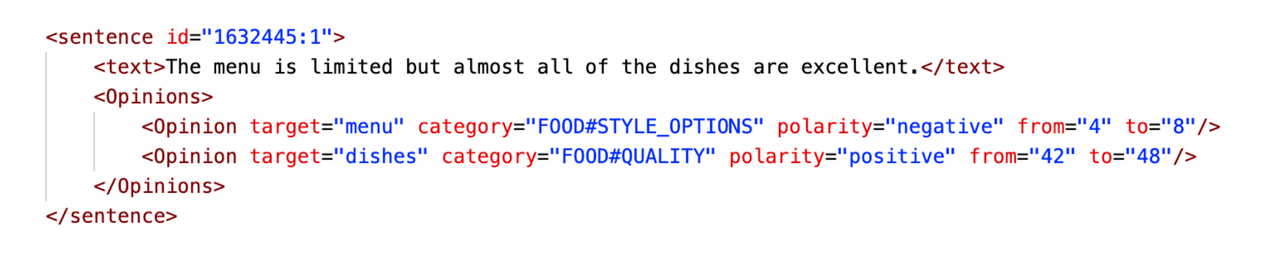
Example

Slide 10
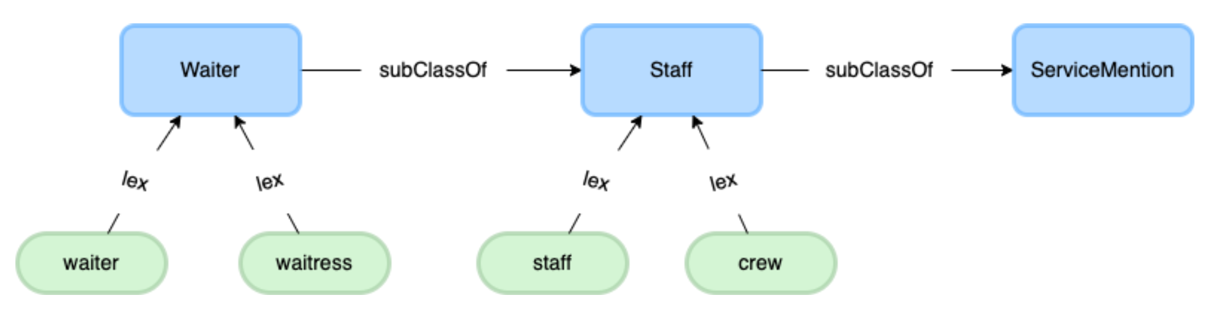
Data – Domain Sentiment Ontology
Ontology Features:
  Concepts:
    Captures restaurant-specific aspects
    Total: 444 concepts
  Lexical Representations:
    Maps concepts to their textual representations
    Total: 453 lexical representations
  Subclass Relationships:
    Links concepts hierarchically
    Total: 576 subclass relationships

Slide 11
Methodology – LCR-Rot-hop++
LCR-Rot-hop++
  For training, we use the input sentence (BERT). For testing, we use the input sentence and information from the domain ontology (K-BERT).
  The embeddings are used as input for three separate Bi-LSTMS and give three hidden states.
  The Bi-LSTM hidden states are used in a two-step rotatory attention mechanism which aligns left/right context and target phrases.
  Then, we use a hierarchical attention model to improve model flexibility.
  The left context, right context and target representations are combined into a single vector. The vector is passed through a softmax layer. The outputs are the probabilities for the sentiment classes: Positive, Negative, Neutral.

Slide 12
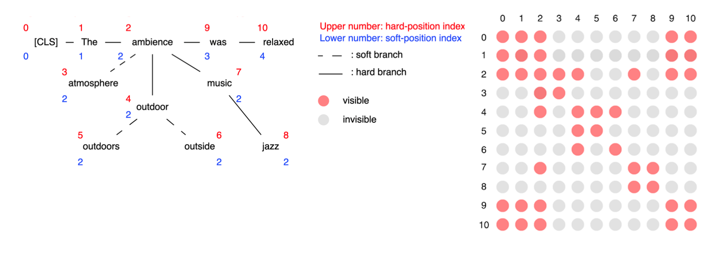
Methodology – Knowledge Injection
During the testing phase, knowledge is injected using the domain sentiment ontology.
k-Hops in the ontology:
  Defines the distance to traverse in the ontology
    0-hop: Synonyms – the ontology does not have to be traversed. Added by inserting soft branches to the sentence tree.
    1-hop, 2-hop: subclasses related to concepts. Added by inserting hard branches to the sentence tree.

Slide 13
Methodology – Knowledge Injection
Challenges with knowledge injection
  Challenge 1: Incompatibility with BERT Embedding Layer.
    After injecting knowledge, the sentence tree contains branches that cannot be processed directly by BERT’s embedding layer.
    The sentence tree is rearranged by inserting the tokens located in the branches subsequent to their originating nodes.
    Solution: Soft-Positioning.
      All the injected tokens get the same soft-position as the original word in the sentence.
      Limits the effect of Knowledge Noise (KN)

Slide 14
Methodology – Knowledge Injection
Challenges with knowledge injection
  Challenge 2: Loss of Sentence Meaning
    While soft-positioning preserves sentence structure, the injection of additional tokens can distort the original meaning of the sentence.
    Solution: Visibility Matrix.
      Ensures injected tokens influence only relevant words:
        Tokens in different branches do not influence each other
        Tokens in the same branch interact with one another
      Limits the effect of KN

Slide 15
Example Visibility Matrix & Soft-Positioning

Slide 16
Methodology – Knowledge Injection
Challenges with knowledge injection
  Challenge 3: Effect of increasing the number of hops
    On the one hand, increasing the number of hops might introduce concepts with increasingly distinct meanings, causing the original meaning of the sentence to change.
    On the other hand, alternative lexical representations of present concepts might be better able to capture the sentiment because people sometimes use a variety of words. Therefore, lexical representations can be more important than the original words due to their presence in the training data.
    Solution: Hop Weight Mechanism
      Control the influence of injected tokens based on their distance in the ontology.

Slide 17
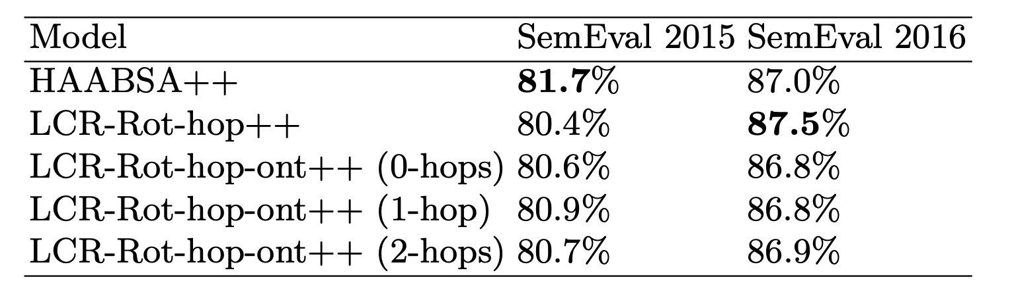
Evaluation
SemEval 2015:
  LCR-Rot-hop-ont++ outperforms LCR-Rot-hop++ for all hop levels.
  HAABSA++ achieves highest accuracy.
  1-hop injection achieves highest accuracy for LCR-Rot-hop-ont++
SemEval 2016:
  HAABSA++ outperforms LCR-Rot-hop-ont++ for all hop levels.
  Performance declines as more distant hops are injected due to increased knowledge noise

Slide 18
Evaluation
Wilcoxon signed rank test on 100 bootstraps on the test data:
  LCR-Rot-hop-ont++ is statistically significant better than LCR-Rot-hop++ on SemEval 2015
  LCR-Rot-hop++ is statistically significant better than LCR-Rot-hop-ont++ on SemEval 2016
Leveraging a domain sentiment ontology both in a hybrid approach and directly injecting in a neural network increases accuracy for smaller datasets. However, a hybrid approach is preferred over knowledge injection.
An ontology does not boost performance for larger datasets, as these allow for a better trained neural model.

Slide 19
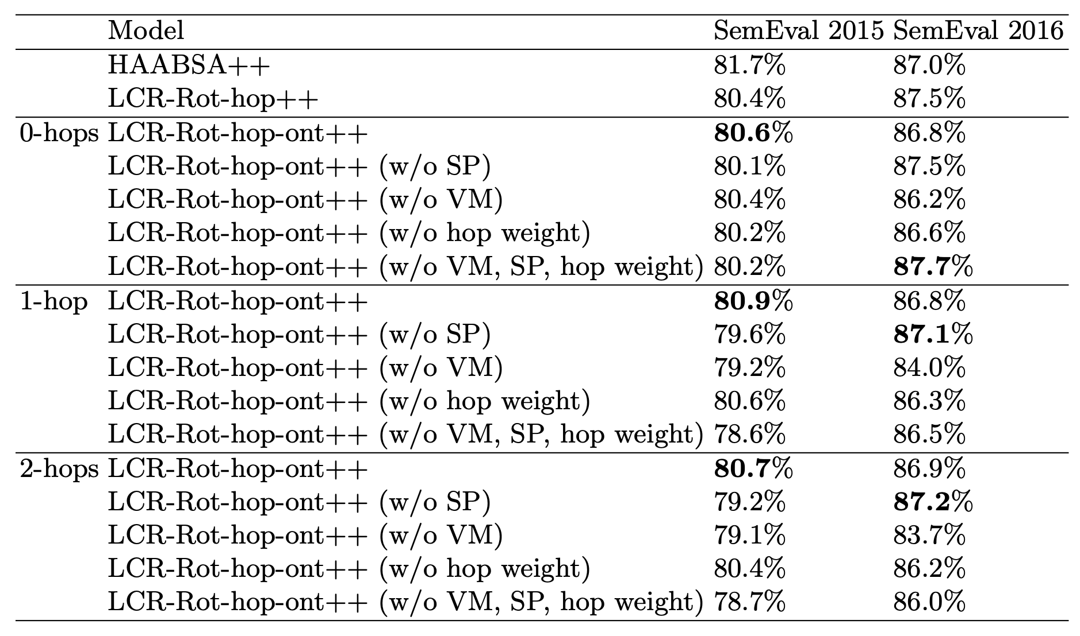
Evaluation – Ablation Experiment
Objective: Assess the impact of soft-positioning, visibility matrix, and hop weighting on the performance of the model
SemEval 2015:
  Accuracy LCR-Rot-hop-ont++ higher with SP, VM and hop weight mechanism for all hops.
SemEval 2016:
  Accuracy LCR-Rot-hop-ont++ higher without SP
  Accuracy LCR-Rot-hop-ont++ higher with VM and hop weight mechanism.

Slide 20
Evaluation – Ablation Experiment
Key Insights:
  Visibility Matrix:
    Essential for all datasets; removing it consistently decreases performance.
    Highlights its importance regarding limiting knowledge noise.
  Soft-Positioning:
    Critical for small datasets
    For larger datasets, soft-positioning degrades performance:
      Likely due to the heuristic introducing excessive noise in models already well-trained on large datasets.

Slide 21
Conclusion
We have proposed two extensions for LCR-Rot-hop-ont++:
  Injecting lexical representations of selected subconcepts in addition to the lexical representations of the original concepts.
  Hop weight mechanism to control for injected knowledge.
LCR-Rot-hop-ont++ outperforms LCR-Rot-hop++ for small datasets.
Hop Weighting Mechanism significantly enhances performance.
Future work:
  Explore knowledge injection during training to improve learning from external information.
  Use RoBERTa word embeddings for better contextual understanding.
  Investigate limiting the amount of injected knowledge to reduce knowledge noise.

Slide 22
References
Dekker, R., Gielisse, D., Jaggan, C., Meijers, S., Frasincar, F.: Knowledge graph injection for aspect-based sentiment classification. In: 34th International Conference on Database and Expert Systems (DEXA 2023). LNCS, vol. 14147, pp. 173–187. Springer (2023)
Liu, W., Zhou, P., Zhao, Z., Wang, Z., Ju, Q., Deng, H., Wang, P.: K-BERT: Enabling language representation with knowledge graph. In: 34th AAAI Conference on Artificial Intelligence (AAAI 2020). vol. 34, pp. 2901–2908. AAAI (2020)
Trusca, M.M., Wassenberg, D., Frasincar, F., Dekker, R.: A hybrid approach for aspect-based sentiment analysis using deep contextual word embeddings and hierarchical attention. In: 20th International Conference on Web Engineering (ICWE 2020). LNCS, vol. 12128, pp. 365–380. Springer (2020)
Schouten, K., Frasincar, F., de Jong, F.: Ontology-enhanced aspect-based sentiment analysis. In: 17th International Conference on Web Engineering, (ICWE2017). LNCS, vol. 10360, pp. 302–320. Springer (2017)

