Slide 1
Multilingual, Cross-lingual, and Unilingual Models for Aspect-Based Sentiment Classification*
Flavius Frasincar
frasincar@ese.eur.nl
*Joint work with Steinar Horst

Slide 2
Contents
Motivation
Related Work
Data
Methodology
Evaluation
Conclusion
Future Work
Further Information
References

Slide 3
Motivation
Growing number of reviews:
  In 2020: the number of reviews on Amazon around 250 million
Growing importance of reviews:
  Consumers:
    80% of the consumers read online reviews
    75% of the consumers consider reviews important
  Companies:
    Improve products
    Market products
Reading all reviews is time consuming, therefore the need for automation

Slide 4
Motivation
Sentiment mining is defined as the automatic assessment of the sentiment expressed in text (in our case by consumers in product reviews)
Several granularities of sentiment mining:
  Document-level
  Paragraph-level
  Sentence-level
  Aspect-level (product aspects are sometimes referred to as product features): Aspect-Based Sentiment Analysis (ABSA) firstly surveyed by Schouten and Frasincar (2016):
    Document-level
    Paragraph-level
    Sentence-level [our focus here]

Slide 5
Motivation
ABSA has two stages:
  Aspect Detection (AD): finding aspects in product reviews recently surveyed by Trusca and Frasincar (2023)
    Explicit aspect detection: aspects appear literally in product reviews [our focus here]
    Implicit aspect detection: aspects do not appear literally in the product reviews
  Aspect-Based Sentiment Classification (ABSC): assigning the sentiment associated to explicit or implicit aspects recently surveyed by Brauwers and Frasincar (2023) [our focus here]
Three approaches for ABSA:
  Knowledge Representation (KR)
  Machine Learning (ML)
  Hybrid: current state-of-the-art, e.g., A Hybrid Approach for Aspect-Based Sentiment Analysis++ (HAABSA++) proposed by Trusca et al. (2020)

Slide 6
Motivation
HAABSA++ is a two-step approach for ABSA at sentence-level:
  Ontology-based reasoning
  Deep learning (backup solution): LCR-Rot-hop++
Problem: LCR-Rot-hop++ has been made for English, but there is no support for other languages
  Support also resource-poor languages and not just resource-rich languages
Solution: Explore various ways to adapt LCR-Rot-hop++ to make it work also for other languages
  Focus on resource-poor languages

Slide 7
Related Work
Multiple language support for ABSC:
  Multilingual ABSC (MABSC): train on data from multiple languages and test on data from multiple languages [one model]
  Cross-lingual ABSC (XABSC): train on data from the source language (often English) and test on data from a target language [many models]
    Translate source language data to target language data and train on the translated language data
    Aspect-Code Switching (ACS): translate source language data to target language data, switch aspects, and train on the combined datasets by Zhang et al. (2021)
  Unilingual ABSC (UABSC): train and test on data from the same language [many models]
Contrastive Learning for XABSA (CL-XABSA): better separate the representations of instances with different labels by Lin et al. (2023)

Slide 8
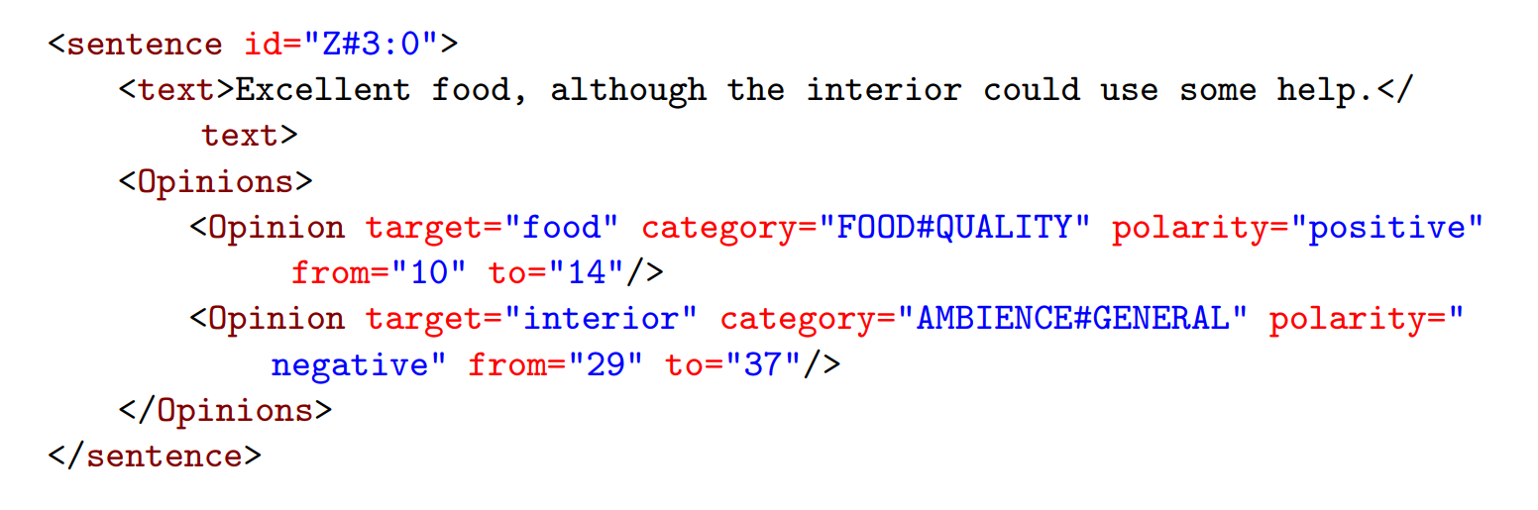
Data
SemEval:
  SemEval 2016, Task 5, Subtask 3 for restaurant reviews
  3-point sentiment scale: positive, neutral, and negative
Example:

Slide 9
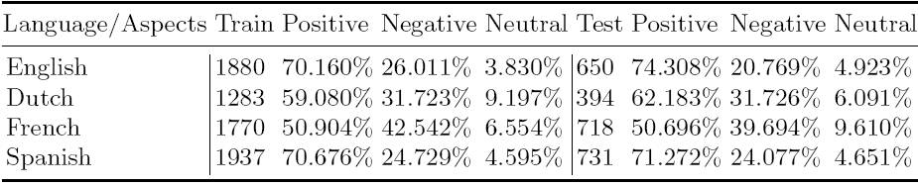
Data
SemEval Descriptive Statistics:
Removed instances with implicit aspects (25% of the data)
Neutral is the minority class
Positive is the majority class (more for English and Spanish)
20% of training data set aside for validation (hyperparameter tuning):
  Tree-structured Parzen Estimator (TPE) for setting hyperparameters

Slide 10
Methodology
ABSC: LCR-Rot-hop++
LCR-Rot-hop++:
  BERT word embeddings
  Three Bi-LSTMs (left context, aspect target, right context)
  Two iterative steps using bilinear attention:
    Target2Context: uses the target representation (initially pooled) to obtain target-dependent left/right context representations (two vectors)
    Context2Target: uses the left/right context representations to obtain left/right context-dependent target representations (two vectors)
  Hierarchical attention (part of the previous two iterative steps):
    After Target2Context: apply attention to the obtained two vectors
    After Context2Target: apply attention to the obtained two vectors
  Repeat the two iterative steps a number of hops (e.g., 3)

Slide 11
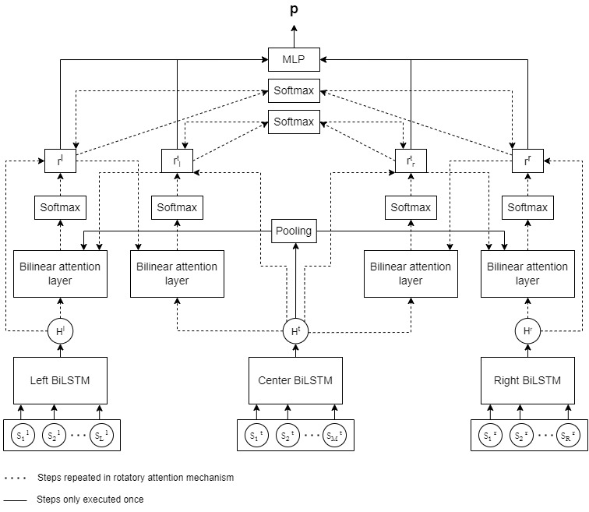
Methodology

Slide 12
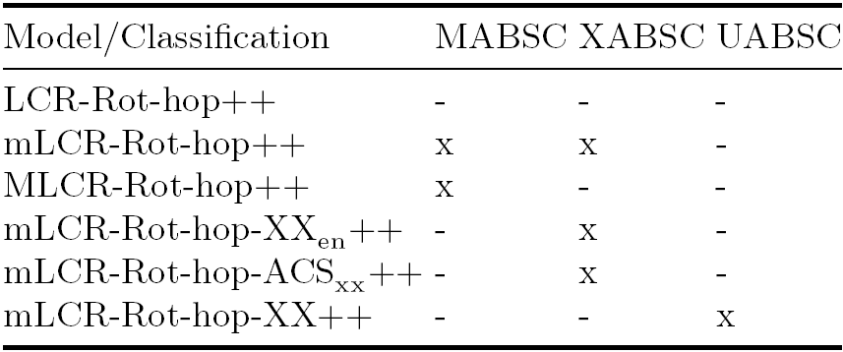
Methodology

Slide 13
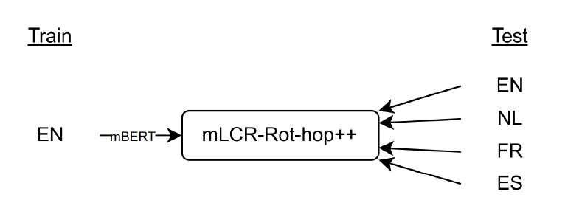
mLCR-Rot-hop++ Base Model
Uses multilingual BERT (mBERT) trained on 104 languages
We use four languages: English, Dutch, French, and Spanish
Trained on the English data
Tested on individual language data

Slide 14
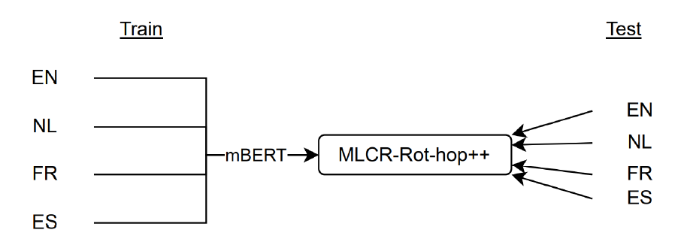
MABSC Models
LCR-Rot-hop++ (baseline with BERT for English)
mLCR-Rot-hop++ (with multilingual mBERT)
MLCR-Rot-hop++:
  Trained on data from multiple languages
  Tested on individual language data

Slide 15
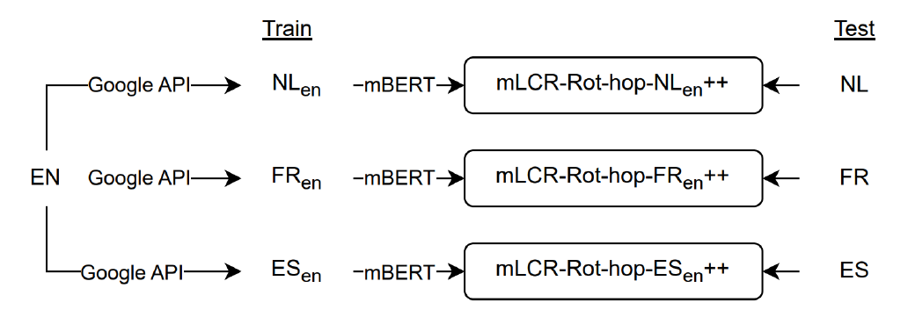
XABSC Models
mLCR-Rot-hop-XX_{en}++:
  Translate using Google API the source English language data to the target language data for training
  Use Alignment-Free (AF) label projection:
    Uses markers to delineate the aspect in the data before translation (serves also as label)
    It is better than the alternative Translate-then-Align (TA) which possibly suffers from the mismatch between the translated label and translated aspect in context
  Tested on the corresponding target language data

Slide 16
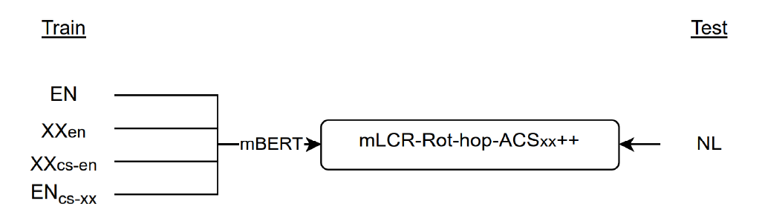
XABSC Models
mLCR-Rot-hop-ACS_{xx}++:
  Translate the source English language data to the target data (XXen)
  Apply ACS for aspect swapping between the two languages:
    Target language data code switched (XX_{cs-en})
    English language data code switched (EN_{cs-xx})
  Four times as much training data

Slide 17
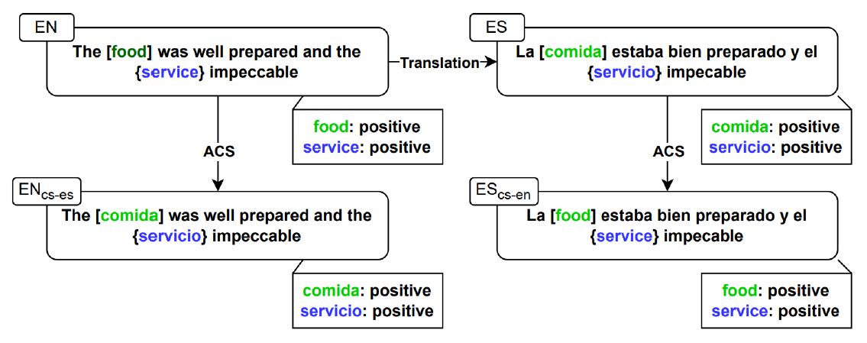
XABSC Models

Slide 18
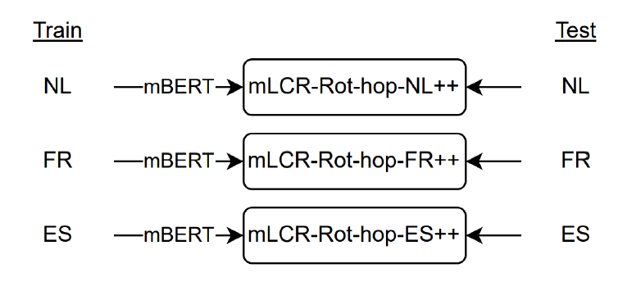
UABSC Models
Trained on one language data
Tested on the corresponding same language data

Slide 19
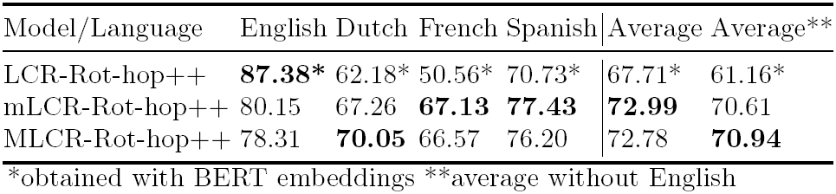
Evaluation – MABSC Models
LCR-Rot-hop++: best model for English
  Trained only for English with BERT (baseline)
mLCR-Rot-hop++: best model overall
  Trained only for English with mBERT
MLCR-Rot-hop++: best model overall (without English):
  Trained on multiple languages
Surprise observation: mLCR-Rot-hop++ performs on average (with English) better than MLCR-Rot-hop++
  The similarity between Latin languages might confuse MLCR-Rot-hop++
Best MABSC model: MLCR-Rot-hop++

Slide 20
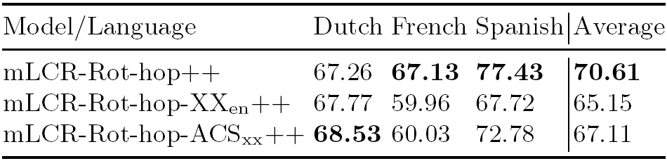
Evaluation – XABSC Models
mLCR-Rot-hop++: best model overall
  Trained only on English (no translation)
mLCR-Rot-hop-XX_{en}++: better than mLCR-Rot-hop++ for Dutch
  Trained on translation from English
mLCR-Rot-hop-ACS_{xx}++: best model for Dutch
  Trained on English, translation from English, and their ACS variants
Surprise observation: translation-based models do not improve overall from mLCR-Rot-hop++
  Different data distribution between translations and test target language data
Best XABASC model: mLCR-Rot-hop++

Slide 21

Evaluation – UABSC Models
mLCR-Rot-hop-XX++: 2.4 percentage points better than MLCR-Rot-hop++ with an average of 70.94 (the specialized model is better than the all-purpose model)
  The interference between languages negatively impacts the performance of the MABSC models
We do not compare with XABSC models as these use translations and ACS
Best overall model: mLCR-Rot-hop-XX++

Slide 22
Conclusion
Problem: ABSC for resource-poor languages
Solution:
    MABSC: train on multiple languages
      mLCR-Rot-hop++ (use mBERT and train on English) and MLCR-Rot-hop++ (use mBERT and train on multiple languages)
      Best model: MLCR-Rot-hop++
    XABSC: train only on the source language (translated to the target language)
      mLCR-Rot-hop++ (trained on English), mLCR-Rot-hop-XX_{en}++ (trained on translation from English), and mLCR-Rot-hop-ACS_{xx}++ (trained on English and translation from English data with ACS)
      Best model: mLCR-Rot-hop++
    UABSC: train only on the target language
      mLCR-Rot-hop-XX++ (train and test on the same language)
Best model: mLCR-Rot-hop-XX++

Slide 23
Future Work
Experiment with other types of reviews: laptops, hotels, and consumer electronics
Experiment with other languages: Chinese, Russian, and Turkish
Combine the translated from English language data and English language data (possibly with ACS) for many languages to better train MLCR-Rot-hop++
Improve XABSC using CL
Experiment with other multilingual contextual word embeddings:
  XLM-R: extension of RoBERTa for multiple languages (100) – Meta (Facebook)
  mBART: extension of BART for multiple languages (50) – Meta (Facebook)

Slide 24
Further Information
Dataset and code publicly available at: https://github.com/Steinar2049/mLCR-Rot-hop-plus-plus is written in Python
Feel free to try it out and improve our research
Questions about the code should be sent to Steinar Horst (steinar.horst@gmail.com)

Slide 25
References
ABSA:
  Kim Schouten and Flavius Frasincar: Survey on Aspect-Level Sentiment Analysis. IEEE Transactions on Knowledge and Data Engineering 28(3):813-830 (2016)
AD:
  Maria Mihaela Trusca and Flavius Frasincar: Survey on Aspect Detection for Aspect-Based Sentiment Analysis. Artificial Intelligence Review 56(5):3797-3846 (2023)
ABSC:
  Gianni Brauwers and Flavius Frasincar: A Survey on Aspect-Based Sentiment Classification. ACM Computing Surveys 55(4):65:1-65:37 (2023)

Slide 26
References
HAABSA++:
  Maria Mihaela Trusca, Daan Wassenberg, Flavius Frasincar, and Rommert Dekker: A Hybrid Approach for Aspect-Based Sentiment Analysis Using Deep Contextual Word Embeddings and Hierarchical Attention. 20th International Conference on Web Engineering (ICWE 2020). LNCS, Volume 12128, Springer, 365-380 (2020)
ACS:
  Wenxuan Zhang, Ruidan He, Haiyun Peng, Lidong Bing, Wai Lam: Cross-lingual Aspect-based Sentiment Analysis with Aspect Term Code-Switching. 2021 Conference on Empirical Methods in Natural Language Processing (EMNLP 2021). ACL, 9220-9230 (2021)

Slide 27
References
CL-XABSA:
  Nankai Lin, Yingwen Fu, Xiaotian Lin, Dong Zhou, Aimin Yang, Shengyi Jiang: CL-XABSA: Contrastive Learning for Cross-Lingual Aspect-Based Sentiment Analysis. IEEE/ACM Transactions on Audio, Speech and Language Processing. 31: 2935-2946 (2023)

