Slide 1
Adversarial Training for a Hybrid Approach to Aspect-Based Sentiment Analysis
Ron Hochstenbach
Erasmus University Rotterdam
hochstenbach.ron@gmail.com
Flavius Frasincar
Erasmus University Rotterdam
fransincar@ese.eur.nl
Maria Trusca
Bucharest University of Economic Studies
maria.trusca@csie.ase.ro
Notes:
My name is Maria Trusca, I am Bucharest University of Economic Studies. The name of our work is “A Hybrid Approach for Aspect-Based Sentiment Analysis Using Deep Contextual Word Embeddings and Hierarchical Attention”. My colleagues are Daan Wassenberg, Flavius Frasincar and Rommert Dekker. They all are from Erasmus University Rotterdam

Slide 2
Aspect-based Sentiment Analysis (ABSA)
Aspect Category Detection: identifies the pair Entity#Aspect, e.g. Food#Quality;
Opinion Target Extraction: identifies the expression used in the text to describe the aspect, e.g. pad se ew chicken;
Sentiment Classification: finds the sentiment label of the pair Entity#Aspect.

Slide 3
Our Approach
Given the following benefits of adversarial training in the field of affective computing and sentiment analysis:
The sparse availability of labeled sentiment data is overcome;
The generated emotions are more natural and more understandable to humans;
The trained models are more robust as the problems with samples gathered from different contexts are reduced;
The quality evaluation of the generated samples is automatically executed.
we rely on the Categorical Generative Adversarial Networks (Cat-GANs) to enhance the performance of a state-of-the-art model developed for ABSA, by better recognizing the input characteristics of instances belonging to different sentiment classes.

Slide 4
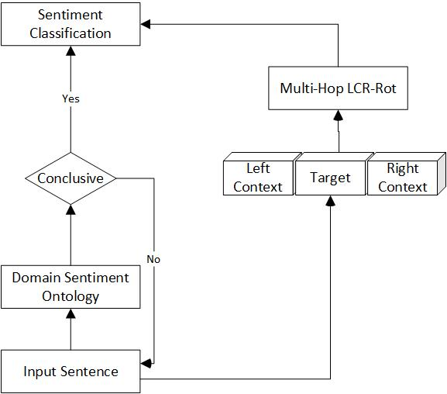
Baseline Approach
Domain Sentiment Ontology
Deep Neural Network

Slide 5
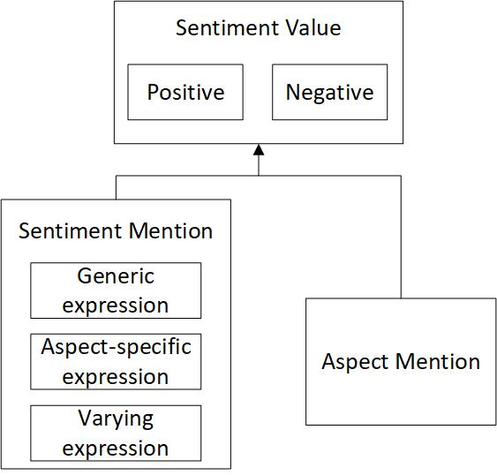
Domain Sentiment Ontology
The domain sentiment ontology has three main classes:
SentimentMention class represents sentiment expressions;
AspectMention class identifies aspects related to sentiment expressions;
SentimentValue class groups aspects in the Positive and Negative subclasses based on the type of sentiment expression.
Generic sentiment expression
Aspect-specific sentiment expression
Varying sentiment expression

Slide 6
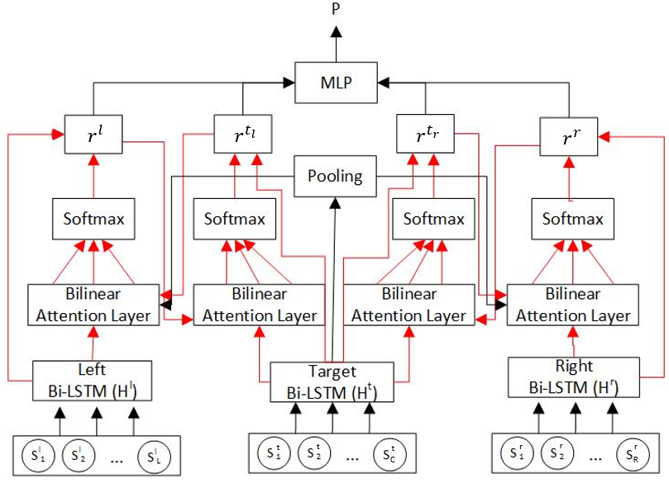
LCR-Rot-hop ++
The backup model is a Left-Center-Right Separated Neural Network with Hierarchical Rotatory Attention. The main layers of the neural network are:
Input (word embeddings)
LSTM (context-based word embeddings)
Hierarchical Rotatory Attention (applied multiple times)
Target2context vectors
$r^{l}= \sum_{i=1}^{L}{α_{i}^{l}} ×h_{i}^{l}$ (example for the left context)
Context2target vectors
$r^{t_{l}}= \sum_{i=1}^{T}{α_{i}^{t_{l}}} ×h_{i}^{t}$ (example for the left context)
Where $α_{i}^{l}$ and $α_{i}^{t_{l}}$ are attention scores and $h_{i}^{l}$ and $h_{i}^{t}$ are hidden states
MLP layer

Slide 7
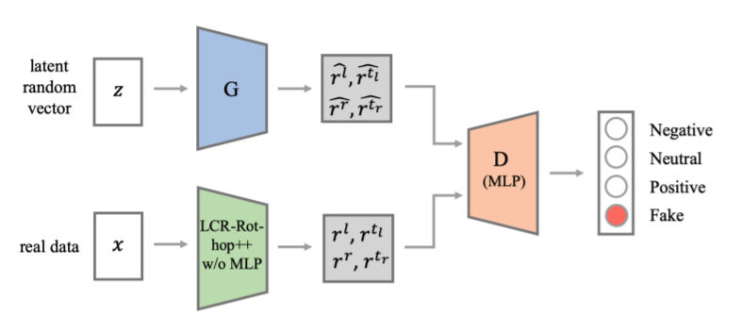
Cat-GAN
Discriminator (D): the LCR-Rot-hop++ neural network is adjusted to work as a discriminator that should distinguish not only sentiment classes but also the generated (fake) instances.
Generator (G): A fully connected 4-layer MLP is used to encode randomly generated inputs similar to the real input instances.

Slide 8
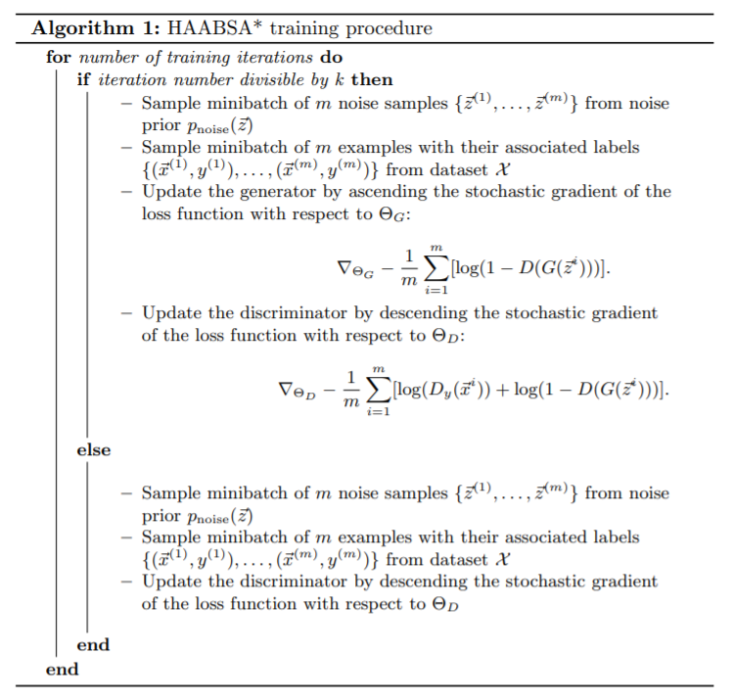
Cat-GAN
Knowing that J and I are the batches of real and generated samples, and D($∙$) represents the probability that the data is real or generated, the loss function of the Cat-GAN neural network is defined as:
$$L_{G,D}=−\sum_{j∈J}{\vec{y_{j}}×\log\left(\hat{p_{j}}\right)}−\sum_{i∈I}{\vec{y_{i}}×\log\left(\hat{p_{i}}\right)}+$$
$$λ({\left|\left|Θ_{G}\right|\right|}^{2}+{|\left|Θ_{D}\right||}^{2})$$
or:
$$L_{G,D}=−\sum_{j∈J}{{log⁡[D}_{y}(\vec{x_{j}})]}−\sum_{i∈I}{{log⁡[1−D}_{y}(G(\vec{z}))]}+$$
$$λ({\left|\left|Θ_{G}\right|\right|}^{2}+{|\left|Θ_{D}\right||}^{2})$$
and is solved as an optimization problem:
$$\max_{G}{\min_{D}{L_{G,D}}}$$

Slide 9
Cat-GAN – Implementation details
The minimax game implemented by the Cat-GAN neural network is able to converge or to reach its optimum if:
The generator is updated at each k-th iteration (the discriminator reaches its optimum given an instance of the generator before the generator is updated again);
The learning rates and momentum terms of the generator are modified with respect to the discriminator as follows:
$${lr}_{gen}= μ_{lr}×{lr}_{dis} and {mom}_{gen}= μ_{mom}×{mom}_{dis}$$
The loss function includes the L2-regularization term, and the dropout adjusts the layers of the neural network;

Slide 10
Results
The comparison between the baseline model HAABSA++ and HAABSA*: To get a better understanding of how the backup neural network performs for both HAABSA++ and HAABSA*, the accuracies without ontology are also reported.
 |  | SemEval 2015 |  | SemEval 2016
 |  | In-sample | Out-of-sample | In-sample | Out-of-sample
w ontology | HAABSA++ | 88.8% | 81.7% | 91.0% | 84.4%
 | HAABSA* | 89.7% | 82.5% | 91.5% | 87.3%
w/o ontology | HAABSA++ | 94.9% | 80.7% | 95.1% | 80.6%
 | HAABSA* | 96.6% | 82.2% | 96.2% | 88.2%

Slide 11
Conclusion and Future Work
In this work, we extended the backup neural network of a state-of-the-art hybrid approach method for ABSA using adversarial training. Overall, the GAN-based HAABSA model increased the testing accuracy as follows:
With ontology: +0.8 p.p. (SemEval 2015), +2.9 p.p. (Semeval 2016);
Without ontology: +0.5 p.p. (SemEval 2015), +7.6 p.p. (SemEval 2016).
Future work:
Investigate the effect of different input perturbations as an alternative of the random input generation;
Refine the neural network of the generator.

Slide 12
Thank you! The code can be found at https://github.com/RonHochstenbach/HAABSAStar

