Slide 1
Alleviating the Cold Start Problem in Recommender Systems Using Error-Based Learning
Ricardo Laanen & Flavius Frasincar
Notes:
Good afternoon everyone.
My name is Ricardo Laanen, and in this presentation I will discuss the research paper I wrote with Flavius Frasincar, titled “Alleviating the Cold Start Problem in Recommender Systems Using Error-Based Learning”.

Slide 2
Problem Statement
Information overload
Recommender systems
The cold-start problem
First test of strategies proposed
Original variants of strategies introduced
Notes:
A situation that many of us are familiar with, is ‘information overload’: being so overwhelmed with options, that it becomes impossible to make a choice.
To fight this issue, we make use of recommender systems, which have become part of our digital lives.
But, for a recommender system to make fitting recommendations, it needs data about its user.
This introduces an unsolved problem with recommender systems: the cold start problem, which occurs when a new user or item is introduced to the system.
This research paper investigated several methods to increase recommendation accuracy for cold users. It is the first time these methods have been tested, and the first paper to introduce variants of the proposed strategies based on risk.

Slide 3
Methodology
Active-learning strategies
Error-based learning methods
Instance-based learning methods

Slide 4

Y-Change Strategy
Assumption: if changes in output estimates lead, on average, to an increase in accuracy, an item that changes many output estimates is considered useful
How much would the estimates change if a cold user rated candidate item $i_{x}$ with rating $y$?
Proposed in: N. Rubens, R. Tomioka, and M. Sugiyama, “Output divergence criterion for active learning in collaborative settings,” IPSJ Online Transactions, vol. 2, 2009, pp. 240–249.
Notes:
The first method is the output-estimates-change strategy, or Y-change for short.
It is based on the assumption that if output estimates lead, on average, to increased accuracy, an item that changes many estimates is considered useful.
It answers the question: how much would the estimates change if a cold user rated a candidate item with a specific rating.

Slide 5




Y-Change Strategy
How much would my estimation of your overall preferences changes if I knew this about you?
Notes:
Let’s illustrate with an example.
You are a cold user, and I don’t know anything about you.
Now, how much would I learn about you, if I knew that you love the Incredibles?
Maybe, not too much. Everyone loves the incredibles, it’s objectively a great movie.
What about if I knew you hate Titanic?
That would completely change my estimated preferences. I now estimate you don’t like emotional drama and you might prefer a movie with loads of cool action. Such as the Incredibles?

Slide 6
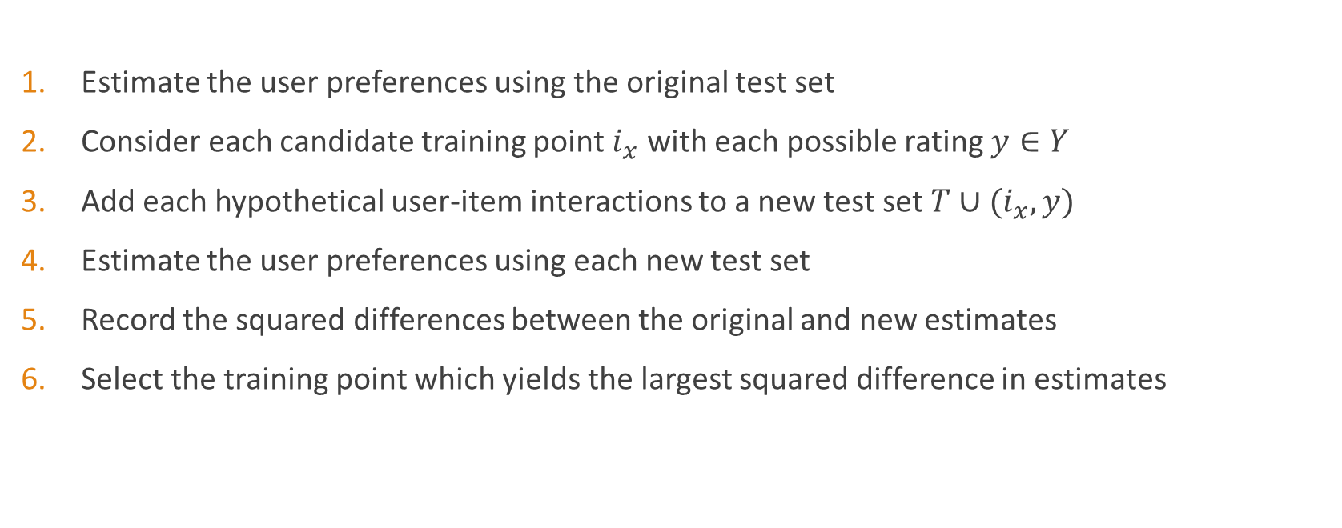
Y-Change Strategy
Estimate the user preferences using the original test set
Consider each candidate training point $i_{x}$ with each possible rating $y∈Y$
Add each hypothetical user-item interactions to a new test set $T∪(i_{x}, y)$
Estimate the user preferences using each new test set
Record the squared differences between the original and new estimates
Select the training point which yields the largest squared difference in estimates
Proposed in: N. Rubens, R. Tomioka, and M. Sugiyama, “Output divergence criterion for active learning in collaborative settings,” IPSJ Online Transactions, vol. 2, 2009, pp. 240–249.

Slide 7
Y-Change Strategy
How much would my estimation of your overall preferences changes if I knew this about you?
Notes:
Let’s go back to the example.
I will first make some initial estimates about your movie preferences.
To understand by how much my estimates would change if I know your opinion about these movies, I will first assume that you love the incredibles.
I will then recalculate my estimates about you, using my original test set with this one observation added.
I will repeat, for each combination of movies I could ask you about, and the possible rating you can give it.
Finally, I will choose the item that gives me the largest change in estimates, compared to my initial estimates.

Slide 8
Y-Change Strategy
Conservative variant: choose the candidate item that results in the largest change in output estimates, based on the rating that gives the smallest change in output estimates.
Moderate variant: choose the candidate item that, on average for every rating, results in the largest change in output estimates
Risky variant: choose the candidate item that results in the largest change in output estimates, based on the rating that gives the largest change in output estimates.
Notes:
Finally, we introduce three variants for the strategy: one conservative, one moderate, and one risky.
The conservative variant decides which candidate item to show based on the rating that gives the lowest change in output estimates. It makes sure that, even if the item is rated in a way that gives us comparatively less information, we choose an item that gives us a decent change in estimates.
The moderate variant decides on the item based on the average change in output estimates for each rating.
The risky variant chooses the item that can potentially result in the largest change in output estimates if the optimal rating is given, but doesn’t take into consideration what happens if a suboptimal rating is given.

Slide 9

Y-Change Strategy
How much would my estimation of your overall preferences changes if I knew this about you?
Notes:
Once more.
If you rate the incredibles positively, my estimates do not change by much overall.
If you rate the incredibles negatively, my estimates will change a lot, and we will not hang out in the near future.
Whichever way you rate Titanic, my estimates will change a decent amount.
If I was being conservative, I would ask your opinion about Titanic. No matter your rating, I will get a decent amount of information.
If I was being moderate, I would ask your opinion about Titanic as well, because on average, I would gain more information.
If I was feeling risky, I would ask you about the Incredibles. If you rate it negatively, I gain the most information.

Slide 10

Y-Change Strategy - Equation
Conservative: ${\hat{G}}_{ΔY−C}\left(i_{x}\right)=−\min_{y∈Y}{\sum_{\left(u, i\right)∈A^{Test}}{{({\hat{f}}_{T}\left(u, i\right)−{\hat{f}}_{T∪\left(i_{x,} u_{0}, y\right)}\left(u, i\right))}^{2}} }$
Moderate: ${\hat{G}}_{ΔY−M}\left(i_{x}\right)=−\frac{1}{|Y|}{\sum_{y∈Y, \left(u, i\right)∈A^{Test}}{{({\hat{f}}_{T}\left(u, i\right)−{\hat{f}}_{T∪\left(i_{x,} u_{0}, y\right)}\left(u, i\right))}^{2}} }$
Risky: ${\hat{G}}_{ΔY−R}\left(i_{x}\right)=−\max_{y∈Y}{\sum_{\left(u, i\right)∈A^{Test}}{{({\hat{f}}_{T}\left(u, i\right)−{\hat{f}}_{T∪\left(i_{x,} u_{0}, y\right)}\left(u, i\right))}^{2}} }$

Slide 11

Error-Change Strategy
Assumption: an item that allows for approximation of preferences is considered useful
How accurate will the estimations be if a cold user rated candidate item $i_{x}$ with rating $y$?
Proposed in: S. A. Danziger, J. Zeng, Y. Wang, R. K. Brachmann, and R. G. Lathrop, “Choosing where to look next in a mutation sequence space: Active learning of informative p53 cancer rescue mutants,” Bioinformatics, vol. 23, no. 13, 2007, pp. 104–114.

Slide 12
Error-Change Strategy
How accurately could I predict your overall preferences if I knew this about you?
Notes:
I already know your preferences, but I will pretend that I don’t.
If I assumed that you love the incredibles and then tried to predict your preferences, how accurate would they be?
What about the Titanic? Would my predictions be more or less accurate if I knew your opinion about the Incredibles, or Titanic?

Slide 13
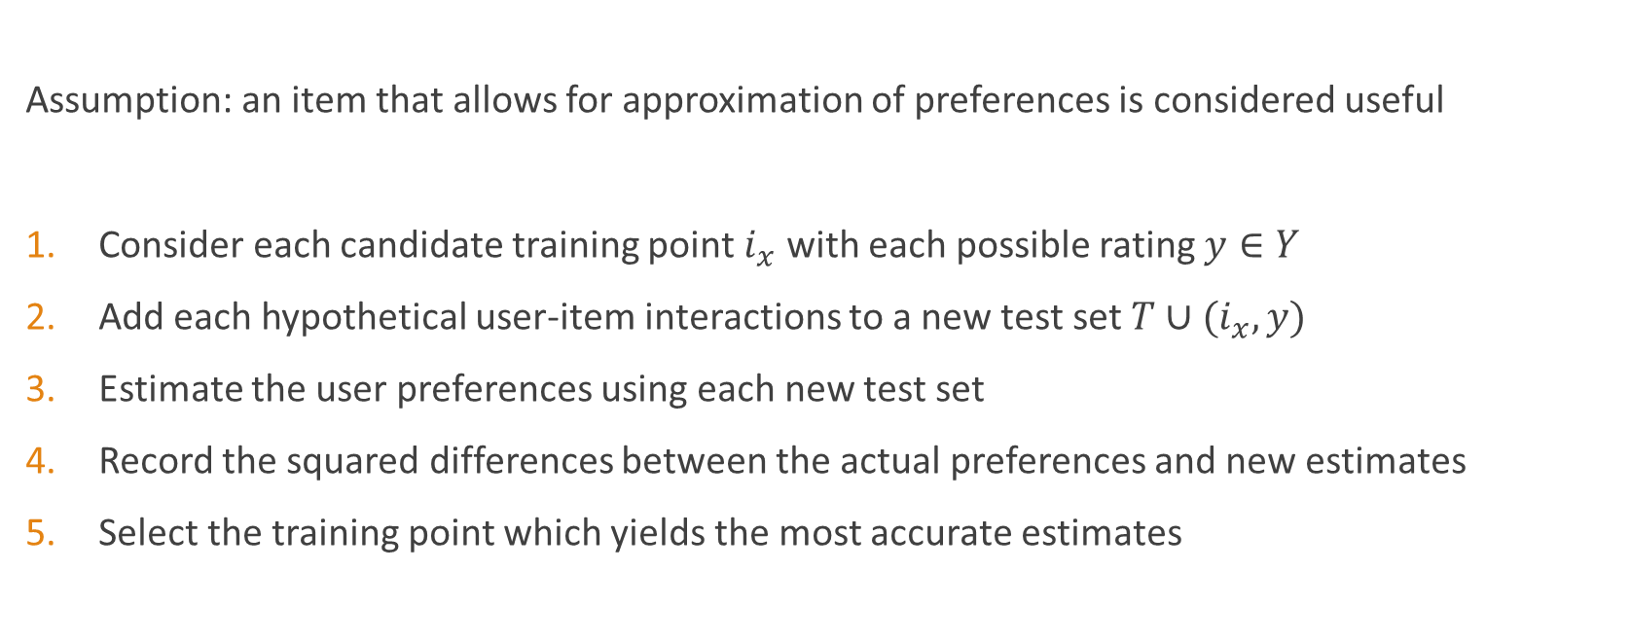
Error-Change Strategy
Assumption: an item that allows for approximation of preferences is considered useful
Consider each candidate training point $i_{x}$ with each possible rating $y∈Y$
Add each hypothetical user-item interactions to a new test set $T∪(i_{x}, y)$
Estimate the user preferences using each new test set
Record the squared differences between the actual preferences and new estimates
Select the training point which yields the most accurate estimates
Proposed in: S. A. Danziger, J. Zeng, Y. Wang, R. K. Brachmann, and R. G. Lathrop, “Choosing where to look next in a mutation sequence space: Active learning of informative p53 cancer rescue mutants,” Bioinformatics, vol. 23, no. 13, 2007, pp. 104–114.

Slide 14
Error-Change Strategy
How accurately could I predict your overall preferences if I knew this about you?
Notes:
Let’s go back to the example.
I will first record your actual preferences and then pretend I don’t know them.
I will first assume that you love the incredibles, and calculate my estimates about your preferences, using my original test set with this one observation added.
I will repeat, for each combination of movies I could ask you about, and the possible rating you can give it.
Finally, I will choose the item that gives me the best estimates when compared to your actual preferences.

Slide 15
Error-Change Strategy
Conservative variant: choose the candidate item that results in the most accurate estimates, based on the rating that gives the largest error in output estimates.
Moderate variant: choose the candidate item that, on average for every rating, results in the smallest error in output estimates
Risky variant: choose the candidate item that results in the most accurate output estimates, based on the rating that gives the smallest error in output estimates.

Slide 16

Error-Change Strategy - Equation
Conservative: ${\hat{G}}_{ΔE−C}\left(i_{x}\right)=\max_{y∈Y}{\sum_{\left(u, i\right)∈A^{Test}}{{(a_{ui}−{\hat{f}}_{T∪\left(i_{x,} u_{0}, y\right)}\left(u, i\right))}^{2}} }$
Moderate: ${\hat{G}}_{ΔE−M}\left(i_{x}\right)=\frac{1}{|Y|}{\sum_{y∈Y, \left(u, i\right)∈A^{Test}}{{(a_{ui}−{\hat{f}}_{T∪\left(i_{x,} u_{0}, y\right)}\left(u, i\right))}^{2}} }$
Risky: ${\hat{G}}_{ΔE−R}\left(i_{x}\right)=\min_{y∈Y}{\sum_{\left(u, i\right)∈A^{Test}}{{(a_{ui}−{\hat{f}}_{T∪\left(i_{x,} u_{0}, y\right)}\left(u, i\right))}^{2}} }$

Slide 17
Strategies for Comparison
Random Strategy
PopGini
Based on: T. Geurts and F. Frasincar, “Addressing the cold user problem for model-based recommender systems,” in Proceedings of the International Conference on Web Intelligence (WI-2017), ACM, 2017, pp. 745–752.

Slide 18
Dataset
Dataset from Dutch department store Bijenkorf
2.5 million+ user-item interactions
200.000+ unique items
500.000+ unique items
Random sample of 100.000 interactions
Binary variables to denote positive (=1) and negative (=0) evaluations
1 = The user purchased an item and did not return it
0 = The user purchased an item and returned it
Based on: T. Geurts and F. Frasincar, “Addressing the cold user problem for model-based recommender systems,” in Proceedings of the International Conference on Web Intelligence (WI-2017), ACM, 2017, pp. 745–752.

Slide 19
Set-Up
25% of users randomly selected as cold users test set
The most informative items are chosen using the eight different methods
Cold users are shown a selection of 10, 25, 50, and 100 items
Predict user preferences
RMSE for each combination of method and selection size is calculated
Based on: T. Geurts and F. Frasincar, “Addressing the cold user problem for model-based recommender systems,” in Proceedings of the International Conference on Web Intelligence (WI-2017), ACM, 2017, pp. 745–752.
Notes:
The evaluation was conducted as follows:
First, 25% of users were randomly selected to be cold users. The remaining 75% of users had their user-item interactions included in the train set.
Next, all candidate items are ranked using the eight different methods.
Then, the cold users are ‘shown’ a selection of 10, 25, 50, and 100 items, so that the methods can be tested using different numbers of items.
After the items are ‘shown’, we can use the cold user preferences of these items by adding them to the train set.
Then, the recommender system can predict the user preferences, keeping in mind the cold user preferences for the set of items shown.
The RMSE for each combination of method and selection size is calculated for comparison.

Slide 20
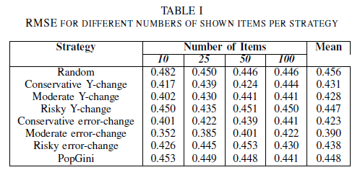
Evaluation
Notes:
The results show that for each number of items, the moderate error-change strategy outperforms the other strategies. This means that, even when there is only a small amount of items to receive feedback for, this strategy performs best.
All strategies outperform the random strategy as expected.
The moderate versions of both strategies perform better than the conservative version, while the risky versions perform the worst.
Moderate and conservative variants of the Y-change and Error-change strategy outperform the PopGini strategy.

Slide 21
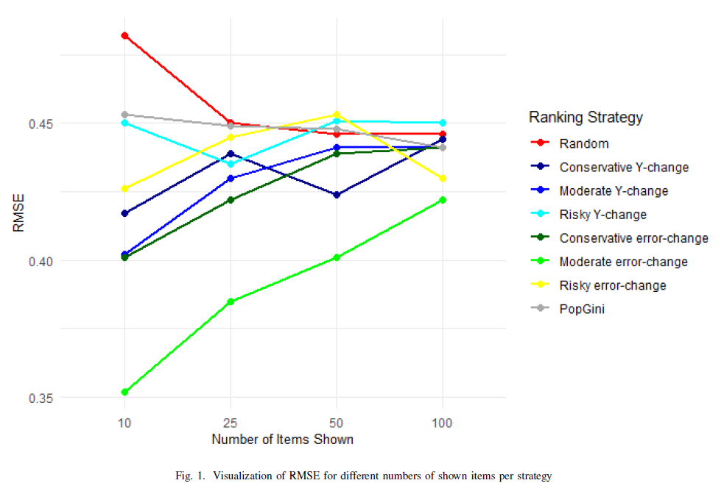
Evaluation
Notes:
Visualized, it is clear that the moderate error-change strategy (in light green) outperforms the other strategies.

Slide 22
Conclusion
…
…
Suggestions:
Evaluate ‘feedback’ after each item is shown
Test (weighted) combination of Y-change and Error-change
Incorporate probability of evaluations in variants

