Slide 1
A Comparison Study for Novelty Control Mechanisms Applied to Web News Stories
Arnout Verheij verheij.a@gmail.com | Allard Kleijn allardkleijn@hotmail.com
Flavius Frasincar frasincar@ese.eur.nl | Frederik Hogenboom frasincar@ese.eur.nl
Erasmus University Rotterdam PO Box 1738, NL-3000 DR Rotterdam, the Netherlands

Slide 2
Introduction (1)
The Web is a great source of information
However, there is an information overload
Solution: information filtering and structuring based on user interests (commonly derived from queries)
Example: Hermes news personalization framework retrieves relevant news based on preferences expressed using concepts from an ontology

Slide 3
Introduction (2)
Most news filtering systems filter out relevant articles with respect to user interests, topics, etc.
However, within this subset of relevant articles, not all information is new
Only articles with high novelty should be retrieved
!
!
news
relevant
novel

Slide 4
Introduction (3)
Key solution: story-based news representation combined with novelty control mechanisms
Novelty control:
Sorting news items based on novelty compared to the seed item and previously browsed items
Based on distance measures for similarity
News items that are dissimilar to other news items but belong to the same topic indicate that the storyline is developing and should receive a high novelty score

Slide 5
Introduction (4)
Most novelty control methods use all words from documents in a vector-based news representation
Considering all words generates noise
Named entities (persons, companies, products, etc.) could carry a large part of the story information contained in a news item
Hence, we explore different frequently used novelty control mechanisms and compare word-based and named entity-based vector representations approaches
Notes:
Common models operate on vectors containing all words in a document and calculate dissimilarities using various methods. We hypothesize that these words generate a lot of noise and that named entities could be of use.
Therefore, in our paper we compared word-based and named entity-based vector representations using various novelty control mechanisms / distance measures.

Slide 6
Novelty Control (1)
News is sorted based on novelty scores of new items compared to already browsed items
Novelty score is calculated using a distance metric:
Based on a certain document representation
Can be used pairwise:
Compare a document to all previously browsed documents
Determine novelty scores by computing the similarity (distance) to the most similar document
Can also be used non-pairwise (aggregated):
Aggregate document representations from all previous documents
Determine novelty scores by computing the document distance to the aggregated documents
Notes:
News is sorted based on novelty scores. These scores are always calculated using a distance metric, which is based on a certain document representation, and can be used pairwise and aggregated.

Slide 7
Novelty Control (2)
Document representation:
Language models:
A model θ is a vector of probabilities P(T_{i}|D) of picking term T_{i} randomly from document D for i = 1 … n
Kullback-Leibler divergence & Jenson-Shannon divergence
Vector space models:
A model θ is a vector of weights for terms T₁ … T_{n} in document D based on, e.g., term presence, term counts, term frequency – inverse document frequency (TF-IDF), etc.
Cosine similarity
Notes:
There are two common document representations, i.e., language models and vector space models. They both have their own popular distance measures.
Language models represent documents as a vector (set) of probabilities for each term. These probabilities represent the probability of picking a term randomly from the document. A popular distance metric is the KL divergence, which measures the information lost when model 2 is used to approximate model 1. Basically, for each term you calculate the probability of occurrence in model 1 and multiply that by the log of the occurrence probability in model 1 divided by that of model 2.
Another popular measure is the Jensen-Shannon measure, which is a symmetric and smoothed variant of the KL divergence (so the distance between model 1 and 2 is the same as the distance between model 2 and 1).
Vector space models represent documents as vectors of weights, which can be based on booleans indicating the presence of words, word counts, TF-IDF, etc. A popular similarity measure is the cosine similarity, which measures the similarity of two weight vectors by multiplying their values and dividing it by the product of their magnitudes.

Slide 8
Implementation
Hermes News Portal:
Java-based news personalization framework
News is scraped from RSS feeds
Named Entity recognition using the Stanford Named Entity Recognition and Information Extraction Package
Information is stored in a domain ontology:
Title
Body
Date
Publisher
Named entities (+ frequencies)
Domain ontology is queried using Jena/ARQ

Slide 9
Evaluation (1)
Evaluated methods:
Frequently used novelty control mechanisms:
Cosine similarity
Kullback-Leibler divergence
Jensen-Shannon divergence
Distance measures usage:
Pairwise
Aggregate
Vector-based news representations:
All words
Named entities
This yields 12 configurations, which are compared with the baseline: ordered by time

Slide 10
Evaluation (2)
Data set:
8,097 news items from 28-02-2011 to 08-04-2011
10 storylines (small storylines of less than 4 items are omitted):
Debt crisis in Portugal
Oil and gas prices rise by trouble in Middle East
Detroit musicians on strike
Pennsylvania judge corruption case
…
9 news items per storyline (average)
Storylines span 2 to 38 days

Slide 11
Evaluation (3)
Golden standard:
3 annotators
Rankings from 0 to 3
Based on novelty with respect to:
Seed item
List of previously read items
Measures:
Kendall’s τ:
-1: rankings are reversed
1: rankings are the same
Discounted Cumulative Gain:
0: bad correlation between rankings
1: perfect correlation between rankings

Slide 12
Evaluation (4)
Kendall’s τ
Method | Overall | P | A | WORDS | NE
COS | 0,183 | 0,165 | 0,201 | 0,116 | 0,250
KL | 0,216 | 0,257 | 0,175 | 0,179 | 0,254
JS | 0,173 | 0,252 | 0,095 | 0,156 | 0,191
Time | -0,192
Discounted Cumulative Gain
Method | Overall | P | A | WORDS | NE
COS | 0,755 | 0,755 | 0,755 | 0,751 | 0,760
KL | 0,789 | 0,760 | 0,818 | 0,785 | 0,794
JS | 0,753 | 0,769 | 0,737 | 0,752 | 0,754
Time | 0,721
Notes:
For both measures, overall, the Kullback-Leibler divergence performs best, followed by cosine similarity and Jenson-Shannon divergence. The baseline is outperformed by all methods.
Pairwise distance measures offer slightly better performance, due to the fact that aggregate methods decrease the quality because of merging.
Most importantly, named entity-based approaches indeed outperform the word-based approaches. Apparently indeed named entities capture an important part of the information that depicts the story within a news item. All words contain more information, but are also more susceptible to noise (like an author’s writing style).

Slide 13
Conclusions
We have evaluated several novelty control mechanisms for ranking Web news articles depicting a storyline
Overall, pairwise KL divergence performs best when considering named entities instead of all words from news items
Future work:
Story detection techniques that take into account the age difference between news items
Semantic approaches for novelty control using concepts from a domain ontology

Slide 14
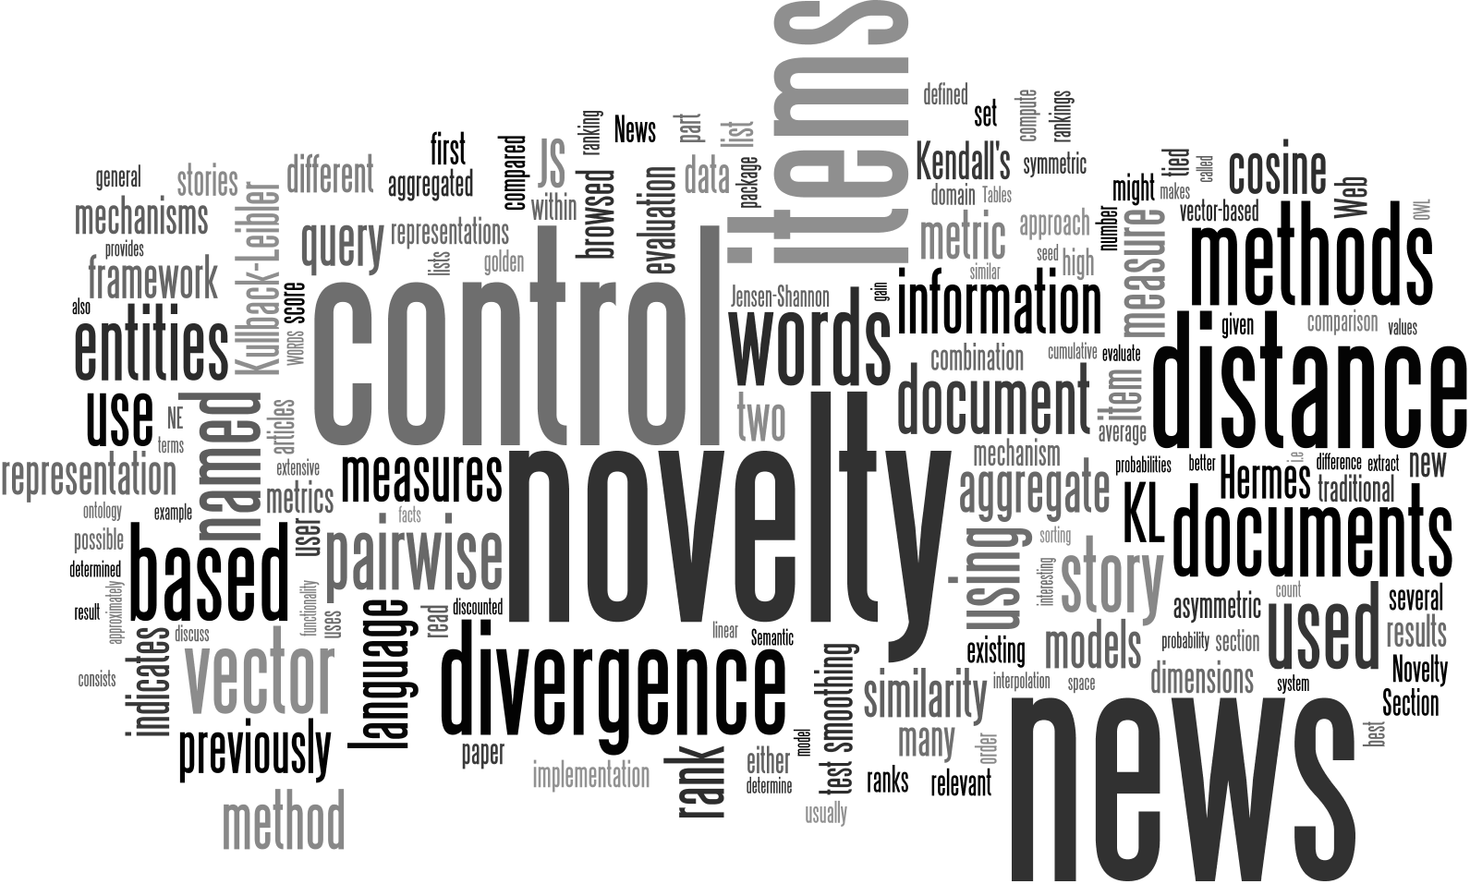
Questions

