Slide 1
An Unsupervised Approach for Aspect-Based Sentiment Classification Using Attentional Neural Models*
Flavius Frasincar
frasincar@ese.eur.nl
*Joint work with Luca Zampierin

Slide 2
Contents
Motivation
Related Work
Data
Methodology
Evaluation
Conclusion
Future Work
Further Information
References

Slide 3
Motivation
Increasing Electronic Word-of-Mouth (eWOM) data (e.g., reviews)
eWOM valuable for:
Consumers: purchase decisions
Businesses: marketing, product development
Summarizing eWOM using sentiment analysis, subfiled of Natural Language Processing (NLP):
Finding the sentiment in text
Aspect-Based Sentiment Analysis (ABSA), subfield of sentiment analysis:
Finding the sentiment with respect to an aspect of an item of interest discussed in text (often at sentence level)

Slide 4
Motivation
ABSA tasks:
Opinion Target Extraction (OTE): finding the aspect target in text
Aspect Category Detection (ACD): find the aspect category discussed in text
Aspect-Based Sentiment Classification (ABSC): finding the sentiment for a given aspect discussed in text [our focus]
According to (Schouten and Frasincar, 2016) ABSC models are classified as:
Dictionary-based: use sentiment dictionaries and rules
Machine learning:
Supervised: extract patterns using labeled data
Unsupervised: extract patterns using unlabeled data [our focus]
Hybrid: use both dictionary-based and machine learning

Slide 5
Motivation
Our approach:
Unsupervised:
Difficult to acquire labeled data
Better deals with unbalanced data
Less risk of overfitting
Deep Learning (DL): Automatically learn the features of interest
We propose two methods:
Attention-Based Aspect-Based Sentiment Extraction 1 (ABABSE1): uses directly the input word embeddings
Attention-Based Aspect-Based Sentiment Extraction 2 (ABABSE2): uses a Bi-directional Long Short-Term Memory (Bi-LSTM) on the input word embeddings (in order to better capture contextual information)
One of the first unsupervised deep learning models dedicated to ABSC

Slide 6
Related Work
V3:
Proposed by García-Pablos et al. (2015)
Uses word2vec similarities with respect to seed words
W2VLDA:
Proposed by García-Pablos et al. (2018)
Biases Latent Dirichlet Allocation (LDA) using seed words
Ontology:
Proposed by Schouten and Frasincar (2018)
Uses a domain sentiment ontology
Attention-Based Aspect Extraction (ABAE):
Proposed by He et al. (2017)
Unsupervised DL model for ACD w/o using seed words
Joint Aspect Sentiment Autoencoder (JASA):
Proposed by Zhuang et al. (2020)
Unsupervised DL model for ACD and ABSC using seed words

Slide 7
Related Work
Our model, ABABSE, inspired by ABAE
Similarities with ABAE:
Unsupervised DL model
Uses an auto-encoder like structure
Uses redundancy regularization
Differences with ABAE:
ABSC instead of ACD task
Learns a sentiment embedding matrix instead of aspect embedding matrix
Uses seed regularization inspired by JASA
Main results:
ABABSE outperforms the investigated unsupervised ABSC models (V3, W2VLDA, and Ontology)
ABABSE2 better than ABABSE1

Slide 8
Data
Two real-world English restaurant reviews datasets:
SemEval 2015 (task 12)
SemEval 2016 (task 5, subtask 1)
SemEval 2015:
1315 training sentences (from 254 reviews)
685 test sentences (from 96 reviews)
SemEval 2016:
2000 training sentences (from 350 reviews)
676 test sentences (from 90 reviews)

Slide 9
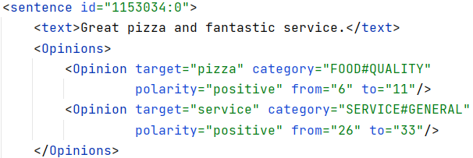
Data
Each sentence expresses sentiment polarity (positive, neutral, or negative) for 1 or more aspect targets (words) classified using aspect categories (predefined)
Position of the aspect target is given
Implicit aspects have assigned to target NULL

Slide 10
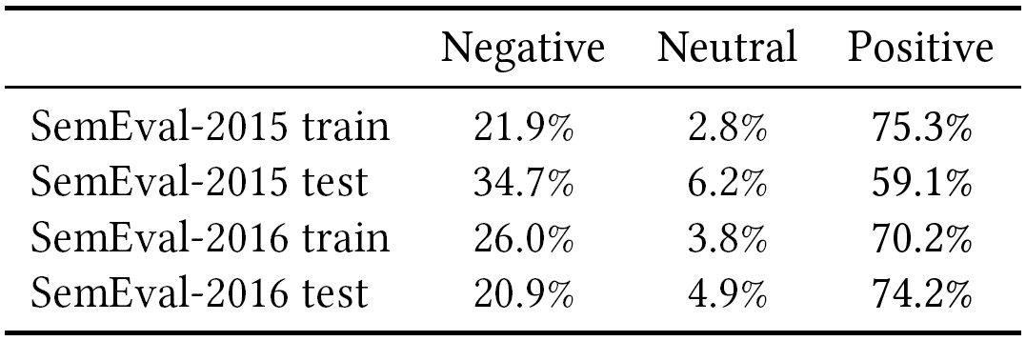
Data–Polarity Distribution
Unbalanced data:
Positive is the majority class
Neutral is the minority class
Accentuated in the SemEval-2016 test
Less of a problem for our model as it is unsupervised

Slide 11
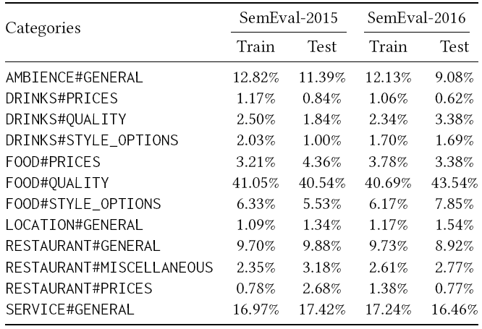
Data–Category Distribution
Unbalanced data
The top three categories are:
FOOD#QUALITY
SERVICE#GENERAL
AMBIENCE#GENERAL
Less of a problem for our model as it is unsupervised

Slide 12
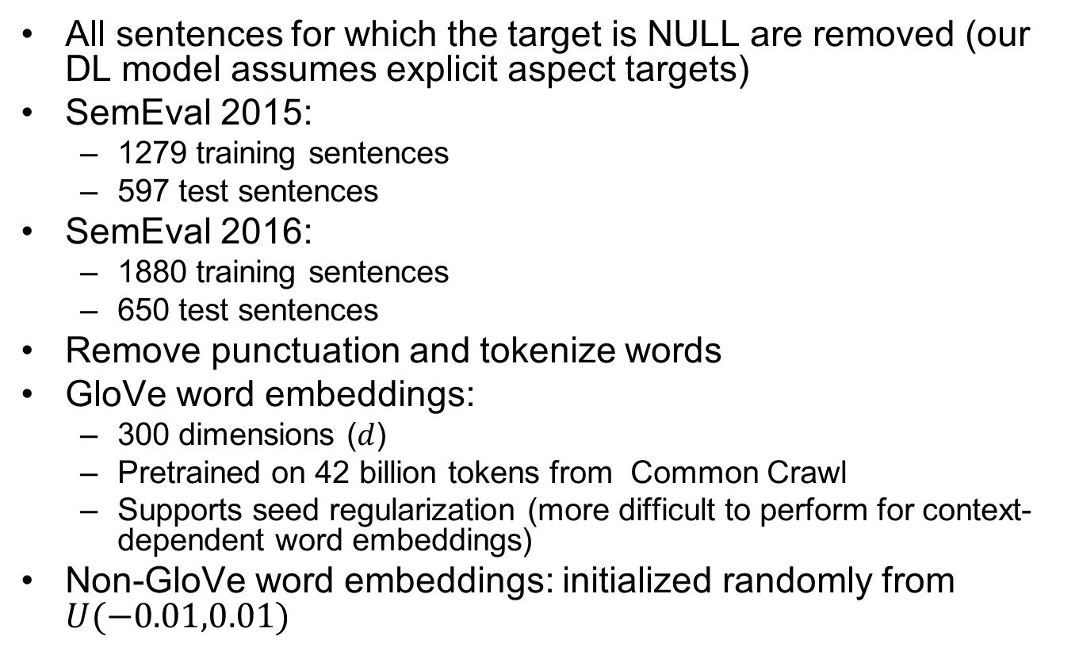
Data–Preprocessing
All sentences for which the target is NULL are removed (our DL model assumes explicit aspect targets)
SemEval 2015:
1279 training sentences
597 test sentences
SemEval 2016:
1880 training sentences
650 test sentences
Remove punctuation and tokenize words
GloVe word embeddings:
300 dimensions ($d$)
Pretrained on 42 billion tokens from Common Crawl
Supports seed regularization (more difficult to perform for context-dependent word embeddings)
Non-GloVe word embeddings: initialized randomly from $U(−0.01,0.01)$

Slide 13
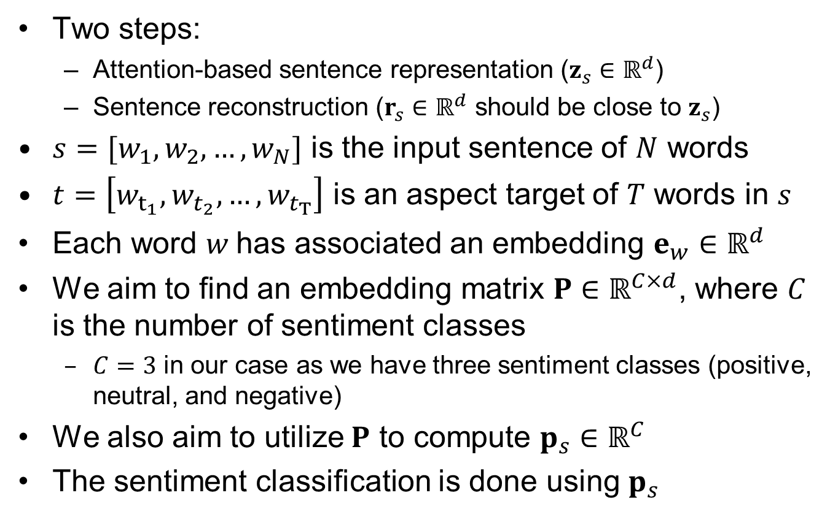
Methodology
Two steps:
Attention-based sentence representation ($z_{s}{∈ℝ}^{d}$)
Sentence reconstruction ($r_{s}{∈ℝ}^{d}$ should be close to $z_{s}$)
$s=[w_{1},w_{2},…,w_{N}]$ is the input sentence of $N$ words
$t=\left[w_{t_{1}},w_{t_{2}},…,w_{t_{T}}\right]$ is an aspect target of $T$ words in $s$
Each word $w$has associated an embedding $e_{w}∈ℝ^{d}$
We aim to find an embedding matrix $P∈ℝ^{C×d}$, where $C$ is the number of sentiment classes
$C=3$ in our case as we have three sentiment classes (positive, neutral, and negative)
We also aim to utilize $P$ to compute $p_{s}{∈ℝ}^{C}$
The sentiment classification is done using $p_{s}$

Slide 14
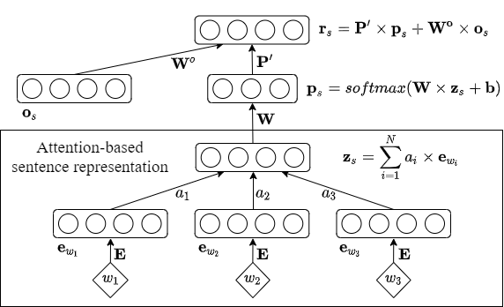
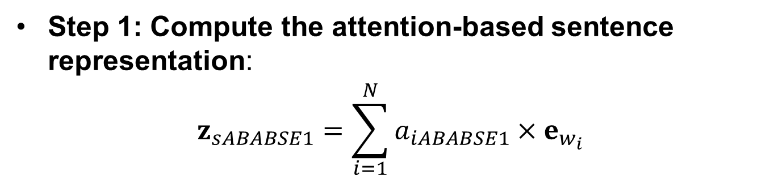
Methodology–ABABSE1
Step 1: Compute the attention-based sentence representation:
$$z_{sABABSE1}=\sum_{i=1}^{N}{a_{iABABSE1}}×e_{w_{i}}$$

Slide 15
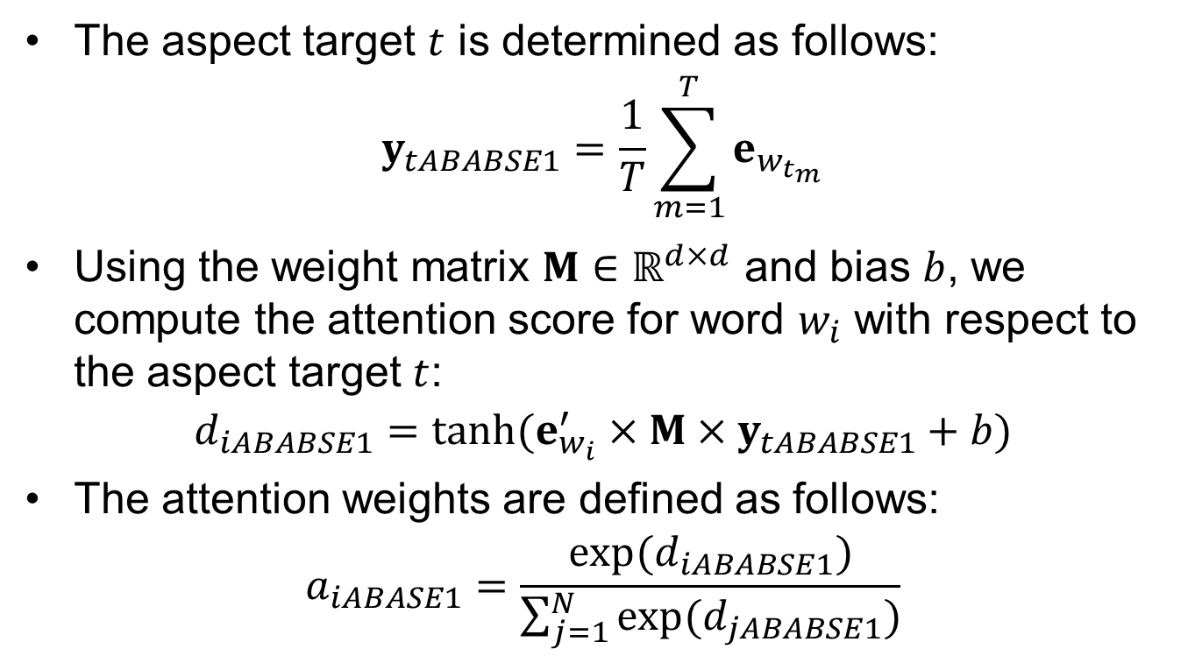
Methodology–ABABSE1
The aspect target $t$ is determined as follows:
$$y_{tABABSE1}=\frac{1}{T}\sum_{m=1}^{T}{e_{w_{t_{m}}}}$$
Using the weight matrix $M∈ℝ^{d×d}$ and bias $b$, we compute the attention score for word $w_{i}$ with respect to the aspect target $t$:
$$d_{iABABSE1}=tanh⁡(e_{w_{i}}^{′}×M×y_{tABABSE1}+b)$$
The attention weights are defined as follows:
$$a_{iABASE1}=\frac{exp(d_{iABABSE1})}{\sum_{j=1}^{N}{\exp{(d_{jABABSE1})}}}$$

Slide 16
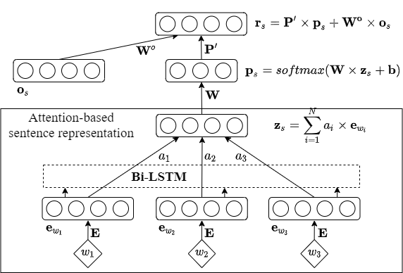
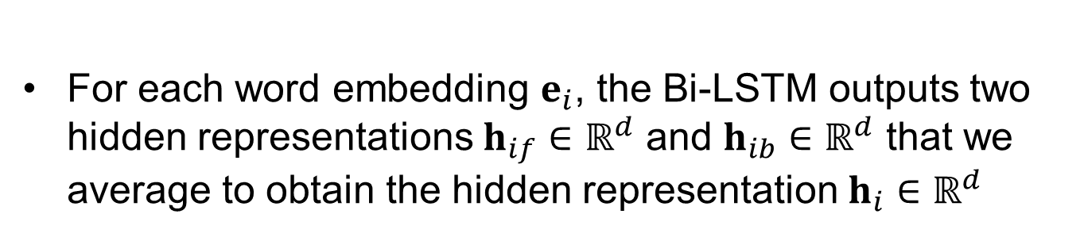
Methodology–ABABSE2
For each word embedding $e_{i}$, the Bi-LSTM outputs two hidden representations $h_{if}∈ℝ^{d}$ and $h_{ib}∈ℝ^{d}$ that we average to obtain the hidden representation $h_{i}∈ℝ^{d}$

Slide 17
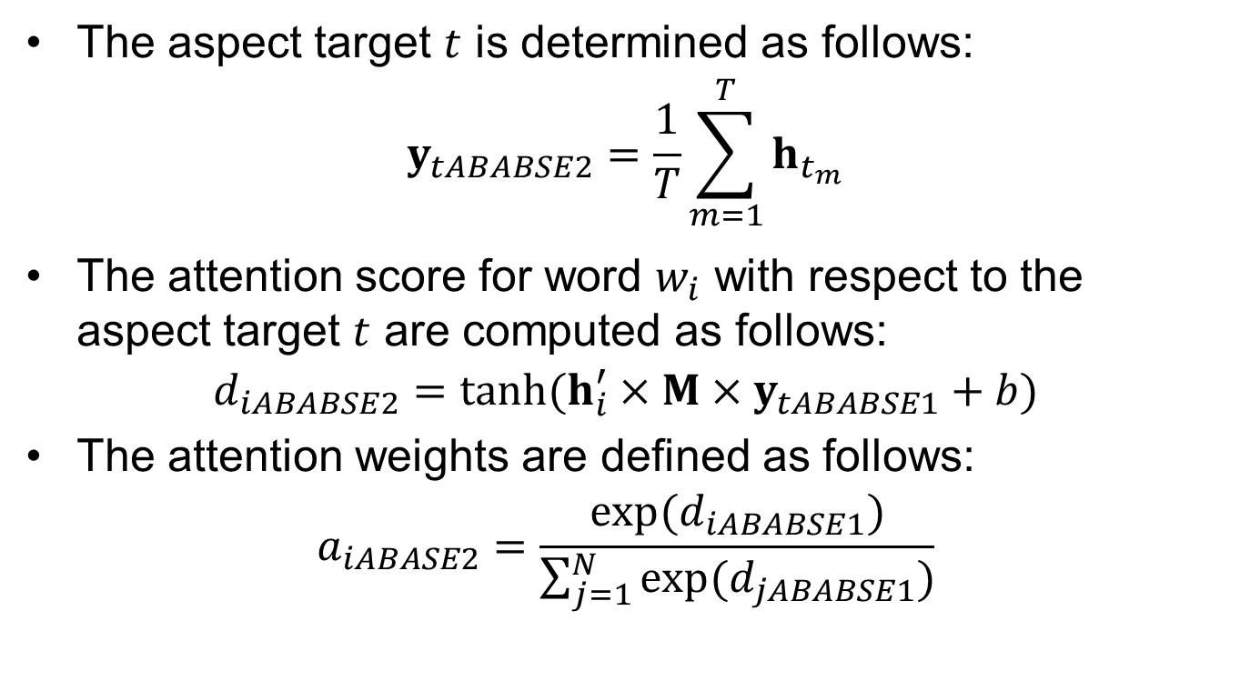
Methodology–ABABSE2
The aspect target $t$ is determined as follows:
$$y_{tABABSE2}=\frac{1}{T}\sum_{m=1}^{T}{h_{t_{m}}}$$
The attention score for word $w_{i}$ with respect to the aspect target $t$ are computed as follows:
$$d_{iABABSE2}=tanh⁡(h_{i}^{′}×M×y_{tABABSE1}+b)$$
The attention weights are defined as follows:
$$a_{iABASE2}=\frac{exp(d_{iABABSE1})}{\sum_{j=1}^{N}{\exp{(d_{jABABSE1})}}}$$

Slide 18
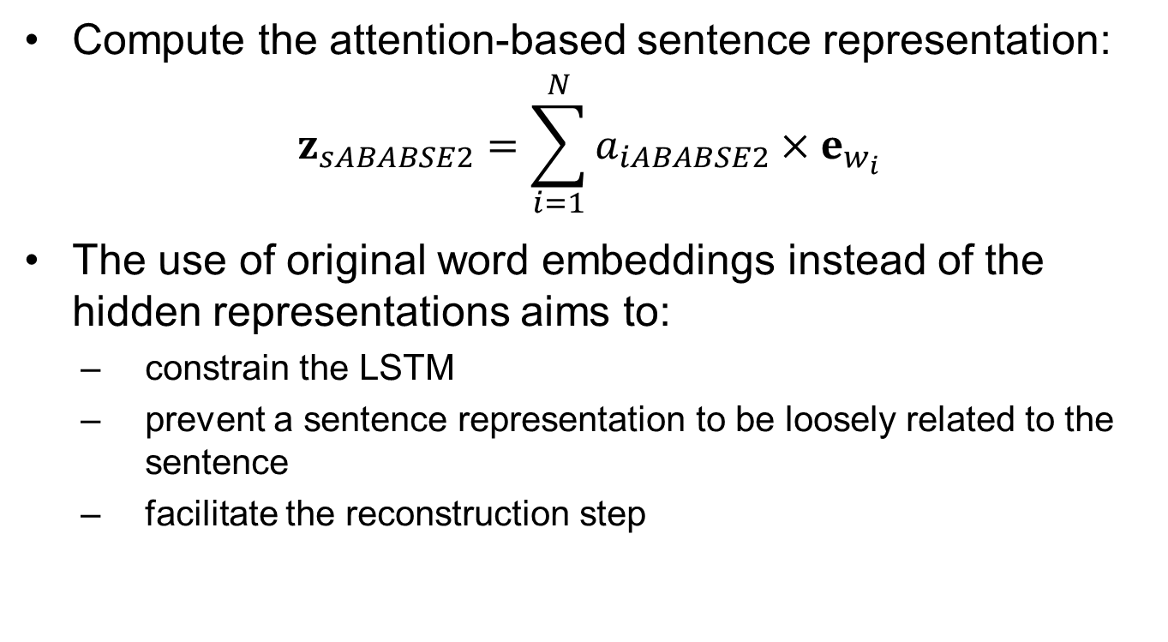
Methodology–ABABSE2
Compute the attention-based sentence representation:
$$z_{sABABSE2}=\sum_{i=1}^{N}{a_{iABABSE2}}×e_{w_{i}}$$
The use of original word embeddings instead of the hidden representations aims to:
constrain the LSTM
prevent a sentence representation to be loosely related to the sentence
facilitate the reconstruction step

Slide 19
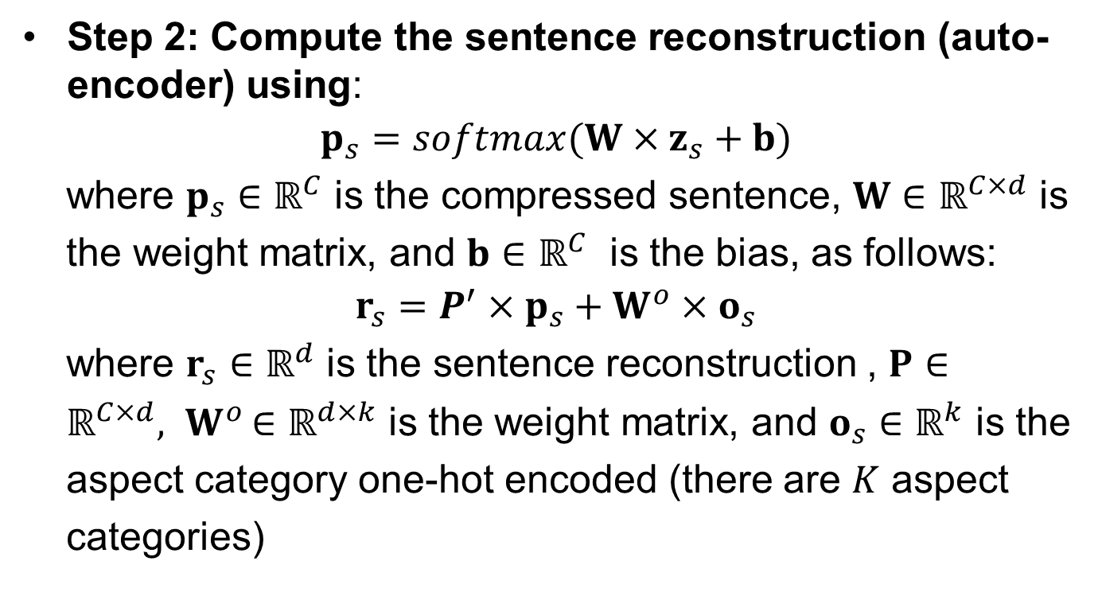
Methodology–ABABSE
Step 2: Compute the sentence reconstruction (auto-encoder) using:
$$p_{s}=softmax(W×z_{s}+b)$$
where $p_{s}∈ℝ^{C}$ is the compressed sentence, $W∈ℝ^{C×d}$ is
the weight matrix, and $b∈ℝ^{C}$ is the bias, as follows:
$$r_{s}=P^{′}×p_{s}+W^{o}×o_{s}$$
where $r_{s}∈ℝ^{d}$ is the sentence reconstruction , $P∈$
$ℝ^{C×d}{, W}^{o}∈ℝ^{d×k}$ is the weight matrix, and $o_{s}∈ℝ^{k}$ is the
aspect category one-hot encoded (there are $K$ aspect
categories)

Slide 20
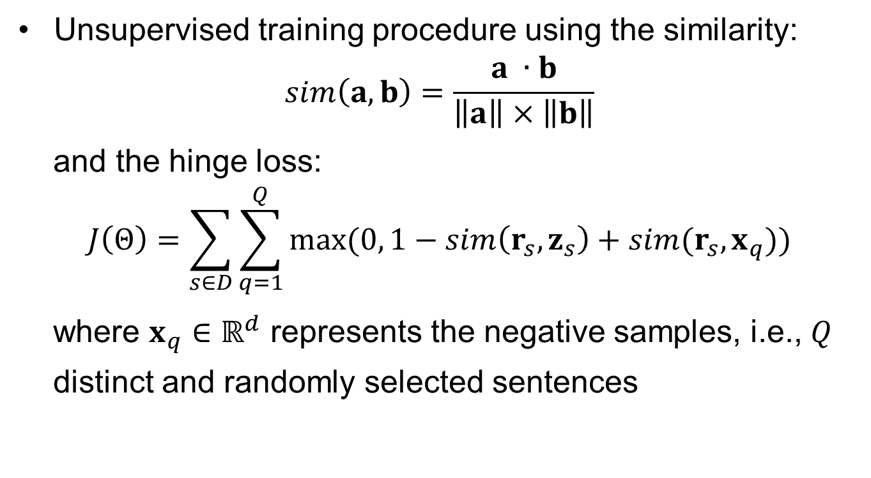
Methodology–ABABSE
Unsupervised training procedure using the similarity:
$$sim\left(a,b\right)=\frac{a ∙b}{\left\|a\right\|×\left\|b\right\|}$$
and the hinge loss:
$$J\left(Θ\right)=\sum_{s∈D}{\sum_{q=1}^{Q}{max⁡(0,}}1−sim\left(r_{s},z_{s}\right)+sim(r_{s},x_{q}))$$
where $x_{q}∈ℝ^{d}$ represents the negative samples, i.e., $Q$
distinct and randomly selected sentences

Slide 21
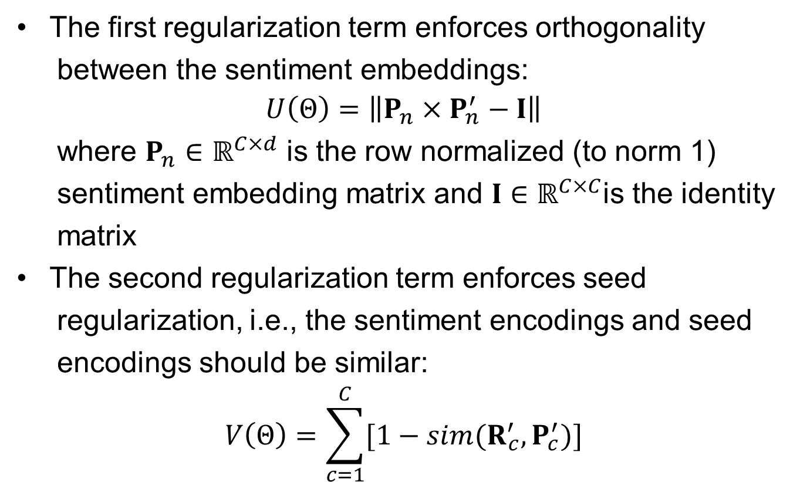
Methodology–ABABSE
The first regularization term enforces orthogonality
between the sentiment embeddings:
$$U\left(Θ\right)=\left\|P_{n}×P_{n}^{′}−I\right\|$$
where $P_{n}∈ℝ^{C×d}$ is the row normalized (to norm 1)
sentiment embedding matrix and $I∈ℝ^{C×C}$is the identity
matrix
The second regularization term enforces seed
regularization, i.e., the sentiment encodings and seed
encodings should be similar:
$$V\left(Θ\right)=\sum_{c=1}^{C}{[1−sim(R_{c}^{′},P_{c}^{′})]}$$

Slide 22
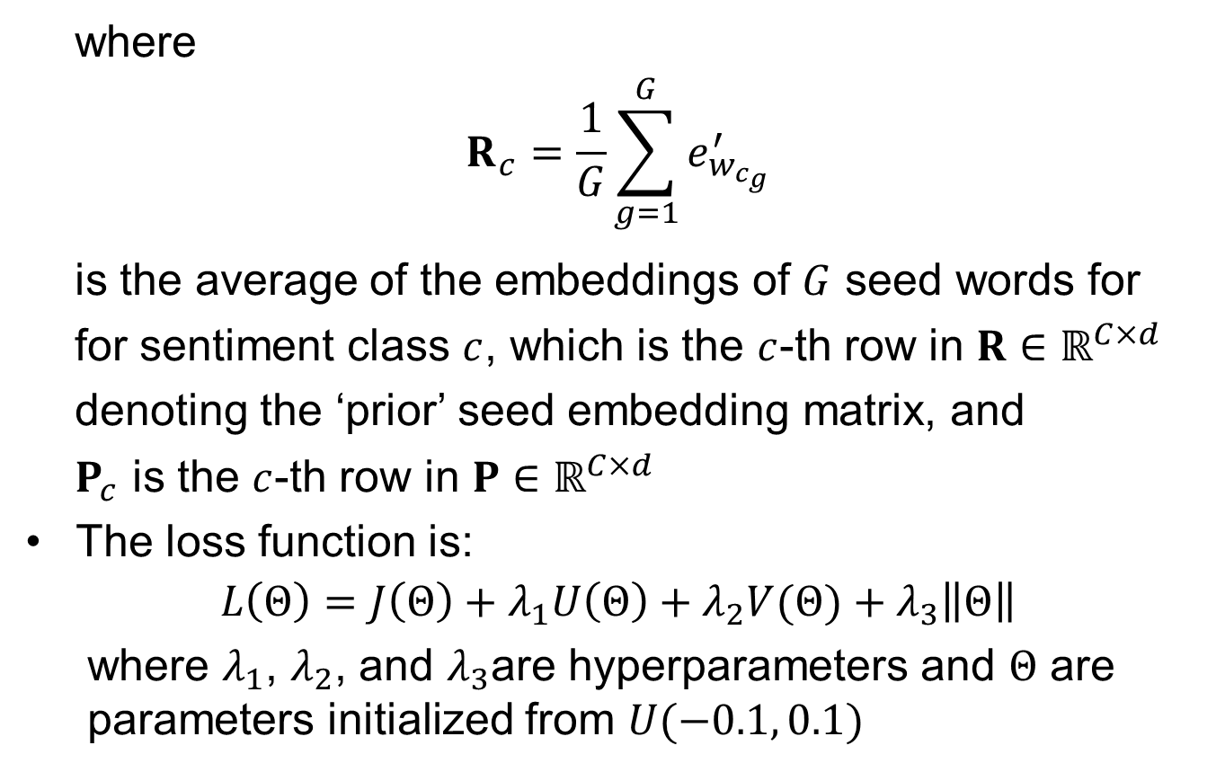
Methodology–ABABSE
where
$$R_{c}=\frac{1}{G}\sum_{g=1}^{G}{e_{w_{c_{g}}}^{′}}$$
is the average of the embeddings of $G$ seed words for
for sentiment class $c$, which is the $c$-th row in $R∈ℝ^{C×d}$
denoting the ‘prior’ seed embedding matrix, and
$P_{c}$ is the $c$-th row in $P∈ℝ^{C×d}$
The loss function is:
$$L\left(Θ\right)=J\left(Θ\right)+λ_{1}U\left(Θ\right)+λ_{2}V(Θ)+λ_{3}\left\|Θ\right\|$$
where $λ_{1}$, $λ_{2}$, and $λ_{3}$are hyperparameters and $Θ$ are parameters initialized from $U(−0.1, 0.1)$

Slide 23
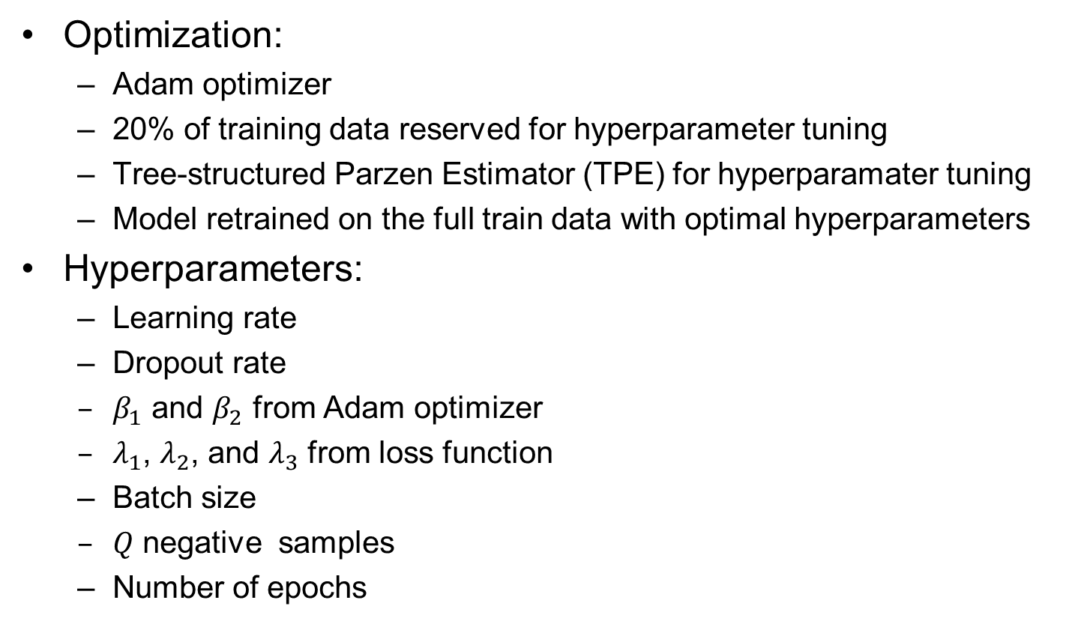
Methodology–ABABSE
Optimization:
Adam optimizer
20% of training data reserved for hyperparameter tuning
Tree-structured Parzen Estimator (TPE) for hyperparamater tuning
Model retrained on the full train data with optimal hyperparameters
Hyperparameters:
Learning rate
Dropout rate
$β_{1}$ and $β_{2}$ from Adam optimizer
$λ_{1}$, $λ_{2}$, and $λ_{3}$ from loss function
Batch size
$Q$ negative samples
Number of epochs

Slide 24
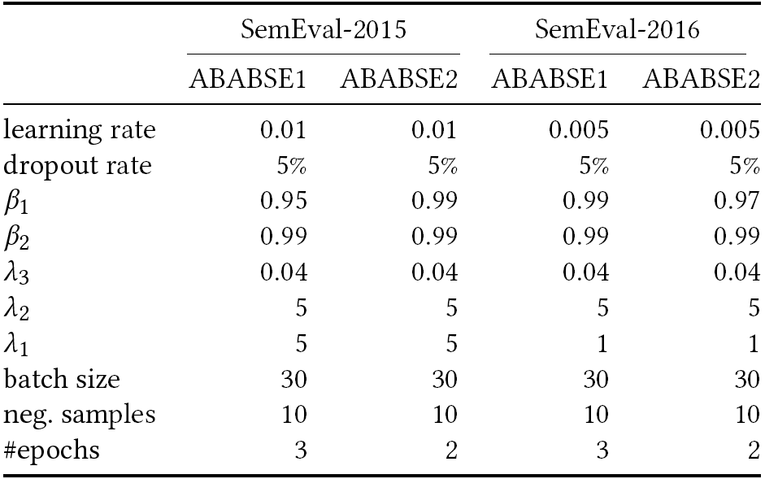
Methodology–ABABSE

Slide 25
Evaluation
Comparison ABABSE1 and ABABSE2:
Predictive performance (in-sample accuracy, out-sample accuracy, precision, recall, and F1) based on averages of ten runs
Quality of the attention mechanism based on examples
Quality of the sentiment embeddings using 5 seed words per class:
Positive: “amazing”, “great”, “nice”, “impeccable”, and “excellent”
Negative: “rude”, “bad”, “terrible”, “awful”, and “horrible”
Neutral: “mediocre”, “ordinary”, “decent”, “average”, and “ok”
Comparison ABABSE and existing methods:
Unsupervised methods: majority heuristic, W2VLDA, V3, and Ontology
Supervised methods: LCR-Rot and HAABSA++

Slide 26
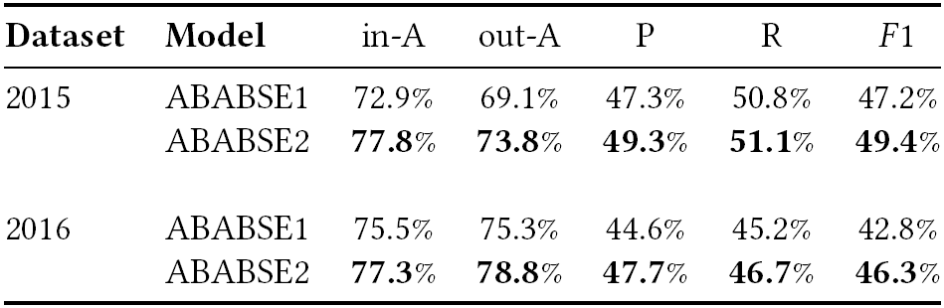
Evaluation–Predictive Performance
ABABSE2 better than ABABSE1 in any performance measure
ABABSE2 outperforms ABABSE1 by 4.7 percentage points for SemEval-2015 and 3.5 percentage points for SemEval-2016 for the out-of-sample accuracy
The out-of-sample accuracy results are better for the (larger) SemEval-2016 dataset than the SemEval-2015 dataset
The precision, recall, and F1 are relatively low due to class imbalance

Slide 27
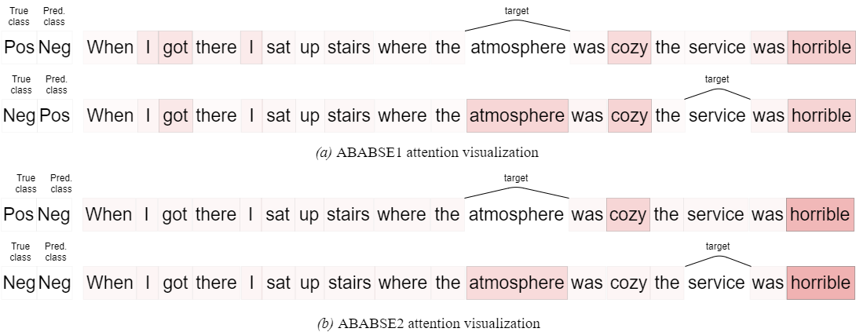
Evaluation–Attention Quality
2 aspect terms:
“atmosphere” (predicted wrongly by ABABSE1 and ABABSE2)
“service” (predicted wrongly by ABABSE1 and correctly by ABABSE2)

Slide 28
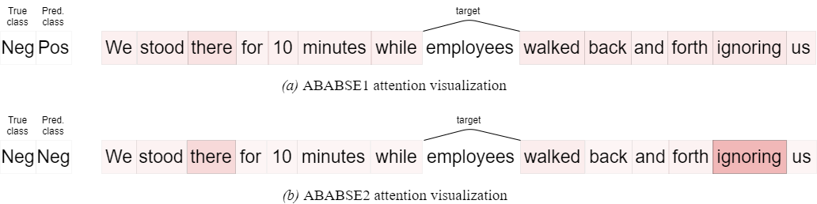
Evaluation–Attention Quality
The above sentence has an implicit sentiment
1 aspect term “employees”:
Sentiment is wrongly predicted by ABABSE1 which distributes uniformly the attention over words
Sentiment is correctly predicted by ABABSE2 which focuses on the word “ignoring”

Slide 29
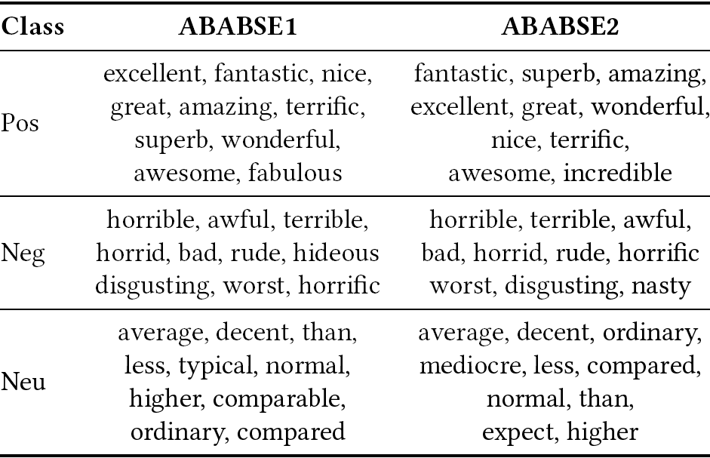
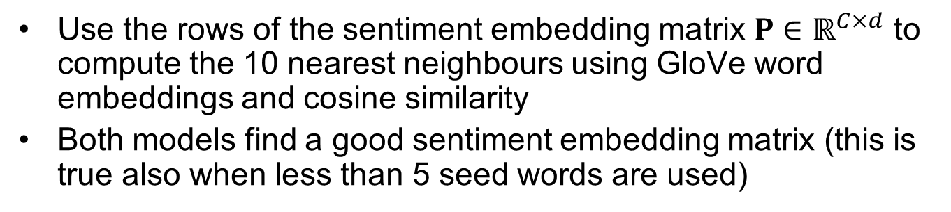
Evaluation–Sentiment Embedding Quality
Use the rows of the sentiment embedding matrix $P∈ℝ^{C×d}$ to compute the 10 nearest neighbours using GloVe word embeddings and cosine similarity
Both models find a good sentiment embedding matrix (this is true also when less than 5 seed words are used)

Slide 30
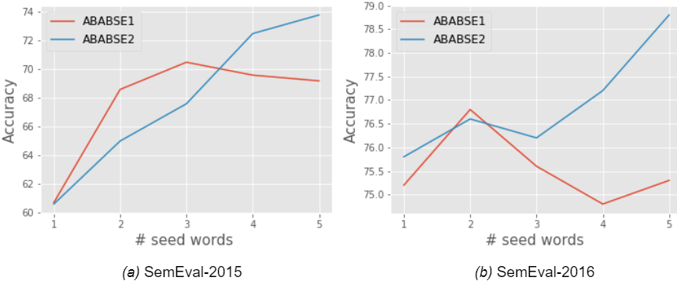
Evaluation–Impact of Seed Words
ABABSE1: achieves best performance for 3 seed words (SemEval-2015) and 2 seed words (SemEval-2016)
ABABSE2: performance improves as the number of seed words increases (as expected, as the model is more complex)
Both models have good performance even with 1 seed word

Slide 31
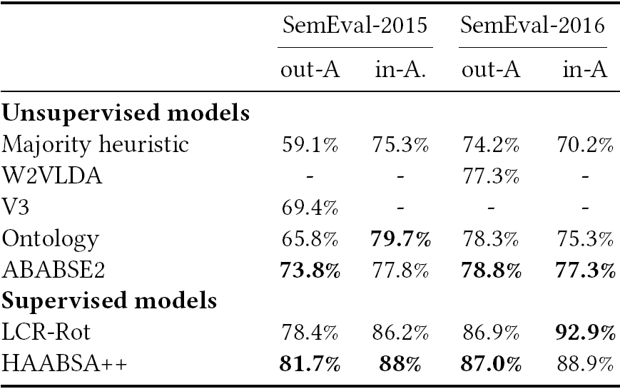
Evaluation–Model Comparison
Using out-of-sample accuracy ABABSE2 beats all unsupervised methods (the majority classifier, V3/W2VLDA, and Ontology by 14.47, 4.4, and 8.0 percentage points on SemEval-2015 and by 4.6, 1.5, and 0.5 percentage points on SemEval-2016)
Supervised approaches perform better but ABASE2 has less overfitting as expected

Slide 32
Conclusion
We proposed an unsupervised approach for ABSC called ABABSE with two variants:
ABABSE1
ABABSE2: introduces an extra LSTM layer to better capture the context (sentiment words related to the aspect)
ABABSE2 is better than ABABSE1
ABABSE2 is better than the investigated unsupervised approaches
ABABSE is not better than supervised approaches but overfits less
ABASE2 obtains an out-of-sample accuracy of 73.8% for SemEval-2015 and 78.8% for SemEval-2016

Slide 33
Future Work
Experiment with another domain, laptop reviews datasets:
More challenging: more domain-specific words and categories
Change the sentence representation:
Use the hidden representations in the weighted average
Constrain the sentence representation to be similar to the average word embeddings
Use contextual word embeddings instead of non-conetxtual word embeddings:
BERT
BART
GPT

Slide 34
Further Information
Dataset and code publicly available at: https://github.com/LucaZampierin/ABABSE
Code is written in Python
Feel free to try it out and improve our research
Questions about the code should be sent to Luca Zampierin (luca.zampierin@hotmail.com)

Slide 35
References
ABAE:
Ruidan He, Wee Sun Lee, Hwee Tou Ng, and Daniel Dahlmeier. 2017. An unsupervised neural attention model for aspect extraction. In Proceedings of the 55th Annual Meeting of the Association for Computational Linguistics (ACL 2017) . ACL, 388–397.
JASA:
Honglei Zhuang, Fang Guo, Chao Zhang, Liyuan Liu, and Jiawei Han. 2020. Joint Aspect-Sentiment Analysis with Minimal User Guidance. In Proceedings of the 43rd International ACM SIGIR Conference on Research and Development in Information Retrieval (SIGIR 2020). ACM, 1241–1250.
W2LDA:
Aitor García-Pablos, Montse Cuadros, and German Rigau. 2018. W2VLDA: almost unsupervised system for aspect based sentiment analysis. Expert Systems with Applications 91 (2018), 127–137.

Slide 36
References
V3:
Aitor García-Pablos, Montse Cuadros, and German Rigau. 2015. V3: Unsupervised aspect based sentiment analysis for SemEval2015 task 12. In Proceedings of the 9th International Workshop on Semantic Evaluation (SemEval 2015). ACL, 714–718.
Ontology:
Kim Schouten and Flavius Frasincar. 2018. Ontology-driven sentiment analysis of product and service aspects. In Proceedings of the 15th Extended Semantic Web Conference (ESWC 2018) (LNCS, Vol. 10843). Springer, 608–623.
HAABSA++:
Maria Mihaela Trusca, DaanWassenberg, Flavius Frasincar, and Rommert Dekker. 2020. A hybrid approach for aspect-based sentiment analysis using deep contextual word embeddings and hierarchical attention. In Proceedings of the 20th International Conference on Web Engineering (ICWE 2020) (LNCS, Vol. 12128). Springer, 365–380.

