Slide 1
Weighted Neural Collaborative Filtering: Deep Implicit Recommendation with Weighted Positive and Negative Feedback*
Flavius Frasincar
frasincar@ese.eur.nl
*Joint work with Stan Hennekes

Slide 2
Contents
Motivation
Related Work
Data
Methodology
Evaluation
Conclusion
Future Work
Further Information
References

Slide 3
Motivation
Problem: information overload
Solution: recommender systems
User feedback data:
Explicit data: user rates items
Implicit data: user interacts with items (e.g., views/buys items) [our focus, as easier to get]
Challenge 1: uncertainty in implicit data
No user feedback can mean no user interaction yet with the item or the user does not like the item
Focus: grocery store
Challenge 2: user can buy a product multiple times (fast-moving products)

Slide 4
Motivation
Recommendation systems output:
Point-wise [our focus, as most flexible]
Pair-wise
List-wise
Recommender systems methods:
Content-Based
Collaborative-Filtering:
Memory-Based
Model-Based [our focus, due to their good performance and no need of user/item metadata]
Hybrid

Slide 5
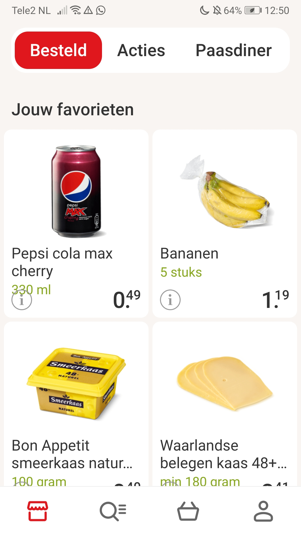
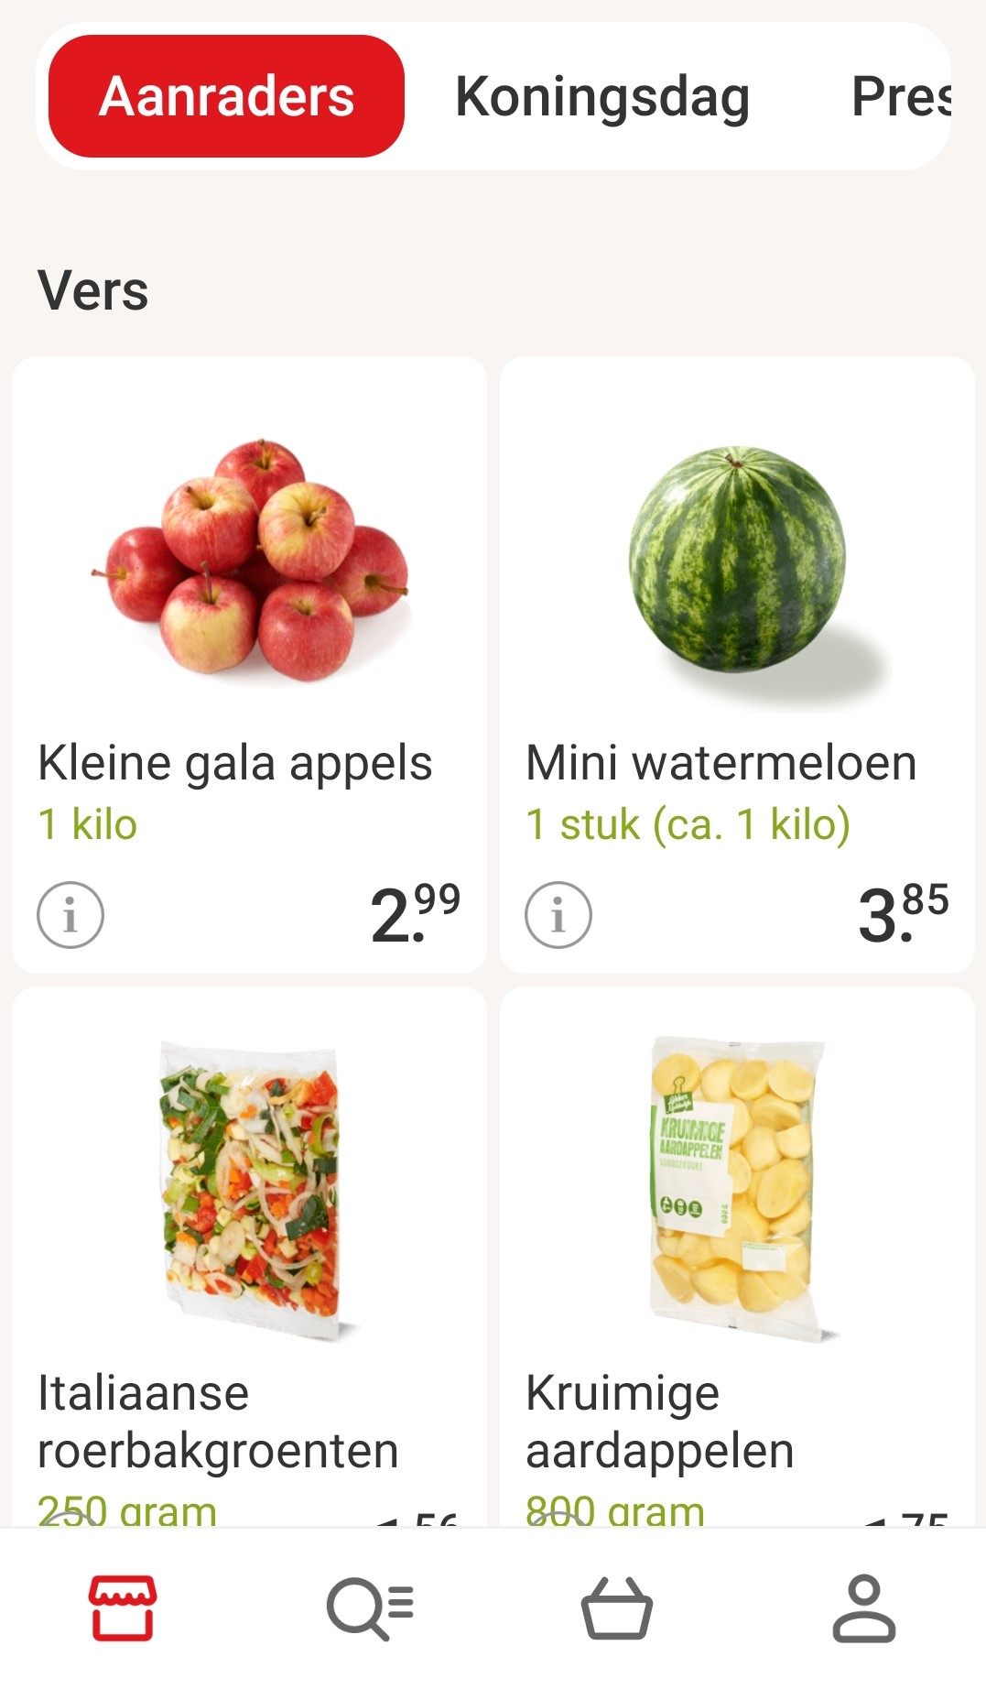
Motivation
Now: personalization of items you already bought
Goal: personalization of previously unbought items

Slide 6
Related Work
Weighted Matrix Factorization (WMF) with positive feedback (WMF_pos):
Proposed by Hu et al. (2008)
Positive (present) user-item interactions are weighted in the loss function by the corresponding number of user-item interactions (the more a user interacts with an item, the more confident we are that the user likes the item)
WMF with negative feedback (WMF_neg):
Proposed by He et al. (2016)
Negative (missing) user-item interactions are weighted in the loss function by item popularity (popular items not interacted with by a user are regarded are more probable not to be liked by the user)

Slide 7
Related Work
Neural Matrix Factorization (NeuMF):
Proposed by He et al. (2017)
Combines the simplicity of Matrix Factorization (MF) [shallow model] with the complexity of Neural Networks (NN) [deep model]
As NN it uses a Multi-Layer Perceptron (MLP)
MF:
models linear interactions so it cannot pick up complex interactions in the low-dimensional latent space (especially true for sparse data)
good at modeling the similarity relationships between items and relatively easy to interpret
MLP:
model non-linear interactions so it can represent complex interactions between users and items
more difficult to interpret

Slide 8
Methodology
The proposed methodology is NeuWMF:
Reuses the weights from WMF (WMF_pos_neg):
Positive weights from WMF_pos: adapts these weights to account for the fast-moving products)
Negative weights from WMF_neg
Uses NeuMF with the WMF loss function for building the model
Adds a regularization term to the loss function

Slide 9
WMF
$R ∈ℝ^{M×N}$ is the user-item rating matrix, where $M$ is the number of users and $N$ is the number of items:
$r_{ui}=R\left(u,i\right)$ is the number of interactions (in our context purchases) user $u$ had with item $i$
$ℛ^{+}$is the set of user-item pairs that have non-zero values in $R$
$ℛ^{−}$is the set of user-item pairs that have zero values in $R$
$ℛ^{+}∩$ $ℛ^{+}=∅$
MF decomposes matrix $R$ into the embedding matrices $P∈ℝ^{M×K}$ and $Q∈ℝ^{N×K}$ where $K$ is the number of latent factors:
Each element $r_{ui}$ can be estimated as ${\hat{r}}_{ui}=p_{u}^{\text{T}}q_{i}$

Slide 10
WMF
$B∈{\{0,1\}}^{M×N}$ is the Boolean matrix denoting if users are interested in items or not:
$$b_{ui}=\left\{\begin{aligned}1, r_{ui}>0 \\ 0,r_{ui}=0\end{aligned}\right.$$
The loss function is L2-loss:
$$L_{WMF}=\sum_{\left(u,i\right)∈ℛ^{+}}{w_{ui}{\left(1−{\hat{b}}_{ui}\right)}^{2}}+\sum_{\left(u,i\right)∈ℛ^{−}}{c_{i}{\hat{b}}_{ui}^{2}}+Λ(p_{u}, q_{i})$$
where $w_{ui}$ is the weight for positive feedback, $c_{i}$ is the
weight for negative feedback (not user dependent), and
$Λ\left(p_{u}, q_{i}\right)=λ\left(\sum_{u=1}^{M}{{\left\|p_{u}\right\|}^{2}}+\sum_{i=1}^{N}{{\left\|q_{i}\right\|}^{2}}\right)$ is a regularization
term with regularization constant $λ$.

Slide 11
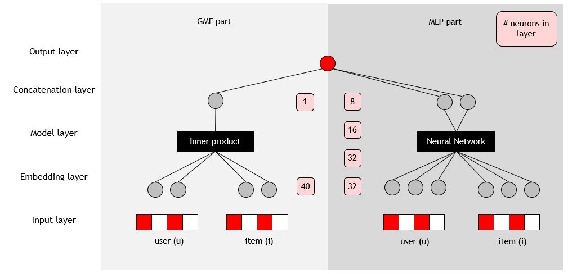
NeuMF
Two components:
Generalized MF (GMF)
MLP

Slide 12
GMF
GMF applies a neural view on MF
MF is just a neural network with one hidden layer
$$φ^{GMF}\left(p_{u}^{GMF},q_{i}^{GMF}\right)=<p_{u}^{GMF},q_{i}^{GMF}>$$
where $<a,b≥a^{T}b$ is the dot product
The output (without the MLP part)
$${\hat{b}}_{ui}=a_{out}(h^{T}φ^{GMF}\left(p_{u}^{GMF},q_{i}^{GMF}\right))$$
where $a_out\left(∙\right)$ is the activation function (the identity function here) and $h$ are the hidden weights (a vector of 1 here)

Slide 13
MLP
First layer concatenates the user and item embeddings
$$z_{1}=φ_{1}^{MLP}\left(p_{u}^{MLP},q_{i}^{MLP}\right)=p_{u}^{MLP}q_{i}^{MLP}$$
Then for the next $L$ layers we have for the $x$-th layer
$$φ_{x}^{MLP}\left(z_{x−1}\right)=a_{x}\left(H_{x}^{T}z_{x−1}+β_{x}\right)$$
where $H_{x}$ is the weight matrix, $β_{x}$is the bias vector, and
$a_{x}\left(∙\right)$ is the activation function (we used ReLU for the
first L-1 layers and sigmoid function)
The output layer (without the GMF)
$${\hat{b}}_{ui}=φ_{L}^{MLP}\left(z_{L−1}\right)=a_{L}\left(H_{L}^{T}z_{L−1}+β_{L}\right)$$

Slide 14
NeuMF
The output layer
$${\hat{b}}_{ui}=σ(γ^{T}φ^{GMF}φ^{MLP})$$
where $σ$ is the sigmoid function and $γ$ ($\left[1,1\right]$ here) determines the weights between the output of GMF and the final layer
of MLP (that are concatenated)
The loss function is the negative log likelihood (binary cross-entropy)
$$L_{NeuMF}=−\sum_{\left(u,i\right)∈ℛ}{b_{ui}\log\left({\hat{b}}_{ui}\right)+\left(1−b_{ui}\right)log⁡(1−{\hat{b}}_{ui})}$$
Minimization of the loss function done with Stochastic Gradient Descent (SGD)
All user-item interactions have the same weight

Slide 15
WMF_pos_neg
Positive feedback:
The more interactions a user has with an item, the more confident we are that the user likes the item (affects interactions in $ℛ^{+}$)
Risk of bias for fast-moving products (e.g., milk)
We define the confidence weights for positive interactions:
$$w_{ui}=1+α\log_{2}⁡(1+\frac{{\tilde{r}}_{ui}}{ε})$$
where:
${\tilde{r}}_{ui}=r_{ui}/{\overline{r}}_{i}$, ${\overline{r}}_{i}$ is the average number of purchases for item $i$
$α∈ℝ^{+}$ is a scaling constant to tune
$ε∈ℝ_{∗}^{+}$ is a scaling constant to tune
$\log_{2}{ }$makes sure that the confidence decreases for larger amount of interactions

Slide 16
WMF_pos_neg
Negative feedback:
The more popular an item is, the more confident we are that the user does not like it if it did not buy it (affects interactions in $ℛ^{−}$)
We define the confidence weights for negative interactions:
$$c_{i}=c_{0}\frac{f_{i}^{η}}{\sum_{j=1}^{N}{f_{j}^{η}}}$$
where:
$f_{i}=\left|ℛ_{i}^{+}\right|/\sum_{j=1}^{N}{\left|ℛ_{j}^{+}\right|}$ is the fraction of users having interacted with item $i$ compared to all items
$c_{0}∈ℝ$ is a constant to tune
$η∈ℝ^{+}$ is a constant that controls the effect of popularity:
$η=0$ gives a uniform effect
$η∈\left(0,1\right)$ dampens the effect of popularity
$η>1$ amplifies the effect of popularity

Slide 17
WMF Weighting Schemes
All weighting schemes use the L2-loss
The optimization procedure for each weighting scheme
WMF_pos: Alternating Least Squares (ALS): $P→Q→P→Q→$…
WMF_neg: Element-wise ALS (eALS): $p_{uf}→q_{if}→p_{uf}→q_{if}$ $→$…
WMF_pos_neg: eALS
Model | Positive feedback | Negative feedback
WMF_pos (Hu et al., 2008) | weighted ($w_{ui}$) | uniform ($c_{i}=1)$
WMF_neg (He et al., 2016) | uniform ($w_{ui}=1$) | weighted ($c_{i}$)
WMF_pos_neg (ours) | weighted ($w_{ui}$) | weighted ($c_{i}$)

Slide 18
NeuWMF
L2-loss:
$$L_{NeuWMF}=\sum_{\left(u,i\right)∈ℛ^{+}}{w_{ui}{\left(1−{\hat{b}}_{ui}\right)}^{2}}+\sum_{\left(u,i\right)∈ℛ^{−}}{c_{i}{\hat{b}}_{ui}^{2}}$$
$$+λ\left(\sum_{u=1}^{M}{\left({\left\|p_{u}^{GMF}\right\|}^{2}+{\left\|p_{ui}^{MLP}\right\|}^{2}\right)}+\sum_{i=1}^{N}{\left({\left\|q_{i}^{GMF}\right\|}^{2}+{\left\|q_{i}^{MLP}\right\|}^{2}\right)} \right)$$
New compared to NeuMF:
L2-loss (as WMF) instead of the binary cross-entropy
Confidence weights (positive and negative feedback)
Regularization term (overfitting a bigger issue here than for NeuMF due to the extra information added in the form of weights)
Optimization: SGD

Slide 19
NeuWMF
Bottleneck: the negative feedback term contains many elements in the sum
Solution:
Sample the negative interaction terms $(u,i)$proportional with $c_{i}$ (yields set $ℛ_{s}^{−}⊂ℛ^{−}$)
For every positive interaction sample $n$ negative interactions
Negative feedback taken in account in an implicit manner
Approximate loss function
$$L_{NeuWMF}=\sum_{\left(u,i\right)∈ℛ^{+}}{w_{ui}{\left(1−{\hat{b}}_{ui}\right)}^{2}}+\sum_{\left(u,i\right)∈ℛ_{s}^{−}}{{\hat{b}}_{ui}^{2}}$$
$$+λ\left(\sum_{u=1}^{M}{\left({\left\|p_{u}^{GMF}\right\|}^{2}+{\left\|p_{ui}^{MLP}\right\|}^{2}\right)}+\sum_{i=1}^{N}{\left({\left\|q_{i}^{GMF}\right\|}^{2}+{\left\|q_{i}^{MLP}\right\|}^{2}\right)}\right)$$
Optimization: Adam (faster convergence than SGD) with a batch size of 256 (like in NeuMF)

Slide 20
NeuMF Recap
GMF user/item embedding size: 20 (same as in WMF)
MLP user/item embedding size: 16

Slide 21
Evaluation
Three performance measures:
Hit Rate (HR): the percent of the true interactions that are recommended
$HRu@k$: HR computed for the top $k$ recommended items and user $u$
$HR@k$: average of $HRu@k$ over all users
Normalized Discounted Cumulative Gain (NDCG): the fraction of the sum of the discounted (by ranking position) of the relevance of recommended items with respect to the ideal (true) sum
$NDCGu@k$: NDCG computed for the top $k$ recommended items and user $u$
$NDCG@k$: average of $NDCGu@k$ over all users
NDCG New (our proposal): same as NDCG but applied only to new items that the user did not see before in the training data (deals with fast-moving products)

Slide 22
Performance Measures
HR (also known as recall):
$${HR}_{u}@k=\frac{\#{hits}_{u}@k}{\left|{Test}_{u}\right|}$$
where $\#{hits}_{u}@k$ is the number of true interactions in top $k$list of
recommended items for user $u$ and $\left|{Test}_{u}\right|$ is the number of true interactions
for user $u$ (in the test set)
NDCG:
$${NDCG}_{u}@k=\frac{1}{{INDCG}_{u}@k}\sum_{i=1}^{k}{\frac{2^{rel_{u,i}}−1}{\log_{2}{(i+1)}}}=\frac{1}{{INDCG}_{u}@k}\sum_{i=1}^{k}{\frac{rel_{u,i}−1}{\log_{2}{(i+1)}}}$$
$${INDCG}_{u}@k=\sum_{i=1}^{\left|Test_{u,k}\right|}{\frac{2^{rel_{u,i}}−1}{\log_{2}{(i+1)}}}=\sum_{i=1}^{\left|Test_{u,k}\right|}{\frac{rel_{u,i}−1}{\log_{2}{(i+1)}}}$$
where $rel_{u,i}$ is the true binary relevance ($b_{ui}$) of item at position $i$ for user $u$
in the top $k$items of the recommended list (${NDCG}_{u}@k$) or of item at position $i$ for user $u$ in the top $k$items of the true list $Test_{u,k}$(${INDCG}_{u}@k$)

Slide 23
Experimental Setup
Anonymized dataset from Picnic (Dutch online supermarket)
Training dataset: purchases data over two years (2017-2018)
Test dataset: purchase data in one year (2019)
Validation dataset: random sample of 1000 items and 1000 user from training data (to speed-up the hyperparameter tunning):
Hyperparameters decided based the highest value of NDCG New on the validation dataset
Build a model based on the best hyperparameters on the training dataset and report results on the test dataset

Slide 24
Data Preprocessing
Considered users that ordered at least 5 times in the training set (to be able to learn) and at least 1 time in the test set (to be able to test)
Considered only items that are present in both training and test datasets (so that they are representative)
Removed the top 10 most popular items (so that they do not dominate the latent variables)
Further filtered users so that they have at least 50 unique items (mild assumptions compared to the 1-5% of most active users used in the literature)
Filtered items so that are bought by at least 50 unique users
Final dataset (interaction matrix): 5636 users and 4134 items
Sparsity of the train matrix: 0.0545
Sparsity of the test matrix: 0.0379

Slide 25
Hyperparameter Setting
Grid Search:
Hyperparameter | Range | Used
$$K$$ | $$\{1,2,3,…, 200\}$$ | $$20$$
$$α^{WMF}$$ | $$[0, 20]$$ | $$12$$
$$c_{0}^{WMF}$$ | $$[0, 100000]$$ | $$50000$$
$$λ^{WMF}$$ | $$[0, 10000]$$ | $$500$$
$$α^{NeuWMF}$$ | $$\{0.25,0.5,0.75,1,1.25,1.5,2,5,10,12\}$$ | $$1$$
$$c_{0}^{NeuWMF}$$ | $$\{100,1000,10000,500000\}$$ | $$1000$$
$$λ^{NeuWMF}$$ | $$\{\left[{0,10}^{−4}\right],1,10,100,500\}$$ | $$0.00005$$
$$n$$ | $$\{0,1,2,3,4,5\}$$ | $$3$$
emb. size GMF | $$\{10,20,30,40\}$$ | $$20$$
emb. size MLP | $$\{8,16,24\}$$ | $$16$$
$$ε$$ | $$[0.5,1.5]$$ | $$1$$
$$η$$ | $$[0,1]$$ | $$0.5$$

Slide 26
Model Comparison
We choose $k=20$ for $HR@k$, $NDCG@k$, and $NDCG@k New$
Two baselines (non-personalized):
Random: user-item combinations get a random score between $0$ and $1$
ItemPop: recommends the most popular $k$ items
Three models from the literature:
WMF_neg ($w_{ui}=1$)
WMF_pos ($c_{i}=1$)
NeuMF
Our models:
WMF_pos_neg
NeuWMF

Slide 27
Model Comparison
Model | NDCG | NDCG New | HR
Random | 0.03815 | 0.01972 | 0.00348
ItemPop | 0.35442 | 0.14820 | 0.04897
WMF_neg ($w_{ui}=1$) | 0.35335 | 0.14992 | 0.04948
WMF_pos ($c_{i}=1)$ | 0.39809 | 0.15994 | 0.05002
WMF_pos_neg (ours) | 0.40989 | 0.16671 | 0.05649
NeuMF | 0.42499 | 0.16853 | 0.06092
NeuWMF (ours) | 0.42618 | 0.16998 | 0.06111
Non-baseline methods are better than the baselines
WMF_pos better than WMF_neg (positive feedback more important than negative feedback)
WMF_pos_neg is better than WMF_neg and WMF_pos
NeuMF better than all WMF models
NeuWMF gives best results

Slide 28
Ablation Experiments for NeuWMF
Experiment 1: Positive Feedback
Compare the original NeuMF model but with L2-loss like NeuWMF with NeuWMF_pos (no regularization) to check the effect of the positive feedback
Model | NDCG test | HR test | NDCG train | HR train
NeuMF_L2 | 0.42275 | 0.06086 | 0.58519 | 0.05931
NeuWMF_pos | 0.42566 | 0.06125 | 0.58933 | 0.05971
Result: positive weights improve performance compared to no weights

Slide 29
Ablation Experiments for NeuWMF
Experiment 2: Negative Feedback
Compare the original NeuMF model but with L2-loss like NeuWMF with NeuWMF_neg (no regularization) to check the effect of the negative feedback
Model | NDCG test | HR test | NDCG train | HR train
NeuMF_L2 | 0.42275 | 0.06086 | 0.58519 | 0.05931
NeuWMF_neg | 0.41174 | 0.05963 | 0.60190 | 0.06179
Result: negative weights improve performance on the training set compared to no weights, but regularization is needed for the test set

Slide 30
Ablation Experiments for NeuWMF
Experiment 3: L2-loss
Compare the original NeuMF model but with L2-loss like NeuWMF with original NeuMF_pos with binary cross-entropy (no regularization) to check the effect of the L2-loss
Model | NDCG test | NDCG New test
NeuMF_L2 | 0.42275 | 0.16997
NeuMF_cross-entropy | 0.42499 | 0.16853
Result: the differences are rather small with a slight preference for L2-loss with regard to new items only (NDCG New)
The change from binary cross-entropy to L2-loss has not a big influence

Slide 31
Ablation Experiments for NeuWMF
Experiment 4: Regularization
Compare NeuWMF with no regularization with NeuWMF with regularization (the risk of overfitting is higher for NeuWMF than NeuMF due to the extra information added in the form of weights)
Model | NDCG train | NDCG test | NDCG New test
NeuWMF_no_reg | 0.57242 | 0.40117 | 0.14736
NeuWMF_reg | 0.49353 | 0.42618 | 0.16998
Result: regularization helps get better performance on the test set influence, reducing the overfitting

Slide 32
Most Recommended Items
Analyse the items that are ranked the highest by WMF_pos_neg and NeuWMF per user and aggregate their counts across users
WMF_pos_neg | # users | NeuWMF | # users
Seedless white grapes | 842 | Minced beef | 708
Bin bags | 729 | Bin bags | 409
Mushrooms | 647 | Seedless white grapes | 344
Garlic | 627 | Garlic | 297
Avocado | 526 | Avocado | 283
Washed spinach | 297 | Tangerines | 255
Minced beef | 279 | Onions | 233
Onions | 217 | Medium eggs | 228
Tangerines | 184 | Mushrooms | 200
Medium eggs | 173 | Cauliflower | 171

Slide 33
Most Recommended Items
All items that are ranked high are quite generic:
Expected as the personalized model results aggregated across all users boils down to the most popular items
The amount of users having the same first ranked product for NeuWMF is lower than for WMF_pos_neg
NeuWMF is better in personalization (recommending items other than the most popular ones) than WMF_pos_neg

Slide 34
Conclusion
We focused on recommender systems applicable in a grocery store
Fast-moving products
Implicit user feedback data
We modeled the uncertainty of user feedback:
Positive feedback (using relative user-item interaction frequency to prevent bias towards fast-moving products)
Negative feedback (using item popularity)
We have proposed two new MF-based recommender systems that deal with implicit user data uncertainty:
WMF_pos_neg
NeuWMF

Slide 35
Conclusion
WMF_pos_neg extends WMF_pos/WMF_neg:
Positive feedback
Negative feedback
NeuWMF extends NeuMF:
L2-loss (as WMF) instead of the binary cross-entropy
Confidence weights (positive and negative feedback)
Regularization term
Proposed a new evaluation measure NDCG New to focus on the predicting of new items
Using a real-world data dataset we have shown that:
WMF_neg < WMF_pos < WMF_pos_neg < NeuMF< NeuWMF

Slide 36
Future Work
Redo the experiments on a different dataset
Experiment with different functions for the positive and negative weights
Give more confidence to positive feedback that happened recently
Add user and item bias to the model
Hypertune $λ$ separately for GMF and MLP
Hypertune $γ$ (importance of GMF and MLP)
Hypertune learning rate and momentum terms in Adam, and batch size
Add dropouts and hypertune dropout rate
Analyse different layer/neurons configurations for MLP

Slide 37
Further Information
Dataset and code publicly available at: https://github.com/Stan-Hennekes/weighted-neural-collaborative-filtering
Dataset is anonymized (provided by Picnic)
Code is written in Python
Feel free to try it out and improve our research
Questions about the code should be sent to Stan Hennekes (stanhennekes@gmail.com) who currently works as a data scientist at Picnic

Slide 38
References
WMF_pos:
Yifan Hu, Yehuda Koren, and Chris Volinsky (2008). Collaborative Filtering for Implicit Feedback Datasets. In Proceedings of the 8th International Conference on Data Mining (ICDM 2008). IEEE Computer Society, 263–272.
WMF_neg:
Xiangnan He, Han Zhang, Min-Yen Kan, and Tat-Seng Chua (2016). Fast Matrix Factorization for Online Recommendation with Implicit Feedback. In Proceedings of the 39th International ACM SIGIR Conference on Research and Development in Information Retrieval (SIGIR 2016). ACM, 549–558.
NeuMF:
Xiangnan He, Lizi Liao, Hanwang Zhang, Liqiang Nie, Xia Hu, and Tat-Seng Chua (2017). Neural collaborative filtering. In Proceedings of the 26th International Conference on World Wide Web (WWW 2017). ACM, 173–182.

